Slide 1
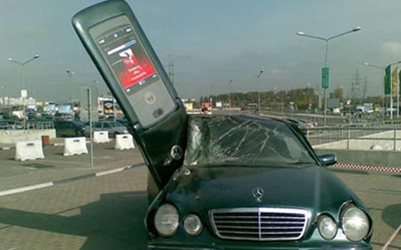
Mobile Computing
CSE 40814/60814
Spring 2017

Slide 2
Public Switched Telephone Network - PSTN
Transit
switch
Transit
switch
Transit
switch
Long distance network
Local
switch
Local
switch
Outgoing
call
Incoming
call
- Transfer mode: circuit switching
- All the network (except part of the access network) is digital
- Each voice channel is usually 64kb/s

Slide 3
Basic Call
Calling terminal
Network
Called terminal
Off-hook
Resource allocation
Dial tone
Dialing
Translation + routing
Ring indication
Alert signal
Remove ring indication
Off hook
Bi-directional channel
Conversation
On hook
On hook signal
Billing

Slide 4
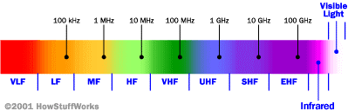
Cellular Network Basics
Cellular network/telephony is a radio-based technology; radio waves are electromagnetic waves that antennas propagate
Most signals are in the 850 MHz, 900 MHz, 1800 MHz, and 1900 MHz frequency bands
Cell phones operate in this frequency range (note the logarithmic scale)

Slide 5
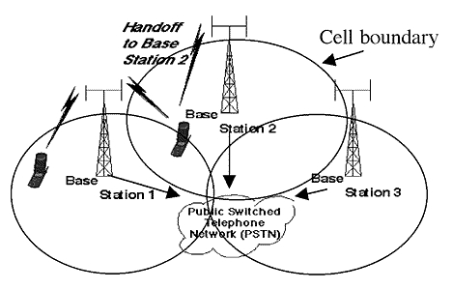
Cellular Network
Base stations transmit to and receive from mobile devices at the assigned spectrum
  Multiple base stations use the same spectrum (spectral reuse)
The service area of each base station is called a cell
Each mobile terminal is typically served by the ‘closest’ base stations
  Handoff when terminals move

Slide 6

Architecture of Cellular Networks
Server
(e.g., Home Location
Register)
External
Network
Mobile
Station
Base
Station
Mobile
Switching
Center
Cellular Network

Slide 8
Registration
Nr: 079/4154678
Tune on the strongest signal

Slide 9
Service Request
079/4154678
079/8132627
079/4154678
079/8132627

Slide 10
Paging Broadcast
079/8132627?
079/8132627?
079/8132627?
079/8132627?
Note: paging makes sense only over a small area

Slide 11
Response
079/8132627
079/8132627

Slide 12
Channel Assignment
Channel
47
Channel
47
Channel
68
Channel
68

Slide 13
Conversation

Slide 14
Handoff (or Handover)

Slide 15
Message Sequence Chart
Base
Station
Switch
Base
Station
Caller
Callee
Periodic registration
Periodic registration
Service request
Service request
Page request
Page request
Paging broadcast
Paging broadcast
Paging response
Paging response
Assign Ch. 47
Assign Ch. 68
Tune to Ch. 68
Tune to Ch.47
Ring indication
Ring indication
Alert tone
User response
User response
Stop ring indication
Stop ring indication

Slide 16
Cellular Network Generations
It is useful to think of a cellular network in terms of generations:
  0G: Briefcase-size mobile radio telephones
  1G: Analog cellular telephony
  2G: Digital cellular telephony
  3G: High-speed digital cellular telephony (including video telephony)
  4G: IP-based “anytime, anywhere” voice, data, and multimedia telephony at faster data rates than 3G
  (being deployed now)

Slide 17
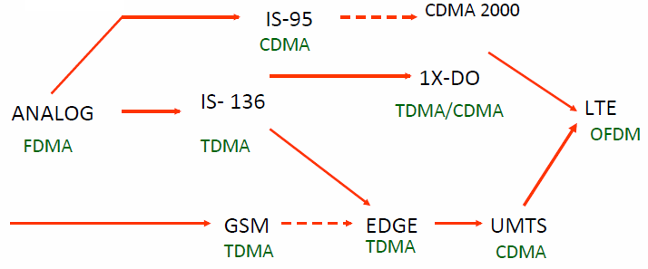
Evolution of Cellular Networks
1G
2G
2.5G
3G
4G

Slide 18
The Multiple Access Problem
The base stations need to serve many mobile terminals at the same time (both downlink and uplink)
All mobiles in the cell need to transmit to the base station
Interference among different senders and receivers
So we need multiple access scheme

Slide 19
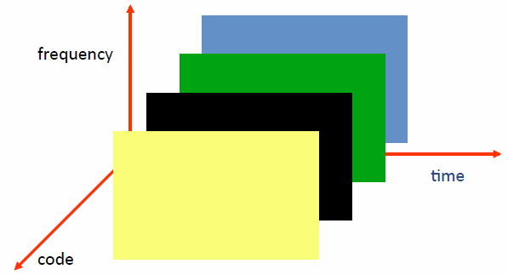
Multiple Access Schemes
3 orthogonal schemes:
Frequency Division Multiple Access (FDMA)
Time Division Multiple Access (TDMA)
Code Division Multiple Access (CDMA)

Slide 20
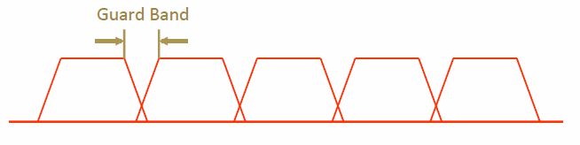
Frequency Division Multiple Access
frequency
Each mobile is assigned a separate frequency channel for the duration of the call
Sufficient guard band is required to prevent adjacent channel interference
Usually, mobile terminals will have one downlink frequency band and one uplink frequency band
Different cellular network protocols use different frequencies
Frequency is a precious and scarce resource
  Cognitive radio research

Slide 21
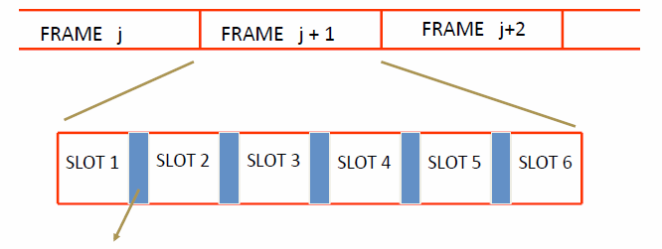
Time Division Multiple Access
Guard time – signals transmitted by mobile terminals at different locations do not arrive at the base station at the same time
Time is divided into slots and only one mobile terminal transmits during each slot
Each user is given a specific slot. No competition in cellular network
  Unlike Carrier Sensing Multiple Access (CSMA) in Wi-Fi

Slide 22
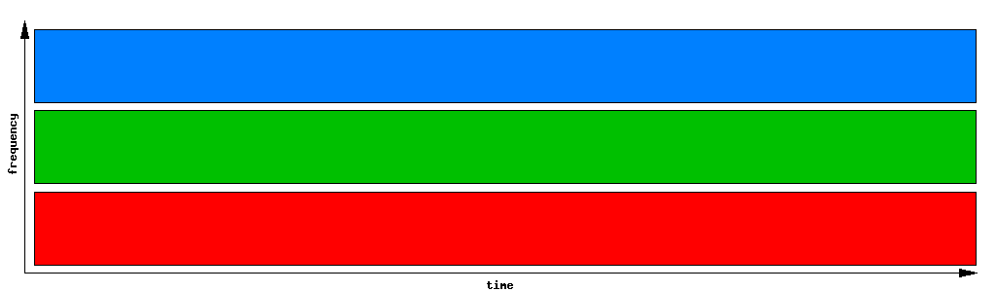
FDMA (1G)

Slide 23
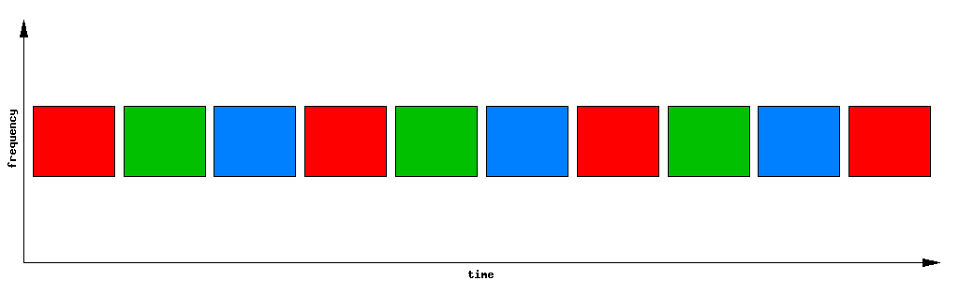
TDMA

Slide 24
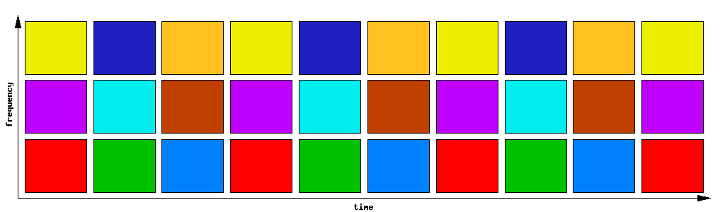
F/TDMA (2G)

Slide 25
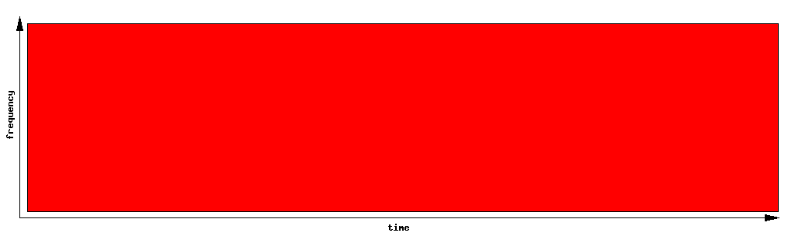
CDMA
Uses the whole band!

Slide 26
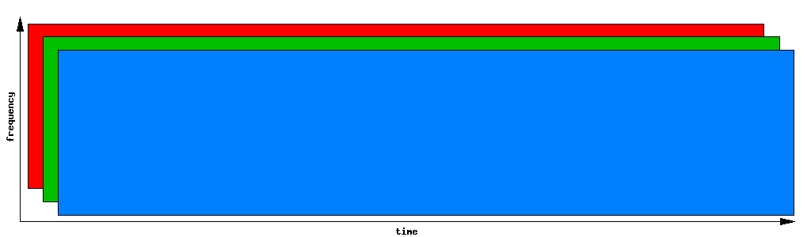
CDMA (sometimes shown like this:)

Slide 27
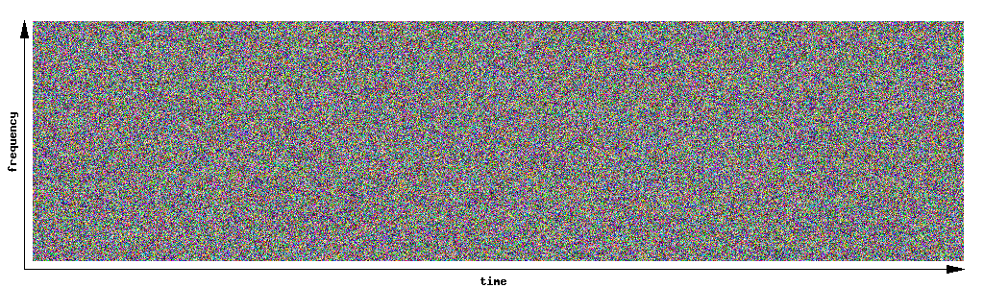
CDMA (3G) (or this:)

Slide 28
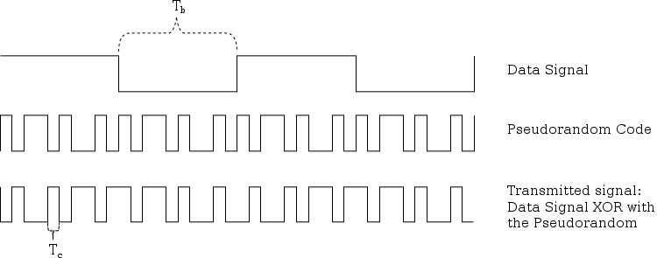
Code Division Multiple Access
Use of orthogonal codes to separate different transmissions
Each symbol of bit is transmitted as a larger number of bits using a user-specific code – spreading
  Bandwidth occupied by the signal is much larger than the information transmission rate
  But all users use the same frequency band together
Orthogonal among users

Slide 29
Basics: Some Math
1
x
1
=
1
1
x
-1
=
-1
-1
x
1
=
-1
-1
x
-1
=
1

Slide 30
CDMA Example
Low-Bandwidth Signal:
High-Bandwidth Spreading Code:
...repeated...

Slide 31
CDMA Example
Low-Bandwidth Signal:
High-Bandwidth Spreading Code:
Mix is a simple multiplication
… and then transmit.

Slide 32
CDMA Example
To Decode / Receive, take the signal:
Multiply by the same Spreading Code:
… to get ...

Slide 33
What If We Use Wrong Code?
Take the same signal:
Multiply by the wrong Spreading Code:
… you get ...
… which clearly hasn't recovered the original signal.
Using wrong code is like being off-frequency.

Slide 34
CDMA
Requires right code AND accurate timing!

Slide 35
Another Example
Data | 1 |  |  |  |  |  |  |  | -1
x | x | x | x | x | x | x | x | x | x | x | x | x | x | x | x | x
Spreading Code | 1 | -1 | 1 | -1 | -1 | 1 | -1 | 1 | 1 | -1 | 1 | -1 | -1 | 1 | -1 | 1
= | = | = | = | = | = | = | = | = | = | = | = | = | = | = | = | =
CDMA

Slide 36
Another Example
Data | 1 |  |  |  |  |  |  |  | -1
x | x | x | x | x | x | x | x | x | x | x | x | x | x | x | x | x
Spreading Code | 1 | -1 | 1 | -1 | -1 | 1 | -1 | 1 | 1 | -1 | 1 | -1 | -1 | 1 | -1 | 1
= | = | = | = | = | = | = | = | = | = | = | = | = | = | = | = | =
CDMA | 1

Slide 37
Another Example
Data | 1 |  |  |  |  |  |  |  | -1
x | x | x | x | x | x | x | x | x | x | x | x | x | x | x | x | x
Spreading Code | 1 | -1 | 1 | -1 | -1 | 1 | -1 | 1 | 1 | -1 | 1 | -1 | -1 | 1 | -1 | 1
= | = | = | = | = | = | = | = | = | = | = | = | = | = | = | = | =
CDMA | 1 | -1

Slide 38
Another Example
Data | 1 |  |  |  |  |  |  |  | -1
x | x | x | x | x | x | x | x | x | x | x | x | x | x | x | x | x
Spreading Code | 1 | -1 | 1 | -1 | -1 | 1 | -1 | 1 | 1 | -1 | 1 | -1 | -1 | 1 | -1 | 1
= | = | = | = | = | = | = | = | = | = | = | = | = | = | = | = | =
CDMA | 1 | -1 | 1 | -1 | -1 | 1 | -1 | 1

Slide 39
Another Example
Data | 1 |  |  |  |  |  |  |  | -1
x | x | x | x | x | x | x | x | x | x | x | x | x | x | x | x | x
Spreading Code | 1 | -1 | 1 | -1 | -1 | 1 | -1 | 1 | 1 | -1 | 1 | -1 | -1 | 1 | -1 | 1
= | = | = | = | = | = | = | = | = | = | = | = | = | = | = | = | =
CDMA | 1 | -1 | 1 | -1 | -1 | 1 | -1 | 1 | -1

Slide 40
Another Example
Data | 1 |  |  |  |  |  |  |  | -1
x | x | x | x | x | x | x | x | x | x | x | x | x | x | x | x | x
Spreading Code | 1 | -1 | 1 | -1 | -1 | 1 | -1 | 1 | 1 | -1 | 1 | -1 | -1 | 1 | -1 | 1
= | = | = | = | = | = | = | = | = | = | = | = | = | = | = | = | =
CDMA | 1 | -1 | 1 | -1 | -1 | 1 | -1 | 1 | -1

Slide 41
Another Example
Data | 1 |  |  |  |  |  |  |  | -1
x | x | x | x | x | x | x | x | x | x | x | x | x | x | x | x | x
Spreading Code | 1 | -1 | 1 | -1 | -1 | 1 | -1 | 1 | 1 | -1 | 1 | -1 | -1 | 1 | -1 | 1
= | = | = | = | = | = | = | = | = | = | = | = | = | = | = | = | =
CDMA | 1 | -1 | 1 | -1 | -1 | 1 | -1 | 1 | -1 | 1

Slide 42
Another Example
Data | 1 |  |  |  |  |  |  |  | -1
x | x | x | x | x | x | x | x | x | x | x | x | x | x | x | x | x
Spreading Code A | 1 | -1 | 1 | -1 | -1 | 1 | -1 | 1 | 1 | -1 | 1 | -1 | -1 | 1 | -1 | 1
= | = | = | = | = | = | = | = | = | = | = | = | = | = | = | = | =
CDMA | 1 | -1 | 1 | -1 | -1 | 1 | -1 | 1 | -1 | 1 | -1 | 1 | 1 | -1 | 1 | -1

Slide 43
Another Example
Data | 1 |  |  |  |  |  |  |  | -1
x | x | x | x | x | x | x | x | x | x | x | x | x | x | x | x | x
Spreading Code B | 1 | -1 | -1 | 1 | -1 | 1 | 1 | -1 | 1 | -1 | -1 | 1 | -1 | 1 | 1 | -1
= | = | = | = | = | = | = | = | = | = | = | = | = | = | = | = | =
CDMA | 1 | -1 | -1 | 1 | -1 | 1 | 1 | -1 | -1 | 1 | 1 | -1 | 1 | -1 | -1 | 1

Slide 44
Another Example
CDMA A | 1 | -1 | 1 | -1 | -1 | 1 | -1 | 1 | -1 | 1 | -1 | 1 | 1 | -1 | 1 | -1
+ | + | + | + | + | + | + | + | + | + | + | + | + | + | + | + | +
CMDA B | 1 | -1 | -1 | 1 | -1 | 1 | 1 | -1 | -1 | 1 | 1 | -1 | 1 | -1 | -1 | 1
+ | + | + | + | + | + | + | + | + | + | + | + | + | + | + | + | +
NOISE | 3 | 2 | 3 | 2 | 5 | 5 | 3 | 2 | 5 | 4 | 5 | 4 | 2 | 4 | 5 | 5
= | = | = | = | = | = | = | = | = | = | = | = | = | = | = | = | =
BAND

Slide 45
Another Example
CDMA A | 1 | -1 | 1 | -1 | -1 | 1 | -1 | 1 | -1 | 1 | -1 | 1 | 1 | -1 | 1 | -1
+ | + | + | + | + | + | + | + | + | + | + | + | + | + | + | + | +
CMDA B | 1 | -1 | -1 | 1 | -1 | 1 | 1 | -1 | -1 | 1 | 1 | -1 | 1 | -1 | -1 | 1
+ | + | + | + | + | + | + | + | + | + | + | + | + | + | + | + | +
NOISE | 3 | 2 | 3 | 2 | 5 | 5 | 3 | 2 | 5 | 4 | 5 | 4 | 2 | 4 | 5 | 5
= | = | = | = | = | = | = | = | = | = | = | = | = | = | = | = | =
BAND | 5 | 0 | 3 | 2 | 3 | 7 | 3 | 2 | 3 | 6 | 5 | 4 | 4 | 2 | 5 | 5

Slide 46
Another Example
BAND | 5 | 0 | 3 | 2 | 3 | 7 | 3 | 2 | 3 | 6 | 5 | 4 | 4 | 2 | 5 | 5
x | x | x | x | x | x | x | x | x | x | x | x | x | x | x | x | x
Spreading Code A | 1 | -1 | 1 | -1 | -1 | 1 | -1 | 1 | 1 | -1 | 1 | -1 | -1 | 1 | -1 | 1
= | = | = | = | = | = | = | = | = | = | = | = | = | = | = | = | =
Demod | 5
Add these | └───────┬───────┘ + |  |  |  |  |  |  |  | └───────┬───────┘ +
Total
1 or -1?

Slide 47
Another Example
BAND | 5 | 0 | 3 | 2 | 3 | 7 | 3 | 2 | 3 | 6 | 5 | 4 | 4 | 2 | 5 | 5
x | x | x | x | x | x | x | x | x | x | x | x | x | x | x | x | x
Spreading Code | 1 | -1 | 1 | -1 | -1 | 1 | -1 | 1 | 1 | -1 | 1 | -1 | -1 | 1 | -1 | 1
= | = | = | = | = | = | = | = | = | = | = | = | = | = | = | = | =
Demod | 5 | 0 | 3 | -2 | -3 | 7 | -3 | 2 | 3 | -6 | 5 | -4 | -4 | 3 | -5 | 5
Add these | └───────┬───────┘ + |  |  |  |  |  |  |  | └───────┬───────┘ +
Total
1 or -1?

Slide 48
Another Example
BAND | 5 | 0 | 3 | 2 | 3 | 7 | 3 | 2 | 3 | 6 | 5 | 4 | 4 | 2 | 5 | 5
x | x | x | x | x | x | x | x | x | x | x | x | x | x | x | x | x
Spreading Code | 1 | -1 | 1 | -1 | -1 | 1 | -1 | 1 | 1 | -1 | 1 | -1 | -1 | 1 | -1 | 1
= | = | = | = | = | = | = | = | = | = | = | = | = | = | = | = | =
Demod | 5 | 0 | 3 | -2 | -3 | 7 | -3 | 2 | 3 | -6 | 5 | -4 | -4 | 3 | -5 | 5
Add these | └───────┬───────┘ + |  |  |  |  |  |  |  | └───────┬───────┘ +
Total | 9 |  |  |  |  |  |  |  | -3
1 or -1?

Slide 49
Another Example
BAND | 5 | 0 | 3 | 2 | 3 | 7 | 3 | 2 | 3 | 6 | 5 | 4 | 4 | 2 | 5 | 5
x | x | x | x | x | x | x | x | x | x | x | x | x | x | x | x | x
Spreading Code | 1 | -1 | 1 | -1 | -1 | 1 | -1 | 1 | 1 | -1 | 1 | -1 | -1 | 1 | -1 | 1
= | = | = | = | = | = | = | = | = | = | = | = | = | = | = | = | =
Demod | 5 | 0 | 3 | -2 | -3 | 7 | -3 | 2 | 3 | -6 | 5 | -4 | -4 | 3 | -5 | 5
Add these | └───────┬───────┘ + |  |  |  |  |  |  |  | └───────┬───────┘ +
Total | 9 |  |  |  |  |  |  |  | -3
1 or -1? | 1 |  |  |  |  |  |  |  | -1

Slide 50
GSM (2G)
Abbreviation for Global System for Mobile Communications
Concurrent development in USA and Europe in the 1980s
The European system was called GSM and deployed in the early 1990s

Slide 51
GSM Services
    Voice, 3.1 kHz
    Short Message Service (SMS)
  1985 GSM standard that allows messages of at most 160 chars. (incl. spaces) to be sent between handsets and other stations
  Multi-billion $ industry
    General Packet Radio Service (GPRS)
  GSM upgrade that provides IP-based packet data transmission up to 114 kbps
  Users can “simultaneously” make calls and send data
  GPRS provides “always on” Internet access and the Multimedia Messaging Service (MMS) whereby users can send rich text, audio, video messages to each other
  Performance degrades as number of users increase
  GPRS is an example of 2.5G telephony – 2G service similar to 3G

Slide 52


GSM Channels
Downlink
Channels
Uplink
Physical Channel: Each timeslot on a carrier is referred to as a physical channel
Logical Channel: Variety of information is transmitted between the MS and BTS. Different types of logical channels:
  Traffic channel
  Control Channel

Slide 53
GSM Frequencies
Originally designed on 900MHz range, now also available on 800MHz, 1800MHz and 1900 MHz ranges.
Separate uplink and downlink frequencies
  One example channel on the 1800 MHz frequency band, where RF carriers are spaced every 200 kHz
UPLINK FREQUENCIES
DOWNLINK FREQUENCIES
1710 MHz
1785 MHz
1805 MHz
1880 MHz
UPLINK AND DOWNLINK FREQUENCY SEPARATED BY 95MHZ

Slide 54
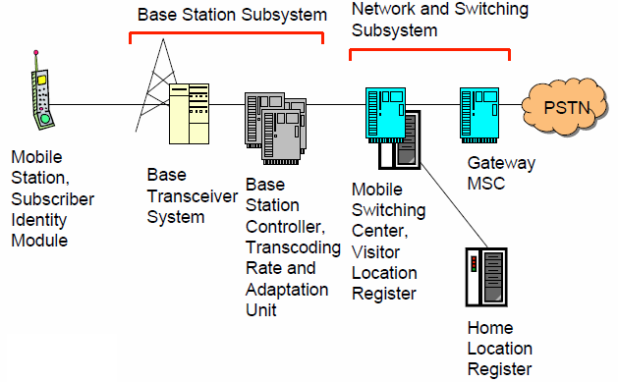
GSM Architecture

Slide 55
Mobile Station (MS)
MS is the user’s handset and has two parts
Mobile Equipment
  Radio equipment
  User interface
  Processing capability and memory required for various tasks
    Call signalling
    Encryption
    SMS
  Equipment IMEI (Intl. Mobile Equipment Identity) number (like serial number)
Subscriber Identity Module (SIM)

Slide 56
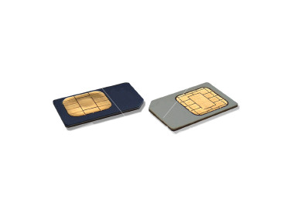
Subscriber Identity Module
A small smart card
Encryption codes needed to identify the subscriber
Subscriber IMSI (Intl. Mobile Subscriber Identity) number
  64 bit number; includes:
  MCC (Mobile Country Code): 3 decimal places, intl. standardized
  MNC (Mobile Network Code): 2 decimal places, network within country
  MSIN (Mobile Subscriber Identification Number): max. 10 decimal places
Subscriber’s own information (telephone directory)
Third party applications (banking, etc.)
Can also be used in other systems besides GSM, e.g., some WLAN access points accept SIM based user authentication

Slide 57
Base Station Subsystem
Transcoding Rate and Adaptation Unit (TRAU)
  Performs coding between the 64kbps PCM coding used in the backbone network and the 13kbps coding used for the Mobile Station (MS)
Base Station Controller (BSC)
  Controls the channel (time slot) allocation implemented by the BTSes
  Manages the handovers within BSS area
  Knows which mobile stations are within the cell and informs the MSC/VLR about this
Base Transceiver System (BTS)
  Controls several transmitters
  Each transmitter has 8 time slots, some used for signaling, on a specific frequency

Slide 58
Network and Switching Subsystem
The backbone of a GSM network is a telephone network with additional cellular network capabilities
Mobile Switching Center (MSC)
  A typical telephony exchange (ISDN exchange) which supports mobile communications
  Visitor Location Register (VLR)
    A database, part of the MSC
    Contains the location of the active Mobile Stations
Gateway Mobile Switching Center (GMSC)
  Links the system to PSTN and other operators
Home Location Register (HLR)
  Contain subscriber information, including authentication information in Authentication Center (AuC)
Equipment Identity Register (EIR)
  International Mobile Station Equipment Identity (IMEI) codes for e.g., blacklisting stolen phones

Slide 59
Home Location Register
One database per operator
Contains all the permanent subscriber information
  MSISDN (Mobile Subscriber ISDN number) is the telephone number of the subscriber
  International Mobile Subscriber Identity (IMSI) is a 15 digit code used to identify the subscriber
  IMSI code is used to link the MSISDN number to the subscriber’s SIM (Subscriber Identity Module)
  Charging information
  Services available to the customer
Also the subscriber’s present Location Area Code, which refers to the MSC, which can connect to the MS.

Slide 60
Other Systems
Operations Support System
  The management network for the whole GSM network
  Usually vendor dependent
  Very loosely specified in the GSM standards
Value added services
  Voice mail
  Call forwarding
  Group calls
Short Message Service Center
  Stores and forwards the SMS messages
  Like an E-mail server
  Required to operate the SMS services

Slide 61
Location Updates
The cells overlap and usually a mobile station can ‘see’ several transceivers (BTSes)
The MS monitors the identifier for the BSC controlling the cells
When the mobile station reaches a new BSC’s area, it requests a location update
The update is forwarded to the MSC, entered into the VLR, the old BSC is notified and an acknowledgement is passed back

Slide 62
Handoff (Handover)
When a call is in process, the changes in location need special processing
Within a BSS, the BSC, which knows the current radio link configuration (including feedbacks from the MS), prepares an available channel in the new BTS
The MS is told to switch over to the new BTS
This is called a hard handoff
  In a soft handoff, the MS is connected to two BTSes simultaneously

Slide 63
4 types of handover
1
2
3
4
MS
MS
MS
MS
BTS
BTS
BTS
BTS
BSC
BSC
BSC
MSC
MSC

Slide 64
Handover decision
receive level
BTS_{old}
receive level
BTS_{old}
HO_MARGIN
MS
MS
BTS_{old}
BTS_{new}

Slide 65
Handover procedure
MS
BTS_{old}
BSC_{old}
MSC
BSC_{new}
BTS_{new}
measurement
report
measurement
result
HO decision
HO required
HO request
resource allocation
ch. activation
HO request ack
ch. activation ack
HO command
HO command
HO command
HO access
Link establishment
HO complete
HO complete
clear command
clear command
clear complete
clear complete

Slide 66
Roaming
When a MS enters another operators network, it can be allowed to use the services of this operator
  Operator to operator agreements and contracts
  Higher billing
The MS is identified by the information in the SIM card and the identification request is forwarded to the home operator
  The home HLR is updated to reflect the MS’s current location

Slide 67
UMTS*
Universal Mobile Telecommunications System (UMTS)
UMTS is an upgrade from GSM via GPRS or EDGE
The standardization work for UMTS is carried out by Third Generation Partnership Project (3GPP)
Data rates of UMTS are:
  144 kbps for rural
  384 kbps for urban outdoor
  2048 kbps for indoor and low range outdoor
Virtual Home Environment (VHE)

Slide 68
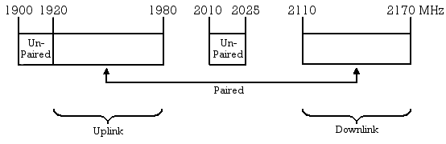
UMTS Frequency Spectrum*
UMTS Band
  1900-2025 MHz and 2110-2200 MHz for 3G transmission
  In the US, 1710–1755 MHz and 2110–2155 MHz will be used instead, as the 1900 MHz band was already used.

Slide 69
UMTS Architecture*

Slide 70
UMTS Network Architecture*
UMTS network architecture consists of three domains
  Core Network (CN): Provide switching, routing and transit for user traffic
  UMTS Terrestrial Radio Access Network (UTRAN): Provides the air interface access method for user equipment.
  User Equipment (UE): Terminals work as air interface counterpart for base stations. The various identities are: IMSI, TMSI, P-TMSI, TLLI, MSISDN, IMEI, IMEISV

Slide 71
4G (LTE)
LTE stands for Long Term Evolution
Next Generation mobile broadband technology
Promises data transfer rates of 100 Mbps
Based on UMTS 3G technology
Optimized for All-IP traffic

Slide 72
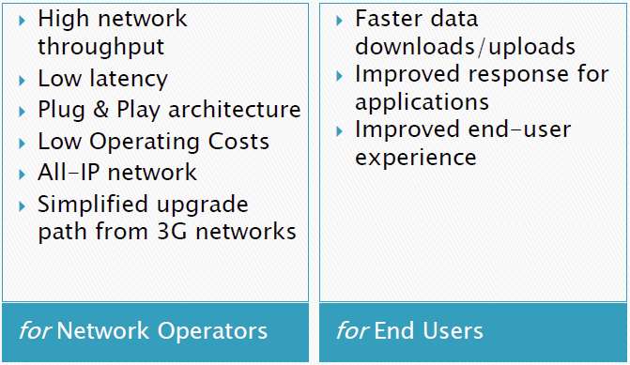
Advantages of LTE

Slide 73
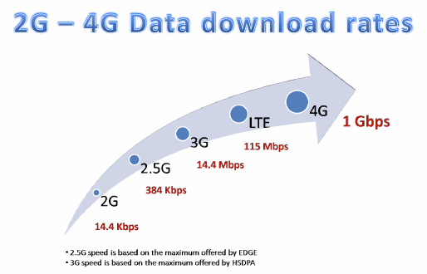
Comparison of LTE Speed

Slide 74
Major LTE Radio Technogies
Uses Orthogonal Frequency Division Multiplexing (OFDM) for downlink
Uses Single Carrier Frequency Division Multiple Access (SC-FDMA) for uplink
Uses Multi-input Multi-output (MIMO) for enhanced throughput
Reduced power consumption
Higher RF power amplifier efficiency (less battery power used by handsets)

Slide 75
5G Challenges & Scenarios*
Avalanche of
Traffic Volume
Massive growth in
Connected Devices
Large diversity of
Use cases
&
Requirements
Further expansion of
mobile broadband
Additional traffic due to communicating machines
“Communicating machines”
Device-to-Device Communications
Car-to-Car Comm.
New requirements and characteristics due to communicating machines
“1000x in ten years”
“50 billion devices in 2020”

Slide 76
5G Future
Integration
of access technologies
into one seamless experience
Evolution
and / or
and / or
Revolution
Complementary
new technologies
Massive MIMO
D2D Communications
Ultra-Dense
Networks
Respond to traffic explosion
Extend to novel applications
Ultra-Reliable
Communications
10 x longer battery life
for low power M2M
Moving Networks
10 -100 x higher typical user rate
1000 x higher mobile data volume per area
10 -100 x higher number of connected devices
Higher Frequencies
Massive Machine
Communications
5 x reduced E2E latency
Existing technologies in 2012
3G
Wifi
4G

Slide 77
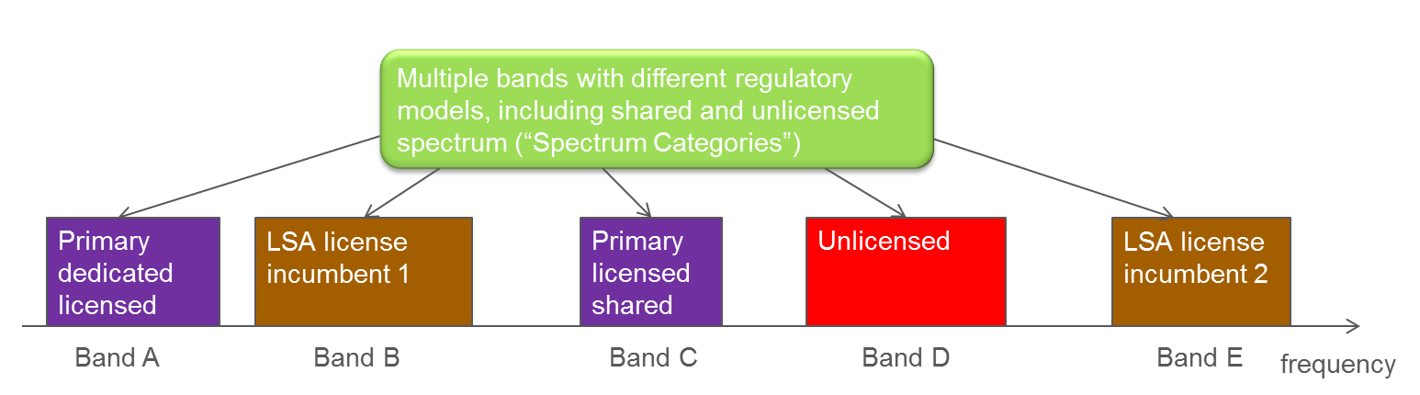
Spectrum Scenario*
Dedicated licensed spectrum complemented with various forms of shared spectrum
“Toolbox” of different sharing enablers required
In order for 5G system to work under such scenarios

Slide 78
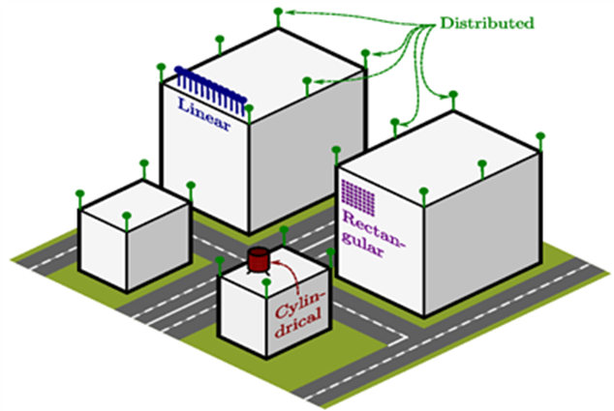
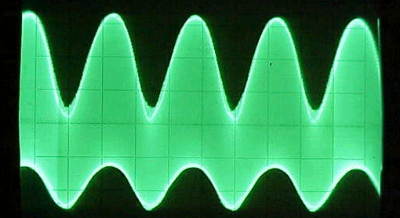


Technology Components*
300 MHz
3 GHz
30 GHz
300 GHz
New spectrum bands and access methods
Nomadic nodes
Buildings
Bus stop
Park area
Lamp posts nodes
Dense and moving networks
Multi-hop wireless backhaul
VL-MIMO
Massive multi-antenna systems
Context-aware interference and mobility management
Air interfaces for new applications and reduced signaling
Mobile
Device-to-device

