Slide 1
How to Write a Research paper
Slides Borrowed From:
Simon Peyton Jones, Microsoft Research, Cambridge

Slide 2
Writing papers is a skill
Many papers are badly written
Good writing is a skill you can learn
It’s a skill that is worth learning:
  More papers accepted
  Get your Ph.D. (faster)
  Your ideas will have more impact
  You will have better ideas
Increasing importance

Slide 3
Writing papers: model 1
Idea
Do research
Write paper

Slide 4
Writing papers: model 2
Idea
Do research
Write paper
Idea
Write paper
Do research
Forces us to be clear, focused
Crystallizes what we don’t understand
Opens the way to dialogue with others: reality check, critique, and collaboration

Slide 5
Do not be intimidated
Fallacy You need to have a fantastic idea before you can write a paper. (Everyone else seems to.)
Write a paper,
and give a talk, about
any idea,
no matter how insignificant it may seem to you

Slide 6
Do not be intimidated
Write a paper, and give a talk, about any idea, no matter how insignificant it may seem to you
Writing the paper is how you develop the idea in the first place
It usually turns out to be more interesting and challenging that it seemed at first

Slide 7
The purpose of your paper

Slide 8
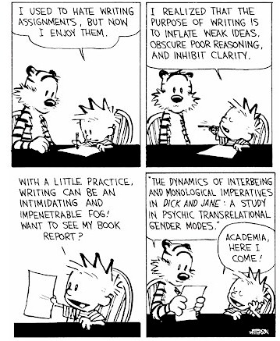
Why bother?
Good papers and talks are a fundamental part of research excellence
Fallacy
we write papers and give talks mainly to impress others, gain recognition, and get promoted

Slide 9
Papers communicate ideas
Your goal: to infect the mind of your reader with your idea, like a virus
Papers are far more durable than programs (think Mozart)
The greatest ideas are (literally) worthless if you keep them to yourself

Slide 10
The Idea
Idea
A re-usable insight,
useful to the reader
Figure out what your idea is
Make certain that the reader is in no doubt what the idea is. Be 100% explicit:
  “The main idea of this paper is....”
  “In this section we present the main contributions of the paper.”
Many papers contain good ideas, but do not distil what they are.

Slide 11
One ping
Your paper should have just one “ping”: one clear, sharp idea
Read your paper again: can you hear the “ping”?
You may not know exactly what the ping is when you start writing; but you must know when you finish
If you have lots of ideas, write lots of papers

Slide 12
The purpose of your paper is not...
To describe the WizWoz system
Your reader does not have a WizWoz
She is primarily interested in re-usable brain-stuff, not executable artefacts

Slide 13
Your narrative flow
I wish I knew how to solve that!
Here is a problem
It’s an interesting problem
It’s an unsolved problem
Here is my idea
My idea works (details, data)
Here’s how my idea compares to other people’s approaches
I see how that works. Ingenious!

Slide 14
Structure (conference paper)
Title (1000 readers)
Abstract (4 sentences, 100 readers)
Introduction (1 page, 100 readers)
The problem (1 page, 10 readers)
My idea (2 pages, 10 readers)
The details (5 pages, 3 readers)
Related work (1-2 pages, 10 readers)
Conclusions and further work (0.5 pages)

Slide 15
The abstract
Write abstract first AND finish last!
Used by program committee members to decide which papers to read
Four sentences [Kent Beck]
  State the problem
  Say why it’s an interesting problem
  Say what your solution achieves
  Say what follows from your solution

Slide 16
Example
Many papers are badly written and hard to understand
This is a pity, because their good ideas may go unappreciated
Following simple guidelines can dramatically improve the quality of your papers
Your work will be used more, and the feedback you get from others will in turn improve your research

Slide 17
Structure
Abstract (4 sentences)
Introduction (1 page)
The problem (1 page)
My idea (2 pages)
The details (5 pages)
Related work (1-2 pages)
Conclusions and further work (0.5 pages)

Slide 18
The introduction (1 page)
Describe the problem
State your contributions
...and that is all
ONE PAGE!

Slide 19
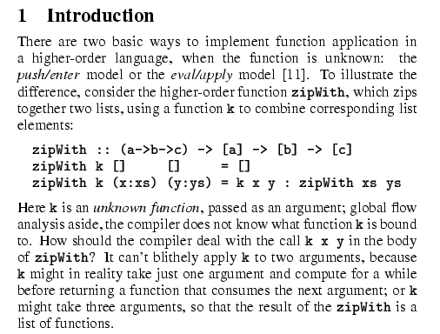
Describe the problem
Use an example to introduce the problem

Slide 20
State your contributions
Write the list of contributions first
The list of contributions drives the entire paper: the paper substantiates the claims you have made
Reader thinks “gosh, if they can really deliver this, that’d be exciting; I’d better read on”

Slide 21
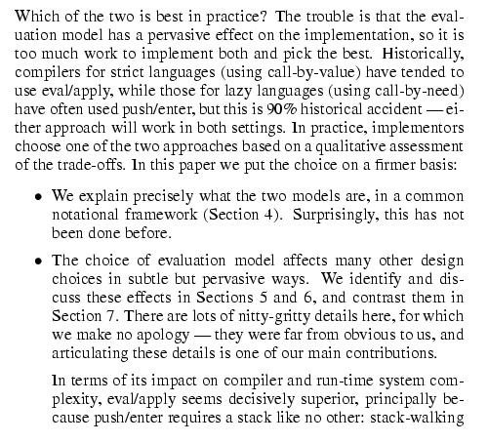
State your contributions
Bulleted list of contributions
Do not leave the reader to guess what your contributions are!

Slide 22
Contributions should be refutable
NO! | YES!
We describe the WizWoz system. It is really cool. | We give the syntax and semantics of a language that supports concurrent processes (Section 3). Its innovative features are...
We study its properties | We prove that the type system is sound, and that type checking is decidable (Section 4)
We have used WizWoz in practice | We have built a GUI toolkit in WizWoz, and used it to implement a text editor (Section 5). The result is half the length of the Java version.

Slide 23
No “rest of this paper is...”
Not:
Instead, use forward references from the narrative in the introduction.
The introduction (including the contributions) should survey the whole paper, and therefore forward reference every important part.
“The rest of this paper is structured as follows. Section 2 introduces the problem. Section 3 ... Finally, Section 8 concludes”.

Slide 24
Structure
Abstract (4 sentences)
Introduction (1 page)
Related work
The problem (1 page)
My idea (2 pages)
The details (5 pages)
Related work (1-2 pages)
Conclusions and further work (0.5 pages)

Slide 25
No related work yet!
Related work
Your reader
Your idea
We adopt the notion of transaction from Brown [1], as modified for distributed systems by White [2], using the four-phase interpolation algorithm of Green [3]. Our work differs from White in our advanced revocation protocol, which deals with the case of priority inversion as described by Yellow [4].

Slide 26
No related work yet
I feel stupid
Problem 1: the reader knows nothing about the problem yet; so your (carefully trimmed) description of various technical tradeoffs is absolutely incomprehensible
Problem 2: describing alternative approaches gets between the reader and your idea
I feel tired

Slide 27
Structure
Abstract (4 sentences)
Introduction (1 page)
The problem (1 page)
My idea (2 pages)
The details (5 pages)
Related work (1-2 pages)
Conclusions and further work (0.5 pages)

Slide 28
Presenting the idea
3. The idea
Consider a bifircuated semi-lattice D, over a hyper-modulated signature S. Suppose p_{i} is an element of D. Then we know for every such p_{i} there is an epi-modulus j, such that p_{j} < p_{i}.
Sounds impressive...but
Sends readers to sleep
In a paper you MUST provide the details,
but FIRST convey the idea

Slide 29
Presenting the idea
Explain it as if you were speaking to someone using a whiteboard
Conveying the intuition is primary, not secondary
Once your reader has the intuition, she can follow the details (but not vice versa)
Even if she skips the details, she still takes away something valuable

Slide 30
Putting the reader first
Do not recapitulate your personal journey of discovery. This route may be soaked with your blood, but that is not interesting to the reader.
Instead, choose the most direct route to the idea.

Slide 31
The payload of your paper
Introduce the problem, and your idea, using
EXAMPLES
and only then present the general case

Slide 32
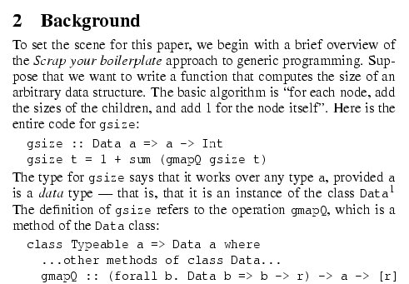
Using examples
Example right away

Slide 33
The details: evidence
Your introduction makes claims
The body of the paper provides evidence to support each claim
Check each claim in the introduction, identify the evidence, and forward-reference it from the claim
Evidence can be: analysis and comparison, theorems, measurements, case studies

Slide 34
Structure
Abstract (4 sentences)
Introduction (1 page)
The problem (1 page)
My idea (2 pages)
The details (5 pages)
Related work (1-2 pages)
Conclusions and further work (0.5 pages)

Slide 35
Related work
Fallacy To make my work look good, I have to make other people’s work look bad

Slide 36
The truth: credit is not like money
Giving credit to others does not diminish the credit you get from your paper
Warmly acknowledge people who have helped you
Be generous to the competition. “In his inspiring paper [Foo98] Foogle shows.... We develop his foundation in the following ways...”
Acknowledge weaknesses in your approach

Slide 37
Credit is not like money
Failing to give credit to others can kill your paper
If you imply that an idea is yours, and the referee knows it is not, then either
  You don’t know that it’s an old idea (bad)
  You do know, but are pretending it’s yours (very bad)

Slide 38
Structure
Abstract (4 sentences)
Introduction (1 page)
The problem (1 page)
My idea (2 pages)
The details (5 pages)
Related work (1-2 pages)
Conclusions and further work (0.5 pages)

Slide 39
Conclusions and further work
Be brief.

Slide 40
The process of writing

Slide 41
The process
Start early. Very early.
  Hastily-written papers get rejected.
  Papers are like wine: they need time to mature
Collaborate
Use CVS to support collaboration

Slide 42
Getting help
Get your paper read by as many friendly guinea pigs as possible
Experts are good
Non-experts are also very good
Each reader can only read your paper for the first time once! So use them carefully
Explain carefully what you want (“I got lost here” is much more important than “Jarva is mis-spelt”.)

Slide 43
Getting expert help
A good plan: when you think you are done, send the draft to the competition saying “could you help me ensure that I describe your work fairly?”.
Often they will respond with helpful critique (they are interested in the area)
They are likely to be your referees anyway, so getting their comments or criticism up front is Jolly Good.

Slide 44
Listening to your reviewers
Treat every review like gold dust
Be (truly) grateful for criticism as well as praise
This is really, really, really hard
But it’s
really, really, really, really, really, really, really, really, really, really
important

Slide 45
Listening to your reviewers
Read every criticism as a positive suggestion for something you could explain more clearly
DO NOT respond “you stupid person, I meant X”. Fix the paper so that X is apparent even to the stupidest reader.
Thank them warmly. They have given up their time for you.

Slide 46
Language and style

Slide 47
Basic stuff
Submit by the deadline
Keep to the length restrictions
  Do not narrow the margins
  Do not use 6pt font
  On occasion, supply supporting evidence (e.g. experimental data, or a written-out proof) in an appendix
Always use a spell checker

Slide 48
Visual structure
Give strong visual structure to your paper using
  sections and sub-sections
  bullets
  italics
  laid-out code
Find out how to draw pictures, and use them

Slide 49
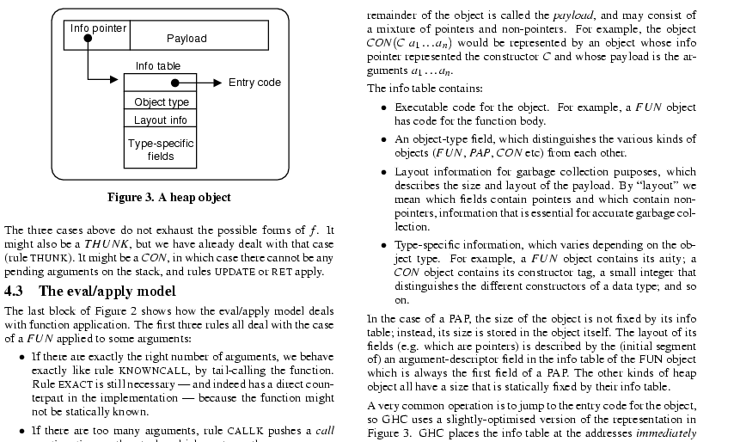
Visual structure

Slide 50
Use the active voice
The passive voice is “respectable” but it DEADENS your paper. Avoid it at all costs.
“We” = you and the reader
NO | YES
It can be seen that... | We can see that...
34 tests were run | We ran 34 tests
These properties were thought desirable | We wanted to retain these properties
It might be thought that this would be a type error | You might think this would be a type error
“We” = the authors
“You” = the reader

Slide 51
Passive voice is vague
BAD: By removing an item from the list during each iteration,
it is guaranteed that the loop will terminate.
The first part of the sentence suggests that you will
reveal who or what is removing.
To what does “it” refer?
GOOD: We remove an item from the list during each iteration
of the loop; thus, the loop is guaranteed to terminate.
GOOD: In the algorithm of Figure 3, we remove …

Slide 52
Active voice is stronger & clearer
UGLY: In a queue, insertions are performed at the rear
and deletions are performed at the front; therefore
a pointer to the front and the rear must be maintained.
GOOD: We use a queue, a structure that permits insertions
at the rear and deletions from the front. We maintain
a pointer to the front and rear of the structure.

Slide 53
Use present tense
Present tense is stronger than future tense
WEAK: In this paper, we will show…
STRONG: In this paper, we show that …

Slide 54
Use present tense
Past tense degrades into “diary writing”
BAD: In this work we wanted to …
GOOD: The goals of our work are to …

Slide 55
Don’t change tense
BAD: In this chapter, we have described what happens when
we do the wrong thing. We examined the behavior
and determine that they are correct.
BAD: The analysis reported in the preceding section will
show that Nick can differentiate shod from shoddy.

Slide 56
Use simple, direct language
NO | YES
The object under study was displaced horizontally | The ball moved sideways
On an annual basis | Yearly
Endeavour to ascertain | Find out
It could be considered that the speed of storage reclamation left something to be desired | The garbage collector was really slow

Slide 57
You MUST read each of your sentences for:
Content/meaning
Structure
Style

Slide 58
Be consistent: call a spade a spade!
Can’t change terminology, even for a good reason, w/out explanation
remote proxy vs proxy
data structure vs structure

Slide 59
Which vs that
that identifies the object about which you are speaking
which provides further info about the object
GOOD: The car that is speeding down the road
is about to crash into a pole.
GOOD: The car, which is speeding down the road,
is about to crash into a pole.

Slide 60
Avoid fuzzy words
very, easily, actually, truly, in fact, some, thing
etc.
BAD: In comparing our algorithm with the algorithm
described in reference 17, we see that ours is
very fast.
BAD: In this section, we define the terms node, tree,
graph, etc.

Slide 61
Semicolon
Connects two sentences that are closely related to each other
Use a semicolon when what follows constitutes a complete sentence
When what follows is a fragment, you must use a comma or an em dash

Slide 62
Semicolon
CAREFUL: Max’s head was throbbing; Lyn’s heart was sinking.
The semicolon implies that there is a connection between Max’s
head throb and Lyn’s sinking heart!!
BAD: Holly wanted to live on a farm with plenty of chickens;
and to have a stellar career as well.
GOOD: This machine is difficult to use; for example, it
crashes whenever you turn it on.

Slide 63
Commas
Commas provide guidance to your reader about how to parse your sentence!
Place them wherever a speaker should pause
UGLY: Greg was worried; however he remained calm.
GOOD: Brendan was hungry; however, he remained calm.
OKAY: Lyn and Richard were still puzzled, however
many times they reread the directions for assembling the
stepper climber; however, they remained calm.

Slide 64
Colon
The colon signifies that what follows it expands on or explains what precedes it: this sentence is an example.
Frequently a period or an em dash will also work
Use at the end of a sentence, followed by a list
Lyn could tell that Red had been out hunting again: There
were three mice neatly laid out on the upstairs rug.
GOOD: This talk does not assume that you know the basics:
how to form a sentence, how to use words, and how
to laugh at your mistakes.

Slide 65
Summary
Every claim must be explained and substantiated
Everything that you state is a claim
Any decent reviewer will assume that “if you don’t state it, you didn’t do it and you can’t handle it!”
Get a “reader” to read your paper
Writing a well-written paper is a lot of work!

