Slide 1

Project Presentation Notes
Logo / identifier for project
Who Are You
Affiliation is Key
Is grey on white
really a good idea?

Slide 2
Presentation Prep
How many of you….
  Had fault tolerance?
    Flash drive
    Uploaded to Box
  Were pro-active?
    Tested before class
    Checked if your presentation rendered
  Did validation?
    Dry run, more than one dry run
    Video-taped / watched?
Presentation-Fu
Rapid jump to a
slide, type the #
and then press
enter
Which slide is this?

Slide 3
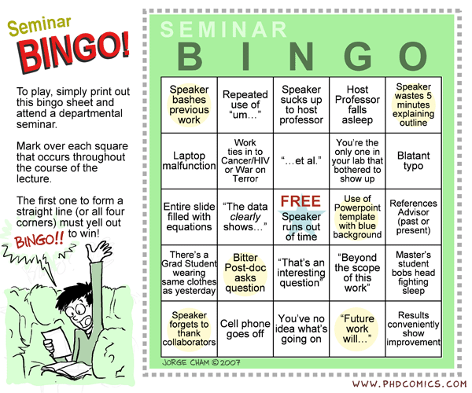

Slide 4
Presentation - Overview
Did your slides?
  Introduce non-experts to why your topic is important
  Have a graphic describing the process
  Explain / visualize key problem (project)
Most people are visual, active learners
What type of learner are you?
Most people in grad school / academia are not

Slide 5
Presentation
Tone / voice
  Soft / meek?
  Loud enough?
  Speak at board vs. speak to class?
Nervous?
  Um, um, um
Pacing
Practice, practice, practice
Is that text kind of hard to read?

Slide 6
KISS
Keep It Simple, Stupid
Rule of thumb
  Tell me what you are going to tell me
  Tell me
  Tell me what you told me
HCI Principles
  White space
  Grouping / proximity / balance
  Coloring

Slide 7
Not So Keep It Simple Stupid (!KISS)
KISS stands for Keep It Simple, Stupid and is extremely important for making your slides easier to understand.
Rules of thumb that you should follow.
  Tell me what you are going to tell me. This should be short and sweet but it foreshadows what is important.
  Tell me what you are going to tell me. This is the meat of the talk and really your focus.
  Tell me what you told me. Summarize and offer conclusions to your audience such that the audience can remember what you just told them.
Human Computer Interface (HCI) Principles
  White space is EXTREMELY critical. If you do not have sufficient white space, your slides are harder to digest. Sort of like this example.
  Grouping / proximity / balance. You must keep your slide content grouped together. Things that appear together seem to be related whether you want your reader to view them as related or not. Don’t forget to keep your slides balanced.
  Coloring. Using bad colors or poor contrast can make your slides hard to read. For instance, you are probably struggling on reading this set of text.

Slide 8
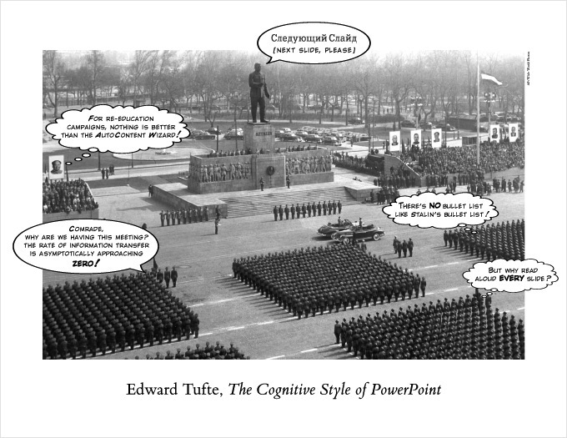
If your presentations,
need help, get
this book

Slide 9
We Still Are Engineers
Don’t forget your audience
  Technical content is OK
  Some density is OK
    Sometimes you can’t avoid it
Polish / effort to make your
outstanding content GREAT

Slide 10
Talk Premise
Example
Management during operations is often an after-thought
of system design, not a first order property.
The modern digital spelunking that typifies system management
is untenable in the face of increasing system scale.
Furthermore, limited resources are choking on nearly useless data
without providing insight to the network “system” behavior.
How do we better enable management?
Lockdown

Slide 11
What if We Could Measure It?
Example
Prevalence
How often do we see nodes in
close proximity?
Stability
How stable are the relationships
when we see them?
Reciprocity
How reciprocal are the
relationships?
This is what our paper sets out to do.
Measuring potential on a live network over 15 months.

Slide 12
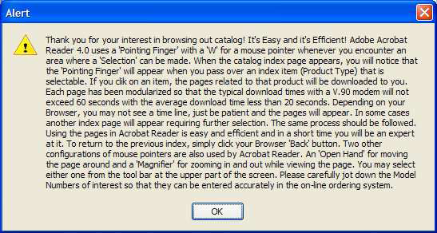
Text -> N’est pas tres bien

Slide 13
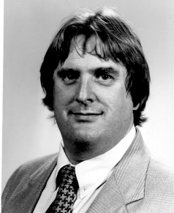








Why existing tools fail…
user
compromised
admin
Examine log files
3 hours later …
Notes:
User account is compromised via phishing email
Need to find out: 1) on which hosts the compromised user account has used? 2) has those hosts been compromised as well? 3) What applications did that user account invoke? 4) What data file has that user account touched during the past two weeks since the user revealed his password. Admin must make sure the student/faculty’s sensitive information and intellectual property was not leaked from the network.
The admin does not know: 1)what files have been read/modified or been sent out to external hosts; 2) what applications have been run by that user account because the data is not
available.

Slide 14
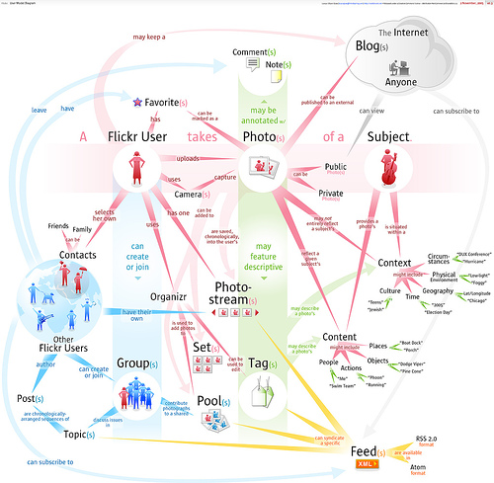
Will this render well
on a washed out
screen?

Slide 15
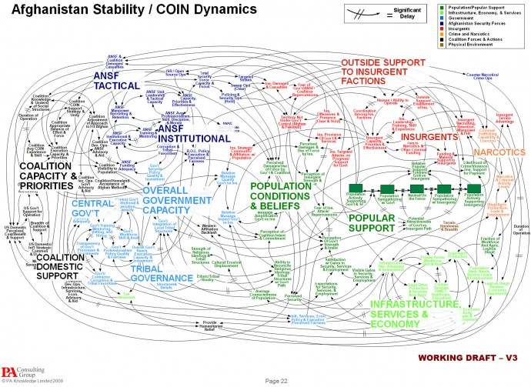

Slide 16
Color / Position
Cereal
Toast
Bathroom
Sheep
Cow
Bedroom
Bagel
Donut
Kitchen
Goat
Basement
Pig
How awesome is yellow on white?
Super awesome
????

Slide 17
Optimization problem
Bandwidth unit-price function
Unused residual spectrum bandwidth
Valuation of the spectrum by the secondary users
Notes:
We formulate the optimization problem to find the optimal equilibrium price p*(S,R,P)
S_{i}: spectrum bandwidth request from secondary user i
R: residual spectrum bandwidth
P_{i}: unit spectrum bandwidth access bid price
Price is determined dynamically based on the supply and demand of residual spectrum.
Minimize the unused residual spectrum bandwidth
Maximize the valuation of the spectrum by the secondary user i (the utility surplus for using the spectrum, i.e., revenue – cost)

Slide 18
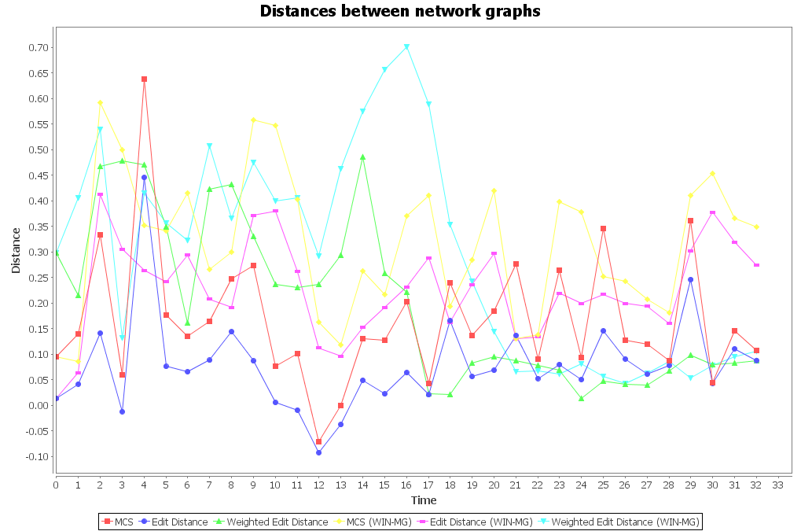

Graph distance
Point out interesting
areas of your graphs
For instance, yellow
for a line was a bad idea
Yes, your selection of 10 point
font is totally readable, thank you for
testing my recent LASIK
Notes:
Six distance metrics: MCS-based, GED-based, edge-weighted GED based, and then for each metric a median graph (taking the medians of edge weights of all graphs) was computed over a sliding time window of 5 days and was used to compare against rather than immediate previous graphs.
What are the main causes behind spikes of changes in day 14 and 15?
Is network state after day 15 moving back to that before day 14, or moving further away?

Slide 19
Figures
Redraw in PowerPoint / Keynote
  Please do not copy / paste
  Same for graphs
But that is hard and time-consuming
  Yes

Slide 20
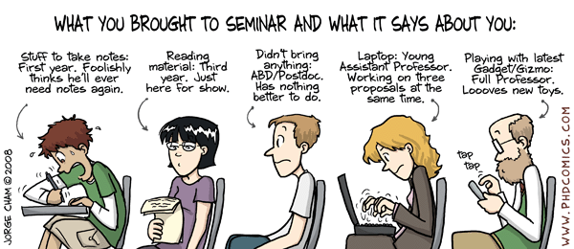
Weekly Seminar

