Slide 1
CSE 30341
Operating System Principles
Virtual Memory

Slide 2
Virtual Memory
Definition & Background
Demand Paging
Copy-on-Write
Page Replacement
Allocation of Frames
Thrashing
Memory-Mapped Files
Allocating Kernel Memory
Other Considerations

Slide 3
Objectives
To describe the benefits of a virtual memory system
To explain the concepts of demand paging, page-replacement algorithms, and allocation of page frames
To discuss the principle of the working-set model

Slide 4
Memory Pages
Why do we have pages?
What are advantages & disadvantages of using “page model”?

Slide 5
Background
Is all of your code used?
  Error code
  Unusual routines, certain options/features
  Large data structures, lists, arrays, ...
Entire program code not
needed at same time!
What if we could only partially load what we need?

Slide 6
Virtual Memory
Separation of user logical memory
from physical memory
Can be implemented via demand paging & demand segmentation

Slide 7
Benefits
Huge accessible space
  Map virtual to physical
Can easily share things
  Open once, point to the same spot in memory
Allows for more efficient process creation
  Only load partial process
More programs running concurrently
  Actually physical memory used per process smaller
Less I/O needed to load or swap processes
  Some parts of process will never be needed

Slide 8
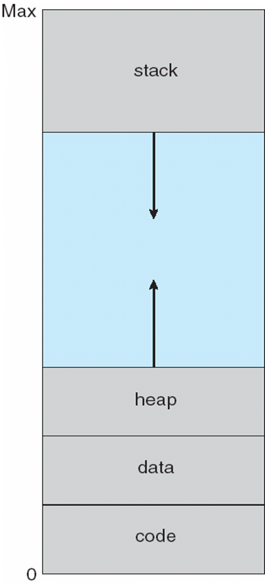
Virtual Address Space

Slide 9
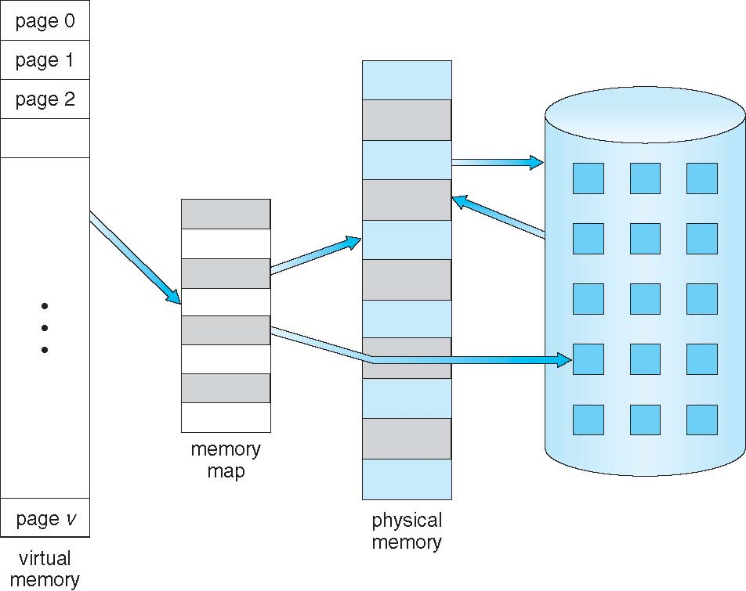
Virtual Memory >> Physical Memory

Slide 10
Virtual Address Space
Enables sparse address spaces
  Holes are OK
  Dynamically linked libraries
System libraries shared via mapping into virtual address space
Shared memory by mapping pages read-write into virtual address space
Pages can be shared during fork(), speeding process creation

Slide 11
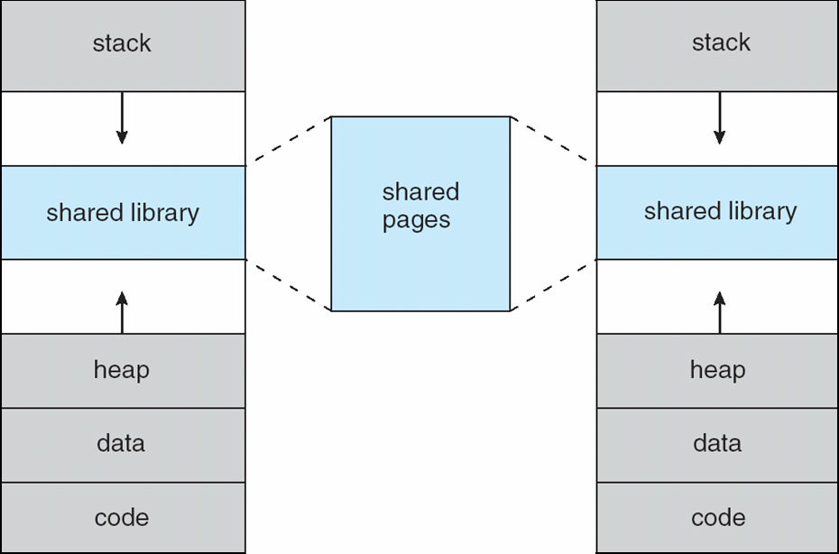
Shared Library Using Virtual Memory
Real memory is the
same, point to the
same thing

Slide 12
Demand Paging
Load page ONLY WHEN NEEDED:
  Less I/O needed
  Less memory needed
  Faster response
  More users
Lazy swapper – never swaps a page into memory unless page will be needed
  Swapper that deals with pages is a pager

Slide 13
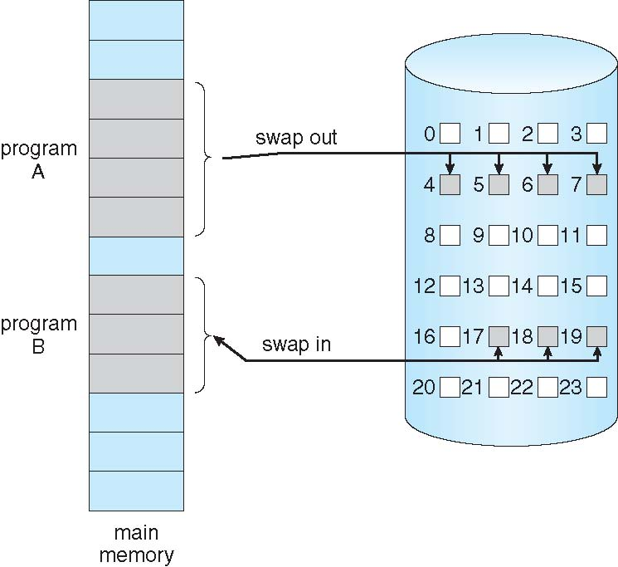
Demand Paging

Slide 14
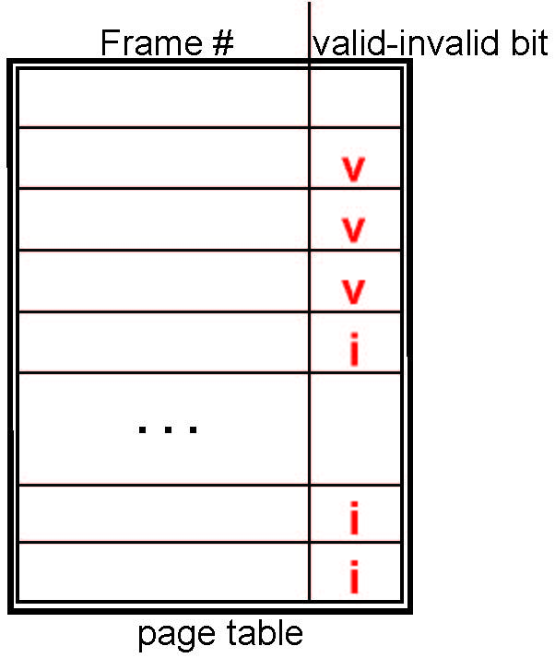
Valid-Invalid Bit
With each page table entry a valid–invalid bit is associated
  v ⇒ in-memory (memory resident)
  i ⇒ not-in-memory
Initial valid–invalid bit
  Set to i on all entries
During address translation, if valid–invalid bit in page table entry is i ⇒ page fault

Slide 15
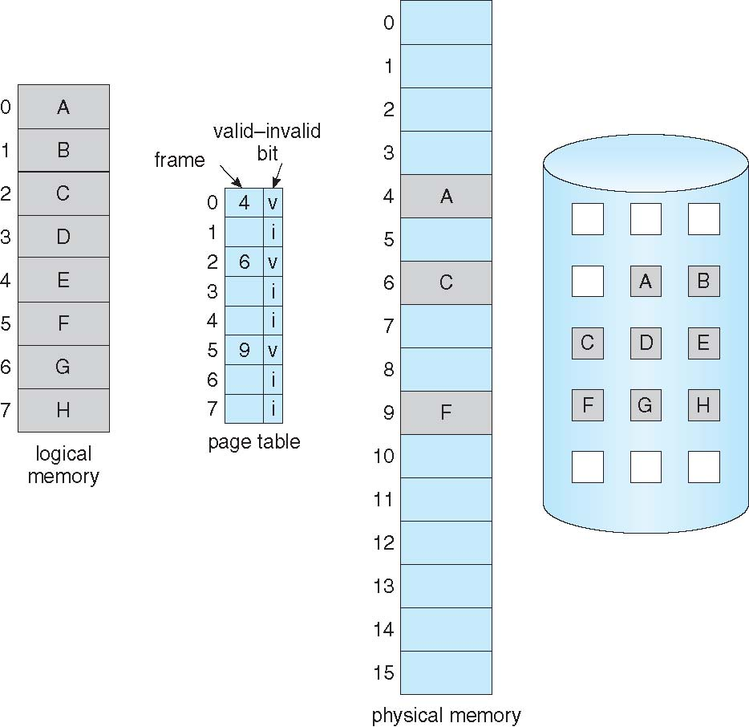
Page Table When Some Pages Are Not in Main Memory
Storage
Memory
Map
Virtual
Memory
Actual
Memory

Slide 16
Page Fault
If there is a reference to a page, first reference to that page will trap to operating system:
page fault
Operating system looks at another table (kept with PCB) to decide:
  Invalid reference ⇒ abort
  Just not in memory
Get empty frame
Swap page into frame
Reset tables to indicate page now in memory
Set validation bit = v
Restart the instruction that caused the page fault

Slide 17
Aspects of Demand Paging
Pure Demand Paging
  Never bring page into memory until needed
Multiple page faults could be triggered in one instruction (but unlikely due to “locality of reference”)
  Example: block move (IBM, MVC, move up to 256 bytes)

Slide 18
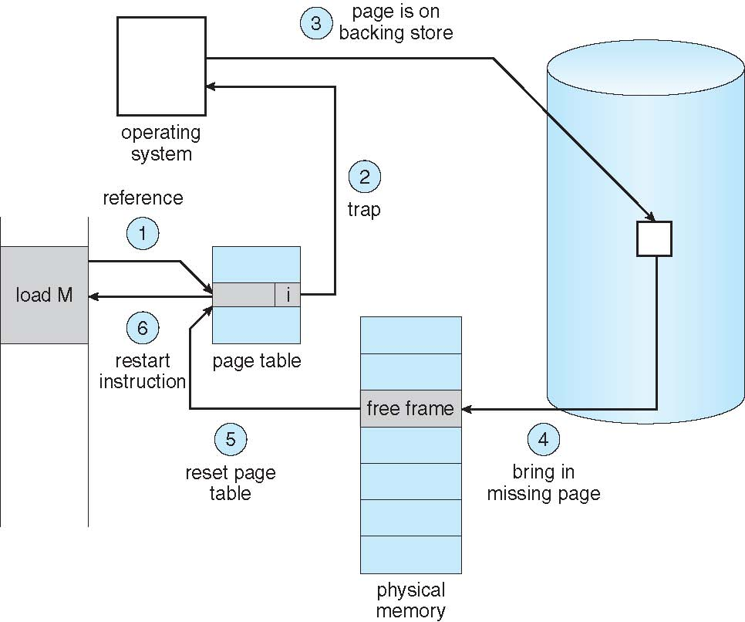

Slide 19
Stages in Demand Paging
Trap to the operating system
Save the user registers and process state
Determine that the interrupt was a page fault
Check that the page reference was legal and determine the location of the page on the disk
Issue a read from the disk to a free frame:
  Wait in a queue for this device until the read request is serviced
  Wait for the device seek and/or latency time
  Begin the transfer of the page to a free frame
While waiting, allocate the CPU to some other user
Receive an interrupt from the disk I/O subsystem (I/O completed)
Save the registers and process state for the other user
Determine that the interrupt was from the disk
Correct the page table and other tables to show page is now in memory
Wait for the CPU to be allocated to this process again
Restore the user registers, process state, and new page table, and then resume the interrupted instruction

Slide 20
Performance of Demand Paging
Page Fault Rate 0 ≤ p ≤ 1
  if p = 0 no page faults
  if p = 1, every reference is a fault
Effective Access Time (EAT)
EAT = (1 – p) x memory access +
p (page fault overhead + swap page out +
swap page in + restart overhead)

Slide 21
Demand Paging Example
Memory access time = 200 nanoseconds
Average page-fault service time = 8 milliseconds
EAT = (1 – p) x 200 + p (8 milliseconds)
= (1 – p) x 200 + p x 8,000,000
= 200 + p x 7,999,800
If one access out of 1,000 causes a page fault, then
EAT = 8.2 microseconds.
This is a slowdown by a factor of 40!!
If want performance degradation < 10 percent
  220 > 200 + 7,999,800 x p
  20 > 7,999,800 x p
  p < .0000025
  < one page fault in every 400,000 memory accesses

Slide 22
Process Creation: Copy-on-Write
Copy-on-Write (COW) allows both parent and child processes to initially share the same pages in memory
  If either process modifies a shared page, only then is the page copied
COW allows more efficient process creation as only modified pages are copied
In general, free pages are allocated from a pool of zero-fill-on-demand pages
  Why zero-out a page before allocating it?
vfork() variation on fork()system call has parent suspend and child using copy-on-write address space of parent
  Designed to have child call exec()
  Very efficient

Slide 23
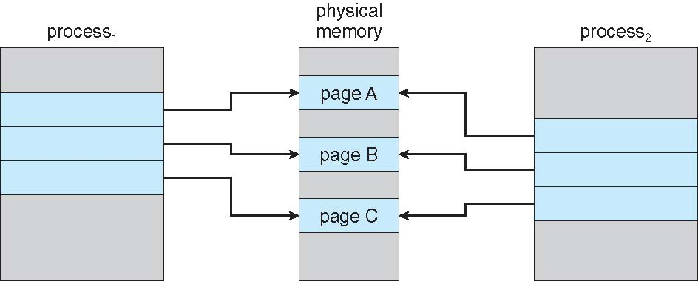
Before Process 1 Modifies Page C

Slide 24
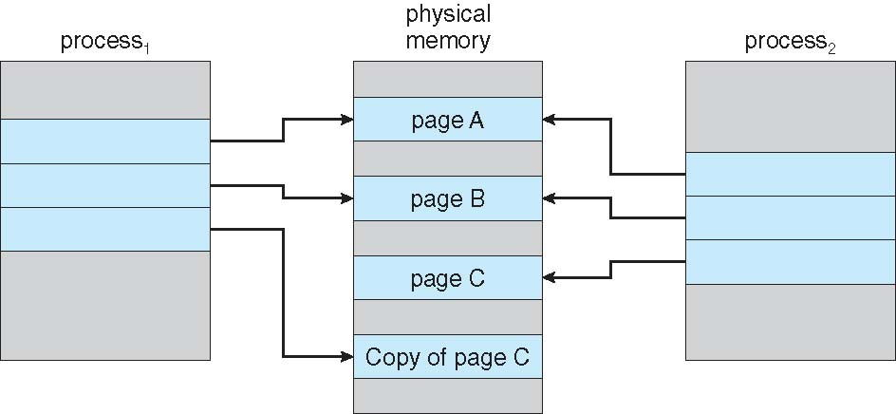
After Process 1 Modifies Page C

Slide 25
What Happens if There is no Free Frame?
Page replacement – find some page in memory, but not really in use, page it out
  Algorithm – terminate? swap out? replace the page?
  Performance – want an algorithm which will result in minimum number of page faults
Same page may be brought into memory several times

Slide 26
Page Replacement
Prevent over-allocation of memory by modifying page-fault service routine to include page replacement
Use modify (dirty) bit to reduce overhead of page transfers – only modified pages are written to disk
Assumption: Have Swap Space to Get It Back

Slide 27
Basic Page Replacement
Find the location of the desired page on disk
Find a free frame:
- If there is a free frame, use it
- If there is no free frame, use page replacement algorithm to select the victim frame
- Write victim frame to disk if dirty
Bring the desired page into the (newly) free frame; update the page and frame tables
Continue the process by restarting the instruction that caused the trap

Slide 28
Page Replacement Dilemma
Raw Performance
  If it is dirty, need to write it to swap space (expensive)
  Need to write the whole page
Future Page Faults
  The one swapped out could be used soon

Slide 29
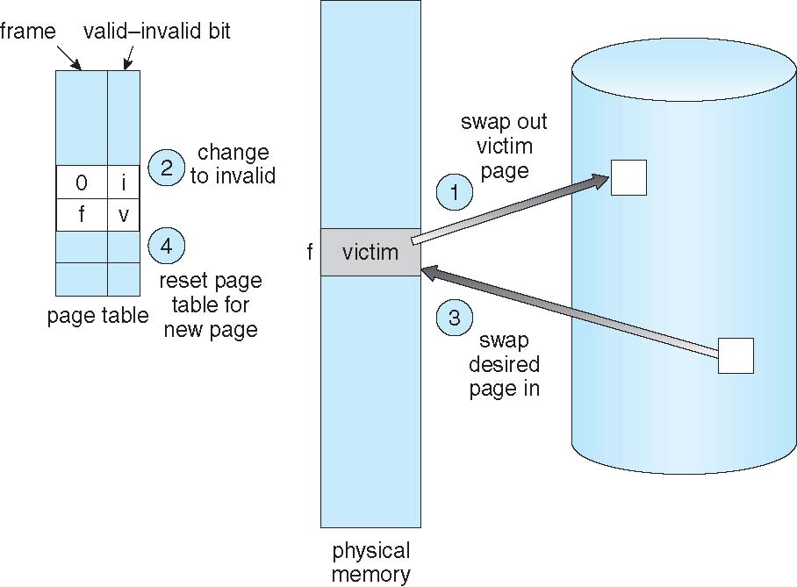
Page Replacement

Slide 30
Page and Frame Replacement Algorithms
Frame-allocation algorithm determines
  How many frames to give each process
  Which frames to replace
Page-replacement algorithm
  Want lowest page-fault rate on both first access and re-access
Evaluate algorithm by running it on a particular string of memory references (reference string) and computing the number of page faults on that string
  String is just page numbers, not full addresses
  Repeated access to the same page does not cause a page fault
In all our examples, the reference string is
7,0,1,2,0,3,0,4,2,3,0,3,0,3,2,1,2,0,1,7,0,1

Slide 31
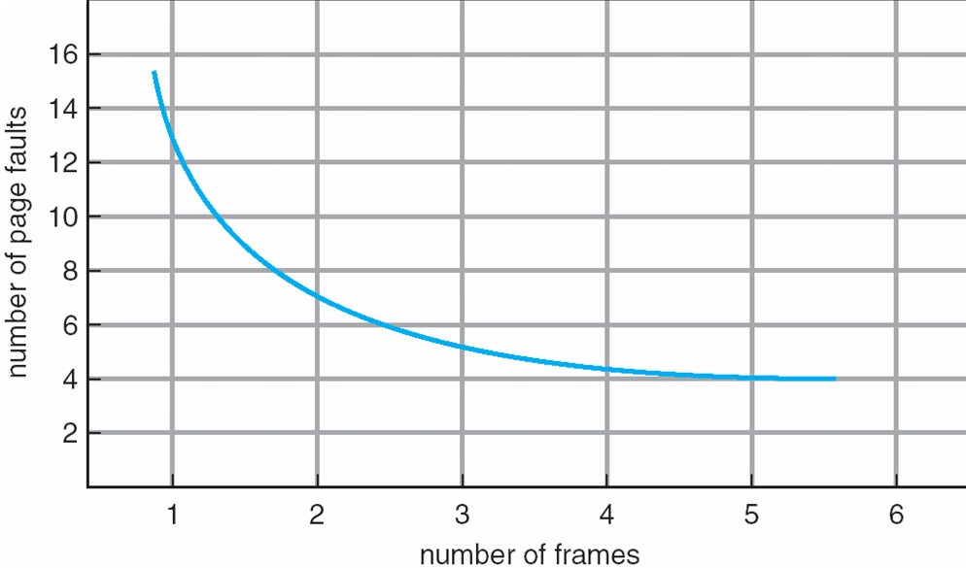
Page Faults vs Number of Frames

Slide 32
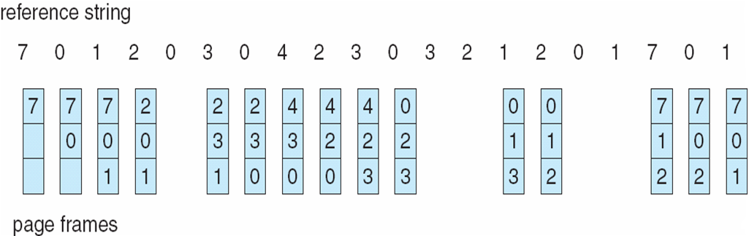
FIFO Page Replacement
3 pages available
7,0,1,2,0,3,0,4,2,3,0,3,0,3,2,1,2,0,1,7,0,1
Do more available pages always improve performance?
Possibly to actually make things worse – Belady’s Anomaly

Slide 33
Belady’s Anomaly
1,2,3,4,1,2,5,1,2,3,4,5
3 frames (9 page faults) versus 4 frames (10 page faults)

Slide 34
Optimal Algorithm (OPT)
Replace page that will not be used for longest period of time
How do you know this?
Used for measuring how well your algorithm performs

Slide 35
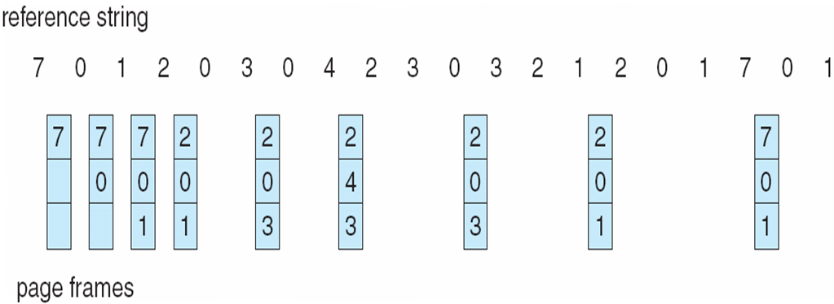
Optimal Page Replacement
FIFO

Slide 36
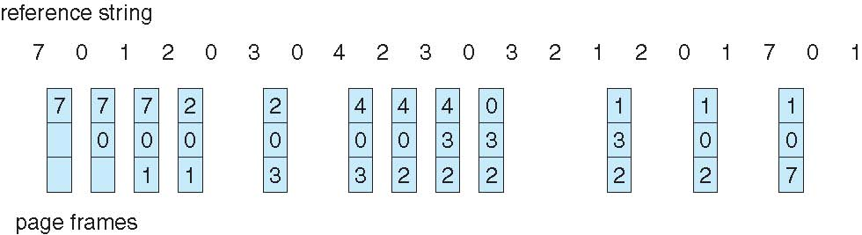
Least Recently Used (LRU) Algorithm
Use past knowledge rather than future
Replace page that has not been used in the most amount of time
Associate time of last use with each page
12 faults – better than FIFO but worse than OPT
Generally good algorithm and frequently used
But how to implement?

Slide 37
LRU Algorithm
Stack implementation
  Keep a stack of page numbers in a double link form:
  Page referenced:
    move it to the top
    requires 6 pointers to be changed
  But each update more expensive
  No search for replacement
LRU and OPT are cases of stack algorithms that don’t have Belady’s Anomaly

Slide 38
Stack Approach

Slide 39
LRU Approximation Algorithms
Reference bit
  With each page associate a bit, initially = 0
  When page is referenced bit set to 1
  Replace any with reference bit = 0 (if one exists)
    We do not know the order, however
Second-chance algorithm
  Generally FIFO, plus hardware-provided reference bit
  Clock replacement
  If page to be replaced has
    Reference bit = 0 -> replace it
    reference bit = 1 then:
      set reference bit 0, leave page in memory
      replace next page, subject to same rules

Slide 40
LRU Approximation Algorithms

Slide 41
Counting Algorithms
Keep a counter of the number of references that have been made to each page
  Not common
LFU Algorithm: replaces page with smallest count
MFU Algorithm: based on the argument that the page with the smallest count was probably just brought in and has yet to be used

Slide 42
Allocation of Frames
Each process needs minimum number of frames
Example: IBM 370 – 6 pages to handle SS MOVE instruction:
  instruction is 6 bytes, might span 2 pages
  2 pages to handle from
  2 pages to handle to
Maximum of course is total frames in the system
Two major allocation schemes
  fixed allocation
  priority allocation
Many variations

Slide 43
Fixed Allocation
Equal allocation – For example, if there are 100 frames (after allocating frames for the OS) and 5 processes, give each process 20 frames
  Keep some as free frame buffer pool
Proportional allocation – Allocate according to the size of process
  Dynamic as degree of multiprogramming, process sizes change

Slide 44
Fixed Allocation

Slide 45
Priority Allocation
Use a proportional allocation scheme using priorities rather than size
If process P_{i} generates a page fault,
  select for replacement one of its frames
  select for replacement a frame from a process with lower priority number

Slide 46
Global vs. Local Allocation
Global replacement – process selects a replacement frame from the set of all frames; one process can take a frame from another
  But then process execution time can vary greatly
  But greater throughput, so more common
Local replacement – each process selects from only its own set of allocated frames
  More consistent per-process performance
  But possibly underutilized memory

Slide 47
Thrashing
If a process does not have “enough” pages, the page-fault rate is very high
  Page fault to get page
  Replace existing frame
  But quickly need replaced frame back
  This leads to:
    Low CPU utilization
    Operating system thinking that it needs to increase the degree of multiprogramming
    Another process added to the system
Thrashing ≡ a process is busy swapping pages in and out

Slide 48
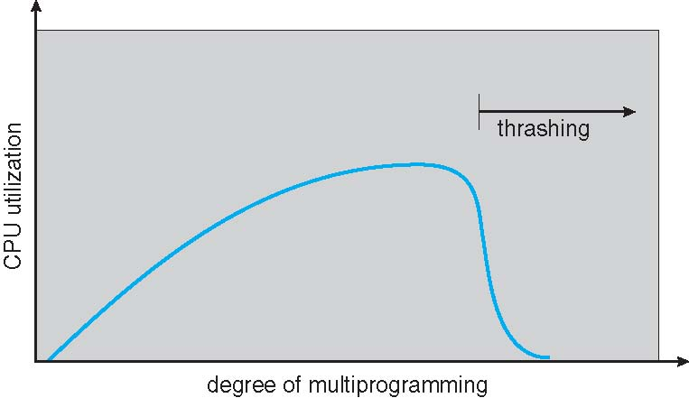
Thrashing (Cont.)

Slide 49
Demand Paging and Thrashing
Why does demand paging work?
Locality model
  Process migrates from one locality to another
  Localities may overlap
Why does thrashing occur?
Σ size of locality > total memory size
  Limit effects by using local or priority page replacement

Slide 50
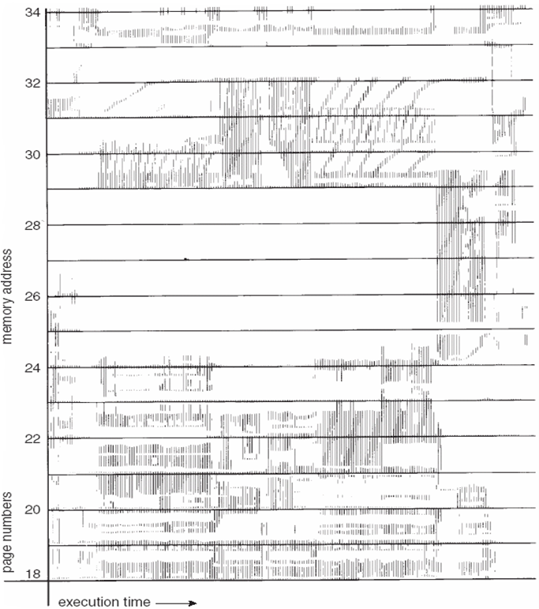
Locality In A Memory-Reference Pattern

Slide 51
Working-Set Model
Δ ≡ working-set window ≡ a fixed number of page references
Example: 10,000 instructions
WSS_{i} (working set of Process P_{i}) =
total number of pages referenced in the most recent Δ (varies in time)
  if Δ too small will not encompass entire locality
  if Δ too large will encompass several localities
  if Δ = ∞ ⇒ will encompass entire program
D = Σ WSS_{i} ≡ total demand frames
  Approximation of locality
if D > m ⇒ Thrashing
Policy if D > m, then suspend or swap out one of the processes

Slide 52
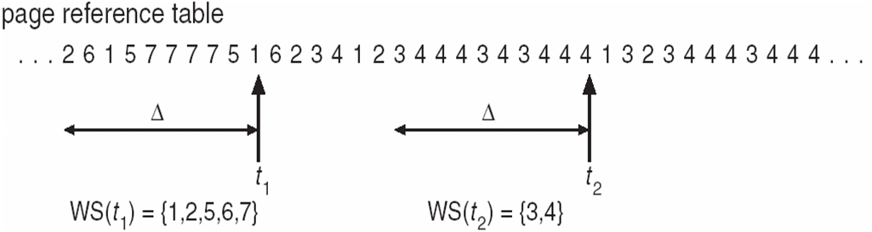
Working-Set model
What are the things that need to be in memory for me to get work done?

Slide 53
Keeping Track of the Working Set
Approximate with interval timer + a reference bit
Example: Δ = 10,000
  Timer interrupts after every 5000 time units
  Keep in memory 2 bits for each page
  Whenever a timer interrupts copy and sets the values of all reference bits to 0
  If one of the bits in memory = 1 ⇒ page in working set
Why is this not completely accurate?
Improvement = 10 bits and interrupt every 1000 time units

Slide 54
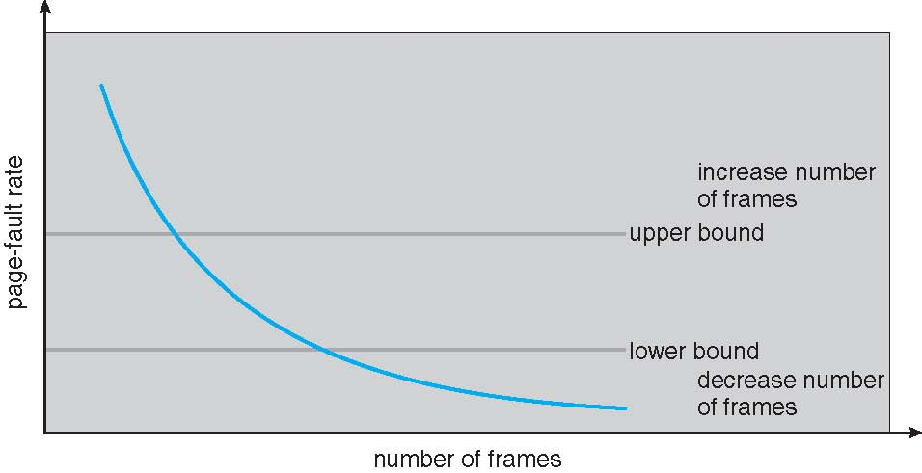
Page-Fault Frequency
More direct approach than WSS
Establish “acceptable” page-fault frequency rate and use local replacement policy
  If actual rate too low, process loses frame
  If actual rate too high, process gains frame

Slide 55
Memory-Mapped Files
Memory-mapped file I/O allows file I/O to be treated as routine memory access by mapping a disk block to a page in memory
A file is initially read using demand paging
  A page-sized portion of the file is read from the file system into a physical page
  Subsequent reads/writes to/from the file are treated as ordinary memory accesses
Simplifies and speeds file access by driving file I/O through memory rather than read()and write() system calls
Also allows several processes to map the same file allowing the pages in memory to be shared
But when does written data make it to disk?
  Periodically and / or at file close() time
  For example, when the pager scans for dirty pages

Slide 56
Memory-Mapped File Technique for all I/O
Some OSes uses memory mapped files for standard I/O
Process can explicitly request memory mapping a file via mmap() system call
  Now file mapped into process address space
Memory mapped files can be used for shared memory

Slide 57
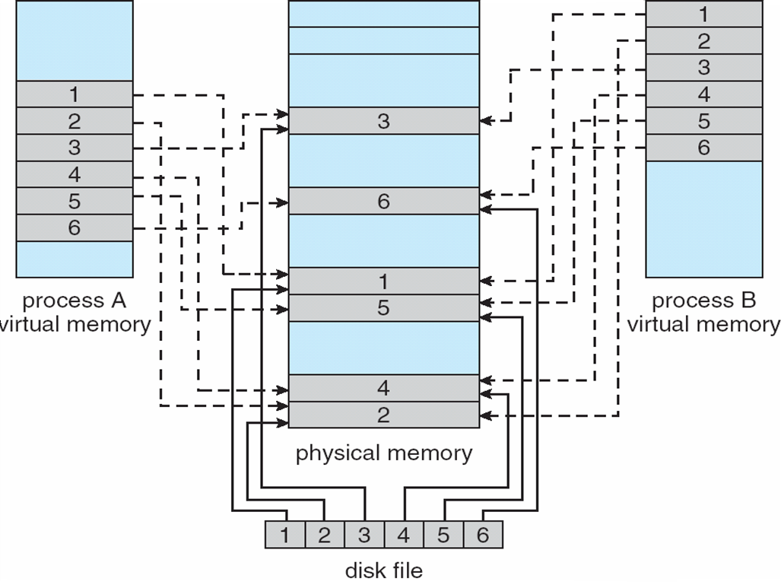
Memory Mapped Files

Slide 58
Allocating Kernel Memory
Treated differently from user memory
Often allocated from a free-memory pool
  Kernel requests memory for structures of varying sizes
  Some kernel memory needs to be contiguous
    i.e. for device I/O

Slide 59
Buddy System
Allocates memory from fixed-size segment consisting of physically-contiguous pages
Memory allocated using power-of-2 allocator
  Satisfies requests in units sized as power of 2
  Request rounded up to next highest power of 2
  When smaller allocation needed than is available, current chunk split into two buddies of next-lower power of 2
    Continue until appropriate sized chunk available
For example, assume 256KB chunk available, kernel requests 21KB
  Split into A_{L} _{and} A_{r} of 128KB each
    One further divided into B_{L} and B_{R} of 64KB
      One further into C_{L} and C_{R} of 32KB each – one used to satisfy request
Advantage – quickly coalesce unused chunks into larger chunk
Disadvantage - fragmentation

Slide 60
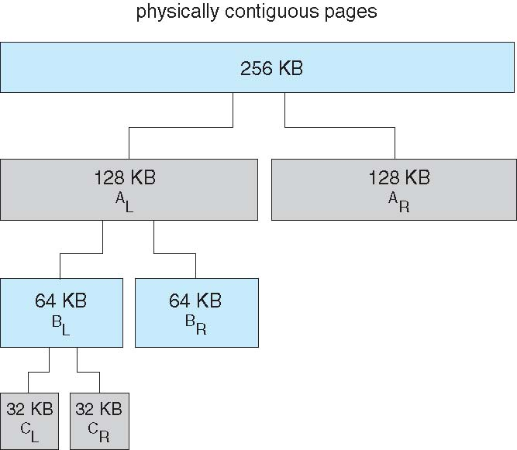
Buddy System Allocator

Slide 61
Slab Allocator
Alternate strategy
Slab is one or more physically contiguous pages
Cache consists of one or more slabs
Single cache for each unique kernel data structure
  Each cache filled with objects – instantiations of the data structure
When cache created, filled with objects marked as free
When structures stored, objects marked as used
If slab is full of used objects, next object allocated from empty slab
  If no empty slabs, new slab allocated
Benefits include no fragmentation, fast memory request satisfaction

Slide 62
Slab Allocator

Slide 63
Other Considerations -- Prepaging
Prepaging
  To reduce the large number of page faults that occurs at process startup
  Prepage all or some of the pages a process will need, before they are referenced
  But if prepaged pages are unused, I/O and memory was wasted
  Assume s pages are prepaged and α of the pages is used
    Is cost of s * α saved page faults > or < than the cost of prepaging s * (1- α) unnecessary pages?
    α near zero ⇒ prepaging loses

Slide 64
Other Issues – Page Size
Sometimes OS designers have a choice
  Especially if running on custom-built CPU
Page size selection must take into consideration:
  Fragmentation
  Page table size
  I/O overhead
  Number of page faults
  Locality
  TLB size and effectiveness
Always power of 2, usually in the range 2¹² (4,096 bytes) to 2²² (4,194,304 bytes)

Slide 65
Other Issues – TLB Reach
TLB Reach - The amount of memory accessible from the TLB
TLB Reach = (TLB Size) X (Page Size)
Ideally, the working set of each process is stored in the TLB
  Otherwise there is a high degree of page faults
Increase the Page Size
  This may lead to an increase in fragmentation as not all applications require a large page size
Provide Multiple Page Sizes
  This allows applications that require larger page sizes the opportunity to use them without an increase in fragmentation

Slide 66
Other Issues – Program Structure
Program structure
  int[128,128] data;
  Each row is stored in one page
  Program 1
for (j = 0; j <128; j++)
for (i = 0; i < 128; i++)
data[i,j] = 0;
  128 x 128 = 16,384 page faults
  Program 2
  for (i = 0; i < 128; i++)
  for (j = 0; j < 128; j++)
  data[i,j] = 0;
  128 page faults

