Slide 1
Internet-of-Things (IoT)
Summer Engineering Program 2018
University of Notre Dame
LAB COMPONENT

Slide 2
Setting Up Python
Jupyter Notebook:
https://jupyter.readthedocs.io/en/latest/install.html
IDLE: Integrated Development and Learning Environment

Slide 3
Python 101
Unlike C/C++ or Java, Python statements do not end in a semicolon
In Python, indentation is the way you indicate the scope of a conditional, function, etc.
Look, no braces!
Python is interpretive, meaning you don’t have to write programs
You can just enter statements into the Python environment and they’ll execute

Slide 4
Python 101
As in every language, a variable is the name of a memory location
Python is weakly typed, i.e., you don’t declare variables to be a specific type
A variable has the type that corresponds to the value you assign to it
Variable names begin with a letter or an underscore and can contain letters, numbers, and underscores
Python has reserved words that you can’t use as variable names

Slide 5
Python 101
At the >>> prompt, do the following:
x=5
type(x)
x=“this is text”
type(x)
x=5.0
type(x)

Slide 6
Python 101
You’ve already seen the print statement
You can also print numbers with formatting
[flags][width][.precision]type
print (”pi: {0:8.2f}”.format(3.141592))
These are identical to Java or C format specifiers

Slide 7
Python 101
All code should contain comments that describe what it does
In Python, lines beginning with a # sign are comment lines
You can also have comments on the same line as a statement
# This entire line is a comment
x=5 # Set up loop counter

Slide 8
Python 101
Arithmetic operators we will use:
+ - * / addition, subtraction/negation, multiplication, division
% modulus, a.k.a. remainder
** exponentiation
Precedence: Order in which operations are computed.
* / % ** have a higher precedence than + - 1 + 3 * 4 is 13
Parentheses can be used to force a certain order of evaluation. (1 + 3) * 4 is 16

Slide 9
Python 101
When integers and reals are mixed, the result is a real number.
Example: 1 / 2.0 is 0.5
The conversion occurs on a per-operator basis.
7 / 3 * 1.2 + 3 / 2
2 * 1.2 + 3 / 2
2.4 + 3 / 2
2.4 + 1
3.4

Slide 10
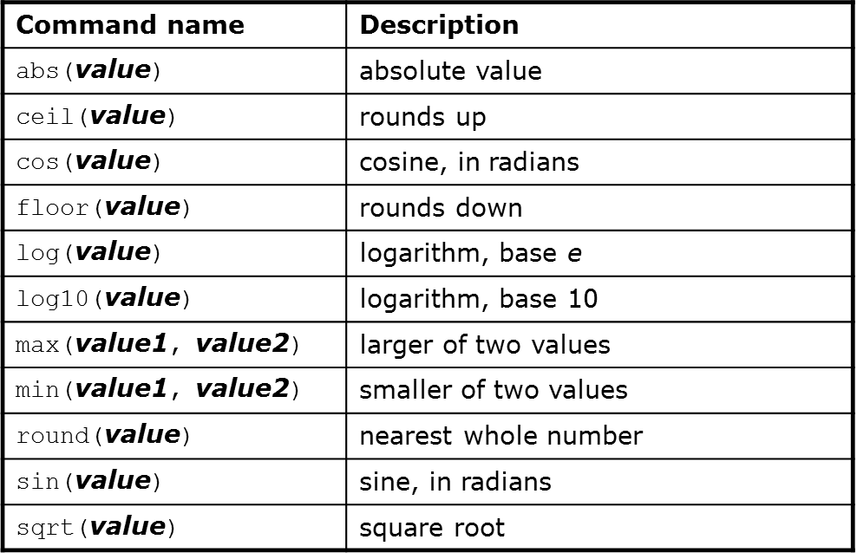
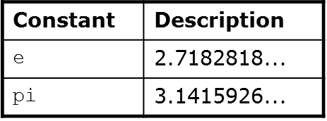
Python 101
Use this at the top of your program: from math import *

Slide 11
Python 101
Many logical expressions use relational operators:

Slide 12
Python 101
These operators return true or false

Slide 13
Python 101
Syntax:
if <condition>:
<statements>
x = 5
if x > 4:
print(“x is greater than 4”)
print(“This is not in the scope of the if”)

Slide 14
Python 101
The colon is required for the if
Note that all statements indented by one level below the if are within it scope:
x = 5
if x > 4:
print(“x is greater than 4”)
print(“This is also in the scope of the if”)

Slide 15
Python 101
if <condition>:
<statements>
else:
<statements>
Note the colon following the else
This works exactly the way you would expect

Slide 16
Python 101
Syntax for “for” statement:
for variableName in groupOfValues:
<statements>
variableName gives a name to each value, so you can refer to it in the statements
groupOfValues can be a range of integers, specified with the range function
Example:
for x in range(1, 6):
print x, "squared is", x * x

Slide 17
Python 101
The range function specifies a range of integers:
range(start, stop)- the integers between start (inclusive) and stop (exclusive)
It can also accept a third value specifying the change between values:
range(start, stop, step)- the integers between start (inclusive) and stop (exclusive) by step

Slide 18
Python 101
“While:” executes a group of statements as long as a condition is True
Good for indefinite loops (repeat an unknown number of times)
Syntax:
while <condition>:
<statements>
Example:
number = 1
while number < 200:
print number,
number = number * 2

Slide 19
Exercise
Write a Python program to compute and display the first 16 powers of 2, starting with 1

Slide 20
Strings
String: A sequence of text characters in a program
Strings start and end with quotation mark " or apostrophe ' characters
Examples: "hello" "This is a string" ‘This, too, is a string. It can be very long!’

Slide 21
Strings
A string can represent characters by preceding them with a backslash
\t tab character
\n new line character
\" quotation mark character
\\ backslash character
Example: "Hello\tthere\nHow are you?"

Slide 22
Strings
As with other languages, you can use square brackets to index a string as if it were an array:
name = “Arpita Nigam”
print(name, “starts with “, name[0])

Slide 23
Strings
len(string) - number of characters in a string
str.lower(string) - lowercase version of a string
str.upper(string) - uppercase version of a string
str.isalpha(string) - True if the string has only alpha chars
Many others: split, replace, find, format, etc.
Note the “dot” notation: These are static methods

Slide 24
Byte Arrays and Strings
Strings are Unicode text and not mutable
Byte arrays are mutable and contain raw bytes
For example, reading Internet data from a URL gets bytes
Convert to string:
cmd = response.read()
strCmd = str(cmd)

Slide 25
Other Built-In Types
Tuples, lists, sets, and dictionaries
They all allow you to group more than one item of data together under one name
You can also search them

Slide 26
Tuples
Unchanging sequences of data
Enclosed in parentheses:
tuple1 = (“This”, “is”, “a”, “tuple”)
print(tuple1)
This prints the tuple exactly as shown
print(tuple1[1])
Prints “is” (without the quotes)

Slide 27
Lists
Changeable sequences of data
Lists are created by using square brackets:
breakfast = [ “coffee”, “tea”, “toast”, “egg” ]
You can add to a list:
breakfast.append(“waffles”)
breakfast.extend([“cereal”, “juice”])

Slide 28
Dictionaries
Groupings of data indexed by name
Dictionaries are created using braces
sales = {}
sales[“January”] = 10000
sales[“February”] = 17000
sales[“March”] = 16500
food = {"ham" : "yes", "egg" : "yes", "spam" : "no"}
food
food[“ham”]
food[“egg”] = ‘no’

Slide 29
Sets
Sets are similar to dictionaries in Python, except that they consist of only keys with no associated values
Essentially, they are a collection of data with no duplicates
They are very useful when it comes to removing duplicate data from data collections.

Slide 30
Writing Functions
Define a function:
def <function name>(<parameter list>)
The function body is indented one level:
def computeSquare(x)
return x * x
# Anything at this level is not part of the function

Slide 31
Error Handling
Use try/except blocks, similar to try/catch:
fridge_contents = {“egg”:8, “mushroom”:20, “pepper”:3, “cheese”:2, “tomato”:4, “milk”:13}
try:
if fridge_contents[“orange juice”] > 3:
print(“Let’s have some juice!”)
except KeyError:
print(“Awww, there is no orange juice.”)

Slide 32
Error Handling
Note that you must specify the type of error
Looking for a key in a dictionary that doesn’t exist is an error
Another example:
try:
sock = BluetoothSocket(RFCOMM)
sock.connect((bd_addr, port))
except BluetoothError as bt
Print(“Cannot connect to host: “ + str(bt))

Slide 33
File I/O
You can read and write text files in Python much as you can in other languages, and with a similar syntax
To open a file for reading:
try:
configFile = open(configName, "r")
except IOError as err:
print(“could not open file: “ + str(err))

Slide 34
File I/O
To read from a file:
while 1:
line = configFile.readline()
if len(line) == 0:
break

Slide 35
File I/O
You can also read all lines from a file into a set, then iterate over the set:
lines = file.readlines()
for line in lines:
print(line)
file.close()

Slide 36
File I/O
Writing to a text file
file=open(‘test.txt’,”w”)
file.write(“This is how you create a new text file”)
file.close()
with open('/etc/passwd') as f:
for line in f:
print(line)

Slide 37
Assignment 1: Task 1
stock = { "banana": 6,
"apple": 0,
"orange": 32,
"pear": 15 }
prices = { "banana": 4,
"apple": 2,
"orange": 1.5,
"pear": 3 }
Write a function “Rechnung” (bill) that takes a list of foods (e.g., ["banana", "orange", "apple"]) as input and computes the total price (only for items in stock) and adjusts the stock accordingly. Write the bill computation as function that takes one parameter (list of foods).

Slide 38
Assignment 1: Task 2
Continue Task 1 by writing the shopping list into a newly created file, each item in a new line. Then write a second program that reads the file in a loop, line by line and prints each line.

Slide 39
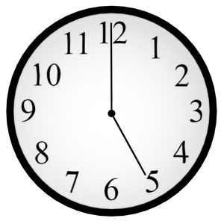
Feierabend

