Slide 1
Internet-of-Things (IoT)
Summer Engineering Program 2018
University of Notre Dame

Slide 2
Course Overview
 | Lecture | Lab
Week 1 | Fundamentals of IoT, basic concepts, applications | Basic Python & Raspberry Pi programming
Week 2 | Human-computer interfaces, sensing, actuation | Sensor programming, control loops, digital/analog I/O
Week 3 | Fundamentals of computer and wireless networks | Wi-Fi and Bluetooth networks, network measurements
Week 4 | Sensor networks, mesh networks, routing, WPANs | ZigBee, WPANs, WBANs, routing, network measurements
Week 5 | Processing, IoT cloud, analytics, visualization | IoT cloud integration, sensor fusion, analytics, visualization
Week 6 | RFID, IoT ecosystem, security, privacy, ethics, case studies | Final project

Slide 3
Administrative Items - Lectures
Occasional assignments before lectures
Questions, discussions, etc. encouraged
One midterm exam (~ 20 minutes)
One final exam (35-40 minutes)
Five lab reports (~weekly); summarizing lab work done that week

Slide 4
Administrative Items - Lab
Multiple lab exercises
Start in class, complete on your own
Teamwork encouraged!
But everybody needs to develop their own code and submit a weekly lab report (due Friday midnight via Sakai)
Website: schedule, handouts, assignments, etc.
Sakai: deliverables, scores, etc.
Piazza: collaboration & discussions
Limited hardware components; sharing will be required

Slide 5
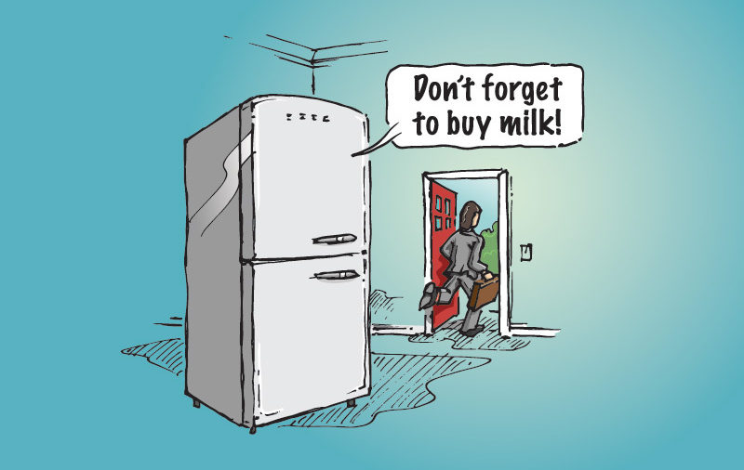
What is the Internet-of-Things?

Slide 6
How Does My Fridge Do That?
You are leaving the home (sense user)
There’s no milk in fridge (sense object)
Use this information to make a decision (process)
Inform user of decision (communicate)

Slide 7
How Does My Fridge Do That?
You are leaving the home (sense user)
What type of sensor?
Distinguish between parent and child
Identify reason for leaving home
Identify other contexts (e.g., store hours)
There’s no milk in fridge (sense object)
Use this information to make a decision (process)
Inform user of decision (notify)

Slide 8
How Does My Fridge Do That?
You are leaving the home (sense user)
There’s no milk in fridge (sense object)
What type of sensor?
Is milk needed?
No milk or “little” milk? (prediction)
Use this information to make a decision (process)
Inform user of decision (notify)

Slide 9
How Does My Fridge Do That?
You are leaving the home (sense user)
There’s no milk in fridge (sense object)
Use this information to make a decision (process)
Where is processor?
What are the rules?
Fixed rules versus dynamic rules (learning)
Inform user of decision (notify)

Slide 10
How Does My Fridge Do That?
You are leaving the home (sense user)
There’s no milk in fridge (sense object)
Use this information to make a decision (process)
Inform user of decision (notify)
How?
When?
Privacy?
Subtleness?
Information overflow?

Slide 11
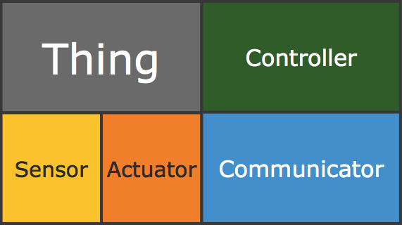
Internet-of-Things (IoT)
Physical object (“thing”)
+
Controller (“brain”)
+
Sensors
+
Actuators
+
Networks (Internet)

Slide 12
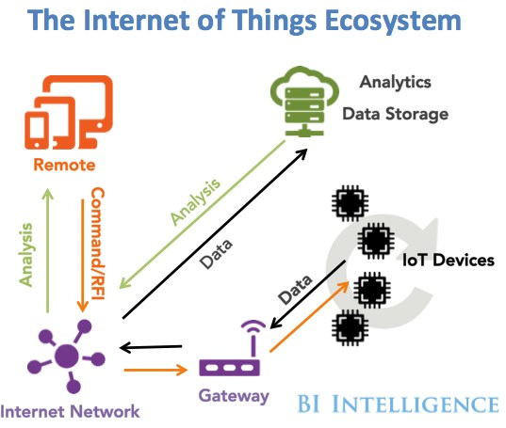
Internet-of-Things (IoT)

Slide 13
Related Areas/Terminology
Embedded systems: not necessarily connected
Sensor networks: collection of sensor devices connected through wireless channels
Cyber-physical systems: focus on interaction between physical and cyber systems
Real-time systems: focus on time constraints
Pervasive/ubiquitous computing: focus on anytime/anywhere computing

Slide 14
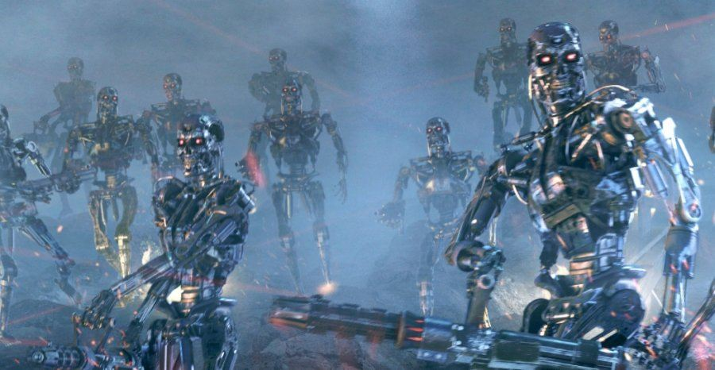
Related Areas
Machine-to-machine (M2M) communications
Internet of Everything (Cisco Systems)
“Skynet” (Terminator movie)

Slide 15
“Internet-of-Things”
Term coined by British entrepreneur Kevin Ashton, while working at MIT Auto-ID Labs
Referred to (and envisioning) a future global network of objects connected specifically by RFID (radio-frequency identification)
Complete automation of data collection
First article about IoT in 2004 from MIT; called “Internet 0”

Slide 16
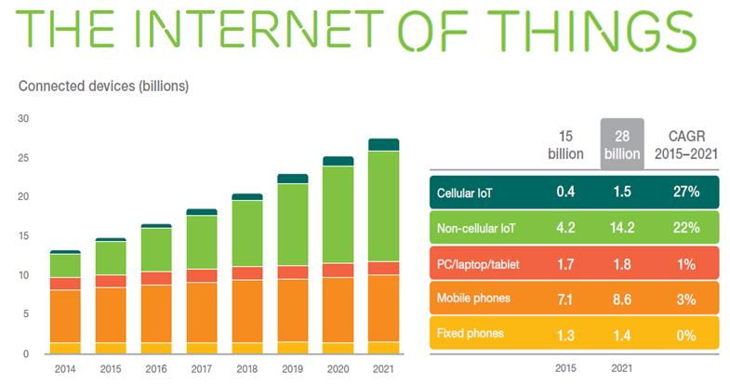
Internet-of-Things Vision & Growth

Slide 17
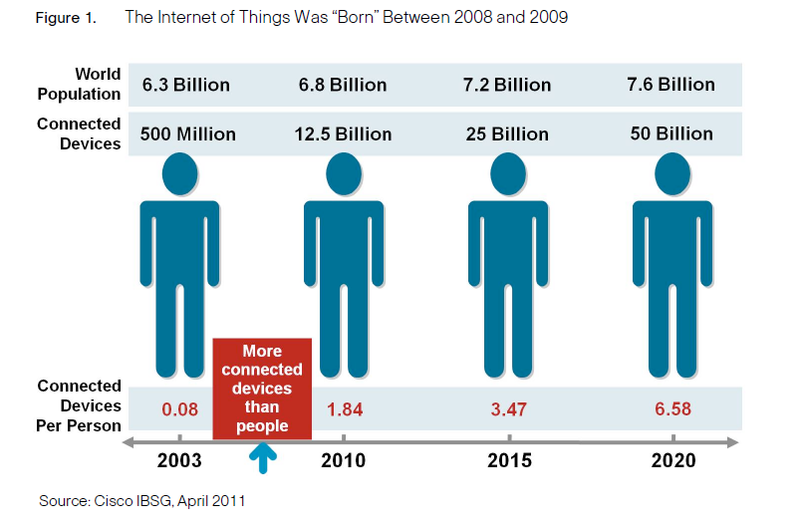
Internet-of-Things Vision & Growth

Slide 18
Internet-of-Things Vision & Growth

Slide 19
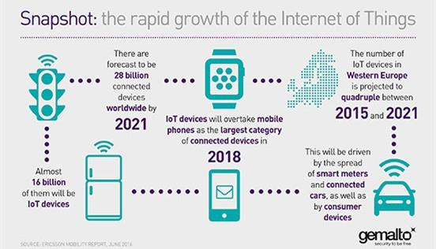
Internet-of-Things Vision & Growth

Slide 20
Internet-of-Things Vision & Growth

Slide 21
Cisco Commercial

Slide 22
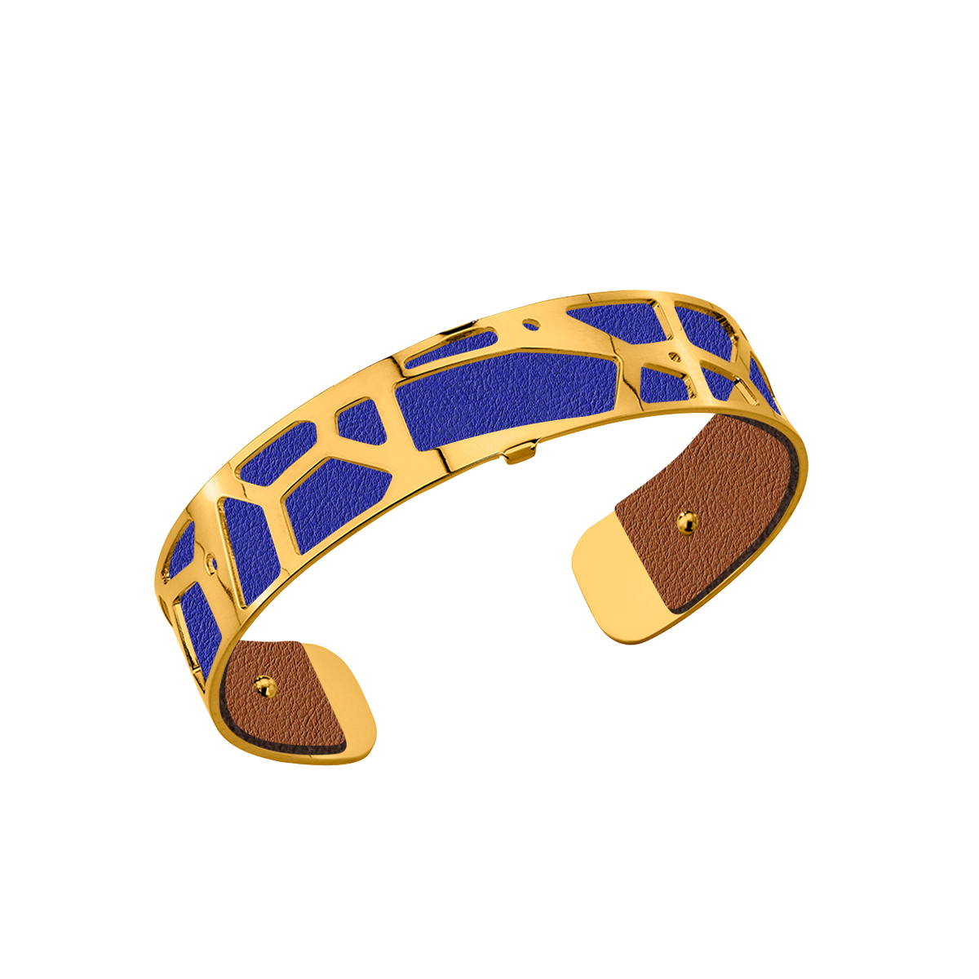
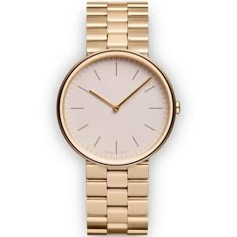
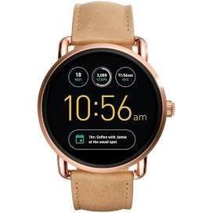
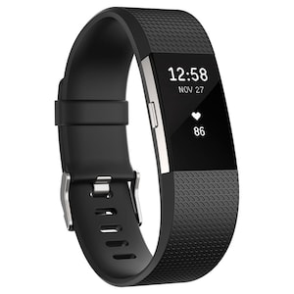
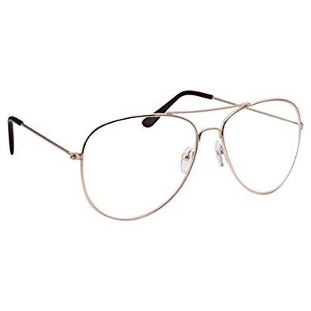
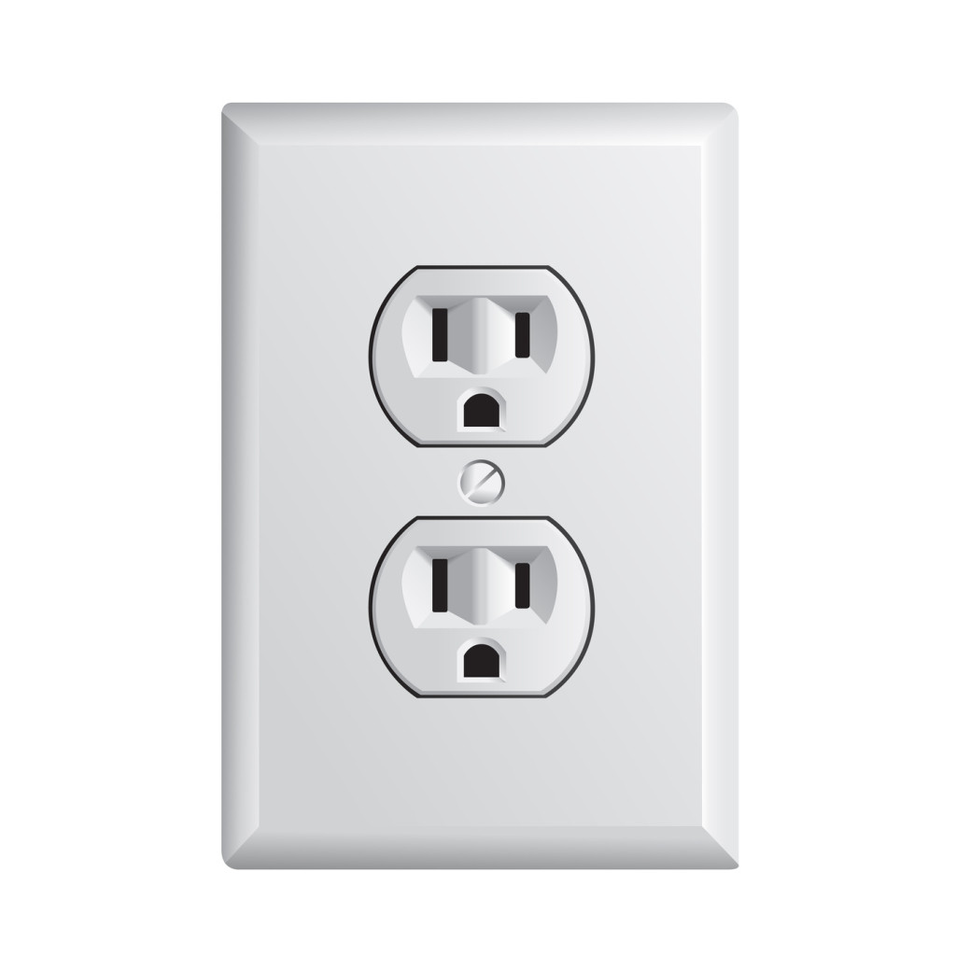
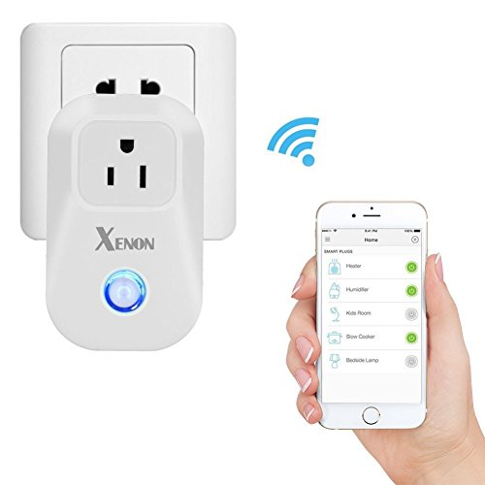
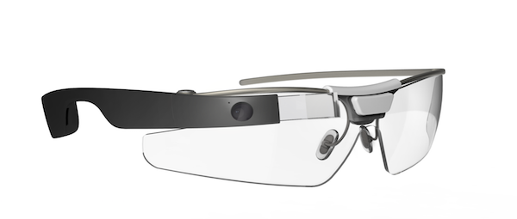
Augment Existing Things

Slide 23
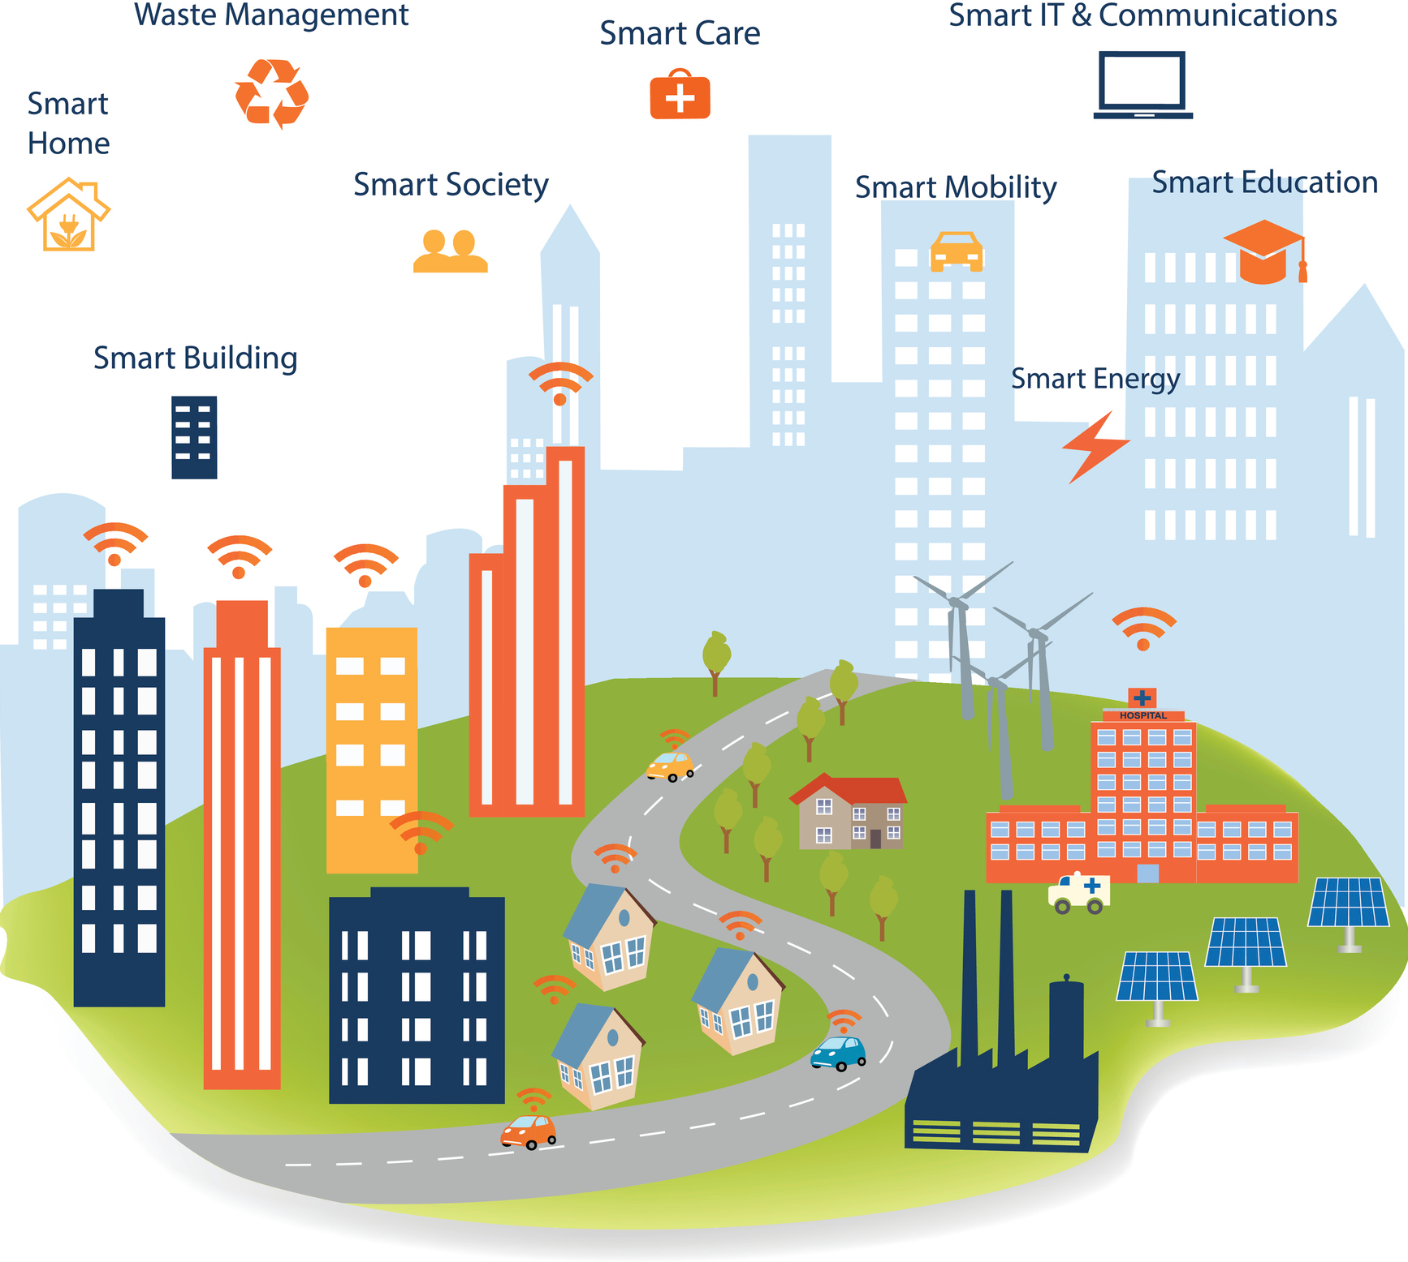
Augmenting Life With New Things
Smart City
Smart Car
Smart Me (healthcare, fitness, wellness)

Slide 24
Example: Connected Roadways
US DoT Statistics for 2012:
5.6million crashes
About 31,o00 fatalities (26,500 in EU)
Over 1.6M injuries
1trillion USD in economic loss
5.5billion hours of travel delays per year
CO2 emissions

Slide 25
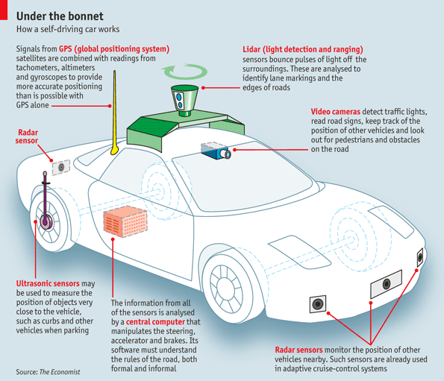
Example: Connected Roadways

Slide 26
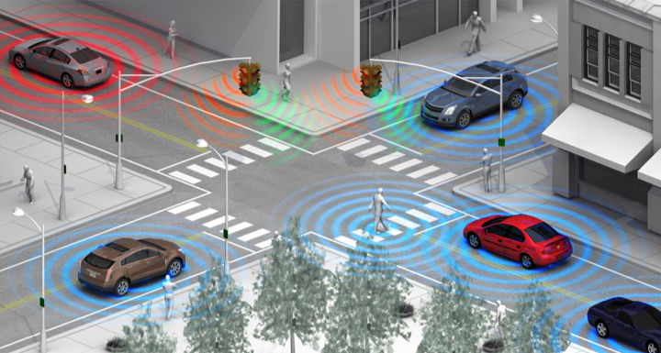
Example: Connected Roadways
State of Self-Driving Car

Slide 27
Example: Connected Factory

Slide 28
Example: Connected Factory
New product and service introductions faster
Increasing production, quality, uptime
Mitigating unplanned downtime
Protecting from cyber threats
Worker productivity and safety

Slide 29
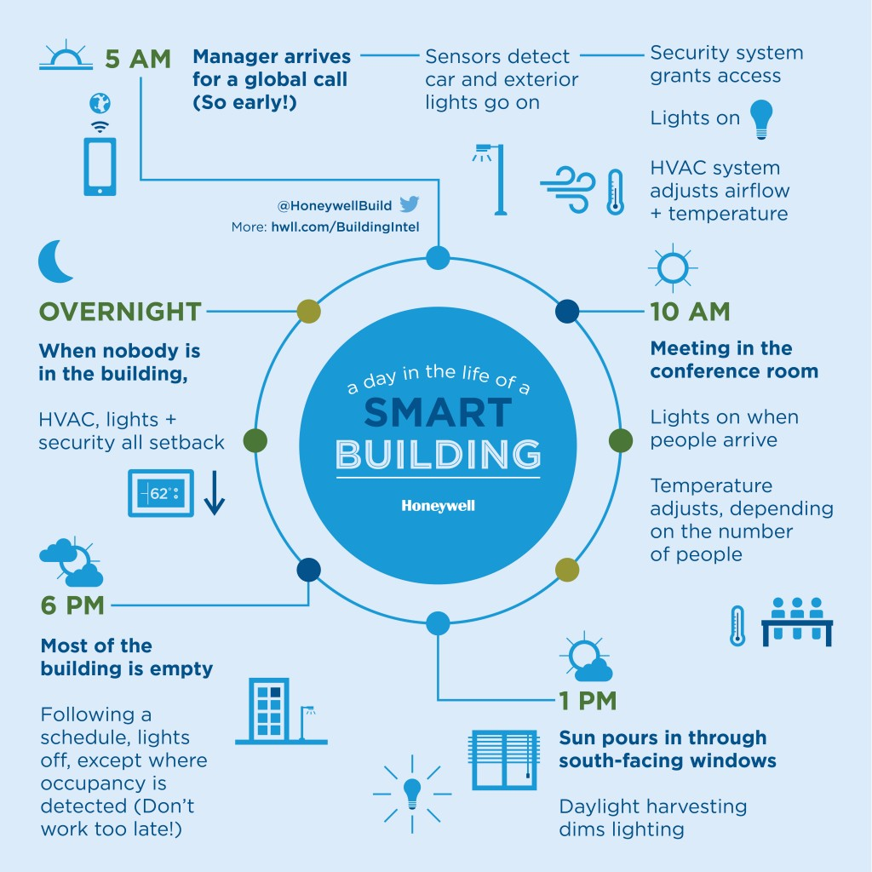
Example: Smart & Connected Buildings
Energy management
Lighting
Safety
HVAC
Building automation
Smart spaces

Slide 30
Example: Smart Creatures

Slide 31
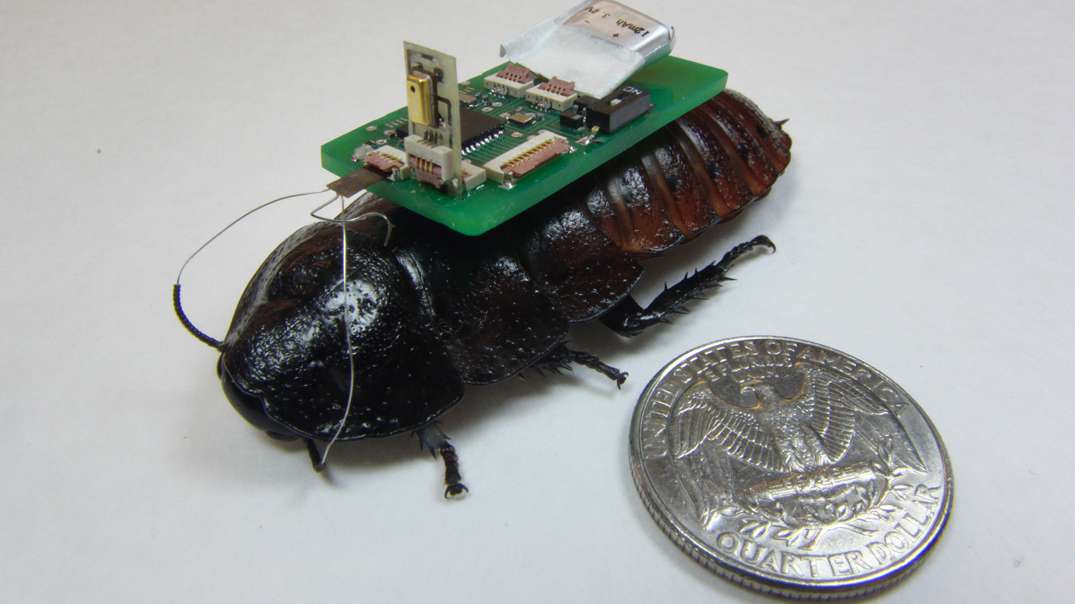
Example: Smart Creatures
IoT-Enabled Roach, NC State University

Slide 32
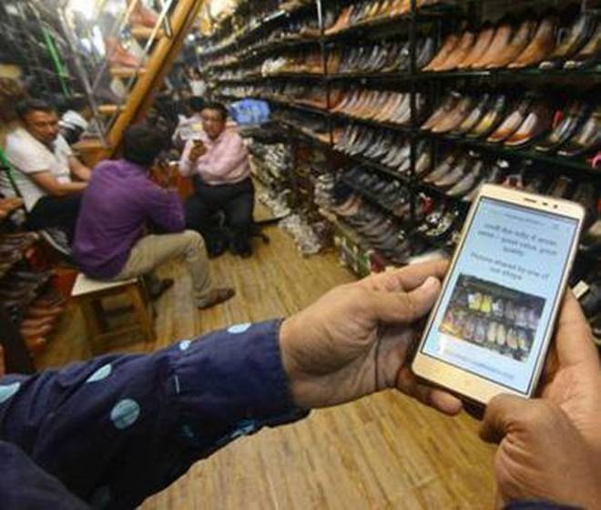
Example: Fight Poverty
Try to get more shoppers from Warden Road to Dharavi in Mumbai

Slide 33
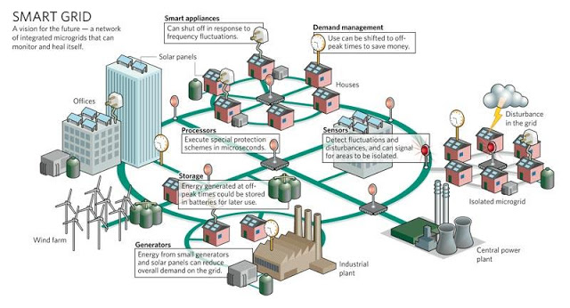
Example: Smart Grid

Slide 34
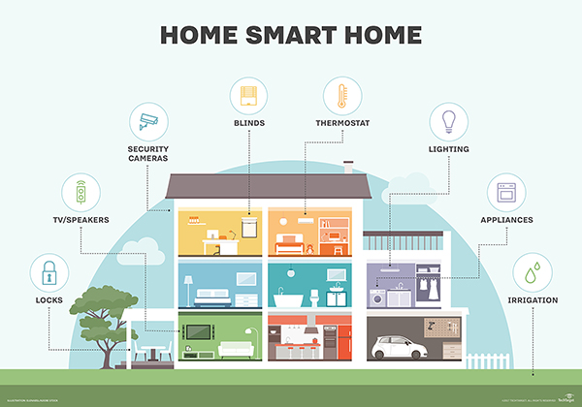
Example: Smart Homes

Slide 35
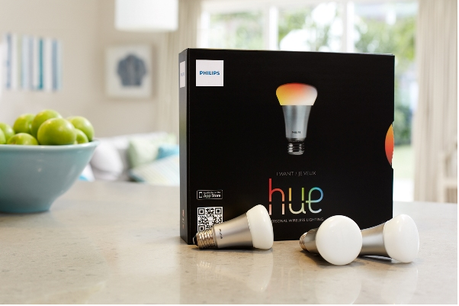
Example: Smart Lighting
Tunable light, 16 million colors
Activated by smartphone or over Zigbee wireless
Can serve as alarm clock
Can synch colors to movies or possibly music
Philips never anticipated the demand - sold out in 3 months at Apple stores!

Slide 36
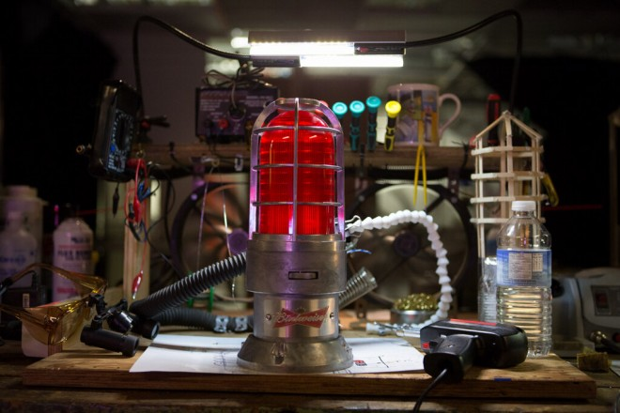
Example: Wi-Fi Connected Goal Light
In-Home Automatic Hockey Goal Light (Budweiser)

Slide 37
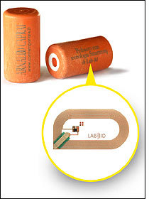
Example: Smart Corks
SmartCorq: allows wine producers and consumers to have greater assurance of the quality and provenance of each bottle of wine
Bottling date
Grape type
Alcohol percentage
and more…

Slide 38
More Smarts
Smart bathroom cabinet for medicine
Smart refrigerator
Smart toilet
Smart history (in museums)
Smart health (sensors in running shoes)
Smart buying (beacons)
Smart shirt (seal wounds)
Smart helmet (detect concussion)
…

Slide 39
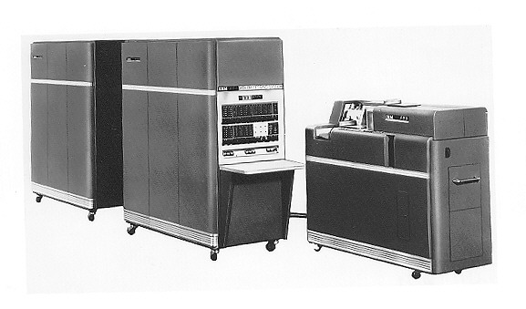
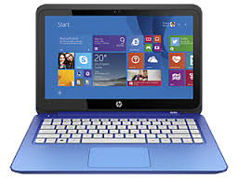
Enablers: Portability
Reducing the size of hardware to enable the creation of computers that could be physically moved around relatively easily

Slide 40
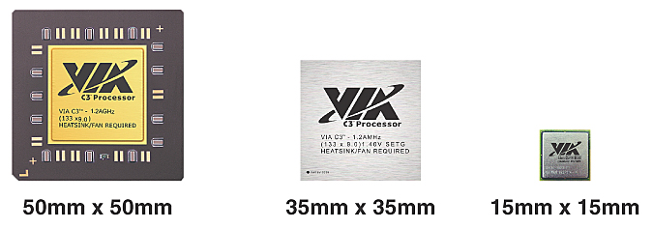
Enablers: Miniaturization
Creating new and significantly smaller mobile form factors that allowed the use of personal mobile devices while on the move

Slide 41
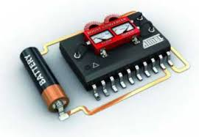
Enablers: Low Power and Low Heat
Low power architectures
Low power radios
Sleep modes
Energy harvesting

Slide 42
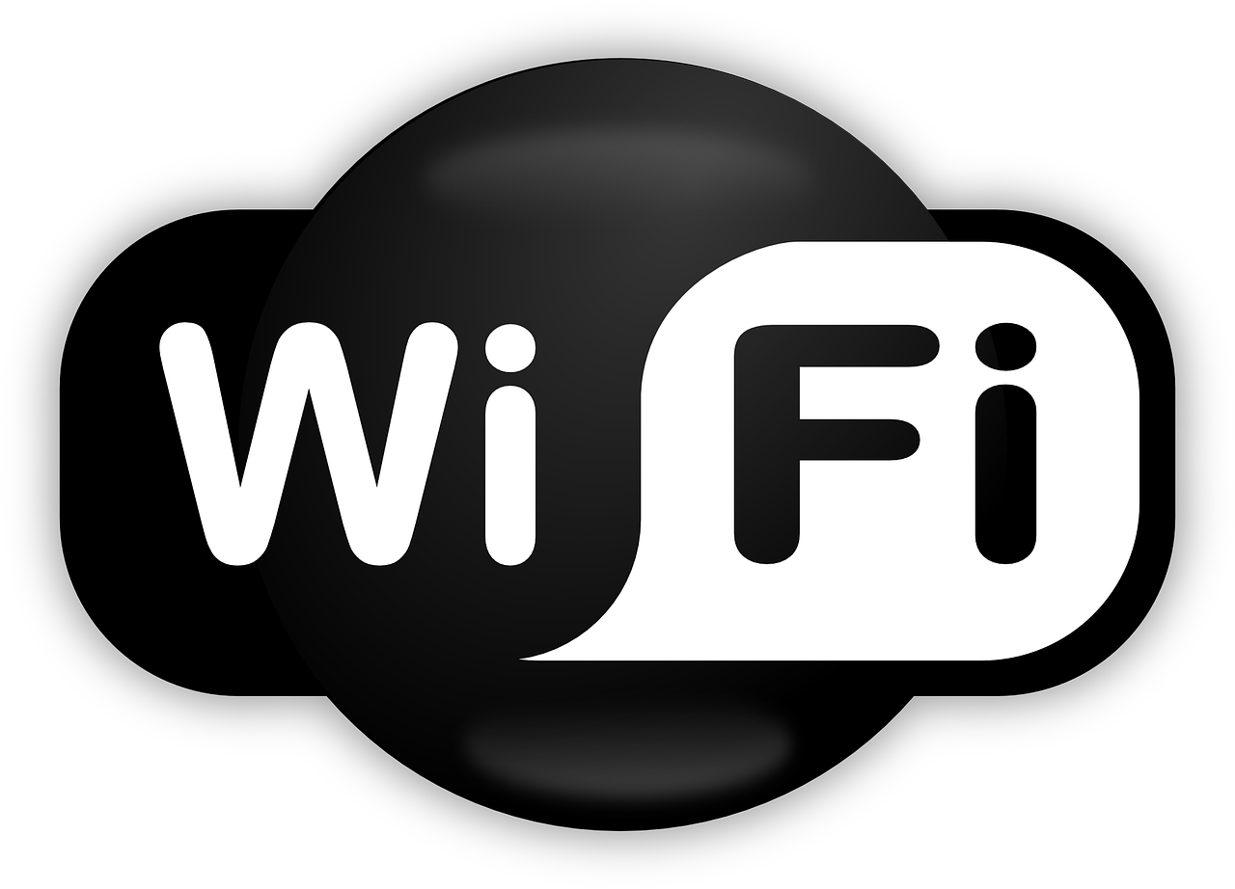
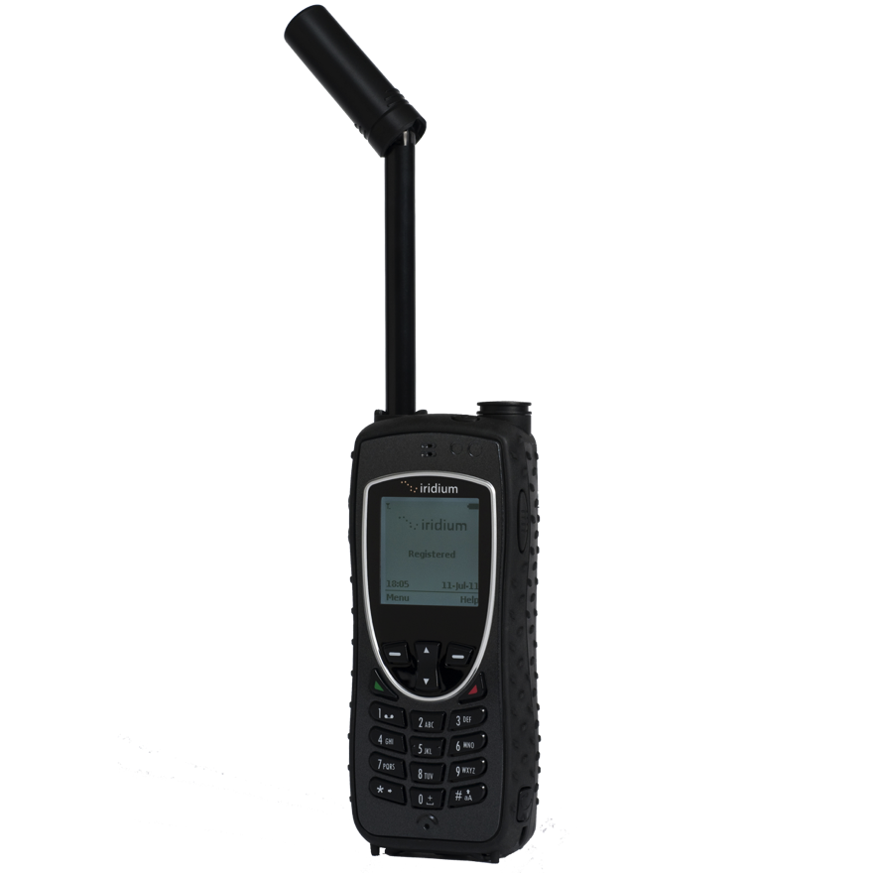
Enablers: Connectivity
Developing devices and applications that allowed users to be online and communicate via wireless data networks while on the move

Slide 43
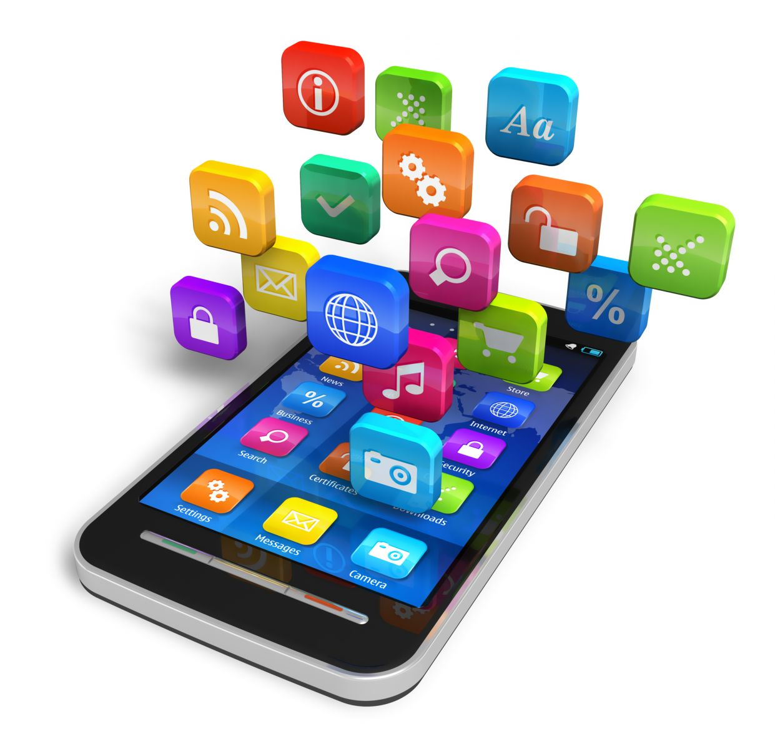
Enablers: Convergence
Integrating emerging types of digital mobile devices, such as Personal Digital Assistants (PDAs), mobile phones, music players, cameras, games, etc., into hybrid devices

Slide 44
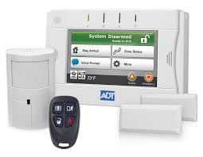
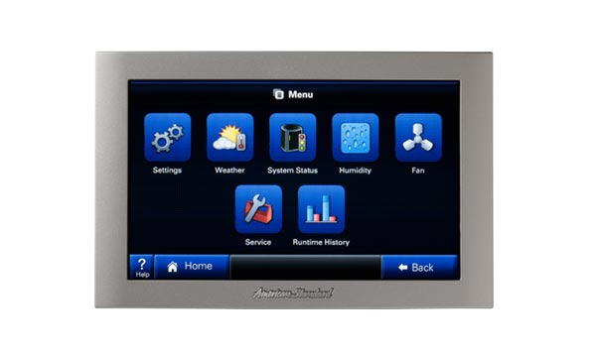
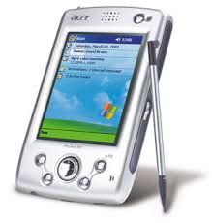
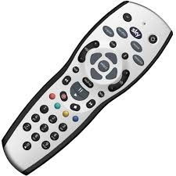
Enablers: Divergence
Opposite approach to interaction design by promoting information appliances with specialized functionality rather than generalized ones

Slide 45
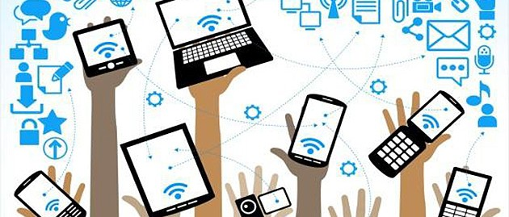
Enablers: Ecosystems
The emerging wave of digital ecosystems is about the larger wholes of pervasive and interrelated technologies that interactive mobile systems are increasingly becoming a part of

Slide 46
Example: Smartphone
Portability: carry it anywhere you want
Miniaturization: make it possible to build device to fit in your pocket
Connectivity: Wi-Fi, LTE/4G, cellular, Bluetooth
Convergence: phone, camera, gaming device, movie streaming, music player, …
Digital Ecosystem: cloud, social networks, software development kits, app stores, big data, standardization …

Slide 47
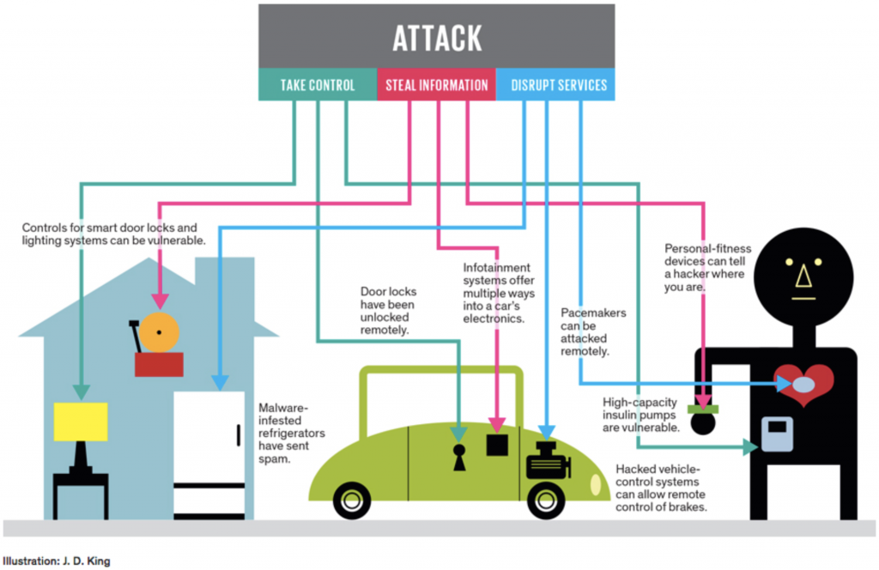
IoT Issues & Challenges

Slide 48
Coke Commercial

Slide 49
Reaction to Commercial
One Perspective
“Coke commercial about security cameras was so cool. Let's look at the world a little differently. Going to drink a coke in honor.”
Another Perspective
“Ad full of hidden security-cam moments: Coke proudly proclaims itself official soft drink of the security state.”

Slide 50
BREAK

