Slide 1
Internet-of-Things (IoT)
Summer Engineering Program 2018
University of Notre Dame
LAB COMPONENT

Slide 2

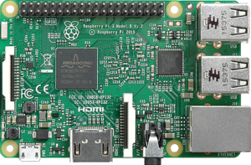
Raspberry Pi 3
https://pihw.wordpress.com/guides/direct-network-connection/
http://www.circuitbasics.com/how-to-connect-to-a-raspberry-pi-directly-with-an-ethernet-cable/

Slide 3
Raspberry Pi 3
Credit card sized bargain micro Linux machine
  Low cost
  Improve programming skills and HW understanding for students
Most recent version: 1 GB of RAM, 1.4 GHz quad – core ARM Cortex-A53 processor
Open hardware with the exception of its primary chip (Broadcom SoC), which runs the main components of the board: CPU, graphics, memory, USB controller, etc.

Slide 4
System on a Chip (SoC/SOC)
An integrated circuit (IC) that integrates all components of a computer or other electronic system into a single chip
Low overall system cost
High performance
Low power consumption
Small form factor (size)
BCM2835 SoC (right) and Samsung K4P2G324ED Mobile DRAM (left)

Slide 5
Typical System on a Chip (SoC)
Microcontroller, microprocessor, or digital signal processor (DSP) core – multiprocessor SoCs (MPSoC) having more than one processor core
Memory blocks including a selection of ROM, RAM, EEPROM, and flash memory
Timing sources including oscillators and phase-locked loops
Peripherals including counter-timers, real-time timers, and power-on reset generators
External interfaces, including industry standards such as USB, FireWire, Ethernet, USART, SPI
Analog interfaces including ADCs and DACs
Voltage regulators and power management circuits

Slide 6
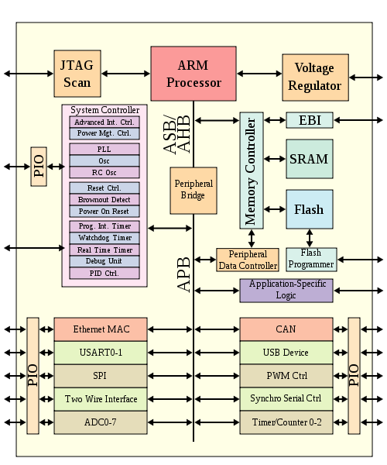
System on a Chip (SoC)

Slide 7
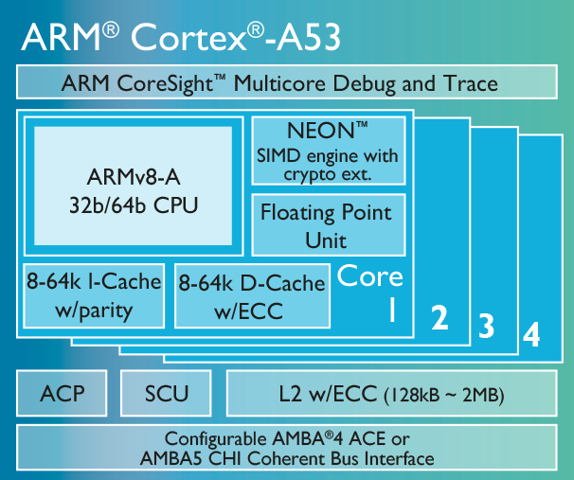
RPi3 SoC (BCM2837)
Broadcom BCM2837 System on a Chip (SoC); it is running at 1.2/1.4Ghz, based on the quad-core ARM Cortex-A53
ARM Cortex-A53:
  Supports 32-bit and 64-bit code
  Implements ARMv8-A architecture
  Uses 8-stage in-order pipeline

Slide 8
Model History
Model A+: low-cost variant of the RPi; 256MB RAM, one USB port, 40 GPIO pins and no Ethernet port
Model B+: final revision of the original RPi; 512MB RAM (twice as much as the A+), four USB ports, 40 GPIO pins, and an Ethernet port
Pi 2: similar to Pi 1 B+, but uses a 900MHz quad-core ARM Cortex-A7 CPU and has 1GB RAM
Pi 3 Model B: launched in February 2016; uses a 1.2GHz 64-bit quad-core ARM Cortex-A53 CPU, 1GB RAM, integrated 802.11n wireless LAN, and Bluetooth 4.1
Pi 3 Model B+: launched in March 2018; uses a 1.4GHz 64-bit quad-core ARM Cortex-A53 CPU, 1GB RAM, integrated 802.11ac wireless LAN, and Bluetooth 4.1
Pi Zero: half the size of a Model A+, 1Ghz single-core CPU, 512MB RAM, and mini-HDMI and USB On-The-Go ports

Slide 9
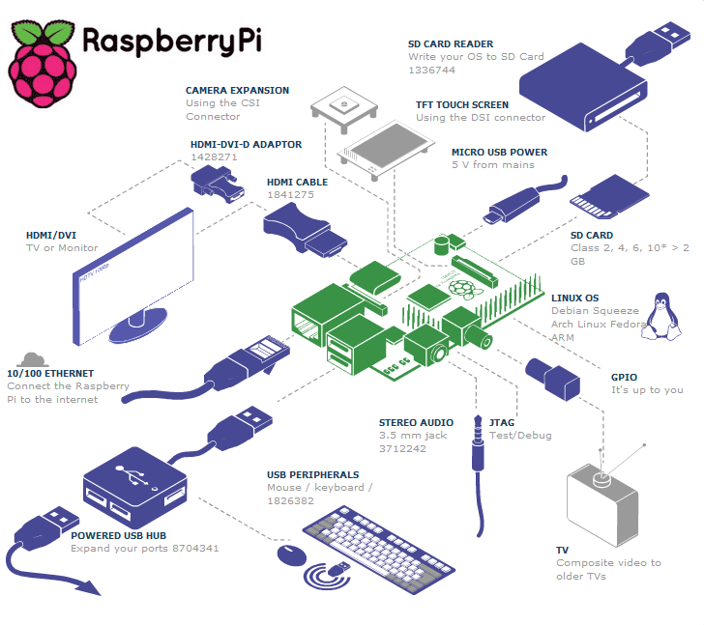
Raspberry Pi Details

Slide 10
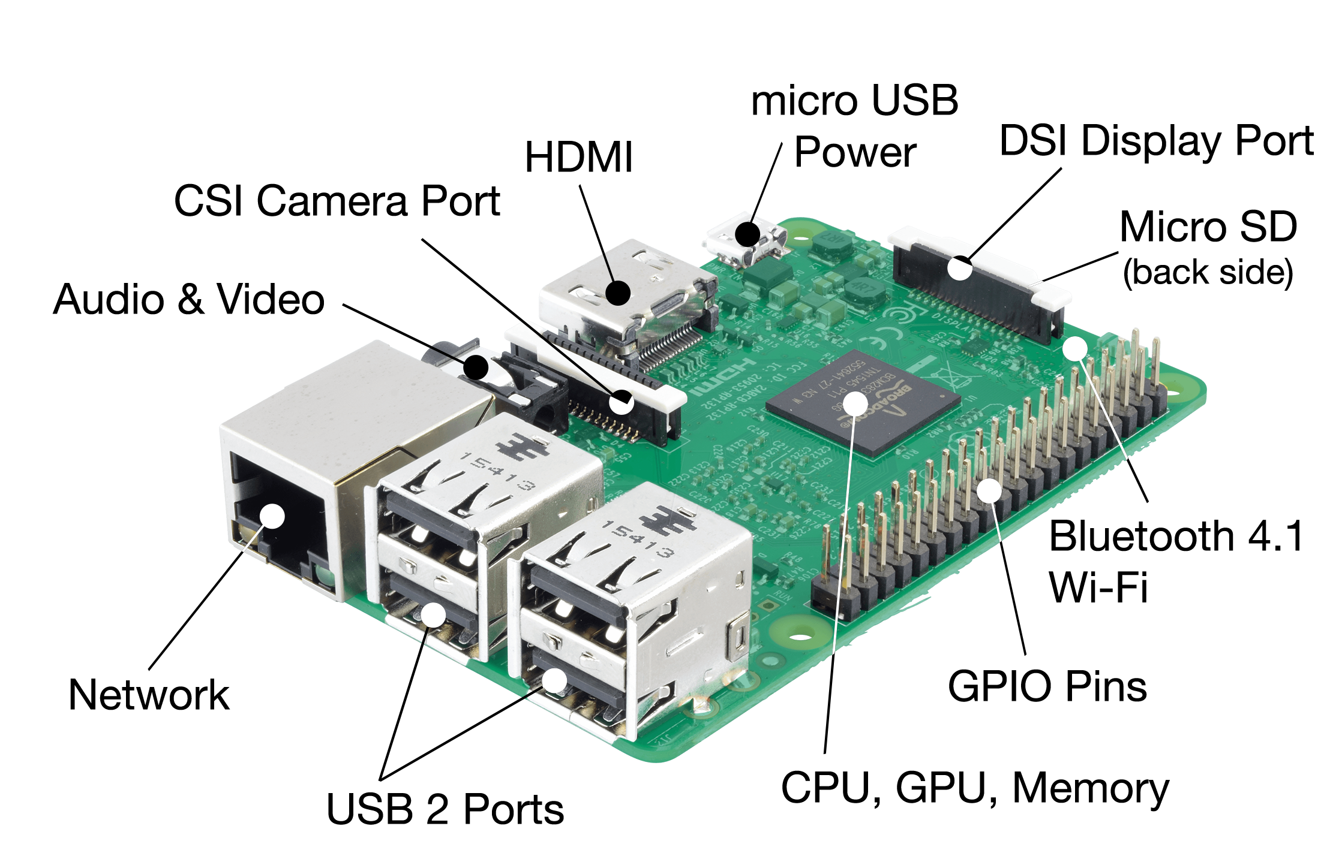
Raspberry Pi 3 Details

Slide 11
Powering the RPi
The Raspberry Pi requires a 5V power line
This is normally provided using the Micro-USB Connector
You can also power the Raspberry Pi through the GPIO Header
This is used when the Pi is powered from another board that is connected to it
You can also use the power signal in the GPIO header to power other boards (as long as they are a light load)

Slide 12
Powering the RPi
The Pi can be used to feed power to other boards connected to it
The maximum current you can take from the 5V rail is based on the used power supply
The board takes around 700 mA from the 5V power supply, any extra current the power supply can provide can be used to external circuits

Slide 13
Powering the RPi
While RPi is powered using 5V, all signaling is done using 3.3V levels
Careful with connecting 5V circuits (e.g., many Arduino boards) to GPIO pins; RPi lacks over voltage protection
If you need to use chips that run with 5V logic:
  If the chip only takes output from the Pi, sometimes, the 3.3V of the Pi is good enough for the external chip to detect logic 1
  If the 3.3V of the Pi is not enough to drive the chip, then you need a 3.3V to 5V level shifter
  If the chip provides input to the Pi, then you will always need to use a 5V to 3.3V level shifter (not doing that may damage your Pi board)

Slide 14
RPi Setup
Step 1: SD Card Setup
Step 2: Raspberry Pi cabling
Step 3: Booting your RPi for the first time
Step 4: Load GUI environment to your RPi
Step 5: Setup a network connection

Slide 15
SD Card Setup
RPi will NOT start without a properly formatted SD Card (with a bootloader and suitable OS)
Two of the most important RPi OS options are Raspbian (based on Debian) and Pidora (based on Fedora)
Insert formatted SD card before powering up
Ways to setup the SD card:
  Easy/safe: buy preloaded card from a reputable supplier or as part of a kit
  Not-so-easy: create your own SD card for RPi using NOOBS or flashing the SD Card using Windows, Mac, or Linux
  http://elinux.org/RPi_Easy_SD_Card_Setup

Slide 16
SD Card Setup Using NOOBS
NOOBS: New Out Of Box Software
1 GB download compared to the 500 MB size of images used for flashing
Download NOOBS from the raspberrypi.org downloads page
Insert a (4 GB+) SD Card into your computer
Format the disk

Slide 17
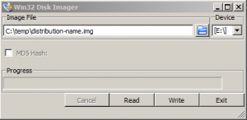
Windows Instructions
Using the Win32DiskImager program
  Download the distribution from raspberrypi.org downloads page. Make sure the distribution is for Raspberry Pi (it will mostly be a compressed file ending in .zip or .gz). Extract this image.
  Insert the SD card into your SD card reader and make note of what drive your SD Card is assigned.
  Download the Win32DiskImager utility from https://sourceforge.net/projects/win32diskimager/ . This can be run from a USB drive.
  Extract the executable from the zip file and run the Win32DiskImager utility (might
  need to ‘Run as Administrator’; Right-click on the file, and select 'Run as Admin’).
  If you see a file error when Win32DiskImager loadsv(in windows 7), ignore the error.
  Select the image file you extracted and the drive letter of SD card as shown here
  Click ‘Write’ and wait for write to complete.
  Exit imager and eject SD card. It can now be plugged into RPi.
  If you are unable to chose the device in Win32DiskImager, try using ‘flashnul’ to do a similar installation. Alternatively, you can use the Fedora ARM Installer to download and install RPi Fedora Remix images (http://fedoraproject.org/wiki/Fedora_ARM_Installer)

Slide 18
Mac Instructions
One way is to run an app with a GUI such as Pi Filler, ApplePi-Baker, or PiWriter; but the way that has worked out for most users is by using systems tool from the command line.
First, download the image you want here : http://www.raspberrypi.org/downloads
Verify the file using the published hash value - from the command line: $ openssl sha1 path_to_file.img, or drag&drop the .img file into command window instead of typing the full path and file name.
Unzip the file to extract the image (.img) file (an app like Unarchiver worked better that the OS X file de-compressor.
Follow this link for instructions on installing OS images from the latest version of MAC OS : https://www.raspberrypi.org/documentation/installation/installing-images/mac.md

Slide 19
Linux Instructions
Download the zip file containing the image of the distribution : http://www.raspberrypi.org/downloads
Extract image with : unzip ~/2012-12-16-wheezy-raspbian.zip
Run df –h to see what devices are currently mounted.
Insert SD card into your computer and run df –h again. Your SD card will be listed as something like "/dev/mmcblk0p1" or "/dev/sdd1". The last part ("p1" or "1" respectively) is the partition number, but you want to write to the whole SD card, not just one partition, so you need to remove that part from the name (getting for example "/dev/mmcblk0" or "/dev/sdd").
Now, unmount the SD card (and all its partitions that show up) - umount /dev/sdd1 (replace /dev/sdd1…)
In the terminal write the image to the card with this command, making sure you replace the input file if= argument with the path to your .img file, and the "/dev/sdd" in the output file of= argument with the right device name (IMPORTANT !!! The wrong device name will cause you to lose all data on the hard drive)
dd bs=4M if=~/2012-12-16-wheezy-raspbian.img of=/dev/sdd --- Might need to sudo for this.
As root run the command sync or if a normal user run sudo sync(this will ensure the write cache is flushed and that it is safe to unmount your SD card)
Remove SD card from reader and insert in RPi.

Slide 20
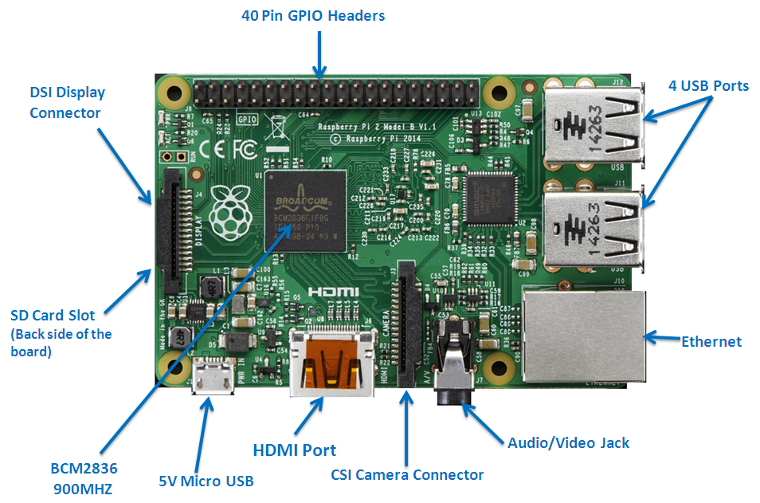
RPi Cabling
Push SD card into SD card slot
Plug HDMI cable into the HDMI output and connect to the TV/monitor
Turn on monitor and switch to the HDMI port
Insert the network cable and connect to the router
Connect the keyboard and mouse via USB ports
Plug the power supply into the micro USB

Slide 21
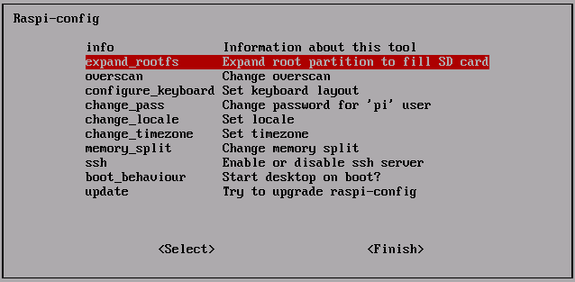
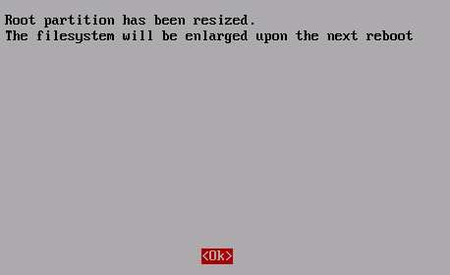
Booting
These steps are for the Debian distribution of Raspberry Pi, Raspbian
The first time you boot the Raspberry Pi you'll see a configuration tool called “raspi-config”
Calling “raspi-config” command from the terminal of your device will open this configuration screen again, if you need to see it
Select “expand_rootfs” and press enter (as shown in the images below); this option expands the installed image to use the maximum available size of your SD card

Slide 22

Booting
Select “configure_keyboard” from the main menu and press enter. From the list of keyboard options that comes up, select your keyboard setup. If you are unable to find your keyboard setup, select the default 105-key option.
Select the keyboard layout as required
The last option to set in the Keyboard configuration is the ALT / CTRL / BACKSPACE feature to kill X11. It is recommended that you enable this, so that in case your GUI ever crashes you can safely kill it without rebooting.

Slide 23
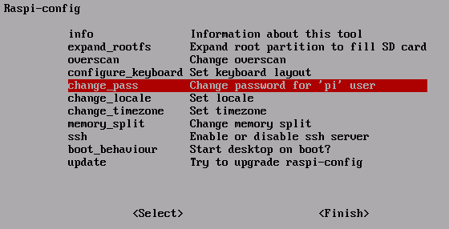

Booting
Setting user password on your device.
From the main menu, select “change_pass” and press Enter. You will be prompted to enter new UNIX password.
Set your “locale” which is the general character set used in your native language (en_US.UTF-8 for USA). Set this as the default locale when prompted.
Set your timezone by selecting the “Change_timezone” option.
Select “Finish” and reboot. Once you are back online, you will see a login prompt like this.

Slide 24
Load GUI Environment
Log in from the login prompt with the username “pi” and the password you set earlier
After logging in, type “startx” to get the GUI environment loaded
After a loading sequence, you will see a UI which looks similar to the Windows UI. It is the LXDE Window Manager which is a light weight UI that runs well on Raspberry Pi
After finishing the whole setup sequence, you now have your device powered up and the LXDE WM running. You can now use this Pi for your projects, or for general computing tasks

Slide 25
Set Up Network
Your device can be connected to the Internet in the following different ways, depending on the model you have used:
  The LAN interface via Ethernet cable to your Internet router (Models B & B +, not the A, A + and Zero)
    If you are using the Ethernet option and your router is configured for DHCP, you should be able to connect without any further configuration.
  The built-in wireless card - Only the Raspberry Pi 3
  A USB wireless dongle - available for all models
    This option consumes more power than other options. If you are using this option, make sure you hve a power supply that can support it.
  Wi-Fi can be setup using either the command line or the graphical interface. Instructions on setting up Wi-Fi are available in detail in this document : https://learn.adafruit.com/downloads/pdf/adafruits-raspberry-pi-lesson-3-network-setup.pdf

Slide 26
IDLE on RPi
Raspbian comes preloaded with Python, the official programming language of the Raspberry Pi and IDLE3 which is a Python Integrated Development Environment
IDLE3 can be loaded up by double-clicking the icon on your LXDE desktop
Click File > New Window, which will then bring up a new blank window which you can type in
Type in your code and save
Click Run > Run Module or press F5 to run your code

Slide 27
SSH on RPi
If you want to access the command line (not the full desktop environment) of your RPi from another computer, you can use ssh
SSH can be enabled using “raspi-config”
Enter sudo raspi-config in the terminal, navigate to ssh, hit Enter, and select Enable or disable ssh server
For access to the full desktop environment via remote control, you can use VNC. It transmits the keyboard and mouse events from the controller, and receives updates to the screen over the network from the remote host
Instructions to enable VNC are here : https://www.raspberrypi.org/documentation/remote-access/vnc/README.md

Slide 28
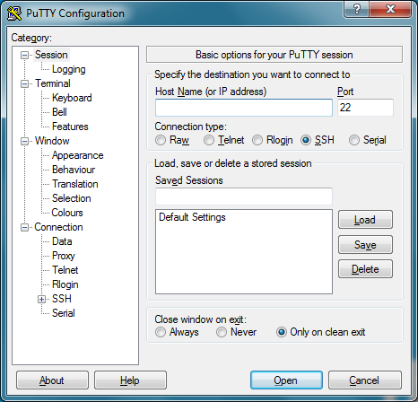
SSH into RPi Using Windows
Download PuTTY (available as ‘putty.exe’)
When you run it, you will see a configuration screen like this ->
Type the RPi’s IP address into the Host name field and ‘Open’.
(Find the IP address using hostname –I )
When the connection starts, you will see a security warning
about the server’s host key not cached in the registry. This can be safely ignored. Click ‘Yes’.
You will now get the usual RPi login prompt. Log in with ‘pi’ as
username and the password you set earlier.
Type exit to close the putty window.
You can use ‘Saved sessions’ on the configuration screen to
connect the second time. You can change the ‘Seconds between
keepalives’ value in the left hand pane to 30 to allow PuTTY to
leave the remote connection open for long periods without any
activity on your RPi.

Slide 29
SSH into RPi Using Mac
SSH from Linux or Mac OS doesn’t require any software installations.
Get your device’s IP address from the terminal using hostname –I
Type the command ssh pi@<IP> where <IP> is the IP address of the RPi into the terminal window of the Linux or Mac OS devices. If your RPi user name is not ‘pi’, replace ‘pi’ in the command with your user name.
If you receive a ‘connection timed out’, check if you have the RPi’s correct IP address.
When you get a security authenticity warning, type yes.
You will now be prompted for the password for the pi (username: pi; password: as in the setup).
X-Forwarding can also be set up from Linux or Mac OS by using the –Y flag as ssh -Y pi@<IP>
With X-forwarding, When you type in commands such as idle3 & you can now open up graphical windows such as Python Editor IDLE remotely.

Slide 30
Resources for learning about RPi
Learning resources : https://www.raspberrypi.org/resources/learn/
Raspberry Pi projects : http://elinux.org/RPi_Projects
Raspberry Pi learning community https://www.element14.com/community/welcome
A project aiming at creating an enhanced router using Raspberry Pi https://ronnyvdbr.github.io/

Slide 31
Assignment 1: Task 3
Write a simple Python program using an editor on your laptop, e.g., a calculator, a game, etc., but something different from Assignment 0. The program should be interactive, i.e., ask the user for input, perform some processing, and present an output.
Then copy it onto your RPi via the Ethernet connection.
Then ssh into your RPi and run the code.

Slide 32
Assignment 1: Task 4
Use ssh to log into your RPi and then use IDLE to write another simple Python program (again interactive) and execute it.
Copy the program from the RPi to your laptop via the Ethernet connection.

Slide 33
Assignment 1: Task 5
Raspbian is a Linux/Unix variant. Become familiar with the Unix environment on your RPi, e.g., learn the commands for the following activities and try them on the RPi:
  Create directories, create subdirectories within these directories, delete directories, change directories, list the content of a directory, and find out what the shortcuts ~, ., and .. mean when you navigate directories
  Learn a command-line editor (e.g., nano, vi, vim, or emacs (note: some may be preinstalled, others have to be installed) and write a simple file (on the RPi), save the file, copy that file to another location, rename the file, and delete the file

Slide 34
Assignment 1 Deliverables
Lab report by Friday midnight (via Sakai; if problems with Sakai, email to iot34468@gmail.com)
PDF format; name & netid on top
Complete source code for Task 1 & 2 (combined)
Complete source code for Task 3
Complete source code for Task 4
End the report with a section called “Problems Encountered:” where you can describe missing features or other problems with your code, or any problems encountered with using ssh/scp or other Unix commands. If there were no problems, just write “None”.

Slide 35

Feierabend

