Slide 1
Internet-of-Things (IoT)
Summer Engineering Program 2018
University of Notre Dame

Slide 2
Course Overview
 | Lecture | Lab
Week 1 | Fundamentals of IoT, basic concepts, applications | Basic Python & Raspberry Pi programming
Week 2 | Human-computer interfaces, sensing, actuation | Sensor programming, control loops, digital/analog I/O
Week 3 | Fundamentals of computer and wireless networks | Wi-Fi and Bluetooth networks, network measurements
Week 4 | Sensor networks, mesh networks, routing, WPANs | ZigBee, WPANs, WBANs, routing, network measurements
Week 5 | Processing, IoT cloud, analytics, visualization | IoT cloud integration, sensor fusion, analytics, visualization
Week 6 | RFID, IoT ecosystem, security, privacy, ethics, case studies | Final project

Slide 3
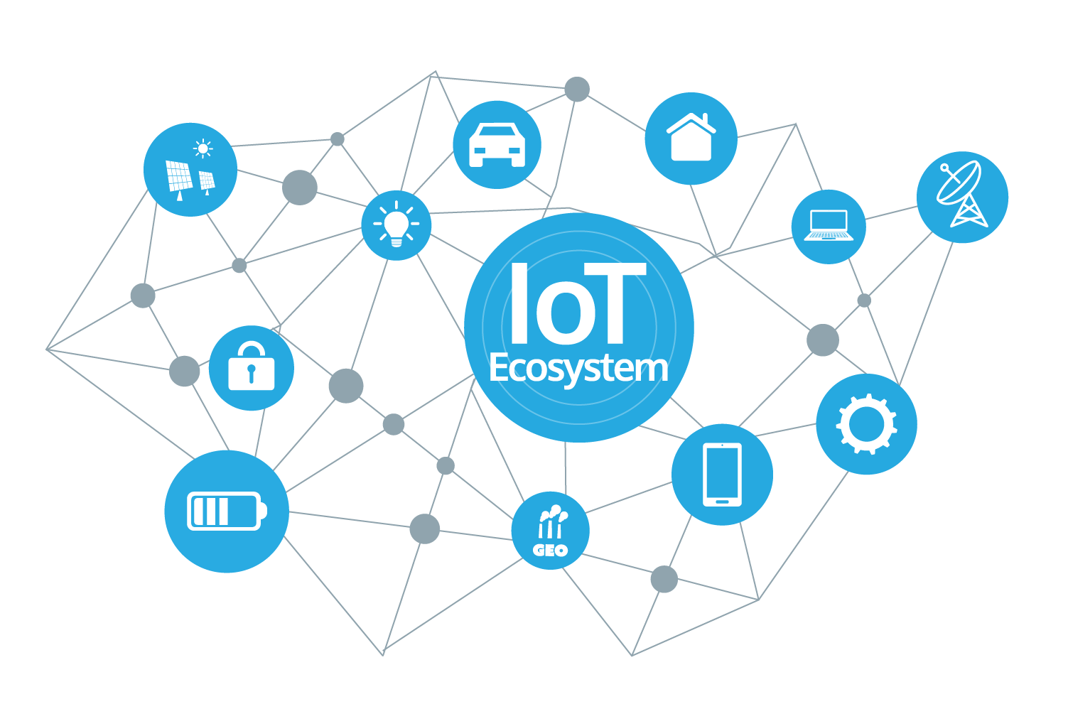
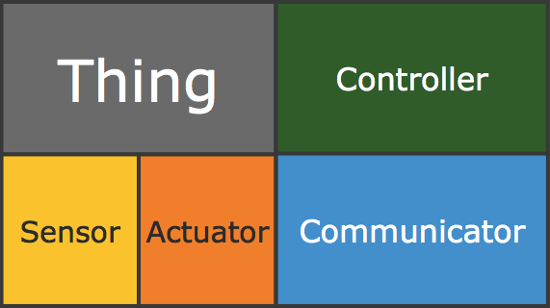
Components of an IoT Device

Slide 4
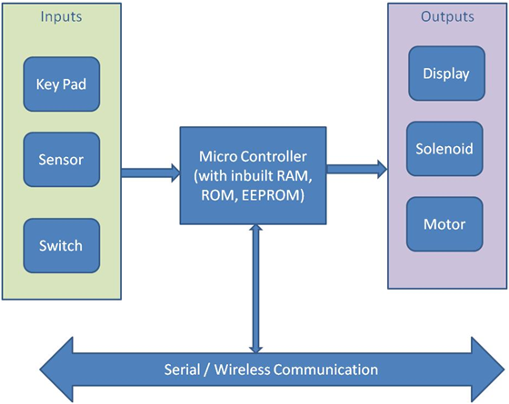
Embedded System/Computer
“Any sort of device which includes a programmable computer but itself is not intended to be a general-purpose computer”
Wayne Wolf
General purpose
Dedicated

Slide 5
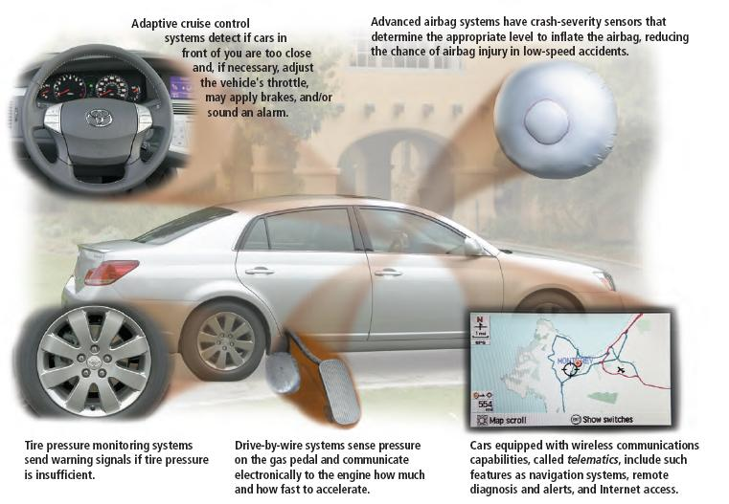
Automotive Embedded Systems

Slide 6
Automotive Embedded Systems
Today’s high-end automobile may have 100+ microprocessors:
Seat belt; dashboard devices; engine control; ABS; automatic stability control; navigation system; infotainment system; collision avoidance system; tire pressure monitoring; lane warning; adaptive cruise control; climate control; airbag control unit; electric window and central locking; parking aid; automatic wiper control; alarm and immobilizer; power seat; electric power steering; electronic transmission; active suspension

Slide 7
Embedded Processor Market
80 million PCs every year
3 billion embedded CPUs every year
Embedded systems market growing, while PC market mostly saturated

Slide 8
General-Purpose Processor
Programmable device, “microprocessor”
Features
Program memory
General data path with large register file and general ALU
User benefits
Low time-to-market and NRE costs
High flexibility
Examples: Intel Core i7, AMD Ryzen 5, etc.
Controller
Datapath
Control
logic and State register
Register
file
General
ALU
IR
PC
Program memory
Data
memory
Assembly code for:
total = 0
for i =1 to …

Slide 9
Dedicated Processor
Digital circuit designed specifically for one purpose
Features
Contains only the components needed to execute a single program
No program memory
Benefits
Fast
Low power
Small size
Controller
Datapath
Control logic
index
total
State register
+
Data
memory

Slide 10
Application-Specific Processor (ASIC)
Programmable processor optimized for a particular class of applications that have common characteristics (compromise)
Features
Program memory
Optimized data path
Special functional units
Benefits
Some flexibility, good performance, size, and power, “reusable”
Controller
Datapath
Control
logic and State register
Registers
Custom
ALU
IR
PC
Data
memory
Program memory
Assembly code for:
total = 0
for i =1 to …

Slide 11
Characteristics of Embedded Systems
Dedicated functionality
Real-time operation
Small size and low weight
Low power
Harsh environments
Safety-critical operation
Cost sensitive

Slide 12
Embedded vs. Real Time Systems
Embedded system: is a computer system that performs a limited set of specific functions; it often interacts with its environment
RTS: Correctness of the system depends not only on the logical results, but also on the time in which the results are produced
Real Time
Systems
Embedded
Systems
Examples?

Slide 13
Examples
Real Time Embedded:
Nuclear reactor control
Flight control
Basically any safety critical system
GPS
MP3 player
Mobile phone
Real Time, but not Embedded:
Stock trading system
Skype
Pandora, Netflix
Embedded, but not Real Time:
Home temperature control
Sprinkler system
Washing machine, refrigerator, etc.

Slide 14
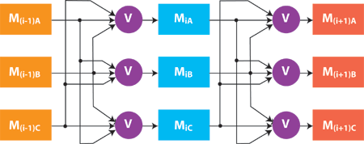
Characteristics of RTS
Event-driven (reactive) vs. time-driven
Reliability/fault-tolerance requirements (example: triple modular redundancy)
Predictability
Priorities in multi-programmed systems

Slide 15
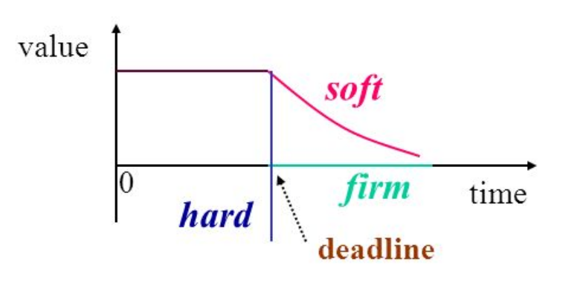
Taxonomy
Hard RT: absolutely imperative to meet all timing constraints
Soft RT: deadlines are important, but the system will still function even if deadline is missed Firm RT: no value, but not catastrophic

Slide 16
Taxonomy: Static
Task arrival times can be predicted
Static (compile-time) analysis possible
Allows good resource usage (low idle time for processors)

Slide 17
Taxonomy: Dynamic
Arrival times unpredictable
Static (compile-time) analysis possible only for simple cases
Processor utilization varies dramatically; must design system to handle “worst case”
Must avoid over-simplifying assumptions
e.g., assuming that all tasks are independent, when this is unlikely

Slide 18
Taxonomy: Periodic
Each task (or group of tasks) executes repeatedly with a particular period
Allows some static analysis techniques to be used
Matches characteristics of many real problems
It is possible to have tasks with deadlines smaller, equal to, or greater than their period
the later are difficult to handle (i.e., multiple concurrent task instances occur)

Slide 19
Taxonomy: Periodic
Single rate:
One period in the system
Simple but inflexible
Used in implementing a lot of wireless sensor networks
Multi rate:
Multiple periods
Should be harmonics to simplify system design

Slide 20
Taxonomy: Aperiodic
Are also called sporadic, asynchronous, or reactive
Creates a dynamic situation
Bounded arrival time intervals are easier to handle
Unbounded arrival time intervals are impossible to handle with resource-constrained systems

Slide 21
Control Systems
Man-Machine
Interface
Instrumentation
Interface
Operator
Real-Time Computer System
Controlled Object
Man-machine interface: input devices, e.g., keyboard and output devices, e.g., display
Instrumentation interface: sensors and actuators that transform between physical signals and digital data
Most control systems are hard real-time
Deadlines are determined by the controlled object, i.e., the temporal behavior of the physical phenomenon (fuel injection vs. ATM)

Slide 22
Control System Example
Example: A simple one-sensor, one-actuator control system.
reference
input r(t)
r_{k}
A/D
control-law
computation
u_{k}
y_{k}
D/A
A/D
y(t)
u(t)
sensor
plant
actuator
Outside effects
The system
being controlled

Slide 23
Control Systems Cont’d.
Pseudo-code for this system:
set timer to interrupt periodically with period T;
at each timer interrupt do
do analog-to-digital conversion to get y;
compute control output u;
output u and do digital-to-analog conversion;
end do
T is called the sampling period. T is a key design choice. Typical
range for T: seconds to milliseconds.

Slide 24
Sensors and Actuators
Sensors:
They are mainly input components
They sense and collect surrounding information
Actuators:
They are mainly output components
They alter the surrounding

Slide 25
Communications
Connects devices with each other & the cloud
Communication type:
Wireline (e.g., copper wires, optical fibers)
Wireless (e.g., RF, IR); RF-based communication is the most popular choice
Popular RF-based communication solutions:
IEEE 802.15.4
IEEE 802.11 (or Wifi)
Bluetooth
Near Field Communication (NFC), e.g., RFID

Slide 26
Components of an IoT Device
IoT EcoSystem
Weeks 5&6
Week 1
Week 1
Week 2
Week 2
Weeks 3&4

Slide 27
BREAK

