Slide 1
Internet-of-Things (IoT)
Summer Engineering Program 2018
University of Notre Dame
UNIX 101

Slide 2
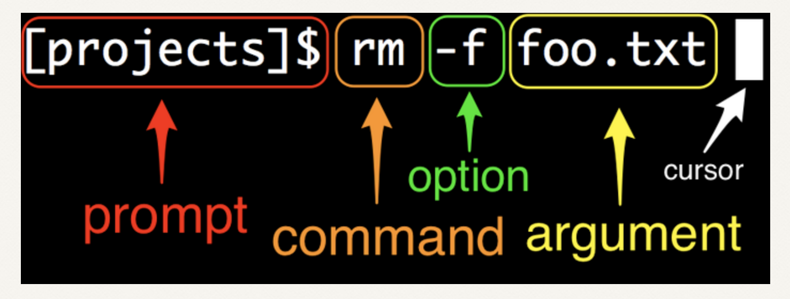
Command Line

Slide 3
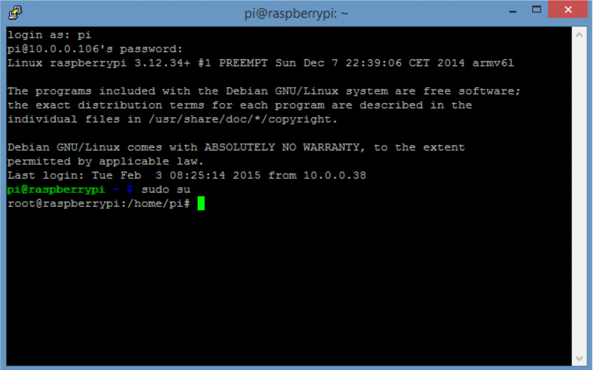
RPi Command Line

Slide 4
Man pages
echo hello world
clear
pwd
man echo
man clear
man pwd

Slide 5
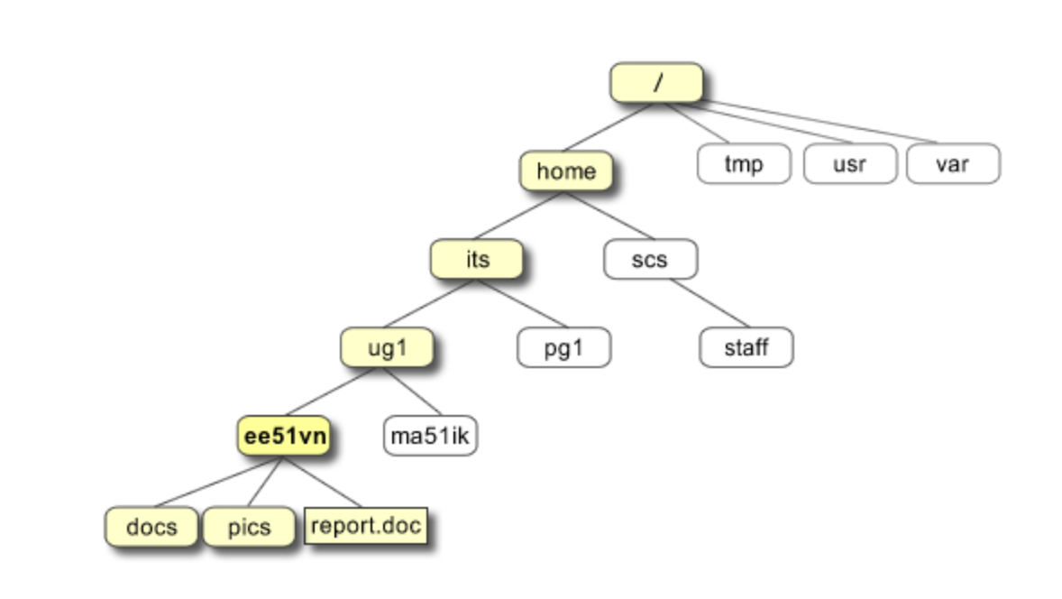
Directory Structure
/home/its/ug1/ee51vn/report.doc

Slide 6
Directory Structure
ls
ls –a
mkdir mynewdirectory
cd mynewdirectory
cd .
cd .. cd ~
pwd
cd ~/mynewdirectory

Slide 7
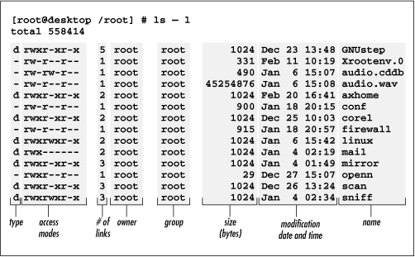
Directory Structure

Slide 8
File Operations
Write simple file (vi, nano, …)
cp, mv, rm, mkdir, rmdir, cat
Wild cards: * ?
find . -name "*.txt" -print

Slide 9
Directory Structure (Files)
r (or -), indicates read permission (or otherwise), that is, the presence or absence of permission to read and copy the file
w (or -), indicates write permission (or otherwise), that is, the permission (or otherwise) to change a file
x (or -), indicates execution permission (or otherwise), that is, the permission to execute a file, where appropriate

Slide 10
Directory Structure (Directories)
r allows users to list files in the directory;
w means that users may delete files from the directory or move files into it;
x means the right to access files in the directory. This implies that you may read files in the directory provided you have read permission on the individual files.

Slide 11
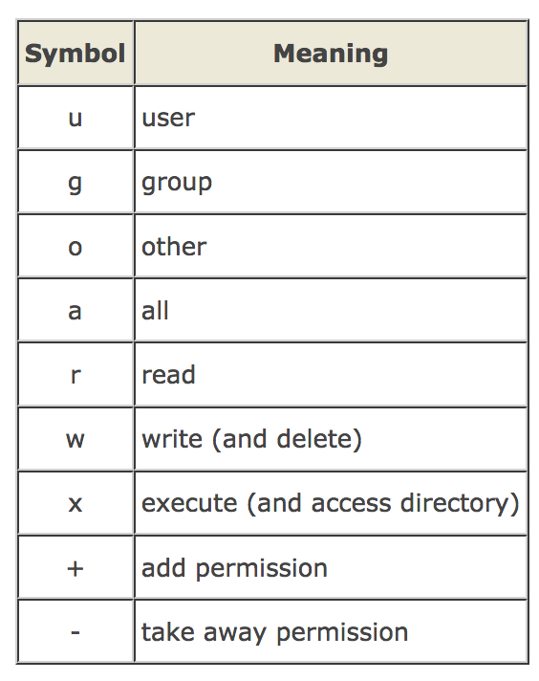
Directory Structure
chmod
chmod go-rwx somefile
chmod a+rw biglist

Slide 12
Processes
ps
kill -9 PID
9: SIGKILL

Slide 13
Superuser
Normal user vs. superuser (root)
su
sudo command
/etc/sudoers

Slide 14
Package Management (APT)
sudo apt-get update
sudo apt-get upgrade
sudo apt-get install PACKAGE

Slide 15
Other Commands
raspi-config
reboot
shutdown –h now
ifconfig
iwconfig
iwlist wlan0 scan
ping IPADDRESS
wget http://www.website.com/example.txt
hostname -I

