Slide 1
Internet-of-Things (IoT)
Summer Engineering Program 2018
University of Notre Dame
LAB COMPONENT

Slide 2
Raspberry Pi Input/Output (I/O)

Slide 3
GPIO Pins
Program the pins to interact in various ways
Input to a pin from a sensor or another computer/device
Motion sensor, temperature sensor, pressure sensor
Output from a pin can do
Turn on an LED
Operate an actuator (e.g., motor)
Send a signal or data to another device
A networked Raspberry Pi
Remote control of attached physical devices
Receiving data from those devices

Slide 4
GPIO Setup (if needed)
GPIO setup: install Python library RPi.GPIO
sudo apt-get update
sudo apt-get install python-dev
sudo apt-get install python-rpi.gpio
I2C: A standard for chips talking to each other
Multiple devices can talk to Raspberry Pi through I2C bus
Unique address for each device through jumper settings
To use with Pi: Enable kernel support from rasp-config
Install the i2c-tools utility
sudo apt-get update
sudo apt-get install python-smbus
sudo apt-get install i2c-tools
Test I2C devices: sudo i2cdetect -y 1

Slide 5
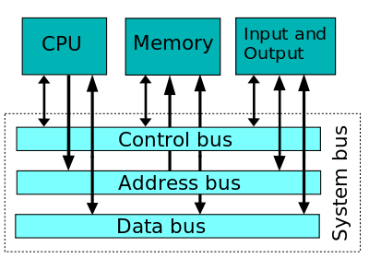
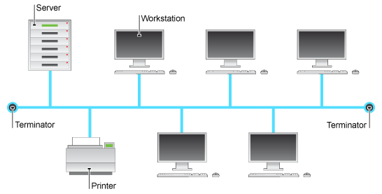
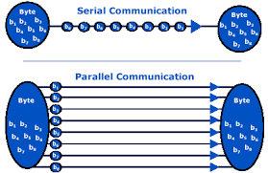
Bus Architecture

Slide 6
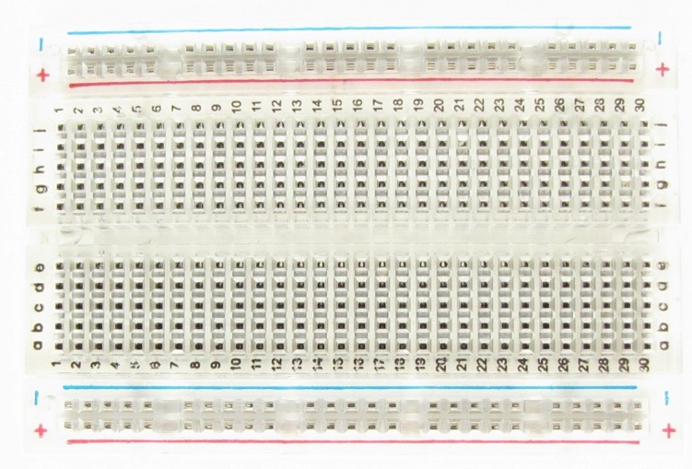
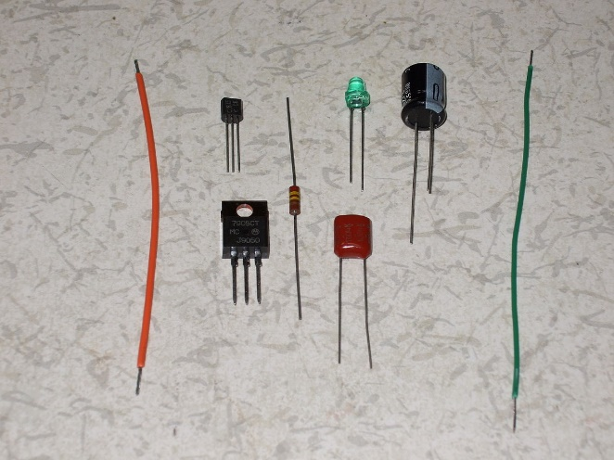
How A Breadboard Works
Internal metal strips underlining the holes as jumper wires
Connecting specific rows/columns of holes
Electric component leads and wires are inserted into the holes
Wires connect electric component leads
Building circuits with a breadboard: stick components and wires into the holes

Slide 7
GPIO Pins
Physical interface between the Pi and the outside world
Can be viewed as switches
That you can turn on or off (input)
Or that the Pi can turn on or off (output)

Slide 8
GPIO Pins
40 pins on the board
26 GPIO pins
Others are power or ground pins

Slide 9
Using the GPIO Pins
The Raspberry Pi has a 40-pin header, many of which are general-purpose I/O pins
Include the library:
import RPi.GPIO as GPIO
Set up to use the pins:
GPIO.setmode(GPIO.BOARD)
or
GPIO.setmode(GPIO.BCM)

Slide 10
Using the GPIO Pins
The GPIO.BCM option means that you are referring to the pins by the “Broadcom SOC channel” number, these are the numbers after “GPIO” in the green rectangles around the outside of the diagram:

Slide 11
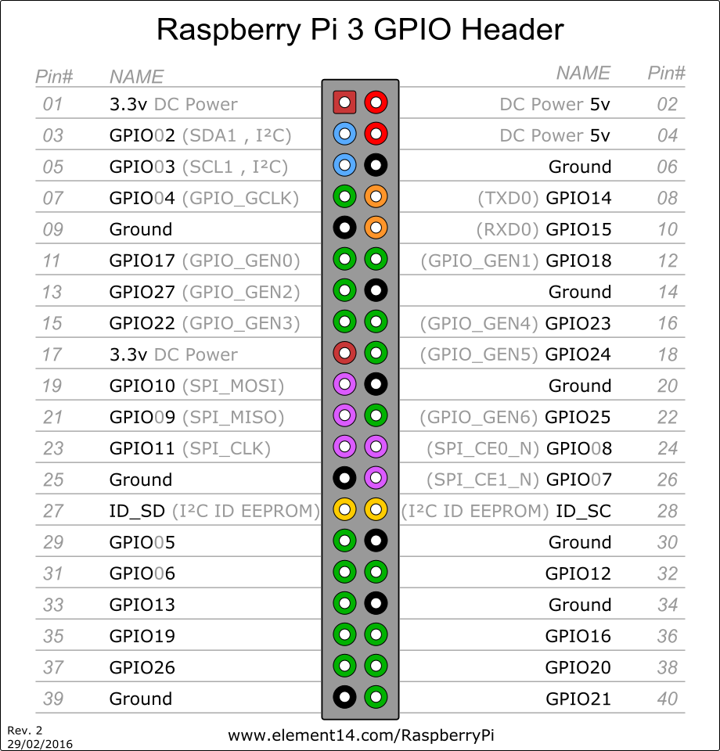
Using the GPIO Pins

Slide 12
Basic GPIO Input/Output
MYSENSOR = 22
GPIO.setup(MYSENSOR, GPIO.IN)
if GPIO.input(MYSENSOR):
print(“Sensor activity detected”)
MYACTUATOR = 23
GPIO.setup(MYACTUATOR, GPIO.OUT)
GPIO.output(MYACTUATOR, True)

Slide 13
Blocking vs. Non-Blocking
Non-blocking: get value and keep going
Examples?
Pros & cons?
Blocking: wait until event occurs
Examples?
Pros & cons?

Slide 14
Multi-Threading & Callbacks
GPIO.setup(23, GPIO.IN, pull_up_down=GPIO.PUD_UP) # 23 goes to GND when event occurs
GPIO.setup(24, GPIO.IN, pull_up_down=GPIO.PUD_DOWN) #24 goes to HIGH when event occurs
def my_callback(channel):
print (“Event detected”)
GPIO.add_event_detect(24, GPIO.RISING, callback=my_callback)

Slide 15
Output
GPIO pin outputs are 3v3 or 0v
Can be called on or off, HIGH or LOW
Each pin can turn on or off
Example use:
Raspberry Pi as the switch and the battery in the left diagram

Slide 16
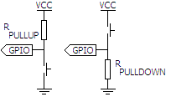
Input
GPIO pins are the simplest I/O on microcontrollers
“pull up” and “pull down” circuits give an input pin a reference

Slide 17
LED
When you pick up an LED, you will notice that usually one leg is longer than the other.
The longer leg (“anode”) is always connected to the positive supply of the circuit
The shorter leg (“cathode”) is connected to the negative side of the power supply, known as “ground”
LEDs will NOT work if power is connected the other way round (i.e., the “polarity” is incorrect or reversed)

Slide 18
Resistor
Resistors are used to limit the amount of electricity going through a circuit; specifically, they limit the amount of ‘current’ that is allowed to flow. The measure of resistance is called Ohm (Ω), and the larger the resistance, the more it limits the current
The Raspberry Pi can only supply a small current (about 60mA)
You must ALWAYS use resistors to connect LEDs to the GPIO pins of the Raspberry Pi
The LED will want to draw more current, and if allowed to they will burn out the Raspberry Pi. Putting a resistor in the circuit will ensure that a current smaller than 60 mA will flow and the Pi will not be damaged

Slide 19
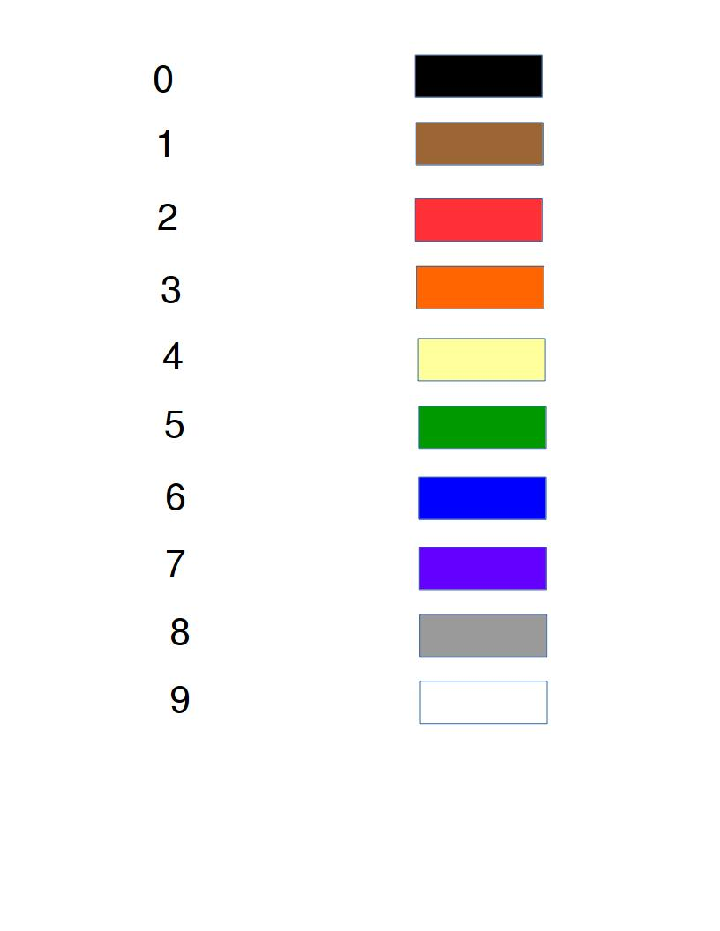
Reading the Resistance
Most common: four band resistor code
First two bands: first two digits
Third band: multiplier
Fourth band: tolerance

Slide 20
Examples
Yellow represents 4, purple represents 7, and red represents 10**2. The resistance is 47 times 10**2 or 4700 ohms
Brown represents 1, black represents 0, and brown represents 10. The resistance is 10 times 10 or 100 ohms.

Slide 21
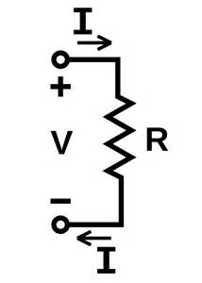
Resistor
Ohm’s Law: The current through a conductor between two points is directly proportional to the voltage across the two points, where I is the current through the conductor in units of amperes, V is the voltage measured across the conductor in units of volts, and R is the resistance of the conductor in units of ohms:
V = IR
Example; if we are passing 5 volts through a 330 ohm resistor, we limit the current in the output circuit to at most:
I = 5/330 = 0.015 Amperes or 15mA

Slide 22
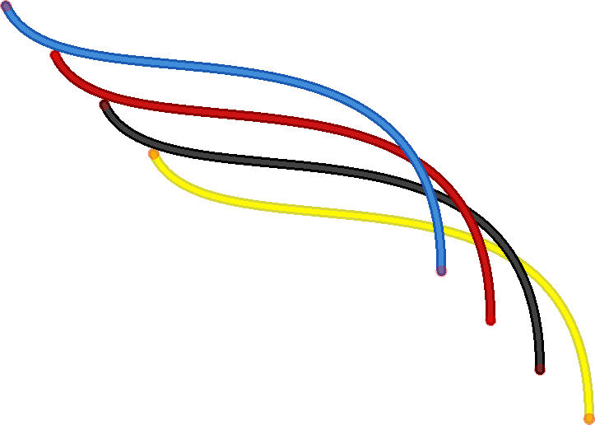
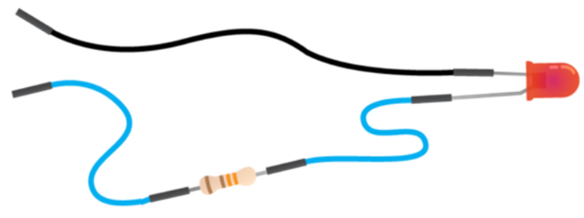
Jumper Wires
Jumper wires are used on breadboards to ‘jump’ from one connection to another. Can have various connectors; ends with ‘pins’ go into the breadboard (male connectors); ends piece of plastic with a hole in it go onto GPIO pins (female connectors)
Male-male: make jumps on breadboard
Male-female: connect GPIO to breadboard
Female-female: connect components to each other (resistor to LED, etc.)

Slide 23
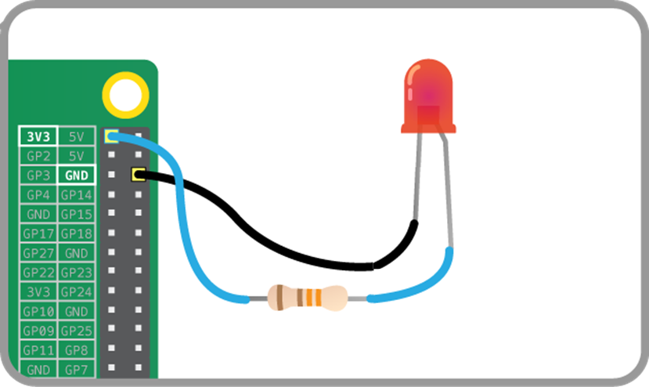
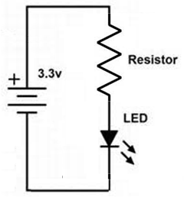
Connect Everything: Testing

Slide 24
Assignment 2: Task 1
Write a Python program that blinks an LED at a rate of 3 second on, one second off
GPIO access requires superuser rights!
sudo python yourscript.py

Slide 25
Code
import RPi.GPIO as GPIO # Import GPIO library
import time # Import time library
GPIO.setmode(GPIO.BCM) #Use BCM pin numbering
GPIO.setwarnings(False) #Ignore GPIO warning messages
led = 4 # Assign 4 to variable led
GPIO.setup(led, GPIO.OUT) # Set pin 4 for outputting information
GPIO.output(led, 1) # Turns the GPIO pin ‘on’ (i.e., outputs 3.3v)
time.sleep(3) # Pause the program for 5 seconds
GPIO.output(led, 0) # Turns the GPIO pin ‘off’ (i.e., outputs 0v)
# Clean up all the used ports in the program. Resets any ports you have used in this program back to input mode
GPIO.cleanup()

Slide 26
Assignment 2: Task 2
Add switch to control LED
When turned on, LED will blink 3s on/off
Will need time function & loop
Use callback for switch

Slide 27
Assignment 2: Task 3
Add another switch to control LED
Second switch is used to change interval
Fast: 1s
Slow: 3s
Use callback for switch

