Slide 1
Internet-of-Things (IoT)
Summer Engineering Program 2018
University of Notre Dame

Slide 2
Course Overview
 | Lecture | Lab
Week 1 | Fundamentals of IoT, basic concepts, applications | Basic Python & Raspberry Pi programming
Week 2 | Human-computer interfaces, sensing, actuation | Sensor programming, control loops, digital/analog I/O
Week 3 | Fundamentals of computer and wireless networks | Wi-Fi and Bluetooth networks, network measurements
Week 4 | Sensor networks, mesh networks, routing, WPANs | ZigBee, WPANs, WBANs, routing, network measurements
Week 5 | Processing, IoT cloud, analytics, visualization | IoT cloud integration, sensor fusion, analytics, visualization
Week 6 | RFID, IoT ecosystem, security, privacy, ethics, case studies | Final project

Slide 3
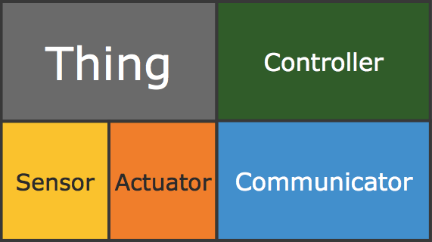
Components of an IoT Device
IoT EcoSystem

Slide 4
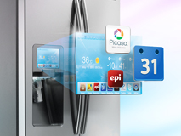
Smart Objects
Objects that are able to sense the environment, interpret the environment, self-configure, interact with other objects and exchange information with people
Smart Refrigerator

Slide 5
Traditional Computing System: HCI
explicit
input
System
explicit
output
"Human-computer interaction is a discipline concerned with the design, evaluation and implementation of interactive computing systems for human use and with the study of major phenomena surrounding them." -- Association for Computing Machinery

Slide 6
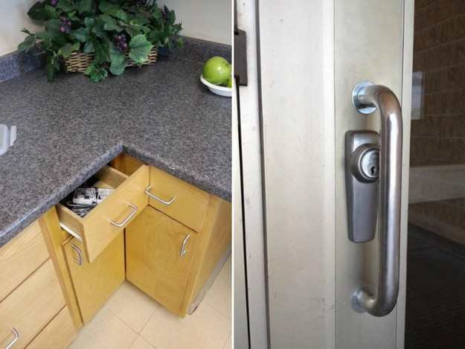
(Bad) Examples of User Interfaces

Slide 7
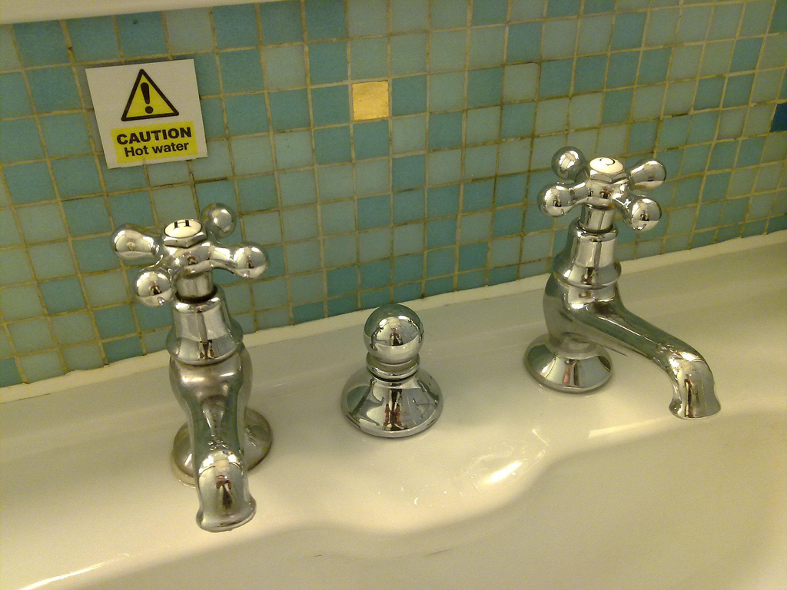
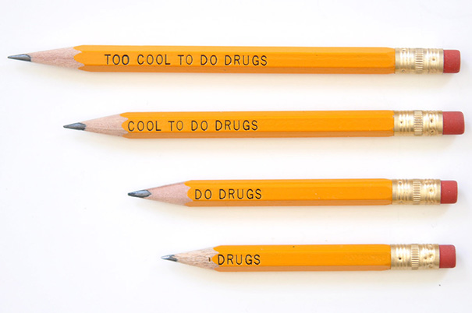
(Bad) Examples of User Interfaces

Slide 8
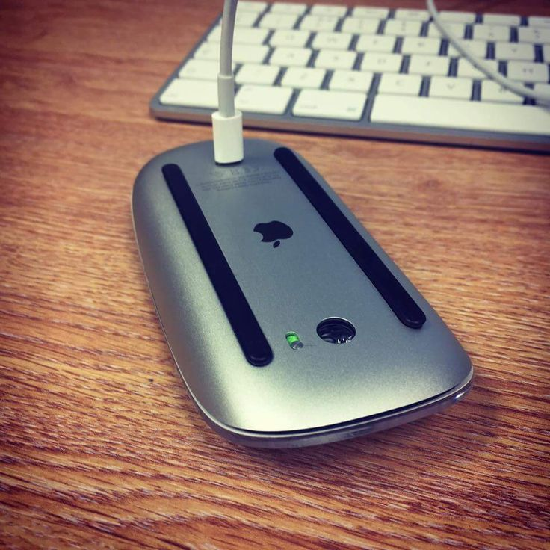
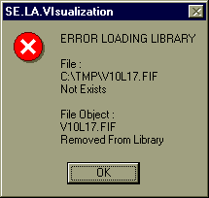
(Bad) Examples of User Interfaces

Slide 9
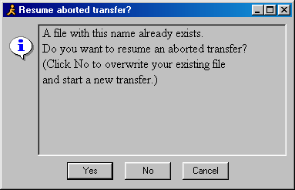
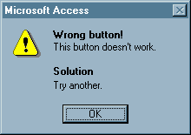
(Bad) Examples of User Interfaces

Slide 10
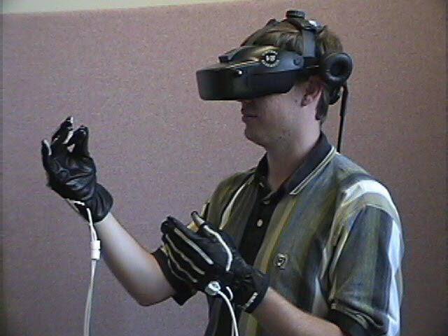
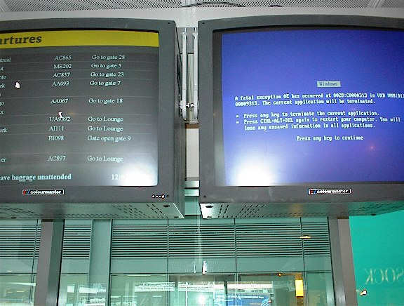
Why is HCI Important?
It can affect
  Effectiveness
  Productivity
  Morale
  Safety
Bad interfaces:
  Confusing
  Cumbersome
  Time-consuming
  Uninformative
  Lead to errors
  …

Slide 11
Interfaces
Keyboard/mouse/screen/speakers
Pen input
Touch
Speech/audio/sound
Gesture, eye movement
Tangible interfaces
Virtual/augmented reality (VR, AR)
Wearable computing
Multi-modal interactive interfaces: more than just one input/output channel

Slide 12
Interface Discussion
Ease-of-Use?
Flexibility?
Accuracy?
Safety?
Privacy?

Slide 13
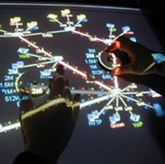
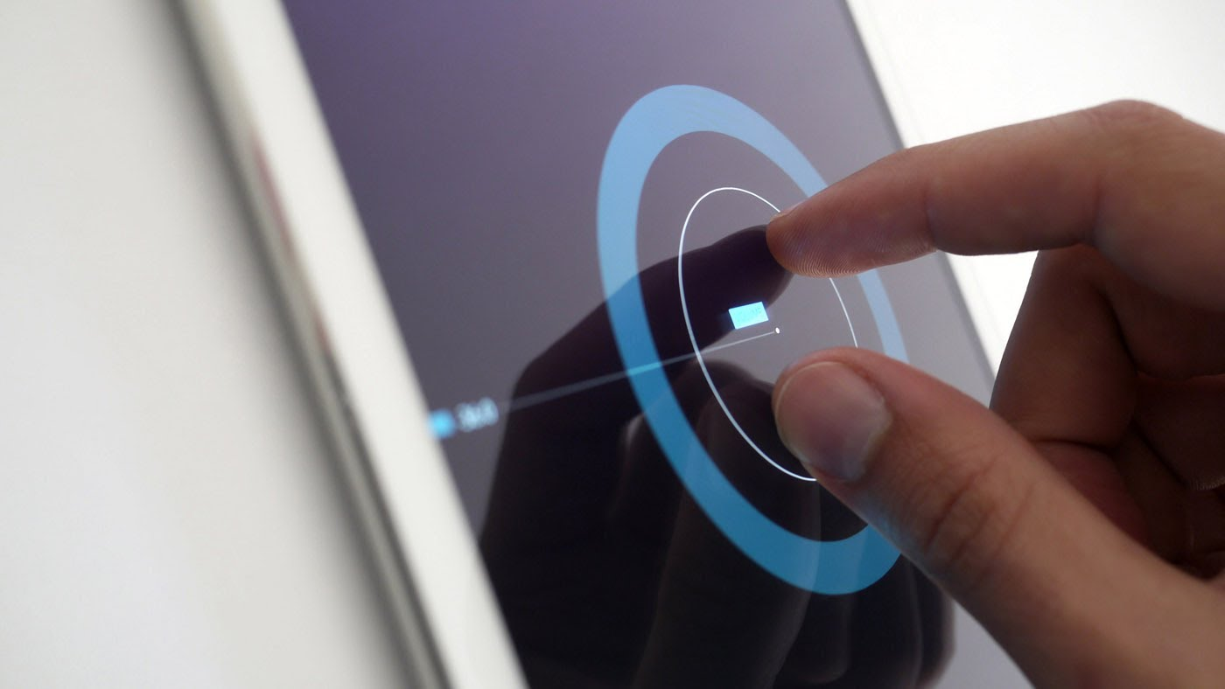
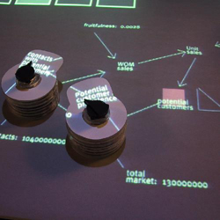
Touch as Input

Slide 14
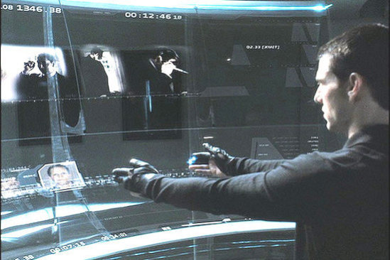
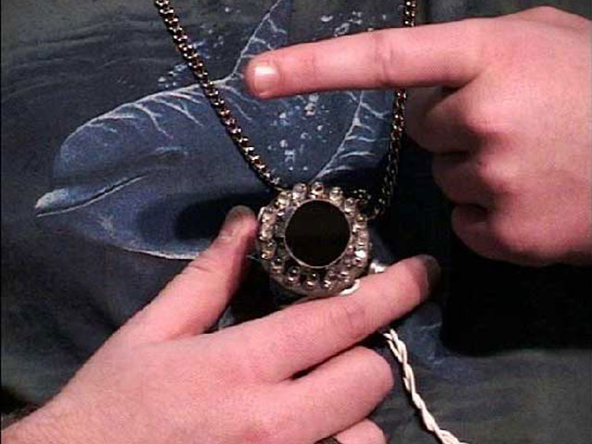
Gesture/Motion as Input

Slide 15
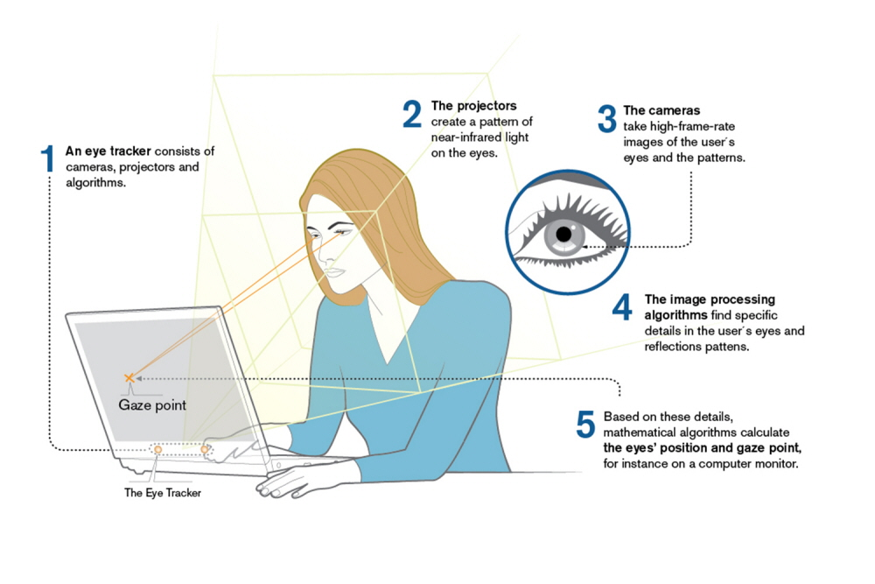
Eye Movement as Input

Slide 16
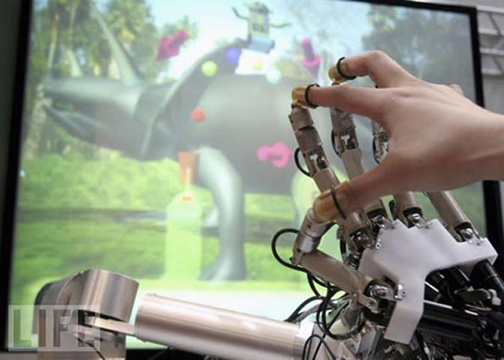
Haptic Interfaces

Slide 17
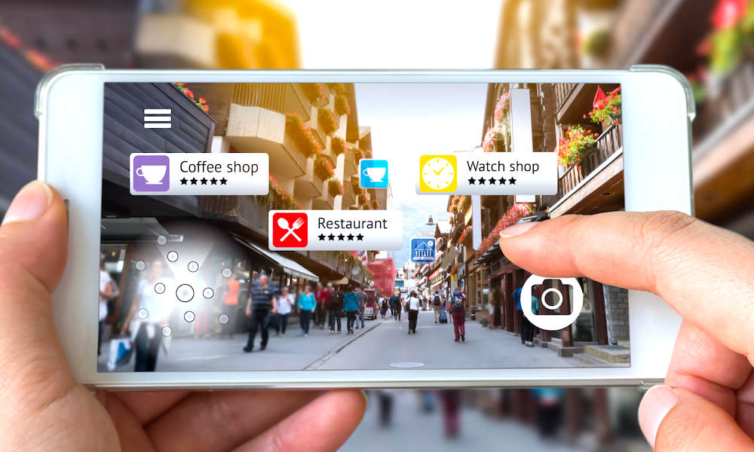
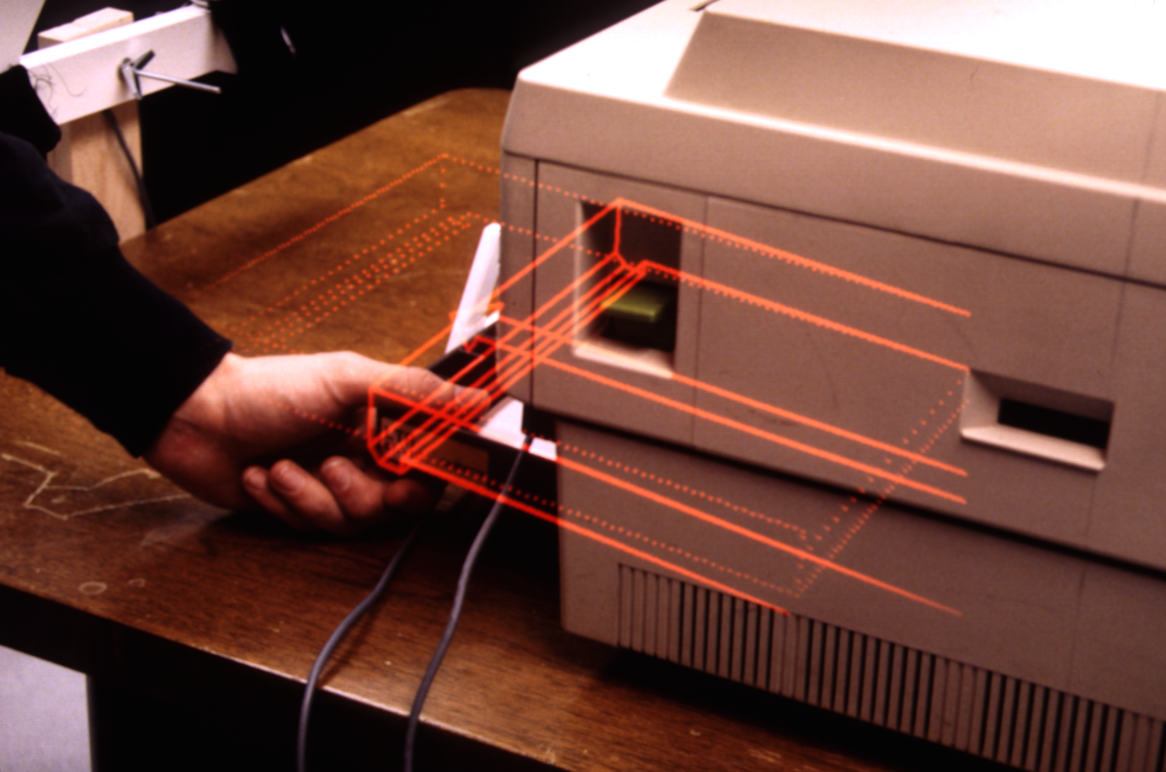
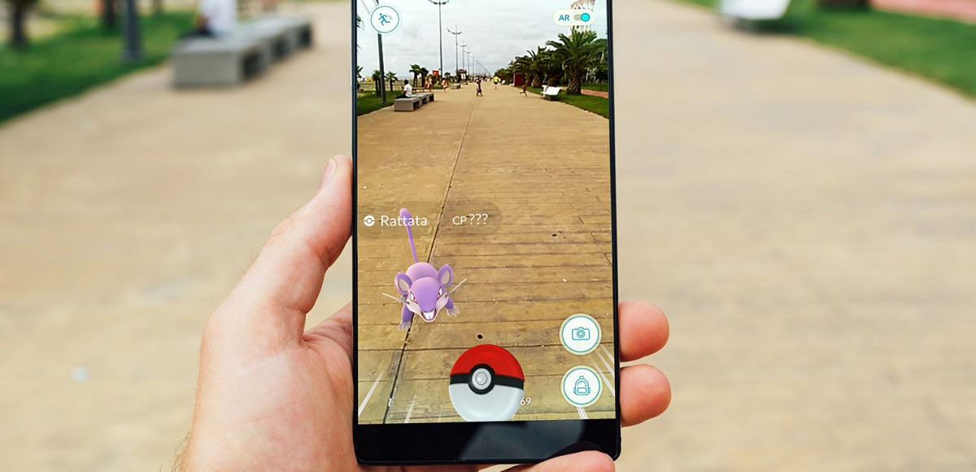
Augmented Reality

Slide 18
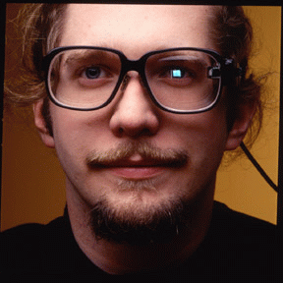
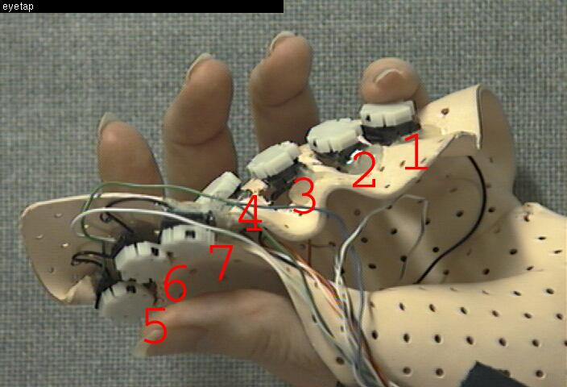
Wearable Computing
Computation devices accompany you, rather than you seeking them out

Slide 19
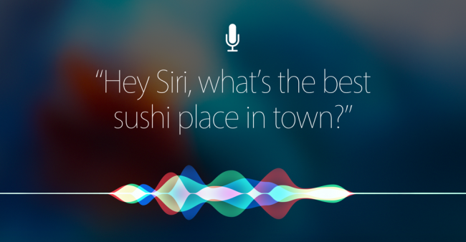
Speech Input
Human beings have a great and natural mastery of speech
  makes it difficult to appreciate the complexities
  but it’s an easy medium for communication

Slide 20
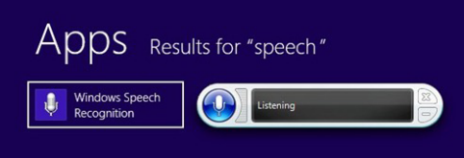
Windows Speech Recognition
Supplied with every Windows machine
  From ‘98 on
  Almost no one used it
What was the problem?
  Need to “train” users to use early virtual assistants (VAs)
  Microphone expense determines quality
  No app buy-in

Slide 21
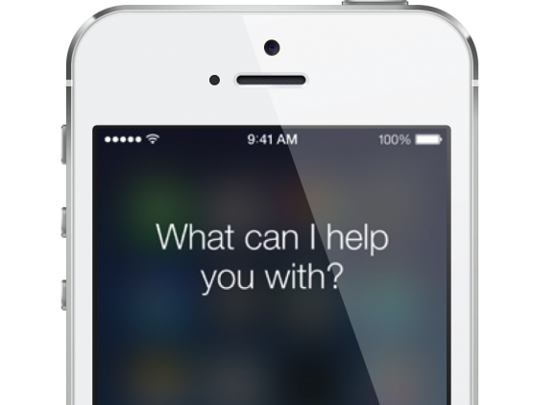
And Then There Was Siri
A Technical Success
  Consistent microphone gives predictable quality
  Inclusion on every iPhone made it mainstream

Slide 22
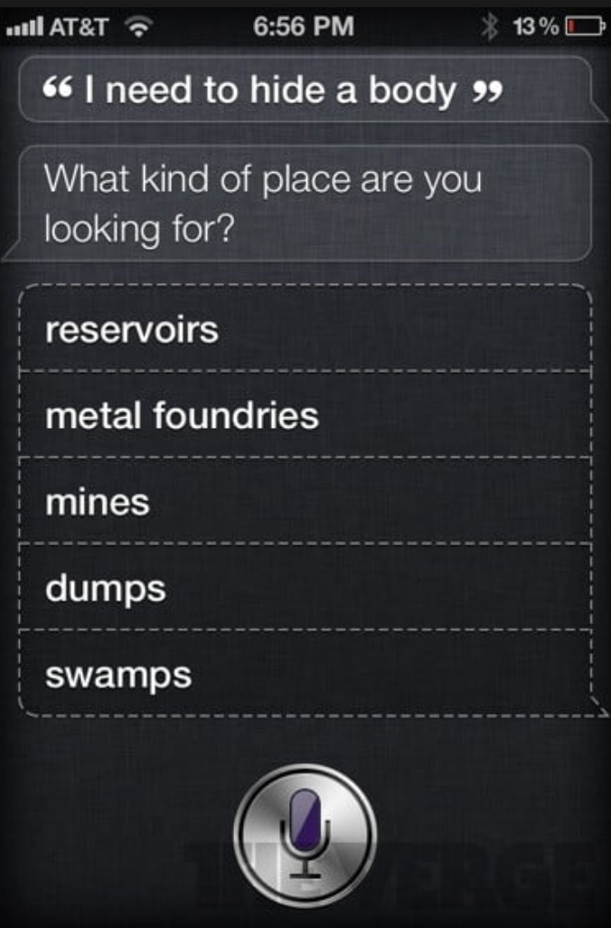
And Then There Was Siri
Misunderstandings
Limited skills
What Apple wants isn’t always what users want
No 3rd parties; limited innovation and evolution

Slide 23
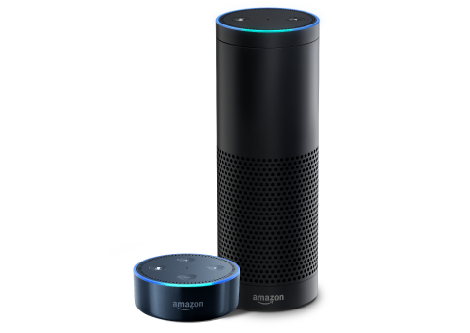
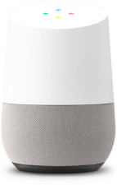
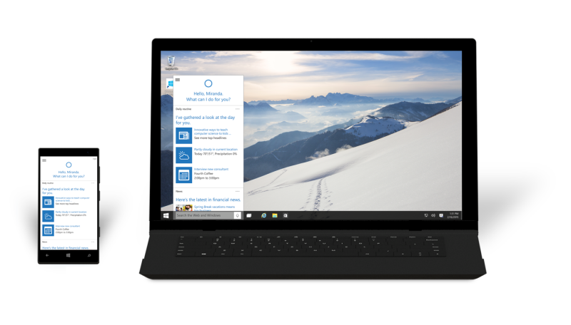

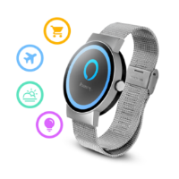
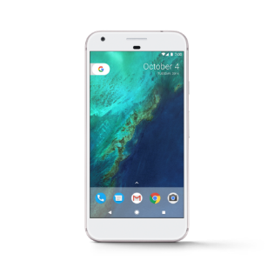
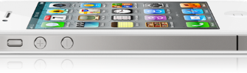
Current Incarnations
What these look like now
  Specialized hardware
  Domestic setting
  Initially aimed at home automation
  Mostly used for home entertainment
  All open to 3rd parties

Slide 24

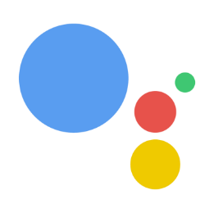




Voice “Explodes” into Mainstream

Slide 25
Seven Design Principles
Equitable use
  same means for all users, do not segregate/stigmatize users, make design appealing
2. Flexibility in use
  provide choice of methods & adapt to user’s pace
3. Simplicity and intuitiveness of use
  support user’s expectations
  accommodate different languages and literacy skills
  provide prompting and feedback

Slide 26
Seven Design Principles
4. Perceptible information
  redundancy of information: use different forms/modes
  emphasize essential information
5. Tolerance for error
  minimize impact caused by mistakes
  remove potentially dangerous situations
  hazards should be shielded by warnings

Slide 27
Seven Design Principles
6. Low physical effort
  comfort; minimize fatigue and effort
  repetitive or sustained actions should be avoided
7. Size and space for approach and use
  placement of system should be reachable by all users
  consider line of sight for standing and sitting user
  allow for variation in hand size
  provide room for assistive devices

Slide 28
Disabilities
Federal law to ensure access to IT, including computers and web sites (1998 Amendment to Rehabilitation Act)
  Vision (low vision, blind, color blind)
  Hearing (deaf, limited hearing)
  Mobility
  Learning (dyslexia, attention deficit)

Slide 29
Disabilities
Keyboard and mouse alternatives
Color coding
Font size
Contrast
Text descriptors for web images
Magnification
Text-to-speech; speech recognition
Head-mounted optical mice
Eye gaze control

Slide 30
Elderly
Reduced
  Motor skills
  Perception
  Vision, hearing, touch, mobility
  Speed
  Memory
Other needs
  Technology experience is varied
  Uninformed on how technology could help them
  Practice skills (hand-eye, problem solving, etc.)
Touch screens, larger fonts, louder sounds, motions/gesture, speech, multiple modalities

Slide 31
System Structure
explicit
input
System
explicit
output

Slide 32
Context as Implicit Input
explicit
input
Context-Aware
System
explicit
output
Context:
state of the user
state of the physical environment
state of the computing system
history of user-computer interaction
...

Slide 33
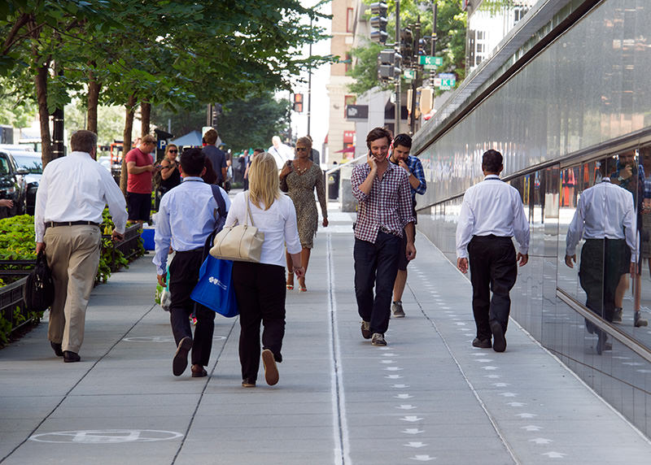
What is Context?

Slide 34
Examples of Context
Identity (user, others, objects)
Location
Date/Time
Environment
Emotional state
Focus of attention
Orientation
User preferences
Calendar (events)
Browsing history
Behavioral patterns
Relationships (phonebook, call history)
… the elements of the user’s environment that the computer knows about…

Slide 35
Relevance of Context Information
Trying to arrange lunch meeting
Going to a job interview
Going home after work and making evening plans
Shopping
Tourist
...

Slide 36
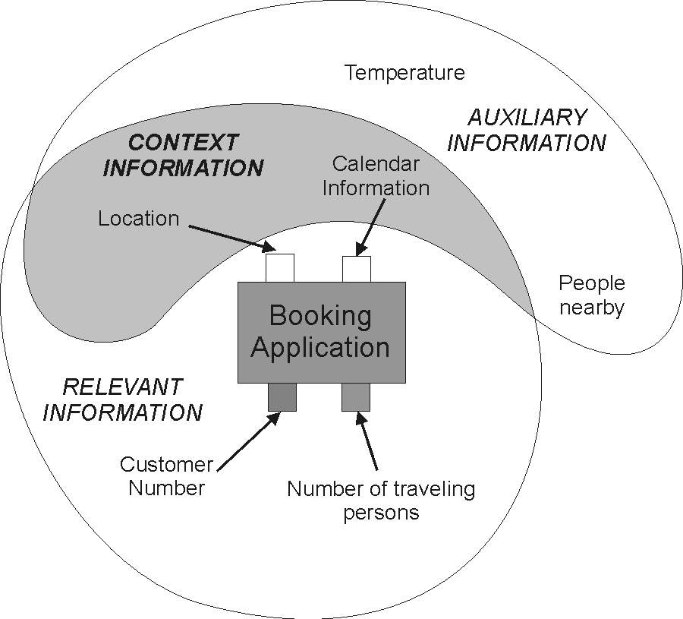
Definitions of Context
“Context is any information that can be used to characterize the situation of an entity. An entity is a person, place, or object that is considered relevant to the interaction between a user and an application, including the user and applications themselves” [Dey et al. 2001]
Auxiliary: not essential
Relevant: can actually be used
  Explicit input
  Context input

Slide 37
Classification
External (physical)
  Context that can be measured by hardware sensors
  Examples: location, light, sound, movement, touch, temperature, air pressure, etc.
Internal (logical)
  Mostly specified by the user or captured monitoring the user’s interaction
  Examples: the user’s goal, tasks, work context, business processes, the user’s emotional state, etc.

Slide 38

Context?

Slide 39
Context?

Slide 40
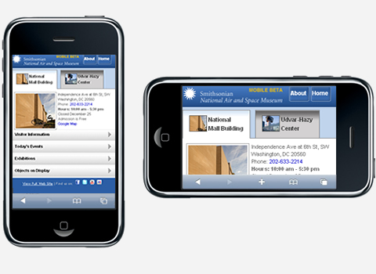
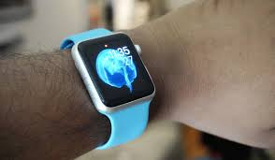
Simple Everyday Examples
Smartphone adjusts the screen to the orientation of the device
Apple Watch turns on display if arm lifted/rotated
Orientation is determined by using both a gyroscope and an accelerometer

Slide 41
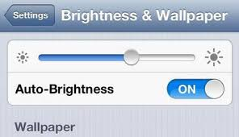
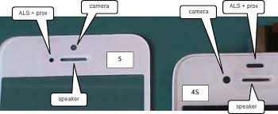
Simple Everyday Examples
Phone display adjusts the brightness of the display based on the surrounding area
Uses a light sensor

Slide 42
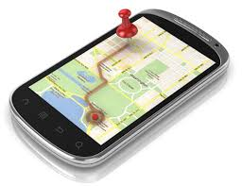
Simple Everyday Examples
Device displays user’s location, shows route to a desired destination, find nearby stores, geotag images on social media, etc.
Uses location sensor

Slide 43
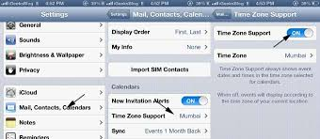
Simple Everyday Examples
The time is displayed on the phone
  Time zone change
  Daylight savings time

Slide 44
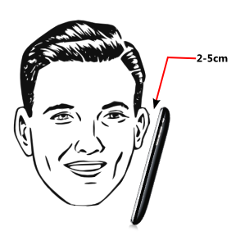
Simple Everyday Examples
Device disables touch screen when the user speaks on the phone
Uses a proximity sensor (infrared signal travel time)

Slide 45
Challenges
Lack of self-awareness
  Knowing when to do or not to do something is hard
Complexity
  More rules do not necessarily yield more intelligence
  But will become harder to maintain and understand
Human-in-the-loop vs. automation
  Loss of control vs. risk of human error
Development
  Sensing, aggregation, rules, etc., are complex issues
Privacy
User preferences
Information overload

