Slide 1
Internet-of-Things (IoT)
Summer Engineering Program 2018
University of Notre Dame
LAB COMPONENT

Slide 2
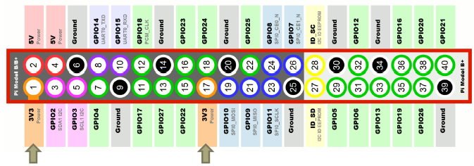
GPIO Header Signals, 3.3V
These pins can be used to provide power to 3.3V circuits (If not going to overload the Pi)

Slide 3
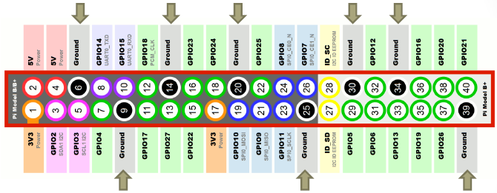
GPIO Header Signals, Ground
These pins represent common signals between the Pi and external circuits connected to it

Slide 4
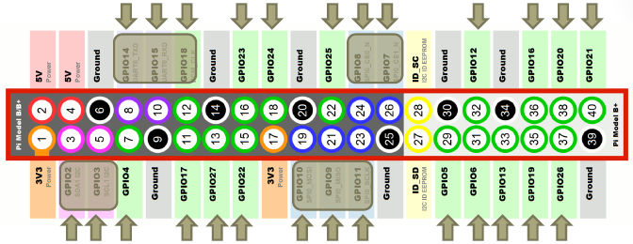
GPIO Header Signals
26 Pin for GPIO (General Purpose Input Output)
These pins can be programmed to be either input or output signals
These signals use 3.3V logic
Some of the GPIO pins have a dual role (either GPIOs or part of another interface)
The default for these pins is to be a GPIO, to switch to the other role, you need to load the driver for the needed interface

Slide 5
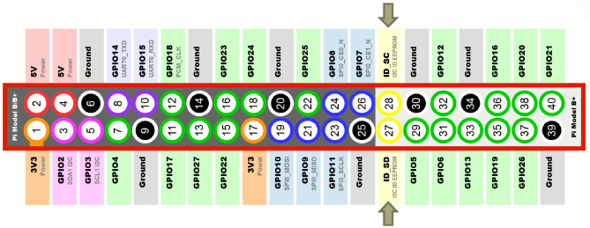
GPIO Header Signals: EEPROM
These two pins are introduced in model B+ to enable a new concept called Raspberry Pi HATs
A Pi HAT (Hardware Attached on Top), is a daughter board that can be connected on top of the Pi
The Pi uses those two pins to read an ID EEPROM that describes the attached hardware and the required configuration of the GPIO pins

Slide 6
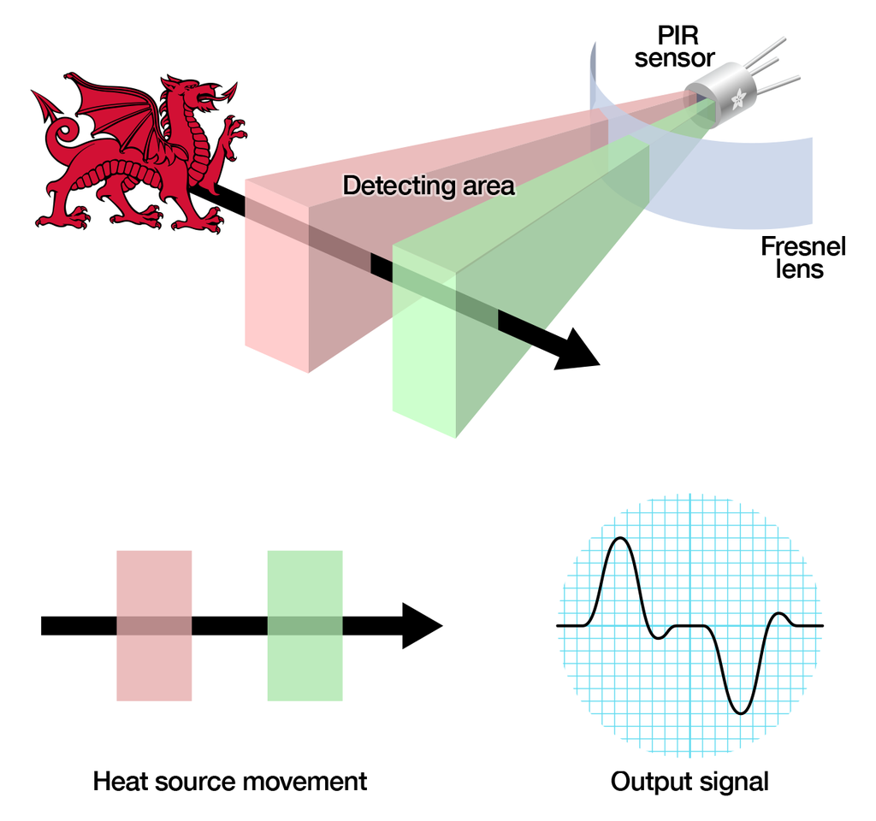
PIR Sensor Principle
The PIR sensor is made of IR sensitive material
The lens over the sensor can change
  breadth, range, sensing pattern
An idle sensor detects the same amount of IR from the environment
Motion detection
  A warm entity entering the sensing zone causes a positive differential change
  The warm entity leaving the sensing zone generates a negative differential change

Slide 7
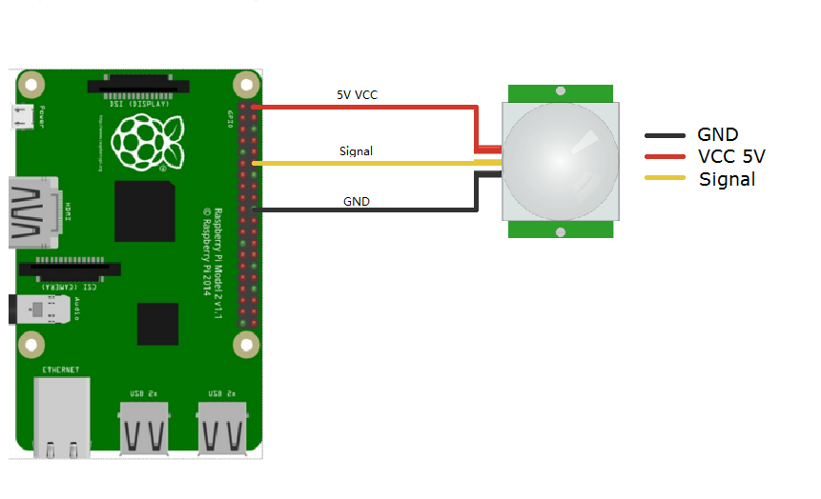
Assignment 2: Task 4
Motion Sensor
Determine the range of the sensor, i.e., start with a small
distance (e.g., a few inches) and see if the motion sensor
responds. Repeat these for increasing distances until the
sensor stops responding.

Slide 8
Circuits
Equivalent Resistances in Series Circuits
Equivalent Resistances in Parallel Circuits

Slide 9
1-Wire Interface
The 1-Wire protocol was developed by Dallas Semiconductor Corp. initially for the iButton
The 1-Wire protocol actually uses two wires:
  Data: The single wire used for data communication
  Ground: The ground or “return” wire
The 1-Wire protocol was designed for communication with low–data content devices like temperature sensors
It provides for low-cost remote sensing by supplying power over the same wire used for data communications
  Each sensor can accept power from the data line while the data line is in the high state
  When the data line is active (going low), the sensor chips continue to run off of their internal capacitors (in parasitic mode)
  The device also provides an optional VDD pin, allowing power to be supplied to it directly. This is sometimes used when parasitic mode doesn’t work well enough. This, of course, requires an added wire, which adds to the cost of the circuit

Slide 10
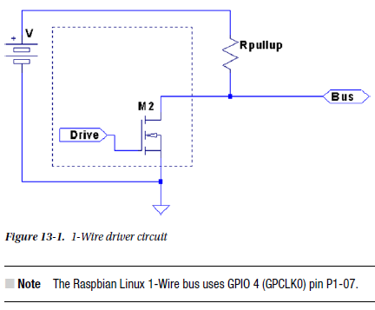
1-Wire Interface
The data line is driven by open collector transistors in the master and slave devices. The line is held high by a pull-up resistor when the driver transistors are all in the Off state
To initiate a signal, one transistor turns on and thus pulls the line down to ground potential

Slide 11
1-Wire Interface: Line Driving
Some voltage V (typically, +5 V) is applied to the 1-Wire bus through the pull-up resistor Rpullup.
When the transistor M2 is in the Off state, the voltage on the bus remains high because of the pull-up resistor
However, when the master device activates transistor M2, current is caused to flow from the bus to the ground, acting like a signal short-circuit. Slave devices attached to the bus will see a voltage near zero

Slide 12
1-Wire Interface: Master and Slave
The master device is always in control of the 1-Wire bus. Slaves speak only to the master, and only when requested
There is never slave-to-slave device communication
If the master finds that communication becomes difficult for some reason, it may force a bus reset. This corrects for an errant slave device that might be jabbering on the line

Slide 13
1-Wire Interface: Data I/O Protocol
Whether writing a 0 or 1 bit, the sending device brings the bus line low.
This announces the start of a data bit
When a 0 is being transmitted, the line is held low for approximately 60 microsec. Then the bus is released and allowed to return high
When a 1 bit is being transmitted, the line is held low for only about 6 microsec before releasing the bus
Another data bit is not begun until 70 microsec after the start of the previous bit. This leaves a guard time of 10 microsec between bits. The receiver then has ample time to process the bit and gains some signal noise immunity

Slide 14
1-Wire Interface: Data I/O Protocol
The receiver notices a data bit is coming when the line drops low
It then starts a timer and samples the bus at approximately 15 microsec
  If the bus is still in the low state, a 0 data bit is registered
  Otherwise, the data bit is interpreted as a 1
Having registered a data bit, the receiver then waits further until the line returns high (in the case of a 0 bit)
The receiver remains idle until it notices the line going low again, announcing the start of the next bit
The sender can be either the master or the slave, but the master always has control
Slaves do not write data to the bus unless the master has specifically requested it

Slide 15
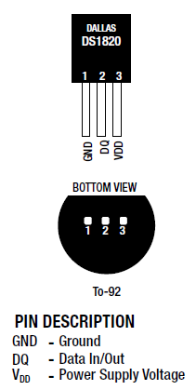
1-Wire Interface: Slave Devices
Dallas DS18B20 slave device; this temperature sensor is typical of many 1-wire slave devices
Slave devices are identified by a pair of digits representing the product family, followed by a hyphen and serial number in hexadecimal.
The Raspberry Pi does not have any ADC (analogue to digital converter) pins in its GPIO, and so a digital temperature sensor should be used
DS18B20: relatively cheap, very easy to find, easy to use, and supply readings accurate to +/-0.5 degrees across the range -10 to +85 degrees Celsius

Slide 16
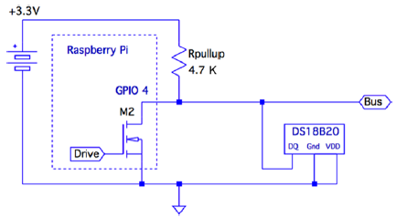
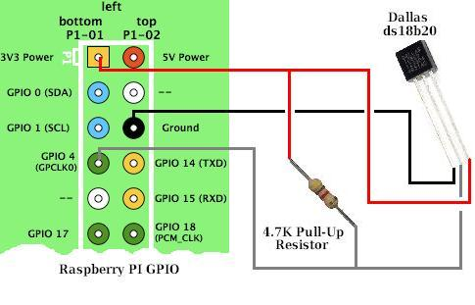
1-Wire Interface: Slave Devices
In order to interface this with the Raspberry Pi we just need one resistor - a 4k7 which acts as a pull-up resistor
Raspbian Linux has its driver support for the 1-Wire bus on GPIO 4

Slide 17
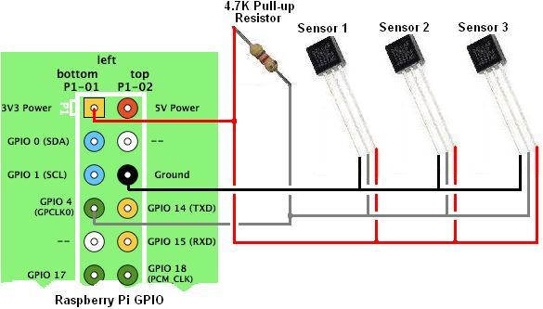
1-Wire Interface: Slave Devices
Reading temperature readings from multiple sensors down one wire is possible because each DS18b20 sensor has a unique serial number coded into it at manufacture which the Raspberry Pi can use to identify them by

Slide 18
Assignment 2: Task 5
Select at least 1 input sensor (not PIR) and 1 output device (LED ok if more than one) and make RPi control output device in response to input device
For example:
  Humidity sensor: LED(s) indicate(s) humidity levels
  Temperature sensor: sounder goes off if temperature high
  Motion sensor: sound and flashing LED if detected
  Ultrasonic sensor: same as motion sensor
  …

