Slide 1
Internet-of-Things (IoT)
Summer Engineering Program 2018
University of Notre Dame

Slide 2
Course Overview
 | Lecture | Lab
Week 1 | Fundamentals of IoT, basic concepts, applications | Basic Python & Raspberry Pi programming
Week 2 | Human-computer interfaces, sensing, actuation | Sensor programming, control loops, digital/analog I/O
Week 3 | Fundamentals of computer and wireless networks | Wi-Fi and Bluetooth networks, network measurements
Week 4 | Sensor networks, mesh networks, routing, WPANs | ZigBee, WPANs, WBANs, routing, network measurements
Week 5 | Processing, IoT cloud, analytics, visualization | IoT cloud integration, sensor fusion, analytics, visualization
Week 6 | RFID, IoT ecosystem, security, privacy, ethics, case studies | Final project

Slide 3
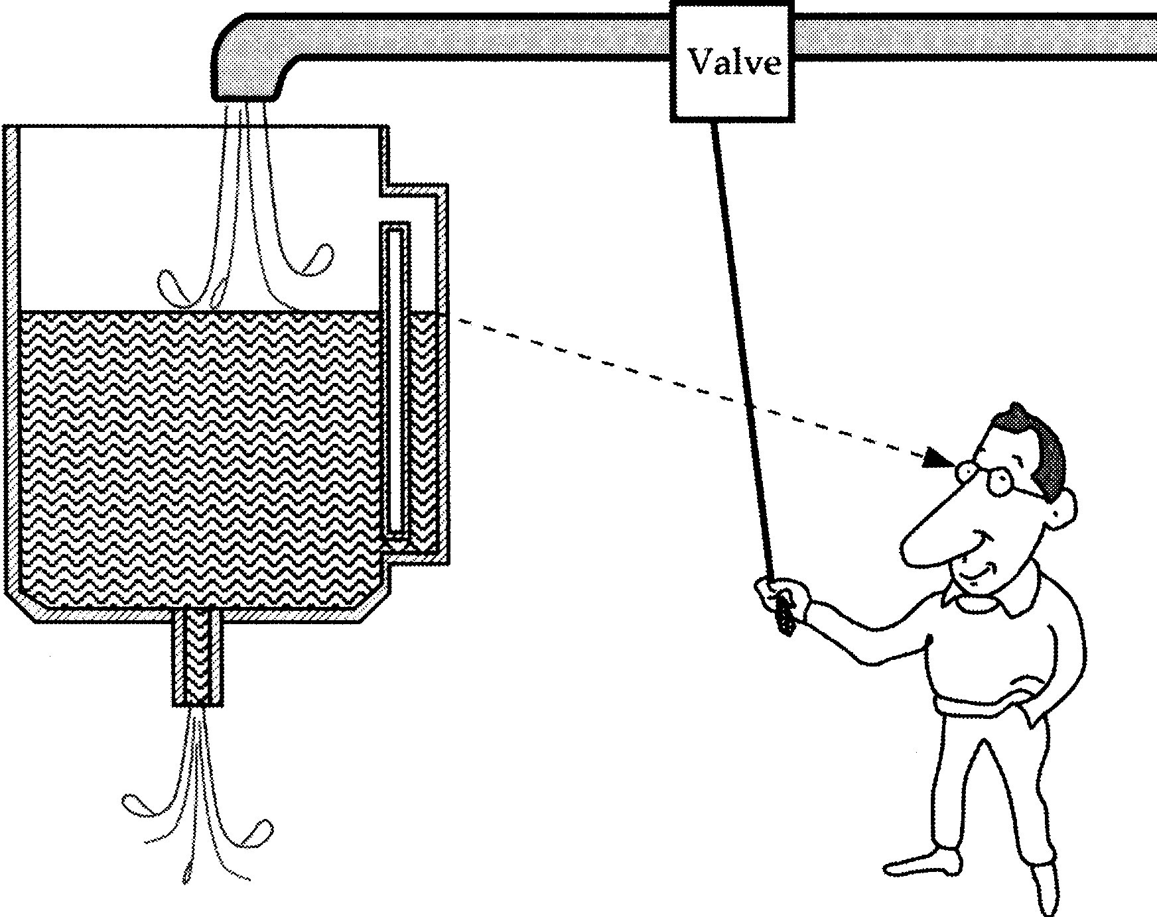
Sensors
A sensor is a device that receives a stimulus and responds with an electrical signal.

Slide 4
Computer Process Control System
Transformation Process
Continuous and Discrete
Parameters
Continuous and Discrete
Variables
Actuators
Sensors
DAC
ADC
Computer
Controller
Output Devices
Input Devices

Slide 5
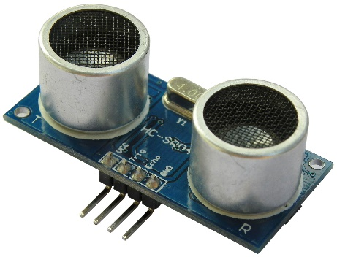
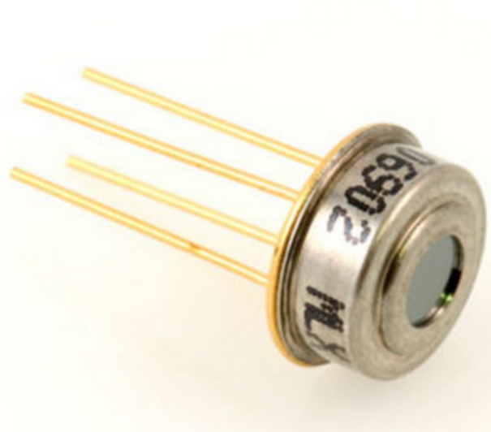
What is a Stimulus?
Motion, position, displacement
Velocity and acceleration
Force, strain
Pressure
Flow
Sound
Moisture
Light
Radiation
Temperature
Chemical presence
Visual Sensor
Ultrasound Sensor
Infrared Sensor

Slide 6
What is a Response?
When we say electrical we mean a signal which can be channeled, amplified, and modified by electronic devices:
Voltage
Current
Charge

Slide 7
Sensor as Energy Converter
This conversion can be direct or it may require transducers
Example:
A chemical sensor may have a part which converts the energy of a chemical reaction into heat (transducer) and another part, a thermopile, which converts heat into an electrical signal

Slide 8
Physical Principles of Sensing
Charges, fields, & potentials
Capacitance
Magnetism
Induction
Resistance
Piezoelectric effect
Seebeck and Peltier effects
Thermal properties of materials
Heat transfer
Light

Slide 9
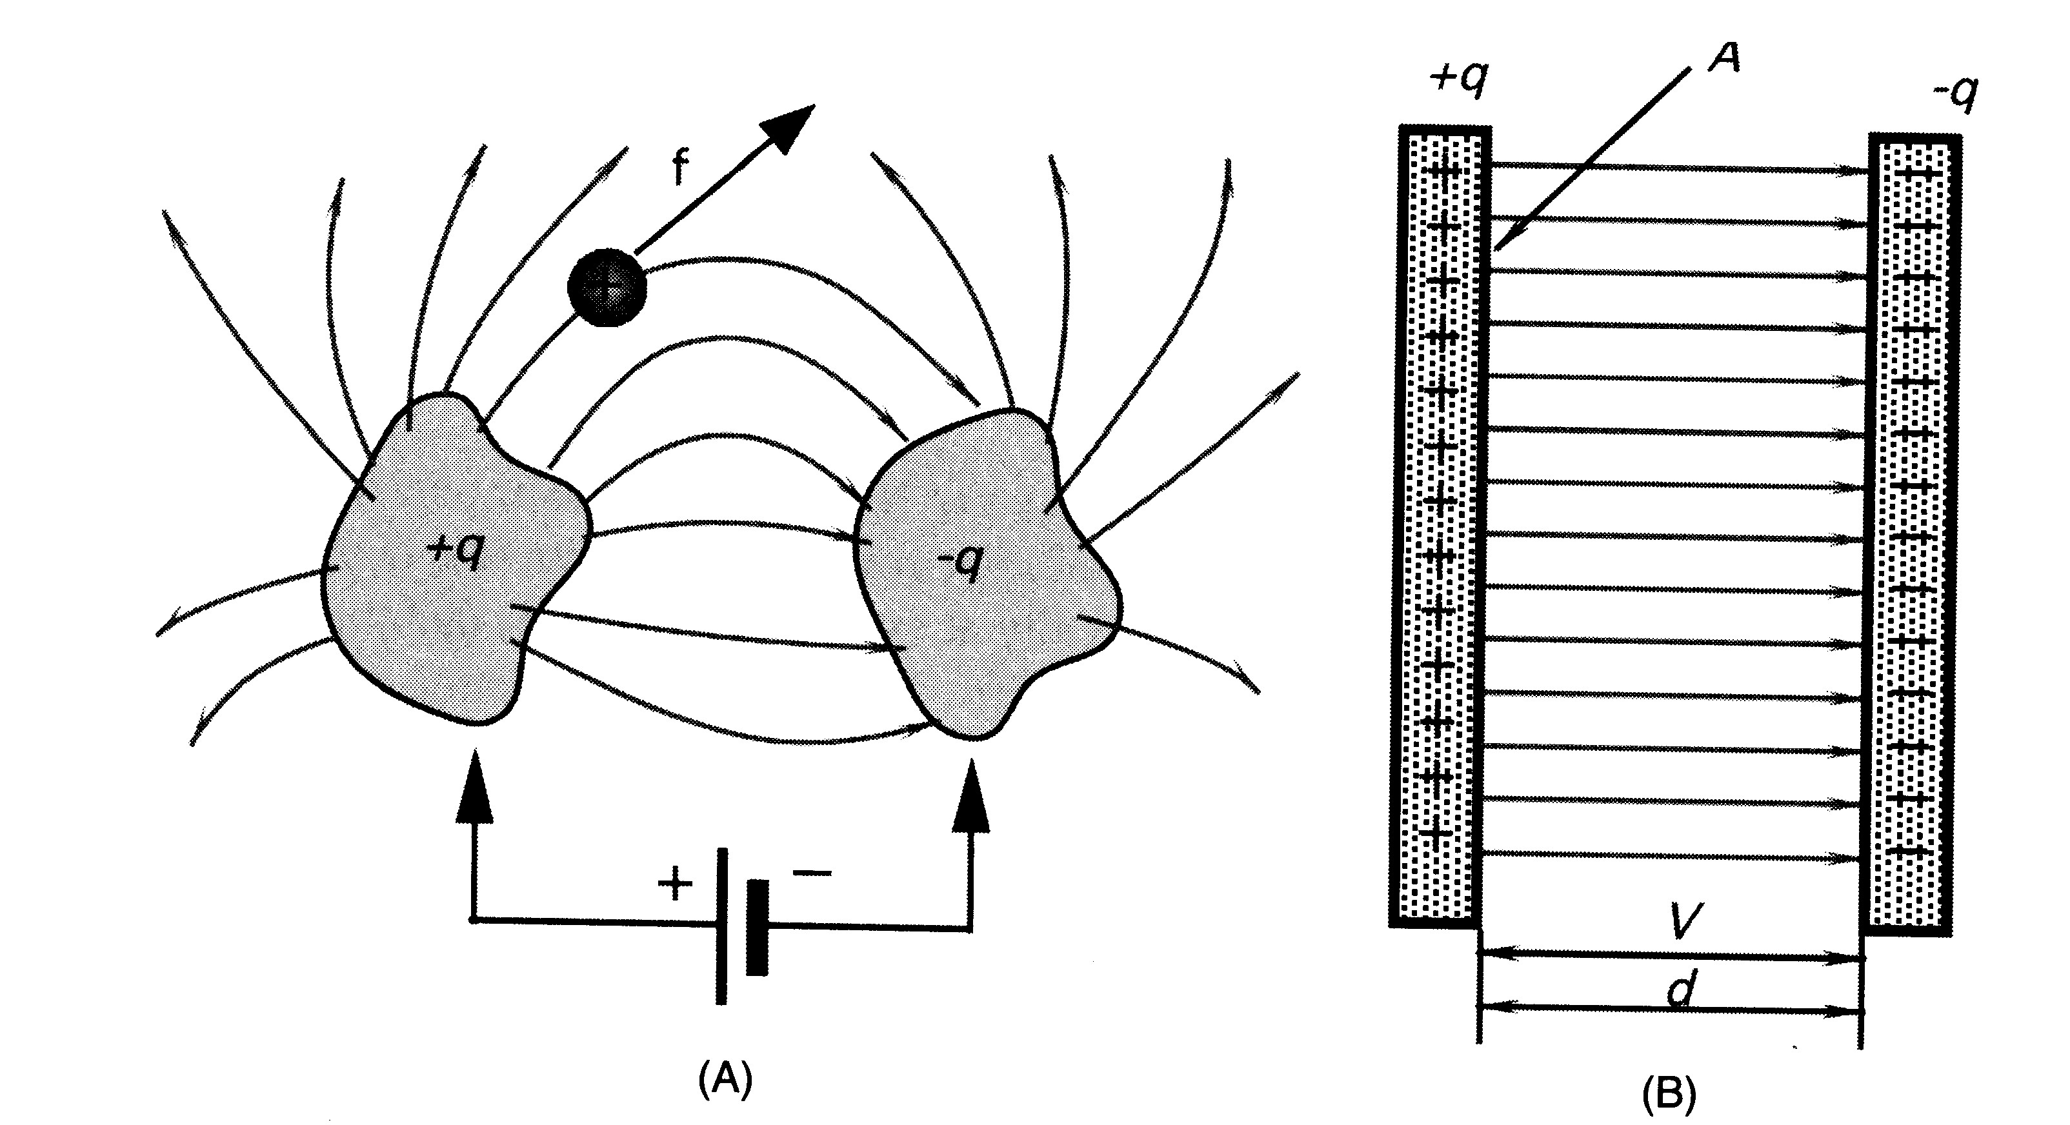
Capacitance
Two isolated conductive objects of arbitrary shape, which can hold an electric charge, are called a capacitor
An electric field is developed between the two conductors

Slide 10
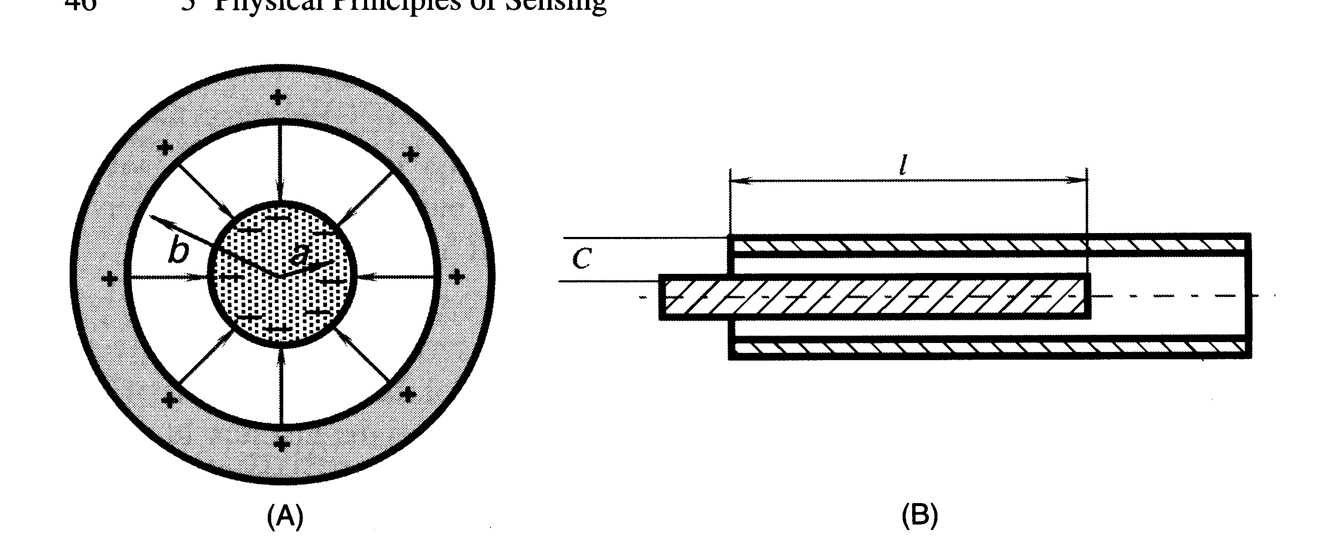
Capacitor as Displacement Sensor
If the inner conductor can be moved in and out, the measured capacitance will be a function of l

Slide 11
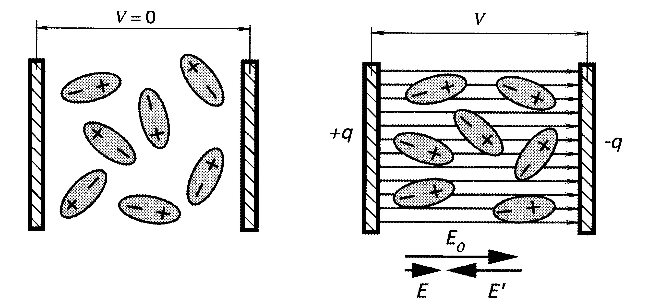
Dielectric Constant
The material between the plates of the capacitor can also be used to sense changes in the environment.
When vacuum (or air) is replaced by another material, the capacitance increases by a factor of κ, known as the dielectric constant of the material
The increase in C is due to the polarization of the molecules of the material used as an insulator

Slide 12
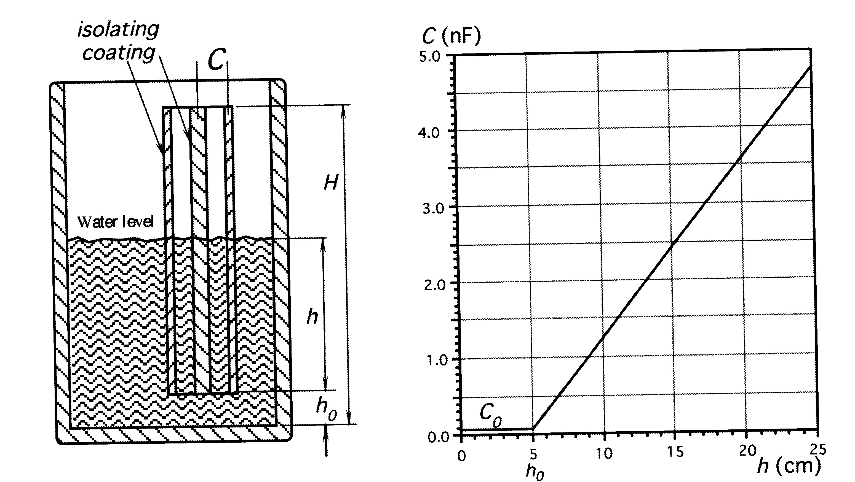
Example – A Water Level Sensor
The total capacitance of the coaxial sensor shown below is the capacitance of the water-free portion plus the capacitance of the water-filled portion; as the level of the water changes, the total capacitance changes

Slide 13
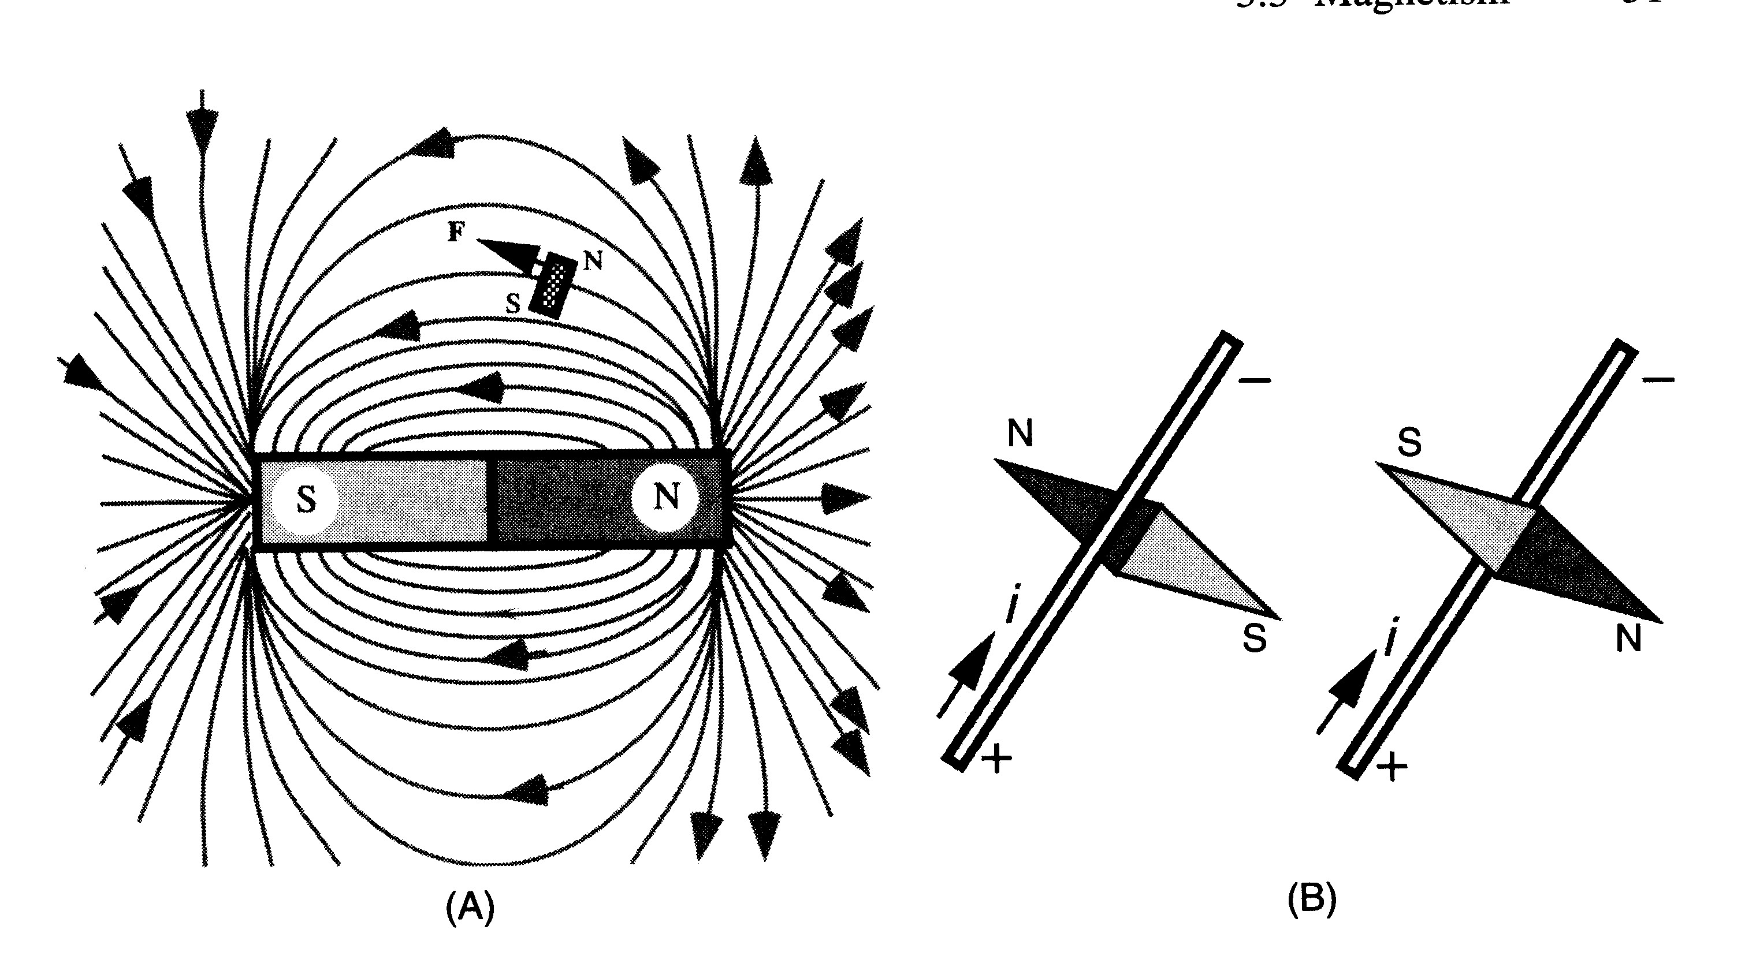
Magnetism
There are two methods of generating a magnetic field:
permanent magnets (magnetic materials)
magnetic field generated by a current
Force is generated on a test magnet in the field of magnetic materials.
A compass needle will respond to the magnetic field generated by a current.
Magnetic field, B
“flux” is the field density, Φ_{B}

Slide 14
Sources of Magnetic Fields
Electric current sets a circular magnetic field around a conductor.
Moving electron sets a field, superposition of field vectors results in a combined magnetic field of a permanent magnet.
Magnets are useful for fabricating magnetic sensors for the detection of motion, displacement, and position.

Slide 15
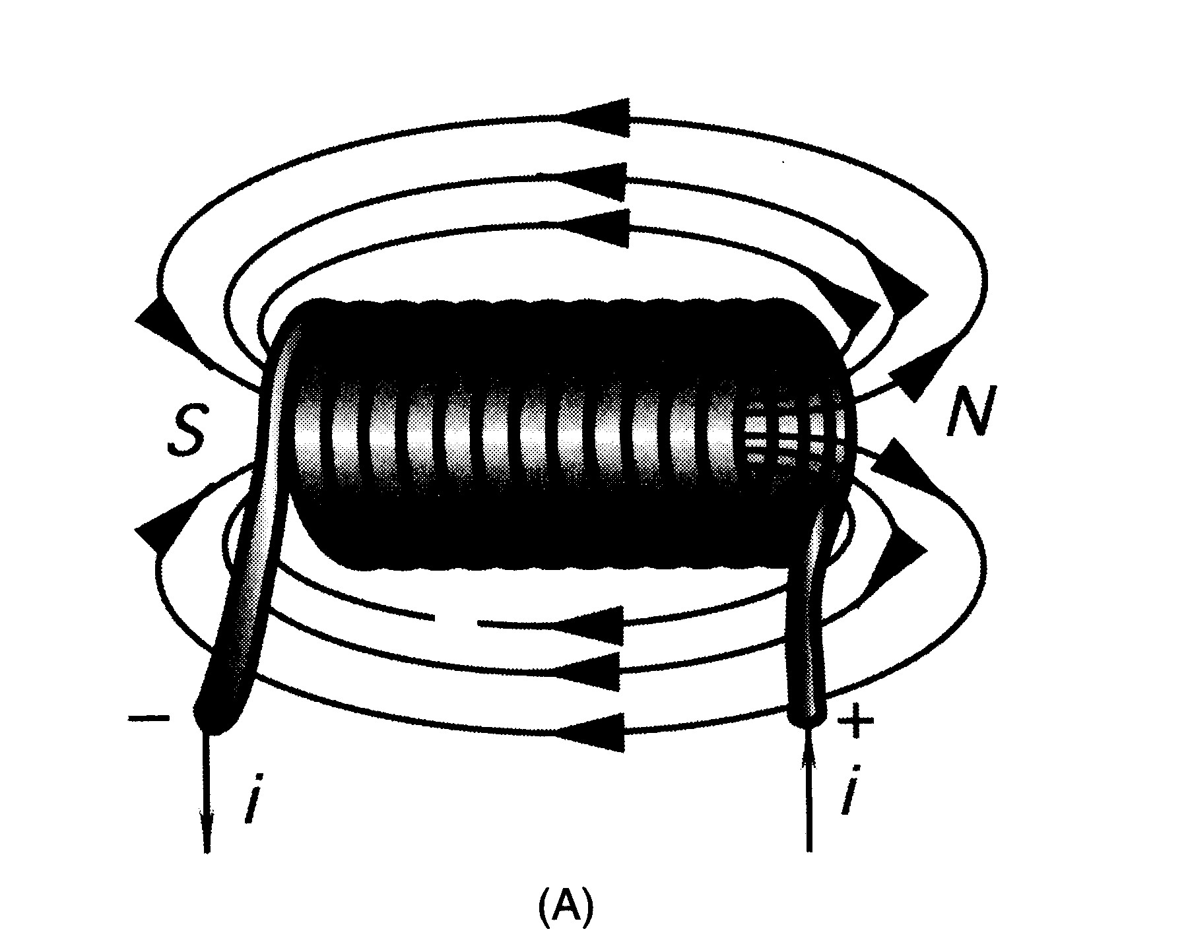
Induction
A phenomenon related to magnetism is induction, the generation of voltage from a changing magnetic field
If the coil has no magnetic core, the flux is proportional to current and the voltage proportional to di/dt

Slide 16
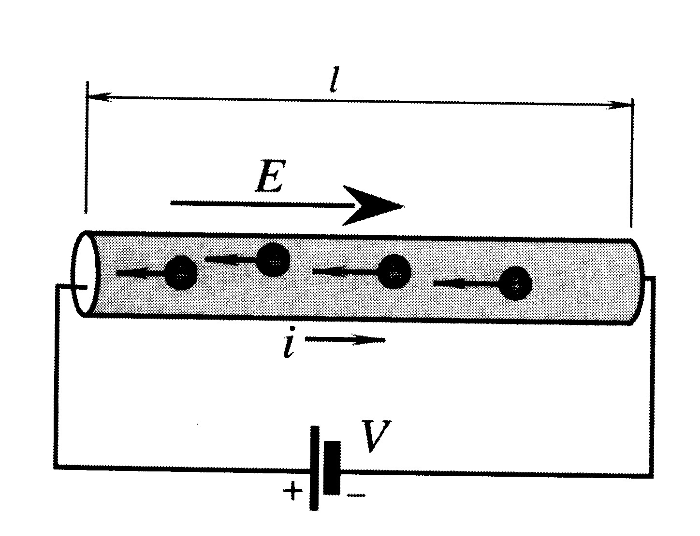
Resistance
If we apply a battery across two points of a piece of material, an electric field will be set up where E=V/l
The tendency of the material to resist the flow of electrons is called its resistivity, ρ, and we say that the material has a particular electrical resistance, R.

Slide 17
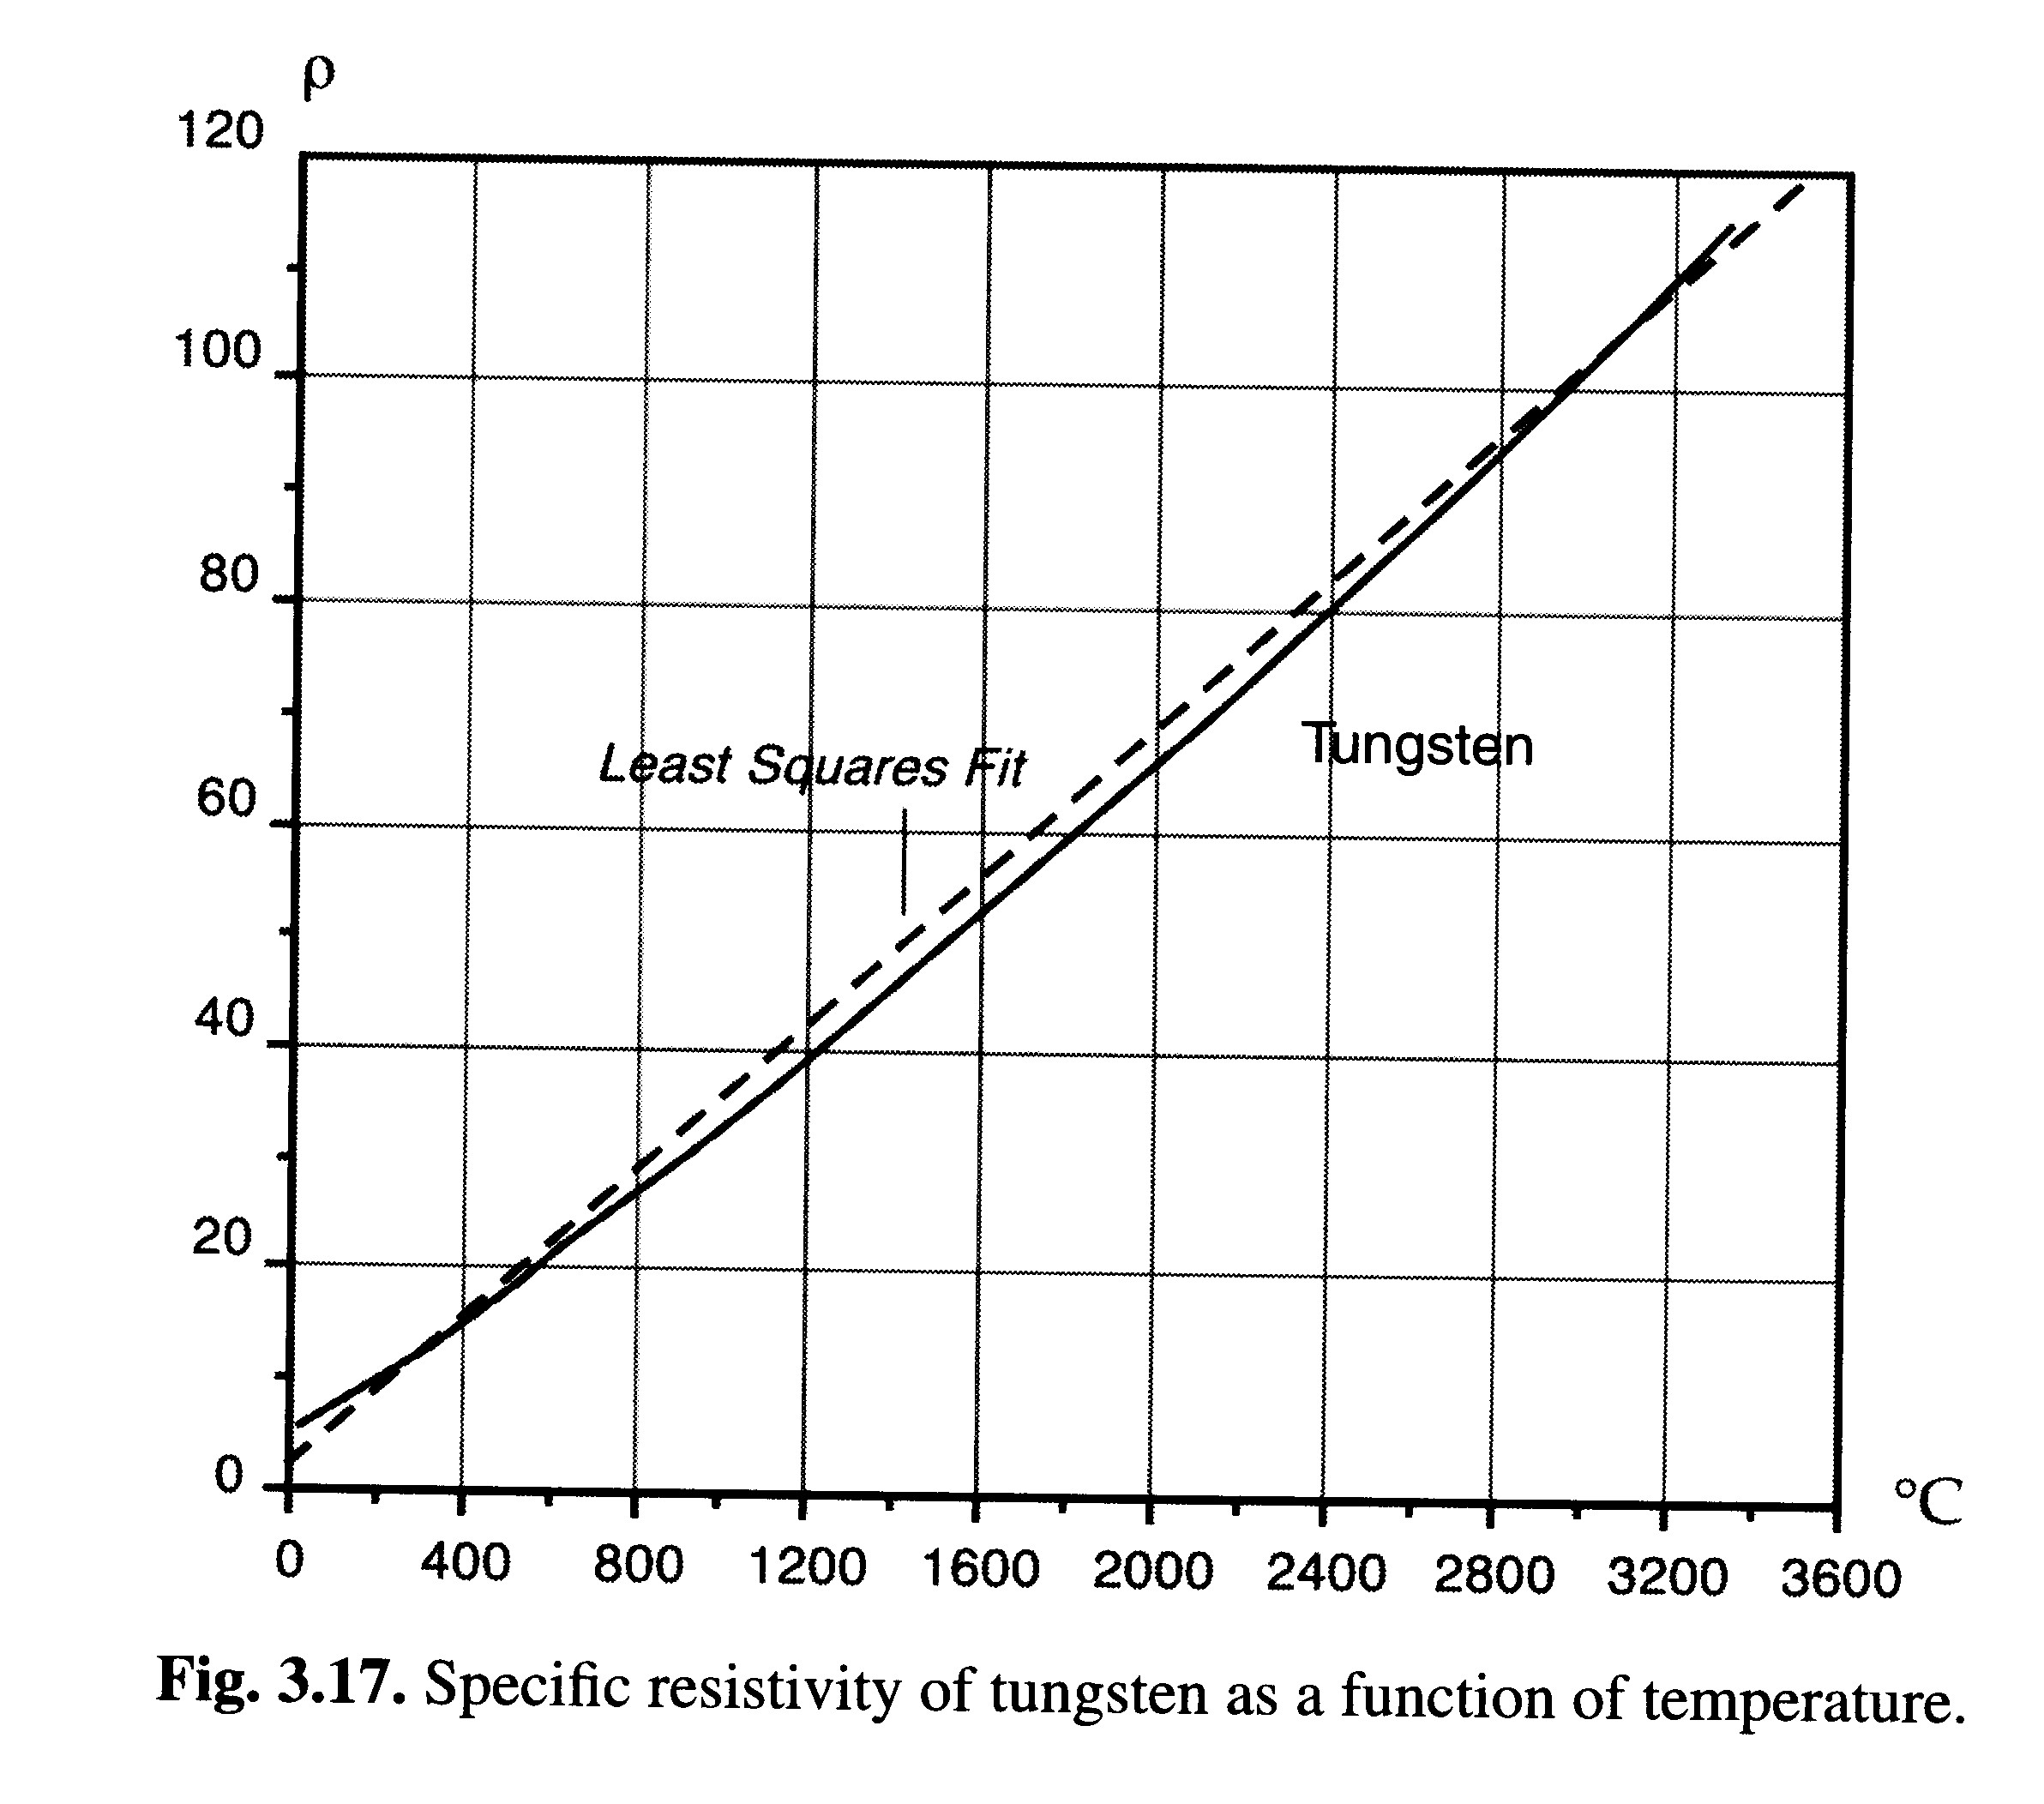
Sensitivity of Resistance
To Temperature:
Specific resistivity of tungsten as a function of temperature.
α is the temperature coefficient of resistivity.

Slide 18
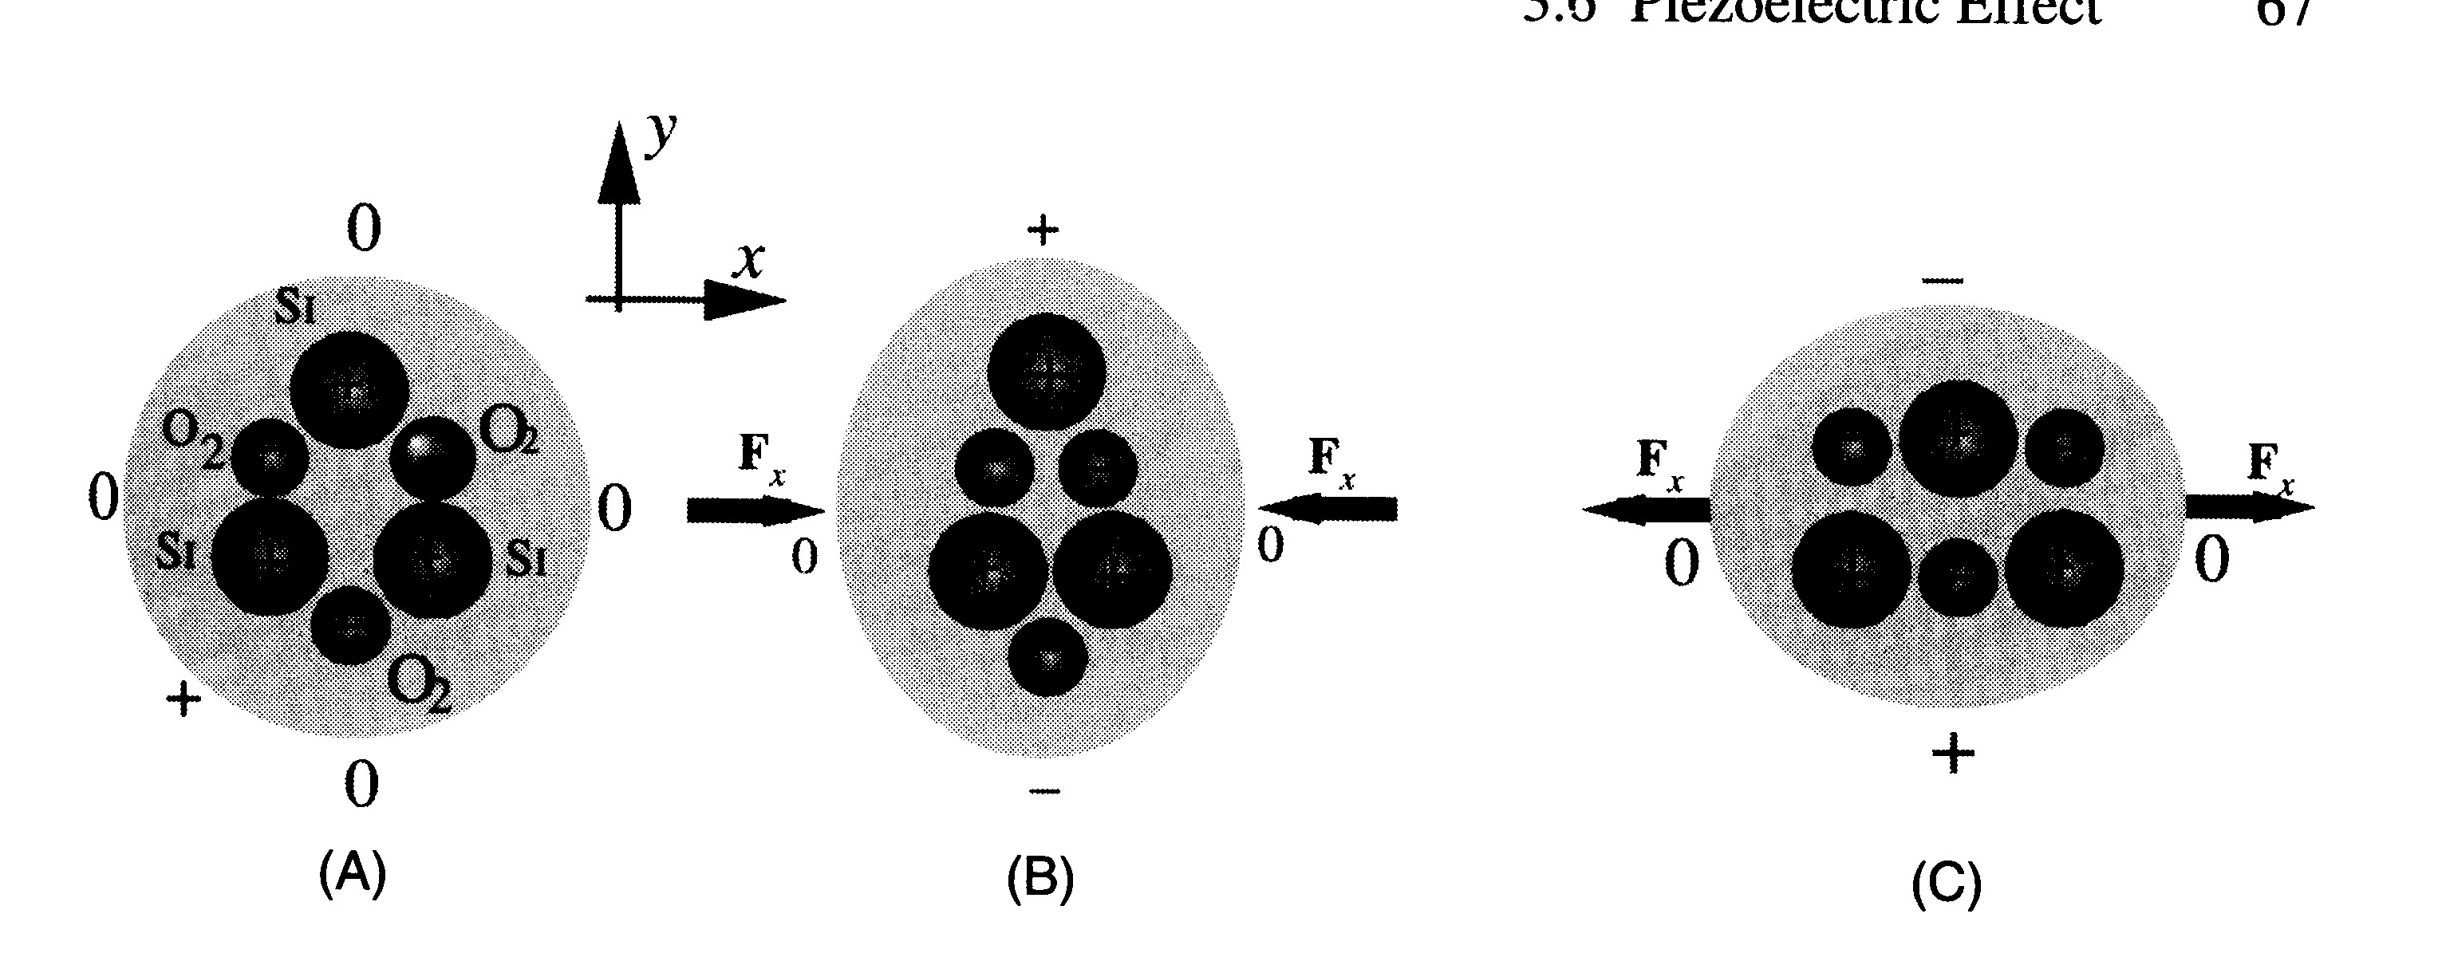
The Piezoelectric Effect
The piezoelectric effect is the generation of electric charge by a crystalline material upon subjecting it to stress

Slide 19
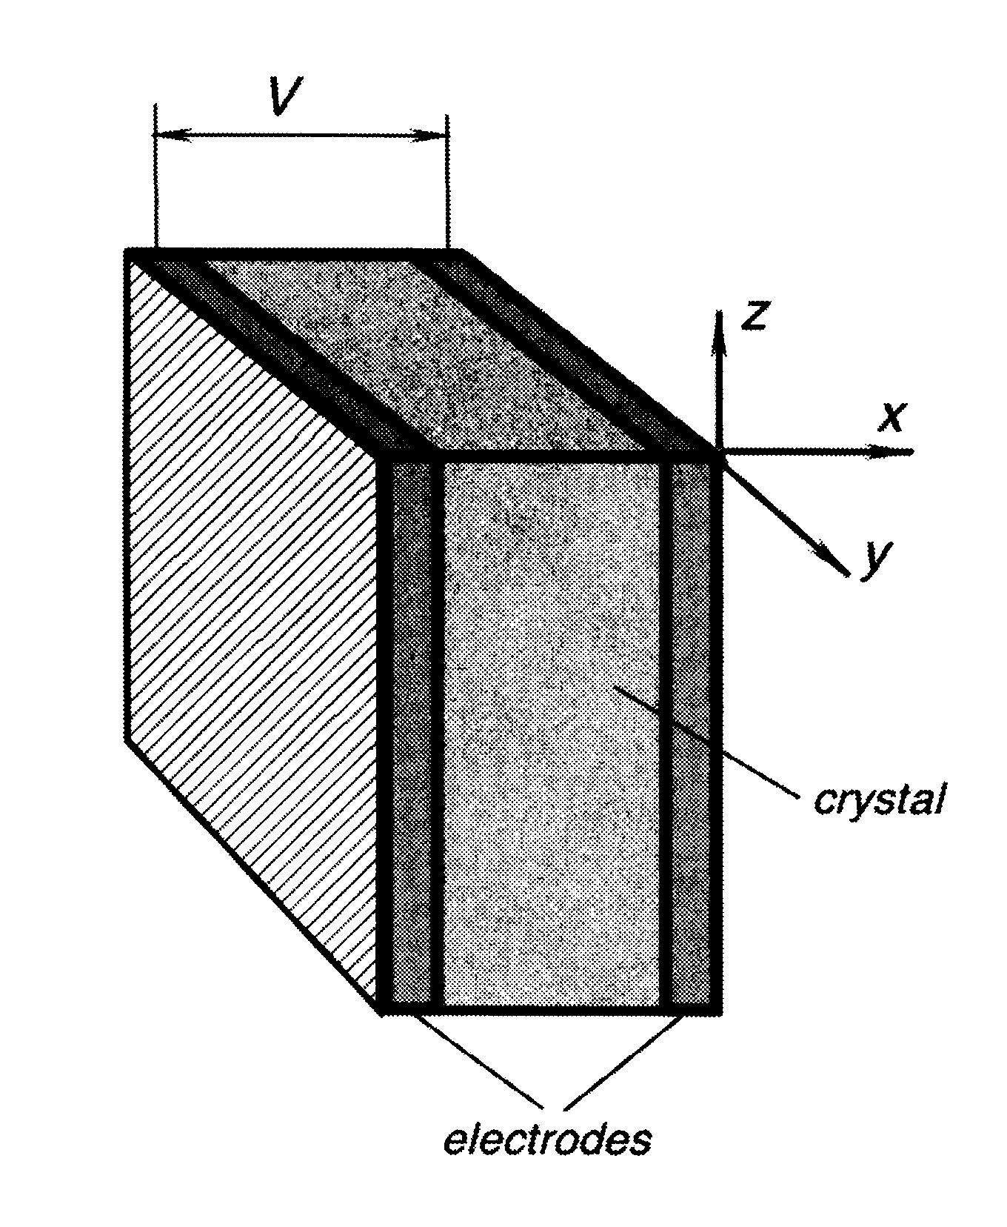
Piezoelectric Sensor
Because a crystal with deposited electrodes forms a capacitor the voltage developed can be expressed as:
Where d_{x} is the piezoelectric coefficient in the x direction and F_{x} is the applied force in the x direction.
Piezoelectric crystals are direct converters of mechanical energy into electrical energy.
Laminated 2-layer piezoelectric sensor

Slide 20
Signal Conditioning
Filter for expected frequency regime
Subtract DC offset (“zeroing”)
Amplify or attenuate signal (“scaling”)
Linearize relationship between measured and observed electrical parameter
Analog-to-Digital (and Digital-to-Analog) conversion

Slide 21
Analog-to-Digital Conversion
Sampling – converts the continuous signal into a series of discrete analog signals at periodic intervals
Quantization – each discrete analog is converted into one of a finite number of (previously defined) discrete amplitude levels
Encoding – discrete amplitude levels are converted into digital code
Variable
Analog Signal
Discrete
Variables
1001
1101
0101
Time

Slide 22
Features of an ADC
Sampling rate – rate at which continuous analog signal is polled (e.g., 1000 samples/sec)
Quantization – divide analog signal into discrete levels
Resolution – depends on number of quantization levels
Conversion time – how long it takes to convert the sampled signal to digital code
Conversion method – means by which analog signal is encoded into digital equivalent
Example: Successive approximation method

Slide 23
Successive Approximation Method
A series of trial voltages are successively compared to the input signal whose value is unknown
Number of trial voltages = number of bits used to encode the signal
First trial voltage is 1/2 the full scale range of the ADC
If the remainder of the input voltage exceeds the trial voltage, then a bit value of 1 is entered, if less than trial voltage then a bit value of zero is entered
The successive bit values, multiplied by their respective trial voltages and added, becomes the encoded value of the input signal

Slide 24
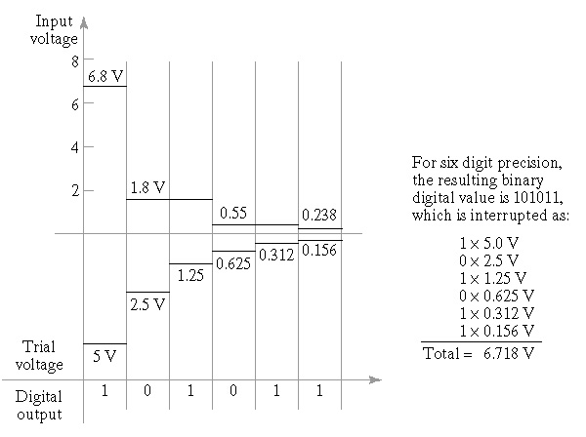
Example
Analogue signal is 6.8 volts. Encode, using SAM, the signal for a 6 bit register with a full scale range of 10 volts.

Slide 25
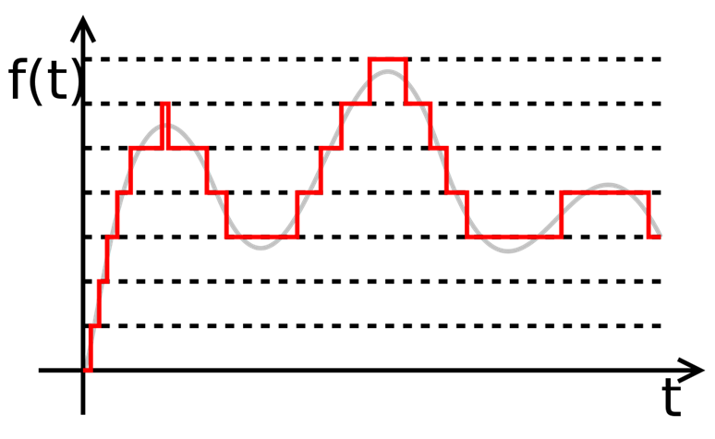
Example
Q = resolution in volts per step
M = resolution in bits
N = Number of intervals (steps, quantization levels)
E_{FSR} = Full scale voltage range
Quantization error = ½ of interval
Voltage range 0 – 10V; M = 12 bits
N = 4096 intervals (steps)
Q = 2.44 mV/code

Slide 26
Example
Using an analogue-to-digital converter, a continuous voltage signal is to be converted into its digital counterpart. The ADC has a 16-bit capacity, and full scale range of 60 V. Determine:
number of quantization levels
resolution
quantization error

Slide 27
Solution
(1) Number of quantization levels:
= 2¹⁶ = 65,536
(2) Resolution:
= 60 / 65,536 = ~ 0.00092 Volts
(3) Quantization error:
= 0.00092/2 = 0.00046 Volts

Slide 28
Digital-to-Analog Conversion
Convert digital values into continuous analogue signal
Decoding digital value to an analogue value at discrete moments in time based on value within register
Where E₀ is output voltage; E_{ref} is reference voltage; B_{n} is status of successive bits in the binary register

Slide 29
Example
A DAC has a reference voltage of 100 V and has 6-bit precision. Three successive sampling instances 0.5 sec apart have the following data in the data register:
Output Values:
Instant Binary Data
1 101000
2 101010
3 101101
E₀₁ = 100{0.5(1)+0.25(0)+0.125(1)+0.0625(0)+0.03125(0)+0.015625(0)}
E₀₁ = 62.50V
E₀₂ = 100{0.5(1)+0.25(0)+0.125(1)+0.0625(0)+0.03125(0)+0.015625(0)}
E₀₂ = 65.63V
E₀₃ = 100{0.5(1)+0.25(0)+0.125(1)+0.0625(0)+0.03125(0)+0.015625(0)}
E₀₃ = 70.31V

Slide 30
Sensor Types: HW & SW
Hardware-based sensors
Physical components built into a device
They derive their data by directly measuring specific environmental properties
Software-based sensors
Not physical devices, although they mimic hardware-based sensors
They derive their data from one or more hardware-based sensors

Slide 31
Sensor List of Smartphones
Sensor | Function Type | Software-based or Hardware-based
Accelerometer | Motion Sensor | Hardware-based
Gyroscope | Motion Sensor | Hardware-based
Gravity | Motion Sensor | Software-based
Rotation Vector | Motion Sensor | Software-based
Magnetic Field | Position Sensor | Hardware-based
Proximity | Position Sensor | Hardware-based
GPS | Position Sensor | Hardware-based
Orientation | Position Sensor | Software-based
Light | Environmental Sensor | Hardware-based
Thermometer | Environmental Sensor | Hardware-based
Barometer | Environmental Sensor | Hardware-based
Humidity | Environmental Sensor | Hardware-based

Slide 32
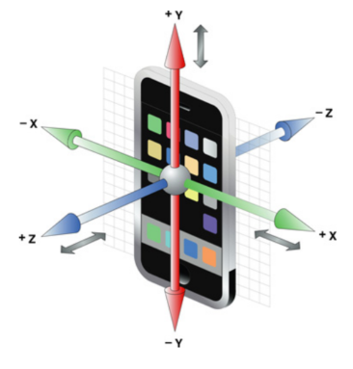
Sensor: Motion and Orientation
Most of the sensors use the same coordinate system
When a device’s screen is facing the user
The X axis is horizontal and points to the right
The Y axis is vertical and points up
The Z axis pints toward outside of the screen face

Slide 33
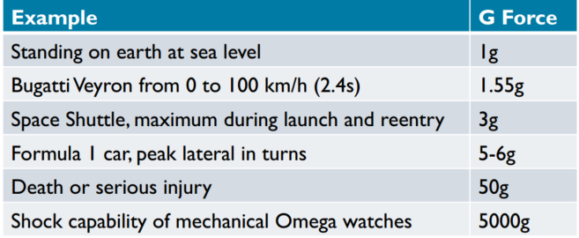
Sensor: Accelerometer
Measure proper acceleration (acceleration it experiences relative to free fall)
Units: g

Slide 34
Sensor: Accelerometer
Acceleration is measured on 3 axes
Note that the force of gravity is always included in the measured acceleration
When the device is sitting on the table stationary, the accelerometer reads a magnitude of 1g
When the device is in free fall, the accelerometer reads a magnitude of 0g
To measure the real acceleration of the device, the contribution of the force of gravity must be removed from the reading, for example, by calibration

Slide 35
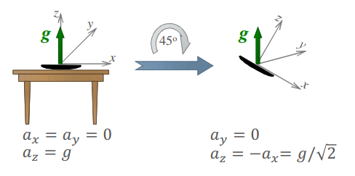
Sensor: Accelerometer
When the device is lying flat
gives +1g (gravitational force) reading on Z axis
Stationary device, after 45 degree rotation
Same magnitude, but rotated

Slide 36
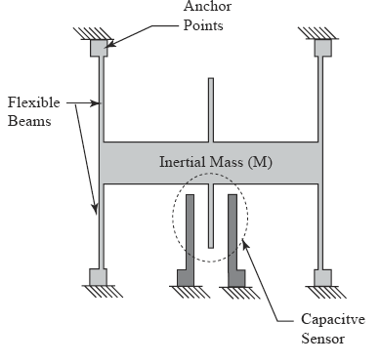
Accelerometer: Inner Working (1 of 2)
It consists of beams and a capacitive sensor with some anchor points

Slide 37
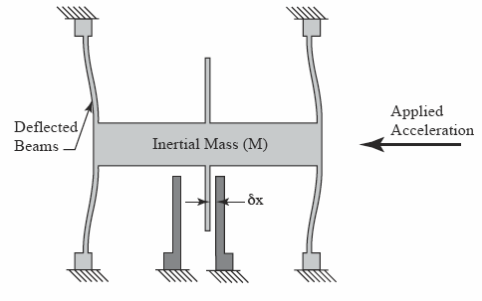
Accelerometer: Inner Working (1 of 2)
On applying the acceleration, the beams deflect and cause the change in capacitance.

Slide 38
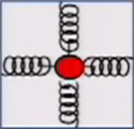
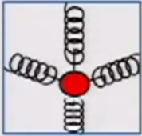
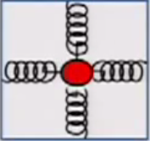
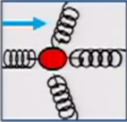
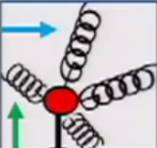
Accelerometer
Mass on spring
-1g
1g
Gravity
Free Fall
Linear Acceleration
Linear Acceleration plus gravity
1g = 9.8m/s²

Slide 39
Smartphones: MEMS Sensors
Micro Electro-Mechanical Systems
Term coined in 1989
Describes creation of mechanical elements at a scale more usually reserved for microelectronics
MEMS use cavities, channels, cantilevers, membranes, etc. to imitate traditional mechanical systems
Small enough to be integrated with the electronics

Slide 40
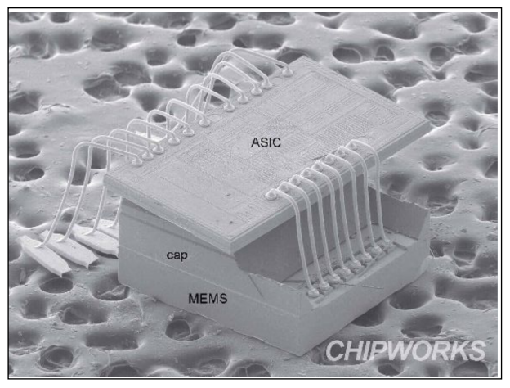
MEMS Accelerometer

Slide 41
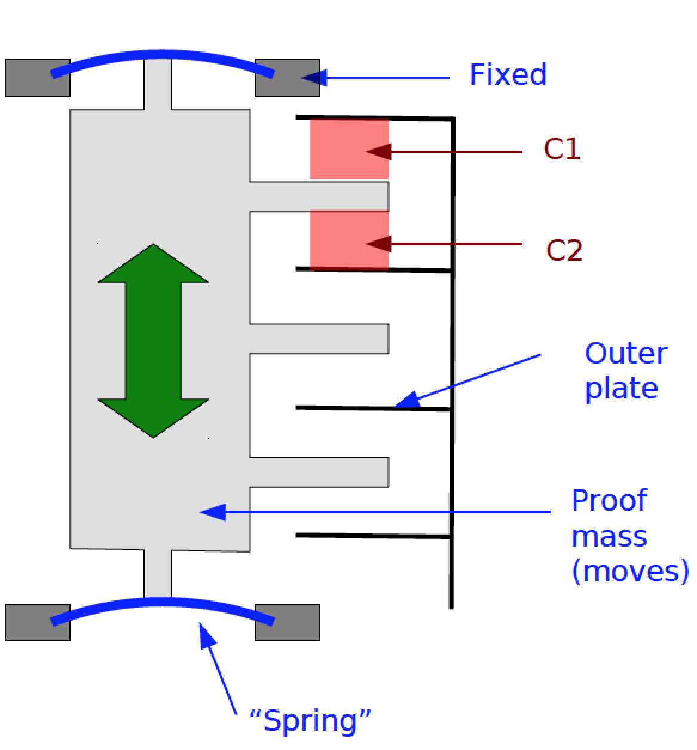
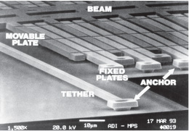
MEMS Accelerometer
Have a proof mass between springs and a series of ‘plates’
Measure deflection via capacitance changes
1-D only

Slide 42
Sensor: Gravity
Gravity sensor is not a separate hardware
It is a virtual sensor based on the accelerometer
It is the result when real acceleration component is removed from the reading

Slide 43
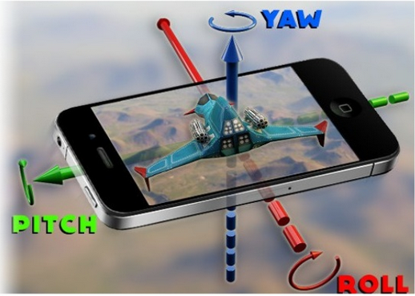
Sensor: Gyroscope
Measures the rate of rotation (angular speed) around an axis
Speed is expressed in rad/s on 3 axis
When the device is not rotating, the sensor values will be zeros
It gives us 3 values
Pitch value (rotation around X axis)
Roll value (rotation around Y axis)
Yaw value (rotation around Z axis)
Gyroscope is error prone over time
As time goes, gyroscope introduces drift in result
By sensor fusion (combining accelerometer and gyroscope), results can be corrected and path of movement of device can be obtained correctly

Slide 44
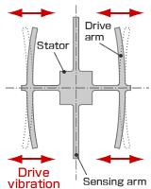
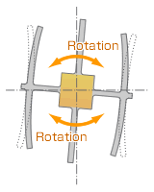
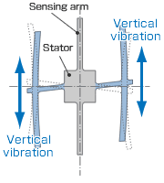
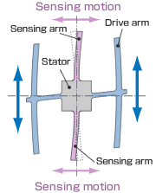
Gyroscope
Normally, a drive arm vibrates in a certain direction.
Direction of rotation
When the gyro is rotated, the Coriolis force acts on the drive arms, producing vertical vibration.
The stationary part bends due to vertical drive arm vibration, producing a sensing motion in the sensing arms.
The motion of a pair of sensing arms produces a potential difference from which angular velocity is sensed. The angular velocity is converted to, and output as, an electrical signal.

Slide 45
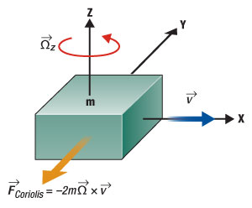
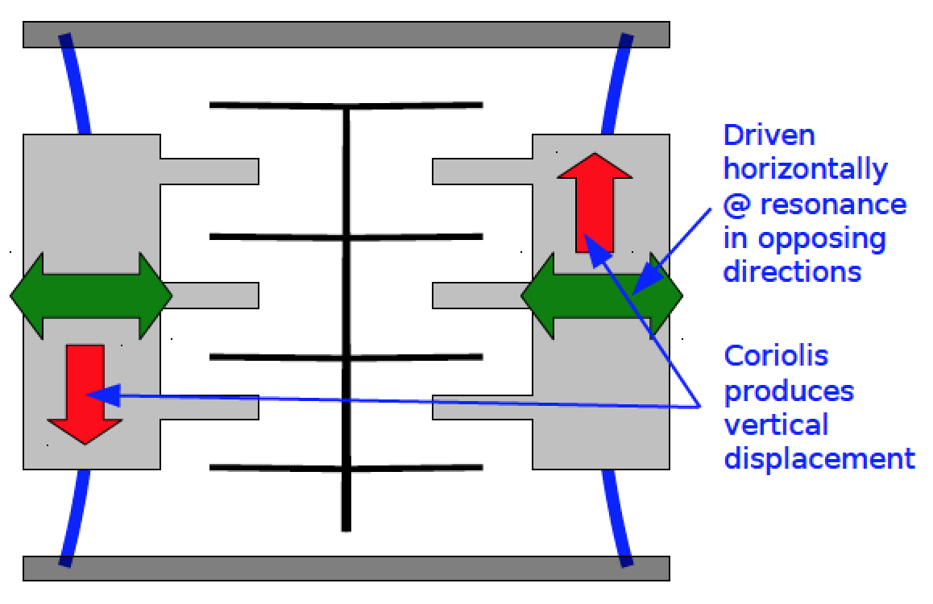
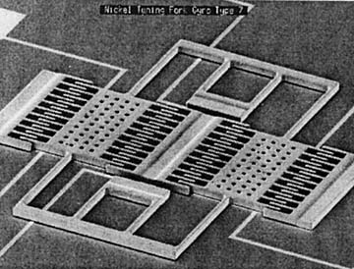
MEMS Gyroscope
Based on measuring Coriolis force as experienced by a moving object in a rotating frame of reference
Many implementations, but the “tuning fork” method is most common

Slide 46
Accelerometer vs. Gyroscope
Accelerometer
Senses linear movement: not good for rotations, good for tilt detection
Does not know difference between gravity and linear movement
Gyroscope
Measures all types of rotations
Not movement
A+G = both rotation and movement tracking possible

Slide 47
Sensor: Magnetic Field
Measures direction and strength of earth’s magnetic field
Strength is expressed in tesla (T)

Slide 48
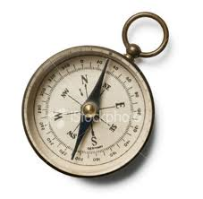
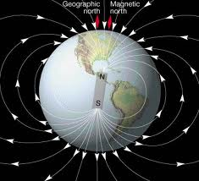
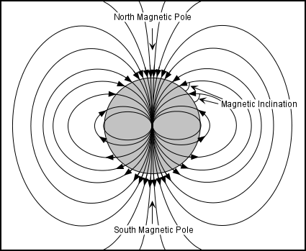
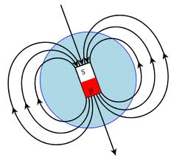
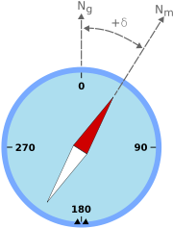
Compass
Magnetic field sensor (magnetometer)
Z
Y
Y
X
X
Z
Geographic north
Magnetic north
Horizontal
Magnetic field vector
Gravity
Magnetic declination
Magnetic inclination

Slide 49
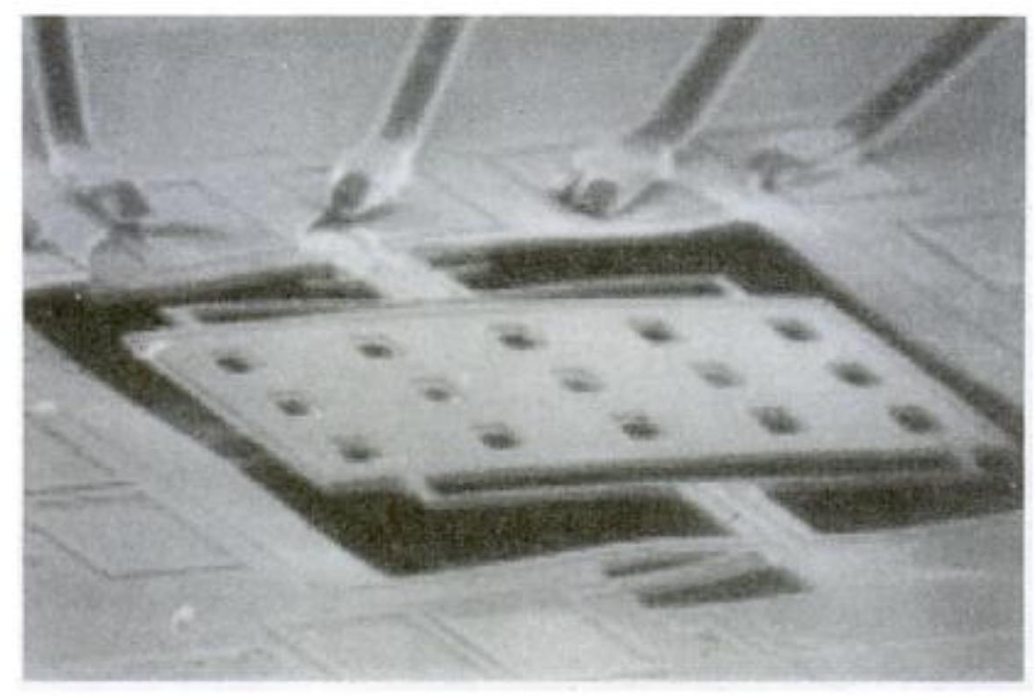
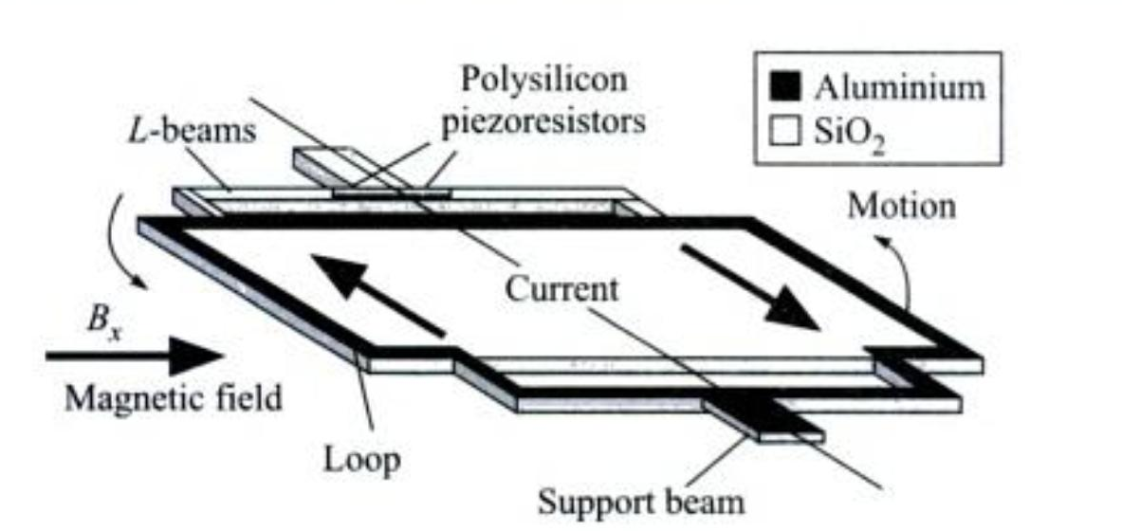
MEMS Compass
Most use Lorentz Force
A current-carrying wire in a magnetic field experiences a perpendicular force

Slide 50
Actuators
Hardware devices that convert a controller command signal into a change in a physical parameter
The change is usually mechanical (e.g., position or velocity)
An actuator is also a transducer because it changes one type of physical quantity into some alternative form
An actuator is usually activated by a low-level command signal, so an amplifier may be required to provide sufficient power to drive the actuator

Slide 51
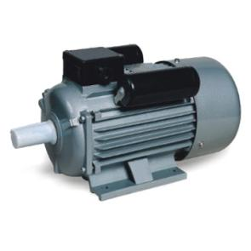
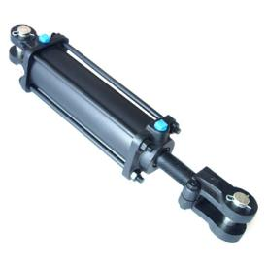
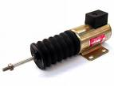
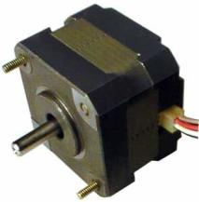
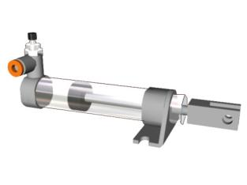
Types of Actuators
Electrical actuators
Electric motors
DC servomotors
AC motors
Stepper motors
Solenoids
Hydraulic actuators
Use hydraulic fluid to amplify the controller command signal
Pneumatic actuators
Use compressed air as the driving force

