Slide 1
Internet-of-Things (IoT)
Summer Engineering Program 2018
University of Notre Dame
LAB COMPONENT

Slide 2
Assignment 3
Task 1: Configure Bluetooth
Task 2: Write a client-server based intruder detection system using 2 Pis, a PIR sensor, and an LED (and/or sounder)
One Pi acts as server and uses a callback function that triggers when motion is detected
The other Pi acts as client and queries the server for the PIR value once every 5 seconds; if an intrusion is detected, the alarm is raised
Test both your client AND server program with the help of one (or more) of your classmates (or the TA if needed)

Slide 3
Assignment 3 Deliverables
By Friday midnight submit a report showing clearly your client and server programs
Indicate your Bluetooth address
Indicate if you ran into any problems during development or if any parts are incomplete/etc.
Provide a brief video (no longer than 30 seconds each) that shows your Pi and your classmate‘s Pi work together as intrusion detection system
Summary: there are two documents for this assignment: one PDF report (with code) and one video

Slide 4
Bluetooth Preparation
Make sure Internet sharing is w0rking (e.g., ping a remote IP address)
Install the Bluez Bluetooth module on your Pi:
sudo apt-get update
sudo apt-get install python-bluez
Configure Bluetooth:
sudo bluetoothctl
type: agent on
type: default-agent
type: scan on
type: quit
Activate scanning:
sudo hciconfig hci0 piscan
This call needs to be done after each reboot of the Pi!
If needed, you can find your Pi‘s BT address using the following command:
hciconfig (the address format is: XX:XX:XX:XX:XX:XX)

Slide 5
Bluetooth Server Template
import bluetooth
hostMACAddress = ''
port = 3
backlog = 1
size = 1024
s = bluetooth.BluetoothSocket(bluetooth.RFCOMM)
s.bind((hostMACAddress, port))
s.listen(backlog)
try:
client, clientInfo = s.accept()
while 1:
data = client.recv(size)
if data:
print(data)
client.send("Returning: " + data)
except:
client.close()
s.close()

Slide 6
Bluetooth Client Template
import bluetooth
serverMACAddress = ‘XX:XX:XX:XX:XX:XX'
port = 3
size = 1024
s = bluetooth.BluetoothSocket(bluetooth.RFCOMM)
s.connect((serverMACAddress, port))
while 1:
text = raw_input("Text to send: ")
if text == "quit":
break
s.send(text)
data = s.recv(size)
print(data)
s.close()

Slide 7
Notes
The client specifies the address of the server
The server specifies an empty address (the server will find its BT adapter address by itself)
The port number can be changed, but must be the same in both client & server
The size value indicates the maximum size of a data transfer

Slide 8
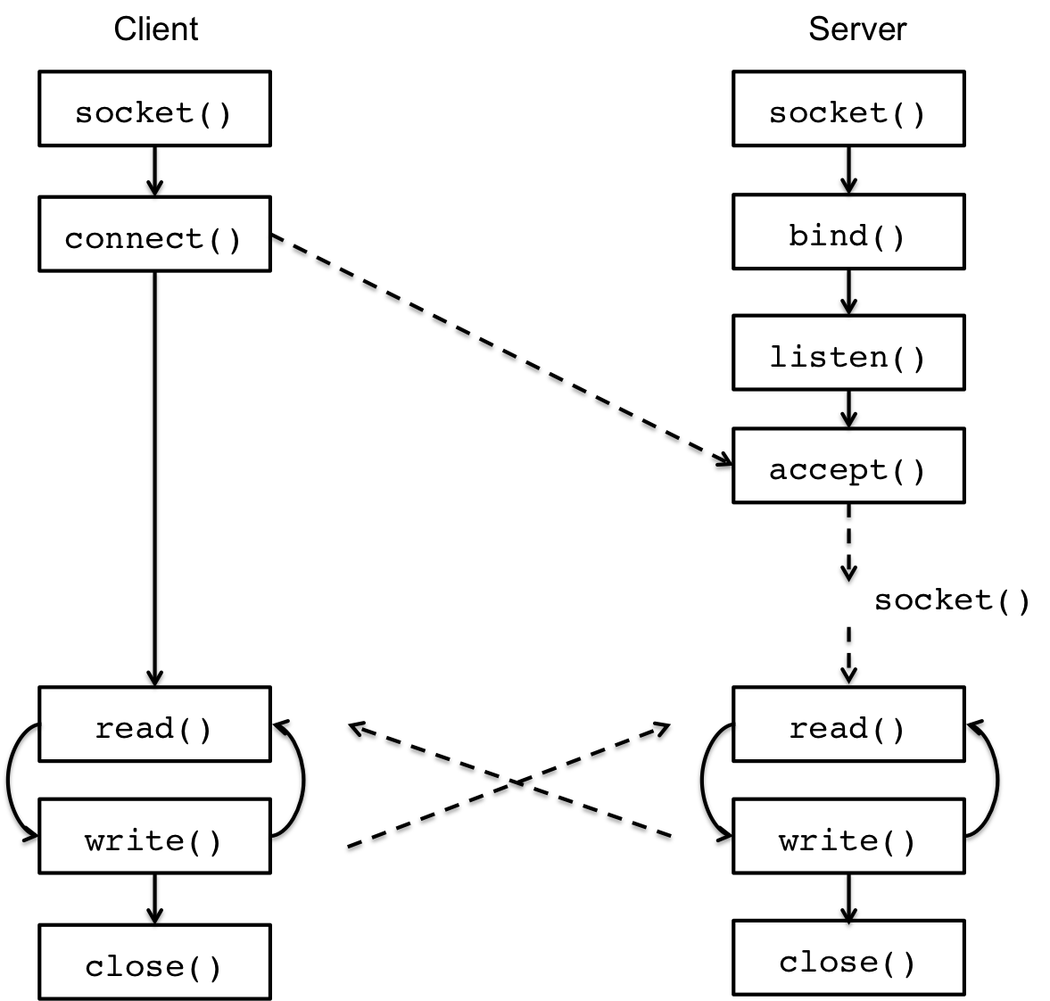
Client/Server Communication

