Slide 1
Internet-of-Things (IoT)
Summer Engineering Program 2018
University of Notre Dame
LAB COMPONENT

Slide 2
Office Hours Reminders & Notes
1 hour before class Mon/Wed and leaving last after class; Fri 9-10.30 (up to 12pm if needed) + Jess‘ office hours
First always try to solve a problem yourself (Google is your friend!)
If stuck, isolate problem (print is your friend!)
Come with specific questions (colleagues, TA, and Prof are your friends!)
Keep in mind we have 26 students; if everybody „consumes“ 1 hour of Jess‘ time, that won‘t work out
„Collaborate“ versus „tutoring“
Do not delay!!! (time is not your friend!)
Keep copies of your code!

Slide 3
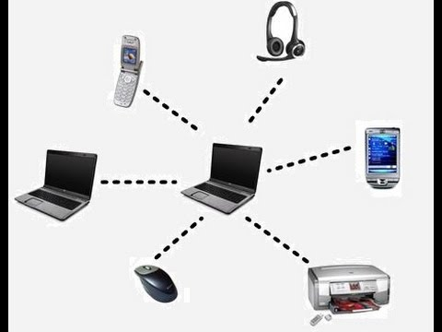
Bluetooth
Basic idea
Universal radio interface for ad-hoc wireless connectivity
Interconnecting computer and peripherals, handheld devices, PDAs, cell phones – replacement of IrDA (Infrared Data Association)
Embedded in other devices, very cheap
Short range (10m), low power consumption, license-free 2.45 GHz ISM
Voice and data transmission

Slide 4
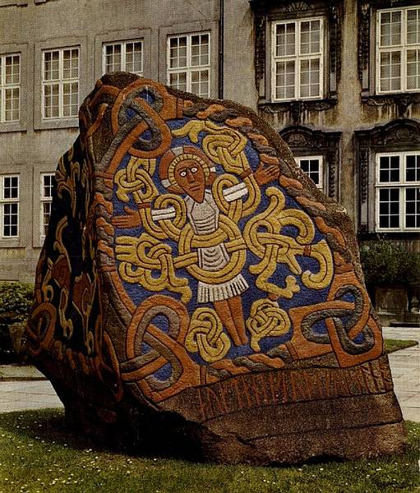
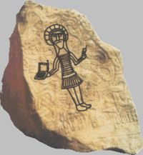
Bluetooth
History
1994: Ericsson worked on “MC-link” project
Later renamed to Bluetooth: Harald “Blåtand” Gormsen [son of Gorm], King of Denmark in the 10th century; united Denmark and spread Christianity
1998: foundation of Bluetooth SIG (Special Interest Group): www.bluetooth.org
2001: first consumer products for mass market, spec. version 1.1 released
2005: 250 million chips
2018: 4 billion chips

Slide 5
Key Characteristics
2.4 GHz ISM band, 79 RF channels
Channel 0: 2402 MHz … channel 78: 2480 MHz
Frequency hopping
1600 hops/s
Hopping sequence in a pseudo random fashion, determined by a master
Two types of traffic:
Voice link – SCO (Synchronous Connection Oriented)
Data link – ACL (Asynchronous Connection Less)

Slide 6
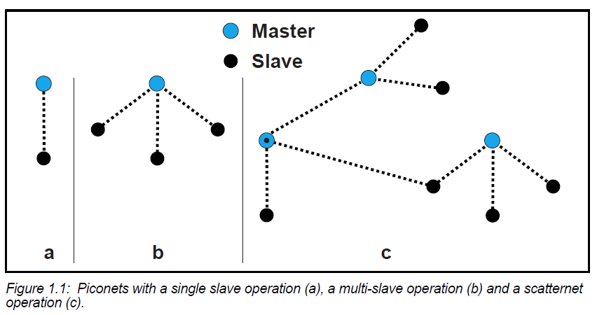
Topology: Piconet & Scatternet

Slide 7
Bluetooth Piconet
Master gives slaves its clock and device ID
Hopping pattern: determined by device ID (48 bit, unique worldwide)
Pseudo random number generator (device ID + clock)
Addressing
Active Member Address (AMA, 3 bit)
Parked Member Address (PMA, 8 bit)
Standby Member (no address)


P
S

S


M
P


SB
S


P
SB
M=Master
S=Slave
P=Parked
SB=Standby

Slide 8
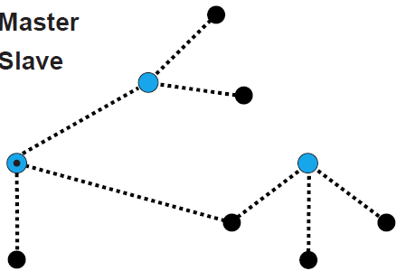
Bluetooth Scatternet
Each piconet has one master, but slaves can participate in different piconets on a time-division multiplex basis
A master in one piconet can be a slave in other piconets
Each piconet has its own hopping sequence

Slide 9
Bluetooth Scatternet
Piconets
P
S
S
S
P
P
M
M
SB
S
M=Master
S=Slave
P=Parked
SB=Standby
P
SB
SB
S

Slide 10
Communication
625 µs
f_{k}
f_{k+1}
f_{k+2}
f_{k+3}
f_{k+4}
f_{k+5}
f_{k+6}
M
S
M
S
M
S
M
t
f_{k}
f_{k+3}
f_{k+4}
f_{k+5}
f_{k+6}
M
S
M
S
M
t
f_{k}
f_{k+1}
f_{k+6}
M
S
M
t

Slide 11
Communication Example
Polling-based time division multiplex
625µs slots, master polls slaves
SCO (Synchronous Connection Oriented) – Voice
ACL (Asynchronous ConnectionLess) – Data
Variable packet size (1, 3, 5 slots)
SCO
ACL
SCO
ACL
SCO
ACL
SCO
ACL
MASTER
f₀
f₄
f₆
f₈
f₁₂
f₁₄
f₁₈
f₂₀
SLAVE 1
f₁
f₇
f₉
f₁₃
f₁₉
SLAVE 2
f₅
f₁₇
f₂₁

Slide 12
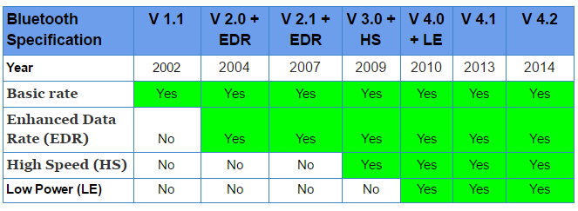
Bluetooth Versions

Slide 13
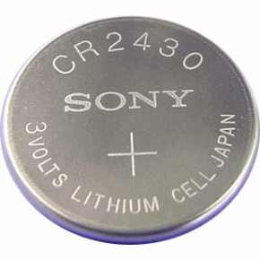
Bluetooth Low Energy (BLE)
Bluetooth low energy is a new, open, short range radio technology
Blank sheet of paper design
Different to Bluetooth classic
Optimized for ultra low power
Enable coin cell battery use cases
< 20mA peak current
< 5uA average current

Slide 14
BLE Basic Concepts
Everything is optimized for lowest power consumption
Short packets reduce TX (transmit) peak current
Short packets reduce RX (receive) time
Fewer RF channels to improve discovery and connection time
Simple state machine
Single protocol
...

Slide 15
“Exposing State” (IoT)
23.2˚C
60.5 km/h
12:23 pm
Gate 10 BOARDING
3.2 kWh
PLAY >>
Network Available
It’s good at small, discrete data transfers
Data can triggered by local events
Data can be read at any time by a client

Slide 16
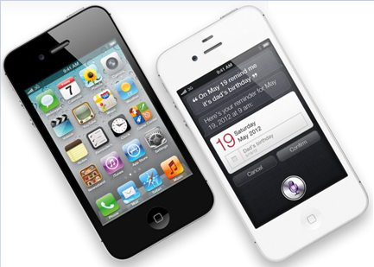
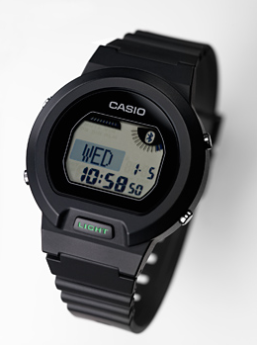
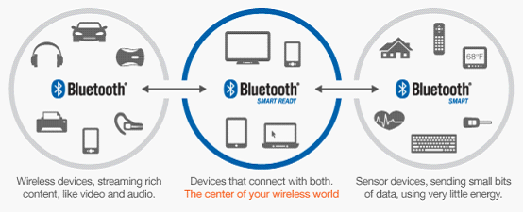
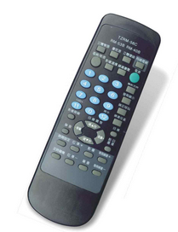
BLE Device Modes
Dual Mode
Bluetooth Classic and LE
Used anywhere BT Classic is used today
Single Mode
Implements only Bluetooth low energy
Will be used in new devices / applications

Slide 17
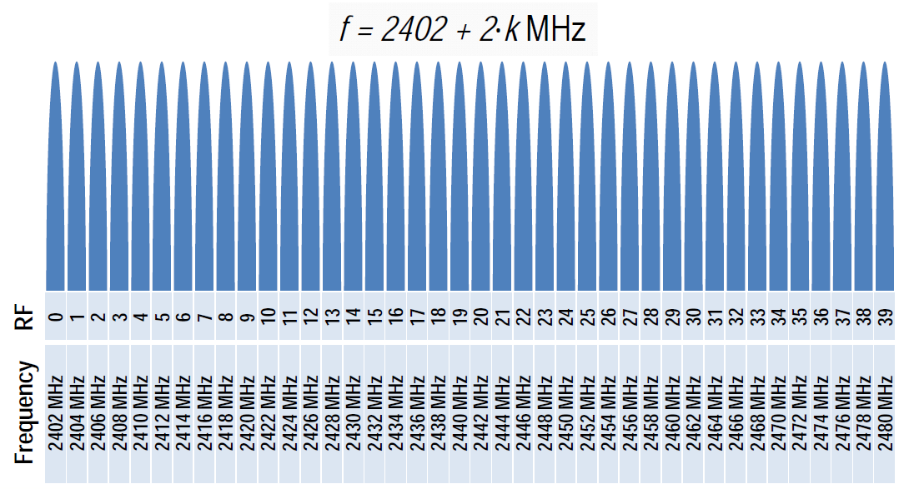
BLE Physical Layer
2.4 GHz ISM band
40 Channels on 2 MHz spacing

Slide 18
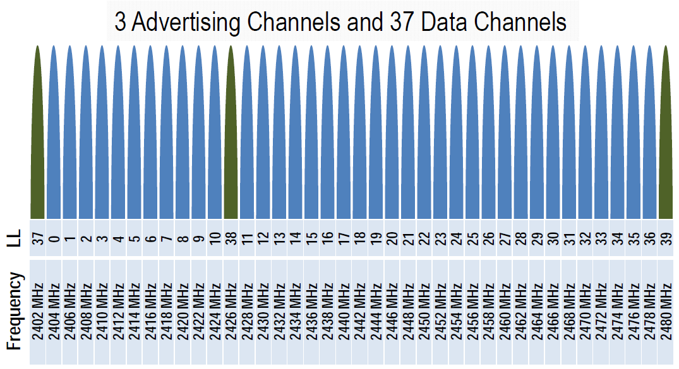
BLE Physical Layer
Two types of channels

Slide 19
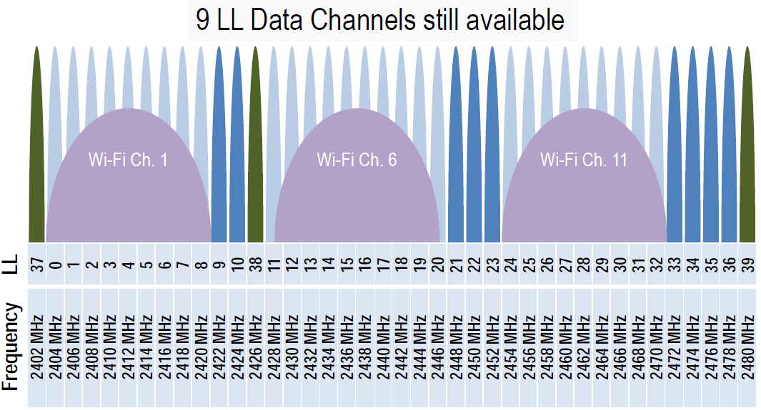
BLE Physical Layer
Advertising channels avoid 802.11

Slide 20
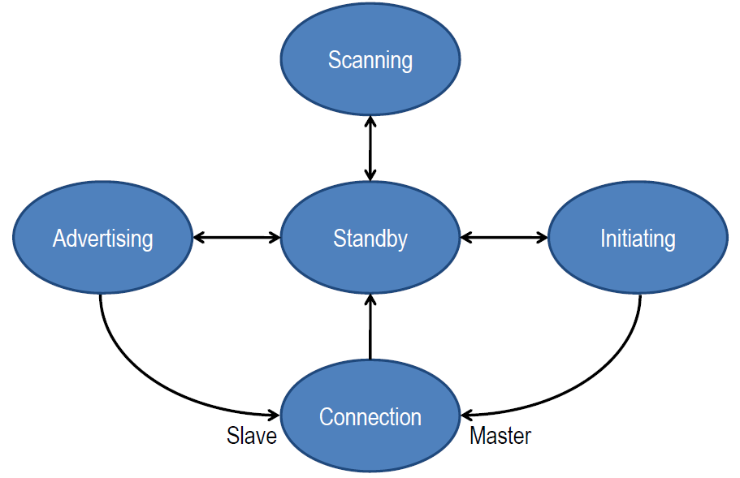
BLE Link Layer
Link Layer state machine

Slide 21
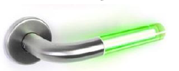
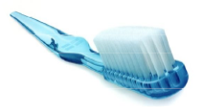
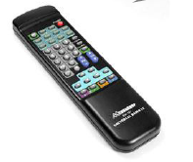
BLE and Internet-of-Things
My pulse is …
My blood glucose is …
My temperature is …
Low power
Low data rate

Slide 22
Assignment 3
Task 1: Configure Bluetooth
Task 2: Write a client-server based intruder detection system using 2 Pis, a PIR sensor, and an LED (and/or sounder)
One Pi acts as server and uses a callback function that triggers when motion is detected
The other Pi acts as client and queries the server for the PIR value once every 5 seconds; if an intrusion is detected, the alarm is raised
Test both your client AND server program with the help of one (or more) of your classmates

Slide 23
Assignment 3 Deliverables
By Friday midnight submit a report showing clearly your client and server programs
Indicate your Bluetooth address
Indicate if you ran into any problems during development or if any parts are incomplete/etc.
Provide a brief video (no longer than 30 seconds each) that shows your Pi and your classmate‘s Pi work together as intrusion detection system
Summary: there are two documents for this assignment: one PDF report (with code) and one video

Slide 24
Bluetooth Preparation
Make sure Internet sharing is w0rking (e.g., ping a remote IP address)
Install the Bluez Bluetooth module on your Pi:
sudo apt-get update
sudo apt-get install python-bluez
Configure Bluetooth:
sudo bluetoothctl
type: agent on
type: default-agent
type: scan on
type: quit
Activate scanning:
sudo hciconfig hci0 piscan
This call needs to be done after each reboot of the Pi!
If needed, you can find your Pi‘s BT address using the following command:
hciconfig (the address format is: XX:XX:XX:XX:XX:XX)

Slide 25
Bluetooth Server Template
import bluetooth
hostMACAddress = ''
port = 3
backlog = 1
size = 1024
s = bluetooth.BluetoothSocket(bluetooth.RFCOMM)
s.bind((hostMACAddress, port))
s.listen(backlog)
try:
client, clientInfo = s.accept()
while 1:
data = client.recv(size)
if data:
print(data)
client.send("Returning: " + data)
except:
client.close()
s.close()

Slide 26
Bluetooth Client Template
import bluetooth
serverMACAddress = ‘XX:XX:XX:XX:XX:XX'
port = 3
size = 1024
s = bluetooth.BluetoothSocket(bluetooth.RFCOMM)
s.connect((serverMACAddress, port))
while 1:
text = raw_input("Text to send: ")
if text == "quit":
break
s.send(text)
data = s.recv(size)
print(data)
s.close()

Slide 27
Notes
The client specifies the address of the server
The server specifies an empty address (the server will find its BT adapter address by itself)
The port number can be changed, but must be the same in both client & server
The size value indicates the maximum size of a data transfer

Slide 28
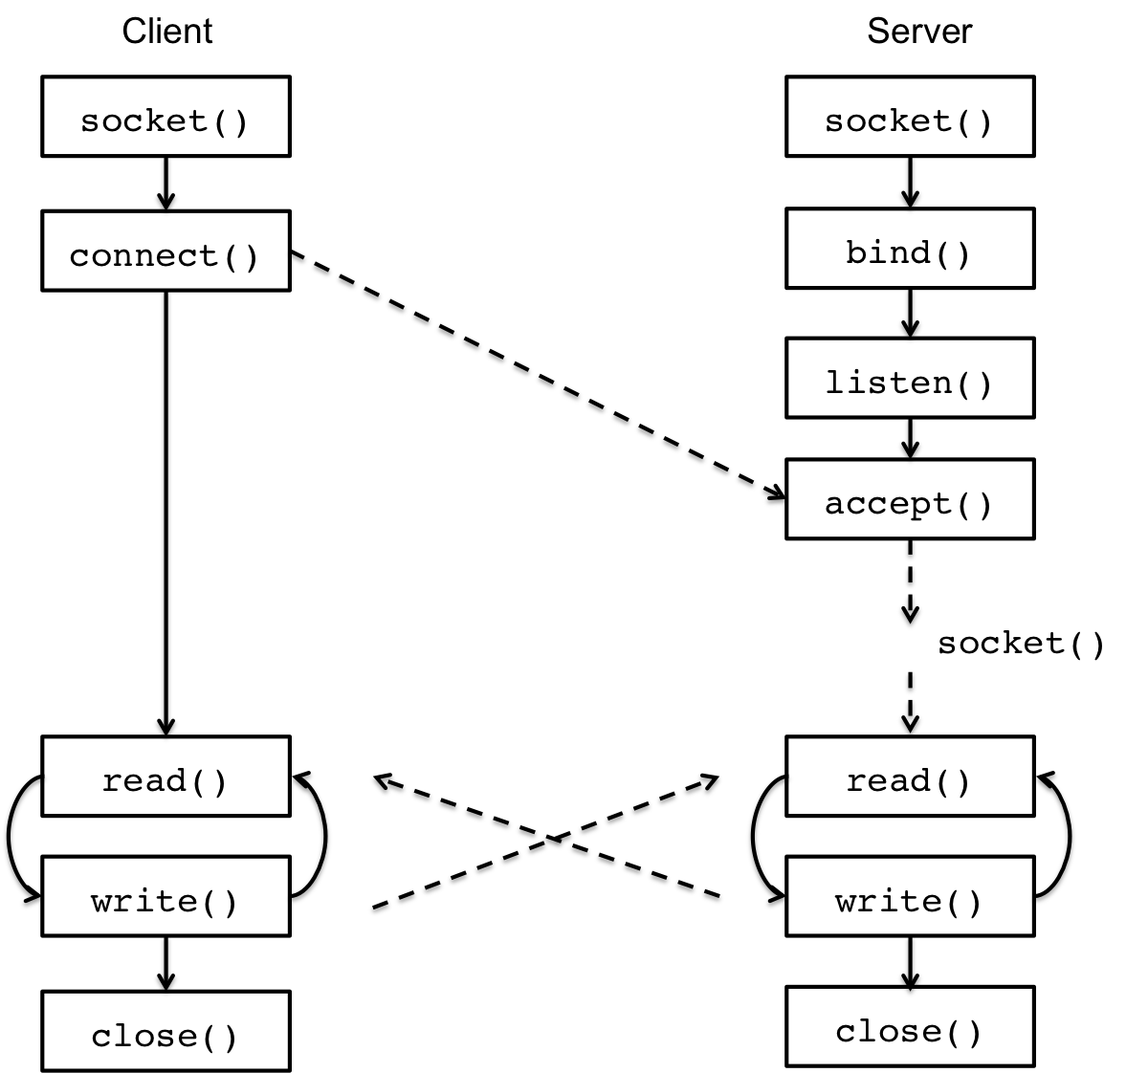
Client/Server Communication

