Slide 1
Internet-of-Things (IoT)
Summer Engineering Program 2018
University of Notre Dame

Slide 2
Course Overview
 | Lecture | Lab
Week 1 | Fundamentals of IoT, basic concepts, applications | Basic Python programming, meet your Raspberry Pi
Week 2 | Smart objects, user interfaces, sensing, actuation | Sensor programming, control loops, digital/analog I/O
Week 3 | Fundamentals of computer and wireless networks | Wi-Fi and Bluetooth networks, network measurements
Week 4 | Sensor networks, mesh networks, routing, WPANs | ZigBee, WPANs, WBANs, routing, network measurements
Week 5 | Processing, IoT cloud, analytics, visualization | IoT cloud integration, sensor fusion, analytics, visualization
Week 6 | IoT ecosystem, security, privacy, ethics, trends, case studies | Final project

Slide 3
Review Munich
IBM speaker
INTELLIGENT IoT (collaboration, conversational interfaces, slow/focused introduction of technology)
Samsung speaker
In-memory analysis; “imprecise computation“
Uppsala speaker
Inter-network interaction; co-locality of networks
USC speaker
IoT marketplace; sharing of data

Slide 4
Review Munich
Vint Cerf (Google)
Reliability, safety, security, privacy, interoperability, autonomy, …
Panel
Closed vs. open approach
Data:Lab Munich
Connected vehicles; data science; quantum computing; natural language processing
SDK (Software Development Kit), API (Application Programming Interface)

Slide 5
Review Munich
Prof. Barker
SWAG
Circuit-switched vs. packet-switched
Packet drop (routers)
Real-time focus
System on a chip (SoC)
State machines
Virtual memory
RPC (remote procedure call)
IPv4 vs. IPv6
Object-oriented vs. predictability
6LowPan

Slide 6
Computer Network Terminology
Network: group of computers and associated devices that are connected by communication facilities
Wide Area Network (WAN): world-wide (Internet)
Metropolitan Area Network (MAN): city-scale
Local Area Network (LAN): laboratory/office-scale (Ethernet)
WLAN: wireless LAN (Wi-Fi)
WPAN: wireless personal area network (Bluetooth)
WBAN: wireless body area network

Slide 7
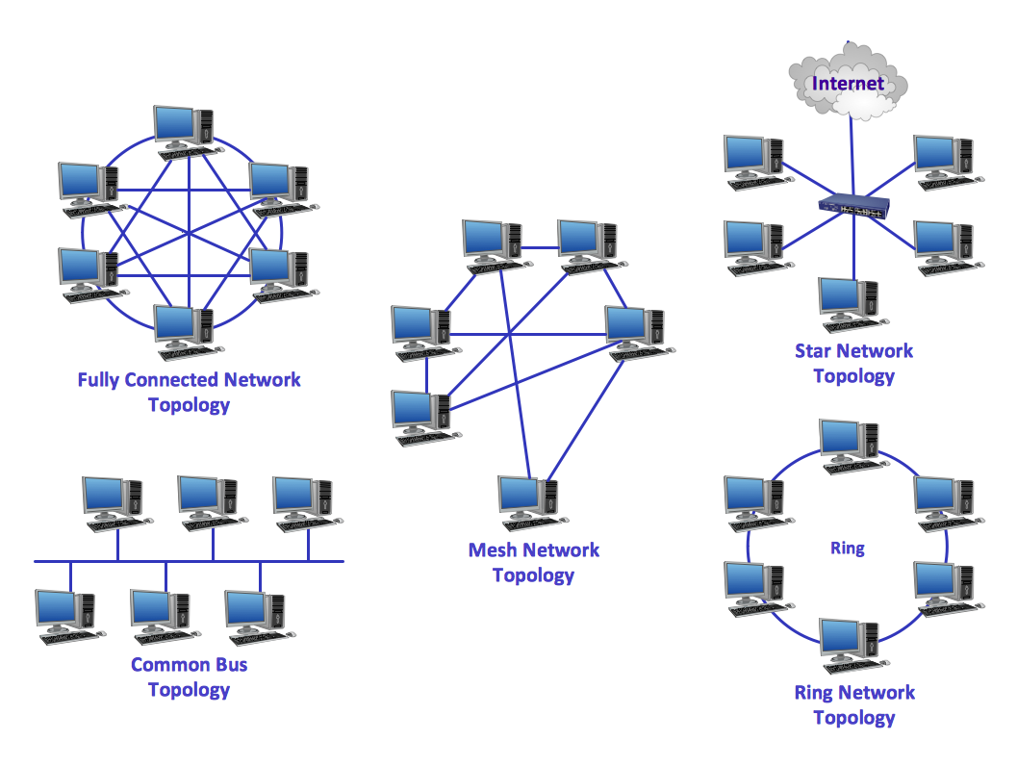
Network Topologies

Slide 8
Network Protocols
Protocols are the building blocks of a network architecture
Formal standards and policies enabling communication
IEEE (Institute of Electrical and Electronics Engineers): standardization
Example: Project 802
802.3: Ethernet
802.11: WLAN
802.15: WPAN

Slide 9
Communication
Who initiates communication?
Order of communication?
How long can I talk?
How loud can I speak?
Do I have to say something specific at beginning or end?
Do I have to add meta information?
What do I do if I get interrupted?
What do I do if I was not understood?

Slide 10
Protocols
Hi
TCP connection
request
Hi
TCP connection
response
Got the
time?
2:00
Get http://www.awl.com/kurose-ross
time
<file>

Slide 11
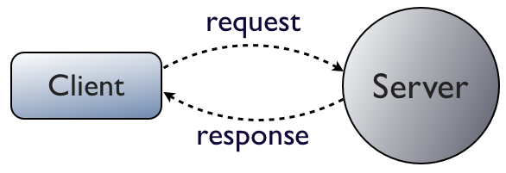
Client/Server Model
Client: “active” (initiates communication)
Server: “passive” (listens and responds)

Slide 12
Client/Server Model Examples
HTTP (Hypertext Transfer Protocol)
SMTP (Simple Mail Transfer Protocol)
SSH (Secure Shell)
DNS (Domain Name System)
NFS/AFS (Network/Andrew File System)

Slide 13
Network Protocols (“Protocol Stack”)
Application
Layer
Application
Layer
Presentation
Layer
Presentation
Layer
Session
Layer
Session
Layer
Transport
Layer
Transport
Layer
Communication Network
Network
Layer
Network
Layer
Network
Layer
Network
Layer
Data Link
Layer
Data Link
Layer
Data Link
Layer
Data Link
Layer
Physical
Layer
Physical
Layer
Physical
Layer
Physical
Layer
Copyright ©2000 The McGraw Hill Companies
Figure 2.6

Slide 14
Network Protocols (Headers/Trailers)
Application A
Application B
data
Application
Layer
data
ah
Application
Layer
Presentation
Layer
Presentation
Layer
data
ph
Session
Layer
data
sh
Session
Layer
Transport
Layer
data
th
Transport
Layer
Network
Layer
data
nh
Network
Layer
Data Link
Layer
Data Link
Layer
dt
data
dh
Physical
Layer
Physical
Layer
bits

Slide 15
Why A Layered Design?
An explicit structure for dealing with a complex system
Simplifies the design process
Modularity of layers eases maintenance and updating of system components
Accommodates incremental changes

Slide 16
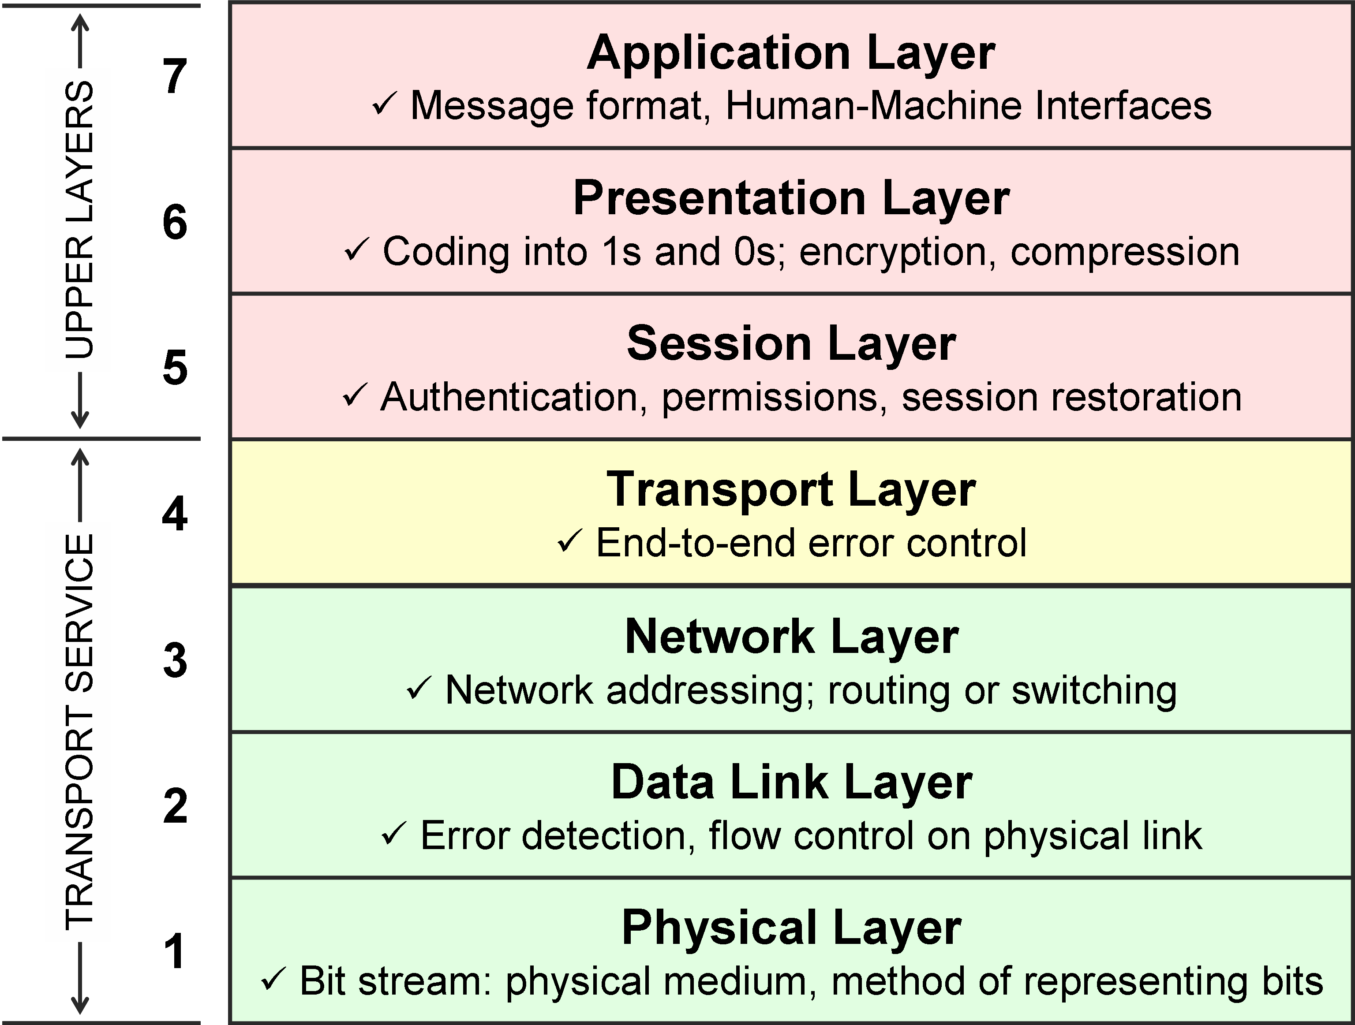
Open System Interconnection (OSI)

Slide 17
Physical Layer (Layer 1)
Physical/electrical characteristics
Cable type, length, connectors, voltage levels, signal durations, ...
Binary data (bits) as electrical or optical signals
Frequencies (wireless)

Slide 18
Wireless Characteristics
VLF = Very Low Frequency UHF = Ultra High Frequency
LF = Low Frequency SHF = Super High Frequency
MF = Medium Frequency EHF = Extra High Frequency
HF = High Frequency UV = Ultraviolet Light
VHF = Very High Frequency
Frequency and wave length
λ = c/f
wave length λ, speed of light c ≅ 3x10⁸m/s, frequency f
1 Mm
300 Hz
10 km
30 kHz
100 m
3 MHz
1 m
300 MHz
10 mm
30 GHz
100 μm
3 THz
1 μm
300 THz
VLF
LF
MF
HF
VHF
UHF
SHF
EHF
infrared
visible light
UV

Slide 19
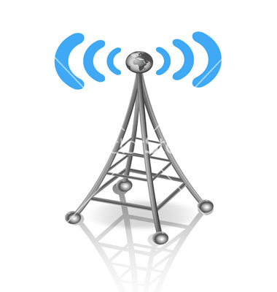
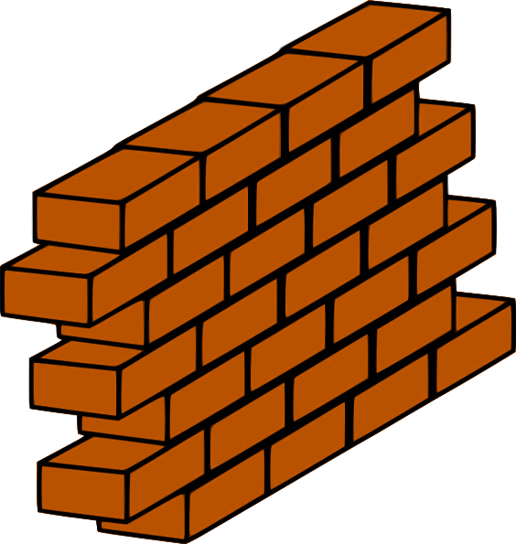
Frequencies for Mobile Communication
Low Frequencies:
low data rates
travel long distances
follow Earth’s surface
penetrate objects and water (submarine communication)
High Frequencies:
high data rates
short distances
straight lines
cannot penetrate objects (“Line of Sight” or LOS)

Slide 20
Other Propagation Effects
Shadowing
Reflection at large obstacles
Refraction depending on the density of a medium
Scattering at small obstacles
Diffraction at edges
shadowing
reflection
refraction
scattering
diffraction

Slide 21
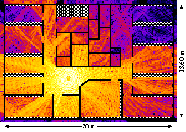
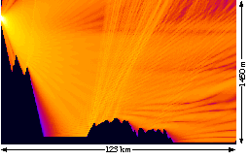
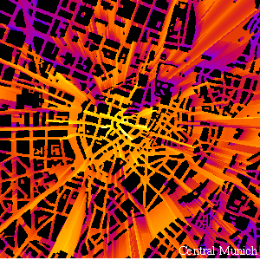
Real World Examples

Slide 22
Multipath Propagation
Signal can take many different paths between sender and receiver due to reflection, scattering, diffraction
Delay Spread
multipath
pulses
LOS pulses
signal at sender
signal at receiver

Slide 23
Digital Modulation
1
0
1
Amplitude Shift Keying (ASK):
very simple
low bandwidth requirements
very susceptible to interference
Frequency Shift Keying (FSK):
needs larger bandwidth
Phase Shift Keying (PSK):
more complex
robust against interference
t
1
0
1
t
1
0
1
t

Slide 24
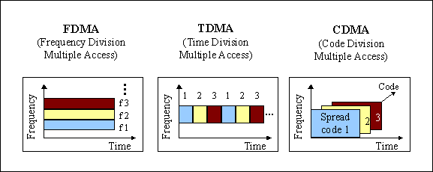
Data Link Layer (Layer 2)
Defines when/how medium will be accessed for transmission
Units typically called “frames”; error detection/correction; divided into sublayers, including: MAC = Medium Access Control (MAC address 6f:00:2b:23:1f:32)
Cell phone example:

Slide 25
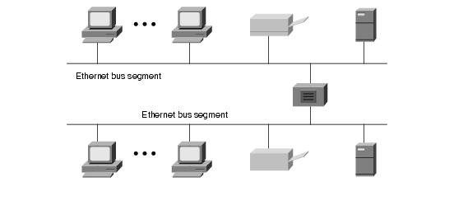
Example: Ethernet (802.3)
Most popular LAN technology, uses bus architecture
Easy to install, inexpensive
Data is broken into packets

Slide 26
Example: Ethernet
Medium Access Control (MAC) protocol
CSMA/CD Protocol
Carrier Sense
Multiple Access
Collision Detection
A
B
C
collision

Slide 27
Example: Ethernet
Don’t
transmit
A
B
C
Can collisions still occur?
“Sense” (listen) carrier (“is anyone else talking right now?”)
If “busy”: wait; if “idle”: transmit
CD: Keep listening while transmitting
If collision detected: retry at a later time

Slide 28
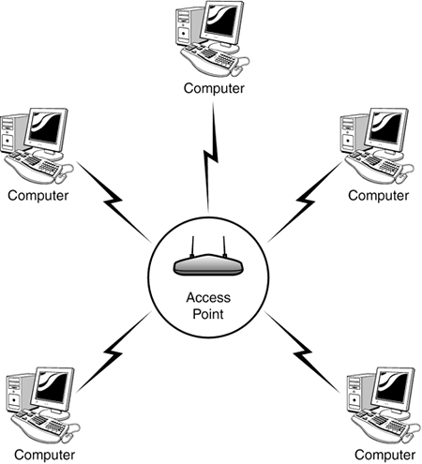
Example: Wi-Fi (802.11)
Most popular wireless LAN architecture
Access point
Wi-Fi router
Base station
Hotspot

Slide 29
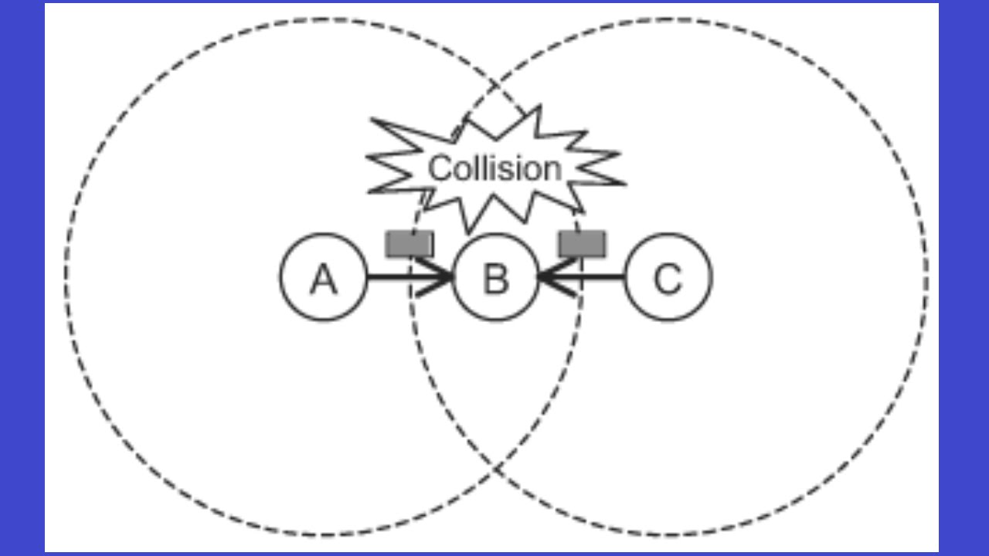
Example: Wi-Fi (802.11)
CSMA/CA Protocol
Carrier Sense
Multiple Access
Collision Avoidance
Channel reservations:
Transmitter sends request-to-send (RTS)
Receiver sends clear-to-send (CTS)
Advantages:
Nodes hearing RTS and/or CTS keep quiet
If collision, only small RTS or CTS packets are lost

Slide 30
Network Layer (Layer 3)
Dominant protocol: IP = Internet Protocol
Addressing and routing (sender & receiver IP address)
Uses 32 bit hierarchical address space with location information embedded in the structure
IPv4 address is usually expressed in dotted-decimal notation, e.g.:
128.100.11.56
Network ID
Host ID
4 bytes

Slide 31
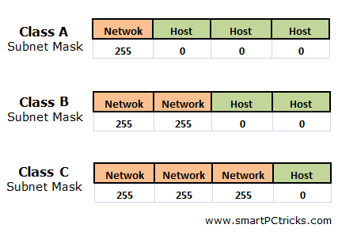
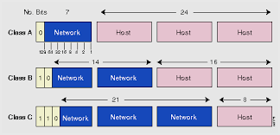
IPv4

Slide 32
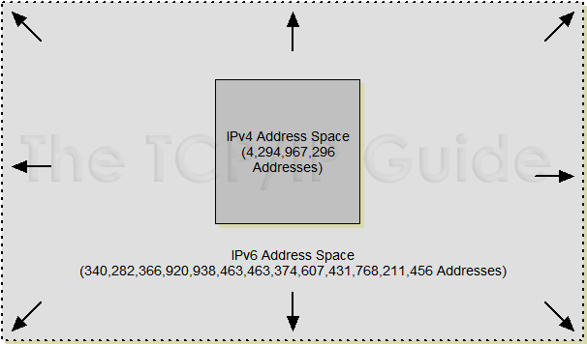
IPv6
IPv6 addresses are 128 bits long
16 bytes of IPv6 address are represented as a group of hexadecimal digits, separated by colons, e.g.:
2000:fdb8:0000:0000:0001:00ab:853c:39a1
Shorthand – leave out groups of zeros and leading zeros:
2000:fdb8:::1:ab:853c:39a1

Slide 33
Network Protocols (“Protocol Stack”)
Application
Layer
Application
Layer
Presentation
Layer
Presentation
Layer
Session
Layer
Session
Layer
Transport
Layer
Transport
Layer
Communication Network
Network
Layer
Network
Layer
Network
Layer
Network
Layer
Data Link
Layer
Data Link
Layer
Data Link
Layer
Data Link
Layer
Physical
Layer
Physical
Layer
Physical
Layer
Physical
Layer
Copyright ©2000 The McGraw Hill Companies
Figure 2.6

Slide 34
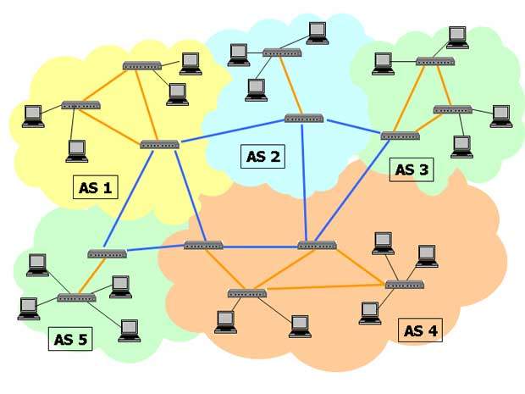
Routers
Form backbone of the Internet
Use IP layer to identify source and destination of packets
Look up routing tables that determines “next hop”
Destination | Next Hop
147.39.21.X | 131.19.18.121
89.44.X.X | 131.19.22.119
203.21.X.X | 137.18.47.48

Slide 35
Transport Layer (Layer 4)
UDP (User Datagram Protocol)
Adds more addressing: “ports”
IP address tell you which computer
Ports tell you which application on that computer
Example: a web server “listens” to requests on port 80
Web browser: http://www.google.com:80 = http://216.58.216.100:80
“:80": optional
Unreliable!
Packets can get lost; packets can arrive out of order
UDP Header
Data

Slide 36
Transport Layer
TCP (Transmission Control Protocol)
Reliable protocol!
Adds ports (just like UDP), but also provides:
In-order delivery of packets (using sequence numbers)
Reliable delivery: using acknowledgment (ACK) packets
Flow control & congestion control:
Allows receiver to slow down sender
Allows “network” to slow down sender
Packet
ACK

Slide 37
UDP vs TCP
TCP:
typical choice of most applications
do not want to lose data, out-of-order arrival, etc.
email, web traffic, financial transactions, etc.
UDP:
can be “faster”
no flow/congestion control “slowing down” traffic
no retransmissions
good for “real-time” traffic
out-of-order arrival: can also “reorder” at application level
loss of data: can be acceptable
missing frames in video/audio stream

Slide 38
Upper Layers (Layers 5-7)
Session Layer
Management of “sessions”
Presentation Layer
Data translation, formatting, encryption, compression
Application Layer
Interface between user applications and lower network services

Slide 39
Example: Web Servers
Request
HTTP
client
HTTP
server
Response

Slide 40
Example: Web Servers
HTTP
client
HTTP
server
Ephemeral
Port #
Port 80
GET 80, #
TCP
TCP
#, 80 STATUS

Slide 41
Example: Web Servers
HTTP Request
Header contains source and destination port numbers
TCP Header
Header contains source and destination IP addresses; transport protocol type
IP Header
Header contains source and destination physical addresses; network protocol type
Ethernet Header
Frame Check Sequence

Slide 42
BREAK

