Slide 1
Internet-of-Things (IoT)
Summer Engineering Program 2018
University of Notre Dame
LAB COMPONENT

Slide 2

ZigBee Protocol
ZigBee is a technological standard designed for control and sensor networks
Example of a WPAN technology
Based on the IEEE 802.15.4 Standard
Created by the ZigBee Alliance
  Global standards for reliable, cost‐effective, low power wireless applications
Development started 1998, when many engineers realized that Wi-Fi and Bluetooth were going to be unsuitable for many applications

Slide 3
ZigBee Platform
Application Profile
ZigBee Stack
Compliant Platform
IEEE 802.15.4

Slide 4
ZigBee Product
Application Profile
Certified Product
ZigBee Stack
Compliant Platform
IEEE 802.15.4

Slide 5
Characteristics
Low cost
Low power consumption
Low data rate
Relatively short transmission range
Scalability
Reliability
Flexible protocol design suitable for many applications

Slide 6
ZigBee Network Topologies
Mesh
Star
Cluster Tree
PAN coordinator
Full Function Device
Reduced Function Device

Slide 7
ZigBee Network Topologies
Star Topology
  Advantage
    Easy to synchronize
    Low latency
  Disadvantage
    Small scale

Slide 8
ZigBee Network Topologies
Mesh Topology
  Advantage
    Robust multihop communication
    Network is more flexible
    Lower latency
  Disadvantage
    Route discovery is costly
    Needs storage for routing table

Slide 9
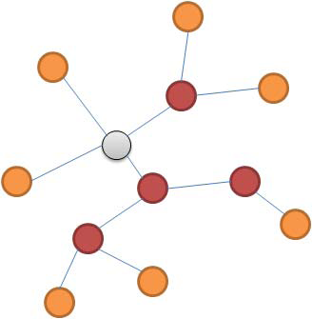
ZigBee Network Topologies
Cluster Tree
  Advantage
    Low routing cost
    Allow multihop communication
  Disadvantage
    Route reconstruction is costly
    Latency may be quite long

Slide 10
Sensor/Control Network Requirements
Networks form by themselves, scale to large sizes and operate for years without manual intervention
Extremely long battery life (years on AA cell),
  low infrastructure cost (low device & setup costs)
  low complexity and small size
Low device data rate and QoS (Quality-of-Service)
Standardized protocols allow multiple vendors to interoperate

Slide 11
Basic Network Characteristics
65,536 network (client) nodes
27 channels over 2 bands
250Kbps data rate
Optimized for time-critical applications and power management
Full mesh networking support
Network coordinator
Full Function node
Reduced Function node

Slide 12
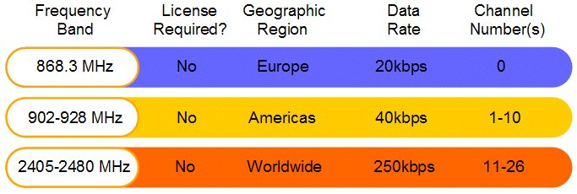
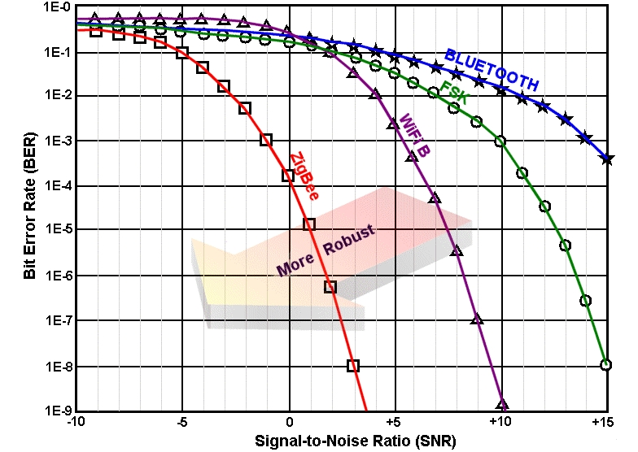
Basic Radio Characteristics
ZigBee technology relies upon IEEE 802.15.4, which has excellent performance in low SNR environments

Slide 13

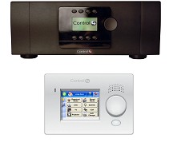
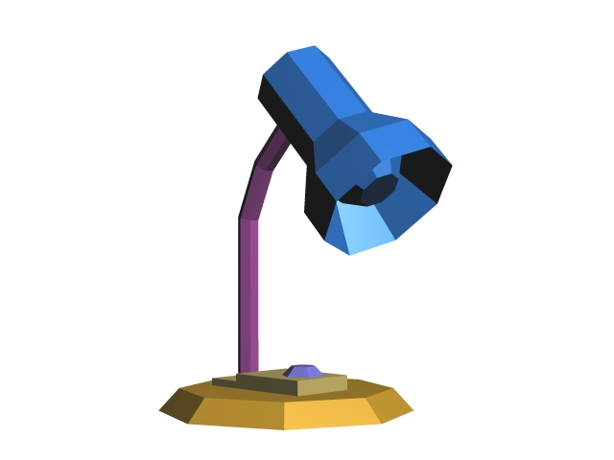
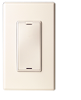
ZigBee Mesh Networking
Slide Courtesy of

Slide 14
ZigBee Mesh Networking
Slide Courtesy of

Slide 15
ZigBee Mesh Networking
Slide Courtesy of

Slide 16
ZigBee Mesh Networking
Slide Courtesy of

Slide 17
ZigBee Mesh Networking
Slide Courtesy of

Slide 18
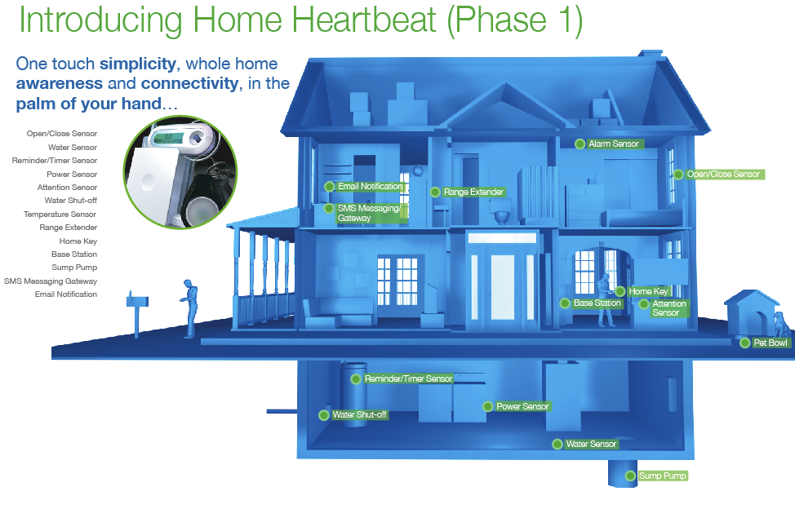
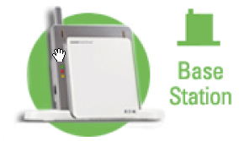


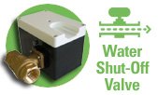
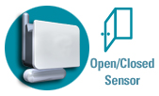


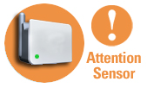

Home Awareness
Home Heartbeat

Slide 19
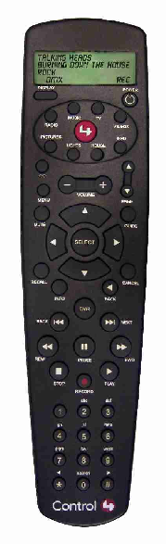
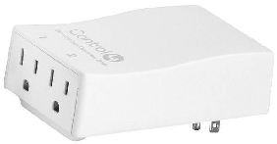

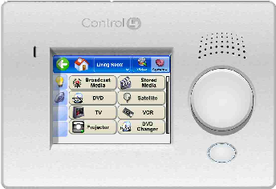


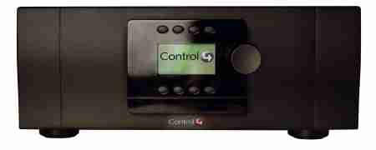
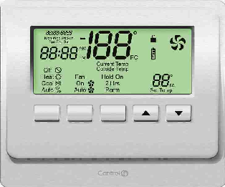

Home Entertainment & Control

Slide 20
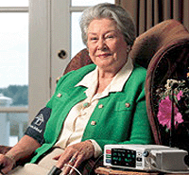

In-Home Patient Monitoring
Patients receive better care at reduced cost with more freedom and comfort:
  Patients can remain in their own home
    Monitors vital statistics and sends via internet
    Doctors can adjust medication levels
  Allows monitoring of elderly family member
    Sense movement or usage patterns in a home
    Turns lights on when they get out of bed
    Notify via mobile phone when anomalies occur
    Wireless panic buttons for falls or other problems
  Can also be used in hospital care
    Patients are allowed greater movement
    Reduced staff to patient ratio
graphic
graphic

Slide 21

Commercial Lighting Control
Wireless lighting control
  Dimmable intelligent ballasts
  Light switches/sensors anywhere
  Customizable lighting schemes
  Quantifiable energy savings
  Opportunities in residential, light commercial and commercial
Extendable networks
  Lighting network can be integrated with and/or be used by other building control solutions

Slide 22
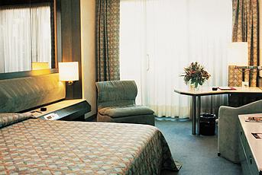
HVAC Energy Management
Hotel energy management
  Centralized HVAC management allow hotel operator to ensure empty rooms are not cooled
  Easy to retrofit
  Battery operated thermostats, occupancy detectors, humidistats can be placed for convenience
  Personalized room settings at check-in

Slide 23
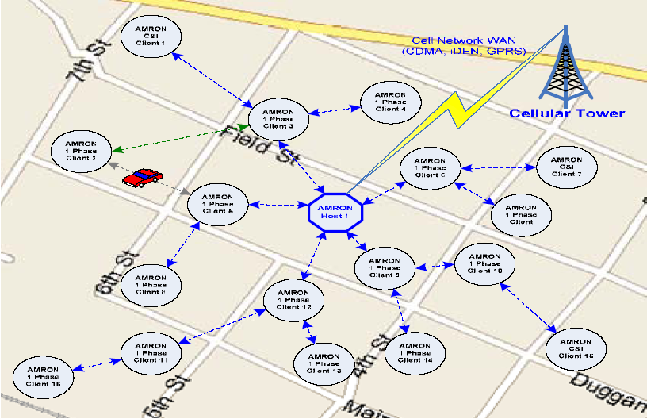
AMR Network Example

Slide 24
Advanced Metering with ZigBee
Rapid method to help manage global electric generation shortage and meet existing and pending legislation for energy control
Can network with other ZigBee devices in the home for load control – e.g. Heating/AC, Security, Lighting, White Goods
Worldwide standard ZigBee allows communications between various meter types from different manufacturers.

Slide 25
ZigBee and Bluetooth Comparison
Feature(s) | Bluetooth | ZigBee
Power Profile | days | years
Complexity | complex | Simple
Nodes/Master | 7 | 64000
Latency | 10 seconds | 30 ms – 1s
Range | 10m | 70m ~ 300m
Extendibility | no | Yes
Data Rate | 1 Mbps | 250 Kbps
Security | 64bit, 128bit | 128bit AES and Application Layer

Slide 26
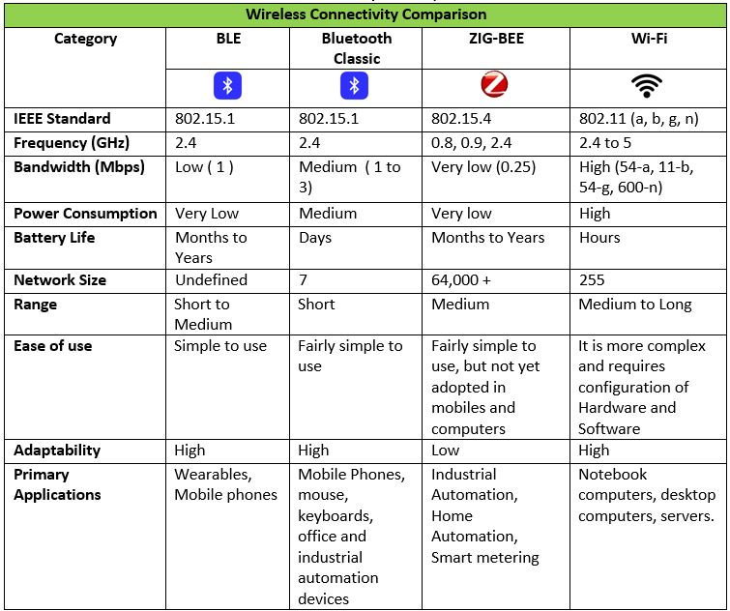
Comparison ZigBee & BLE

Slide 27
Assignment 3
Task 1: Configure Bluetooth
Task 2: Write a client-server based intruder detection system using 2 Pis, a PIR sensor, and an LED (and/or sounder)
  One Pi acts as server and uses a callback function that triggers when motion is detected
  The other Pi acts as client and queries the server for the PIR value once every 5 seconds; if an intrusion is detected, the alarm is raised
  Test both your client AND server program with the help of one (or more) of your classmates

Slide 28
Assignment 3 Deliverables
By Friday midnight submit a report showing clearly your client and server programs
Indicate your Bluetooth address
Indicate if you ran into any problems during development or if any parts are incomplete/etc.
Provide a brief video (no longer than 30 seconds each) that shows your Pi and your classmate‘s Pi work together as intrusion detection system
Summary: there are two documents for this assignment: one PDF report (with code) and one video

Slide 29
Bluetooth Preparation
Make sure Internet sharing is w0rking (e.g., ping a remote IP address)
Install the Bluez Bluetooth module on your Pi:
  sudo apt-get update
  sudo apt-get install python-bluez
Configure Bluetooth:
  sudo bluetoothctl
    type: agent on
    type: default-agent
    type: scan on
    type: quit
Activate scanning:
  sudo hciconfig hci0 piscan
  This call needs to be done after each reboot of the Pi!
If needed, you can find your Pi‘s BT address using the following command:
  hciconfig (the address format is: XX:XX:XX:XX:XX:XX)

Slide 30
Bluetooth Server Template
import bluetooth
hostMACAddress = ''
port = 3
backlog = 1
size = 1024
s = bluetooth.BluetoothSocket(bluetooth.RFCOMM)
s.bind((hostMACAddress, port))
s.listen(backlog)
try:
client, clientInfo = s.accept()
while 1:
data = client.recv(size)
if data:
print(data)
client.send("Returning: " + data)
except:
client.close()
s.close()

Slide 31
Bluetooth Client Template
import bluetooth
serverMACAddress = ‘XX:XX:XX:XX:XX:XX'
port = 3
size = 1024
s = bluetooth.BluetoothSocket(bluetooth.RFCOMM)
s.connect((serverMACAddress, port))
while 1:
text = raw_input("Text to send: ")
if text == "quit":
break
s.send(text)
data = s.recv(size)
print(data)
s.close()

Slide 32
Notes
The client specifies the address of the server
The server specifies an empty address (the server will find its BT adapter address by itself)
The port number can be changed, but must be the same in both client & server
The size value indicates the maximum size of a data transfer

Slide 33
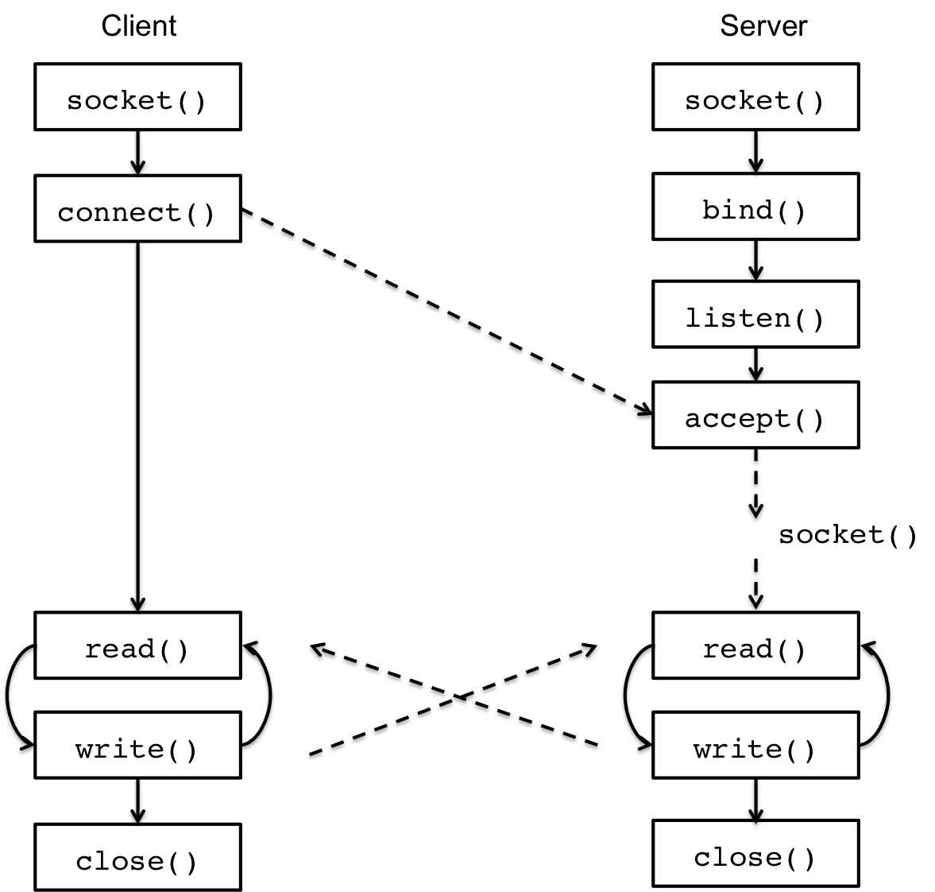
Client/Server Communication

