Slide 1
Internet-of-Things (IoT)
Summer Engineering Program 2018
University of Notre Dame

Slide 2
Course Overview
 | Lecture | Lab
Week 1 | Fundamentals of IoT, basic concepts, applications | Basic Python programming, meet your Raspberry Pi
Week 2 | Smart objects, user interfaces, sensing, actuation | Sensor programming, control loops, digital/analog I/O
Week 3 | Fundamentals of computer and wireless networks | Wi-Fi and Bluetooth networks, network measurements
Week 4 | Sensor networks, mesh networks, routing, WPANs | ZigBee, WPANs, WBANs, routing, network measurements
Week 5 | Processing, IoT cloud, analytics, visualization | IoT cloud integration, sensor fusion, analytics, visualization
Week 6 | IoT ecosystem, security, privacy, ethics, trends, case studies | Final project

Slide 3
Wi-Fi
Wi-Fi:
  name is NOT an abbreviation
  play on “Hi-Fi” (high fidelity)
Wireless Local Area Network (WLAN) technology
WLAN and Wi-Fi often used synonymous
Typically in 2.4 and 5 GHz bands
Based on IEEE 802.11 family of standards

Slide 4
IEEE
IEEE (Institute of Electrical and Electronics Engineers) established the 802.11 Group in 1990. Specifications for standard ratified in 1997.
Initial speeds were 1 and 2 Mbps.
IEEE modified the standard in 1999 to include:
  802.11b
  802.11a
  802.11g
  802.11n
  802.11ac

Slide 5
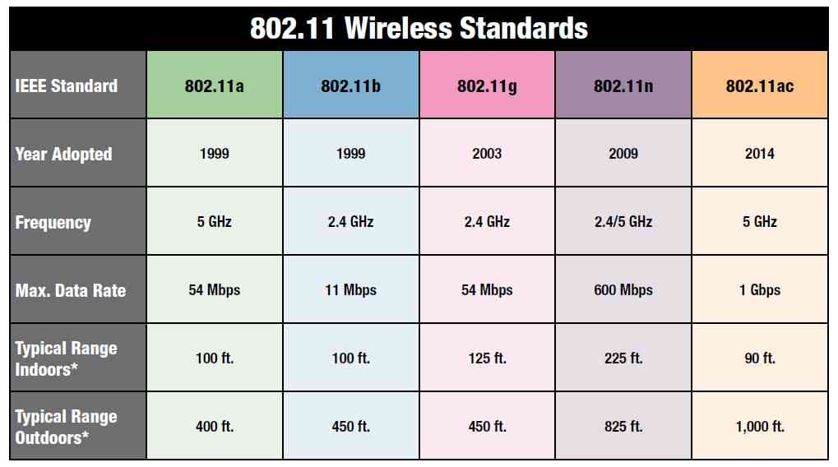
WLAN (Wi-Fi)

Slide 6
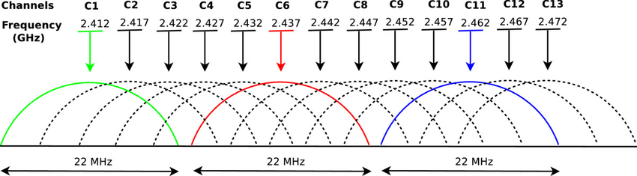
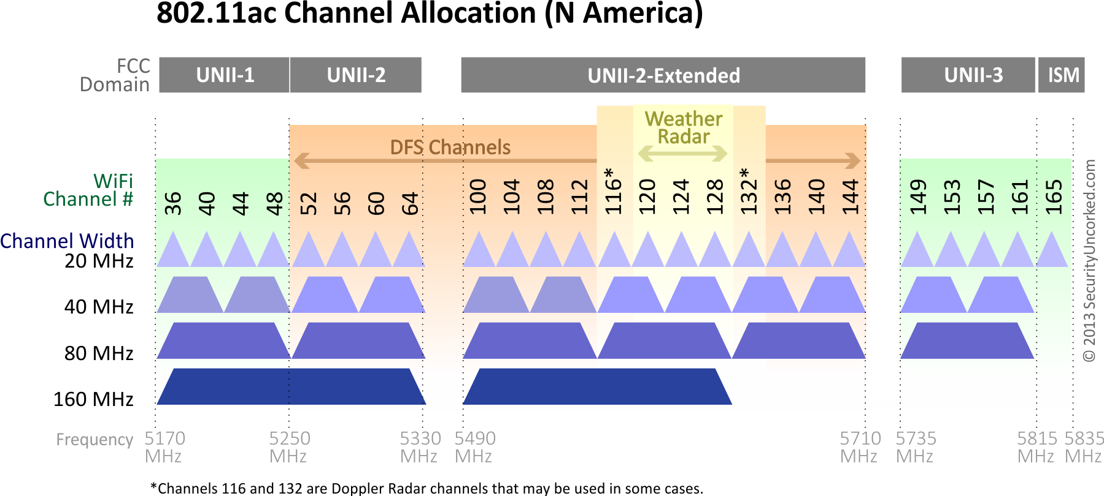
Wi-Fi Channels

Slide 7
802.11 - Architecture of an Infrastructure Network
Station (STA)
  terminal with access mechanisms to the wireless medium and radio contact to the access point
Basic Service Set (BSS)
  group of stations using the same radio frequency
Access Point
  station integrated into the wireless LAN and the distribution system
Portal
  bridge to other (wired) networks
Distribution System
  interconnection network to form one logical network (ESS: Extended Service Set) based on several BSS
802.11 LAN
802.x LAN
STA₁
BSS₁
Access
Point
Portal
Distribution System
ESS
Access
Point
BSS₂
STA₂
802.11 LAN
STA₃

Slide 8
Wi-Fi (802.11)
BSS 1
BSS 2
BSS 1
BSS 2
AP 1
AP 2
AP 1
1
AP 2
1
1
2
2
2
3
3
4
H1
H1
Passive Scanning
Beacons sent from APs
Association Request sent from H1 to selected AP
Association Response sent from AP to H1
Active Scanning
Probe Request (broadcast) sent from H1
Probe Response sent from APs
Association Request sent from H1 to selected AP
Association Response sent from AP to H1

Slide 9
Wi-Fi Alliance Mission Statement
Non-profit organization
Certify the interoperability of products and services based on IEEE 802.11 technology
Grow the global market for Wi-Fi® CERTIFIED products and services across all market segments, platforms, and applications
Rigorous interoperability testing requirements

Slide 10
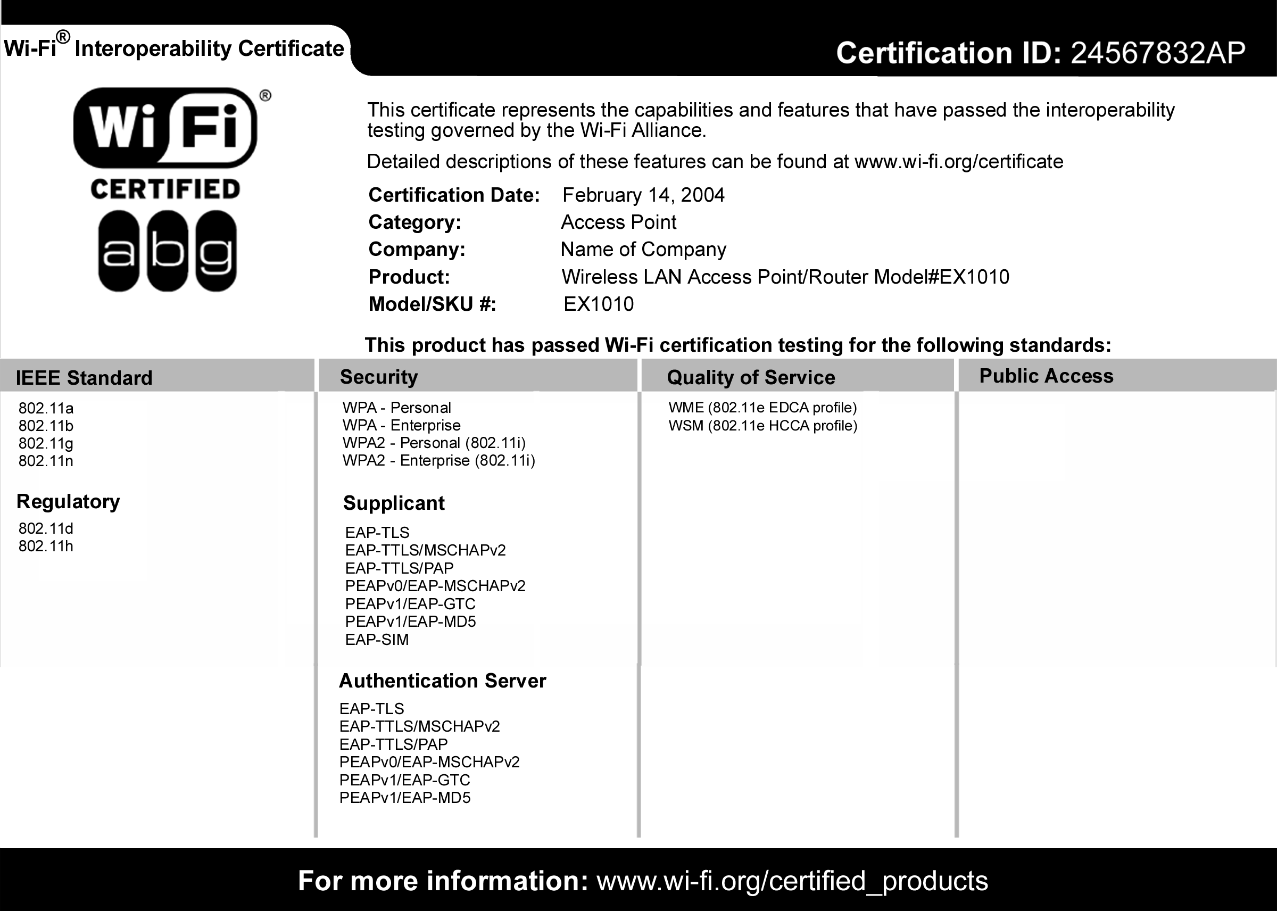
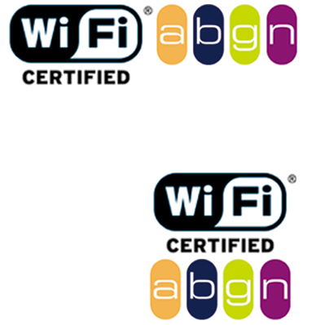

Certificate & Logo
Logo on product packaging (mandatory)
Helps retailers and consumers
Certificate inside packaging (optional)

Slide 11
Infrastructure vs. Ad-Hoc Networks
infrastructure
network
AP: Access Point
AP
AP
wired network
AP
ad-hoc network

Slide 12
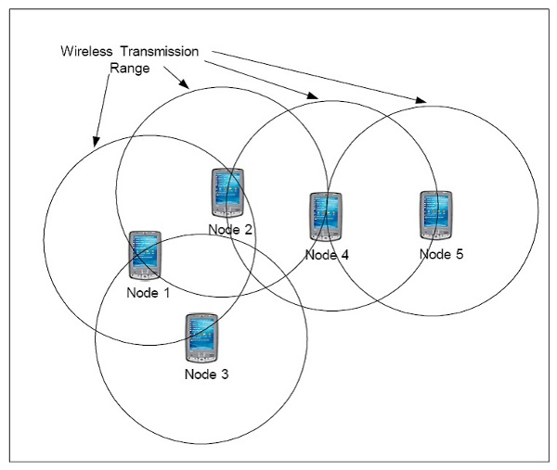
Infrastructure-Less (Ad-Hoc)
Ad-hoc means ‘for this purpose’
No need for infrastructure (like routers, cell towers, etc.)
MANET: Mobile Ad-Hoc Network

Slide 13
Routing
Packets may need to traverse multiple links to reach destination
Mobility causes route changes

Slide 14
Ad-Hoc Routing Protocol
An ad-hoc routing protocol is a convention that controls how nodes decide which way to route packets between computing devices in a mobile ad-hoc network
Foundation in most protocols: neighbor discovery
  Nodes send periodic announcements as broadcast packets (beacon messages, alive messages, …)
  Can embed “neighbor table” into such messages; allows nodes to learn “2-hop neighborhood”
Popular types of routing protocols:
  Proactive
  Reactive
  Geographic

Slide 15
Proactive: “Link-State” Algorithms
Each node shares its link information so that all nodes can build a map of the full network topology
Link
Link
A-B
A-B
B-C
B-C
Link
C-D
C-D
A-B
A
C
D
B-C
C-D
Assuming the topology is stable for a sufficiently long period, all nodes will have the same topology information
B
Link
A-B
B-C
C-D

Slide 16
Proactive: “Link-State” Algorithms
Link
Link information is updated when a link changes state (goes up or down)
  by sending small “hello” packets to neighbors
Nodes A and C propagate the existence of link A-C to their neighbors and, eventually, to the entire network
A-B
A-C
B-C
Link
A-C
C-D
A-C
Link
A-B
A-B
A-C
A
C
D
A-C
B-C
B-C
C-D
C-D
A-C
B
Link
A-B
A-C
B-C
C-D

Slide 17
Reactive: DSR
Dynamic Source Routing
Search for route when needed only
  Search using Route Request (RREQ) broadcasts
  Response using Route Reply (RREP) message
Every message along route contains entire path to help intermediate nodes to decide what to do with message

Slide 18

Route Discovery in DSR
Y
Z
S
E
F
B
C
M
L
J
A
G
H
D
K
I
N
Represents a node that has received RREQ for D from S

Slide 19
Route Discovery in DSR
Y
Broadcast transmission
[S]
Z
S
E
F
B
C
M
L
J
A
G
H
D
K
I
N
Represents transmission of RREQ
[X,Y] Represents list of identifiers appended to RREQ

Slide 20
Route Discovery in DSR
Y
Z
S
E
[S,E]
F
B
C
M
L
J
A
[S,C]
G
H
D
K
I
N
Node H receives packet RREQ from two neighbors:
potential for collision

Slide 21
Route Discovery in DSR
Y
Z
S
E
F
[S,E,F]
B
C
M
L
J
A
G
H
D
K
I
[S,C,G]
N
Node C receives RREQ from G and H, but does not forward
it again, because node C has already forwarded RREQ once

Slide 22
Route Discovery in DSR
Y
Z
S
E
F
[S,E,F,J]
B
C
M
L
J
A
G
H
D
K
I
[S,C,G,K]
N
Nodes J and K both broadcast RREQ to node D
Since nodes J and K are hidden from each other, their
transmissions may collide

Slide 23
Route Discovery in DSR
Y
Z
S
E
F
[S,E,F,J,M]
B
C
M
L
J
A
G
H
D
K
I
N
Node D does not forward RREQ, because node D
is the intended target of the route discovery

Slide 24
Route Reply in DSR
Y
Z
S
E
RREP [S,E,F,J,D]
F
B
C
M
L
J
A
G
H
D
K
I
N
Represents RREP control message

Slide 25
Data Delivery in DSR
Y
DATA [S,E,F,J,D]
Z
S
E
F
B
C
M
L
J
A
G
H
D
K
I
N
Packet header size grows with route length

Slide 26
Proactive vs Reactive
Reactive:
  Only establish/maintain routes between nodes needed them (in contrast: tables store ALL routes)
  Store entire route in each message; message size grows with route length
  Route requests cause “flooding”
Proactive:
  Route information always available; no need to search for route (but route information can be outdated)
  Continuous exchange of route change updates

Slide 27
Geographic Routing
Nodes use location information to make routing decisions
  sender must know the locations of itself, the destination, and its neighbors
  location information can be queried or obtained from a location broker
  location information can come from GPS (Global Positioning System) or some other form of positioning technology

Slide 28
Unicast Location-Based Routing
One single destination
Each forwarding node makes localized decision based on the location of the destination and the node’s neighbors (greedy forwarding)
Challenge: packet may arrive at a node without neighbors that could bring packet closer to the destination (voids or holes)

Slide 29
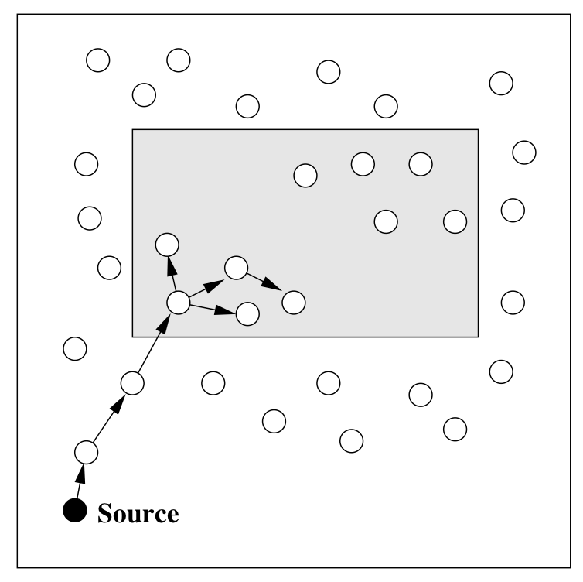
Geocasting
Packet is sent to all or some nodes within specific geographic region
Example: query sent to all sensors within geographic area of interest
Routing challenge:
  propagate a packet near the target region (similar to unicast routing)
  distribute packet within the target region (similar to flooding)

Slide 30

BREAK

