Slide 1
Internet-of-Things (IoT)
Summer Engineering Program 2018
University of Notre Dame

Slide 2
Course Overview
 | Lecture | Lab
Week 1 | Fundamentals of IoT, basic concepts, applications | Basic Python & Raspberry Pi programming
Week 2 | Human-computer interfaces, sensing, actuation | Sensor programming, control loops, digital/analog I/O
Week 3 | Fundamentals of computer and wireless networks | Wi-Fi and Bluetooth networks, network measurements
Week 4 | Sensor networks, mesh networks, routing, WPANs | ZigBee, WPANs, WBANs, routing, network measurements
Week 5 | Processing, IoT cloud, analytics, visualization | IoT cloud integration, sensor fusion, analytics, visualization
Week 6 | RFID, IoT ecosystem, security, privacy, ethics, case studies | Final project

Slide 3
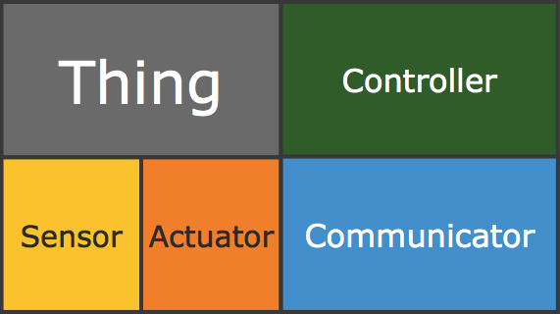
INTERNET of Things
IoT EcoSystem
Weeks 5&6
Week 1
Week 1
Week 2
Week 2
Weeks 3&4

Slide 4
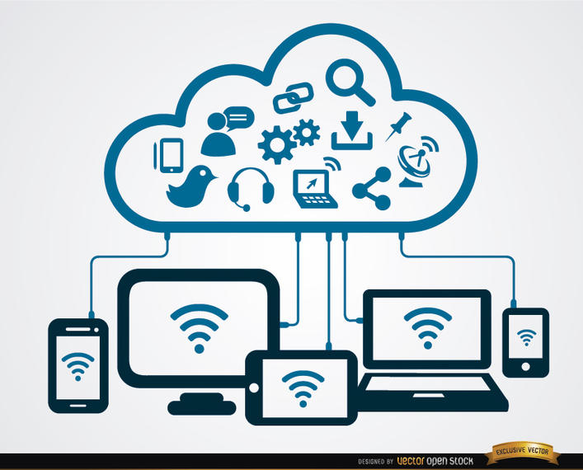
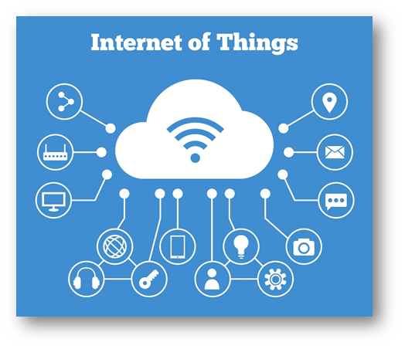
What is Cloud Computing?

Slide 5
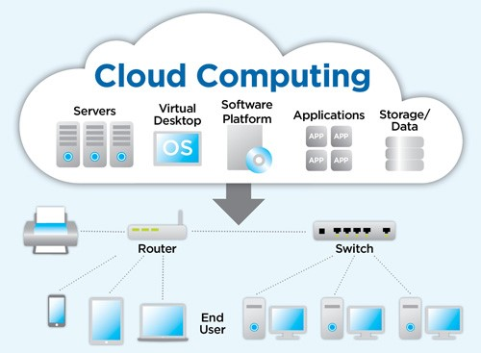
What is Cloud Computing?
Delivery of computing services
servers
storage
analytics
databases
networking
and much more...
Another definition: network-based computing taking place over the Internet, while hiding complexity of underlying infrastructure using simple APIs

Slide 6
What is Cloud Computing?
Collection/group of integrated and networked hardware, software, and Internet infrastructure (called a platform)
Platforms provide on demand services that are always on and accessible anytime and anywhere

Slide 7
What is Cloud Computing?
Advantages:
New applications
Anytime/anywhere access
Homogeneity
Virtualization
Resilient
Cost
Sharing, collaboration
Management/maintenance
Security
…

Slide 8
Cloud Models: IaaS, PaaS, SaaS

Slide 9
Definitions
Virtualization: creation of a virtual resource such as a server, desktop, operating system, file, storage, or network
Middleware: software that acts as a bridge between an operating system or database and applications, especially on a network
Runtime: software designed to support the execution of computer programs

Slide 10
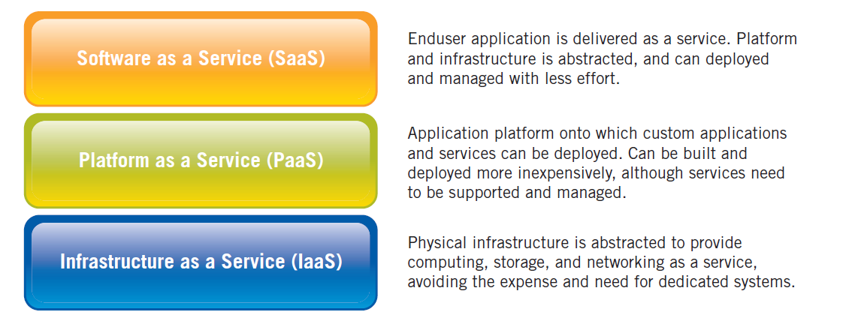
IaaS, PaaS, SaaS
Simple example:
IaaS: barebones computer
PaaS: computer + OS (incl. development environment)
SaaS: complete solution including application(s)

Slide 11
IaaS, PaaS, SaaS
IaaS: Amazon Web Services (AWS), Microsoft Azure, Google Compute Engine
PaaS: Google App Engine, Heroku, OpenShift, AWS Elastic Beanstalk
SaaS: Google Apps, Dropbox, Cisco Webex, Salesforce, Concur, GoToMeeting

Slide 12
Basic Cloud Characteristics
“No-need-to-know”: interact with underlying infrastructure via API
Flexibility and elasticity: scale systems up and down (allocate/release resources) based on needs
Pay as much as used and needed (actual usage vs. service levels)
Anytime anywhere access

Slide 13
Virtualization
Virtual workspaces:
An abstraction of an execution environment that can be made dynamically available to authorized clients by using well-defined protocols
Resource quota (e.g., CPU, memory share)
Software configuration (e.g., OS, provided services)
Implemented on Virtual Machines (VMs):
Abstraction of a physical host machine
Hypervisor intercepts and emulates instructions from VMs, and allows management of VMs
VMWare, Xen, etc.
App
App
App
OS
OS
OS
Hypervisor
Hardware
Virtualized Stack

Slide 14
Virtual Machines
App
App
App
App
App
Xen
Guest OS
(Linux)
Guest OS
(NetBSD)
Guest OS
(Windows)
VMWare
VM
VM
VM
Virtual Machine Monitor (VMM) / Hypervisor
UML
Denali
Hardware
etc.

Slide 15
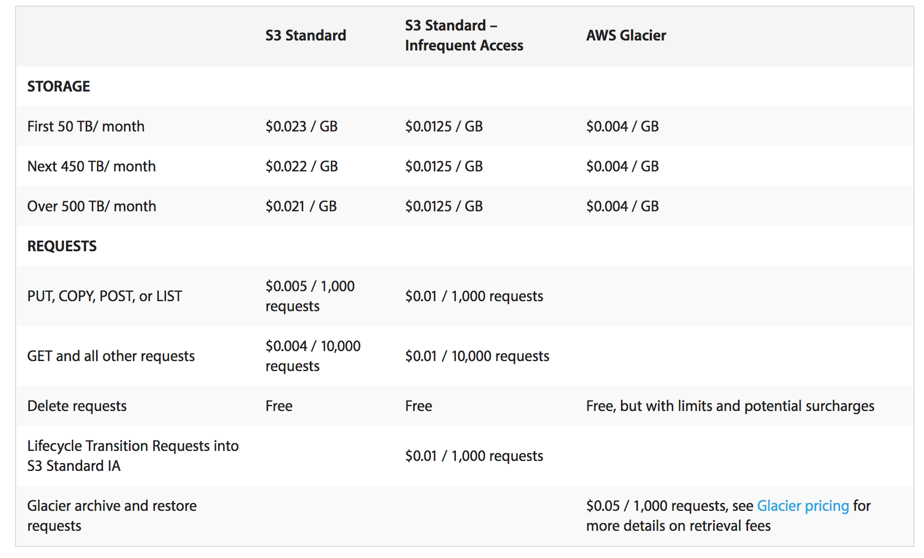
Cloud Example: S3
Amazon Simple Storage Service (S3)
Unlimited storage
Pay for what you use

Slide 16
Cloud Example: EC2
Amazon Elastic Compute Cloud (EC2)
Virtual computing environments (“instances”)
Pre-configured templates for instances
Launch as many virtual servers as needed (“elastic”)
Xen and KVM hypervisor

Slide 17
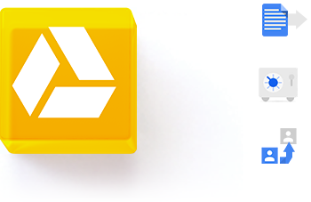
Do You Use The Cloud?

Slide 18
Cloud for IoT

Slide 19
HyperText Transfer Protocol (HTTP)
Clients and servers communicate using the HyperText Transfer Protocol (HTTP)
Client and server establish TCP connection
Client requests content
Server responds with requested content
Client and server close connection (usually)
Web
client
(browser)
HTTP request
Web
server
HTTP response
(content)

Slide 20
Web Content
Web servers return content to clients
a sequence of bytes with an associated MIME (Multipurpose Internet Mail Extensions) type
Example MIME types
text/html HTML document
text/plain Unformatted text
application/postscript Postcript document
image/gif Binary image encoded in GIF format
image/jpeg Binary image encoded in JPEG format

Slide 21
Static & Dynamic Content
The content returned in HTTP responses can be either static or dynamic
Static content: content stored in files and retrieved in response to an HTTP request
Examples: HTML files, images, audio clips
Dynamic content: content produced on-the-fly in response to an HTTP request
Example: content produced by a program executed by the server on behalf of the client
Bottom line: all web content is associated with a file that is managed by the server

Slide 22
URLs
Each file managed by a server has a unique name called a URL (Universal Resource Locator)
URLs for static content:
http://www.cse.nd.edu:80/index.html
http://www.cse.nd.edu/index.html
http://www.cse.nd.edu
Identifies a file called index.html, managed by a web server at www.cse.nd.edu that is listening on port 80
URLs for dynamic content:
http://www.cse.nd.edu:8000/cgi-bin/adder?15000&213
Identifies an executable file called adder, managed by a web server at www.cse.nd.edu that is listening on port 8000, that should be called with two argument strings: 15000 and 213

Slide 23
Anatomy of an HTTP Transaction
unix> telnet www.aol.com 80 Client: open connection to server
Trying 205.188.146.23... Telnet prints 3 lines to the terminal
Connected to aol.com.
Escape character is '^]'.
GET / HTTP/1.1 Client: request line
host: www.aol.com Client: required HTTP/1.1 HOST header
Client: empty line terminates headers.
HTTP/1.0 200 OK Server: response line
MIME-Version: 1.0 Server: followed by five response headers
Date: Mon, 08 Jan 2001 04:59:42 GMT
Server: NaviServer/2.0 AOLserver/2.3.3
Content-Type: text/html Server: expect HTML in the response body
Content-Length: 42092 Server: expect 42,092 bytes in the resp body
Server: empty line (“\r\n”) terminates hdrs
<html> Server: first HTML line in response body
... Server: 766 lines of HTML not shown.
</html> Server: last HTML line in response body
Connection closed by foreign host. Server: closes connection
unix> Client: closes connection and terminates

Slide 24
HTTP Requests
HTTP request is a request line, followed by zero or more request headers
Request line: <method> <uri> <version>
<version> is HTTP version of request (HTTP/1.0 or HTTP/1.1)
<uri> is typically URL for proxies, URL suffix for servers
<method> is either GET, POST, OPTIONS, HEAD, PUT, DELETE, or TRACE

Slide 25
HTTP Requests
HTTP methods:
GET: Retrieve static or dynamic content
Arguments for dynamic content are in URI
Workhorse method (99% of requests)
POST: Retrieve dynamic content
Arguments for dynamic content are in the request body
OPTIONS: Get server or file attributes
HEAD: Like GET but no data in response body
PUT: Write a file to the server
DELETE: Delete a file on the server
TRACE: Echo request in response body
Useful for debugging

Slide 26
HTTP Responses
HTTP response is a response line followed by zero or more response headers
Response line:
<version> <status code> <status msg>
<version> is HTTP version of the response
<status code> is numeric status
<status msg> is corresponding English text
200 OK Request was handled without error
403 Forbidden Server lacks permission to access file
404 Not found Server couldn’t find the file
Response headers: <header name>: <header data>
Provide additional information about response
Content-Type: MIME type of content in response body
Content-Length: Length of content in response body

Slide 27
REST
Representational State Transfer (REST)
A style of software architecture for distributed hypermedia systems such as the World Wide Web
A collection of network architecture principles which outline how resources are defined and addressed

Slide 28
REST & HTTP
The motivation for REST was to capture the characteristics of the Web which made the Web successful
URI Addressable resources
HTTP Protocol
Make a Request – Receive Response – Display Response
Exploits the use of the HTTP protocol beyond HTTP POST and HTTP GET
HTTP PUT, HTTP DELETE

Slide 29
REST
REST is not a standard
is an architectural style
But it uses several standards:
HTTP
URL
XML/HTML/GIF/JPEG/etc (Resource Representations)
text/xml, text/html, image/gif, image/jpeg, etc (Resource Types, MIME Types)

Slide 30
REST Main Concepts
Nouns (Resources) unconstrained i.e., http://example.com/employees/12345
REST
Verbs constrained i.e., GET
Representations constrained i.e., XML

Slide 31
Resources
The key abstraction of information in REST is a resource
A resource is a conceptual mapping to a set of entities
Any information that can be named can be a resource: a document or image, a temporal service (e.g., “today's weather in Berlin”), a collection of other resources, a non-virtual object (e.g., a person), etc.
Represented with a global identifier (URI in HTTP)
http://www.boeing.com/aircraft/747

Slide 32
Naming Resources
REST uses URI to identify resources
http://localhost/books/
http://localhost/books/ISBN-0011
http://localhost/books/ISBN-0011/authors
http://localhost/classes
http://localhost/classes/cs2650
http://localhost/classes/cs2650/students
As you traverse the path from more generic to more specific, you are navigating the data

Slide 33
Verbs
Represent the actions to be performed on resources
HTTP GET
HTTP POST
HTTP PUT
HTTP DELETE

Slide 34
HTTP GET
How clients ask for the information they seek
Issuing a GET request transfers the data from the server to the client in some representation
GET http://localhost/books
Retrieve all books
GET http://localhost/books/ISBN-0011021
Retrieve book identified with ISBN-0011021
GET http://localhost/books/ISBN-0011021/authors
Retrieve authors for book identified with ISBN-0011021

Slide 35
HTTP PUT & POST
HTTP POST creates a resource
HTTP PUT updates a resource
POST http://localhost/books/
Content: {title, authors[], …}
Creates a new book with given properties
PUT http://localhost/books/isbn-111
Content: {isbn, title, authors[], …}
Updates book identified by isbn-111 with submitted properties

Slide 36
Representations
How data is represented or returned to the client for presentation.
Two main formats:
JavaScript Object Notation (JSON)
XML
It is common to have multiple representations of the same data

Slide 37
Representations
XML
<COURSE>
<ID>CS2650</ID>
<NAME>Distributed Multimedia Software</NAME>
</COURSE>
JSON
{course
{id: CS2650}
{name: Distributed Multimedia Software}
}

Slide 38
CoAP
Constrained Application Protocol
REST-based web transfer protocol
manipulates Web resources using the same methods as HTTP: GET, PUT, POST, and DELETE
subset of HTTP functionality re-designed for low power embedded devices such as sensors (for IoT and M2M)

Slide 39
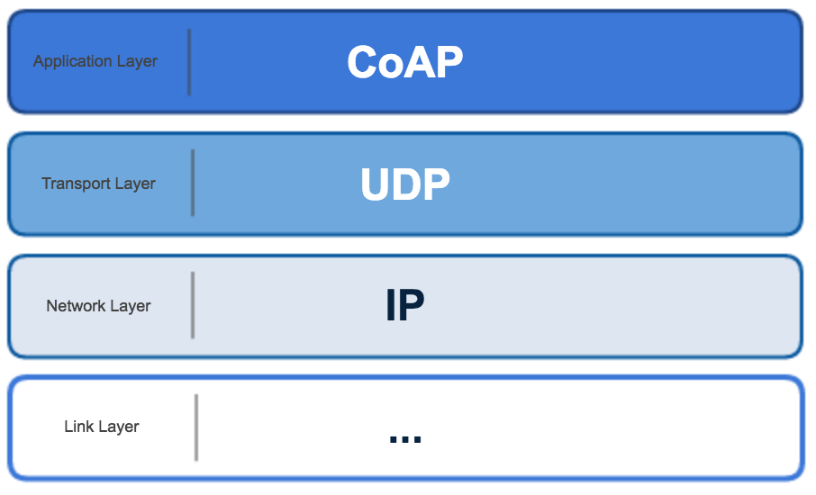
CoAP
TCP overhead is too high and its flow control is not appropriate for short-lived transactions
UDP has lower overhead and supports multicast

Slide 40
CoAP
Four message types:
Confirmable – requires an ACK
Non-confirmable – no ACK needed
Acknowledgement – ACKs a Confirmable
Reset - indicates a Confirmable message has been received but context is missing for processing

Slide 41
CoAP
CoAP provides reliability without using TCP as transport protocol
CoAP enables asynchronous communication
e.g., when CoAP server receives a request which it cannot handle immediately, it first ACKs the reception of the message and sends back the response in an off-line fashion
Also supports multicast and congestion control

Slide 42
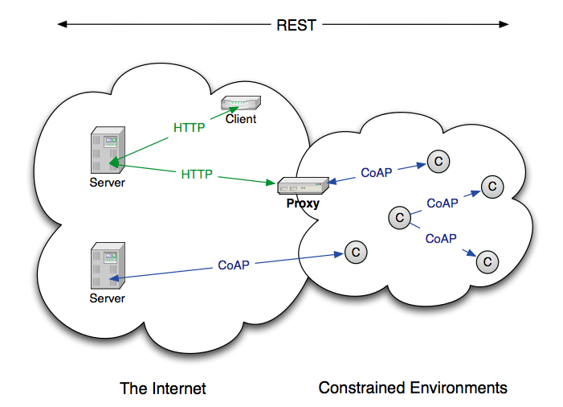
CoAP

Slide 43
What CoAP Is
CoAP is
A RESTful protocol
Both synchronous and asynchronous
For constrained devices and networks
Specialized for M2M applications
Easy to proxy to/from HTTP

Slide 44
BREAK

Slide 45
MQTT
Message Queuing Telemetry Transport
In a nutshell, MQTT consist of three parts:
Broker
Subscribers
Publishers

Slide 46
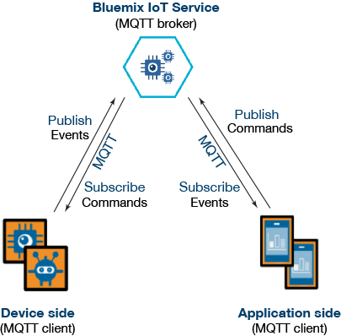
MQTT

Slide 47
MQTT
MQTT was invented by Andy Stanford-Clark (IBM) and Arlen Nipper (Arcom, now Cirrus Link) back in 1999, where their use case was to create a protocol for minimal battery loss and minimal bandwidth connecting oil pipelines over satellite connections. They specified the following goals, which the future protocol should have:
Simple to implement
Provide a Quality of Service Data Delivery
Lightweight and Bandwidth Efficient
Data Agnostic
Continuous Session Awareness

Slide 48
MQTT
Built for proprietary embedded systems; now shifting to IoT
You can send anything as a message; up to 256 MB
Built for unreliable networks
Enterprise scale implementations down to hobby projects
Decouples readers and writers
Message have a topic, quality of service, and retain status associated with them

Slide 49
Publish/Subscribe Concept
Decoupled in space and time:
The clients do not need each others
IP address and port (space) and
they do not need to be running at
the same time (time).
The broker’s IP and port must be
known by clients
Namespace hierarchy used for
topic filtering
It may be the case that a published
message is never consumed by any
subscriber

Slide 50
MQTT: Example
Clients connect to a “Broker”
Clients subscribe to topics e.g.,
client.subscribe(‘toggleLight/1’)
client.subscribe(‘toggleLight/2’)
client.subscribe(‘toggleLight/3’)
Clients can publish messages to topics:
client.publish(‘toggleLight/1’, ‘toggle’);
client.publish(‘toggleLight/2’, ‘toggle’);
All clients receive all messages published to topics they subscribe to
Messages can be anything
Text
Images
etc.

Slide 51
Node.js Example
var mqtt = require('mqtt');
var client = mqtt.createClient('<<PortNumber>>', 'm11.cloudmqtt.com', {
username: '<<UserName>>’,
password: '<<Password>>'
});
client.on('connect', function () { // When connected
// subscribe to a topic
client.subscribe('TEMPERATURE_READING', function () {
// when a message arrives, do something with it
client.on('message', function (topic, message, packet) {
console.log("Received '" + message + "' on '" + topic + "'");
});
});
// publish a message to a topic
client.publish('SET_TEMPERATURE', '24', function () {
console.log("Message is published");
});
});

Slide 52
Topics
Each published data specifies a topic
Each subscriber subscribed to that topic will receive it
Topic format:
separator
/home/rooms/kitchen/temperature
sub-topic
sub-topic
sub-topic
sub-topic

Slide 53
Durable/Transient Subscriptions
Subscriptions
Durable
If the subscriber disconnect messages are buffered at the broker and delivered upon reconnection
Non-durable
Connection lifetime gives subscription lifetime
M1
M2
M3
M4
M5
M6
Subscription
Durable
Connection
Connected
Connected

Slide 54
State Retention
Publications
Retained (“persistent” message)
The subscriber upon first connection receives the last good publication (i.e., does not have to wait for new publication)
One flag set both in the publish packet to the broker and in the published packet to the subscribers
Only the most recent persistent message is stored and distributed

Slide 55
Session Aware
Last Will and Testament (LWT) – topic published upon disconnecting a connection
Any client can register a LWT
Anybody subscribing to the LWT topic will know when a certain device (that registered a LWT) disconnected

Slide 56
Protocol Stack
Application
MQTT
SSL
optional
TCP
IP
TCP/IP Port: 1883
When running over SSL, TCP/IP port 8883
SSL: Secure Socket Layer (encryption)

Slide 57
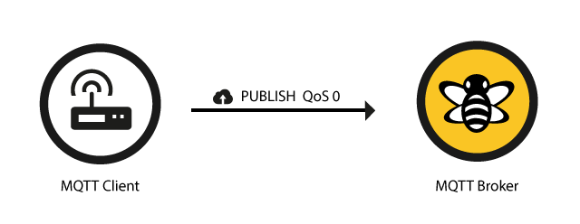
Publishing “QoS” (Reliability)
0 – unreliable (aka “at most once”)
OK for continuous streams, least overhead (1 message)
“Fire and forget”
TCP will still provide reliability

Slide 58
Publishing “QoS” (Reliability)
1 – delivery “at least once” (duplicates possible)
Used for alarms – more overhead (2 messages)
Contains message ID (to match with ACKed message)

Slide 59
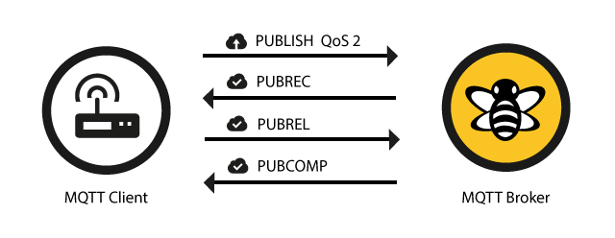
Publishing “QoS” (Reliability)
2 – delivery “exactly once”
Utmost reliability is important – most overhead (4 messages) and slowest

Slide 60
Publishing “QoS” (Reliability)
Reliability maintained even if the TCP connection breaks (intermittent connections)
Separate QoS for publishing and for subscribing

Slide 61
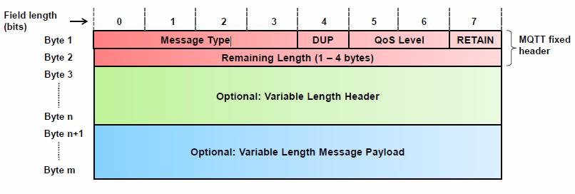
MQTT Message Format
Shortest Message is Two Bytes

Slide 62
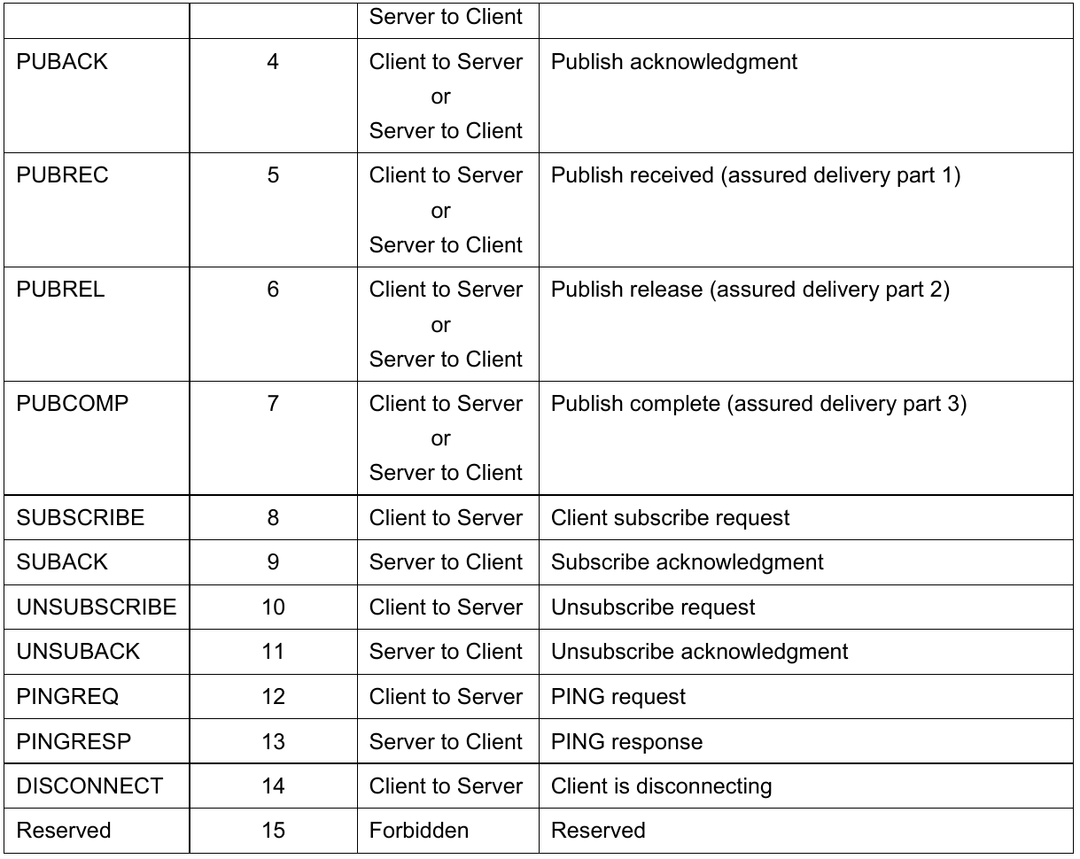
Message Types

Slide 63
Message Types

Slide 64
Comparison CoAP & MQTT
Both used in IoT
CoAP:
one-to-one communication
UDP/IP
unreliable
lightweight and easy to implement
MQTT:
many-to-many communication
TCP/IP
focus on message delivery; reliable
higher overheads (protocol data, processing costs)

Slide 65
BREAK

