Slide 1
Internet-of-Things (IoT)
Summer Engineering Program 2018
University of Notre Dame

Slide 2
Course Overview
 | Lecture | Lab
Week 1 | Fundamentals of IoT, basic concepts, applications | Basic Python & Raspberry Pi programming
Week 2 | Human-computer interfaces, sensing, actuation | Sensor programming, control loops, digital/analog I/O
Week 3 | Fundamentals of computer and wireless networks | Wi-Fi and Bluetooth networks, network measurements
Week 4 | Sensor networks, mesh networks, routing, WPANs | ZigBee, WPANs, WBANs, routing, network measurements
Week 5 | Processing, IoT cloud, analytics, visualization | IoT cloud integration, sensor fusion, analytics, visualization
Week 6 | RFID, IoT ecosystem, security, privacy, ethics, case studies | Final project

Slide 3
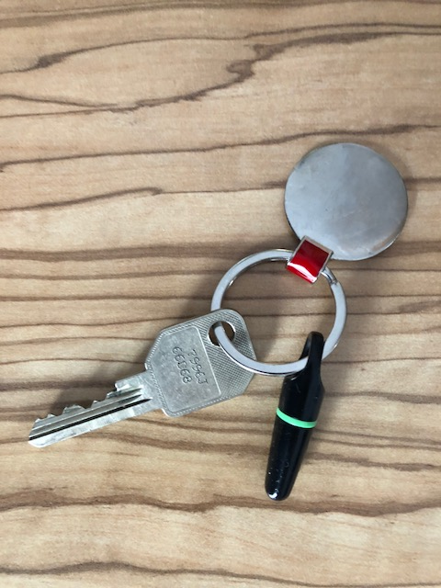

Slide 4
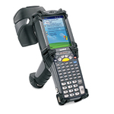
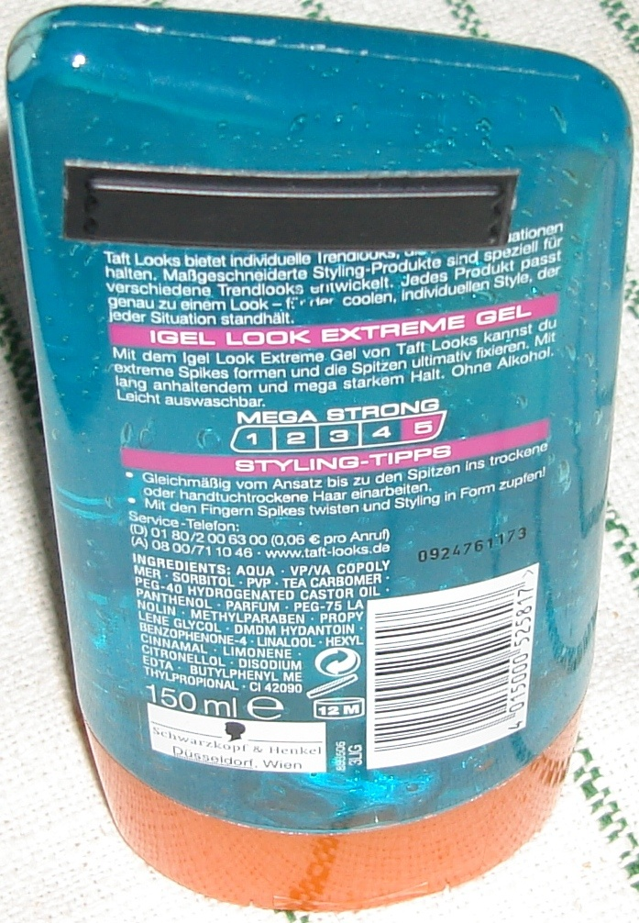
What is RFID?
Radio Frequency IDentification
Who Are You?
I am Product X

Slide 5
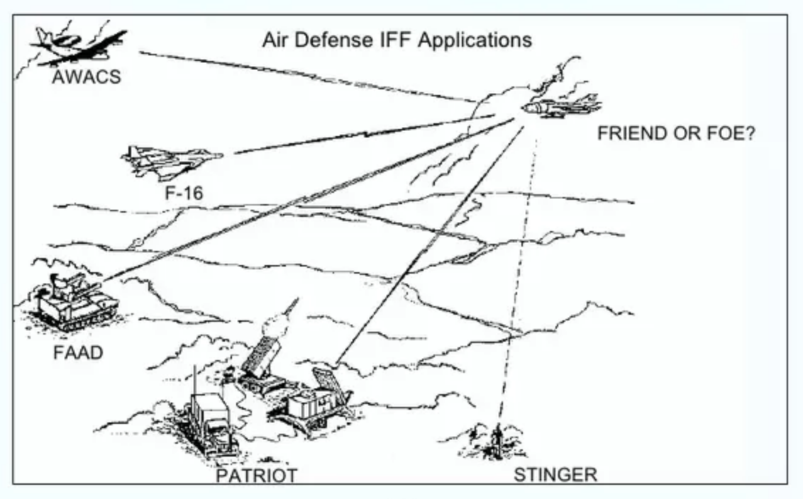
Some Historical Background
Identification Friend or Foe (IFF) used by Allied bombers during World War II
In 1948: passive RFID
In 1972: “inductively coupled transmitter-responder” (2 antennas)
In 1979: “identification device” which combined both antennas into one
1970s: a group of scientists at the Lawrence Livermore Laboratory (LLL) build a handheld receiver stimulated by RF power for secure access to nuclear facilities

Slide 6
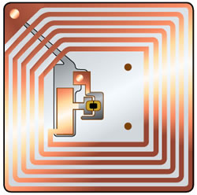
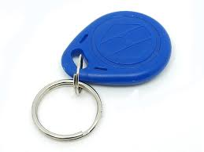
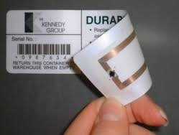
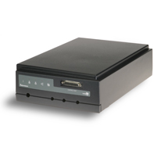
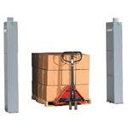
RFID Systems
Main components:
Tags (transponders)
  - Microchip & antenna
Tag reader
  Decoder & antenna
  RFID reader sends pulse of energy and waits for response
  Can be on all the time or activate only in response to external event

Slide 7
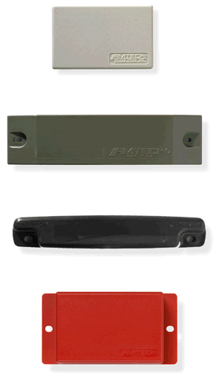
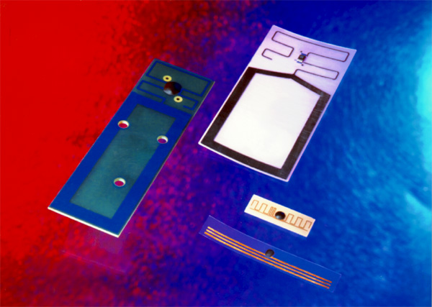
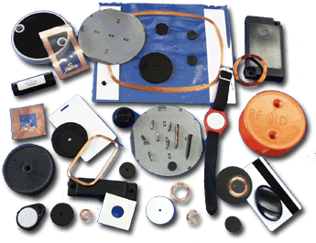
Tags
Variations:
  Memory
    Size (16 bits - 512 Kbytes)
    Read-Only, Read/Write, or WORM
  Arbitration (Anti-collision)
    Ability to read/write one or
    many tags at a time
  Frequency
    125KHz - 5.8 GHz
  Price
    $0.10 to $250
  Physical Dimensions
    Thumbnail to Brick sizes

Slide 8

“Mission Impossible”

Slide 9
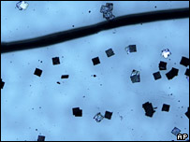
Tiny Tags
2007 Hitachi produced RFID device measuring 0.05×0.05 mm, and thin enough to be embedded in a sheet of paper. The data contained on them can be extracted from as far away as a few hundred meters.

Slide 10
Active versus Passive
 | Active RFID | Passive RFID
Tag Power Source | Internal to tag | Energy transferred using RF from reader
Tag Battery | Yes | No
Required signal strength | Very Low | Very High
Range | Up to 100m | Up to 3-5m, usually less
Multi-tag reading | 1000’s of tags recognized – up to 100mph | Few hundred within 3m of reader, about 3 sec per read => at most 3 mph.
Data Storage | Up to 512 KB | 16 bits – 1 KB

Slide 11
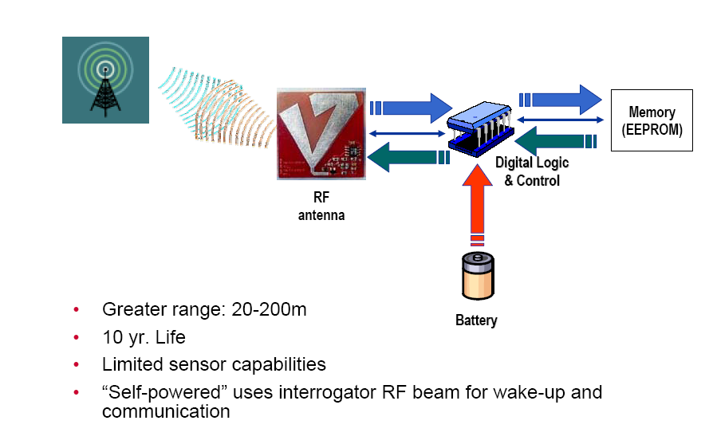
Active Tag

Slide 12
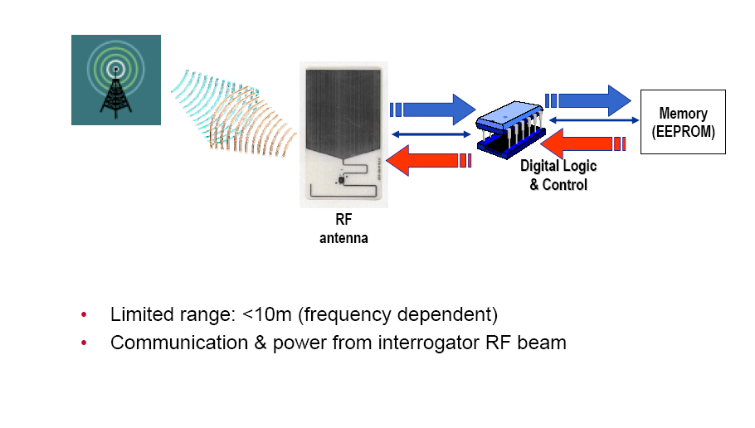
Passive Tag

Slide 13
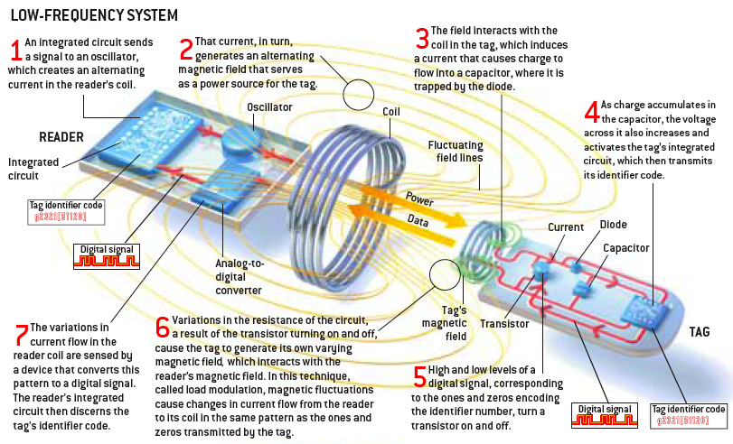
Low Frequency: Load Modulation

Slide 14
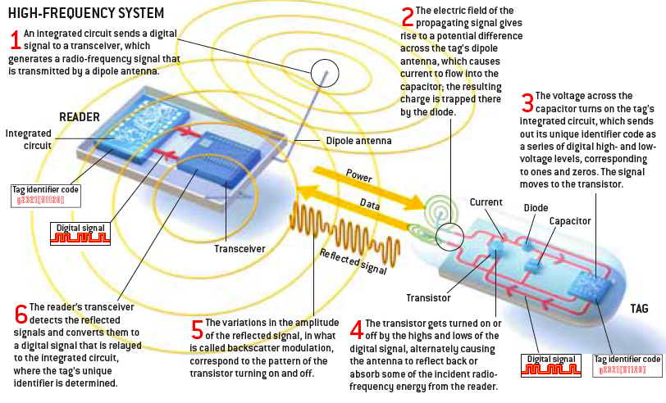
High-Frequency: Backscatter Modulation

Slide 15
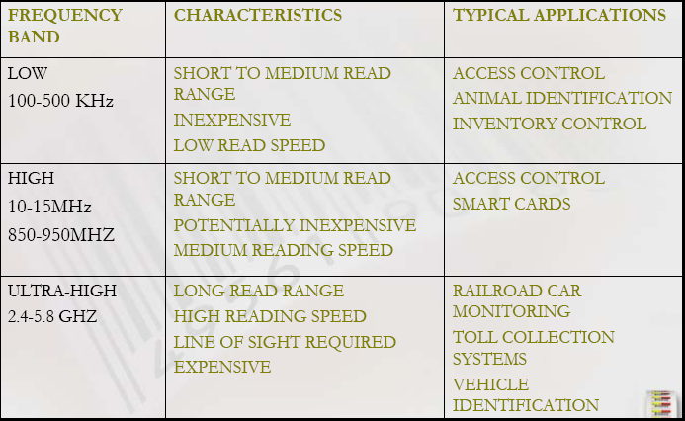
Frequency Ranges

Slide 16
Codes
RFID tag
Bar code

Slide 17
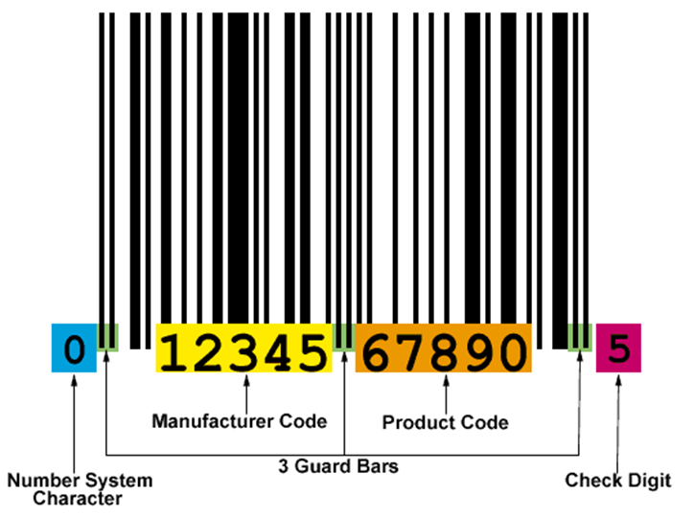
Bar Code

Slide 18
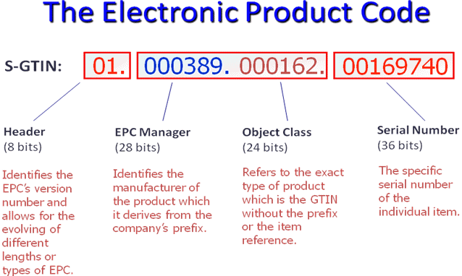
EPC: Electronic Product Code

Slide 19
Communication and Collisions
Very simple packet formats
  General structure:
  Usually reader-to-tag and tag-to-reader format somewhat different.
  Typically 2 byte CRC
Sync | Header | Command | Data | CRC

Slide 20
Collisions
All tags receiving query will respond: collisions!
Many readers feature “simultaneous read” capabilities (resolve collisions)
No “carrier sense” possible

Slide 21
Binary Tree Algorithm
Poll tags bit-by-bit
Example (figure):
  Query “x”: 7 tags respond: collision
  Query “0x”: 3 tags respond: collision
  Query “00x”: 1 tag responds
  Query “01x”: 2 tags respond: collision
  Query “010x”: 2 tags respond: collision
  Query “0100x”: 1 tag responds
  Query “0101x”: 1 tag responds
  Query “011x”: no response
  Query: “1x”: 4 tags respond: collision
  Query: “10x”: 1 tag responds
  Query: “11x”: 3 tags respond: collision
  …

Slide 22
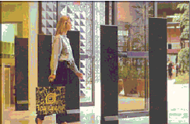
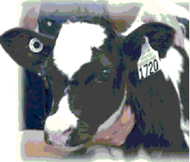
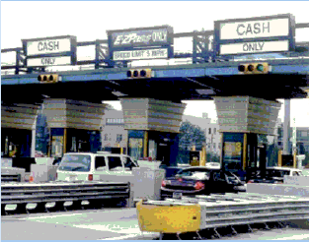
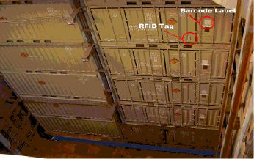
Application Scenarios
Track the movement of consumer product goods
Animal identification/tracking/counting
Toll collection
Implantation of RFID chips into people, e.g., Alzheimer patients

Slide 23
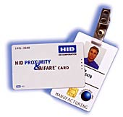
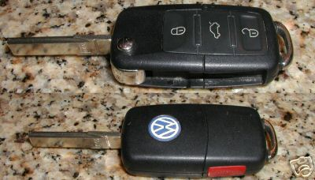
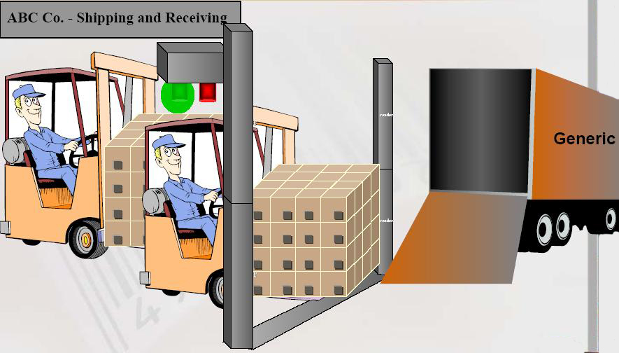
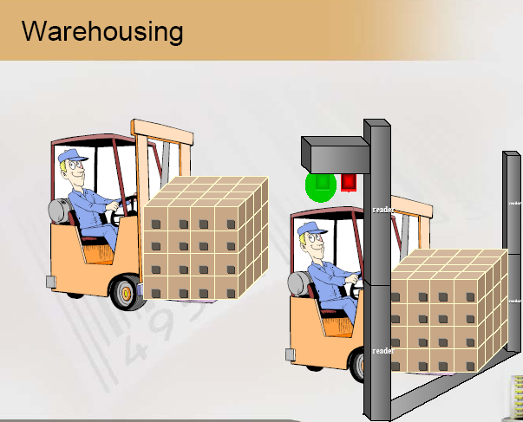
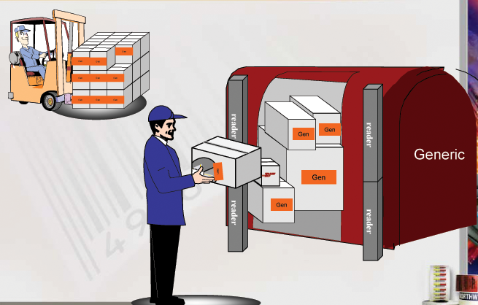
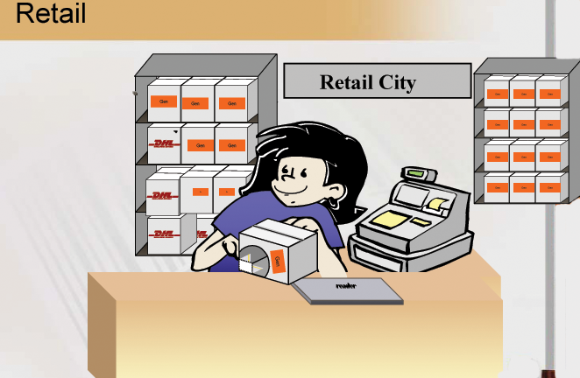
Applications
Keyless entry
Proximity cards
Supply chain management

Slide 24
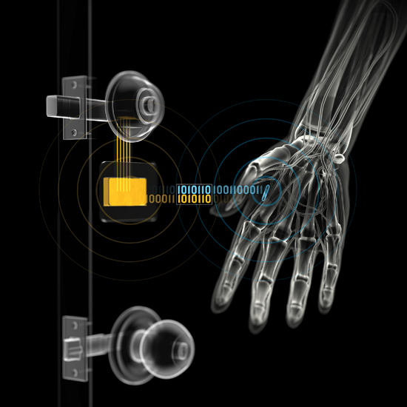
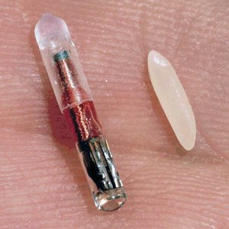
Implants
It is the most controversial application
Small glass cylinders approximately 2 or 3mm wide and between 1 and 1.5cm long
Consists of a microchip, a coiled antenna, and a capacitor
Implanted typically under the skin of arm or the back of the neck
https://www.youtube.com/watch?v=HkKhlLzoGR8

Slide 25
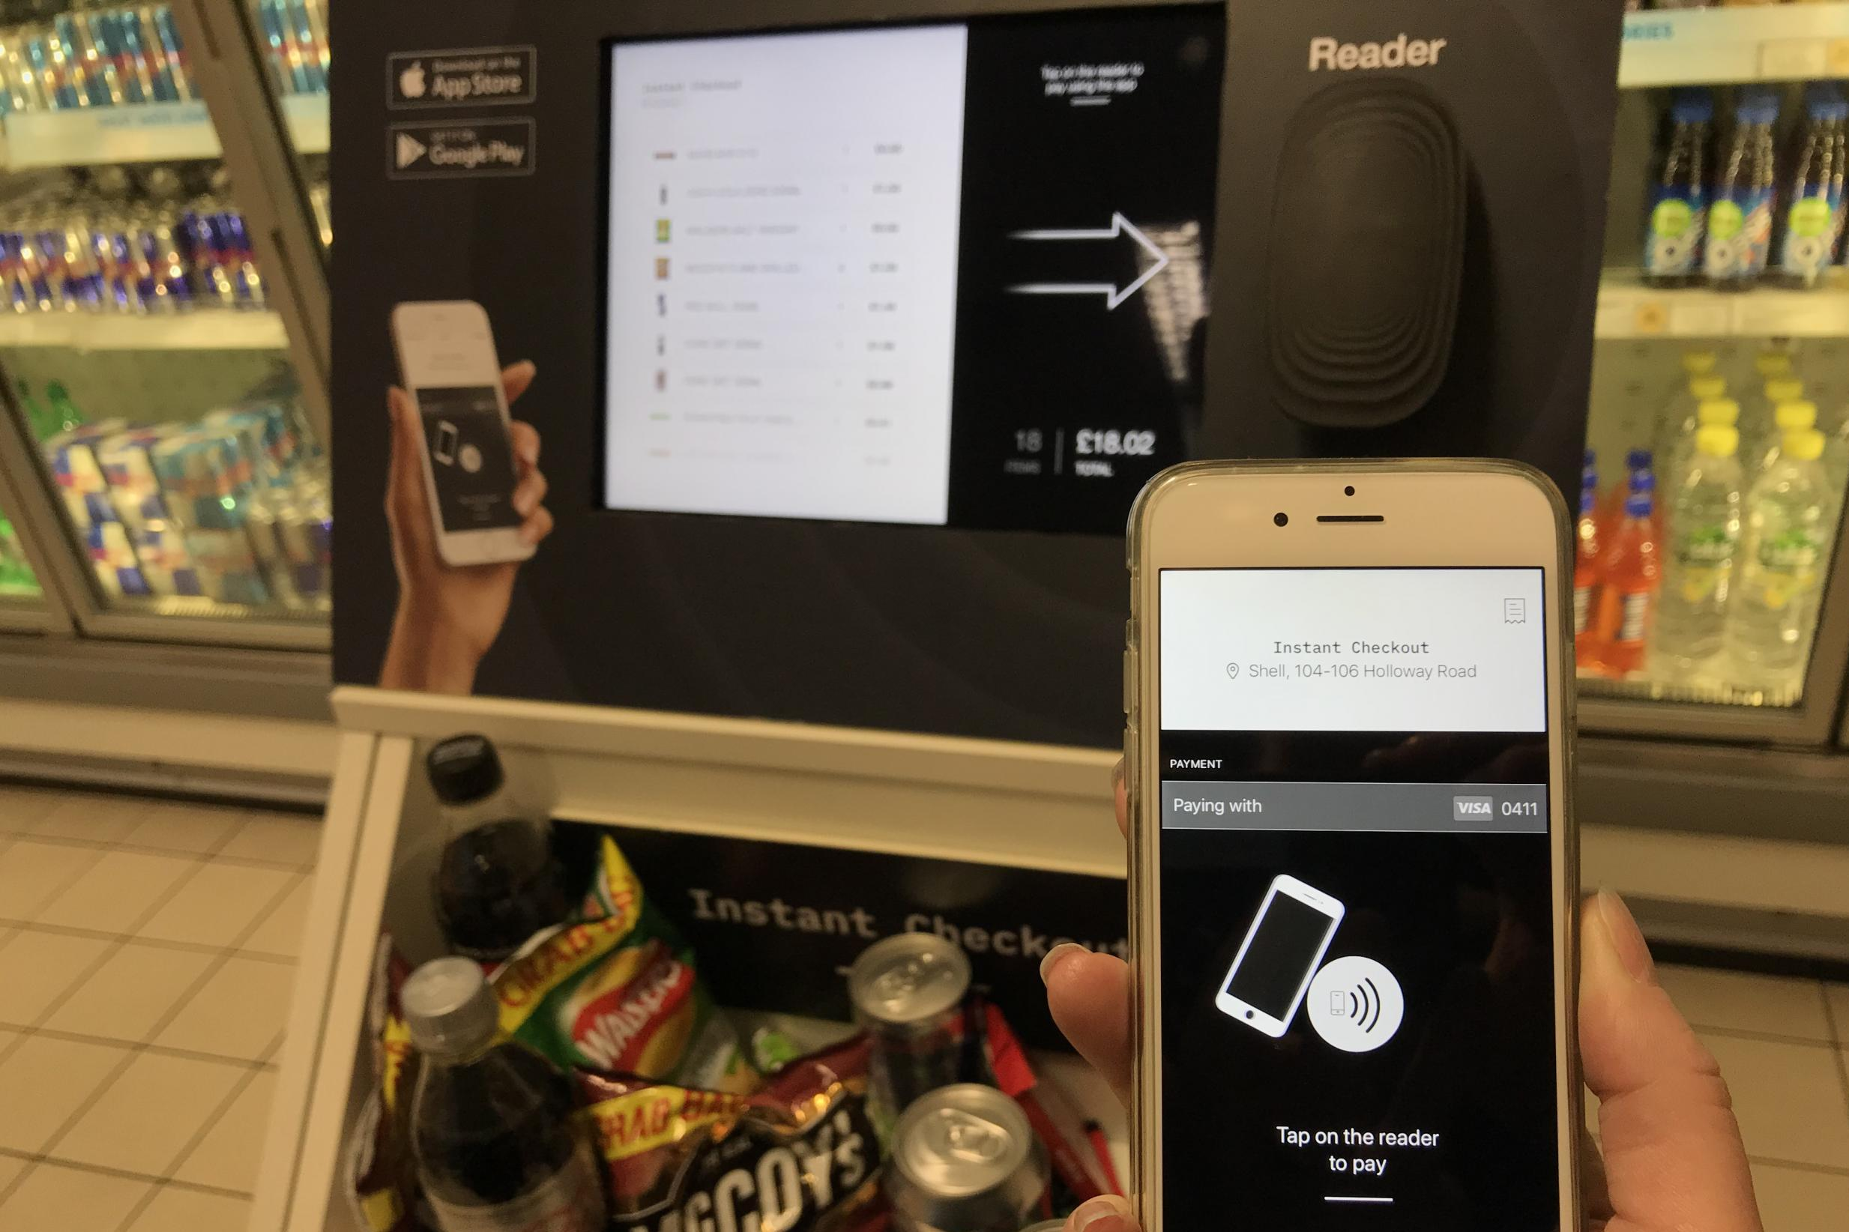
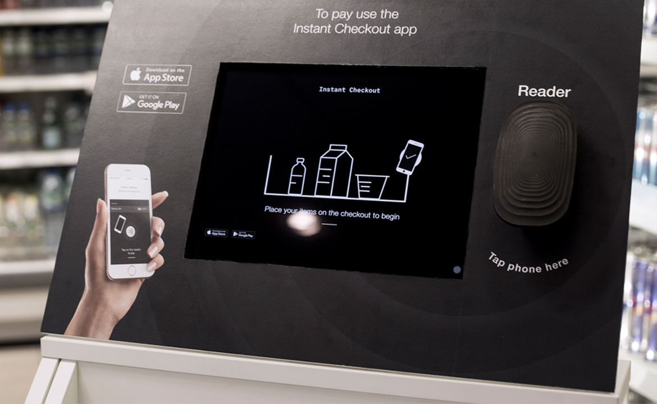
Instant Checkout
https://www.standard.co.uk/tech/supermarket-checkout-designed-to-scan-entire-shopping-basket-trialled-in-london-a3747506.html

Slide 26
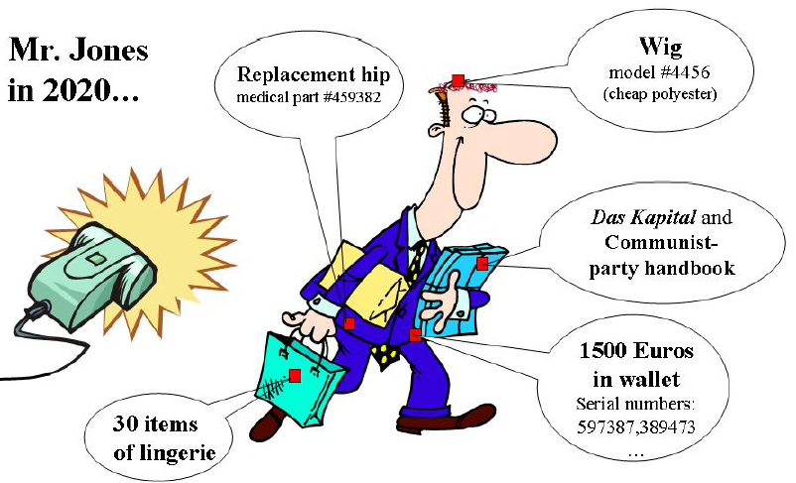
Concerns
Clandestine tracking
Inventorying

Slide 27
Security/Privacy Issues and Solutions
Unauthorized Reading:
  Scan closed boxes and find out what is inside
  Read RFID enabled credit card or ID (metal foil in passports)
Unauthorized Writing:
  Can change UPC/price of an item
  Can kill a tag
RFID Zapper:
  Can burn a tag using overcurrent
RSA Blocker Tag:
  Placed near another RFID; prevents its reading
Put Tag to Sleep:
  Can wake up later; reuse tags
Re-label Tag and Dual-Use Tag:
  Customer sees differed info or can over-write tag with useful information
Authentication:
  Reader has to know PIN

Slide 28
Near-Field Communication (NFC)
NFC is one of the latest wireless communication technologies. As a short-range wireless connectivity technology, NFC offers safe yet simple communication between electronic devices
It enables exchange of data between devices over a distance of 4 cm or less
NFC operates at 13.56 MHz and rates ranging from 106 kbit/s to 848 kbit/s

Slide 29
How NFC Works
NFC is based on RFID technology that uses magnetic field induction between electronic devices in close proximity
For two devices to communicate using NFC, one device must have an NFC reader/writer and one must have an NFC tag. The tag is essentially an integrated circuit containing data, connected to an antenna, that can be read or written by the reader

Slide 30
How NFC Works
The technology is a simple extension of the ISO/IEC14443 proximity-card standard (contactless card, RFID) that combines the interface of a smartcard and a reader into a single device
An NFC device can communicate with both existing ISO/IEC14443 smartcards and readers, as well as with other NFC devices, and is thereby compatible with contactless infrastructure already in use for public transportation and payment
NFC is primarily aimed at usage in mobile phones
2015: ~600 million NFC-equipped phones in use (estimate that 5% are used at least once a month)

Slide 31
NFC Applications
There are currently three main uses of NFC:
Card emulation: The NFC device behaves like an existing contactless card
Reader mode: The NFC device is active and reads a passive RFID tag, for example for interactive advertising
P2P mode: Two NFC devices communicating together and exchanging information

Slide 32
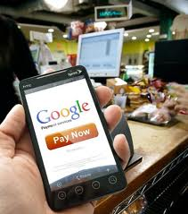
NFC Applications
Mobile payment
Mobile/electronic ticketing
Smart objects
Electronic keys
P2P data transfers
NFC can be used to configure and initiate other wireless network connections such as Bluetooth or Wi-Fi

Slide 33
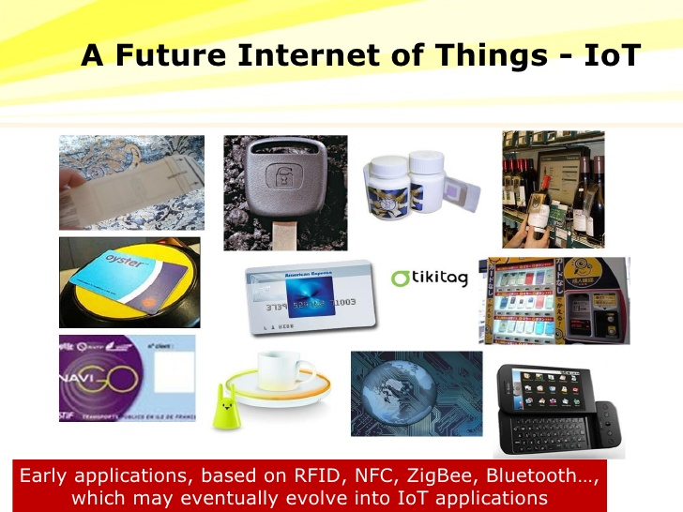
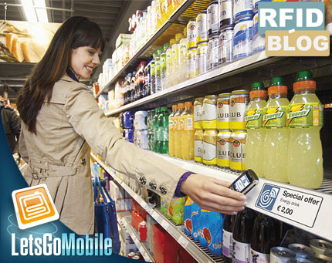
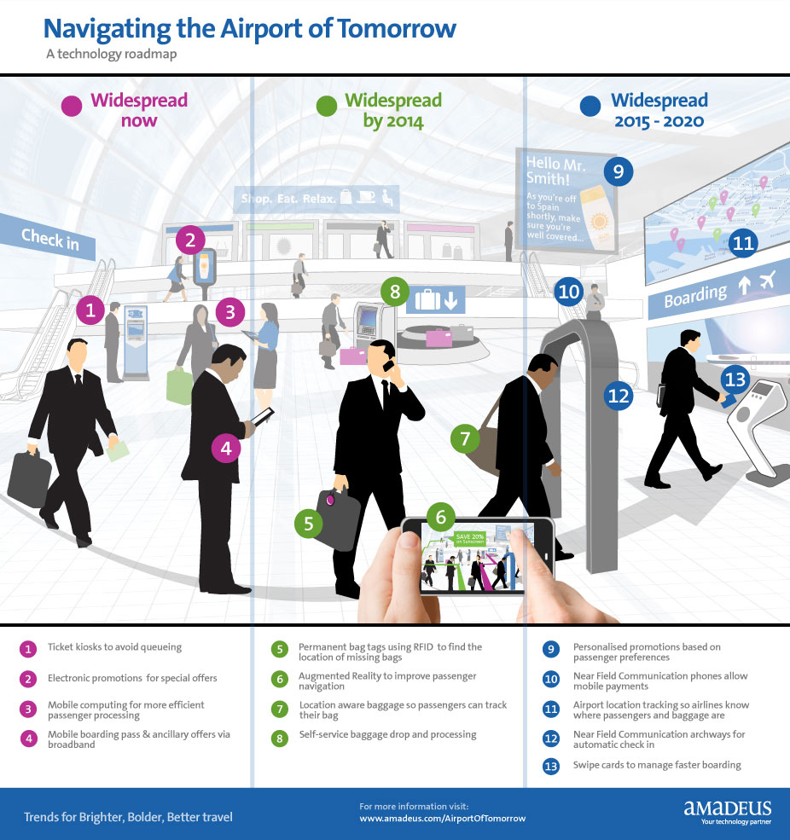

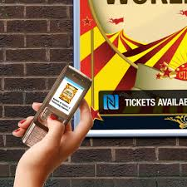
Future of RFID and NFC

Slide 34

BREAK

Slide 35
Location, Location, Location
Location information adds “context” to activity:
  location of sensed events in the physical world
  location-aware services
  location often primary sensor information (supply chain management, surveillance)
  object tracking
  coverage area management
  geo-tagging
Location often not known a priori, therefore, localization is the task of determining the position (e.g., coordinates) of a device or the spatial relationships among objects

Slide 36
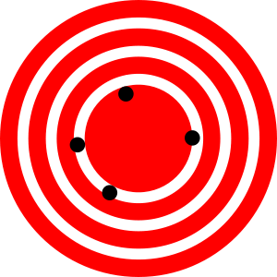

Overview
Global position
  position within general global reference frame
  Global Positioning System or GPS (longitudes, latitudes)
  Universal Transverse Mercator or UTM (zones and latitude bands)
Relative position
  based on arbitrary coordinate systems and reference frames
  distances between nodes (no relationship to global coordinates)
Accuracy versus precision
  GPS: true within 10m for 90% of all measurements
    accuracy: 10m (“how close is the reading to the ground truth?”)
    precision: 90% (“how consistent are the readings?”)
Symbolic position information
  “office 354”
  “mile marker 17 on Highway 23”
High accuracy,
Low precision
Low accuracy,
High precision

Slide 37
Ranging Techniques
Time of Arrival (ToA, time of flight)
  distance between sender and receiver of a signal can be determined using the measured signal propagation time and known signal velocity
  sound waves: 343m/s, i.e., approx. 30ms to travel 10m
  radio signals: 300km/s, i.e., approx. 30ns to travel 10m
One-way ToA
  one-way propagation of signal
  requires highly accurate synchronization of sender and receiver clocks
Two-way ToA
  round-trip time of signal is measured at sender device
  third message if receiver wants to know the distance

Slide 38
Ranging Techniques
Time Difference of Arrival (TDoA)
  two signals with different velocities
  example: radio signal (sent at t₁ and received at t₂), followed by acoustic signal (sent at t₃=t₁+t_{wait} and received at t₄)
  no clock synchronization required
  distance measurements can be very accurate
  need for additional hardware

Slide 39
Ranging Techniques
Angle of Arrival (AoA)
  direction of signal propagation
  typically achieved using an array of antennas or microphones
  angle between signal and some reference is orientation
  spatial separation of antennas or microphones leads to differences in arrival times, amplitudes, and phases
  accuracy can be high (within a few degrees)
  adds significant hardware cost

Slide 40
Ranging Techniques
Received Signal Strength (RSS)
  signal decays with distance
  many devices measure signal strength with received signal strength indicator (RSSI)
    vendor-specific interpretation and representation
    typical RSSI values are in range of 0..RSSI_Max
    common values for RSSI_Max: 100, 128, 256
  in free space, RSS degrades with square of distance
  expressed by Friis transmission equation
  in practice, the actual attenuation depends on multipath propagation effects, reflections, noise, etc.
  realistic models replace R² with R^{n} (n=3..5)

Slide 41
Triangulation
ANCHOR
(BEACON)
ANCHOR
(BEACON)
YOU

Slide 42
Triangulation
Example of range-based localization
Uses the geometric properties of triangles to estimate location
Relies on angle (bearing) measurements
Minimum of two bearing lines (and the locations of anchor nodes or the distance between them) are needed for two-dimensional space

Slide 43
Trilateration
ANCHOR
(BEACON)
ANCHOR
(BEACON)
YOU
ANCHOR
(BEACON)

Slide 44
Trilateration
Localization based on measured distances between a node and a number of anchor points with known locations
Basic concept: given the distance to an anchor, it is known that the node must be along the circumference of a circle centered at anchor and a radius equal to the node-anchor distance
In two-dimensional space, at least three non-collinear anchors are needed and in three-dimensional space, at least four non-coplanar anchors are needed

Slide 45
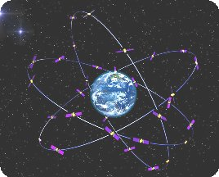
GPS - Background
Mariners relied upon the sun for latitude, and clocks for longitude
With the launch of Sputnik in 1957, radio-based global positioning became a (theoretical) possibility

Slide 46
GPS - Background
This was a very crude form of GPS using only one satellite (1960s)
  Doppler shift for distance measurement
  Submarines used it
  Could only be used every 35-45 minutes
  Submarines had to be non-moving
US systems: TRANSIT, Timation
Major innovation was the inclusion of an atomic clock
Submarines could now be in motion and use the system (but about an hour to get a fix)

Slide 47
GPS-Based Localization
Global Positioning System
  most widely publicized location-sensing system
  provides lateration framework for determining geographic positions
  originally established as NAVSTAR (Navigation Satellite Timing and Ranging)
  example of global navigation satellite system (GNSS)
  consists of at least 24 satellites orbiting at approx. 11,000 miles
  started in 1973, fully operational in 1995
Two levels of service:
  Standard Positioning Service (SPS)
    available to all users, no restrictions or direct charge
    high-quality receivers have accuracies of 3m and better horizontally
  Precise Positioning Service (PPS)
    used by US and Allied military users
    uses two signals to reduce transmission errors

Slide 48
GPS-Based Localization
Satellites are uniformly distributed in six orbits (4 satellites per orbit)
Satellites circle earth twice a day at approx. 7000 miles/hour
At least 8 satellites can be seen simultaneously from almost anywhere
Each satellite broadcasts coded radio waves (pseudorandom code) over frequency 1575.42 MHz, containing
  identity of satellite
  location of satellite
  the satellite’s status
  date and time when signal was sent
Several monitor stations constantly receive satellite data and forward data to a master control station (MCS)
MCS is located near Colorado Springs, Colorado
MCS uses the data from monitor stations to compute corrections to the satellites’ orbital and clock information which are sent back to the satellites

Slide 49
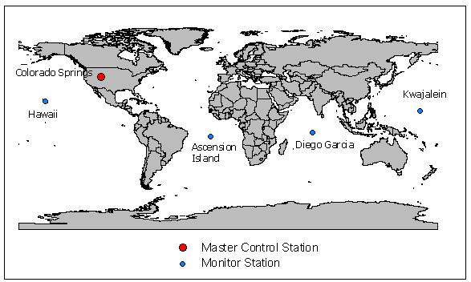
Monitor Stations

Slide 50
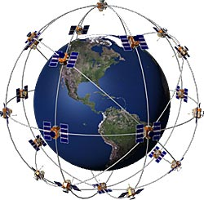
Satellites and orbits

Slide 51
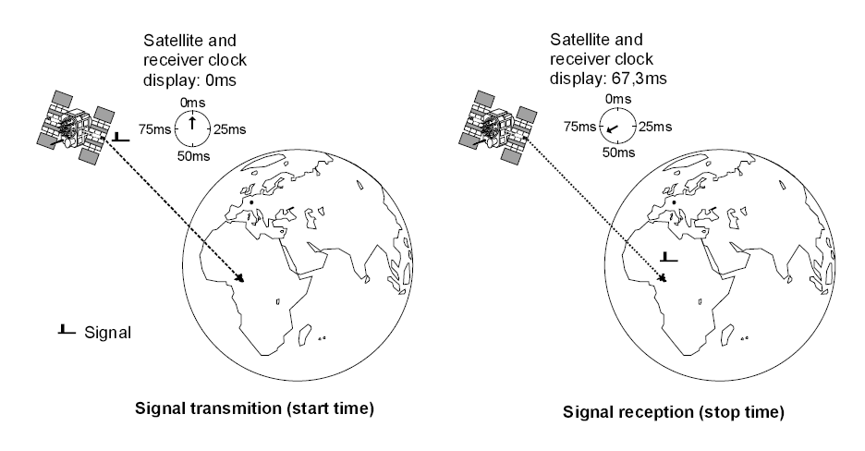
Distance Measurement (Ranging)

Slide 52
GPS-Based Localization
Satellites and receivers use accurate and synchronized clocks
Receiver compares generated code with received code to determine
  the actual code generation time of the satellite
  time difference Δ between code generation time and current time
  Δ expresses the travel time of the code from satellite to receiver

Slide 53
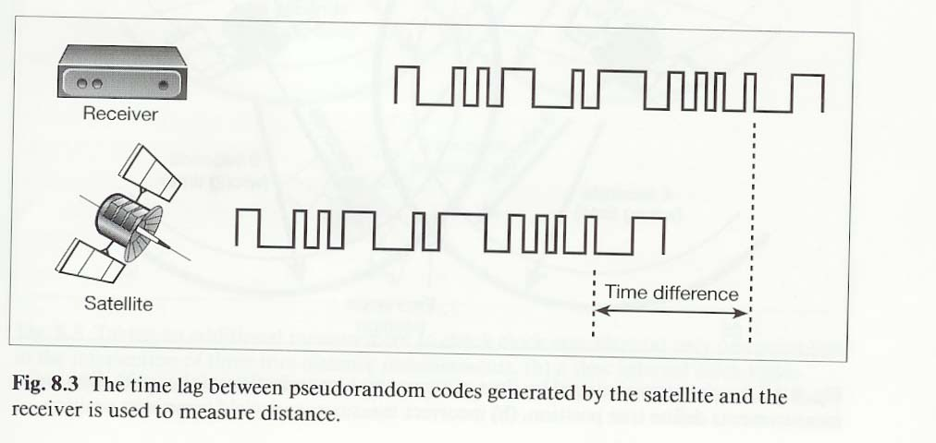
GPS-Based Localization

Slide 54
GPS-Based Localization
Radio waves travel at the speed of light (approx. 186,000 miles/second)
With known Δ, the distance can be determined
Receiver knows that it is located somewhere on a sphere centered on the satellite with a radius equal to this distance
With three satellites, the location can be narrowed down to two points
  typically one of these two points can be eliminated easily
With four satellites, accurate localization is possible
  accurate positioning relies on accurate timing
  receiver clocks are much less accurate than atomic GPS clocks
  small timing errors lead to large position errors
    example: clock error of 1ms translates to a position error of 300km
  fourth sphere would ideally intersect with all three other spheres in one exact location
  spheres too large: reduce them by adjusting the clock (moving it forward)
  spheres too small: increase them by adjusting the clock (moving it backward)

Slide 55
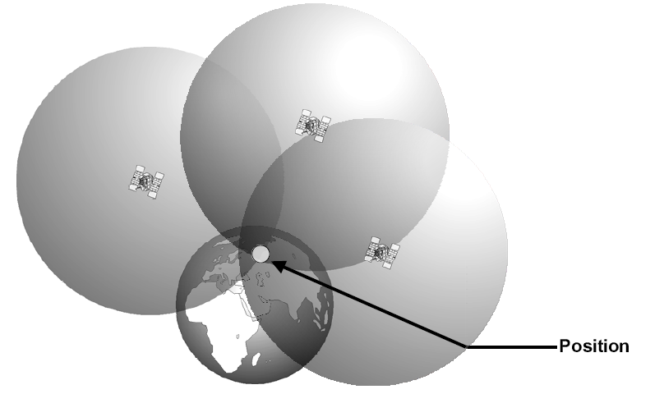
GPS Trilateration

Slide 56
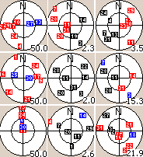
GPS Signals
GPS operates 24/7 and is unaffected by cloud, rain, dark
BUT signals are weak– limited signals indoors, under trees, in bags!
Getting position fix means seeing > 3 satellites in part of sky you can see
As you move, visible satellites change
Signals reflect off buildings leading to ‘multipath’ error
Accuracy under ideal conditions with consumer devices= 5-10m
“Sat nav” systems snap positions to roads
Outer circle= horizon, squares are satellites. Red=blocked, Blue= fixing, black= fixed. Values are DOP quality of fix.

Slide 57
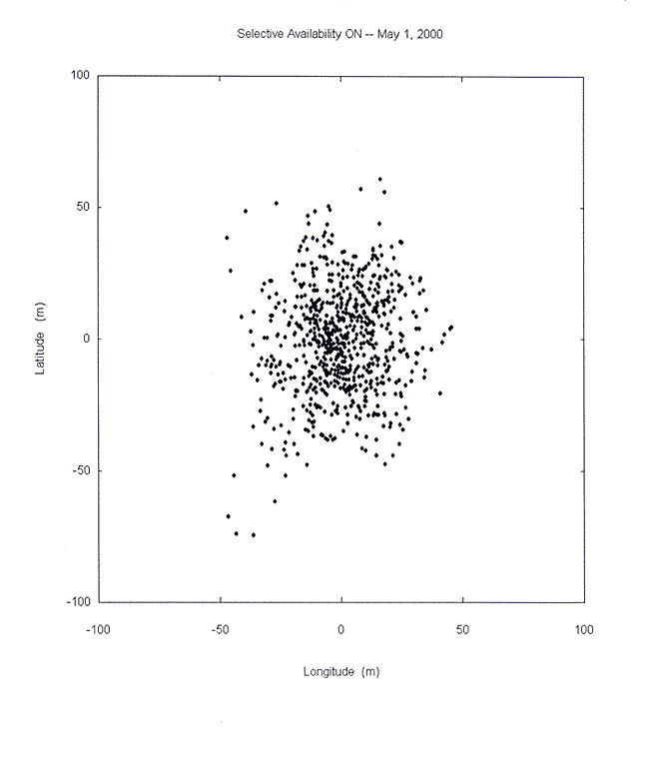
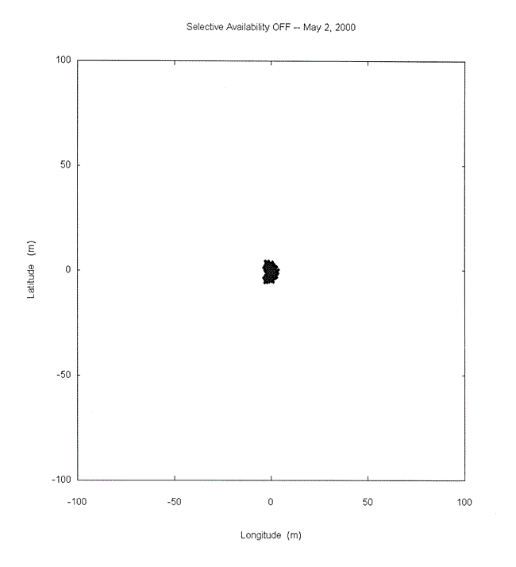
Deliberately Introduced Error
Turned off in 2010 (errors up to 100m)

Slide 58
GPS-Based Localization
Most GPS receivers today can achieve good accuracy (e.g., 10m-15m or better)
Additional advanced techniques can be used to further improve accuracy:
  example: Differential GPS (DGPS)
    relies on land-based receivers with exactly known locations
    they receive signals, compute correction factors, and broadcast them to GPS receivers
    GPS receivers correct their own measurements
    improves location accuracy from say 15m to 10cm

Slide 59

Differential GPS

Slide 60
Wide Area Augmentation System (WAAS)
Error correction system that uses reference ground stations
25 reference stations in US
Monitor GPS and send correction values to two geo-stationary satellites
The two geo-stationary satellites broadcast back to Earth on GPS L1 frequency (1575.42MHz)
Only available in North America, WAAS enabled GPS receiver needed

Slide 61

WAAS

Slide 62

Cellular Positioning: Cell ID
Open-source database of cell IDs: opencellid.org

Slide 63

Cellular Positioning - Cell ID with TA
TA: Timing Advance (time a signal takes to travel from mobile device to cell tower)

Slide 64

Cellular Positioning - EOTD
EOTD: Enhanced-Observed Time Difference
Your location is in the zone at the
intersection of 3 cell circular bands

Slide 65

Cellular Positioning Performance
Maps of the area served by individual cell towers are complex
GSM signal reception
  Attenuated by barriers
  Change with call volume
Cells size varies 100m- 30Km
Resulting positioning is inconsistent and unreliable
Sufficient for some applications

Slide 66

Comparing Cellular and GPS Positioning

Slide 67

Wi-Fi Positioning Systems
Wi-Fi access points (hotspots) broadcast signals up to 100m
Wi-Fi chips in devices detect the name of the access point, signal strength, and (sometimes) angle of arrival
Client devices can detect access points in two ways
  Passively listening on 802.11 channels for beacon frames
  Initiate scan by sending requests which access points reply

Slide 68
Location based on 802.11
802.11 takes advantages of two properties observed by clients
  Spatial variability: signal strength depends on distance & location
  Temporal consistency: good chance this will be true in days/weeks/months/...
Map of “radio fingerprints” can be established

Slide 69

Location based on 802.11

Slide 70


Location based on 802.11

Slide 71

Wi-Fi Localization
Wi-Fi is everywhere now
  No new infrastructure
  Low cost
  APs broadcast beacons
  “War drivers” build AP maps
    Calibrated using GPS
    Constantly updated
Position using Wi-Fi
  Indoor Wi-Fi positioning gives 2-3m accuracy
  But requires high calibration overhead: 10+ hours per building
  Changes over time (adding/removing/relocating APs) impact accuracy
Manhattan (Courtesy of Wigle.net)

Slide 72

Access to Wireless Positioning
Skyhook provides wireless positioning solution (XPS) based on fusion of GPS, Wi-Fi, and cellular
Ekahau offers a commercial solution using fingerprinting mainly for internal building positioning

Slide 73

Hybrid Positioning System (XPS)

Slide 74
Other Indoor Positioning Options
Bluetooth positioning
  Used to send local messages about location/ services
RFID chips embedded in the environment
  RFID scanners can check location/ services available
UWB
  High precision industrial positioning of tags on items
TMSI
  Temporary ID of GSM phones can be tracked for short period within small areas (e.g., shopping centers)
IP positioning
  Using structure of Internet to situate IP address geographically

Slide 75

Indoor Positioning System (IPS)

Slide 76

GPS vs. IPS

Slide 77

iBeacon (Apple, BLE-based)

Slide 78

iBeacon
iBeacon is the Apple Trademark for an indoor positioning system that Apple Inc. calls “a new class of low-powered, low-cost transmitters that can notify nearby iOS devices of their presence.”
The iBeacon works on Bluetooth Low Energy (BLE), also known as Bluetooth Smart. BLE can also be found on Bluetooth 4.0 devices that support dual mode.

Slide 79


Estimote iBeacon
An Estimote Beacon is a small wireless device. When placed in a physical space, it broadcasts tiny radio signals to smart devices
Smartphones that are in range are able to 'hear' these signals and estimate their location very precisely, as well as to communicate with the beacon to exchange data and information

Slide 80

iBeacon

Slide 81

iBeacon

Slide 82
iBeacon
Video: http://www.youtube.com/watch?v=sUIqfjpInxY
Video: http://www.youtube.com/watch?v=SrsHBjzt2E8

Slide 83




iBeacon: Advantages
Accuracy (Bluetooth, low-range)
Privacy (beacon DO NOT track users)
Integration (Apple, Android, ...)
Affordability (low-cost beacons, other devices can be configured as beacons)
Usability (BLE -> low energy); simple to use (built into OS/platform)

Slide 84

Magnetic Positioning
Magnetometer + data connection
Evaluates building’s distortion of Earth’s magnetic field or “magnetic fingerprint”
Correlates to reference data
More steel improves accuracy (1-2 meters)

Slide 85




Magnetic Positioning
Step 1: Adding floor plans
Step 2: Mapping buildings
Step 3: Creating applications

Slide 86

Smartphone Positioning

Slide 87
BREAK

