Slide 1
Application Lifecycle

Slide 2
Application lifecycles
Applications and processes may transition between several states
active
paused
stopped
inactive
suspended
Callback methods allow applications to prepare for and respond to transitions

Slide 3
Android lifecycle methods
Lifecycle state transitions trigger event callback methods
Callback events differ based on type of component
Callback methods take place in foreground and should be brief

Slide 4
Android Activity
Activity. onCreate
Activity. onStart
Activity. onRestore InstanceState
Activity. onSave InstanceState
Activity. onResume
Activity. onPause
Activity. onStop
Activity. onDestroy
Activity. onRestart
Active lifetime
Visible lifetime
Full lifetime
Application is killable

Slide 5
Activity callback methods
Implementation of lifecycle method should always first call superclass
protected void onPause() {
super.onPause();
. . .
}

Slide 6
Activity transition
Activity A
Activity B
ActivityA. onPause
ActivityB. onCreate
ActivityB. onStart
ActivityB. onResume
ActivityA. onStop

Slide 7
Android Service
Service. onCreate
Service. onStartCommand
Service. onDestroy
Service. onBind
Service. onUnbind
Service. onRebind

Slide 8
Service binding methods
Activity
Service
bindService()
.onBind()
ServiceConnection. onServiceConnected
unbindService()
.onUnbind()
ServiceConnection. onServiceDisconnected

Slide 9
Android BroadcastReceiver
BroadcastReceiver. onReceive
Only active while handling onReceive() method

Slide 10
Android ContentProvider
ContentProvider. onCreate
Only active while handling methods supporting ContentResolver
query()
insert()
update()
delete()
getType()

Slide 11
Processes and lifecycles
Old processes removed when memory runs low
Selection base on importance hierarchy
Foreground process
Visible process
Service process
Background process
Empty process

Slide 12
iOS Application lifecycle
UIApplication notified of state transition events
Handled by application delegate
application:didFinishLaunchingWithOptions:
applicationDidBecomeActive:
applicationWillResignActive:
applicationDidEnterBackground:
applicationWillEnterForeground:
applicationWillTerminate:

Slide 13
Pre – iOS 4
application:didFinishLaunchingWithOptions:
applicationDidBecomeActive:
Active
applicationWillTerminate:

Slide 14
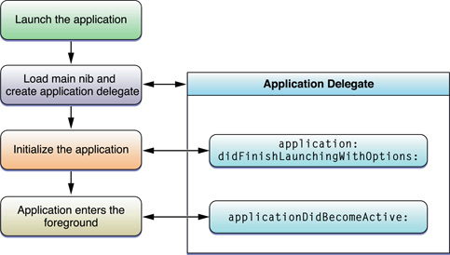
iOS Application launch

Slide 15
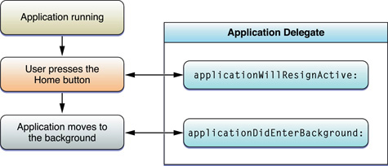
iOS Transition to background

Slide 16
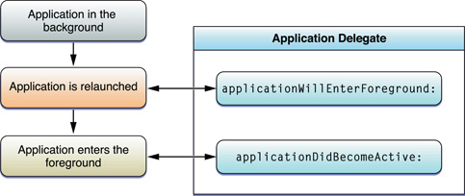
iOS Return to foreground

Slide 17
iOS Interruption handling
UIKit
Delegate
Active
Phone, SMS, or Calendar notification arrives
applicationWillResignActive:
Ignore?
Yes
applicationDidBecomeActive:
No
Application moves to background
applicationDidEnterBackground:

Slide 18
iOS 4 Application lifecycle
application:didFinishLaunchingWithOptions:
applicationDidBecomeActive:
Ignore interrupt
Active
applicationWillEnterForeground:
applicationWillResignActive:
Suspended
applicationDidEnterBackground:
applicationWillTerminate:

Slide 19
Reminder
Proposal due Wednesday

