Slide 1
IPhone/Android & MySQL
Hongsheng Lu
CSE40333/60333 2011 Spring
University of Notre Dame

Slide 2
Background
The need to communicate with a remote database
Create a web service which iphone/android can talk to. The web service communicates with the database.
Write your own database client protocol.

Slide 3
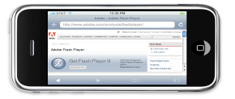
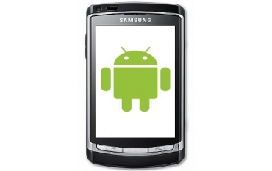
Setting in the lab
Apache
MySQL
Server
Spike.cse.nd.edu
1. iPhone/Android posts a request to spike using HTTP
2. Apache connects to MySQL database
3. Apache returns data to iPhone/Android
4. iPhone/Andorid processes the data

Slide 4
Demo basic MySQL operations
Create, read, drop tables;
Insert, delete rows;
Web service step up;
push data; pull data;
Sample code
<?php
mysql_connect("host","username","password");
mysql_select_db("PeopleData");
$q=mysql_query("SELECT * FROM people WHERE birthyear>'".$_REQUEST['year']."'");
while($e=mysql_fetch_assoc($q))
$output[]=$e;
print(json_encode($output));
mysql_close();
?>

Slide 5
Smart phone side
JSON: JavaScript Object Notation. format is often used for serializing and transmitting
structured data over a network connection. It is primarily used to transmit data between
a server and web application, serving as an alternative to XML
//convert response to string
//http post
HttpClient httpclient = new DefaultHttpClient();
HttpPost httppost = new HttpPost("http://example.com/getAllPeopleBornAfter.php");
httppost.setEntity(new UrlEncodedFormEntity(nameValuePairs));
HttpResponse response = httpclient.execute(httppost);
HttpEntity entity = response.getEntity();
InputStream is = entity.getContent();
//parse json data
JSONArray jArray = new JSONArray(result);
for(int i=0;i<jArray.length();i++){
JSONObject json_data = jArray.getJSONObject(i);
Log.i("log_tag","id: "+json_data.getInt("id")+
", name: "+json_data.getString("name")+
", sex: "+json_data.getInt("sex")+
", birthyear: "+json_data.getInt("birthyear")

Slide 6
Smart phone side
JSON-framework for iphone. Tutorial will be given.

Slide 7
Links
JSON-framework
Download: http://code.google.com/p/json-framework/
Tutorial: http://iphonedevelopertips.com/cocoa/json-framework-for-iphone-part-2.html
Tutorial: http://www.mobileorchard.com/tutorial-json-over-http-on-the-iphone/
MySQL
Download : http://www.mysql.com/
Tutorial: http://dev.mysql.com/doc/refman/5.0/en/tutorial.html
Android
Tutorial: http://www.helloandroid.com/tutorials/connecting-mysql-database
Tutorial: http://www.androidcompetencycenter.com/2009/10/json-parsing-in-android/

