Slide 1
CORE MOTION

Slide 2
CoreMotion
API to access motion sensing hardware
Accelerometer
Gyroscope
iPhone4
New generation iPod Touch
Access using CMMotionManager
Only one instance allowed per application
Create a method to allow all application components to access pointer to single instance

Slide 3
CMMotionManager
Check availability of accelerometer using
BOOL accelerometerAvailable
accelerometerData
CMAccelerometerData *accelerometerData
CMAcceleration acceleration
double x // x-axis acceleration in G’s
double y // y-axis acceleration in G’s
double z // z-axis acceleration in G’s

Slide 4
CMMotionManager
Check availability of gyroscope using
BOOL gyroAvailable
gyroData
CMGyroData *gyroData
CMRotationRate rotationRate
double x // x-axis rotation in radians/s
double y // y-axis rotation in radians/s
double z // z-axis rotation in radians/s

Slide 5
CMMotionManager
Check availability of device-motion using
BOOL deviceMotionAvailable
deviceMotion
CMDeviceMotion *deviceMotion
CMAttitide *attitude
double roll // roll of device in radians (around y-axis)
double pitch // pitch of device in radians (around x-axis)
double yaw // yaw of device in radians (around z-axis)
CMRotationMatrix rotationMatrix
CMQuaternion quaternion
CMRotationRate *rotationRate
CMAcceleration *gravity
CMAcceleration *userAcceleration

Slide 6
CoreMotion
2 ways to get data
Start sampling and poll for values
Set update interval and register handler block
Start sampling to enable polling using
void start{Accelerometer/Gyro/DeviceMotion}Updates
Stop sampling (when not needed to save resources) using
void stop{Accelerometer/Gyro/DeviceMotion}Updates

Slide 7
CoreMotion
Set update interval by setting
NSTimeInterval accelerometerUpdateInterval
NSTimeInterval gyroUpdateInterval
NSTimeInterval deviceMotionUpdateInterval
Register for accelerometer updates
- (void)startAccelerometerUpdatesToQueue:
(NSOperationQueue *)queue
withHandler:(CMAccelerometerHandler)handler;
Implement handler block of type
typedef void (^CMAccelerometerHandler)
(CMAccelerometerData *accelerometerData,
NSError *error);

Slide 8
CoreMotion
Register for gyroscope updates
- (void)startGyroUpdatesToQueue:(NSOperationQueue *)queue
withHandler:(CMGyroHandler)handler;
Implement handler block of type
typedef void (^CMGyroHandler)(CMGyroData *gyroData,
NSError *error);
Register for device motion updates
- (void)startDeviceMotionUpdatesToQueue:
(NSOperationQueue *)queue
withHandler:(CMDeviceMotionHandler)handler;
Implement handler block of type
typedef void (^CMDeviceMotionHandler)
(CMDeviceMotion *motion, NSError *error);

Slide 9
CoreMotion
Use same call to stop interval updates
void stop{Accelerometer/Gyro/DeviceMotion}Updates
To use CoreMotion, add to Frameworks folder of project in Xcode
Frameworks->Add->Existing Frameworks . . .
Also, import to any source files that use CoreMotion
#import <CoreMotion/CoreMotion.h>

Slide 10
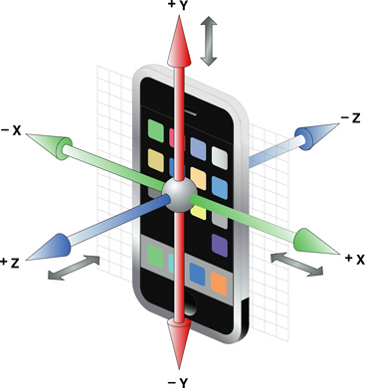
Coordinate system

