Slide 1
Mobile Game Development

Slide 2
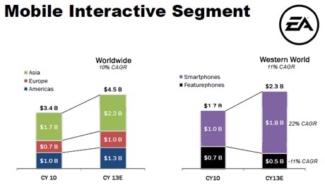
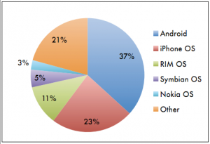
Mobile Game Market

Slide 3
Syllabus
Unity
Corona
Cocos2D/3D
Comparison
Flash

Slide 4
Unity - introduction
Unity iPhone Interface - Demo
Notes:
Unity is an integrated development environment for creating 3D video games and other interactive stuff. It can be run on Mac and windows and produces apps for multiple platforms from PC to mobile phones. So, it is not just for mobile game development but for general game. And it is not free. Here is the website of Unity 3d where you can find the software, user manual tutorials and so on. In fact, in order to run unity apps on iphone or android, unity released unity iphone and unity android which are of pretty much the same GUI with unity3d but a little bit difference when it comes to interaction with the devices which I will show you in a while.
Here is the development environment of unity. It mainly contains five tabbed sections. The first one is called scene view. It basically shows the level. You can zoom in and out using the scrolloer in the scene view. If you click and hold the right button of the mouse, you can look around in 3D space. And also you can click certain object and press F button to find it. Very handy features. Pressing Alt + holding left clicking, you can move around the object this is in focus.
Next we can have a look at the panel above the scene view. The first option is for display model. We are now in texture model which means the scene view displays the surfaces of objects. If your computer is slow and in case you want to see how objects are layed and want it to be transparent in the level, you can switch to wireframe. And there are three more. In the development environment for iphone, an option occlusion exists. It basically means everything that is not in the camera’s view will be hidden. Unity has given very flexible features on how to set up occlusion because it is very important since devices like iphone, itouch, ipad and android are actually pretty slow. So, to save on memory and ram, what you need to do is setting up occulsion by the time the game is done so that things not in the camera will be hidden to save for example over 50% processing power.
The second little menu here is setting the colour channel. Green, red and blue which in most cases you will stay in. The other is alpha channel which you might need when you consider image effects. Here is a light option by clicking which you can turns the lights on and off. If you look into the view carefully, some shadows are not affected by the light. That’s because those shadow are baked into the level before being imported to the unity.
Now let us move to game view. The game view is the place where all the excitement happens and where the game will be played. The first one is for controlling the aspect ratio. In case you want to test your games at different ratio, you can change it. Except the standard ratios here, in unity iphone version, here are options for iphone normal or iphone wide. The miximize on play means you will play the game or test the game. It will maximize the view port and hide all other views out there. Gizmos are basically things in 3D model for example the 3D movehandle. And gizmos can only be seen in the scene view unless you turn it on. Gizmos can also be lines you draw in the 3D space. In case you debug something or check whether your script is correct. You can use gizmos and turn them on. However, if you export your game to iphone or android, gizmos are not visible. The last we have stats which is the status of the game. It has draw calls which pretty much indicates the load or expense of your game on the device. So, keep that in mind. So, if you need to debug the game, the status might be helpful.
Now it is time to focus on the hierarchy view. The hierarchy view holds all the elements inside the current scene that is currently open. So everything you can see here is listed here. Another good thing about hierarchy is you can drag and drop items on top of each other to make them child or parent. It is recommended to do that in script but if you want to do here. Now we have the project panel. The project is not for persific scenes but for the whole projects. In other words, the project can hold multiple scenes and the scene is highlighted by the unity icon. Project is basically what you have on the drive. Everything you have in the project here represents what you have in the certain folder on the hard drive. For example, if you open it in the finder, it will go to the folder on the hard drive. One point we can see here is project panel shows everything under assests folder. Whenever you create a project in unity, there is a asset folder, a library folder and temp folder. The library folder is bascially a data base for holding your preference and asset and you never need to modify them.
Last but not least we have inspector panel. Inspector is the one you will use a lot. If I select something in the scene view, hierarchy view, it shows the property in the inspector panel. As you can see, there are postion, rotation, and scale.

Slide 5
Unity - features
Deployment on multiple platforms
Integration with Blender, Cinema 4D..
Support bump mapping, reflection mapping, shadow mapping….
Built-in physics engine
Unity asset server for version control
Support Multiplayer networking
Larger file sizes
Not optimized for 2d
Notes:
Bump mapping is a technique to model a bump in one objects surface. Reflection mapping is a technique computer graphics for approximating the reflective surfaces of a project. Shadow mapping is a technique to add shadows to 3D object. Physics engine provides an approximate simulation of certain simple physical systems. For example, collision detection, fluid dynamics, gravity and so on.

Slide 6
Corona - introduction
Notes:
Corona is fast and easy development tool created by Ansca Mobile which allows programmers to build mobile applications for the iPhone, iPad, and Android devices. Corona is good for 2D graphically rich applications that are lightweight in size. For example, a high performance Corona-powered apps can run at 30fps as little as 300k. That is because corona is alleged to build its graphics and animation engine by fully leveraging OpenGL hardware acceleration.
Besides this, corona uses Lua as its programming language which is layered on top of objective C. This makes corona-powered apps run at native speed and match the ban released by apple on 3rd party APIs in apple store. Okey, let us have a look at how the corona SDK looks like.
This is the corona SDK I downloaded. Today Ansca Mobile publish a free version and you don’t need to pay any fee as long as the application doesn’t go to apple store or the android market. From the folder we can see, it contains two applications we can launch. The corona simulator is the main one. It allows you to select the project file and render it to one of the many ios or android devices. The other application is the corona terminal, which launches the simulator and also adds a terminal window which is helpful for debugging. As we will use the print command, let’s open the terminal.
From the interface we can see, there are two sections in the screen. One is on the lefthand side which allows you to open up a project, build for actual device, go to online documentations or read programming guide on API interface for sdk. If you are new to corona and want to find out what corona can do, here is the place you might start with. For example, if we click the first example, it opens up the corona simulator and loads the application. This is simulating iphone 4 device. You can see I am having interactions here. My curse is like a finger on the device. This is all one in a few lines lua codes. This is iphone 4 and I can go to select a different skin. Now I am simulating for the ipad. In the simulator, you can do majority of what you do on the device except some functions specific to actual devices, for example the accelerometer. But it is helpful for debugging the code.
Now let us go to the hello world app and have a glimpse on the code. I already created a project. It contains the main.lua file which is of the lua scripts and the assets used in the apps (e.g., images, audio). One thing here is corona is not distributed along with a particular lua editor, you can choose any program like notepad, eclipse with lua plugin to type your code and name the script file main.lua. So, this is how the project

Slide 7
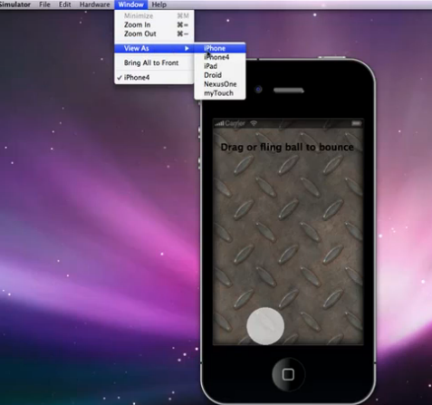
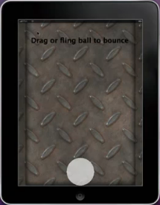
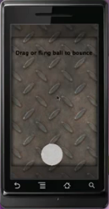
Cocos2d - GUI
Notes:
Cocos2d/3d is an open source game framework. It has two versions written in python or objective-c targting ios. It has a fast learning curve and alleged to be as powerful as OpenGL ES. Lets have a look at how the programming interface looks like.
Basically, cocos2d/3d is based on Xcode and plays as an embeded Xcode framework.

Slide 8
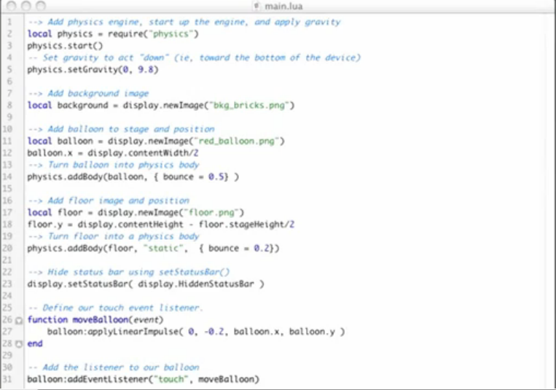
Cocos2d - GUI
Notes:
Cocos2d/3d is an open source game framework. It has two versions written in python or objective-c targting ios. It has a fast learning curve and alleged to be as powerful as OpenGL ES. Lets have a look at how the programming interface looks like.
Basically, cocos2d/3d is based on Xcode and plays as an embeded Xcode framework.

Slide 9
Corona - Features
Native Application Development
Support iOS and android
Optimized performance
Device features
Easy to learn
No support for compressed textures

Slide 10
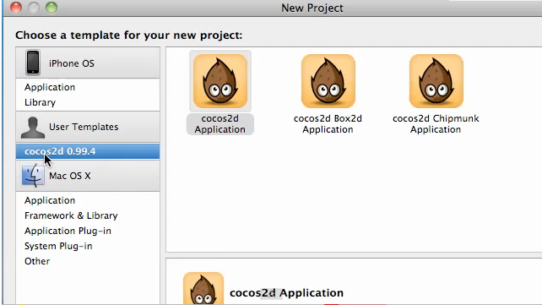
Cocos2d - introduction
Notes:
Cocos2d/3d is an open source game framework. It has two versions written in python or objective-c targting ios. It has a fast learning curve and alleged to be as powerful as OpenGL ES. Lets have a look at how the programming interface looks like.
Basically, cocos2d/3d is based on Xcode and plays as an embeded Xcode framework.

Slide 11
Cocos2d – features
Objective-C based
Easy to learn
High performance

Slide 12
Comparison - Unity corona cocos
Ease of use
Maturity
Performance
2D/3D
Multi-platform capability
Free or Paid license

Slide 13
Flash - tools
Flash CS5 Professional
Flash Builder (i.e., Flex Builder)
Flash development tool

Slide 14
Flash – Available APIs
Accelerometer
Geolocation
Camera Roll
Orientation
Touch Event
Gesture Transform Event
NetConnection
SQLite Database

Slide 15
Flash – APIs not available
Notifications
HTML Loader
….

Slide 16
Thanks a lot

