Slide 1
Processes and Threads

Slide 2
Threads, and processes, and tasks! Oh, my!
Process – linux process
Usually one process per application
Thread – linux thread
May be multiple per process
May encompass multiple application components
Tasks
Android stack of activities
May cross process boundaries
One task stack for each “job”

Slide 3
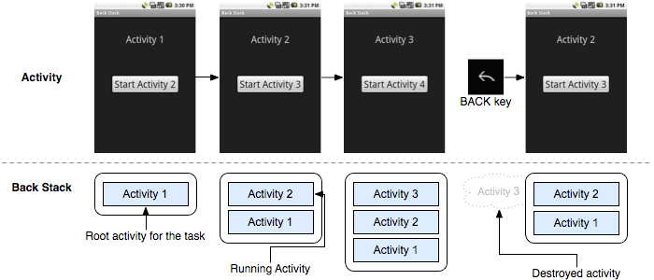
Task stack
Stack of activities rooted at initial activity
Multiple tasks may exists at once
Background task stacks
Back button pops activity from stack

Slide 4
Processes
When an application component is launched, if no other component is running, a new process with single thread is started
Separate process can be specified for component(s) using android:process attribute in manifest file
Processes may be killed due to low memory
importance hierarchy from process lifecycle

Slide 5
Threads
When application is launched, creates “main” thread
UI thread
Long operations should go in extra threads
Background / worker threads
Single-threaded model for UI
2 rules
Do not block UI thread
Do not access the android UI toolkit from outside the UI thread
UI toolkit not thread-safe, must always be manipulated in UI thread
Several ways to access UI thread from extra threads
Activity.runOnUiThread(Runnable)
View.post(Runnable)
View.postDelayed(Runnable, long)
Handler

Slide 6
Threads
Threads and Runnables created using standard Java syntax
Example new thread creation
new Thread (new Runnable() {
public void run() {
// implementation . . .
}
}).start();

Slide 7
UI helper thread example
public void onClick (View v) { new Thread(new Runnable() { public void run() { final Bitmap bitmap = loadImageFromNetwork ("http://exmpl.com/img.png");
mImageView.post (new Runnable() { public void run() { mImageView.setImageBitmap(bitmap); } }); } }).start(); }

Slide 8
Looper
Android class for providing message queue for threads
UI thread has a Looper created for it implicity
Can connect to this queue and handle messages by declaring new handler in main thread
HandlerThread
Handy class for starting a new thread that has a looper

Slide 9
Handler
Handles messages and runnables passed to a thread’s message queue
Connects to thread’s Looper
Thread safe
Extend Handler and override handleMessage(Message msg)

Slide 10
Message
Members
public int what
public int arg1
public int arg2
public object obj
public Messenger replyTo
Typically constructed using Message.obtain()
returns message object from global pool to avoid allocating new objects

Slide 11
Handler
Example implementation
class MyHandler extends Handler { @Override public void handleMessage (Message msg) { switch (msg.what) { case 1: // do something; break; case 2: // do something else; break; default: super.handleMessage(msg); } } }

Slide 12
Looper/Handler example

Slide 13
AsyncTask
Simplifies creation of long-running tasks that need to communicate with the UI
Must be subclassed
Instance must be created on UI thread
Instance can only be executed once
Automatically invokes
doInBackground() on worker thread
onPreExecute(), onPostExecute(), onProgressUpdate() on UI thread
Return value of doInBackground() passed to onPostExecute()
publishProgress() can be called in doInBackground() to execute onProgressUpdate()
Useful for progress bar updates

Slide 14
AsyncTask example
public void onClick(View v) { new DownloadImageTask().execute("http://exmpl.com/img.png"); } private class DownloadImageTask extends AsyncTask<String, Void,
Bitmap> {
protected Bitmap doInBackground(String... urls) { return loadImageFromNetwork(urls[0]); } protected void onPostExecute(Bitmap result) { mImageView.setImageBitmap(result); } }

Slide 15
Interprocess communication
Remote procedure calls can be accomplished two ways
Android interface definition language (AIDL)
Messenger service
AIDL provides custom defined interface
Requires other applications to have AIDL files
Messenger service has standard format but less flexible
Binder of AIDL or Messenger interface can be returned to clients in onBind()

Slide 16
AIDL
Defines an interface for interprocess communication
Needs to be thread-safe
Calls from local process are handled in caller thread
Calls from remote process are handled from thread pool
Calls to interface are direct function calls (synchronous), unless oneway keyword specified (asynchronous)
Interface define in .aidl file
Android SDK tools automatically generate IBinder interface

Slide 17
Example .aidl file
// IRemoteService.aidl package com.example.android; // Declare any non-default types here with import statements /** Example service interface */ interface IRemoteService {
/** Request the process ID of this service */ int getPid(); /** Demonstrates some basic types that you can use as * parameters and return values in AIDL. */ void basicTypes(int anInt, long aLong, boolean aBoolean, float aFloat, double aDouble, String aString); }

Slide 18
Messenger
Pointer to Handler
Allows handler to be called from other processes
Can be used for interprocess message passing
To expose handler
Initialize Messenger with Handler to share
Messenger mMessenger = new Messenger (new MyHandler());
To connect to remote handler
Initialize Messenger with IBinder of remote interface
Messenger mMessenger = new Messenger(serviceIbinder);

Slide 19
IPC example

Slide 20
Thread safe
Interprocess communication with an IBinder performed using a pool of threads in IBinder process
ContentProvider methods called from a pool of threads in content provider’s process
query()
insert()
delete()
update()

Slide 21
LogCat
Android logging system mechanism used to view system debug output
Can be used to view stack trace of emulator errors
Useful for locating line of code were error initiated
LogCat viewable in realtime in Debug or DDMS view of Eclipse
Common logging methods
v - verbose
d - debug
i - information
w - warning
e - error
Usage example
Log.i(“MyActivity”, “MyClass.memberfunction – error message”);

