Slide 1
Stargate Development Environment
Jun Yi
For the wireless sensor networks class in 2010
University of Notre Dame
Notes:
I am the TA of this course. I am going to give a tutorial on TinyOS and Nesc programming languages.

Slide 2
Outline
Hardware Platform
Programming Environment Setup
Wireless Setup
Connection with Motes
Notes:
I am going to introduce the tinyos, the operating system for the sensors and motes. The programming language,nesC, and sensor network programming environment and toolchain.

Slide 3
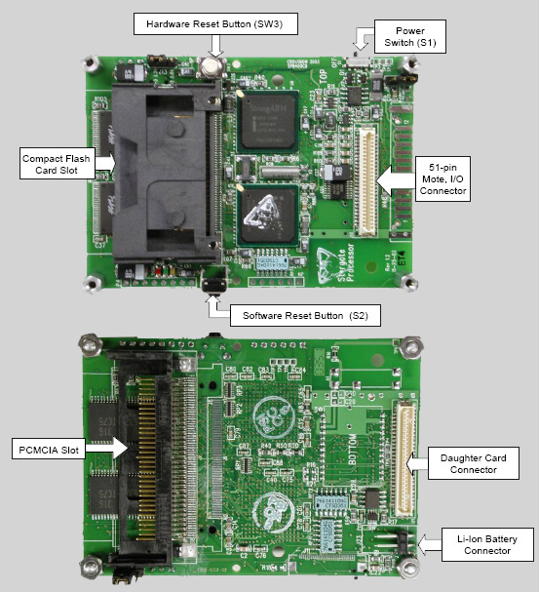
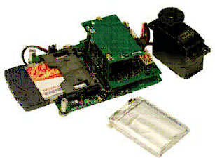
Hardware
Notes:
I am going to introduce the tinyos, the operating system for the sensors and motes. The programming language,nesC, and sensor network programming environment and toolchain.

Slide 4
Connect to Stargate from your PC
Serial connection
Configuration: minicom –s (/dev/ttyS0, 115200 baud, 8 data bits, no parity, 1 stop bit, no flow control)
Connection: minicom
Exit: Ctrl+A+X
Help: Ctrl+A+Z
Notes:
I am going to introduce the tinyos, the operating system for the sensors and motes. The programming language,nesC, and sensor network programming environment and toolchain.

Slide 5
Install the cross-development tool chains
Install tool chain arm-linux-gcc-3.4.1 instead of 3.3.2 in the manual if the stargate Linux is 2.6.xx (the current stargate version is 2.4.19, so don’t install 3.3.2
Export path=$path:/usr/local/arm/3.3.2/bin
I already include this to the /root/.bashrc
Test the compiler: which arm-linux-gcc
Notes:
I am going to introduce the tinyos, the operating system for the sensors and motes. The programming language,nesC, and sensor network programming environment and toolchain.

Slide 6
Cross Compile Stargate Applications
Write the Makefile:
CC = arm-linux-gcc
INCS =
DEFS =
OBJS =
LIBS =
foo-bar: ${OJBS}
$(CC) -o foo-bar ${LIBS} ${OBJS}
foo.o: foo.c
$(CC) ${DEFS} $(INCS) -c foo.c
bar.o: bar.c
$(CC) ${DEFS} $(INCS) -c bar.c
clean:
rm -f foo.c bar.o foo-bar
Run Make: make
Notes:
I am going to introduce the tinyos, the operating system for the sensors and motes. The programming language,nesC, and sensor network programming environment and toolchain.

Slide 7
Download/Upload files from/to Stargate
Using minicom
Press ctrl+A+Z, then select S or R to send/receive files between stargate and PC
Or using scp, if you already set up network connection (easy, convenient, and fast way)
transfer a file (such as hello or classicping) from A to B (your terminal is at A now)
A> scp classicping root@B:
A> scp hello root@B:
Notes:
I am going to introduce the tinyos, the operating system for the sensors and motes. The programming language,nesC, and sensor network programming environment and toolchain.

Slide 8
Setup a WiFi
Ifconfig to set net interface parameters
Iwconfig to set up wireless-related parameters
Example:
stargate:/root# ifconfig wlan0 up
stargate:/root# iwconfig wlan0 essid off
stargate:/root# iwconfig wlan0 mode managed
stargate:/root# iwconfig wlan0 essid nomad
stargate:/root# ifconfig wlan0 up
stargate:/root# dhcpcd wlan0
Notices: the linux in the stargate does not support WPA and so can not join ND-Secure. As a result, you can access the stargate using domain (e.g., stargatexxx.resnet.nd.edu), you must use IP and the IP address is changing every time you restart (restart DHCP daemon).
Notes:
I am going to introduce the tinyos, the operating system for the sensors and motes. The programming language,nesC, and sensor network programming environment and toolchain.

Slide 9
Connect to Motes
Use the 51-pin on the stargate
Look at the source code in the stargate sample application (the source code is for tinyOS 1.x, but we use tinyOS 2.1.0, the source code without modification will not work)
At the mote side: genericBaseM.nc (implant your base station code from Project1)
Change Interface type of UARTSend/Receive to SerialSend/Receive
Change Interface type of RadioSend/Receive to AMSend/Receive
At the stargate side: motetest.c
TOS_PACKET_FORMAT is changed, check the TinyOS document
Notes:
I am going to introduce the tinyos, the operating system for the sensors and motes. The programming language,nesC, and sensor network programming environment and toolchain.

Slide 10
Collection-Tree Routing Protocol (Necessary)
Instead of writing your own multihop forwarding (hardcoded next hop) code, use the CTP, it is address-free (refer to the TinyOS programming e-book, chapter 6)
Component new CollectionSenderC(xxx)
Use Interface Send (from CollectionC component)
Use Interface Receive (from CollectionC component)
Notes:
I am going to introduce the tinyos, the operating system for the sensors and motes. The programming language,nesC, and sensor network programming environment and toolchain.

Slide 11
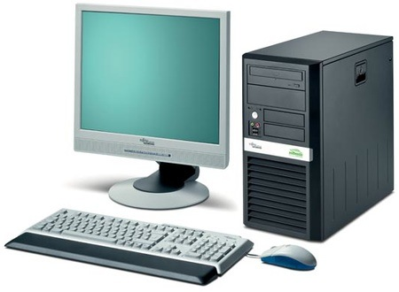
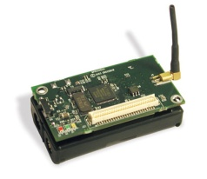
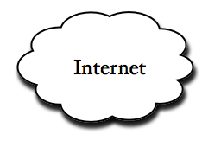
Component of Project2
Wireless: ZigBee
Wireless: ZigBee
Wired at DARTS
TCP/UDP
Wireless: WiFi
Wireless: ZigBee
Wireless: ZigBee
You need to write the tcp/udp code at the PC and stargate, write the serial I/O code for the communication between stargate and mote, write the multihop code for motes, and sound beep and light reading codes, ….
PC—(by ethernet)—the internet---(by WiFi)—Stargate—(by serial)---basestation mote—(by zigbee)—(other motes with sensors attached)
Notes:
I am going to introduce the tinyos, the operating system for the sensors and motes. The programming language,nesC, and sensor network programming environment and toolchain.

Slide 12
Lab settings
The stargate cross-compile environment is setup
The com port is already connected to a stargate platform
Notes:
I am going to introduce the tinyos, the operating system for the sensors and motes. The programming language,nesC, and sensor network programming environment and toolchain.

Slide 13
Notes:
Let me first introduce a typical sensor network and its components. At the left side are sensor nodes, usually consisting of a mote node and a sensor board for various sensing tasks. The mote node is like a old-time personal computer. It has a 8/16 bit CPU, 8-256K memory, and a low-speed radio. The operating system is installed into the flash memory of the mote. A sensor board is attached to the mote as a peripheral. The base station is also a mote, which is connected via serial or USB cable to a PC. The program running in the base station is for receiving messages and forwarding them to the PC, and receiving commands from the PC and dessiminate them to the sensor network. The PC with its application serves as a data analysis and control center

