Slide 1
Stargate Development Environment
Jun Yi
For the wireless sensor networks class in 2010
University of Notre Dame

Slide 2
Outline
Hardware Platform
Programming Environment Setup
Wireless Setup
Connection with Motes

Slide 3
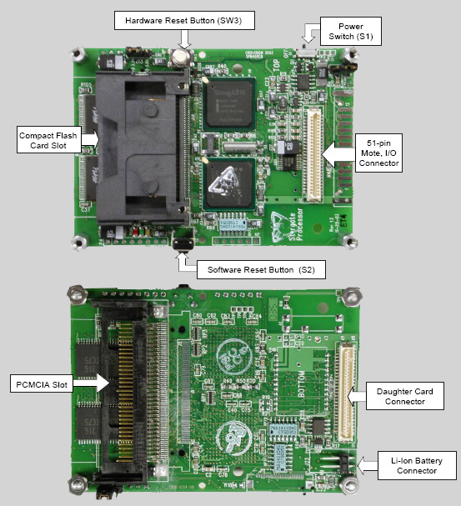
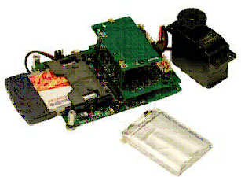
Hardware

Slide 4
Connect to Stargate from your PC
Serial connection
Configuration: minicom –s (/dev/ttyS0, 115200 baud, 8 data bits, no parity, 1 stop bit, no flow control)
Connection: minicom
Exit: Ctrl+A+X
Help: Ctrl+A+Z

Slide 5
Install the cross-development tool chains
Install tool chain arm-linux-gcc-3.4.1 instead of 3.3.2 in the manual if the stargate Linux is 2.6.xx (the current stargate version is 2.4.19, so don’t install 3.3.2
Export path=$path:/usr/local/arm/3.3.2/bin
I already include this to the /root/.bashrc
Test the compiler: which arm-linux-gcc

Slide 6
Cross Compile Stargate Applications
Write the Makefile:
CC = arm-linux-gcc
INCS =
DEFS =
OBJS =
LIBS =
foo-bar: ${OJBS}
$(CC) -o foo-bar ${LIBS} ${OBJS}
foo.o: foo.c
$(CC) ${DEFS} $(INCS) -c foo.c
bar.o: bar.c
$(CC) ${DEFS} $(INCS) -c bar.c
clean:
rm -f foo.c bar.o foo-bar
Run Make: make

Slide 7
Download/Upload files from/to Stargate
Using minicom
Press ctrl+A+Z, then select S or R to send/receive files between stargate and PC
Or using scp, if you already set up network connection (easy, convenient, and fast way)
transfer a file (such as hello or classicping) from A to B (your terminal is at A now)
A> scp classicping root@B:
A> scp hello root@B:

Slide 8
Setup a WiFi
Ifconfig to set net interface parameters
Iwconfig to set up wireless-related parameters
Example:
stargate:/root# ifconfig wlan0 up
stargate:/root# iwconfig wlan0 essid off
stargate:/root# iwconfig wlan0 mode managed
stargate:/root# iwconfig wlan0 essid nomad
stargate:/root# ifconfig wlan0 up
stargate:/root# dhcpcd wlan0
Notices: the linux in the stargate does not support WPA and so can not join ND-Secure. As a result, you can access the stargate using domain (e.g., stargatexxx.resnet.nd.edu), you must use IP and the IP address is changing every time you restart (restart DHCP daemon).

Slide 9
Connect to Motes
Use the 51-pin on the stargate
Look at the source code in the stargate sample application (the source code is for tinyOS 1.x, but we use tinyOS 2.1.0, the source code without modification will not work)
At the mote side: genericBaseM.nc (implant your base station code from Project1)
Change Interface type of UARTSend/Receive to SerialSend/Receive
Change Interface type of RadioSend/Receive to AMSend/Receive
At the stargate side: motetest.c
TOS_PACKET_FORMAT is changed, check the TinyOS document

Slide 10
Collection-Tree Routing Protocol (Necessary)
Instead of writing your own multihop forwarding (hardcoded next hop) code, use the CTP, it is address-free (refer to the TinyOS programming e-book, chapter 6)
Component new CollectionSenderC(xxx)
Use Interface Send (from CollectionC component)
Use Interface Receive (from CollectionC component)

Slide 11
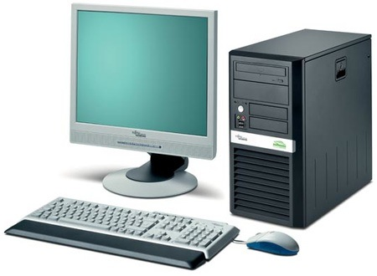
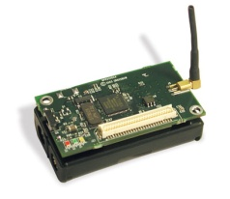
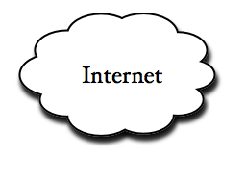
Component of Project2
Wireless: ZigBee
Wireless: ZigBee
Wired at DARTS
TCP/UDP
Wireless: WiFi
Wireless: ZigBee
Wireless: ZigBee
You need to write the tcp/udp code at the PC and stargate, write the serial I/O code for the communication between stargate and mote, write the multihop code for motes, and sound beep and light reading codes, ….
PC—(by ethernet)—the internet---(by WiFi)—Stargate—(by serial)---basestation mote—(by zigbee)—(other motes with sensors attached)

Slide 12
Lab settings
The stargate cross-compile environment is setup under /root/stargate
The com port is already connected to a stargate platform

Slide 13
CTP and Dissemination
Write your own dissemniation based on EasyDissemination, write your own CTP based on EasyCollection.
The base station node ID is 1, and client node ID must >1. make micaz install.1 mib520,/dev/ttyS0 (for base station mote). make micaz install.x mib520,/dev/ttyS0 (X >1 for non-base station mote)
The only trick is that you need to set up non-basestation mote first, then the base station mote, and put them close at the beginning

Slide 14
UDP/TCP between host machine and stargate
Using the sample code stargate/apps/sample/net: there is a server and client code. You must use the stargate as the server due to the security policy of campus network
Use ifconfig to obtain the IP address of stargate and your host machine
There is wifi_network.sh, which can set up the wireless connection to nomad campus network on stargate, already included in .bashrc
Remember to change the Makefile of the sample net application, exchange the HOST_CC and CC role, since the default setting is that stargate acts as a client

Slide 15
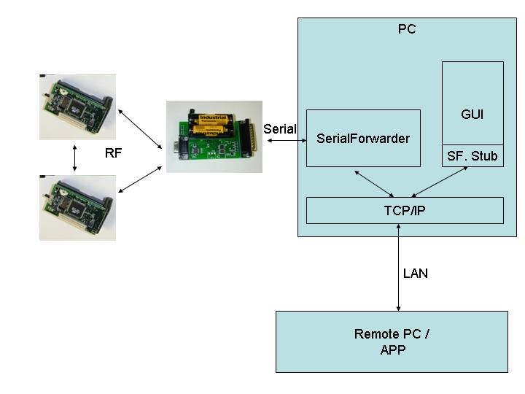
SF

Slide 16
Serial communicaiton between stargate and mote
Two methods to use:
Install tinyos development environment on your host machine (do not use VM), and use arm-linux-gcc instead of standard gcc to compile the serial forwarder tool
Install stargate development environment on the VM, use arm-linux-gcc to compile the serial forwarder under directory /opt/tinyos-2.1.0/support/sdk/c/sf
We take the second method, and I already installed the stargate environment on one VM and will install them on all VMs

Slide 17
Compile SF
$ ./boottrap
$./configure
$ vi Makefile
$ PATH=${PATH}:your-arm-linux-gcc-directory
Edit Makefile, change gcc* to arm-linux-gcc
Make
$ tar –cvf sf.tar *
$ scp sf.tar root@stargateip:/
$ sf port motedevicename baudrate (at stargate)

Slide 18
Introduction of the serial forwarder
The serial port on the stargate to mote is dev/tts/2(the one to the programming board is /dev/tts/0
sf port-on-stargate mote-devicename baudrate
Sf 9002 /dev/tts/2 micaz
Setup a TCP server on the stargate, forwarded received packet from port 9002 to mote and vice versa
Connect your host machine TCP client to the SF server port 9002
other tools: sfsend, sflisten, seriallisten, serialsend, etc.

Slide 19
Hint (Look at the LightGame on the class website)
The hardest part is the program of the base station mote: you need to combine EasyDissemination, EasyCollection, Basestaion (tinyos-2.1.0/apps/Basestation) into one program. You need to be very careful about the code footprint.
You need to install serial forwarder into the stargate (it is a different architecture than x-86), serial forwarder serves as a bridge between the Internet and the mote.
You need the message files generated by mig/ncg to send/collect messages from the mote network. Pull these message files to your TCP client program.

Slide 20
What disseminated and collected
Call the function update within the disseminationUpdate interface
Client2
Disseminate the ID value of the node which is selected to beep
Base Mote
Start to beep if selected
Forward read light values to the stargate from the network, and forward the beeping node ID from the stargate to the network
Client3
Receive Changed event within the disseminationValue interface, using the get() command to obtain the light value
Report light value to the base station with its own node ID
Dissemination
Collection

Slide 21
Sample Code for Light Message
#ifndef LIGHT_MSG_H
#define LIGHT_MSG_H
enum {
AM_LIGHT_MSG = xx //the message type value defined by youself
};
typedef nx_light_msg{
nx_uint16_t uid;
nx_uint16_t value;
} light_msg;
#endif

Slide 22
Sample Code for Motes (interfaces)
You need to create a mote module component using the following interfaces (for serial connection, for radio connection, for dissemination, for collection, for system initialization, for LEDs , for Timers, and for sensors), please see attached lightgame.nc for more details
uses interface CC2420Packet; //for transmission power control
uses interface Boot; //for initialization
uses interface SplitControl as RadioControl; // for radio control (start and stop, etc.)
uses interface StdControl as RoutingControl; //for collection tree protocol
uses interface Send; //radio send
uses interface Leds; //LED
uses interface Timer<TMilli> as Timer1; //Timer
uses interface Timer<TMilli> as Timer2; //Timer
uses interface RootControl; //Base station mote control
uses interface Receive as ReceiveCollection; //radio receive
uses interface StdControl as DisseminationControl; //dissemination control
uses interface DisseminationValue<uint16_t> as Value; //dissemination values
uses interface DisseminationUpdate<uint16_t> as Update; //dissemination update
uses interface Mts300Sounder as Sounder; //sounder sensor
uses interface Read<uint16_t> as ReadLight; //sensor read
uses interface SplitControl as SerialControl; //serial control
uses interface AMSend as UartSend[am_id_t id]; //serial send
uses interface Receive as UartReceive[am_id_t id]; //serial receive
uses interface Packet as UartPacket; //serial raw packet
uses interface AMPacket as UartAMPacket; //serial active message
uses interface Packet as RadioPacket; //radio packet
uses interface AMPacket as RadioAMPacket; //radio active message

Slide 23
Sample Code for Motes (interfaces wiring)
wiring is done at lightgameappc.nc
configuration LightGameAppc{}
implementation {
components CC2420PacketC; components LightGameC as App; components MainC, LedsC, ActiveMessageC; components CollectionC as Collector;
components new CollectionSenderC(0xab); components new TimerMilliC() as Timer1; components new TimerMilliC() as Timer2;
components DisseminationC; components new DisseminatorC(uint16_t, 0x1987) as Diss16C; components SounderC;
components new DemoSensorC() as Sensor; components SerialActiveMessageC as Serial;
App.Boot -> MainC;
App.RadioControl -> ActiveMessageC;
App.RoutingControl -> Collector;
App.Leds -> LedsC;
App.Timer1 -> Timer1;
App.Timer2 -> Timer2;
App.Send -> CollectionSenderC;
App.RootControl -> Collector;
App.ReceiveCollection -> Collector.Receive[0xab];
App.DisseminationControl -> DisseminationC;
App.Value -> Diss16C;
App.Update -> Diss16C;
App.Sounder -> SounderC;
App.ReadLight -> Sensor;
App.SerialControl -> Serial;
App.UartSend -> Serial;
App.UartReceive -> Serial;
App.UartPacket -> Serial;
App.UartAMPacket -> Serial;
App.RadioPacket -> ActiveMessageC;
App.RadioAMPacket -> ActiveMessageC;
App.CC2420Packet -> CC2420PacketC;
}

Slide 24
Sample Code for Motes (Makefiles)
//it is within the makefile
COMPONENT=LightGameAppc
SENSORBOARD=mts300
CFLAGS += -I$(TOSDIR)/lib/net \
-I$(TOSDIR)/lib/net/drip \
-I$(TOSDIR)/lib/net/ctp \
-I$(TOSDIR)/lib/net/le
BUILD_EXTRA_DEPS += LightGame.class
CLEAN_EXTRA = *.class LightGameMsg.java
LightGame.class: $(wildcard *.java) LightGameMsg.java
javac *.java
LightGameMsg.java:
mig java -target=null -java-classname=LightGameMsg LightGameMsg.h LightGameMsg -o $@
include $(MAKERULES)

Slide 25
Sample Code for Motes (system startup)
// Within the lightgame.nc, you need to start the serial and radio when the system boots up, for example,
event void Boot.booted() {
//set up UART queue, better to use a circular ring
//start radio and serial
call RadioControl.start();
call SerialControl.start();
}
//once the radio has been started successfully, start CTP and dissemination, start
event void RadioControl.startDone(error_t err) {
if (err != SUCCESS)
call RadioControl.start();
else{
call RoutingControl.start(); //start CTP
call DisseminationControl.start(); //start dissemination
//set the node with ID=1 to be the root node of the CTP
if (TOS_NODE_ID == 1){
call RootControl.setRoot();
}else{
call Timer2.startPeriodic(500); // start the timer to read light values periodically
}
}
}

Slide 26
Sample Code for Motes (receive beeping information from the base station)
Within lightgame.nc., mote should listen to the disseminated value
event void Value.changed() {
// This is triggered when the base station updates beepingNode
const uint16_t* newVal = call Value.get();
beepid = *newVal;
if (TOS_NODE_ID != 1){
call Leds.set(beepid);
}
if (beepid == TOS_NODE_ID){ //if the node is the selected node, start to beep periodically using timer1
call Sounder.beep(50);
call Timer1.startPeriodic(500);
}else{
call Timer1.stop();
}
}
event void Timer1.fired() { //beep again
// Start this timer when start beeping. Should also beep here.
call Sounder.beep(250);
}

Slide 27
Sample Code for Motes (read and send light values to the base station mote)
Within lightgame.nc., mote should report their light reading periodically
event void Timer2.fired() { //timer2 has been started within the radiostartdone event
// to read the light value
call ReadLight.read();
}
//the light value is read out
event void ReadLight.readDone(error_t result, uint16_t data) {
if (result != SUCCESS){
data = 0xffff;
}
lightValue = data;
if (!sendBusy){
sendMessage(); //send the read value (by CTP) to the base station mote
}
}
void sendMessage() {
light_msg* msg = (light_msg*)call Send.getPayload(&packet, sizeof(light_msg));
msg->uid = TOS_NODE_ID; //send with the node ID
msg->value = lightValue;
msg->txpower = txpower;
call CC2420Packet.setPower(&packet, txpower); (set the transmission power level)
if (call Send.send(&packet, sizeof(light_msg)) != SUCCESS){ //calll radio’s send
}
else{
call Leds.led2Toggle();
sendBusy = TRUE;
}
}

Slide 28
Sample Code for Motes (base station mote receives beeping messages from the stargate)
Within lightgame.nc., the base station mote (via dissemination interface) forwards received the node ID of the node which will be beeping next to the network
event message_t *UartReceive.receive[am_id_t id](message_t *msg, void *payload, uint8_t len) {
call Leds.led2Toggle();
call Leds.led1Off();
call Leds.led0Off();
//call Leds.set(*(char *)payload);
if (*(char *)payload==0x06){ //node id is 6 (set the node id by make micaz install.6 mib520, /dev/ttys0
bid = 6;
call Update.change(&bid);
}
if (*(char *)payload==0x02){
bid = 2;
call Update.change(&bid);
}
if (*(char *)payload==0x03){
bid = 3;
call Update.change(&bid);
}
if (*(char *)payload==0x04){
bid = 4;
call Update.change(&bid);
}
if (*(char *)payload==0x05){
bid = 5;
call Update.change(&bid);
}
return msg;
}

Slide 29
Sample Code for Motes (base station mote sends light value messages to the stargate)
Within lightgame.nc., the base station node store received radio messages into the uartQueue, and forwards them one-by-one to the stargate via the serial connection)
event message_t* ReceiveCollection.receive(message_t* msg, void* payload, uint8_t len){
// This is where the collection node receives the message with nodeid and lightvalue
if (len==sizeof(light_msg)){
message_t *ret = msg;
call Leds.led2Toggle();
atomic {
if (!uartFull){
ret = uartQueue[uartIn];
uartQueue[uartIn] = msg;
uartIn = (uartIn + 1) % UART_QUEUE_LEN;
if (uartIn == uartOut)
uartFull = TRUE;
if (!uartBusy){
post uartSendTask();
uartBusy = TRUE;
}
}
}
return ret;
}
return msg;
}

Slide 30
Sample Code for Motes Cont.
Within lightgame.nc., the base station node store received radio messages into the uartQueue, and forwards them one-by-one to the stargate via the serial connection)
event message_t* ReceiveCollection.receive(message_t* msg, void* payload, uint8_t len){
// This is where the collection node receives the message with nodeid and lightvalue
if (len==sizeof(light_msg)){
message_t *ret = msg;
call Leds.led2Toggle();
atomic {
if (!uartFull){
ret = uartQueue[uartIn];
uartQueue[uartIn] = msg;
uartIn = (uartIn + 1) % UART_QUEUE_LEN;
if (uartIn == uartOut)
uartFull = TRUE;
if (!uartBusy){
post uartSendTask();
uartBusy = TRUE;
}
}
}
return ret;
}
return msg;
}

Slide 31
Sample Code for Motes (base station mote sends light value messages to the stargate)
Within lightgame.nc., the base station node store received radio messages into the uartQueue, and forwards them one-by-one to the stargate via the serial connection)
//using a task to continually send out stored radio messages to the stargate via the serial connection
task void uartSendTask() {
uint8_t len;
am_id_t id;
am_addr_t addr, src;
message_t* msg;
atomic
if (uartIn == uartOut && !uartFull){
uartBusy = FALSE;
return;
}
msg = uartQueue[uartOut];
tmpLen = len = call RadioPacket.payloadLength(msg);
id = call RadioAMPacket.type(msg);
addr = call RadioAMPacket.destination(msg);
src = call RadioAMPacket.source(msg);
call UartPacket.clear(msg);
call UartAMPacket.setSource(msg,src);
if (call UartSend.send[id](addr, uartQueue[uartOut], len) == SUCCESS){
}else{
post uartSendTask();
}
}

Slide 32
Sample Code for Motes cont.
Within lightgame.nc., the base station node store received radio messages into the uartQueue, and forwards them one-by-one to the stargate via the serial connection)
//using a task to continually send out stored radio messages to the stargate via the serial connection, until the circular buffer is empty
event void UartSend.sendDone[am_id_t id](message_t* msg, error_t err){
if (err != SUCCESS){
}else{
atomic
if (msg == uartQueue[uartOut]){
if (++uartOut >= UART_QUEUE_LEN)
uartOut = 0;
if (uartFull)
uartFull = FALSE;
}
}
post uartSendTask();
}
}

Slide 33
The stargate/Mote/HostPC
Base Mote
Stargate
HostPC (at VM)
Start a SF (cross-compiled)
at the stargate,
Which is connected to the
SF at the hostPC:
Start a SF at the hostPC,
Write your own Java/C
Control application, which
Connecting to the SF on the
hostPC.
Sf stargateport /dev/tts/2 micaz
Sf hostPCPORT sf@stargateHOST:stargatePORT
Remember your hostPC is the Virtual Machine,
Otherwise, you need to copy tinyos.jar to the host machine
Read this page for more information: http://docs.tinyos.net/index.php/Mote-PC_serial_communication_and_SerialForwarder

Slide 34
Sample Code for the hostPC game control
import net.tinyos.message.*;
import net.tinyos.packet.*;
import net.tinyos.util.*;
import java.util.*;
import java.io.*;
public class LightGame implements MessageListener {
private MoteIF moteIF;
public LightGame(MoteIF moteIF) {
this.moteIF = moteIF;
this.moteIF.registerListener(new LightGameMsg(), this);
}
public void sendPackets() {
LightGameMsg payload = new LightGameMsg();
int id = rng.nextInt(4);
try {
while (true) {
System.out.println("Sending packet " + counter);
payload.set_uid(id);
moteIF.send(0, payload);
id = rng.nextInt(4);
try {Thread.sleep(1000);}
catch (InterruptedException exception) {}
}
}
catch (IOException exception) {
System.err.println("Exception thrown when sending packets. Exiting.");
System.err.println(exception);
}
}

Slide 35
Sample Code for the hostPC game control (look at TestSerial.java for sample)
import net.tinyos.message.*;
import net.tinyos.packet.*;
import net.tinyos.util.*;
import java.util.*;
import java.io.*;
public class LightGame implements MessageListener {
private MoteIF moteIF;
public LightGame(MoteIF moteIF) {
this.moteIF = moteIF;
this.moteIF.registerListener(new LightGameMsg(), this);
}
public void sendPackets() {
LightGameMsg payload = new LightGameMsg();
int id = rng.nextInt(4);
try {
while (true) {
System.out.println("Sending packet " + counter);
payload.set_uid(id);
moteIF.send(0, payload);
//add your control logic here… id = rng.nextInt(4);
try {Thread.sleep(1000);}
catch (InterruptedException exception) {}
}
}
catch (IOException exception) {
System.err.println("Exception thrown when sending packets. Exiting.");
System.err.println(exception);
}
}

Slide 36
Sample Code for the hostPC game control
public void messageReceived(int to, Message message) {
LightGameMsg msg = (LightGameMsg)message;
//put more information to display here
System.out.println("Received packet from node " + msg.get_uid());
}
private static void usage() {
System.err.println("usage: LightGameMsg [-comm <source>]");
}

Slide 37
Sample Code for the hostPC game control cont.
public static void main(String[] args) throws Exception {
String source = null;
if (args.length == 2) {
if (!args[0].equals("-comm")) {
usage();
System.exit(1);
}
source = args[1];
}
else if (args.length != 0) {
usage();
System.exit(1);
}
PhoenixSource phoenix;
if (source == null) {
phoenix = BuildSource.makePhoenix(PrintStreamMessenger.err);
}
else {
phoenix = BuildSource.makePhoenix(source, PrintStreamMessenger.err);
}
MoteIF mif = new MoteIF(phoenix);
LightGame gameMonitor = new LightGame(mif);
gameMonitor.sendPackets();
}
}

Slide 38
Running the code
Running the programs
1.) Install the LightGame code onto 5 motes with IDs ranging from 1 to 5. This can be accomplished by running the Makefile in the LightGame folder, and download the image to motes.
2.)Setup the mote with ID 1 on the stargate, the rest of the motes need a sensorboard.
3.)Start a SerialForwarder on the Stargate. This can be done by copying "sf“ to the Stargate and running it as "./sf 9002 /dev/tts/2 micaz".
4.)Start a SerialForwarder on the VM. This can be done by running the following command in the VM:"java net.tinyos.sf.SerialForwarder -comm sf@IP ADDRESS OF STARGATE:9002"
5.)Run the java LightGame program within the VM. Do this by running the following command: "java LightGame -comm sf@localhost:9002”

Slide 39
Any questions please email me!!
REFER all codes to the LightGame
tarball on the classwebsite

