Slide 1
Smart Health – CSE 40816
University of Notre Dame
Spring 2020

Slide 2
Mental Illnesses
Mental illness is a term that refers to disorders that are characterized by disturbances in thinking, mood, or behavior, or a combination thereof, associated with distress or impaired functioning
Mental illness can be caused by physical illnesses, biochemical abnormalities in the brain function, stress and other environment factors; often a combination of these factors contributes to causing a mental illness

Slide 3
Signs and Symptoms
Symptoms are subjective feelings and sensations that the person is aware of
A person may say: “I feel low, sad, and depressed”
Signs are objective observable behaviors that the person demonstrates
A person may look very sad, and move and speak very slowly
The more symptoms and signs a person has, the more likely it is that she/he has a mental illness

Slide 4
Common Signs
Agitation: Because the symptoms of mental illness can be very distressing, a person may become very agitated, upset, and restless
Anxiety: Very common symptom and sign of many serious mental illnesses, including depression and psychotic illnesses; the person may show signs of excessive fear such as sweating, breathing very fast, and being agitated
Abnormal mood: In acute phases of mental illness, there are unusual or extreme qualities to the person’s mood; moods can also change very quickly from a reduced emotional response (indifference, apathy) to an extreme of emotions (ecstasy)
Confusion: This is a general term and could mean that the person is disoriented or incoherent (unable to conduct an understandable conversation)

Slide 5
Common Signs
Incoherent speech: Persons with mental illness may not be able to conduct a coherent conversation; their speech may ramble from one unrelated topic to another, they may not be able to answer questions, and they may also talk about things that are strange or unrealistic or not speak at all
Changes in eating and sleeping: A marked change can also indicate a problem
Unusual beliefs or delusions: A person with a mental illness may have strange beliefs and ideas, such as someone trying to destroy them or that they have special powers, or that they are being persecuted or threatened in some way (being poisoned, followed, under threat of assassination)

Slide 6
Common Signs
Hallucinations: Sometimes persons with mental illness experience disturbances in sensory perception (of sight, hearing, smell, taste, or touch); they may say that they are hearing voices or that they are feeling things in their body
Aggression or violent behavior: Although most people with a mental illness do not become aggressive, some may do so, and such persons can display any type of aggression (verbal, physical)

Slide 7
Common Signs
Appearance: In an advanced stage a person with mental disorder may look neglected, unwashed, or may not have changed their clothes for sometime, or may be dressed strangely
Other unusual behavior: The person may be wandering in the streets, appear to be homeless, may also walk into direct traffic, shout in the street, and become verbally abusive or aggressive to bystanders

Slide 8
Types of Mental Illnesses
Adjustment Disorders (stress, sad, hopeless)
Anxiety Disorders (fear, worry, panic)
Dissociative Disorders (memory, identity, sense of self)
Eating Disorders (anorexia, bulimia)
Impulse-Control Disorders (temptation, urge, impulse)
Mood Disorders (depression, bipolar)
Personality Disorders (paranoia)
Psychotic Disorders (schizophrenia)
Sleep Disorders (apnea, narcolepsy)
Somatoform Disorders (hypochondriasis)
Substance Disorders (alcohol, drugs)

Slide 9
Identifying Psychological Disorders
Deciding what behaviors, thoughts, or feelings are “normal” or “abnormal” can be difficult
Normal is average for the majority of people. Using this definition of normality, deviation from the majority becomes the primary criteria for abnormality
Socially Unacceptable Behavior
Laughing is a healthy outlet for most people
Laughing all the time and especially in inappropriate situations, might be considered abnormal
Behavior that violates a society’s accepted norms
Unwritten rules
Culture-bound syndrome
Norms change over time

Slide 10
Maladaptivity
Behavior that impairs an individual’s ability to function adequately in everyday life
Example would be behavior that causes misery and distress rather than happiness and fulfillment
Example: Alcohol abuse is a behavior; alcohol abuse often has strong negative effects on the drinker’s health, work, and family life

Slide 11
Anxiety Disorder
Phobic disorder (irrational fear)
Panic disorder (panic attacks)
Generalized anxiety disorder (excessive, ongoing anxiety about many different things)
Obsessive-compulsive disorder (uncontrollable, reoccurring thoughts and behaviors)
Stress disorders (physical, mental, or emotional stress)

Slide 12
Generalized Anxiety Disorder (GAD)
Excessive or unrealistic worry about life circumstances that lasts for more then 6 months
Most common anxiety disorder
Often people with GAD have other anxiety disorders too

Slide 13
Psychological Views on Anxiety Disorders
Based on learning theorists ideas- if child picks up spiders and adult freaks out then child learns to be phobic

Slide 14
Biological Views on Anxiety Disorders
Born with disorders
Example: if one identical twin shows disorder, the other has a 45% chance of developing the same
Passed down through the gene pool; ancestors more likely to survive and reproduce if they had fears of real dangers, such as heights, snakes, etc.

Slide 15
Obsessive-Compulsive Disorder (OCD)
Obsessions- unwanted thoughts or ideas that occur over and over again (fear of somebody breaking into the house)
Compulsive- repetitive ritual behaviors, often involving checking and/or cleaning something over and over again (rechecking the locks on windows and doors of the house a dozen times or more before can relax)

Slide 16
Post-traumatic Stress Disorder (PTSD)
Occurs after severe trauma: war, rape, child abuse, natural disaster, etc.
Not everyone who experiences a trauma will develop this
Symptoms can start up to 6 months after trauma and last for years
Acute stress disorder- similar to PTSD, but coming on sooner and not lasting as long
Flashbacks
Nightmares
Numbness of feeling
Avoidance of situations related to trauma
Difficulty sleeping and relaxing

Slide 17
Dissociative Disorder
Do you sometimes space out during class?
Do you sometimes miss a turn/exit because you were thinking of something else?
Do you get so involved in a book or show that you don’t hear your name?
If you answered “yes” to any or all of the questions you have dissociated

Slide 18
Dissociative Disorder
People will remove themselves mentally from a stressful/traumatic situation to reduce the anxiety
Sometimes people will lose their memory or identity: dissociative amnesia:
Forget the events surrounding a stressful/traumatic event
Can last a few days to years
Not associated with head injury
Common during war time or natural disasters

Slide 19
Dissociative Disorder
Dissociative Identity Disorder
Multiple personality disorder
Two or more personalities within the same person
Each personality has different voice, personality, facial expression
Personalities control the individual when they are in that state
Common in children who have experienced severe abuse

Slide 20
Depersonalization Disorder
Feelings of being outside body watching events going on around you
Again most often happens after traumatic or stressful event

Slide 21
Mood Disorders
Extreme emotions that are not connected to “real” event or situatation
Depression- feelings of helplessness, hopelessness, worthlessness, guilt, sadness
Bipolar disorder- cycle of moods from depression to manic (elated, hyper-active, etc.)
Major depression is one of the most common mental illnesses, affecting 6.7% (more than 16 million) of American adults each year

Slide 22
Depression Signs
Persistent depressed mood for most of day
Loss of interest or pleasure in all activities
Significant weight loss or gain due to changes
Sleeping more or less than usual
Speeding up or slowing down of physical and emotional reactions
Fatigue or loss of energy
Feelings of worthlessness or unfounded guilt
Reduced ability to concentrate or make meaningful decisions
Recurrent thoughts of death or suicide

Slide 23
Potential Digital Biomarkers
”Easier”:
Avoiding social exposure, seclusion
Mobility and social exposure sensors
Sadness
Activity levels and types; entertainment choices
Repetitive behaviors & memory problems
Activity sensors
Sleep problems
Sleep quality & sleep pattern sensors
Substance
Gait, balance, sweating, heart rate, …
Tougher:
Personality, psychotic, eating, somatoform, …

Slide 24
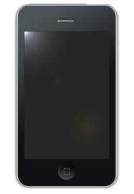
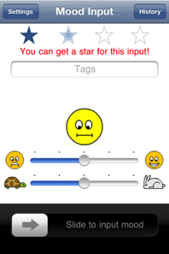
Example: MoodScope
Turn smartphone into “sensor”
Focus on daily mood assessment
Use only available low-power information
No audio/video sensing
No bio instrumentation
Non-invasive
Application-independent

Slide 25
Mood Sensing
Affective Computing
Audio/Video-based
(AffectAura, EmotionSense)
Biometric-based
(Skin conductivity,
Temperature, Pulse rate)
Captures expressions
Power hungry
Slightly invasive
Time series data
High cost of deployment
Requires skin contact

Slide 26
Mood Sensing
Usage trace-based
(MoodScope)
Passive; continuous
How to model mood?
Audio/Video-based
Captures expressions
Power hungry
Slightly invasive
Biometric-based
Very direct; fine-grained
High cost of deployment

Slide 27
MoodScope
f ( ) = mood
usage

Slide 28
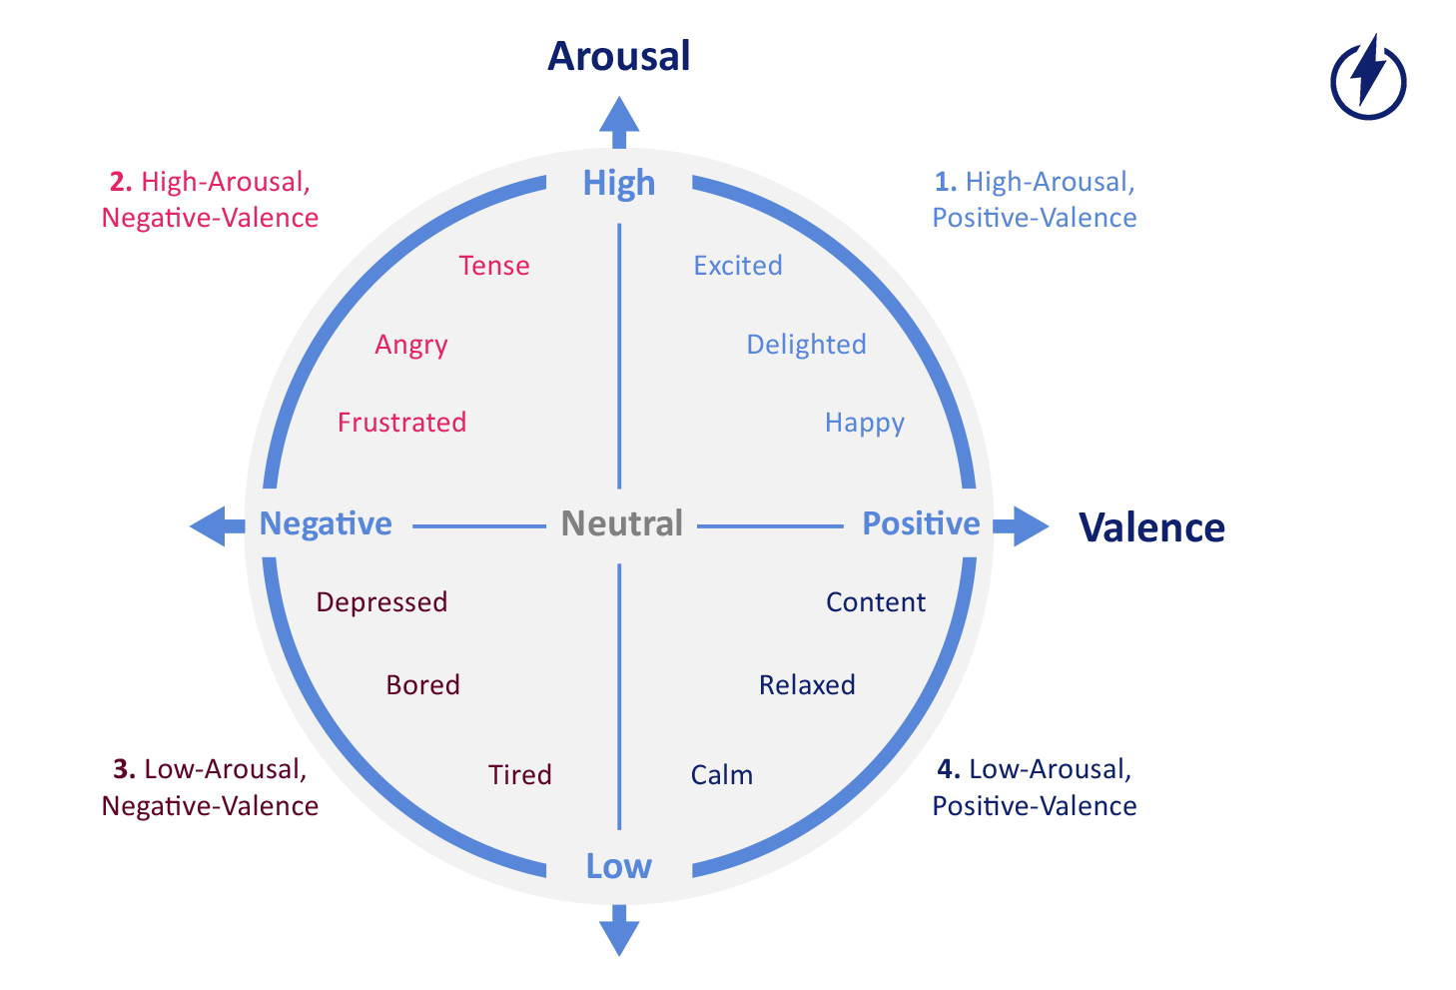
Valence-Arousal Model

Slide 29
MoodScope
How is the user communicating?
Maybe people text more when they’re happy and call more when they are angry
Call mom when sad
Longer text messages
What apps is the user using?
Social applications
Games
Web Browser
Music player

Slide 30
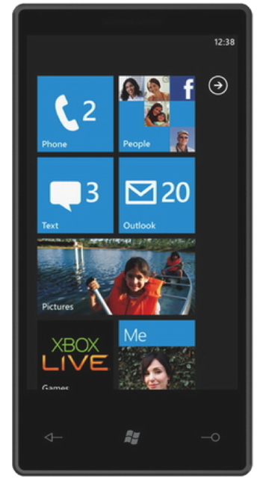
iPhone Livelab Logger
Web history
Phone call history
SMS history
Email history
Location history
App usage
Adapted From C. Shepard, A. Rahmati, C. Tossel, L. Zhong, And P. Kortum, "Livelab: Measuring Wireless Networks And Smartphone Users In The Field," In Hotmetrics, 2010.

Slide 31
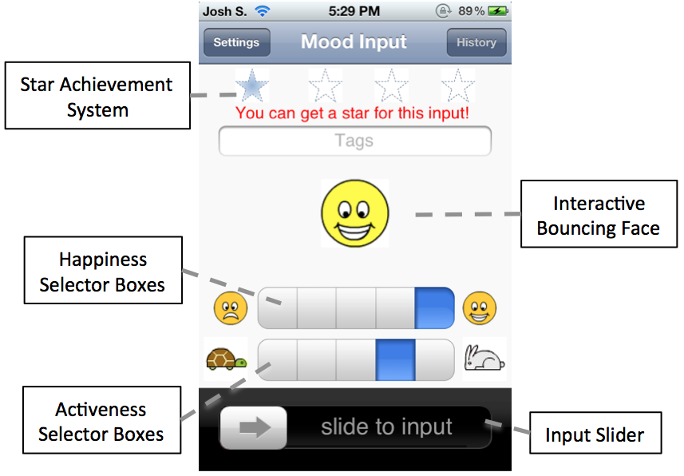
Mood Journaling App
User-base
32 users aged between 18 and 29
11 females

Slide 32
Sample Prediction

Slide 33
Error Distributions
Error² of > 0.25 will misclassify a mood label
93% < 0.25 error²

Slide 34
Personalized Training
All-user model accuracy

Slide 35
Personalized/All-user Hybrid Training

Slide 36
Resource-Friendly Implementation
Phone
Cloud
Inferred Mood
Mood Model
Mood Model
Current Usage
Model Training
Mood Inputs/
Usage Logs
Mood and Usage History

Slide 37
Assignment (Due 4/6, 9.25am EST)
Provide a brief summary of the reading assignment via Sakai; for this lecture there are no additional questions.

