Slide 1


Smart Health – CSE 40816
University of Notre Dame
Spring 2020

Slide 2
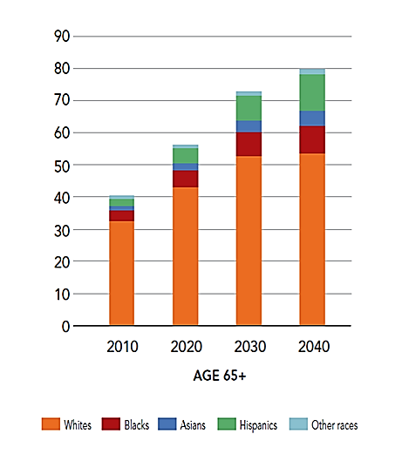
Aging Society
Historic demographic changes
  In 2012, 43.1 million adults age 65+ (13.7% of U.S. population)
  By 2030, 72.7 million adults age 65+ (>20% of U.S. population)
Fastest growing cohort of older adults are those age 80+
  When people are most likely to have a physical or cognitive impairment
  As a result, the demand for caregivers is growing rapidly
The gap between the demand for and supply of family caregivers is increasing
  The size of American families is shrinking and the makeup of families is changing

Slide 3
Independence Is Important
“A primary goal of many older individuals is to maintain an independent lifestyle in their own home” (Willis, 1996)
“Aging successfully will be difficult in homes not designed to meet changing needs and without access to appropriate technologies” (Coughlin, 1999)
“Staying put is contingent on the livability of the dwelling unit” (Lawton, 1997, p. iii)

Slide 4
Concept
The concept of Smart Home or Medical Home aims at giving an autonomous life, in their own home, to people who would normally be placed in institutions: patients suffering from a chronic disease, handicapped people, and fragile elderly

Slide 5
Reasons
Medical
  Early diagnosis or detection of health problems (fall detection, dementia, etc.)
  Detection of poor adherence or problems with regimens
  Changes in sleep patterns, physiological parameters, cognitive abilities, etc.
Personal
  Allow for independent living, avoid depression, etc.
  “Aging in Place”
Economical
  Earlier detection/treatment leads to lower cost
  Can be achieved by constant monitoring

Slide 6
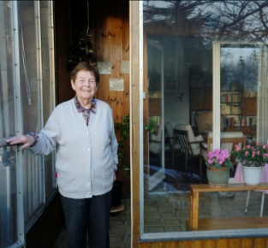
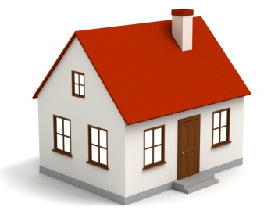

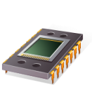
Smart Homes
Sensors & actuators integrated into everyday objects
Knowledge acquisition about inhabitant
Perceptions (sensors)
Environment
Smart Home
Actions (controllers)

Slide 7
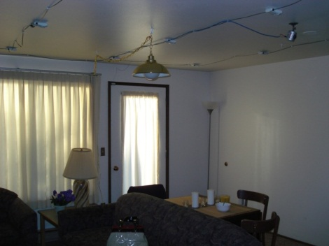
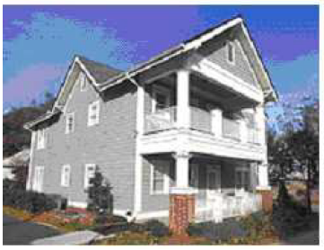
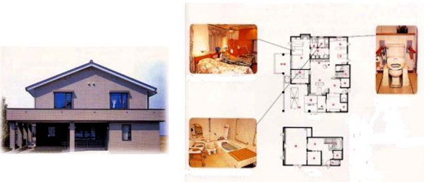
Examples of Smart Homes
US
  TigerPlace (U. of Missouri), Aware Home (Georgia Tech), CASAS (Washington State U.), Elite Care (OHSU, OR), House_n (MIT)
Asia
  Welfare Techno House (Japan), Ubiquitous Home (Japan)
Europe
  iDorm (University of Essex), HIS (France)
Takaoka Welfare Techno House
CASAS, WSU
Aware Home, GaTech

Slide 8
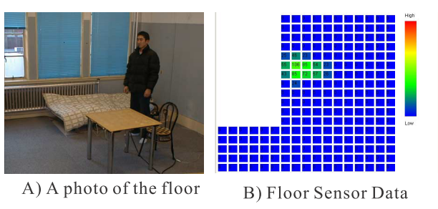
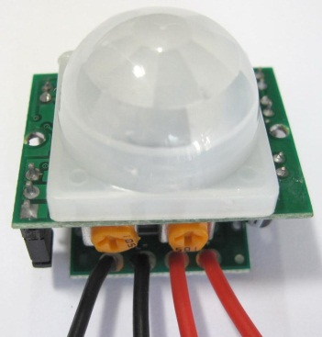
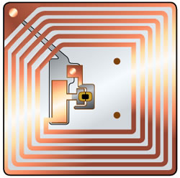
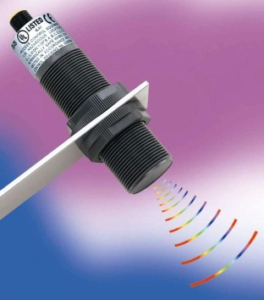
Smart Homes: Tracking Inhabitant
PIR (Passive Infrared Sensor)
RFID
Ultrasonic
Pressure sensors (in beds, floor)
Contact switch sensors
…
Floor Pressure Sensor. Noguchi et al. 2002
PIR
RFID
Ultrasonic

Slide 9
Indoor Localization
Method | Disadvantage
Smart floor | Physical reconstruction
Infrared motion sensors | Inaccurate, sensing motion (not presence)
Vision | Privacy
Infrared (active badge) | Direct sight
Ultrasonic | Expensive
RFID | Range
WiFi | Interference, inaccurate

Slide 10
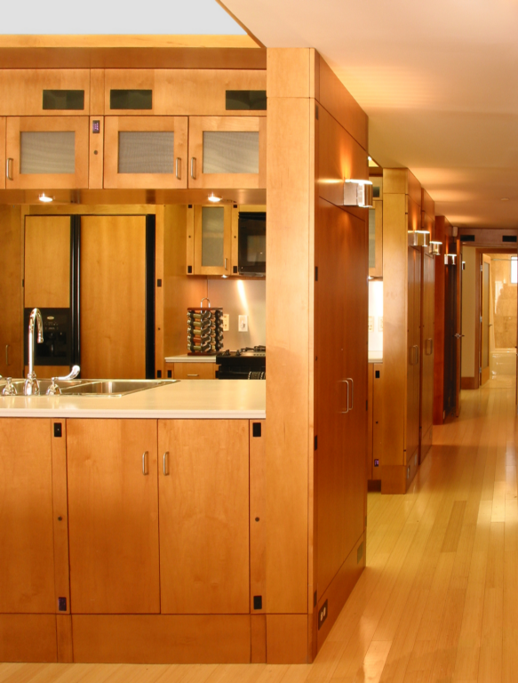
hinged panels to micro-controllers
speakers
air quality sensors
IR illuminators
hinged panels to sensor bus
cabinet door switches
countertop activity cameras
refrigerator use sensors
microwave use sensors
oven & range use sensors
cabinet drawer sensors
hot water use sensor
cold water use sensor
hinged panels to sensor bus
cabinet door switches
sensor network connections
internet connections
temperature sensors
Power integrated into cabinetry
hinged panels to subwoofers
MIT – n_House

Slide 11
Sensor: Smart Floors
Fall detections
  Falls are the second leading cause of unintentional-injury death for people of all ages and the leading cause of death for elders 79 years and older
Smart Floor
  Measure the pressure signals on the floor’s cell via piezoelectric sensors
Mobility Assessment
  Changes in some aspects of mobility correlate with changes in cognitive function and can perhaps predict future cognitive decline

Slide 12
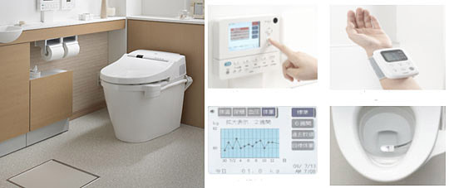
Sensor: Smart Toilet
Analyze of urinary salts and sends the results to a computer through LAN
How many times during the night did a person go to the bathroom?
Analyze blood sugar levels, body weight, and fat percentage; can even have a blood pressure cuff

Slide 13
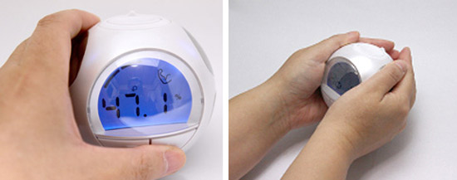
Sensor: Ball Body Check
It sends a weak current through your body, measuring body fat, bone density, and percentage of muscle

Slide 14
Sensor: ECG Chair
ECG waveforms can be obtained using electrodes fixed on a chair or in the bed, and measurements obtained without direct contact with the skin
The signal will be sent to the home central computer via Bluetooth signals

Slide 15
Sensor: Sleeping Disorders
Piezoelectric transducer provides information about heart rate and breathing rate
Temperature sensors attached to the mattress measure the temperature changes of the person
Pressure sensors detect movements of the person while sleeping and when out of bed
Sound recorder for the detection of snoring
Detection of bacterial infection developed in bed sores
All the sensors above allow the subject to sleep comfortably without having to wear electrodes or be hooked up to a machine

Slide 16
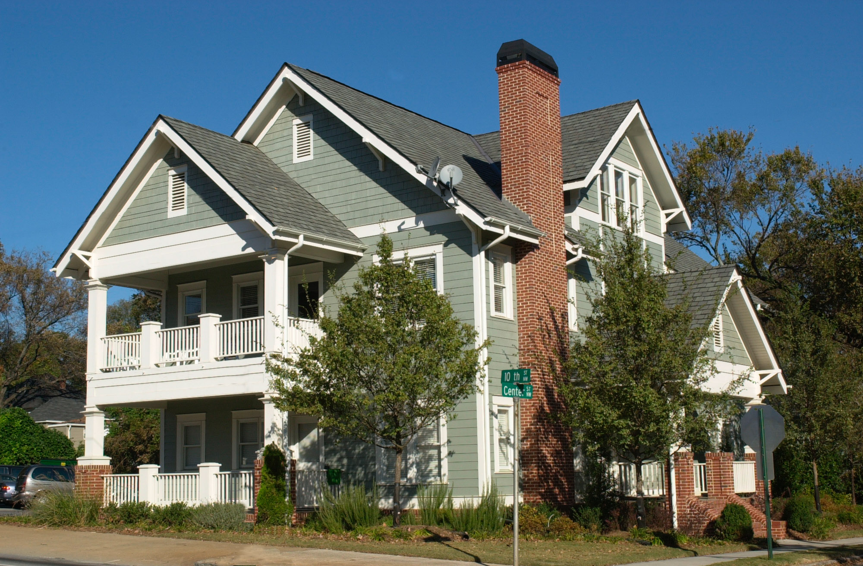
Georgia Tech’s Aware Home

Slide 17
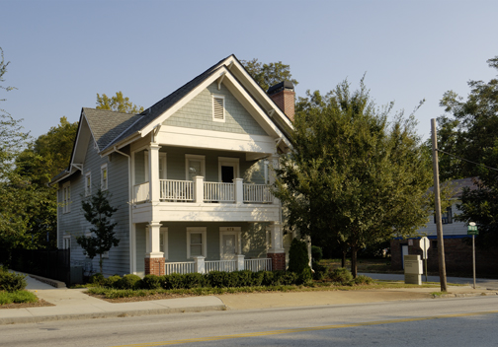
Georgia Tech’s Aware Home
How can our house serve us, if it knows its state and the states of its occupants?
  1998 Georgia Research Alliance Grant
  Completed in 2000
  Authentic testbed for
  prototype development

Slide 18
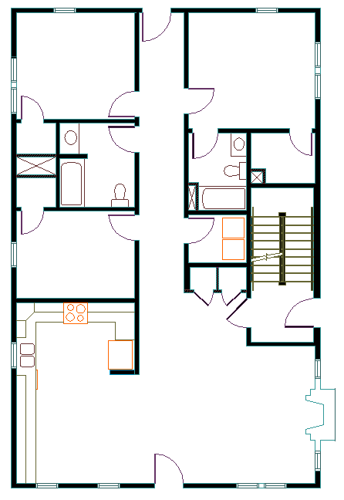
Georgia Tech’s Aware Home
2 identical floor plan apartments
  3 bedroom / 2 bath
  Kitchen, Dining Room, Living Room
Basement
  Meeting space
  Research space
  Server Space
  Work bench
  Facilities
Attic

Slide 19
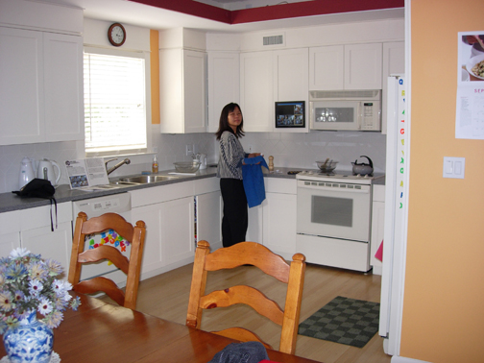
Georgia Tech’s Aware Home
Accessible
  Wide halls and doors
  Bathroom rails
  Push to open cabinets and drawers
  Easy open door handles
  Elevator cut

Slide 20
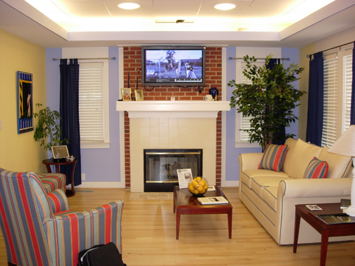
Georgia Tech’s Aware Home
Special features to facilitate research
  Drop Ceiling
  Wire trays in halls
  Wide walls – 4” conduit from basement to attic
  Indirect and soft lighting
  Low sheen flooring

Slide 21
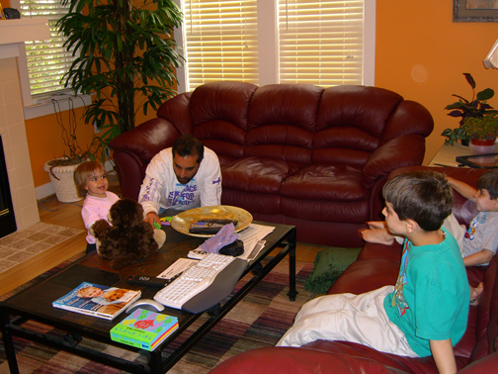
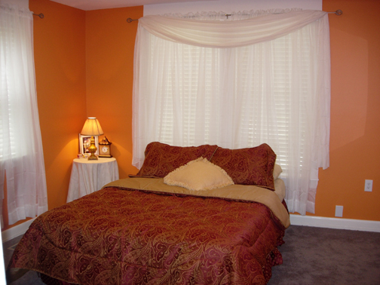
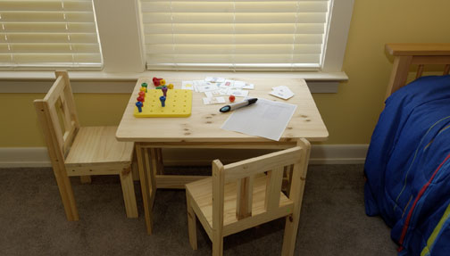
Aware Home Laboratory

Slide 22
Research Areas
Designing Applications for People
  Aging in Place
  Tools for busy families
Designing Technology “Building Blocks”
  Infrastructure
  Sensing

Slide 23
Aware Home Application Themes
First Floor - Aging in Place
  Grandma Burdell (or Mom)
Second Floor – Busy Family
(~2k miles away)
  The Burdell family
    “Sandwich generation” parents
    Aging parent(s)
    Children with social or behavioral disorders

Slide 24
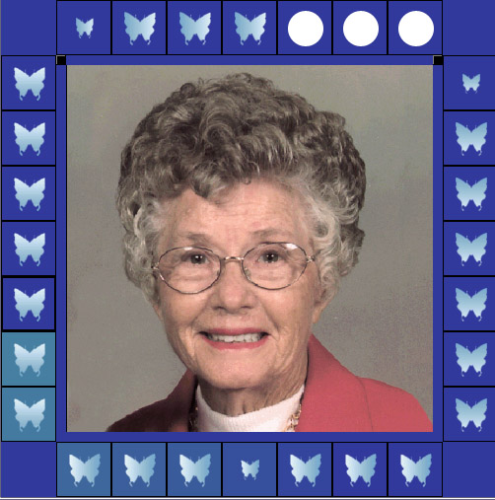
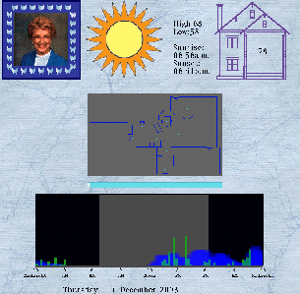
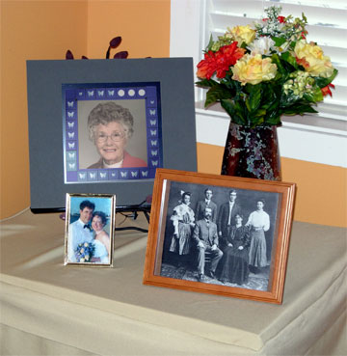
Digital Family Portrait
Supports family communication
  Peace of mind for remote
  family members
Share just enough data
  Activity detection using
  motion sensors
  Weather conditions
  Sunrise / Sunset

Slide 25
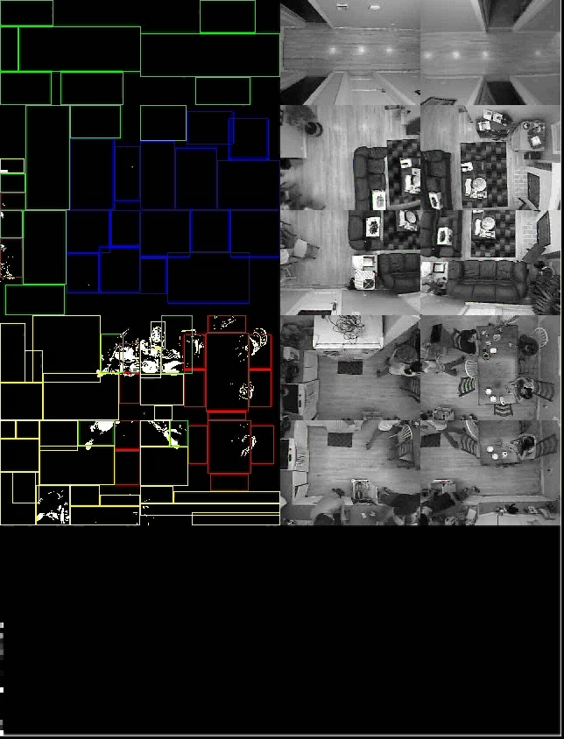
Activity Characterization
Using vision to produce high-resolution motion data
  More accurate information
  Better understanding of activity

Slide 26
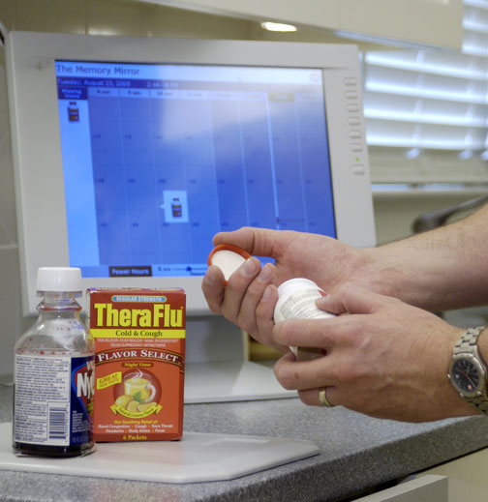
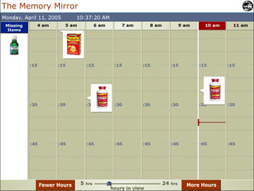
Memory Mirror
Medication management
  RFID tags on medications
  When last taken
  Reminders
  Help with reading label
  Multi-user tracking
  Caregiver connection

Slide 27
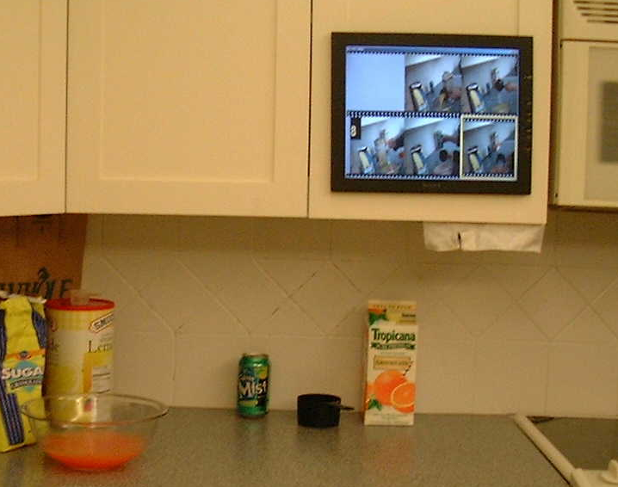
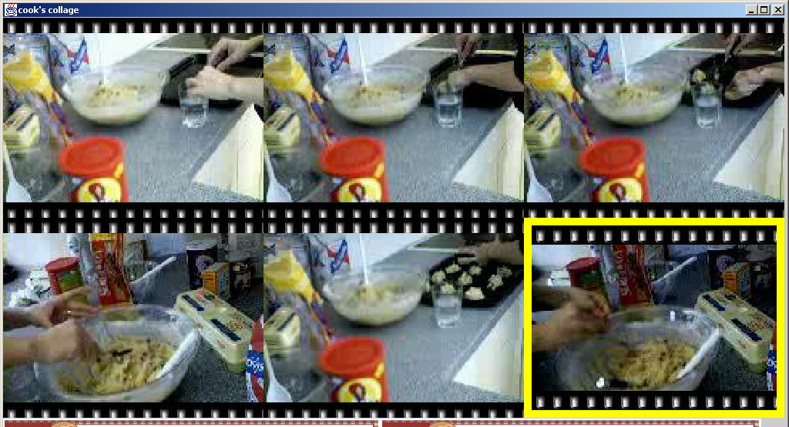
Cook’s Collage
Record of recent past
Mitigate interruption and distraction
What Was I Cooking?

Slide 28
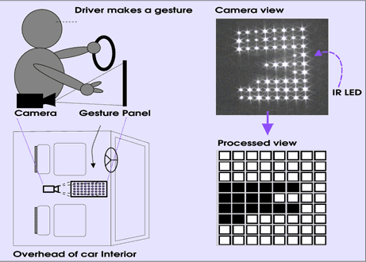
Gesture Technology
  Use gestures to control devices
  For people without dexterity to use typical remote
  Gesture Panel

Slide 29
PowerLine Positioning
Low-cost, easy to deploy indoor sensing using powerlines

Slide 30
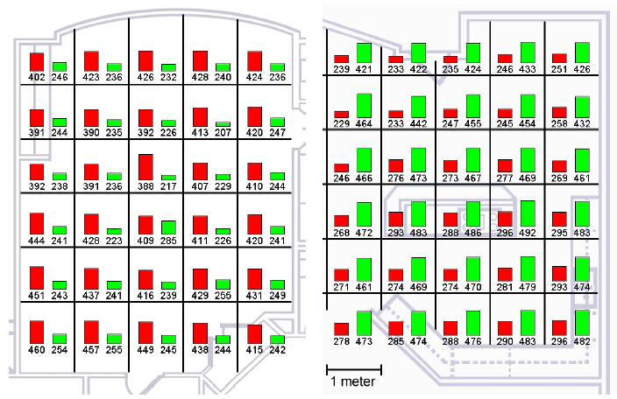
Calibration

Slide 31
Power Event Detection
Detecting use of electrical appliances and light switches using a single plug-in module

Slide 32
Videos
Georgia Tech Aware Home:
  https://www.youtube.com/watch?v=CLmVLsszlGU
Aging in Place:
  https://www.youtube.com/watch?v=iXC25jb5zck
  https://www.youtube.com/watch?v=hXCLQKvHLY4

Slide 33
Assignment (Due 4/8, 9.25am EST)
As part of your brief summary of the reading assignment, add your responses to the following questions and submit via Sakai:
  The reading assignment provides several definitions for smart homes (Lutolf, Berlo, Winkler, Briere, Intertek, etc.). Which of these definitions do you consider the most fitting and why?
  The reading assignment mentions the terms “motes” and “X10”; describe both of them briefly.

