Slide 1
Healthcare and Blockchain
Sean Michalec

Slide 2
Introduction
Electronic medical records and information management
Sharing of patient information between hospitals
Patient access to their own data
Anonymous tracking of health trends across a population

Slide 3
Issue: Patient Data Sharing
Current system
Patient signs document from first hospital
Hard copy from first hospital must be introduced to a new system
Issues of patient consent
Patient has little access control / cannot easily view the data
Typical solution
Centralized
Cloud-based web system

Slide 4
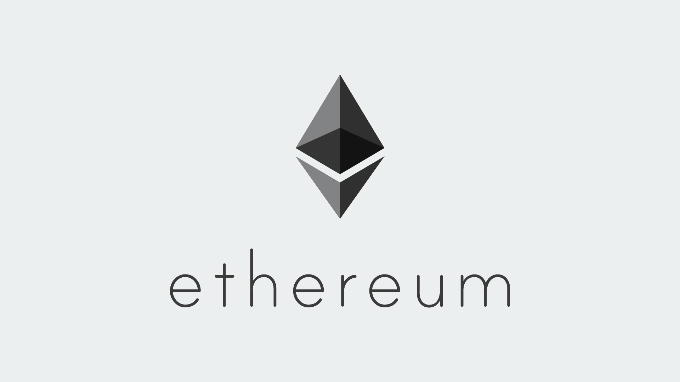
Blockchain?
Time stamped, immutable, decentralized ledger of transactions
Ethereum and Hyperledger fabric
“smart contracts” or “chain codes”
“gas fee”
the cost of a transaction in a smart contract

Slide 5
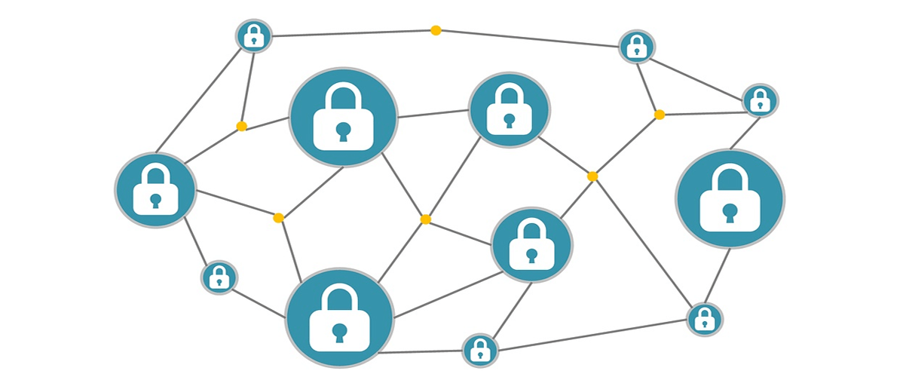
Blockchain.
Decentralized access to patient data
Anonymous addresses
Ensure data Integrity
Issues?
Transaction time
Scalability

Slide 6
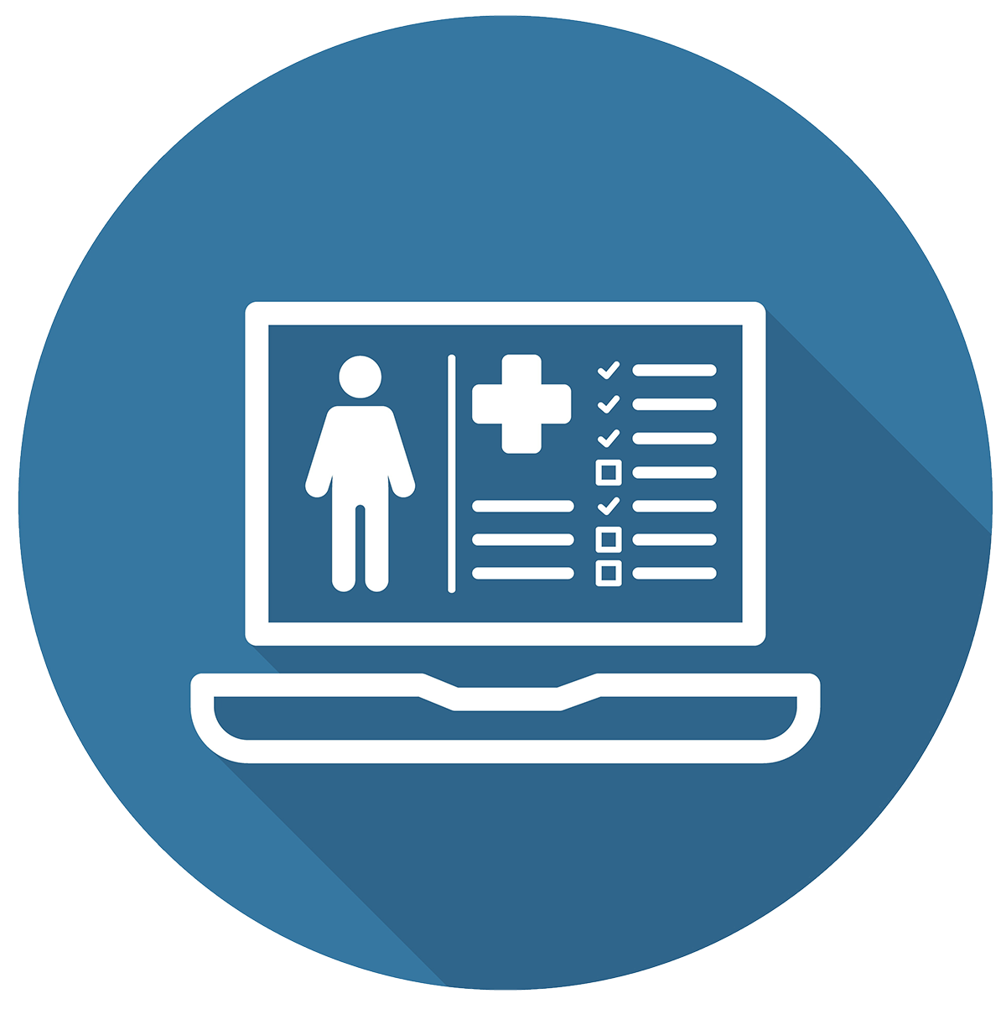
Usage
Solely for ensuring data integrity
A hash of the data is saved as an immutable timestamped transaction
Essentially an electronic health record (EHR)

Slide 7
Architecture
Notes:
In quadrant 1, the traditional EHR with a central server can be seen. This is the architecture which the other blockchain models are meant to replace or enhance, and what most are familiar with when it comes to web applications. Important vocabulary here is the Certificate Authority (CA), which in this context is “the infrastructure that generates, stores, manages, distributes in addition to revoking these keys and related information”¹.

Slide 8
Architecture

Slide 9
Blockchain EHR MODEL
Key generation is more obfuscated
Can be tracked if accessed or tampered with
Shared data is also hashed with a user’s secret key before uploaded
Every transaction that occurs on the blockchain is digitally signed

Slide 10
Example from Research
Hyperledger Fabric chain code
Completely Permissioned
Membership Service
Patient has confidence in access control
Notes:
Dubovitskaya et al developed “a secure and trustable EMR data management and sharing system” using Hyperledger fabric. What makes Hyperledger special is that it is a completely permissioned blockchain, which means exactly what it sounds like - its “membership services manage identity, privacy, and confidentiality on the network”¹. This allows there to be separate power levels in the blockchain, for example patient and doctor. “During the registration of a user as a Doctor, it is important to ensure that it is not a potential malicious user, but a qualified medical doctor. To verify this, the National Practitioner Data Bank could be consulted by the membership service”¹. With this permissioned blockchain approach, consent and membership management for data transfer can be done using logic in the Hyperledger fabric chain code, and user authenticity is guaranteed

Slide 11
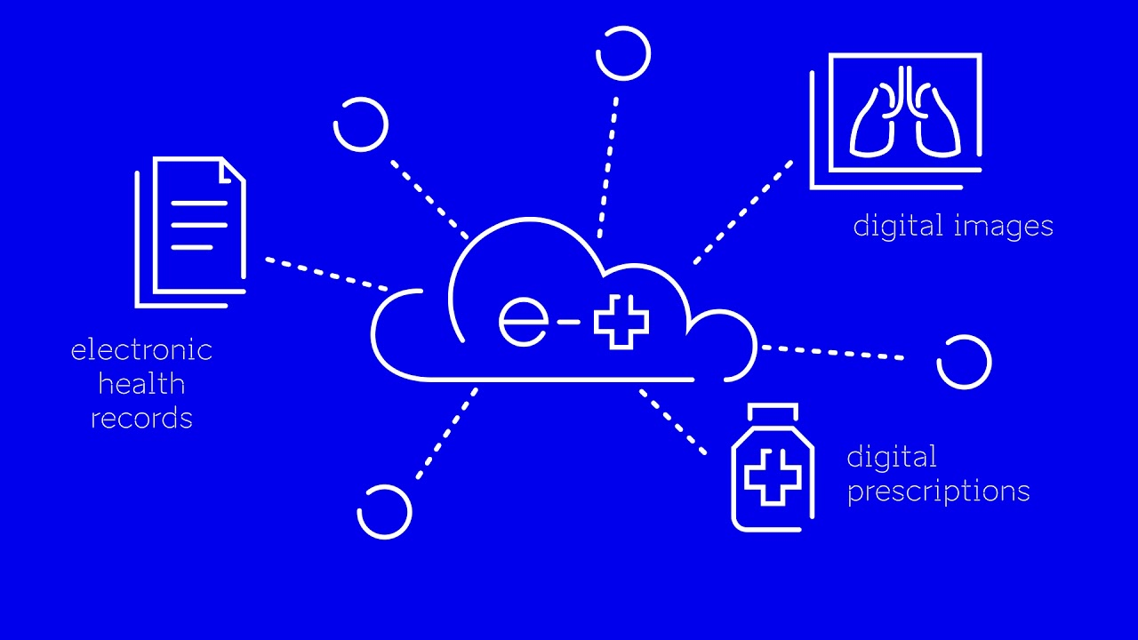
Blockchain in the Real World
Estonia’s Keyless Signature Infrastructure (KSI) blockchain
Hash-based integrity check and logging is used for Estonia’s electronic health records
Actual data is kept off-chain on a centralized server
Doctors across the country in different hospitals can have instant access to patient data, and patients have access to their own records as well as access logs

Slide 12
Blockchain in the Real World (cont’D.)
Fault: corruptible centralized data
KSI Blockchain assures integrity, but not accuracy
Estonia can use the data which has been checked for integrity for measuring health trends and tracking epidemics

Slide 13
Summary
Blockchain can be used in the healthcare industry in order to protect patient and hospital data integrity.
The typical use-case is that of a centralized server with all patient data stored, along with a blockchain used to check data and access
Used to analyze trustworthy patient data and check for trends in the case of an epidemic
This architecture has been successfully implemented in Estonia since 2016
The main drawback is that it tends to be slow and not scale well for large data transactions

