Slide 1

Smart Thermometers
SOPHIE JOHNSON

Slide 2
Annual Influenza Statistics in US
Centers for Disease Control and Prevention estimates burden of flu
Estimates depend on data from 2010 - 2019

Slide 3
Symptoms of Influenza
Fever (+100° F)
Cough
Sore throat
Runny or stuffy nose
Muscle or body aches
Headaches
Fatigue

Slide 4
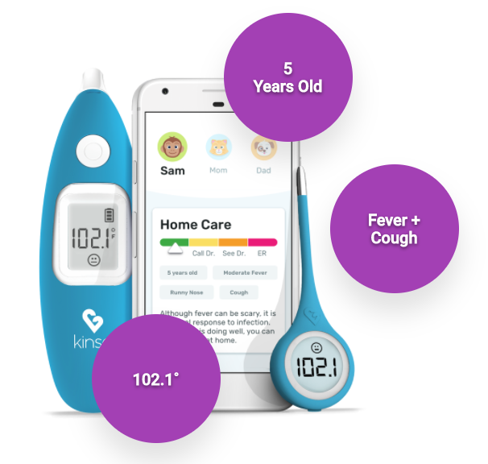
Kinsa Smart Thermometer
5 Years Old
Digital thermometer
Bluetooth connection to mobile device
Interactive app
Fever and symptom upload to cloud
Geocoding
Map display
Fever
+ Cough
102.1°

Slide 5
Influenza Surveillance
CDC Prediction Models
Smart Thermometers
Rely on reports with 1 to 2 week delay
Potentially miss key demographics (geographic location, age, etc.)
Produce real time measurements
Identify trends up to 2 weeks earlier than CDC’s weekly FluView tracker
Accessible in regions with fewer providers that report to CDC
Collect data from young adult population

Slide 6
Improved Influenza Surveillance
University of Iowa study (2018)
  Used 10 million temperature readings from 2015 to 2018
  Improved state-level forecasts by 23.9% accuracy
UCSF Medical Science study (2020)
  Combined temperature readings with records from the California Department of Public Health
  Improved predictions of regional patterns

Slide 7
Challenges
Expensive ($35.99 - $69.99) so might not reach a representative sample
Decreased quality assurance due to crowdsourcing
Security and privacy
Adequate amount of data

Slide 8
Thermometer Count
2,980
2015
450,000
2018
1,000,000+
2020
a year after released in 2014…
generating millions of temperature readings annually…
and the number is only growing…

Slide 9
Smart Thermometers and COVID-19
Fever is most common symptom found in 90% of patients
Kinsa’s smart thermometers have measured 5 years of expected influenza data
Anomalies in recent thermometer data suggest potential COVID-19 outbreaks

Slide 10
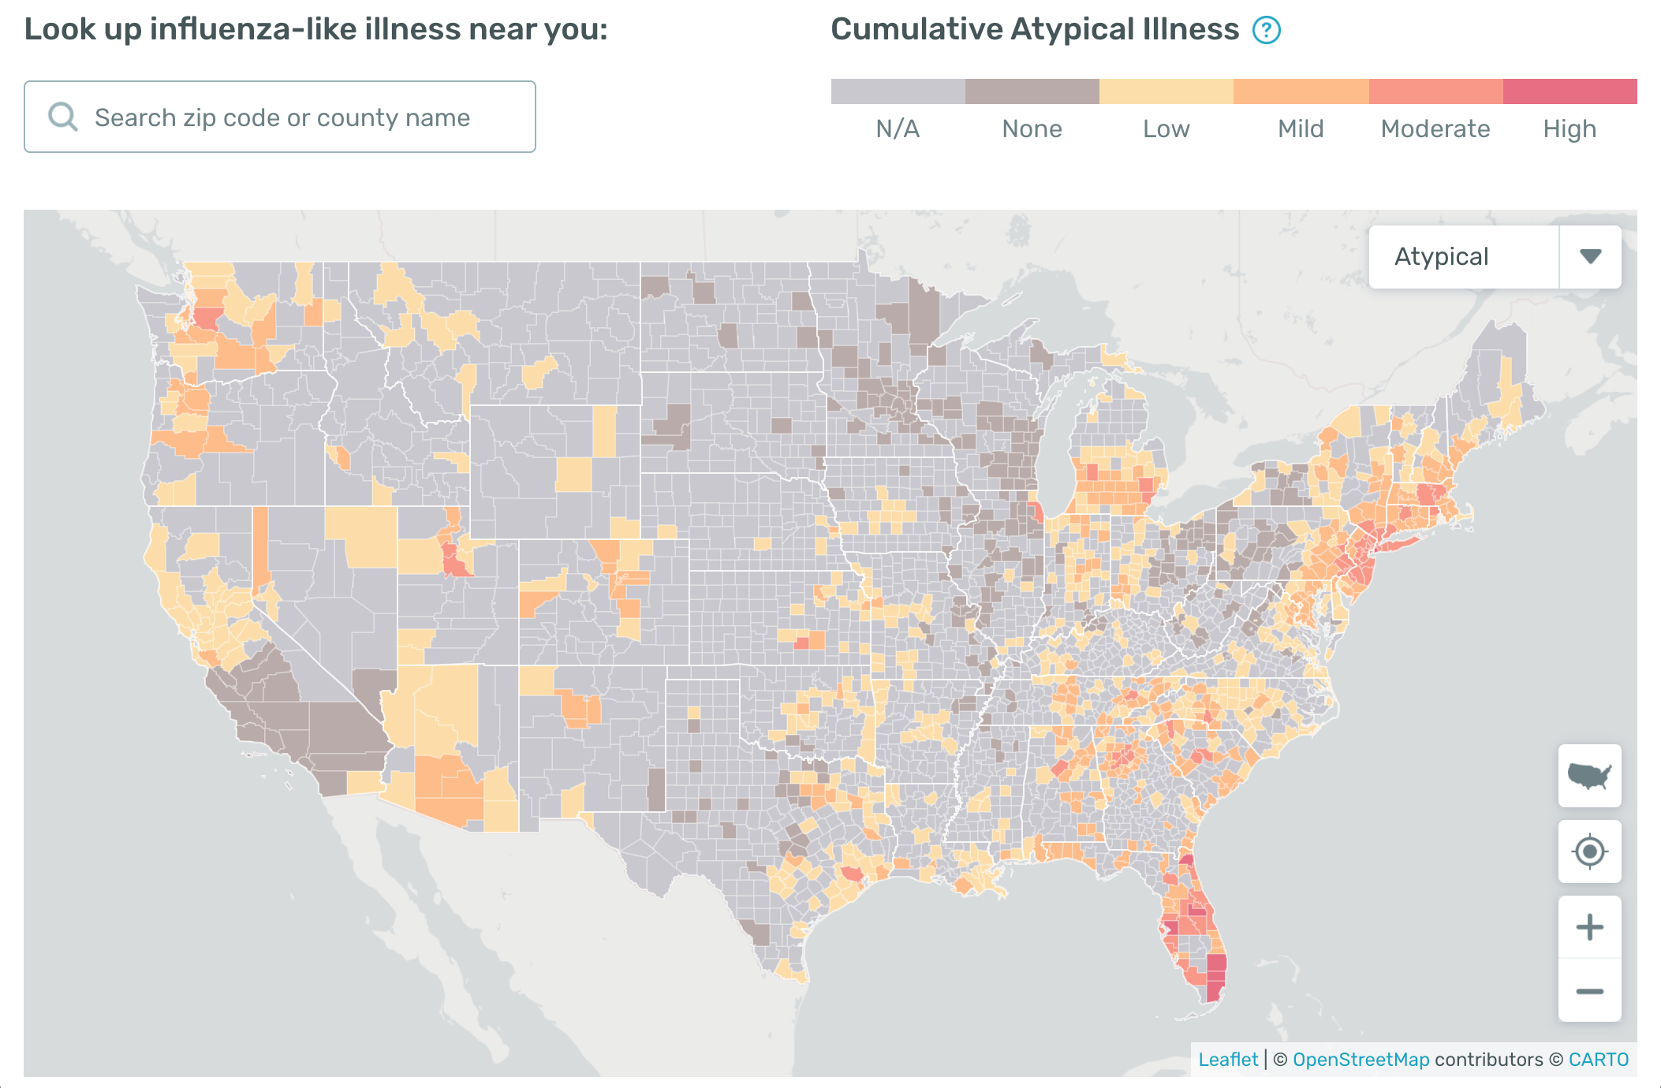
Kinsa’s US Health Weather Map

Slide 11
Coronavirus Cases in the US

Slide 12
Thank you!

