Slide 1
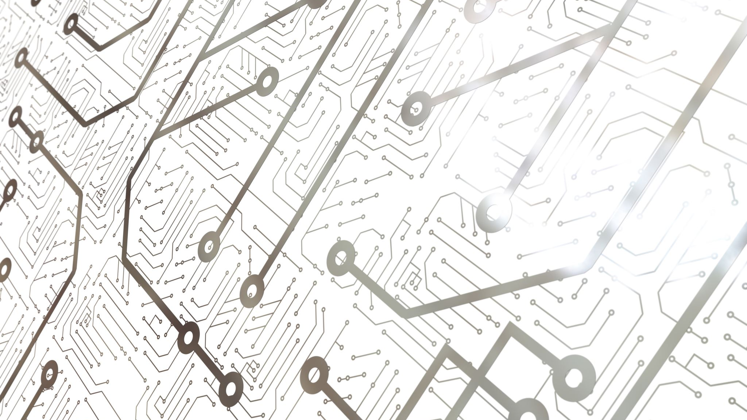
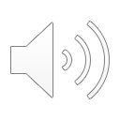
Wearable Consumer Sleep-Tracking Devices: An Overview
Marielle Gleason

Slide 2
Importance of Sleep
Lack of adequate sleep leads to numerous short-term and long-term health issues
Effects can include weight gain, reduced concentration and productivity, depression, and weakened immune system
Despite its importance, often neglected in comparison to fitness and nutrition

Slide 3
Established Sleep-Tracking Methods
Polysomnography (PSG) test
Monitors sleep cycles in addition to physiological functions
Time-consuming and expensive

Slide 4
Consumer Wearable Devices

Slide 5
Examples
Fitbit, Lark, WakeMate, Jawbone
Wrist-watch wearables
Provide information such as total sleep duration, sleep latency, and quality of sleep
Fitbit
Lark
WakeMate
Jawbone

Slide 6
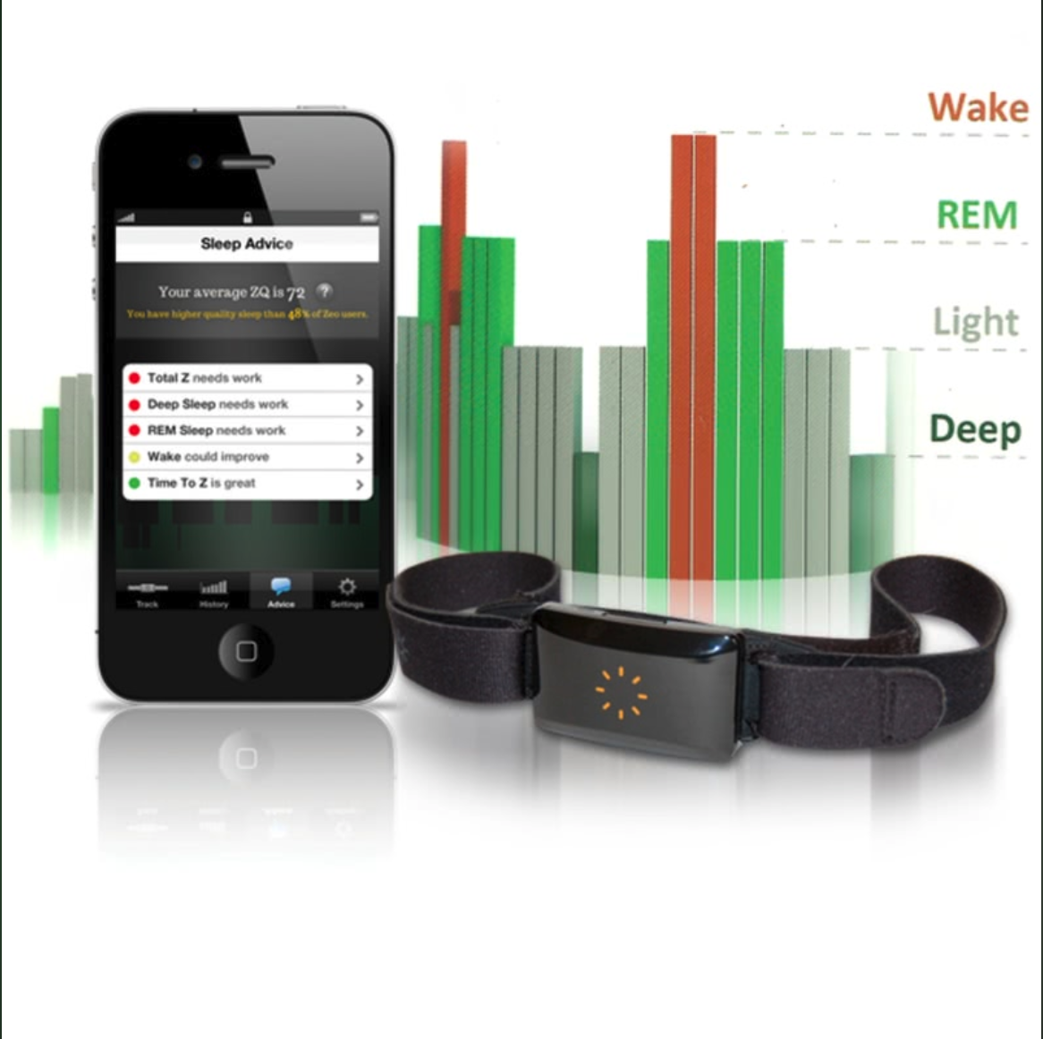
Examples
Zeo
Utilizes a headband to collect EEG and EMG signals from the forehead area, classifying a 30-second epoch into one of three sleep categories: light NREM, deep NREM, and REM
SleepImage
Collects ECG signals, actigraphy, and body movements through a wire electrode attached to the chest with sticky pads
Zeo
SleepImage

Slide 7
Examples
BodyMedia SenseWear Armband
Employs an accelerometer, heat flux, temperature, and galvanic skin response to collect information about the user’s sleep
OURA Ring
Smart ring that utilizes infrared LEDs, a 3D accelerometer and gyroscope, and a body temperature sensor
BodyMedia SenseWear Armband
OURA Ring

Slide 8
Examples
Hexoskin
Smart shirt that measures heart rate, heart rate variability, total sleep time, and body movement

Slide 9
Problems with Accuracy and Effectiveness

Slide 10
Lack of Theoretical Frameworks
“Fitbit Flex, Jawbone UP, and Innovative Sleep Solutions SleepTracker are assumed to be based on previous research but they do not reveal their theoretical frameworks at all.”
“BodyMedia has declared that its own theoretical background—embodied by an ANN-based proprietary algorithm with raw data gathered from all the sensors and certain derived measures—was based on a preliminary study and that it could not be presented in detail”
“Basis Band is known to detect the onset of sleep with decreased activity and lowered heart rate, but does not disclose its theoretical background."
“Zeo is known to use one channel of EEG, recorded at the sampling rate of 128Hz, to estimate sleep stage. Estimating sleep stage with multi-channel EEG has a well-established theoretical background."

Slide 11
Fitbit and BodyMedia studies
“In terms of total sleep time, total wake up time, and sleep efficiency, BodyMedia SenseWear Armband was reported to produce similar to PSG results, both in control patients and in OSA patients. This device was also reported to have high sleep/wake epoch-by-epoch agreement rate (79.9±1.6%) and high sensitivity of sleep estimation (88.7±1.5%). However the device could not estimate wake with high accuracy (specificity, 49.9±3.6%)”
“Montgomery-Downs et al. evaluated and compared the sleep/wake detection performance of Fitbit and standard actigraphy (Actiwatch-64, Philips Healthcare, Andover, MA). As a result, Fitbit and Actiwatch-64 showed 97.8% and 95.7% of agreement rates with PSG for sleep detection but 19.8% and 38.9% for wake detection, respectively.”
“Finally, both devices were found to consistently misidentify wake as sleep and thus overestimated both total sleep time and sleep efficiency.”

Slide 12
Zeo study
“Shambroom et al. reported that Zeo was able to achieve better sleep/wake agreement rates (92.6% and 91.1%) than actigraph (86.3% and 85.7%) when each device’s sleep/wake scoring was compared with two experienced technician’s PSG scores. It also provided a good sleep stage agreement rate (75.8% and 74.75%) while an actigraph could hardly estimate sleep stage.”

Slide 13
Fitbit study

Slide 14
User Interaction

Slide 15
Challenges Encountered by Users
Tracking Continuity
Trust
Data Manipulation
Data Interpretation

Slide 16
Ways to Address
Tracking Continuity
Strike a balance between engagement and automation
Trust
Be transparent about how the devices work
Data Manipulation
Grant users ownership over their own data
Data Interpretation
Allow data flexibility

Slide 17
References
http://mysleepapneatest.com/diagnosing-osa.aspx
https://level1diagnostics.com/sleep-image/
https://www.cpap.com/productpage/zeo-sleep-manager-pro-mobile
https://www.wired.com/2012/01/lark-julia-hu-sleep/
http://billvespa.com/wakemate
https://www.imedicalapps.com/2011/07/bodymedia-wearable-sensors-fight-obesity-epidemic-step-time/
https://ouraring.com/

