Slide 1

Neonatal Nutrition
Ecosystem:
A Software Solution
Michelle Feely

Slide 2
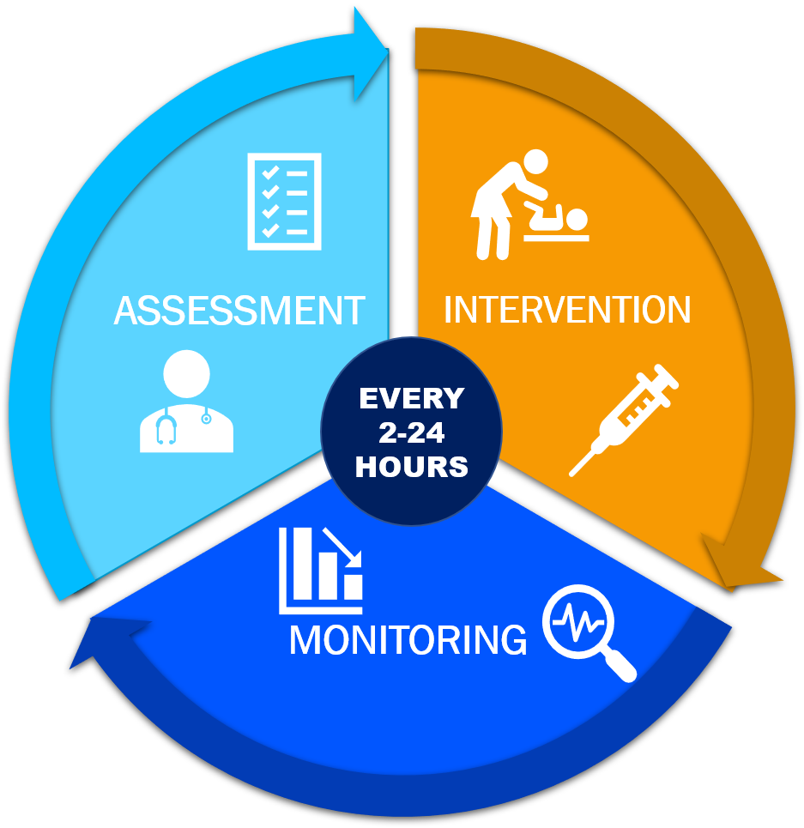
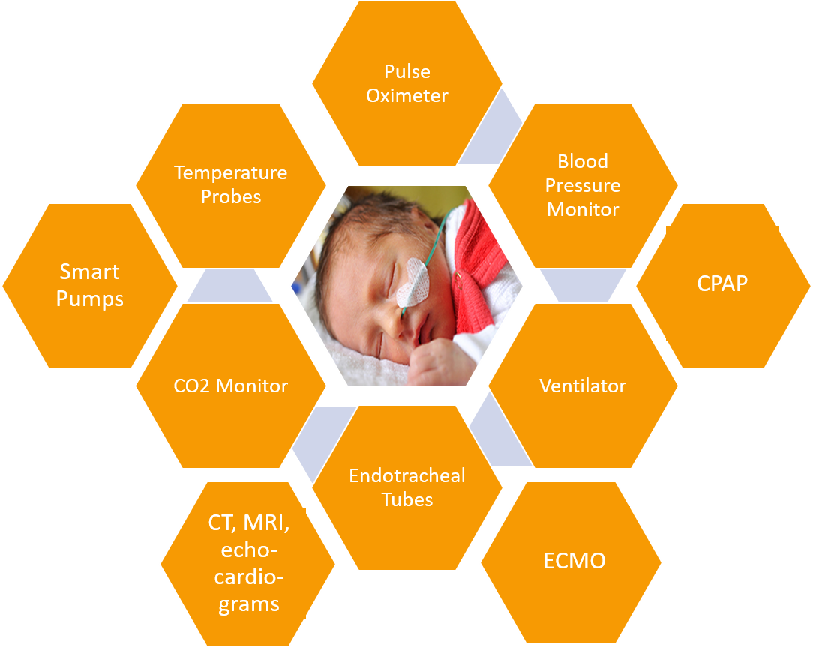
Background
STAKEHOLDERS
Neonatologists
NICU Nurses
Pharmacists
Dieticians
Neonate Care Ecosystem
NICU Professionals Cycle of Care
Notes:
Can take 60 minutes just to aggregate information to write prescription
Doctor sit in front of computer for 4 hours post-rounds (2-3 hours) – takes time away from patient

Slide 3
Needs
Defined Unmet Needs:
Aggregate physiological & biological values of pre-term to provide holistic view of patient status to Healthcare Professionals.
Support prescription procedure for NICU team to reduce daily time of nutrition management.
Accurately diagnose feeding disorders in infants to allow early intervention & reduce associated adverse consequences.
GOAL
Analyze a relevant technology that extracts & centralizes multiple data from neonates in real-time, allowing more effective management of clinicians overall workflow and improving neonatal care.
Notes:
Can take 60 minutes just to aggregate information to write prescription
Doctor sit in front of computer for 4 hours post-rounds (2-3 hours) – takes time away from patient

Slide 4
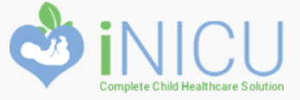
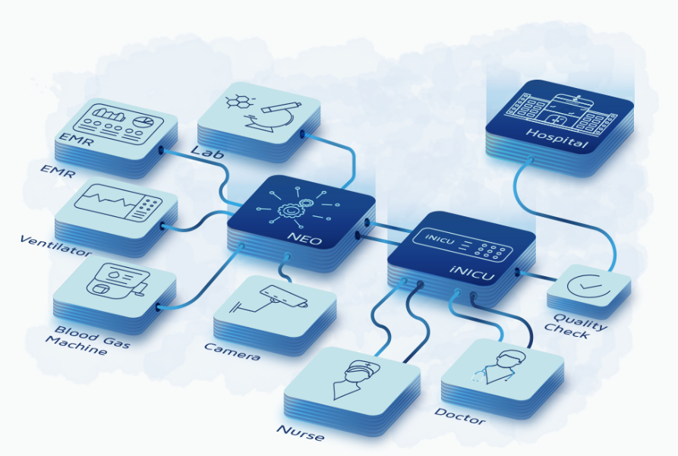
Architecture:
Machine Data Integration
Clinical Interface
Data Analytics Engine
Functions:
Digitization of Clinical Investigation
Neonatal Calculators
Neonatal Scores-based RT Alarms
Deep Learning based Analytical Model for Early Prediction of Disease Onset
Notes:
NP: “Outcomes must show where data pulled from to be believed - will be relied on if based on data. Can see use for neonatal scores and disease onset prediction”

Slide 5
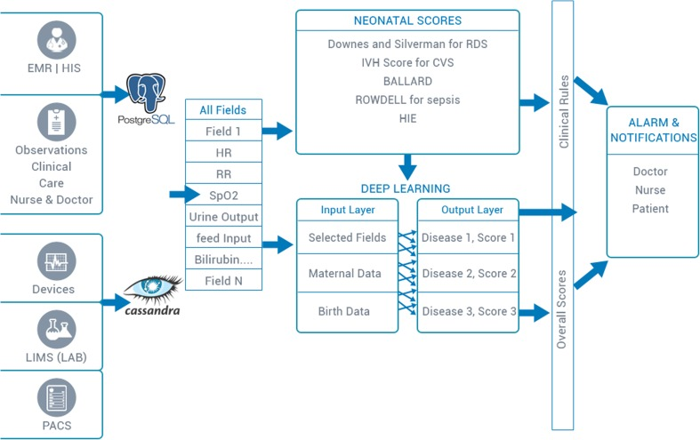
Software:
Integrated Child Health Record cloud (iCHRcloud)
Hardware:
Intel Edison
Beaglebone
HL7
Java-based web portal
Highchart
256 bit HTTPS communication
Notes:
iCHR offers a seamless, secure (256 bit HTTPS) and sustainable solution to reduce child mortality.
HL7 protocol enabling integration with hospital's HIS/EMR system
Java (Enterprise Service Bus and Hibernate) based web portal for doctors and mobile application for parents, enhancing doctor-parent engagement.
highchart to automate chart preparation and provides access of data via Push Notification (GCM and APNS)
offers a seamless, secure (256 bit HTTPS) and sustainable solution to reduce child mortality

Slide 6






iNICU Features
Feature
Provided Value
Interoperability & EMR Integration
Real-time Monitoring & Alerts
Nutrition & Medication Calculators
Neonate Health Timeline
Pattern Analysis/Predictive Analytics
Specialized UIs & Workflow Digitization
Central hub of data, simplified sharing
Continuous adaptation & remote monitoring
Decrease human error, over/under prescribing
Provides holistic view of patient status
Identifies errors, at-risk neonates, disease onset
Increases nurse productivity
●Regulatory Compliance ● Authentication ● Support ● Easy-to-Use ● Tech Readiness

Slide 7
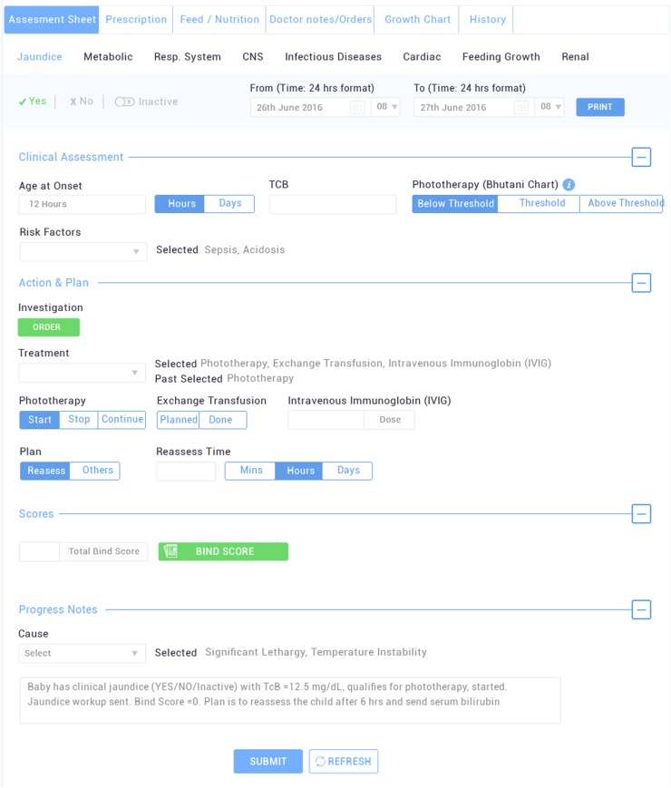
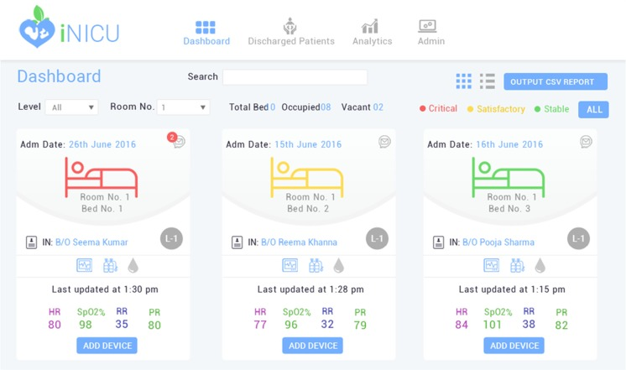
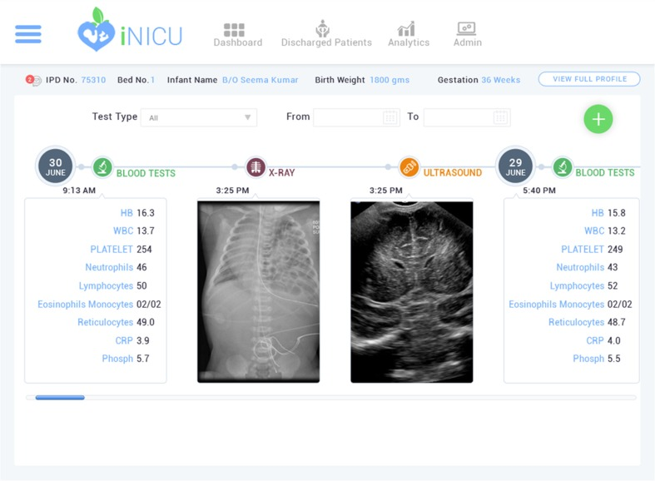
iNICU Interface
Patient dashboard
view
Individual patient laboratory test records
Doctor’s panel with expanded Jaundice Assessment screen
Notes:
Neonatal Researcher: “NICU-specific features needed since EMR is not, hospitals collecting more data so interest in and using data is growing, ppl want to use data more effectively, next move is into ICU settings.”

Slide 8
Future Work
To evaluate the validity of iNICU, the questions below are suggested for future work:
How extensive is the EMR-iNICU field mapping process?
  If EMR updates, will fields need to be re-mapped?
Does iNICU have the ability to adapt the platform to fit into current hospital workflows?
What clinical results exist/ are in testing for neonate/pre-term population?
  What variability exists in accuracy of predicting each disease?
Color-coded dashboard per neonate risk level: What factors determine the risk level?
  What legal risk exists for the Baxter/iNICU if “low-risk” patient dies?
What is the deep learning network that drives the algorithm and how explainable is it to end-users?
How are the neonatal calculators updated as medication/nutrition metrics change?
Notes:
Solution is not an EMR platform itself, but is an analytics platform on top/integrated with an EMR solution, so it should see similar, proportional adoption, if not more since EMR had to take time to change paper to electronic, once hospitals implement EMR technology
Stage 5/6/7 medical record fully electronic → CPOE CDS closed loop admisnitration = fully implemented closed-loop medication administration, identification technology, computerized physician order entry (CPOE), clinical decision support with compliance alerts, and medical image digitization¹
Stage 7 EMR is too advanced with possible EMR software capability to perform NICU specific functions. Stage 4 and below, would not be early adopters in software field. US adoption is 65.9% and Canadian adoption is 5.6% ² 5/6/7 72.4% and 5.9%

Slide 9
Thank You!

