Slide 1
Virtual Reality in the Medical Field
Nathaniel Ekwueme

Slide 2
Exposure Therapy
Behavioral Treatment
Dangers of Avoidance
Virtual Reality Component

Slide 3
Exposure Therapy
VRET
Vietnam War Veterans
Cost and Availability

Slide 4
Autism Awareness
Early Findings
Situational Problem Solving
Gamifying the Problem

Slide 5
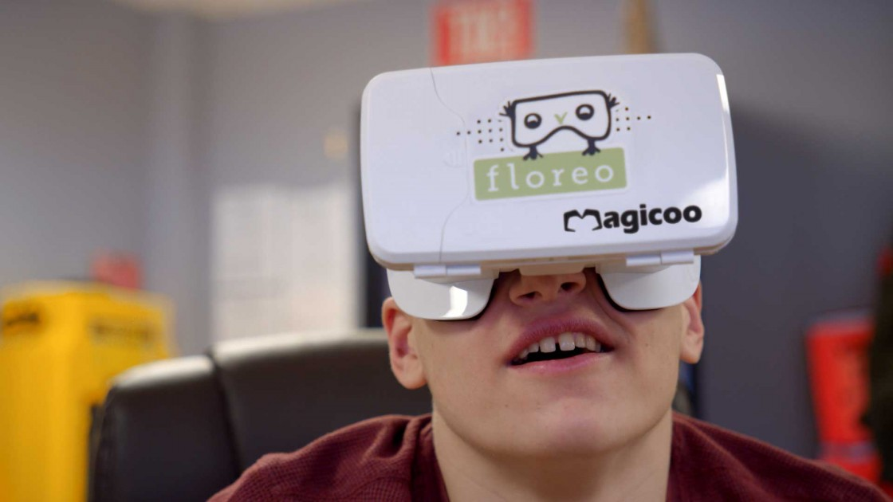
Autism Awareness
Switching Perspectives
Major Projects
https://www.freethink.com/shows/superhuman/season-3/using-virtual-reality-to-help-kids-with-autism

Slide 6
From VR to ER
Development of Skills
Simulation Testing
Surgical Training

Slide 7
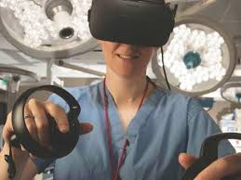
From VR to ER
Empathy
Human Anatomy Immersion
https://www.modernhealthcare.com/article/20180820/NEWS/180829997/virtual-reality-simulations-offer-medical-residents-hands-on-practice

Slide 8
Conclusion
Looking Forward

