Slide 1
A machine learning approach to medical imaging techniques
Fabio Soares
(please use presentation mode)

Slide 2
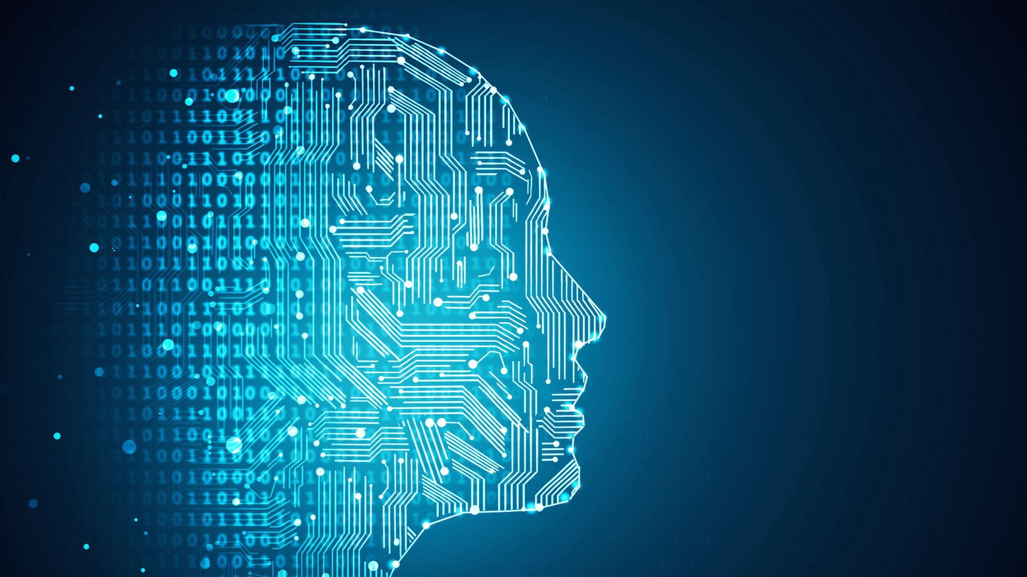
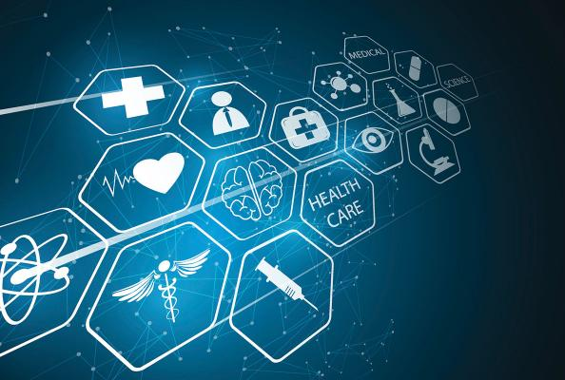
Introduction & Motivation
In 2017, 9.6 million people are estimated to have died from the various forms of cancer
Every sixth death in the world is due to cancer, making it the second leading cause of death – second only to cardiovascular diseases [1]
In the US in 2017 were $147.3 billion
Costs are likely to increase as the population ages
Costs are also likely to increase as new and often more expensive treatments are developed [2]

Slide 3
Project InnerEye
InnerEye is a research project that uses state of the art machine learning technology to build innovative tools for the automatic, quantitative analysis of three-dimensional radiological images
“Project InnerEye turns radiological images into measuring devices”

Slide 4
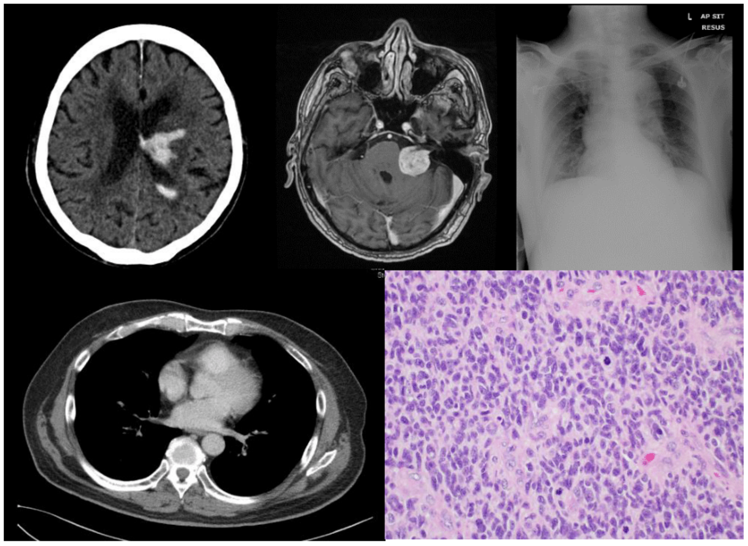
Motivation

Slide 5
Papers covered
“Unsupervised domain adaptation in brain lesion segmentation with adversarial networks”
“Deep Learning Applications in Medical Image Analysis”
“Autofocus Layer for Semantic Segmentation”
IEEE
Project InnerEye
Project InnerEye
2016
2017
2018

Slide 6
Deep Learning Applications in Medical Image Analysis
ML success grows along with a time of dramatically increased use of electronic medical records and diagnostic imaging
ML algorithms as applied to medical image analysis, focusing on convolutional neural networks (CNN), and emphasizing clinical aspects of the field
The advantage of machine learning in an era of medical big data is that significant hierarchal relationships within the data can be discovered algorithmically without laborious hand-crafting of features
They covered key research areas and applications of medical image classification, localization, detection, segmentation, and registration
1st paper

Slide 7
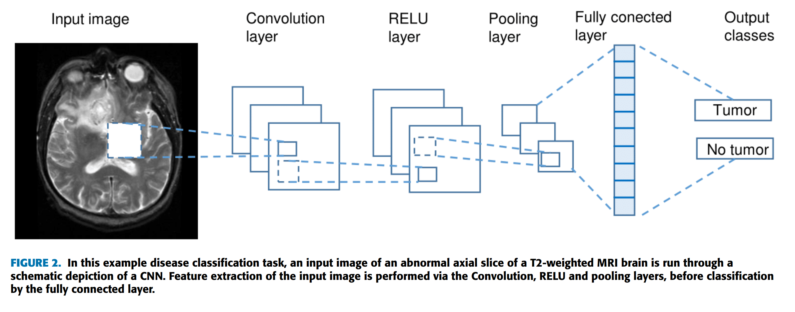
Deep Learning Applications in Medical Image Analysis
ML success grows along with a time of dramatically increased use of electronic medical records and diagnostic imaging
ML algorithms as applied to medical image analysis, focusing on convolutional neural networks (CNN), and emphasizing clinical aspects of the field
The advantage of machine learning in an era of medical big data is that significant hierarchal relationships within the data can be discovered algorithmically without laborious hand-crafting of features
They covered key research areas and applications of medical image classification, localization, detection, segmentation, and registration
1st paper

Slide 8
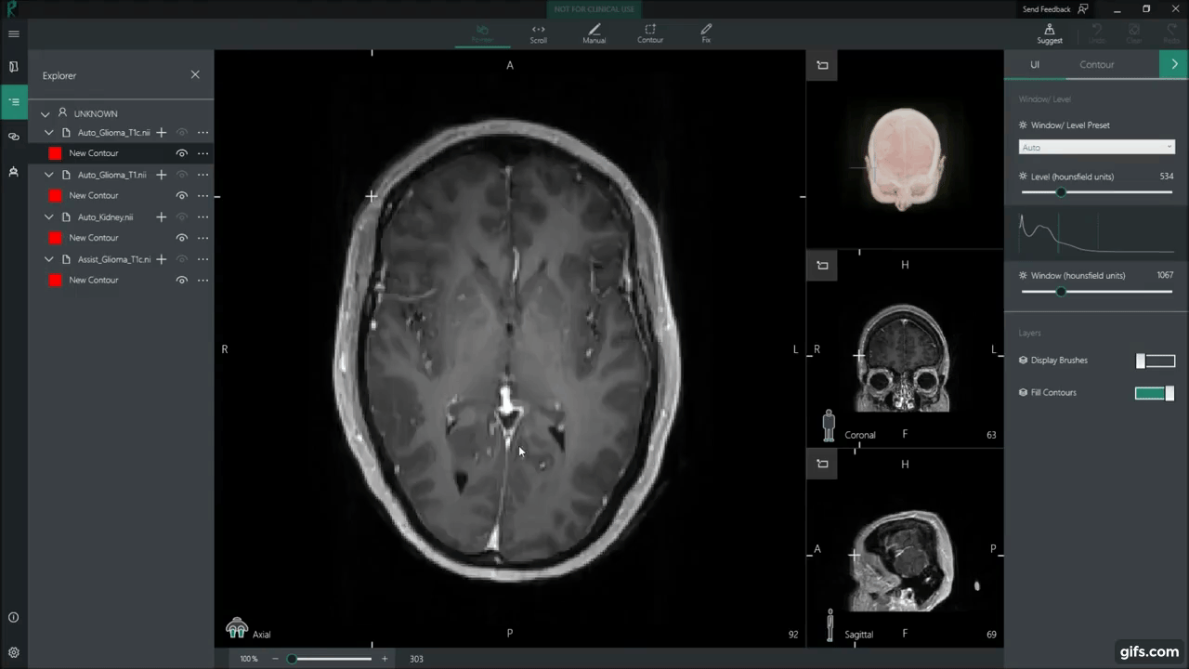
Why it matters
Cancer kills: “”

Slide 9
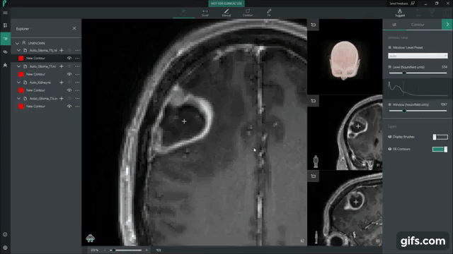
Why it matters

Slide 10
Autofocus Layer for Semantic Segmentation
They propose an autofocus convolutional layer for segmentation of biomedical images
An autofocus layer can adapt the network’s receptive field at different spatial locations in a data-driven manner
Evaluation of shows that they cope well with biological variability in different tasks and generalize well on both MR and CT images
2nd paper

Slide 11
Unsupervised domain adaptation in brain lesion segmentation with adversarial networks
Unsupervised domain adaptation method for image segmentation by using adversarial training of two 3D neural networks. [first work of such an approach on a biomedical imaging problem]
Evaluated using two MR databases of subjects with traumatic brain injuries, acquired using different scanners and imaging protocols
This unsupervised approach obtains segmentation accuracies which are close to the upper bound of supervised domain adaptation
3rd paper

Slide 12
References
[1] This is data from Schutte, A. E. (2017). Global, regional, and national age-sex specific mortality for 264 causes of death, 1980-2016: a systematic analysis for the Global Burden of Disease Study 2016.
[2] “Cancer Statistics.” National Cancer Institute, www.cancer.gov/about-cancer/understanding/statistics.
[3] Ker, Justin et al. “Deep Learning Applications in Medical Image Analysis.” IEEE Access 6 (2018): 9375-9389.Link to download: https://ieeexplore.ieee.org/stamp/stamp.jsp?tp=&arnumber=8241753
[4] Qin Y, Kamnitsas K, Ancha S, Nanavati J, Cottrell G, Criminisi A, et al. Autofocus layer for semantic segmentation, arXiv:1805.08403 (2018). Link to download: https://arxiv.org/abs/1612.08894v1
[5] . Kamnitsaset al., ‘‘Unsupervised domain adaptation in brain lesion segmentation with adversarial networks,’’ inProc. Int. Conf. Inf. Process.Med. Imag., 2017, pp. 597–609. Link to download: https://arxiv.org/abs/1612.08894

