Slide 1
Using Arrays in C
Only fixed-length arrays can be initialized when they are defined. Variable length arrays must be initialized by inputting or assigning the values.

Slide 2
FIGURE 8-8 Initializing Arrays

Slide 3
Note
One array cannot be copied to another using assignment.

Slide 4
Inter-function Communication
To process arrays in a large program, we have to be able to pass them to functions. We can pass arrays in two ways: pass individual elements or pass the whole array. In this section we discuss first how to pass individual elements and then how to pass the whole array.

Slide 5
Passing Array Elements

Slide 6
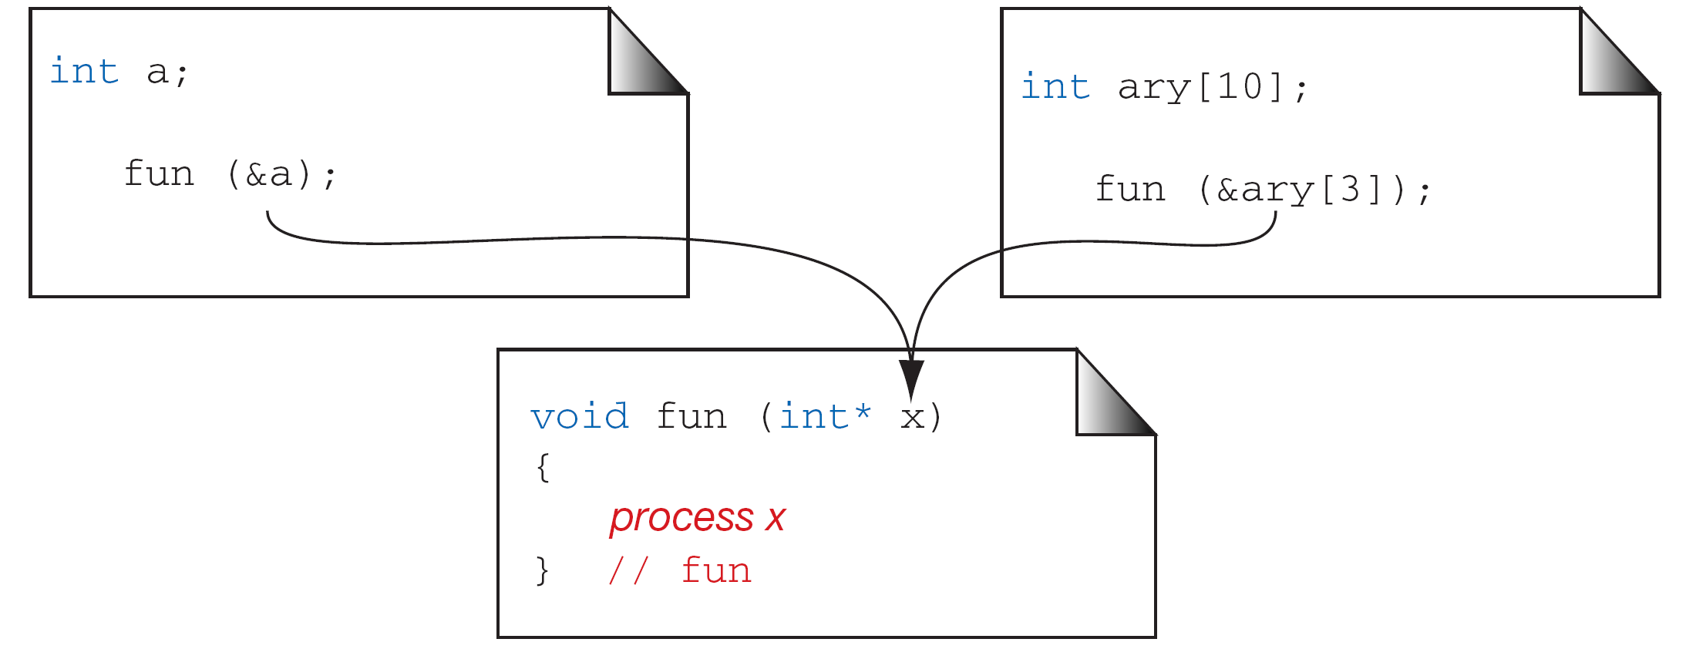
Passing the Address of an Array Element

Slide 7
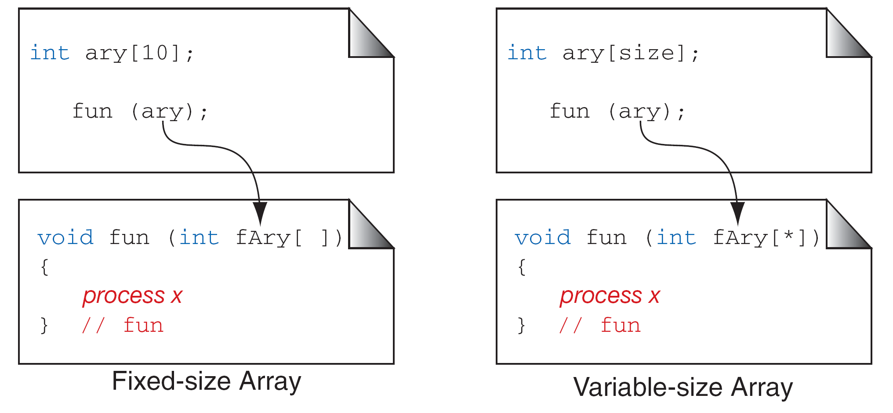
Passing the Whole Array

Slide 8
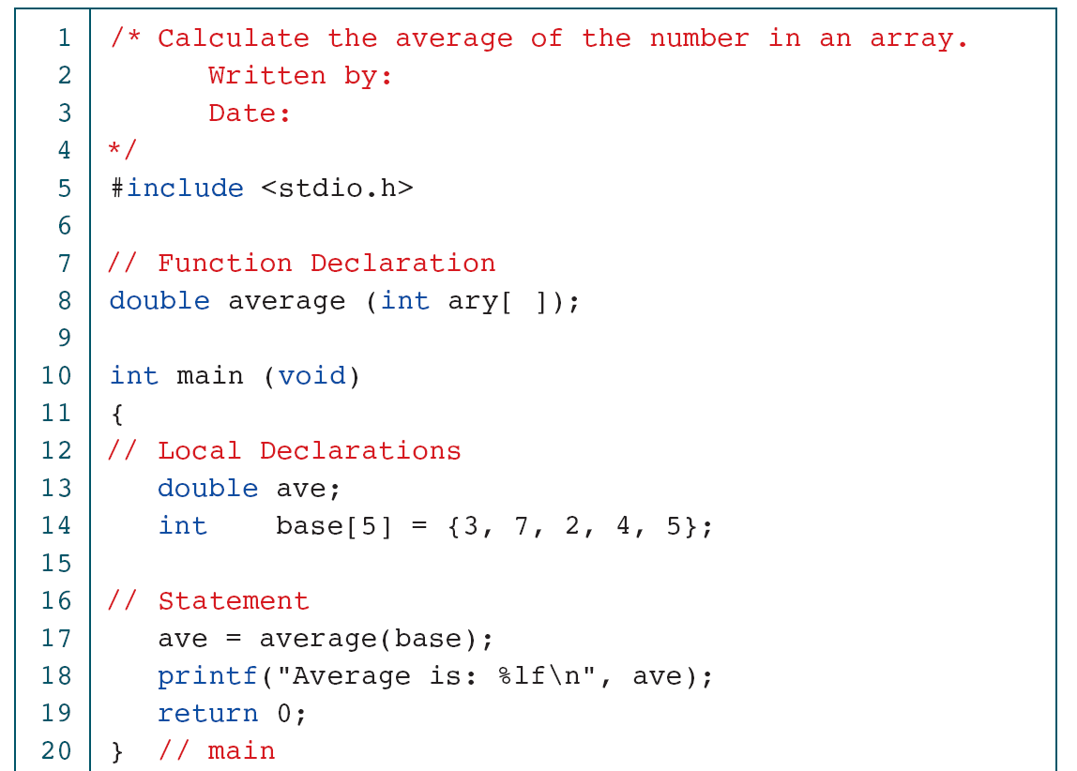
Calculate Array Average

Slide 9
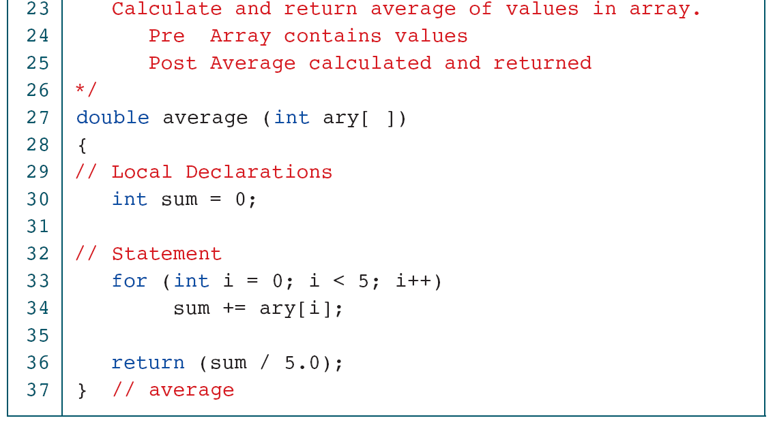
Calculate Array Average

Slide 10
Average Elements in Variable-length Array

Slide 11
Average Elements in Variable-length Array

Slide 12
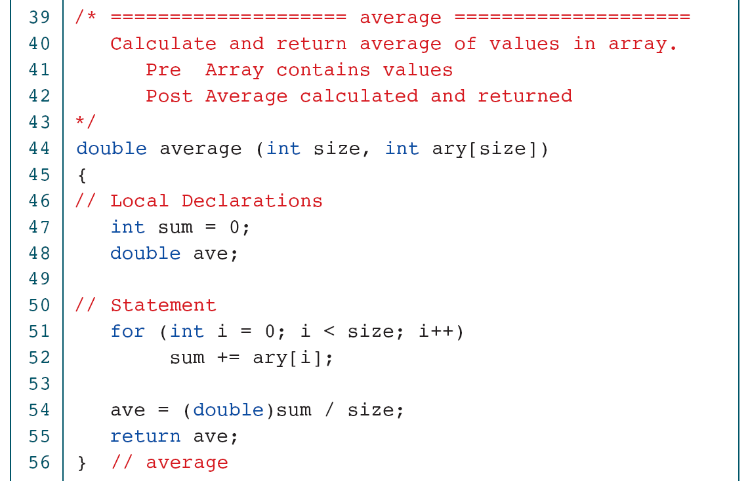
Average Elements in Variable-length Array

Slide 13
Average Elements in Variable-length Array

Slide 14
Change Values in an Array

Slide 15
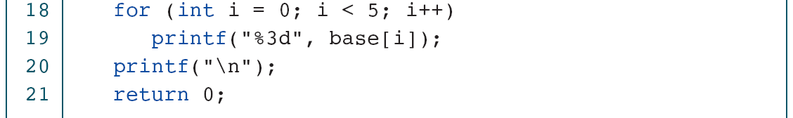
Change Values in an Array

Slide 16
The Type Definition (typedef)
Before discussing the derived types, let’s discuss a C declaration that applies to all of them—the type definition. A type definition, typedef, gives a name to a data type by creating a new type that can then be used anywhere a type is permitted.

Slide 17
FIGURE 12-2 Type-definition Format

Slide 18
Enumerated Types
The enumerated type is a user-defined type based on the standard integer type. In an enumerated type, each integer value is given an identifier called an enumeration constant.

Slide 19
Print Cable TV Stations

Slide 20
Print Cable TV Stations

Slide 21
Note
Don’t be confused about strings and enumerated types.
“Jan” is a string made of three characters; JAN
as defined in the previous code example, is an
enumerated type (identifier) which
has the integer value 1.

Slide 22
Structure
A structure is a collection of related elements, possibly of different types, having a single name.

Slide 23
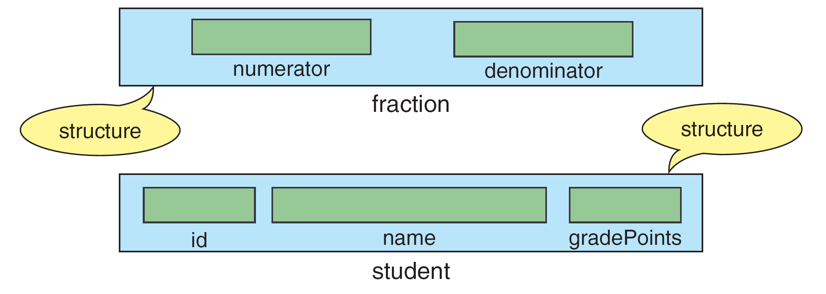
Structure Examples

Slide 24
Note
Elements in a structure can be of the same or different types. However, all elements in the structure
should be logically related.

Slide 25
Tagged Structure Format

Slide 26
Structure Declaration with typedef

Slide 27
Structure Declaration Format and Example

Slide 28
Initializing Structures

Slide 29
Structure Direct Selection Operator

Slide 30
Multiply Fractions

Slide 31
Multiply Fractions

Slide 32
Copying a Structure

Slide 33
Pointers to Structures

Slide 34
Note
(*pointerName).fieldName ↔ pointerName⁻>fieldName.

Slide 35
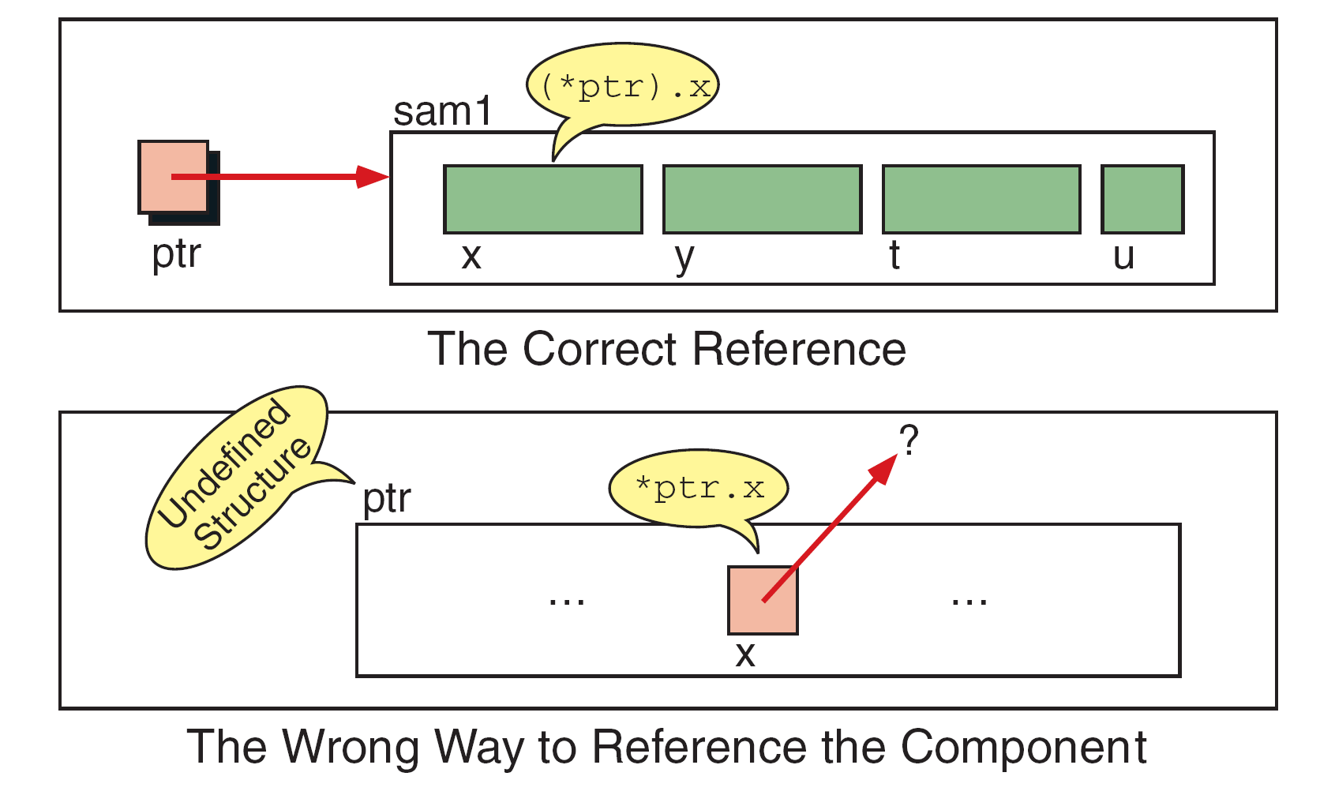
Interpretation of Invalid Pointer Use

Slide 36
Indirect Selection Operator

Slide 37
Clock Simulation with Pointers

Slide 38
Clock Simulation with Pointers

Slide 39
Clock Simulation with Pointers

Slide 40
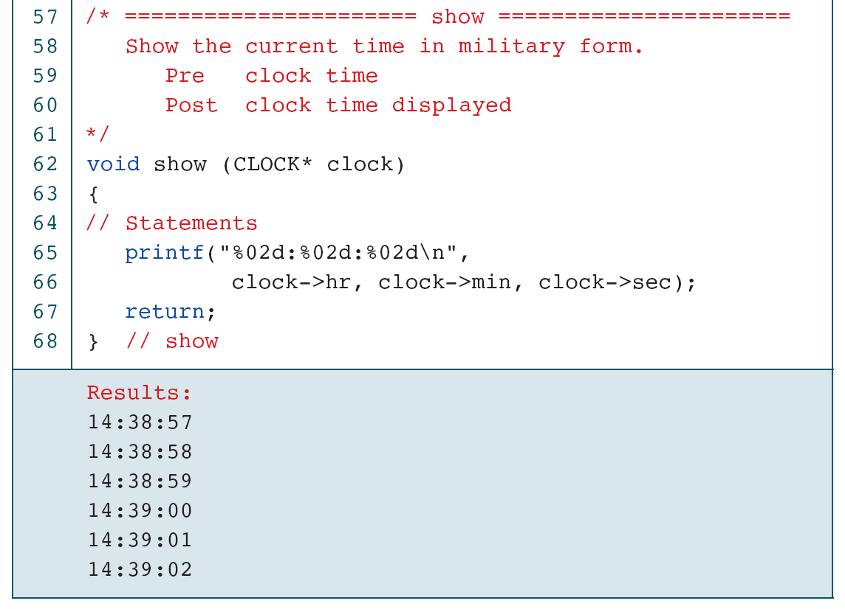
Clock Simulation with Pointers

Slide 41
Nested Structure

Slide 42
Arrays in Structures

Slide 43
Pointers in Structures

Slide 44
Array of Structures

Slide 45
Sort Array of Student Structures

Slide 46
Sort Array of Student Structures

Slide 47
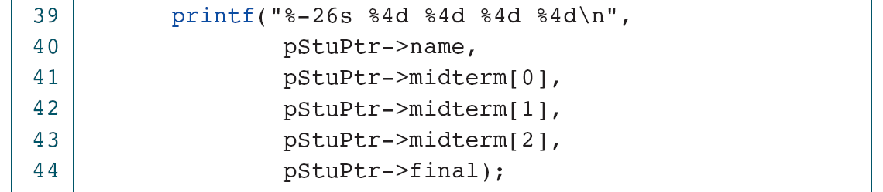
Sort Array of Student Structures

Slide 48
Sort Array of Student Structures

Slide 49
Sort Array of Student Structures

Slide 50
Sort Array of Student Structures

Slide 51
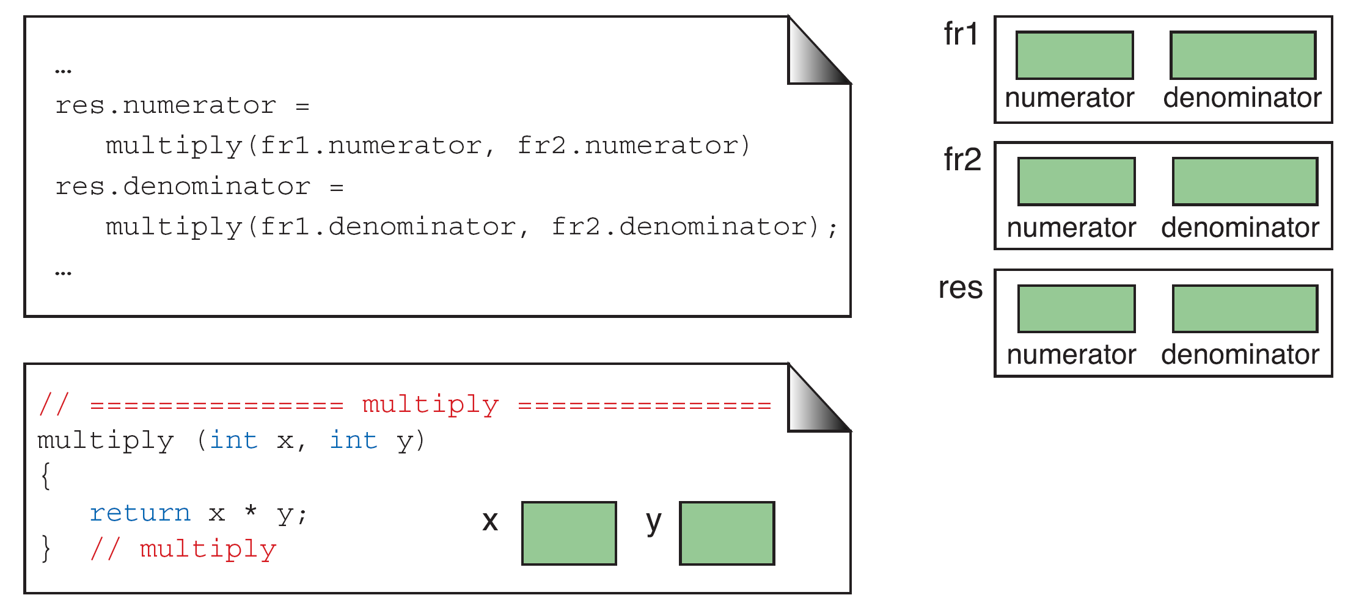
Passing Structure Members to Functions

Slide 52
Passing and returning structures

Slide 53
Passing and Returning Structures

Slide 54
Passing and Returning Structures

Slide 55
Passing and Returning Structures

Slide 56
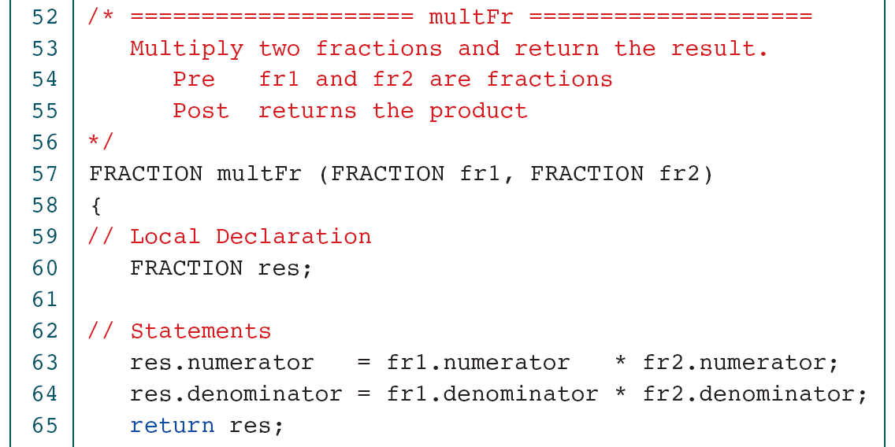
Passing and Returning Structures

Slide 57
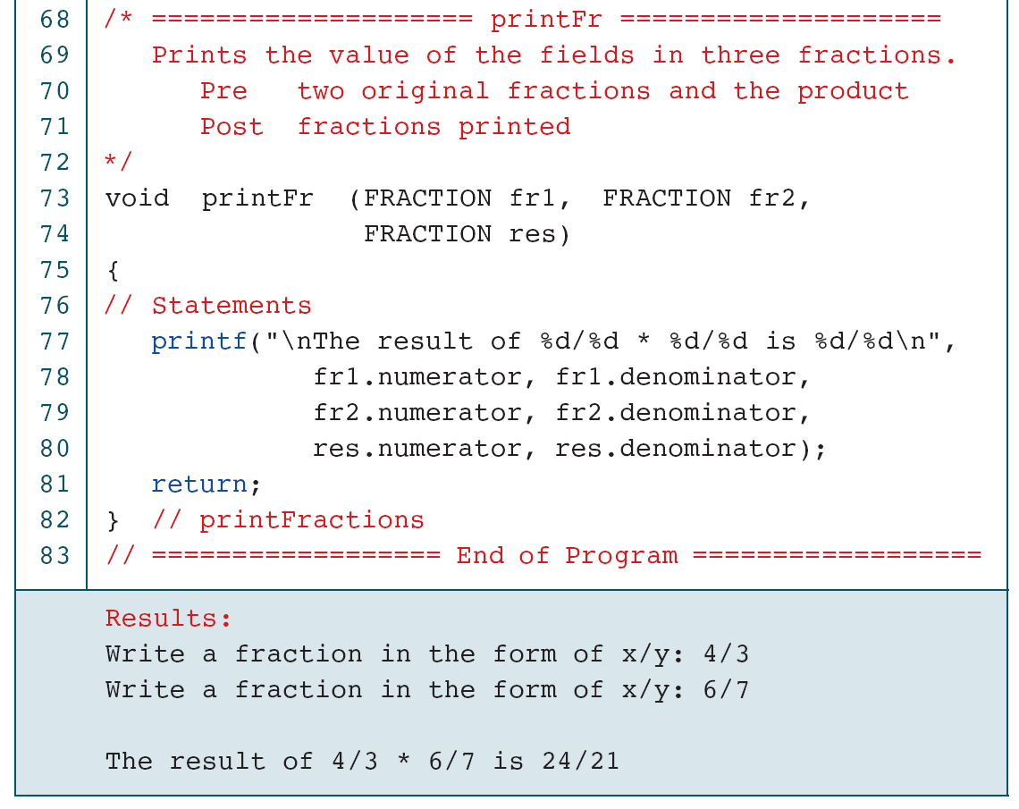
Passing and Returning Structures

Slide 58
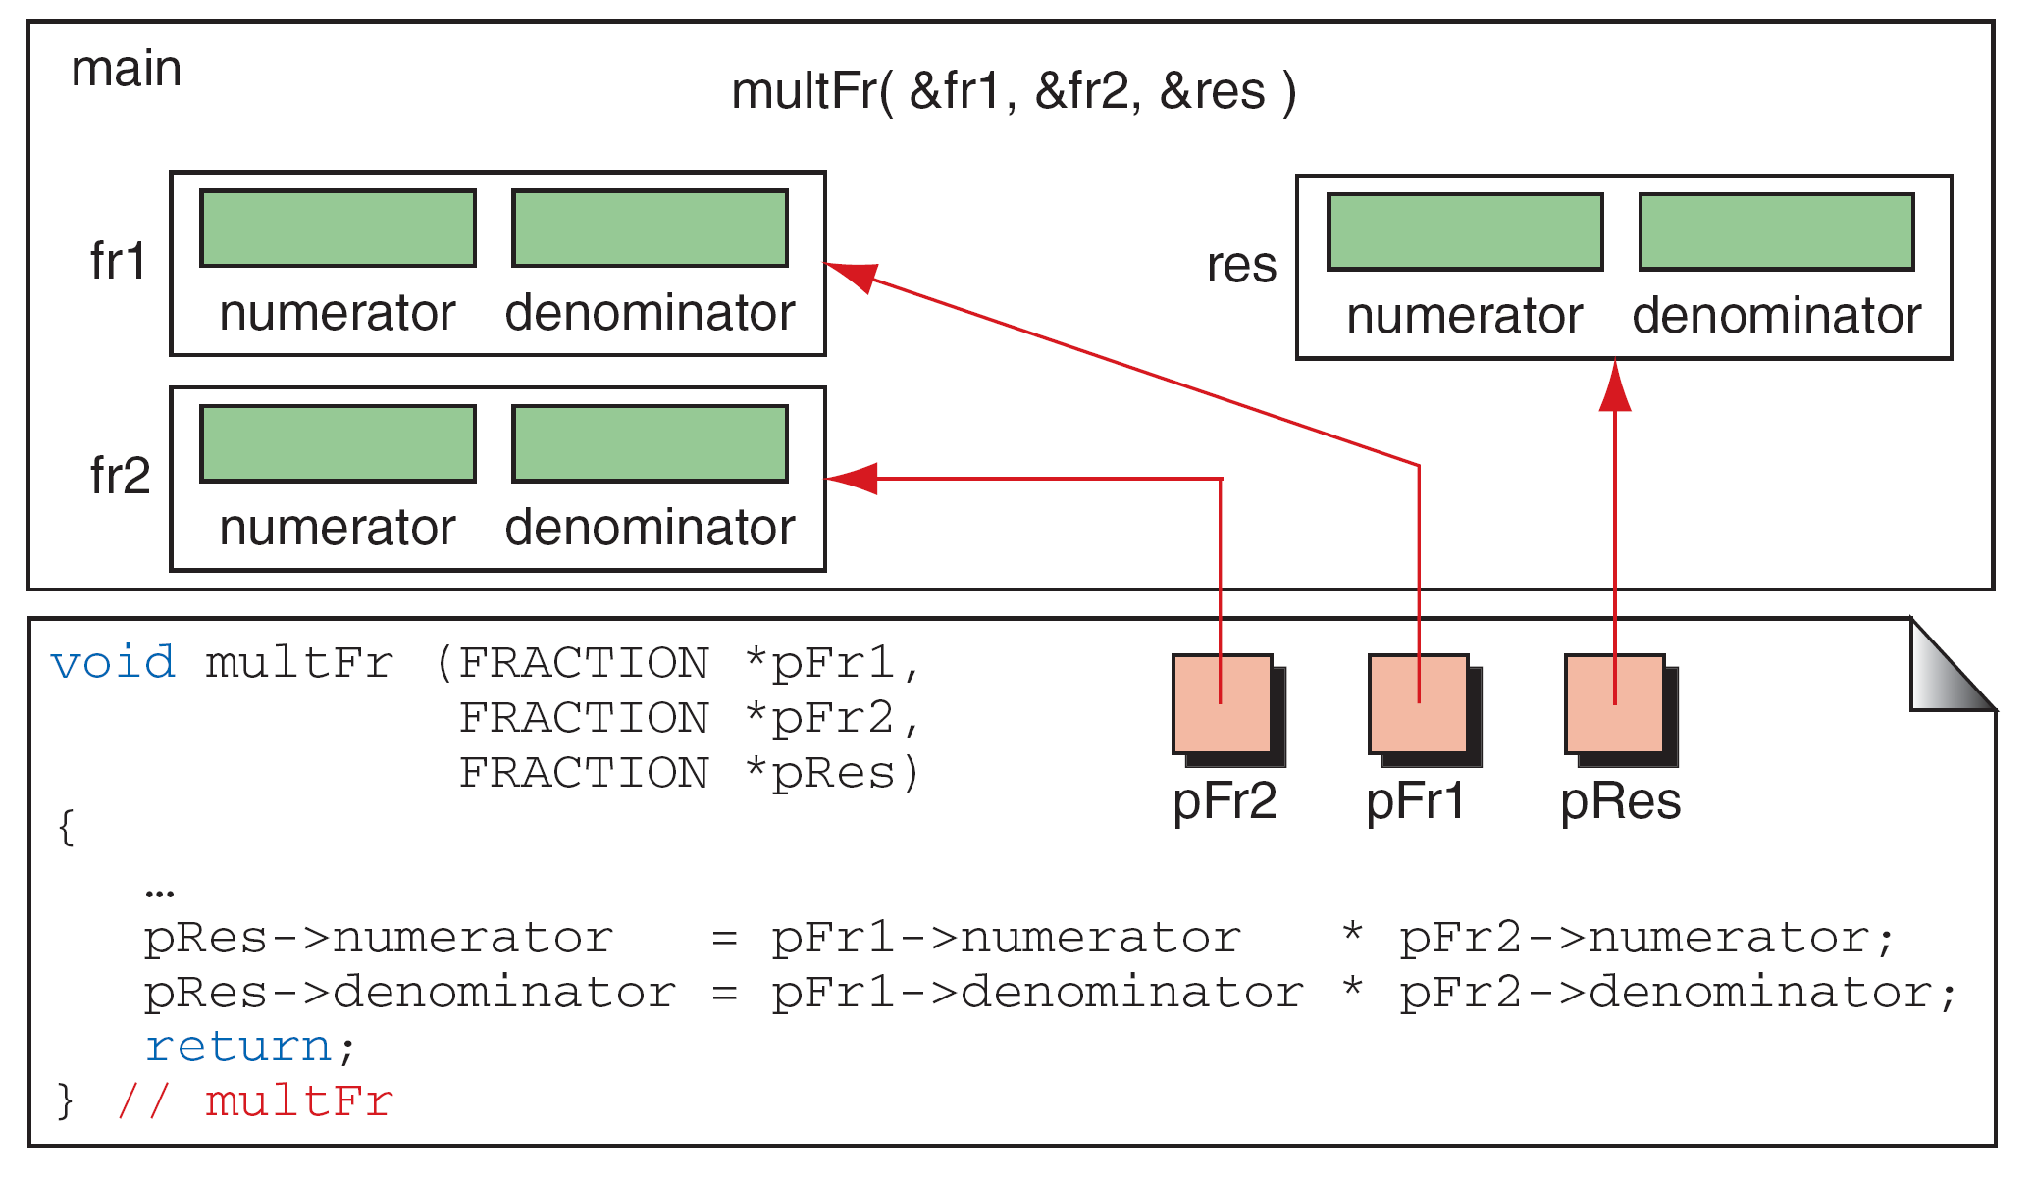
Passing Structures Through Pointers

Slide 59
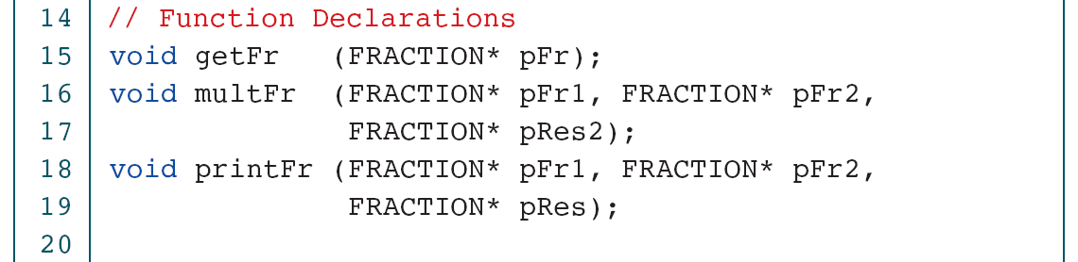
Passing Structures through Pointers

Slide 60
Passing Structures through Pointers

Slide 61
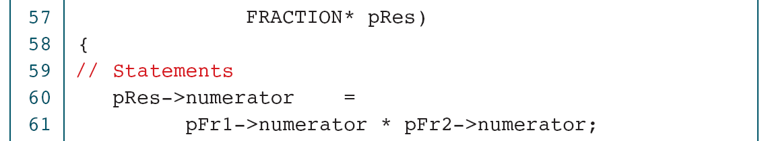
Passing Structures through Pointers

Slide 62
Passing Structures through Pointers

Slide 63
Unions
The union is a construct that allows memory to be shared by different types of data. This redefinition can be as simple as redeclaring an integer as four characters or as complex as redeclaring an entire structure.

Slide 64
Unions

Slide 65
Demonstrate Effect of Union

Slide 66
Demonstrate Effect of Union

Slide 67
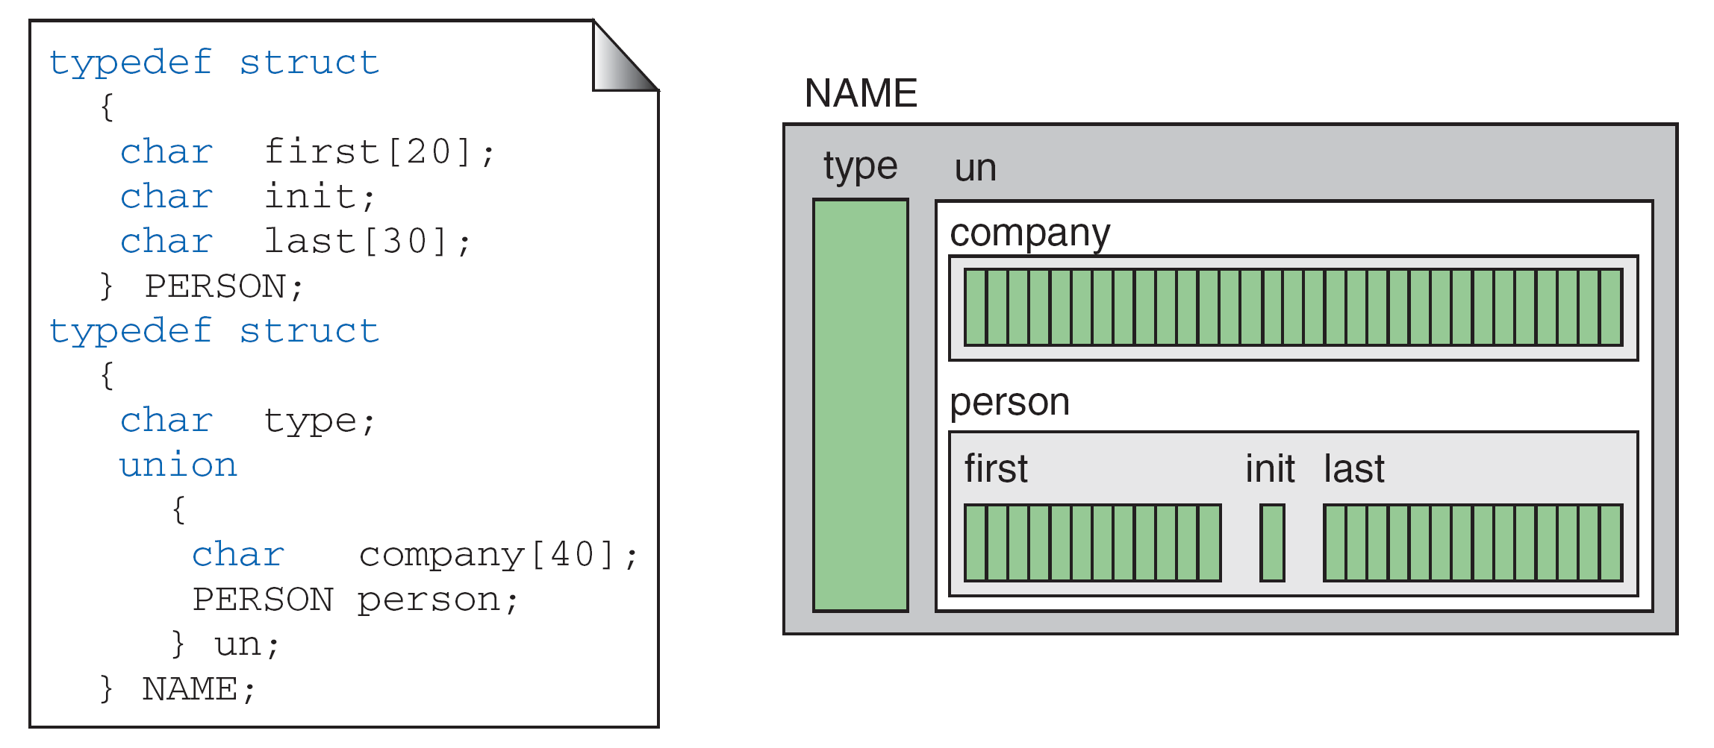
A Name Union

Slide 68
Demonstrate Unions in Structures

Slide 69
Demonstrate Unions in Structures

Slide 70
Demonstrate Unions in Structures

Slide 71
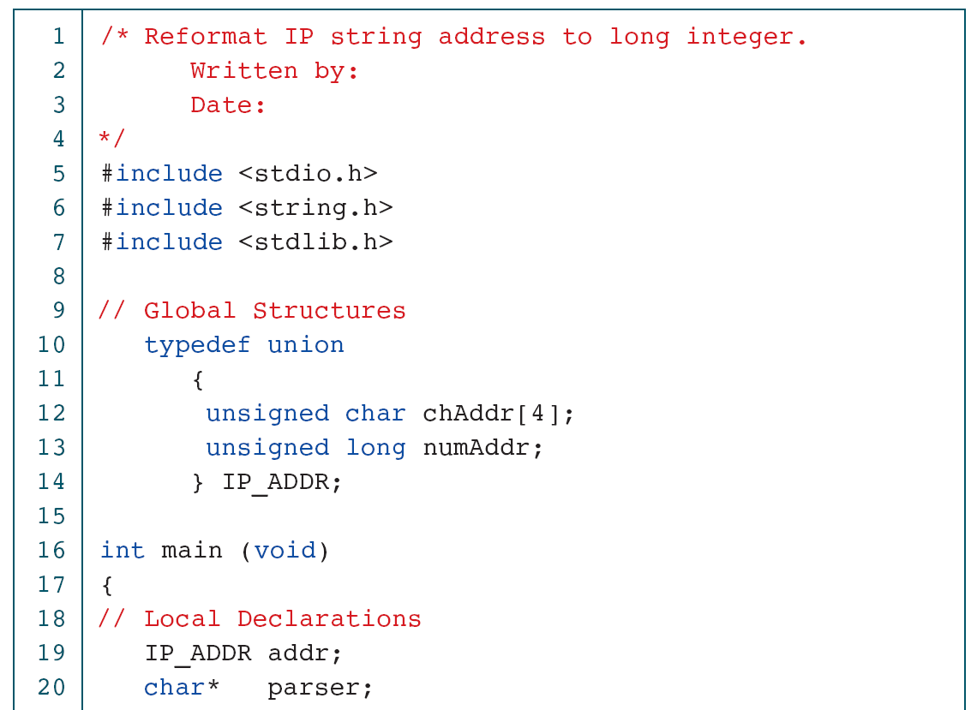
Convert IP Address to long

Slide 72
Convert IP Address to long

Slide 73
PROGRAM 12-9
Convert IP Address to long

