Slide 1
Binary Files

Slide 2
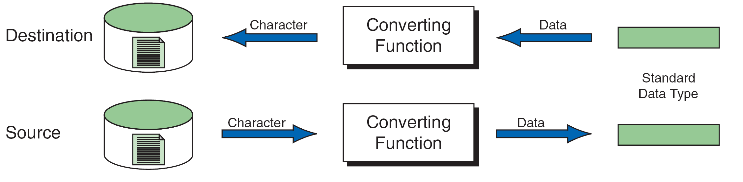
Reading and Writing Text Files

Slide 3
Note
Formatted input/output, character input/output, and string input/output functions can be used only with text files.

Slide 4
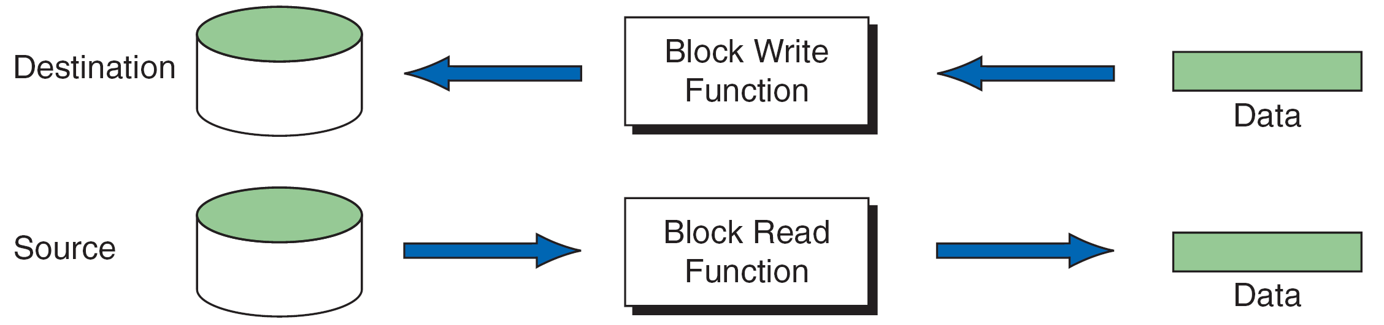
Block Input and Output

Slide 5
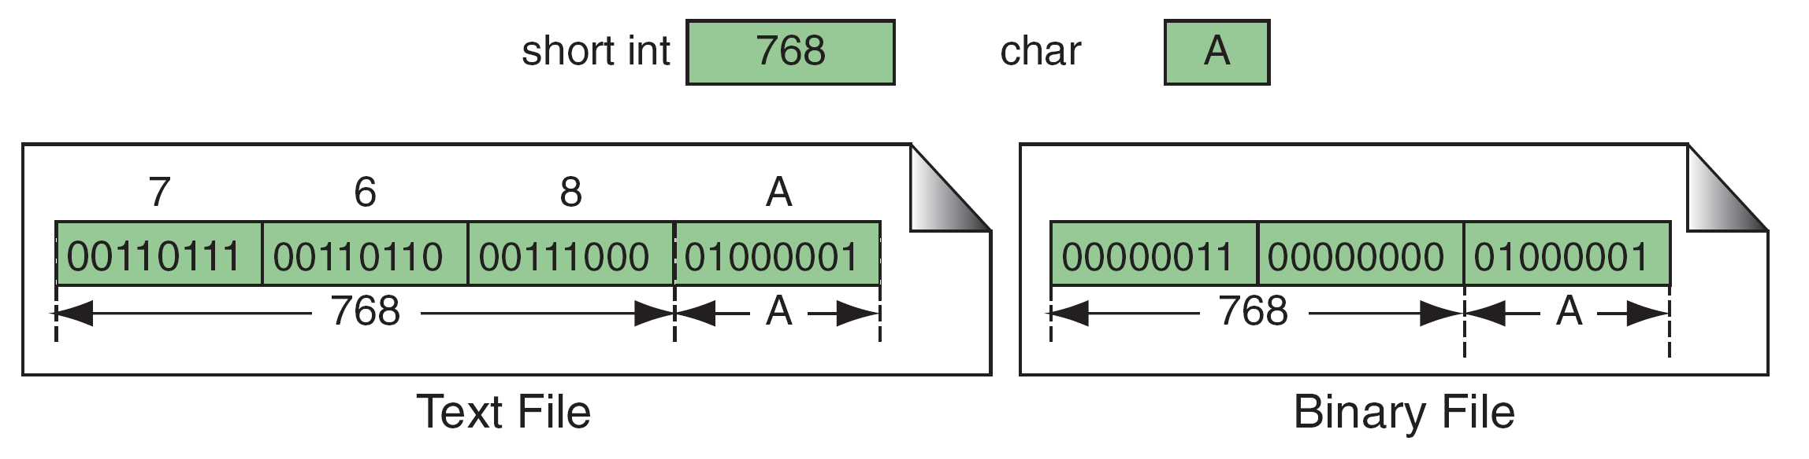
Binary and Text Files

Slide 6
Note
Text files store data as a sequence of characters; binary files store data as they are stored in primary memory.

Slide 7
File Modes

Slide 8
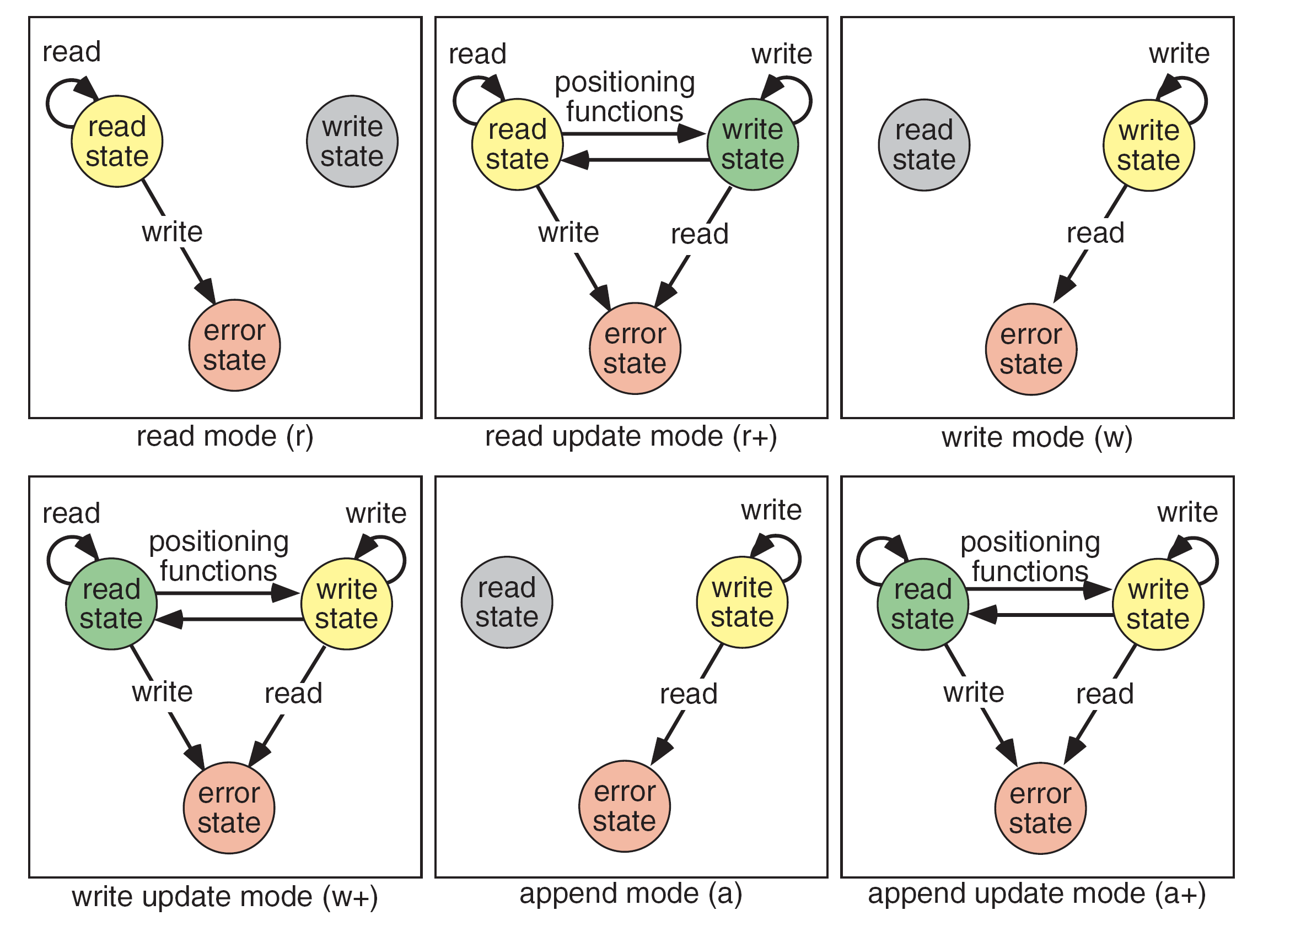
File States

Slide 9
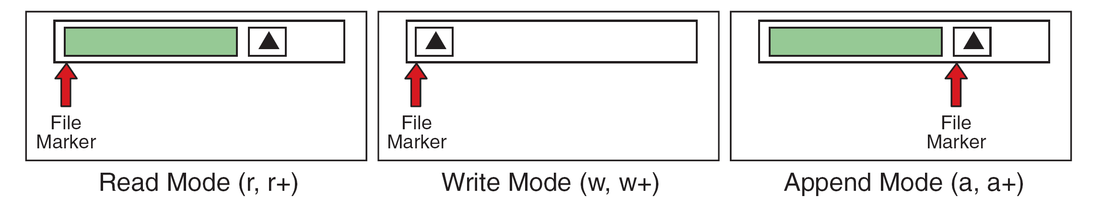
File-Opening Modes

Slide 10
13-2 Standard Library Functions
for Files
C has eight categories of standard file library functions. We have already discussed the first four. We discuss the other four categories, which are more related to binary files, in this section.

Slide 11
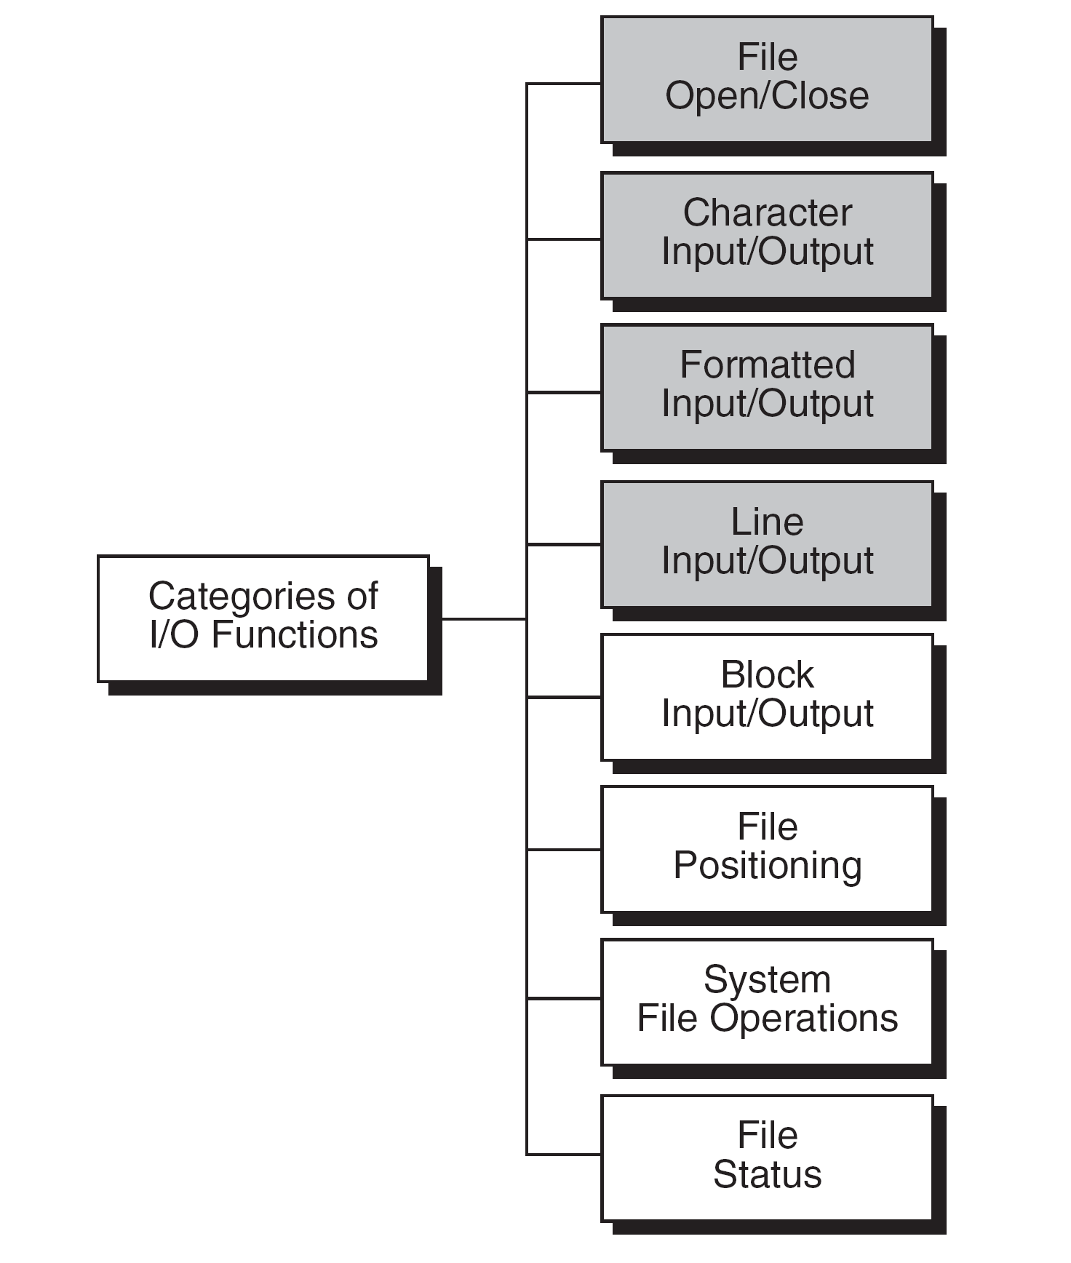
Types of Standard Input/Output Functions

Slide 12
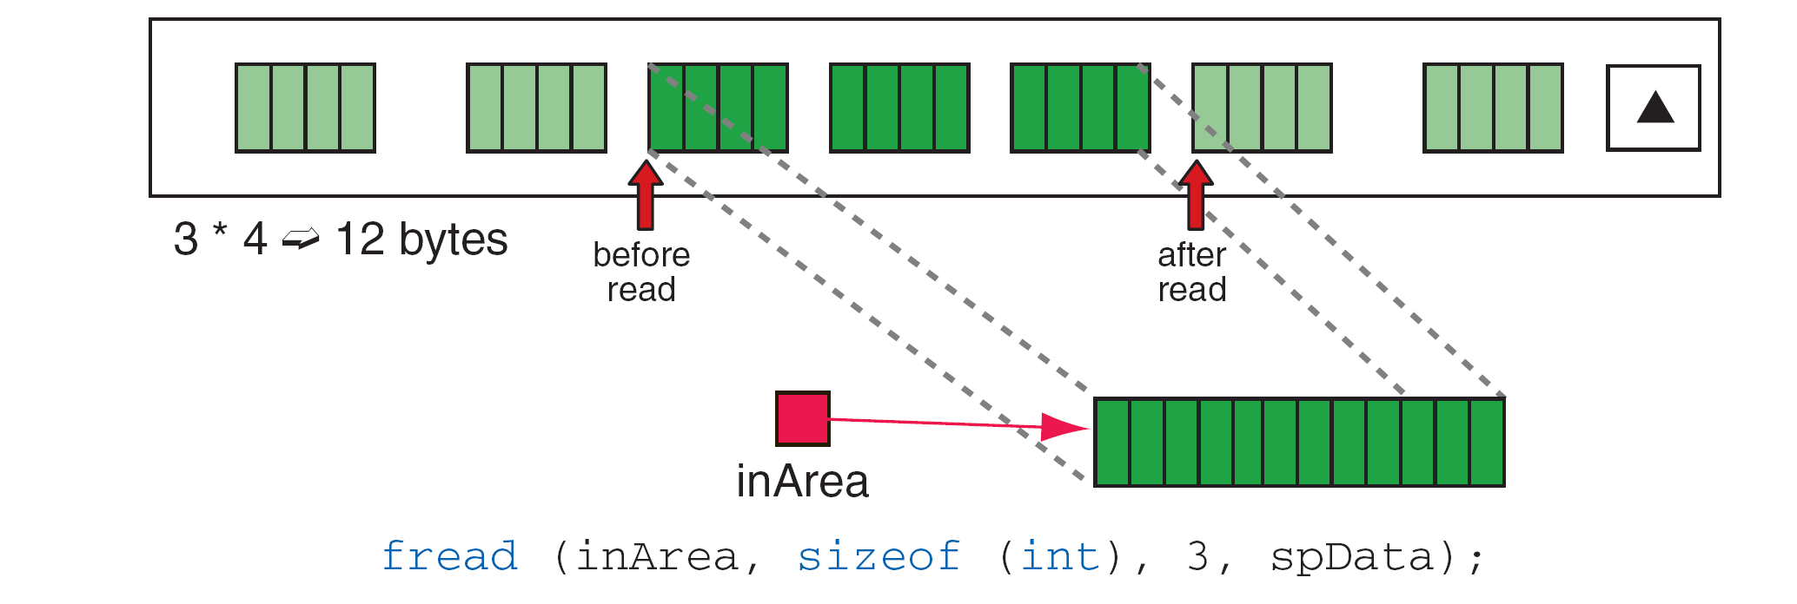
File Read Operation

Slide 13
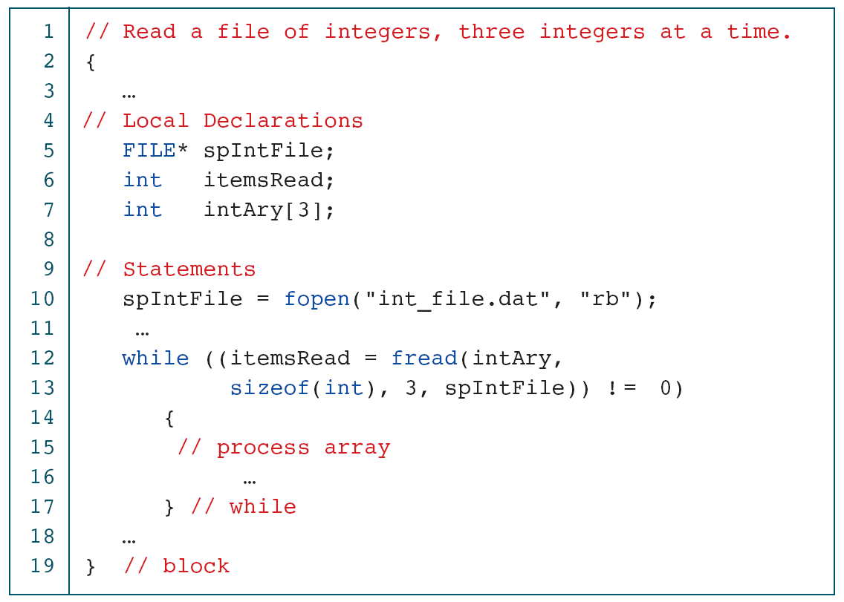
Read File of Integers

Slide 14
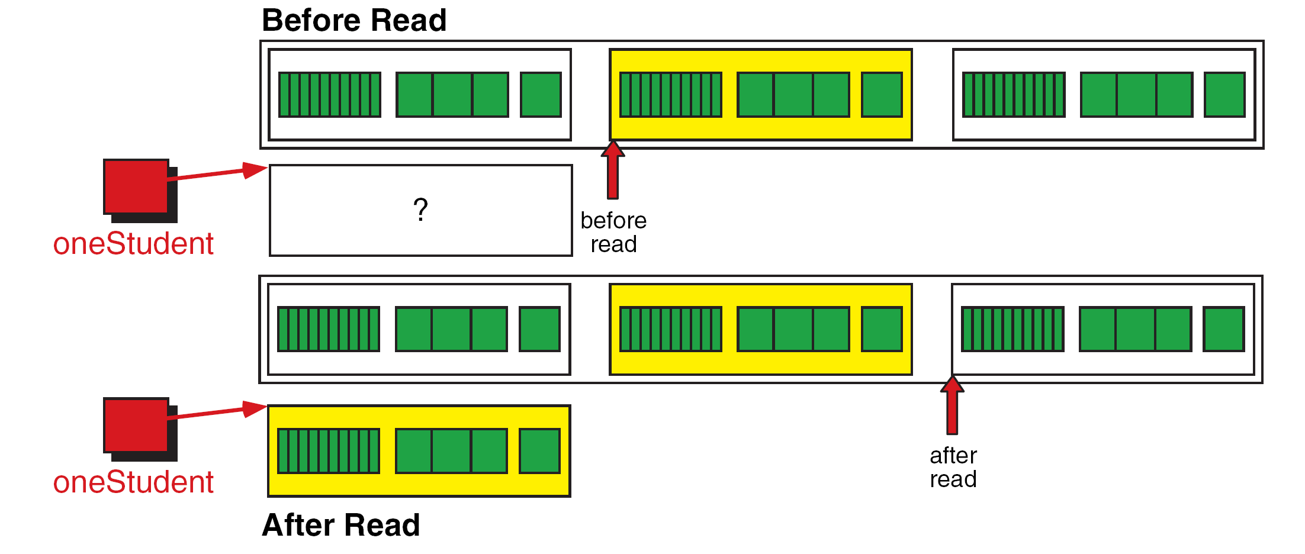
Reading a Structure

Slide 15
Read Student File

Slide 16
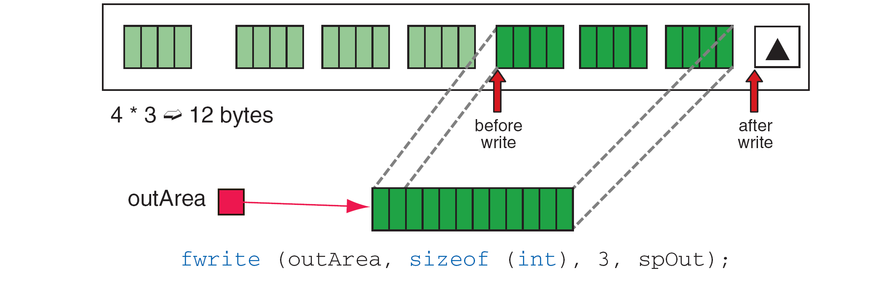
File Write Operation

Slide 17
Writing a Structure

Slide 18
Write Structured Data

Slide 19
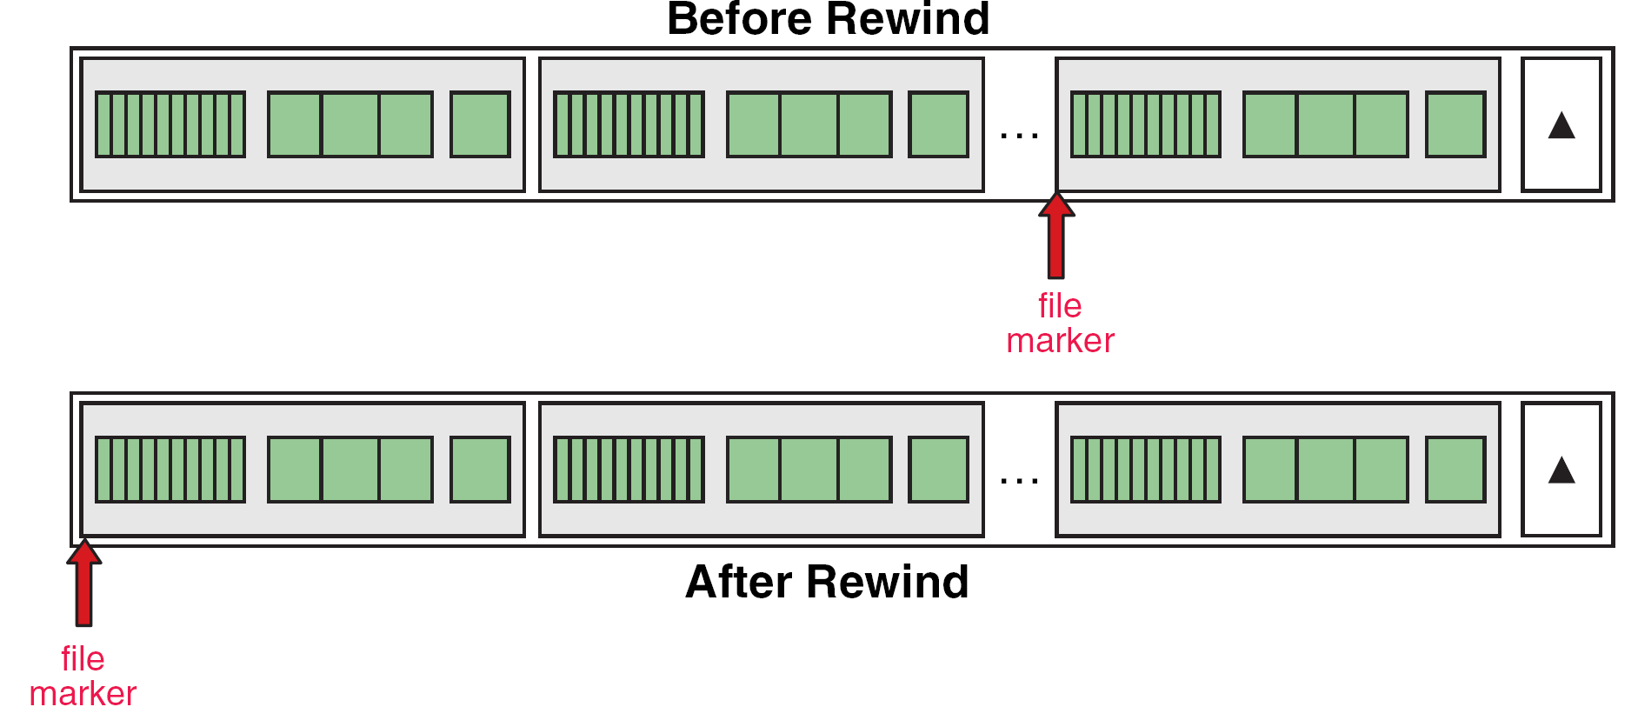
Rewind File

Slide 20
Current Location (ftell) Operation

Slide 21
File Seek Operation

Slide 22
Append Two Binary Files

Slide 23
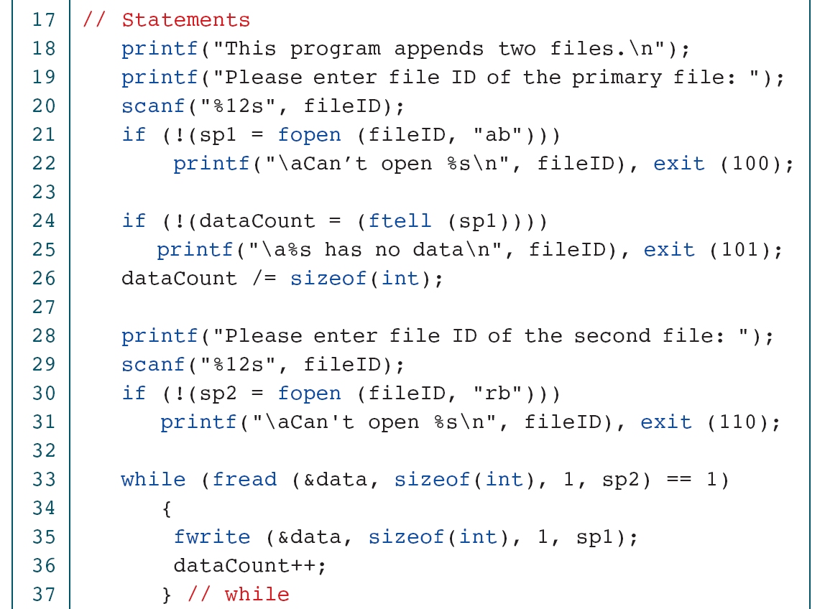
Append Two Binary Files

Slide 24
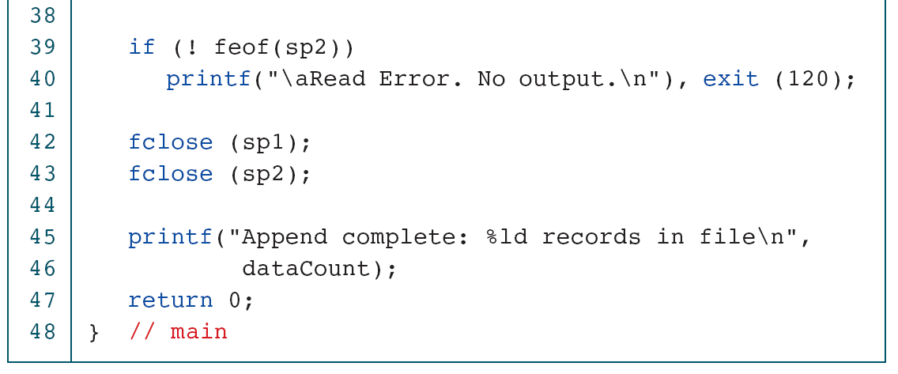
Append Two Binary Files

Slide 25
Converting File Type
A rather common but somewhat trivial problem is to convert a text file to a binary file and vice versa. C has no standard functions for these tasks. We must write a program to make the conversion. We describe the file conversion logic in this section.

Slide 26
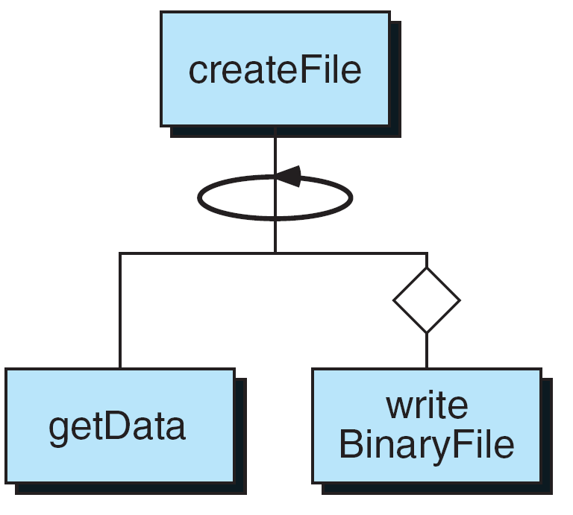
Create Binary File Structure Chart

Slide 27
Text to Binary Student File

Slide 28
Text to Binary Student File

Slide 29
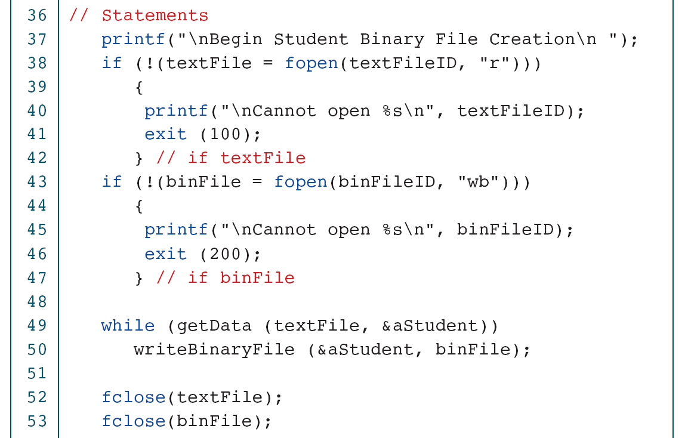
Text to Binary Student File

Slide 30
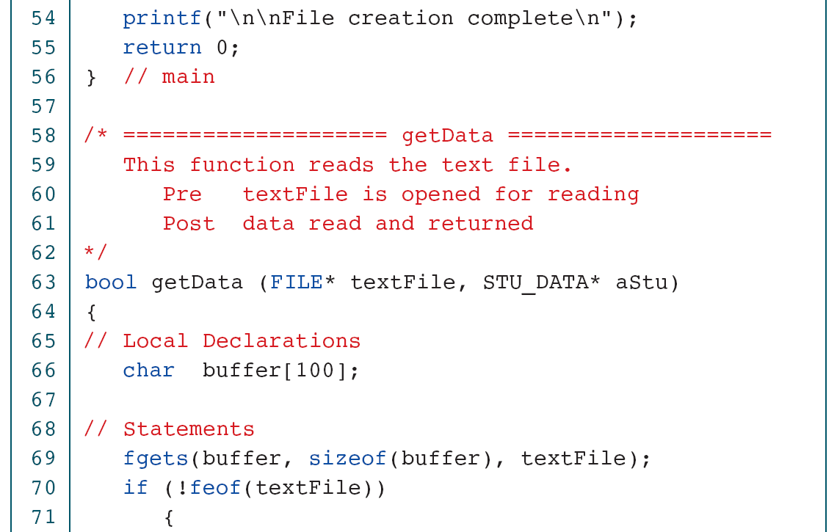
Text to Binary Student File

Slide 31
Text to Binary Student File

Slide 32
Text to Binary Student File

Slide 33
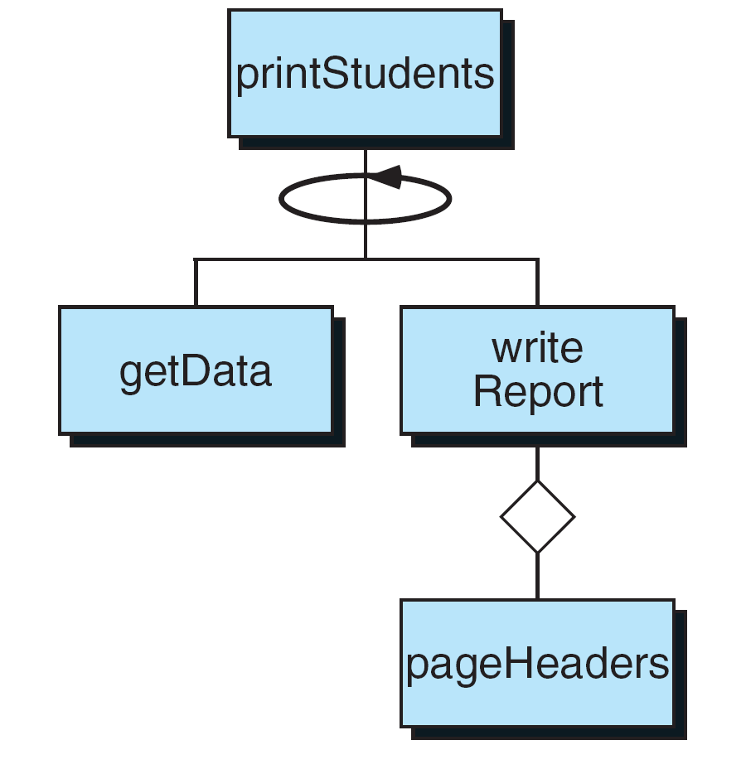
Design for Print Student Data

Slide 34
Print Student Data

Slide 35
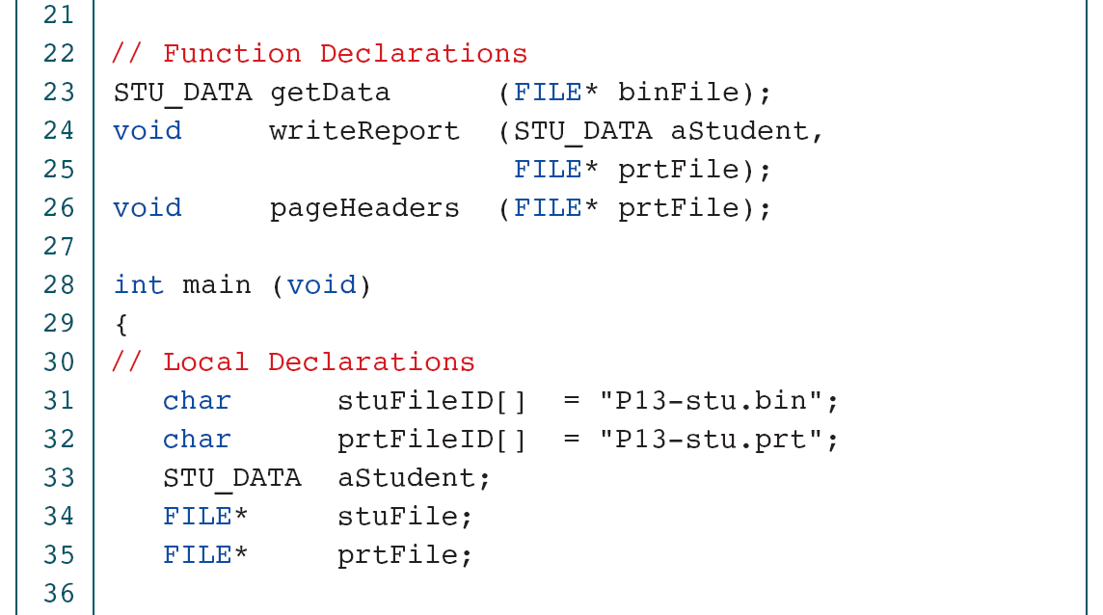
Print Student Data

Slide 36
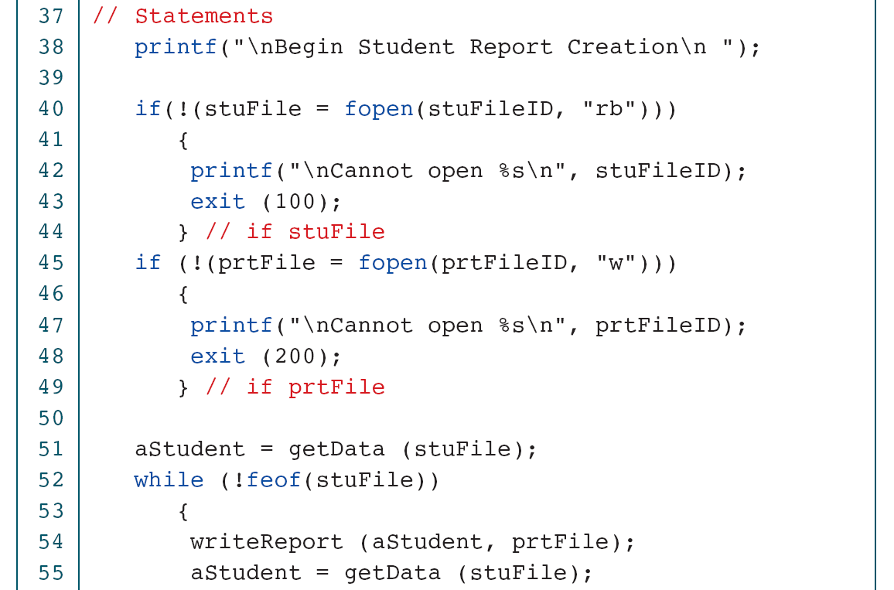
Print Student Data

Slide 37
Print Student Data

Slide 38
Print Student Data

Slide 39
Print Student Data

Slide 40
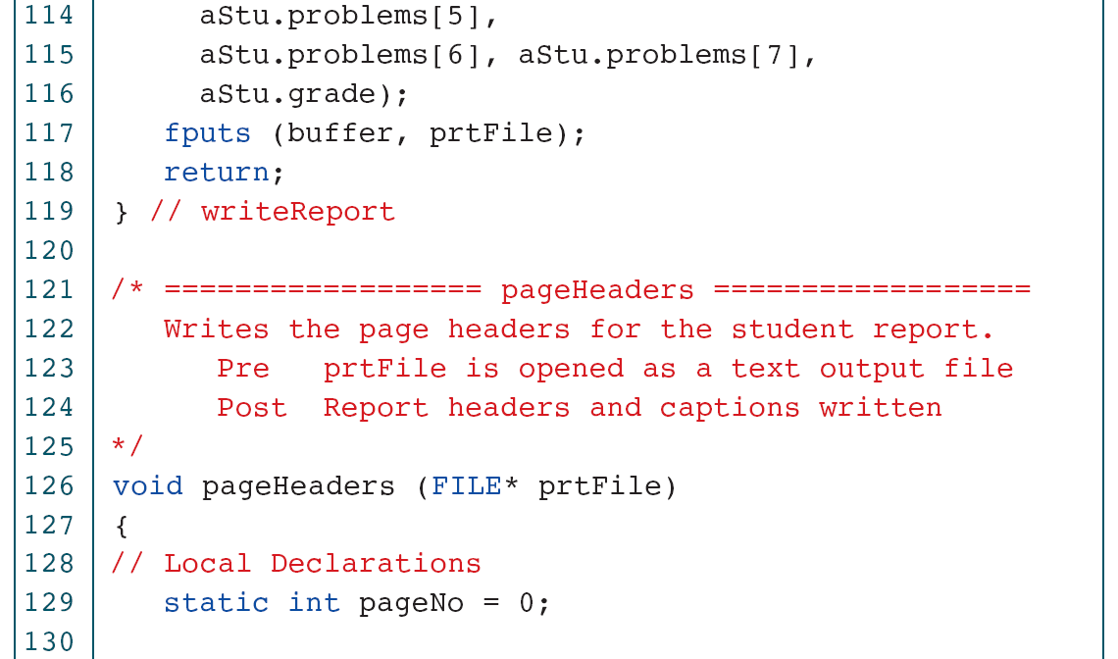
Print Student Data

Slide 41
Print Student Data

Slide 42
File Program Examples
This section contains two common file applications. The first uses the file positioning functions to randomly process the data in a file. The second merges two files.

Slide 43
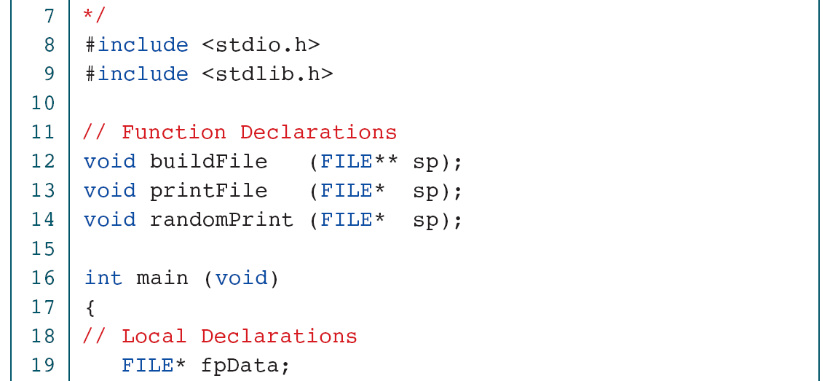
Random File Application

Slide 44
Random File Application

Slide 45
Random File: Build File

Slide 46
Random File: Build File

Slide 47
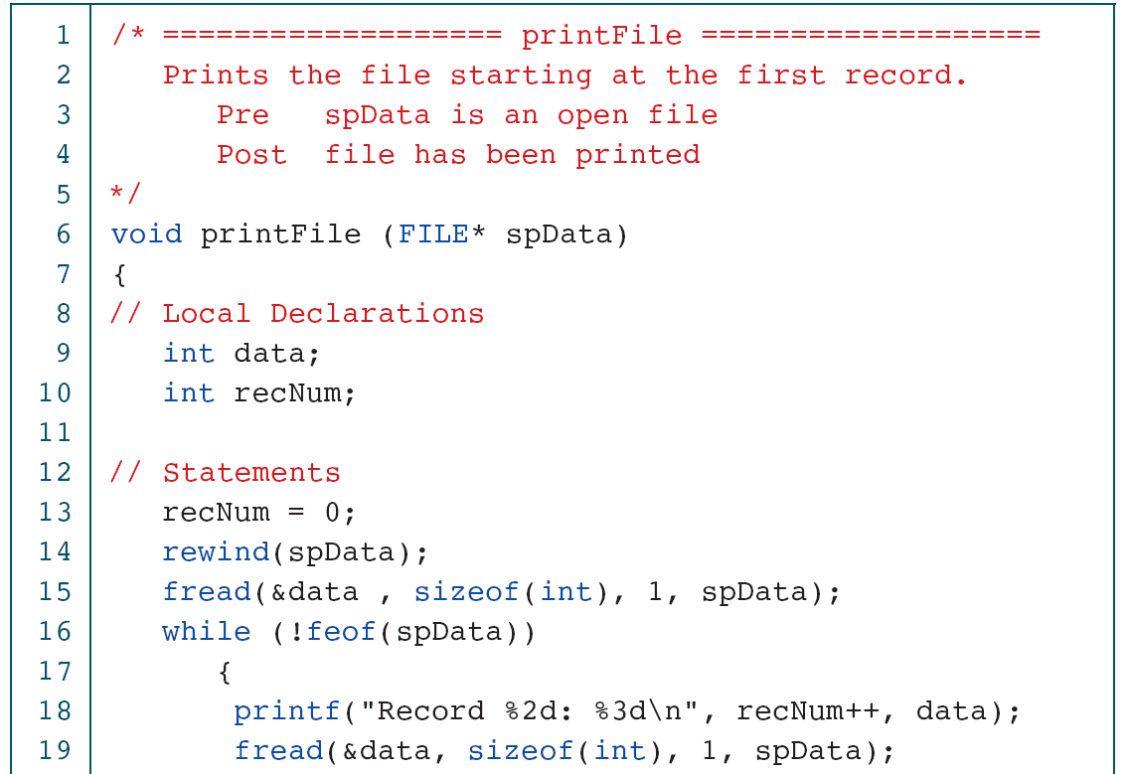
Random File: Sequential Print

Slide 48
Random File: Sequential Print

Slide 49
Random File: Random Print

Slide 50
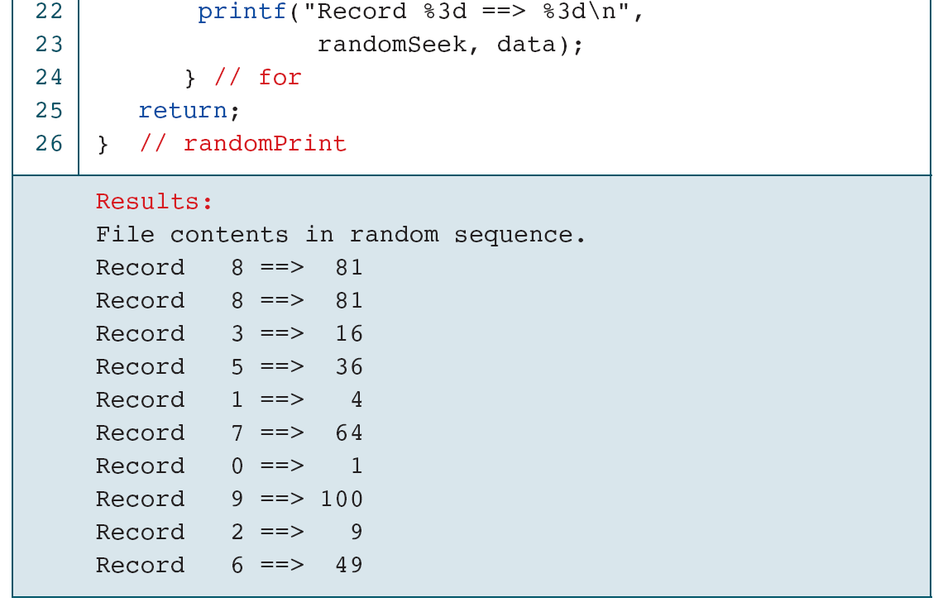
Random File: Random Print

Slide 51
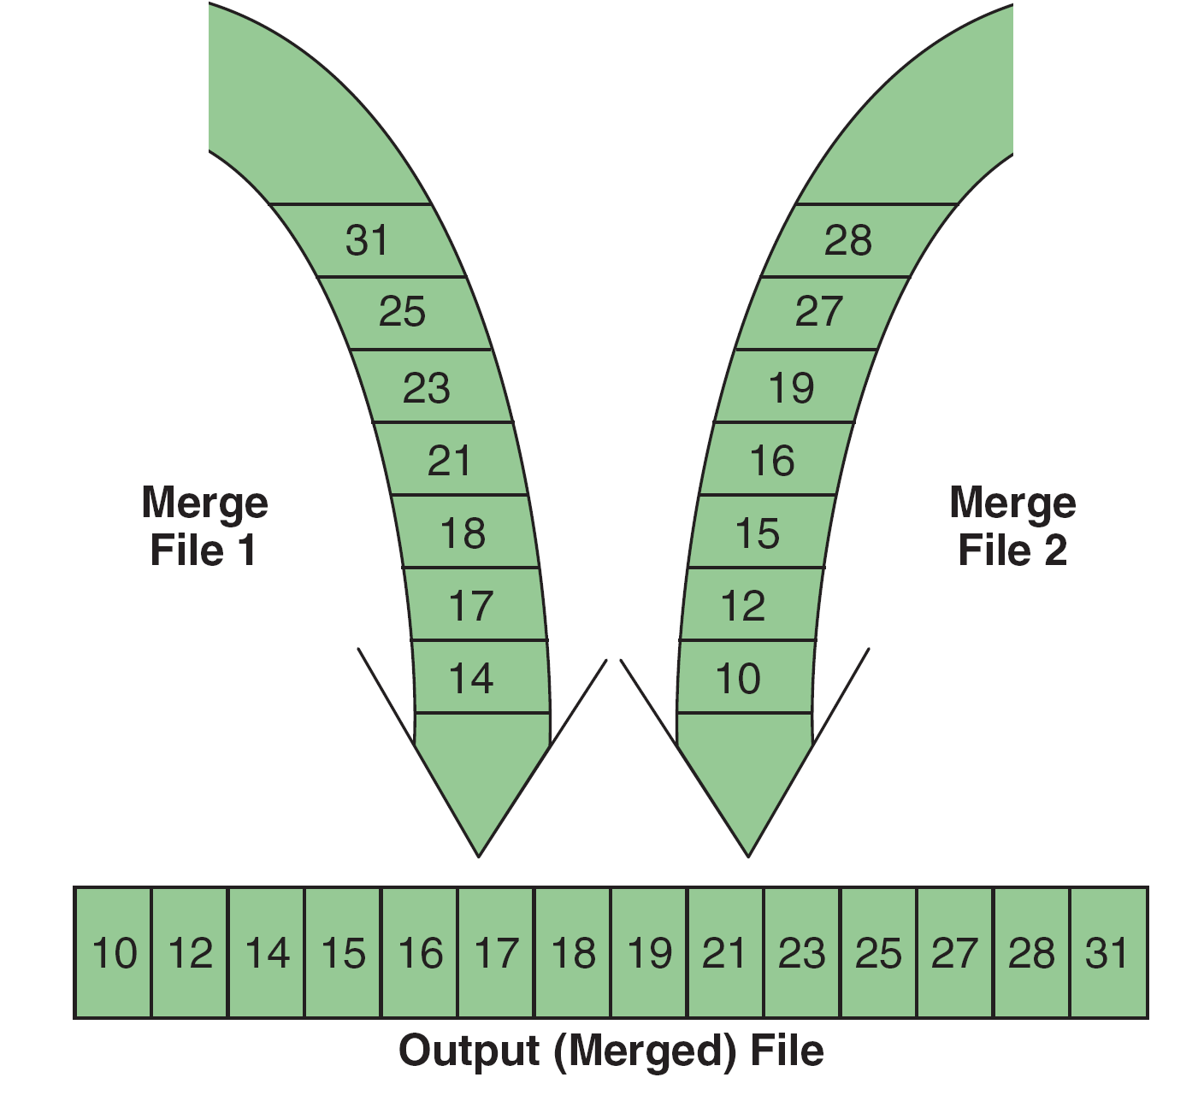
File Merge Concept

Slide 52
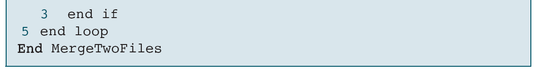
Pseudocode for Merging Two Files

Slide 53
Merge Two Files

Slide 54
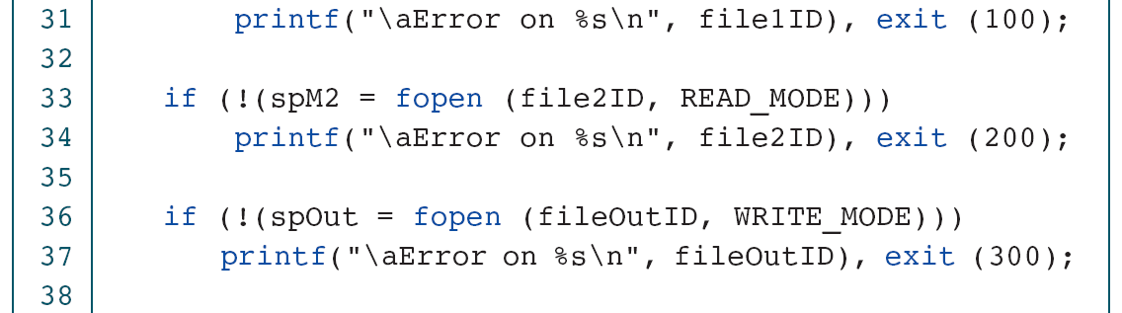
Merge Two Files

Slide 55
Merge Two Files

Slide 56
Merge Two Files

