Slide 1
Functions Review

Slide 2
Designing Structured
Programs
The programs we have presented so far have been very simple. They solved problems that could be understood without too much effort.
The principles of top–down design and structured programming dictate that a program should be divided into a main module and its related modules. Each module should also be divided into submodules.

Slide 3
Functions in C
In C, the idea of top–down design is done using functions. A C program is made of one or more functions, one and only one of which must be named main.
In general, the purpose of a function is to receive zero or more pieces of data, operate on them, and return at most one piece of data. At the same time, a function can have a side effect. A function side effect is an action that results in a change in the state of the program.

Slide 4
Structure Chart for a C Program

Slide 5
Function Concept

Slide 6
Function Facts
A function in C can have a return value, a side effect, or both.
The side effect occurs before the value is returned.
The function’s value is the value in the expression of the return statement.
A function can be called for its value, its side effect, or both.

Slide 7
PROGRAM 4-1
Sample Program with Subfunction

Slide 8
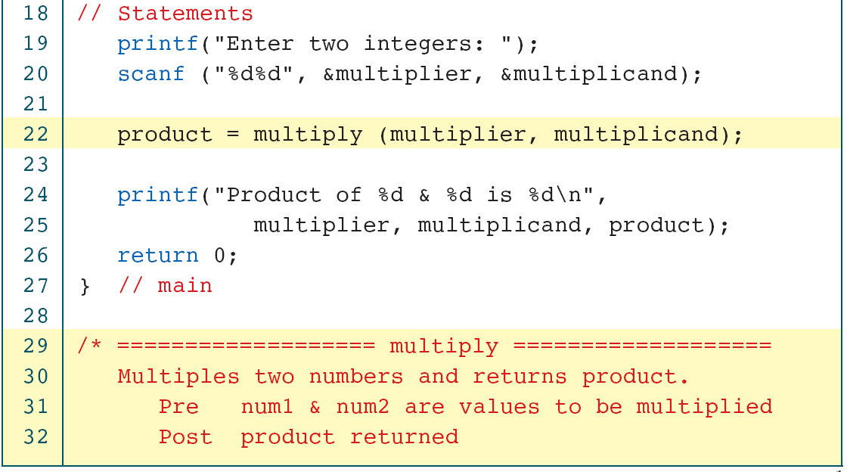
PROGRAM 4-1
Sample Program with Subfunction

Slide 9
PROGRAM 4-1
Sample Program with Subfunction

Slide 10
User-Defined Functions
Like every other object in C, functions must be both declared and defined. The function declaration gives the whole picture of the function that needs to be defined later. The function definition contains the code for a function.
A function name is used three times: for declaration, in a call, and for definition.

Slide 11
Function Return Statements

Slide 12
Formal and Actual Parameters
Formal parameters are variables that are declared in the header of the function definition.
Actual parameters are the expressions in the calling statement.
Formal and actual parameters must match exactly in type, order, and number.
Their names, however, do not need to match.

Slide 13
Parts of a Function Call

Slide 14
Inter-Function Communication
Although the calling and called functions are two separate entities, they need to communicate to exchange data. The data flow between the calling and called functions can be divided into three strategies: a downward flow, an upward flow, and a bi-directional flow.

Slide 15
Data Flow Strategies

Slide 16
Pass by value
The C language uses only pass by value and return to achieve three types of communications between a calling and a called function.

Slide 17
Downward Communication in C

Slide 18
Downward Communication

Slide 19
Upward Communication in C

Slide 20
Upward Communication

Slide 21
Sending data from the Called Function to the calling function
1. We need to use the & symbol in front of the data variable
when we call the function.
2. We need to use the * symbol after the data type when we
declare the address variable
3. We need to use the * in front of the variable when we
store data indirectly

Slide 22
Bi-directional Communication in C

Slide 23
Bi-directional Communication

Slide 24
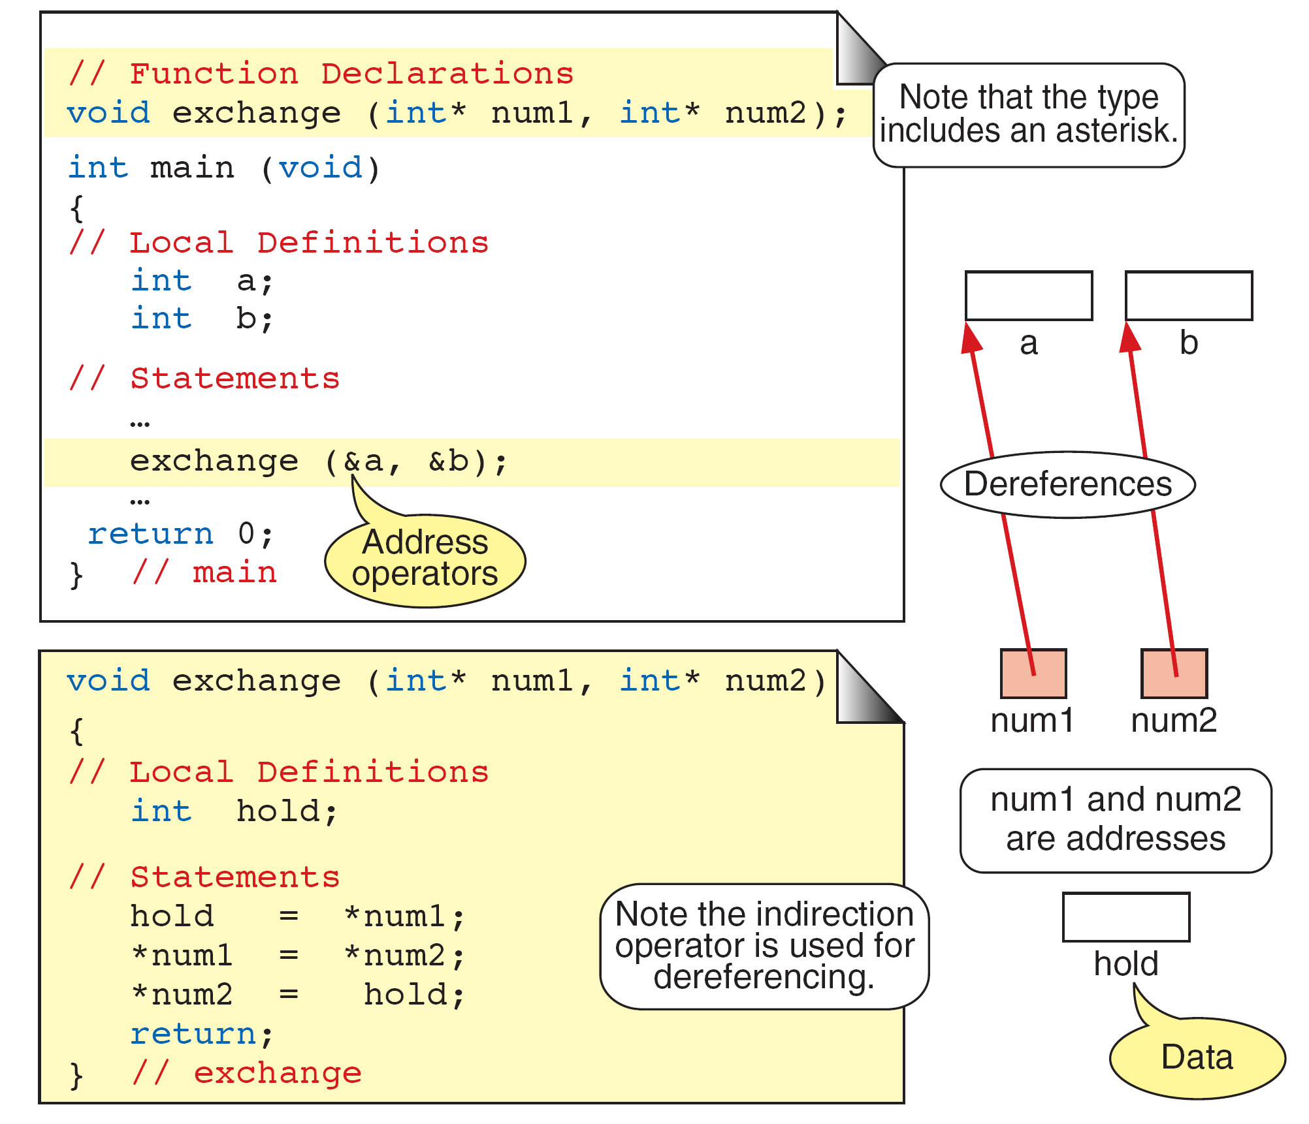
Exchange Function

Slide 25
Calculate Quotient and Remainder

Slide 26
Quotient and Remainder Design

Slide 27
Quotient and Remainder

Slide 28
Quotient and Remainder

Slide 29
Quotient and Remainder

Slide 30
Quotient and Remainder

Slide 31
Scope
Scope determines the region of the program in which a defined object is visible. Scope pertains to any object that can be declared, such as a variable or
a function declaration.
Variables are in scope from declaration until the
end of their block.
It is poor programming style to reuse identifiers
within the same scope.

Slide 32
Scope for Global and Block Areas

Slide 33
Programming Example—
Incremental Development
Top–down development, a concept inherent to modular programming, allows us to develop programs incrementally. By writing and debugging each function separately, we are able to solve the program in smaller steps, making the whole process easier.
Topics discussed in this section:
First Increment: main and getData
Second Increment: add
Final Increment: Print ResultsThe

Slide 34
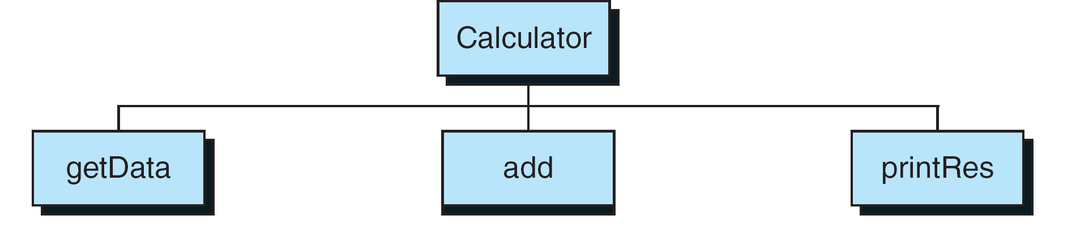
Calculator Program Design

Slide 35
Calculator Program—First Increment

Slide 36
Calculator Program—First Increment

Slide 37
Calculator Program—First Increment

Slide 38
Calculator Program—Second Increment

Slide 39
Calculator Program—Second Increment

Slide 40
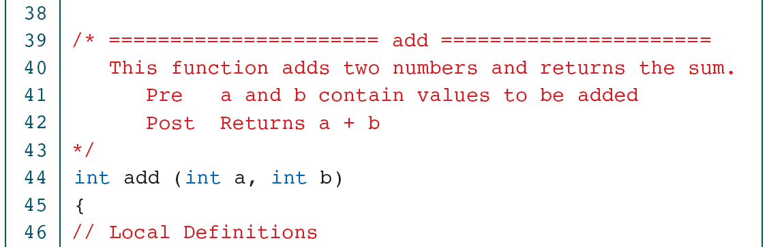
Calculator Program—Second Increment

Slide 41
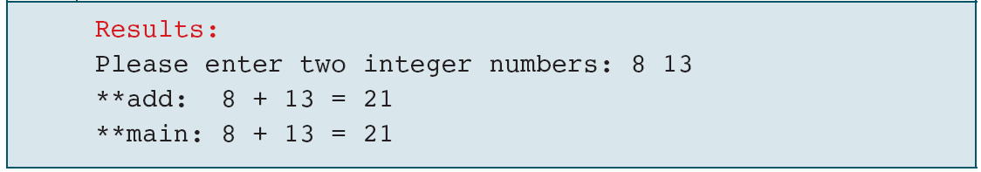
Calculator Program—Second Increment

Slide 42
Calculator Program—Final Increment

Slide 43
Calculator Program—Final Increment

Slide 44
Calculator Program—Final Increment

Slide 45
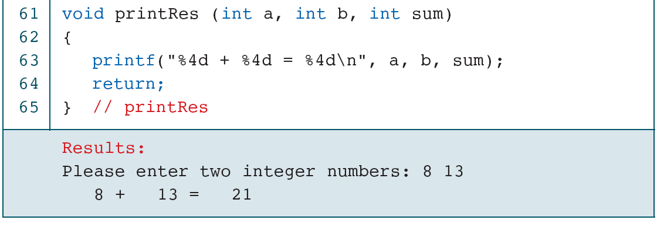
Calculator Program—Final Increment

Slide 46
Menu Driven Calculator
Design for Menu-driven Calculator

Slide 47
Menu-driven Calculator—First Increment

Slide 48
Menu-driven Calculator—First Increment

Slide 49
Menu-driven Calculator—First Increment

Slide 50
Menu-driven Calculator—First Increment

Slide 51
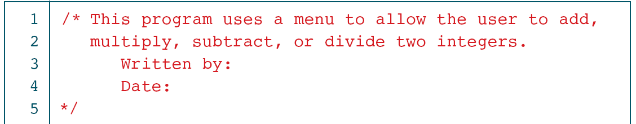
Menu-driven Calculator—Third Increment

Slide 52
Menu-driven Calculator—Third Increment

Slide 53
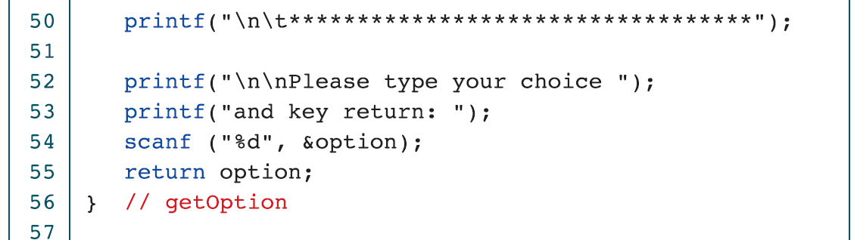
Menu-driven Calculator—Third Increment

Slide 54
Menu-driven Calculator—Third Increment

Slide 55
Menu-driven Calculator—Third Increment

Slide 56
Menu-driven Calculator—Third Increment

Slide 57
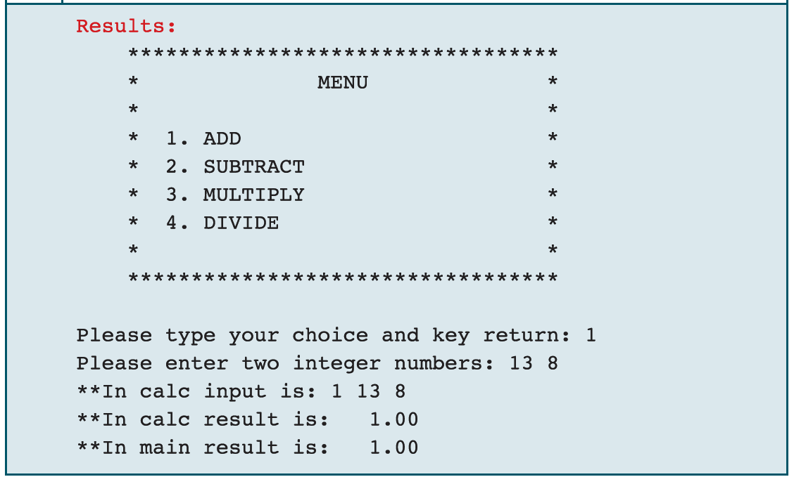
Menu-driven Calculator—Third Increment

Slide 58
Menu-driven Calculator—Fifth Increment

Slide 59
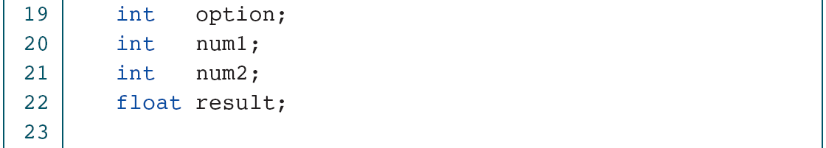
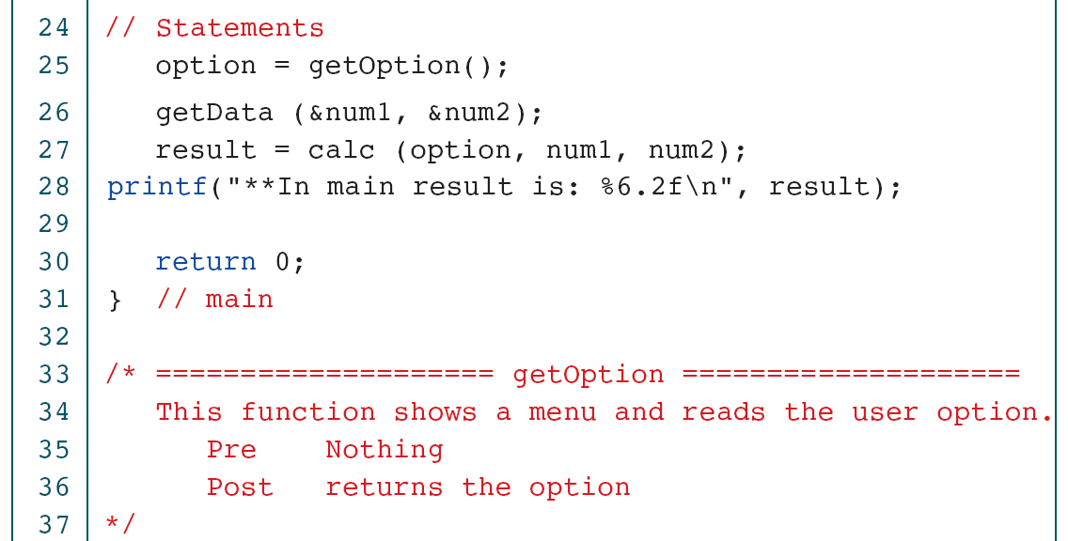
Menu-driven Calculator—Fifth Increment

Slide 60
Menu-driven Calculator—Fifth Increment

Slide 61
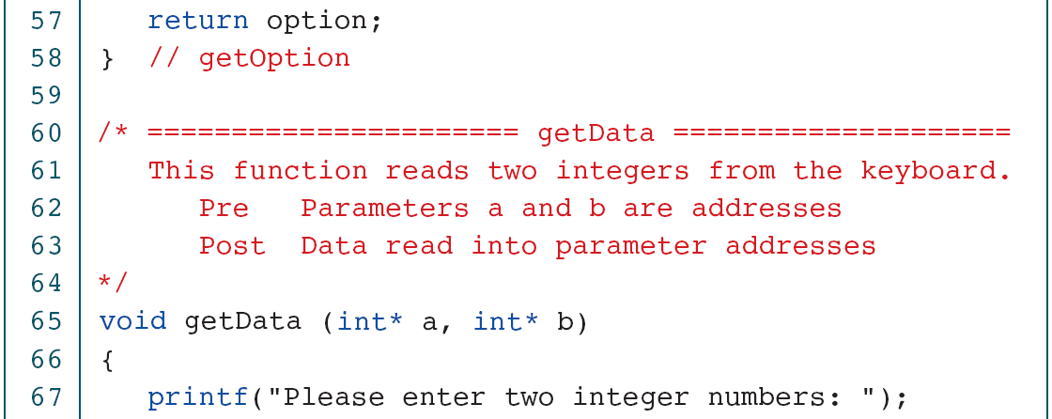
Menu-driven Calculator—Fifth Increment

Slide 62
Menu-driven Calculator—Fifth Increment

Slide 63
Menu-driven Calculator—Fifth Increment

Slide 64
Menu-driven Calculator—Fifth Increment

Slide 65
Menu-driven Calculator—Fifth Increment

Slide 66
Menu-driven Calculator—Fifth Increment

Slide 67
Software Engineering
In this section, we discuss some software engineering issues related to decisions.

Slide 68
Examples of Poor and Good Nesting Styles

Slide 69
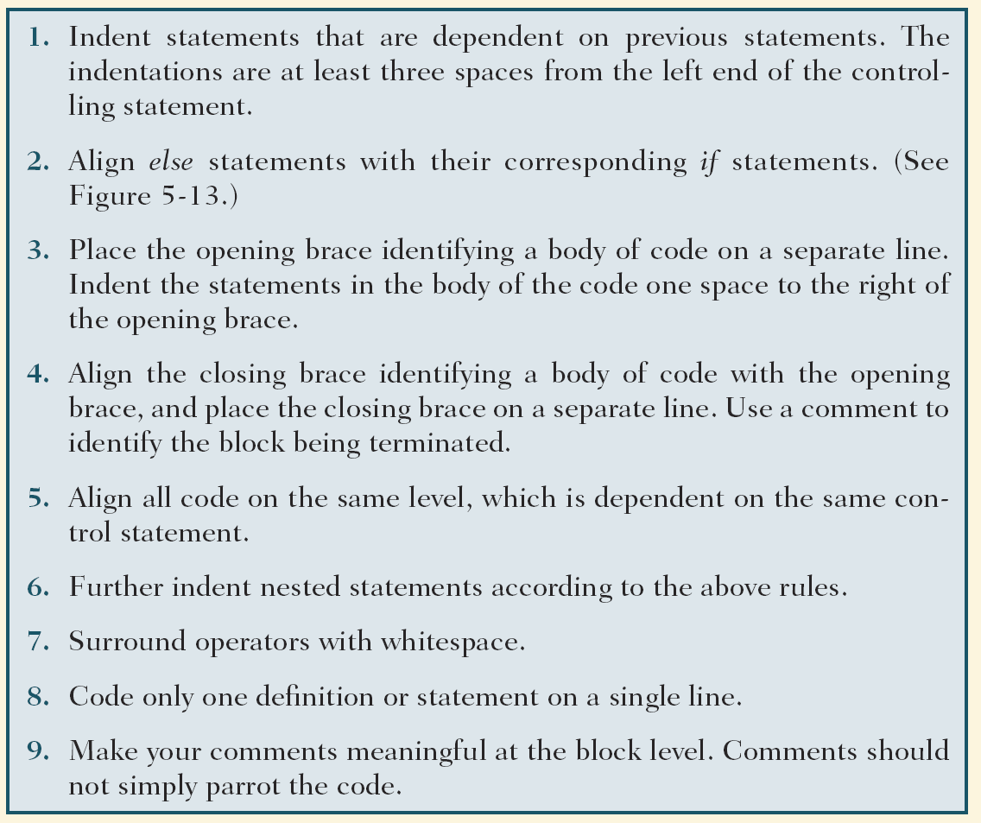
Table 5-8
Indentation Rules

Slide 70
Avoid compound negative statements!
Complementing Expressions
Selection Rules

Slide 71
Static Local Variables
You can include variables that persist even when a function ends. Use the word static before the declaration and what ever value it is at the end of the function will be what it is when the function starts again.
Storage is allocated only once, before the program begins execution.
They are known only in the function where they are declared.

