Slide 1
Memory Allocation Functions
C gives us two choices when we want to reserve memory locations for an object: static allocation and dynamic allocation.

Slide 2
Memory Allocation

Slide 3
A Conceptual View of Memory

Slide 4
Note
We can refer to memory allocated in the heap only
through a pointer.

Slide 5
Accessing Dynamic Memory

Slide 6
Memory Management Functions

Slide 7
Note
Memory Allocation Casting
Prior to C99, it was necessary to cast the pointer returned from a memory allocation function. While it is no longer necessary, it does no harm as long as the cast is correct.
If you should be working with an earlier standard, the casting format is: pointer = (type*) malloc(size)

Slide 8
malloc

Slide 9
calloc

Slide 10
realloc

Slide 11
Freeing Memory

Slide 12
Note
Using a pointer after its memory has been released is a common programming error. Guard against it
by clearing the pointer.

Slide 13
Note
The pointer used to free memory must be of the same type as the pointer used to allocate the memory.

Slide 14
Array of Pointers
Another useful structure that uses arrays and pointers is an array of pointers. This structure is especially helpful when the number of elements in the array is variable.

Slide 15
A Ragged Table

Slide 16
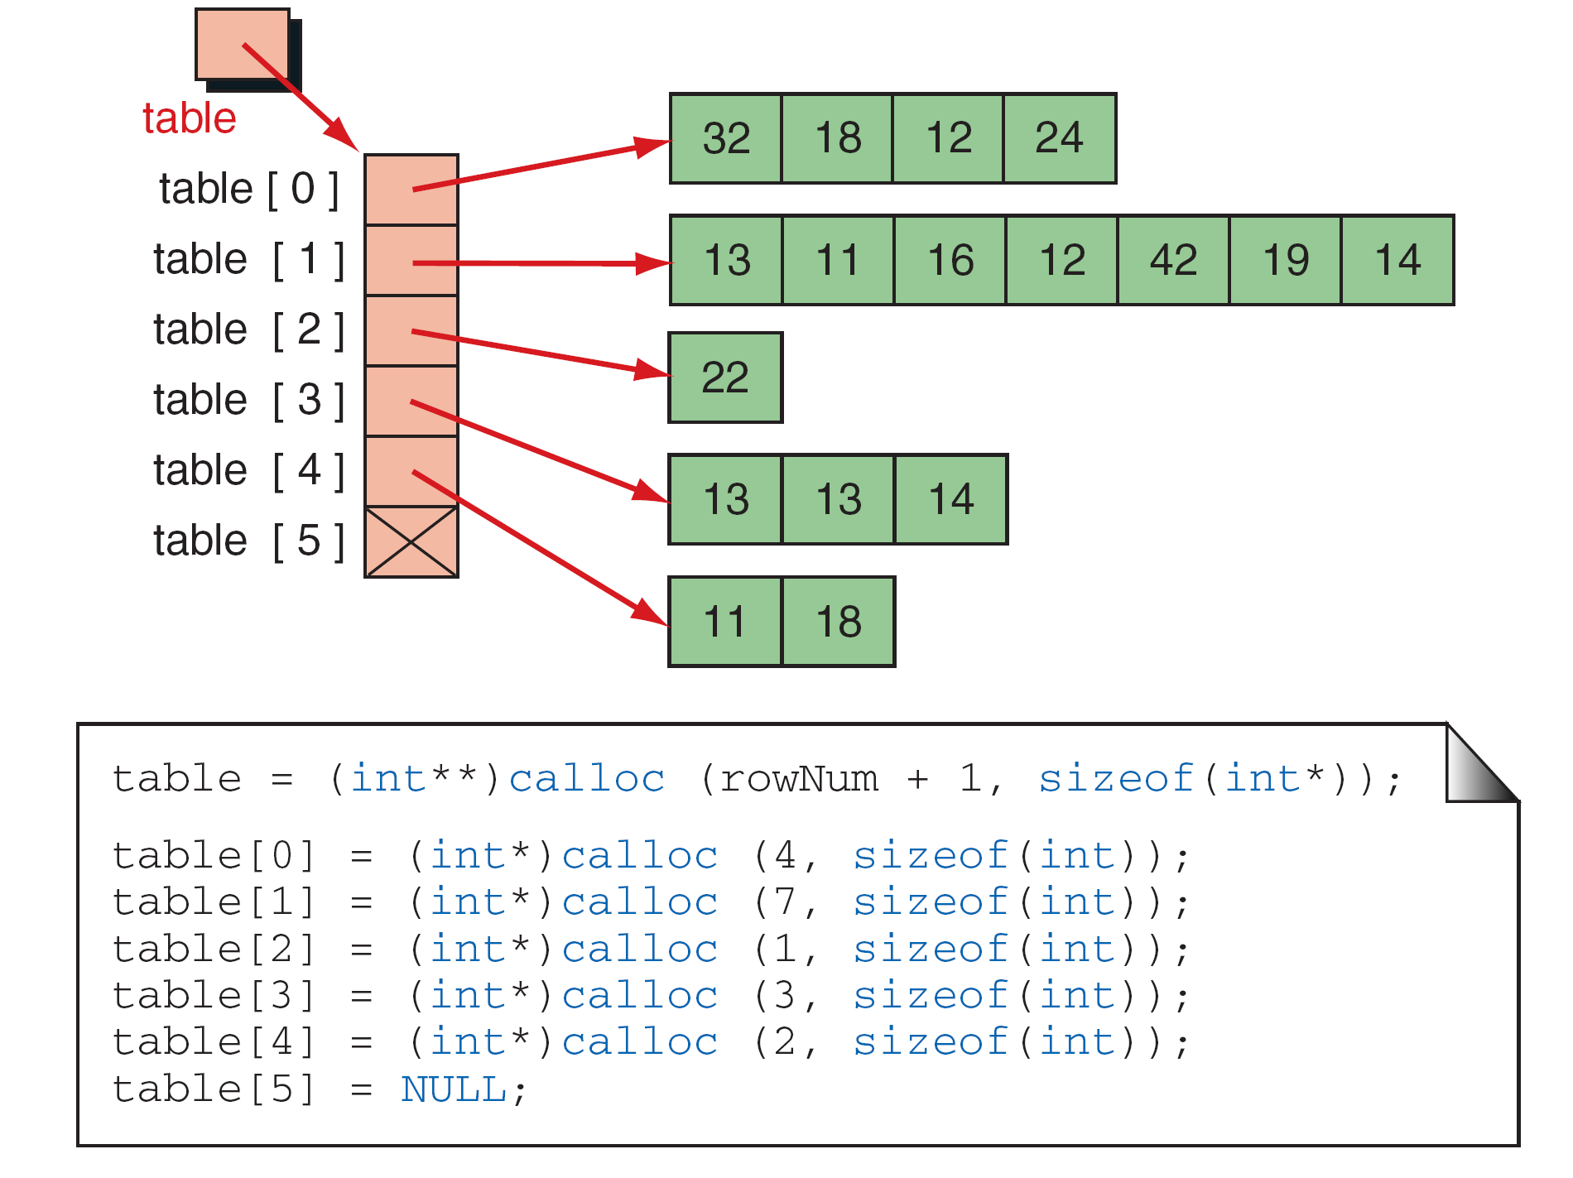
FIGURE 10-19 A Ragged Array

Slide 17
Selection Sort
Selection Sort with Pointers—Structure Chart

Slide 18
Selection Sort Revisited

Slide 19
Selection Sort Revisited

Slide 20
Selection Sort Revisited

Slide 21
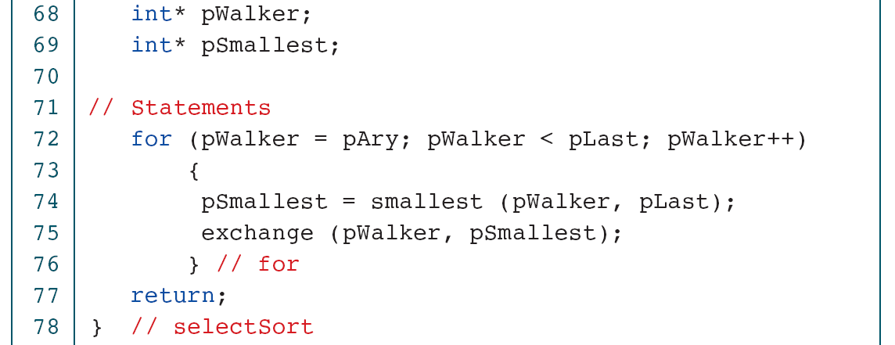
Selection Sort Revisited

Slide 22
Selection Sort Revisited

Slide 23
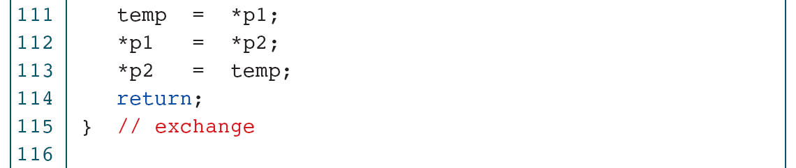
Selection Sort Revisited

Slide 24
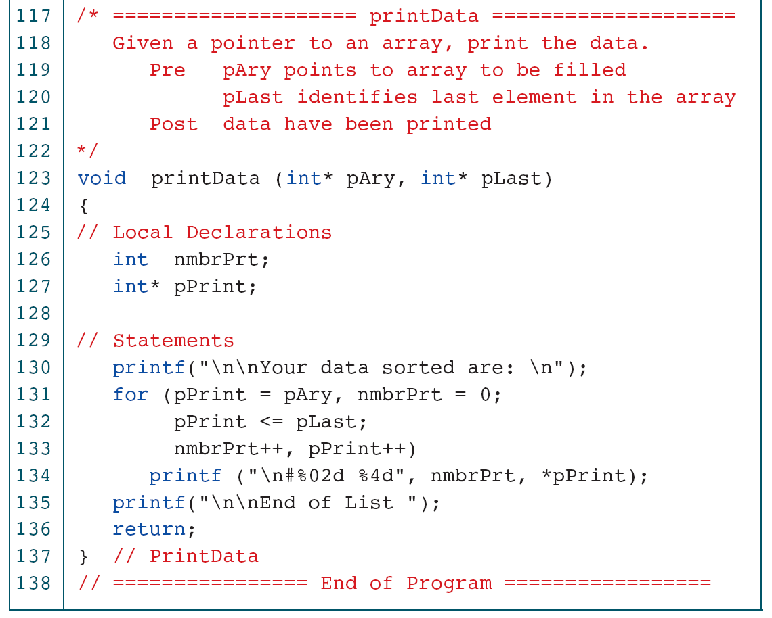
Selection Sort Revisited

Slide 25
Software Engineering
Pointer applications need careful design to ensure that they work correctly and efficiently. The programmer not only must take great care in the program design but also must carefully consider the data structures that are inherent with pointer applications.

Slide 26
Note
Whenever possible, use value parameters.

Slide 27
Testing Memory Reuse

Slide 28
PROGRAM 10-14
Testing Memory Reuse

