Slide 1
Overview of C

Slide 2
Background
C is a structured programming language. It is considered a high-level language because it allows the programmer to concentrate on the problem at hand and not worry about the machine that the program will be using. While many languages claim to be machine independent, C is one of the closest to achieving that goal. That is another reason why it is used by software developers whose applications have to run on many different hardware platforms.

Slide 3
Structure of a C Program

Slide 4
Identifiers
One feature present in all computer languages is the identifier. Identifiers allow us to name data and other objects in the program. Each identified object in the computer is stored at a unique address. If we didn’t have identifiers that we could use to symbolically represent data locations, we would have to know and use object’s addresses. Instead, we simply give data identifiers and let the compiler keep track of where they are physically located.

Slide 5
Rules for Identifiers
An identifier must start with a letter or underscore: it may not have a space or a hyphen.
C is a case-sensitive language.

Slide 6
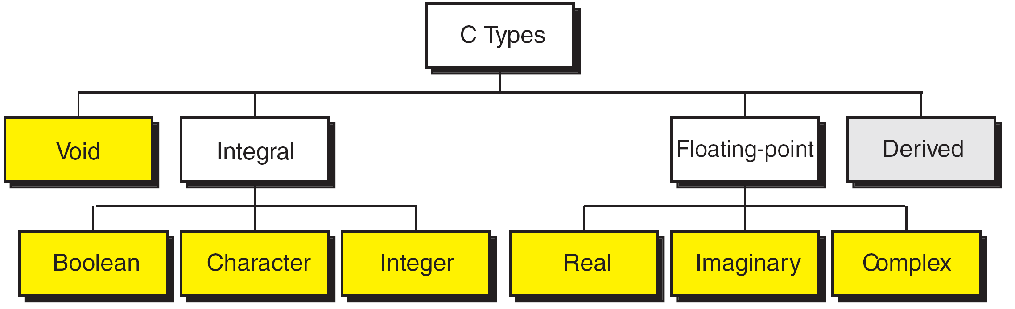
Types
A type defines a set of values and a set of operations that can be applied on those values.

Slide 7
sizeof (short) ≤ sizeof (int) ≤ sizeof (long) ≤ sizeof (long long)
sizeof (float) ≤ sizeof (double) ≤ sizeof (long double)

Slide 8
Variables
Variables are named memory locations that have a type, such as integer or character, which is inherited from their type. The type determines the values that a variable may contain and the operations that may be used with its values.
When a variable is defined, it is not initialized.
We must initialize any variable requiring prescribed data when the function starts.

Slide 9
Constants
Constants are data values that cannot be changed during the execution of a program. Like variables, constants have a type. In this section, we discuss Boolean, character, integer, real, complex, and string constants.
A character constant is enclosed in single quotes.

Slide 10
Symbolic Names for Control Characters

Slide 11
Examples of Integer Constants

Slide 12
Examples of Real Constants

Slide 13
Use single quotes for character constants.
Use double quotes for string constants.
Null Characters and Null Strings

Slide 14
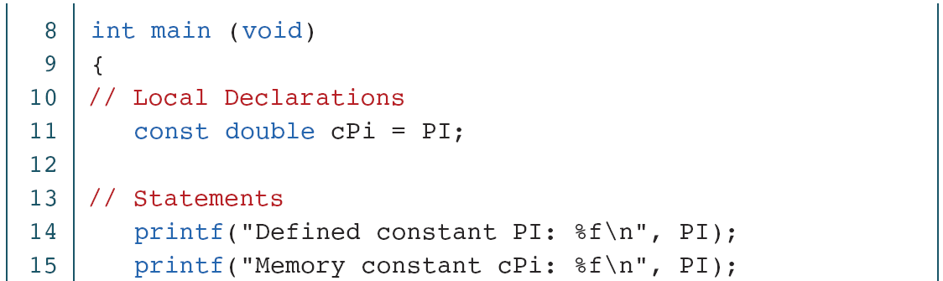
Memory Constants

Slide 15
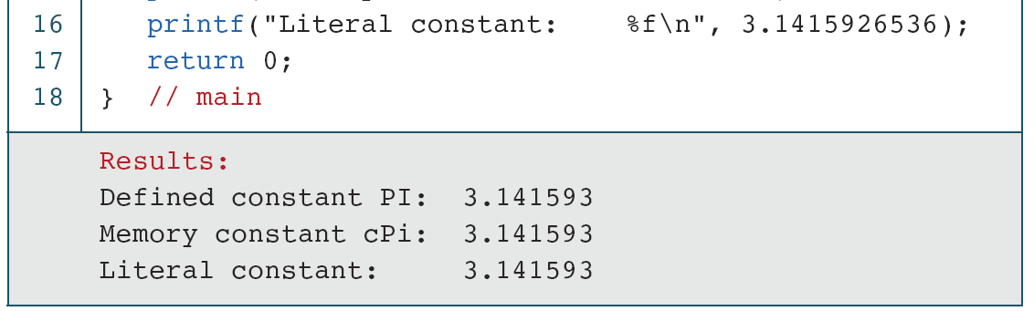
Memory Constants (continued)

Slide 16
Input/Output
Although our programs have implicitly shown how to print messages, we have not formally discussed how we use C facilities to input and output data. In this section, we describe simple input and output formatting.
A terminal keyboard and monitor can be associated only with a text stream. A keyboard is a source for a text stream; a monitor is a destination for a text stream.

Slide 17
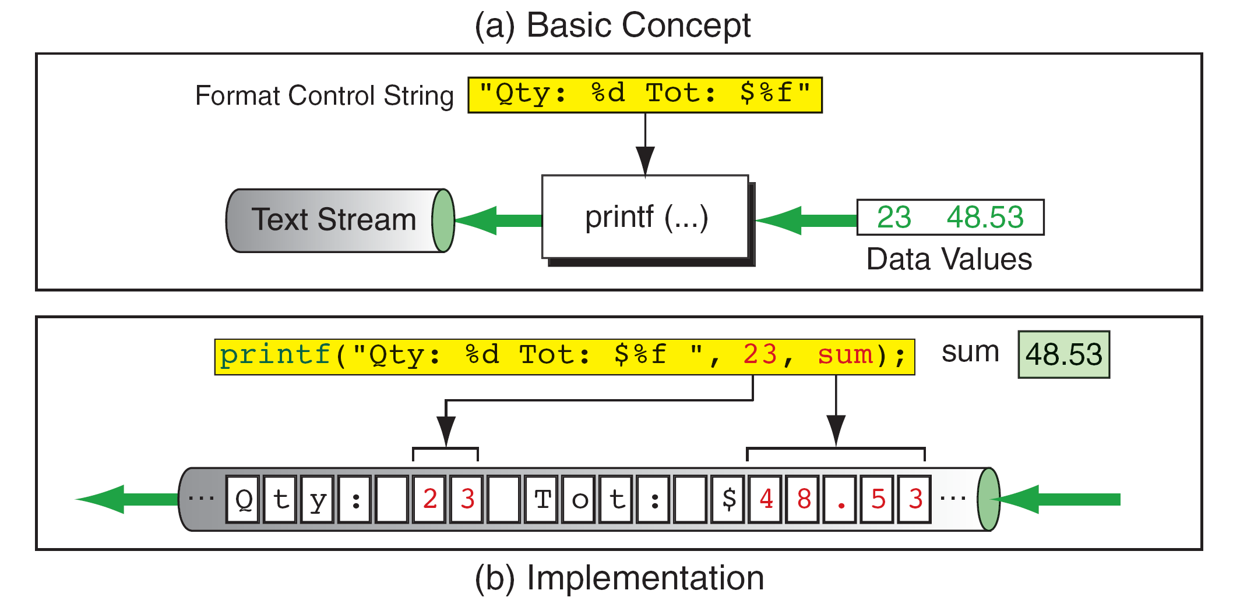
Output Stream Formatting Example

Slide 18
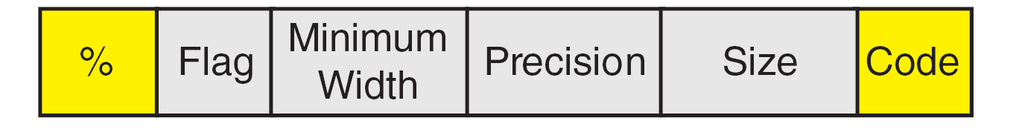
Conversion Specification

Slide 19
Table 2-10
Format Codes for Output

Slide 20
Flag Formatting Options

Slide 21
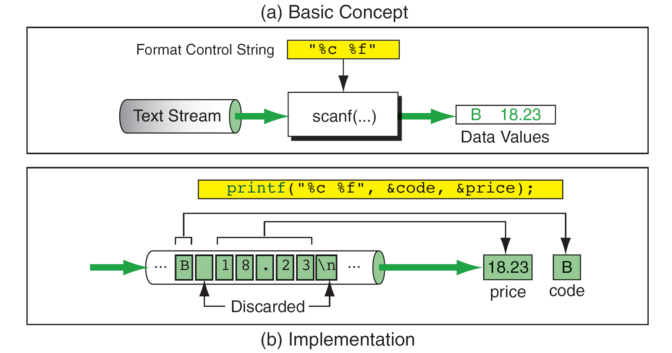
Input Stream Formatting Example

Slide 22
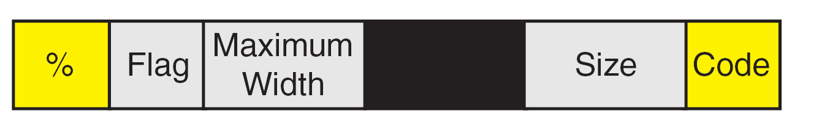
scanf requires variable addresses in the address list.
Conversion Specification

Slide 23
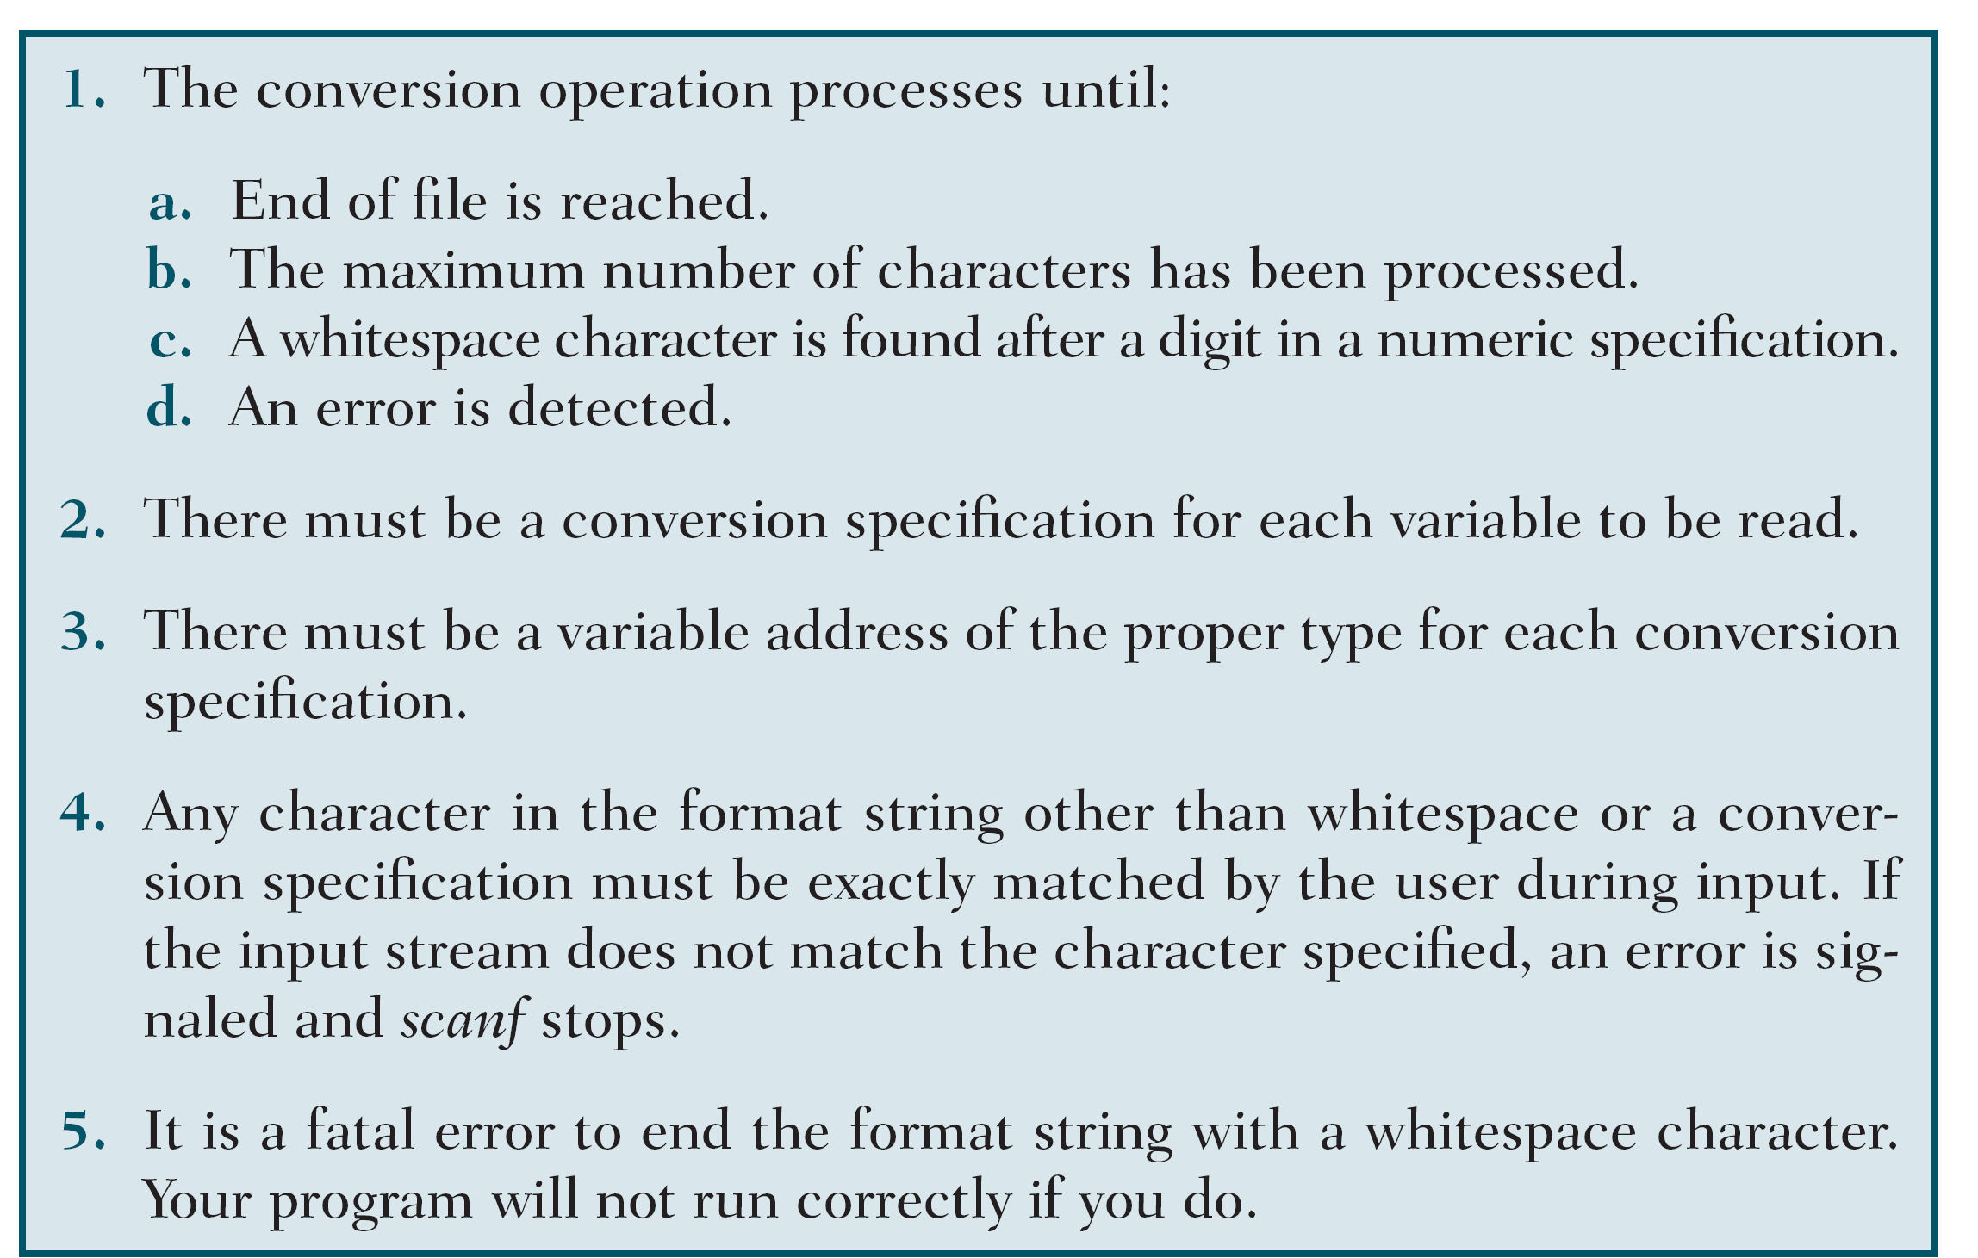
Table 2-12
scanf Rules

Slide 24
Programming Examples

Slide 25
A Program That Prints “Nothing!”

Slide 26
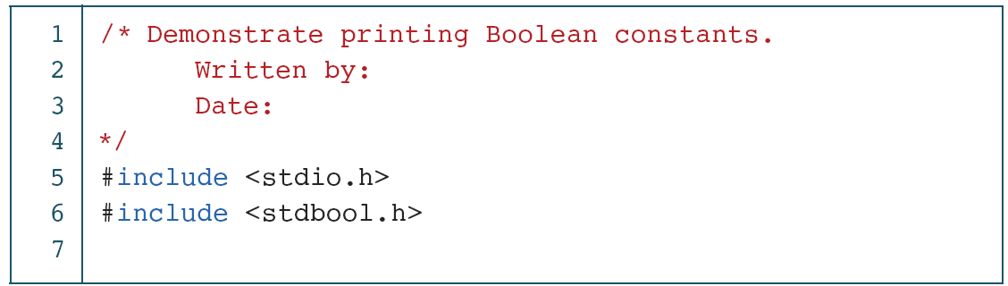
Demonstrate Printing Boolean Constants

Slide 27
Demonstrate Printing Boolean Constants (continued)

Slide 28
Print Value of Selected Characters

Slide 29
Print Value of Selected Characters (continued)

Slide 30
Print Value of Selected Characters (continued)

Slide 31
Print Value of Selected Characters (continued)

Slide 32
Calculate a Circle’s Area and Circumference

Slide 33
Calculate a Circle’s Area and Circumference (continued)

Slide 34
Expressions
An expression is a sequence of operands and operators that reduces to a single value. Expressions can be simple or complex. An operator is a syntactical token that requires an action be taken. An operand is an object on which an operation is performed; it receives an operator’s action.

Slide 35
The operand in a postfix expression must be a variable.
Result of Postfix a++

Slide 36
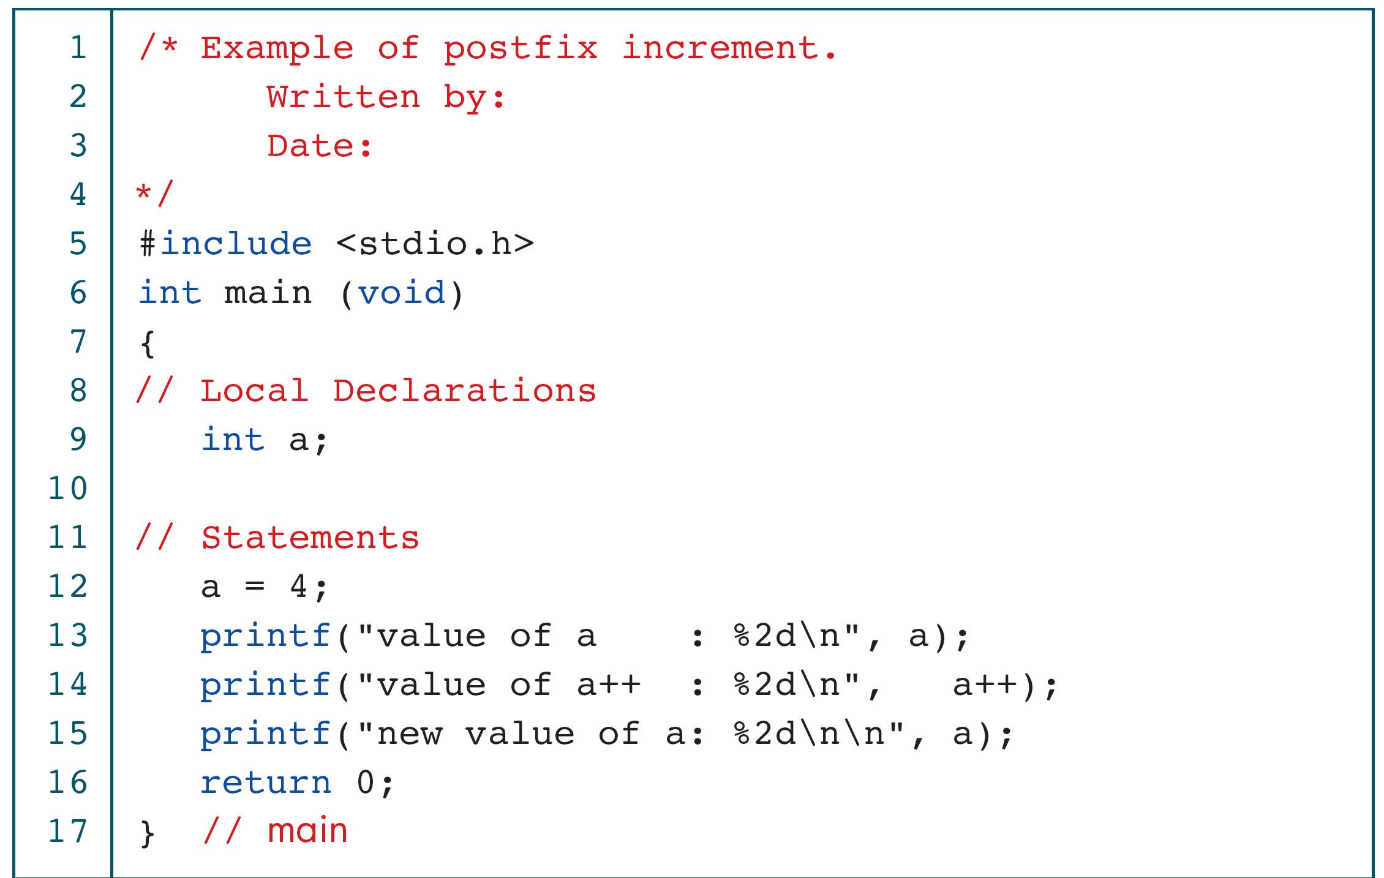
Demonstrate Postfix Increment

Slide 37
Demonstrate Postfix Increment (continued)

Slide 38
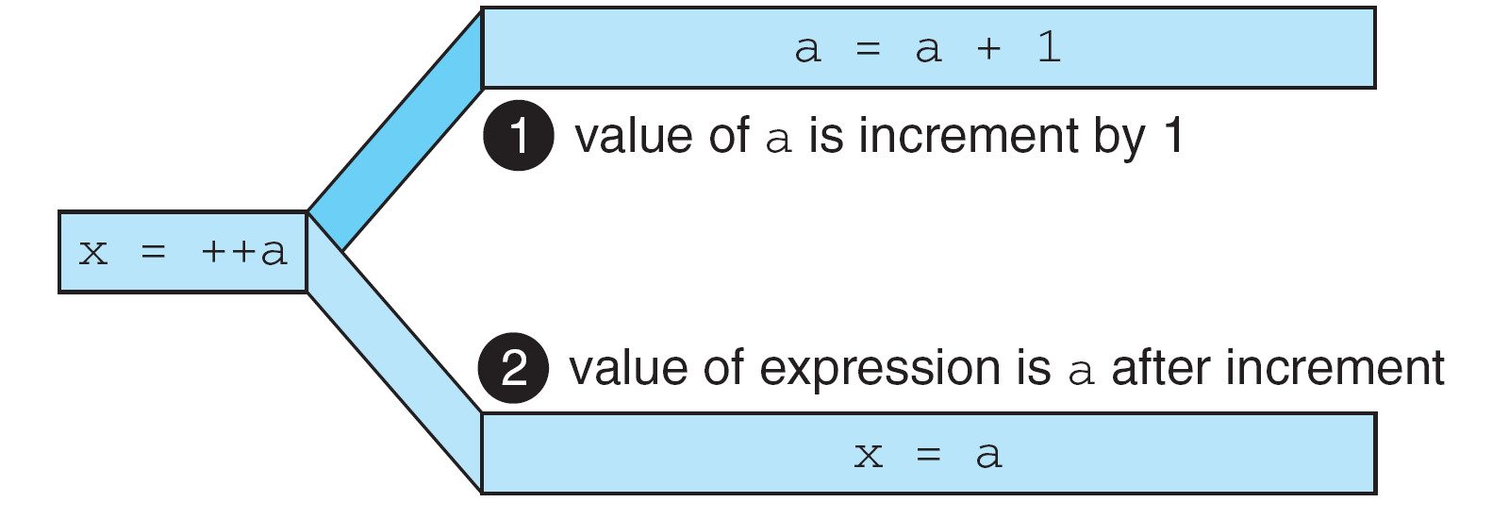
The operand of a prefix expression must be a variable.
Result of Prefix ++a

Slide 39
Demonstrate Prefix Increment

Slide 40
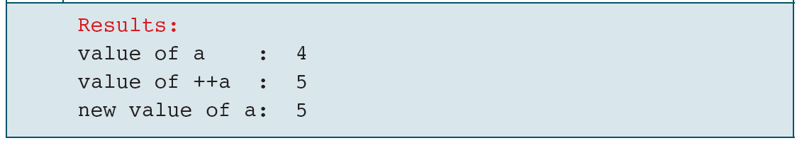
Demonstrate Prefix Increment (continued)
If ++ is after the operand, as in a++, the increment takes place after the expression is evaluated.
If ++ is before the operand, as in ++a, the increment takes place before the expression is evaluated.

Slide 41
Examples of Unary Plus And Minus Expressions
Both operands of the modulo operator (%) must be integral types.
The left operand in an assignment expression must be a single variable.

Slide 42
Expansion of Compound Expressions

Slide 43
Demonstration of Compound Assignments

Slide 44
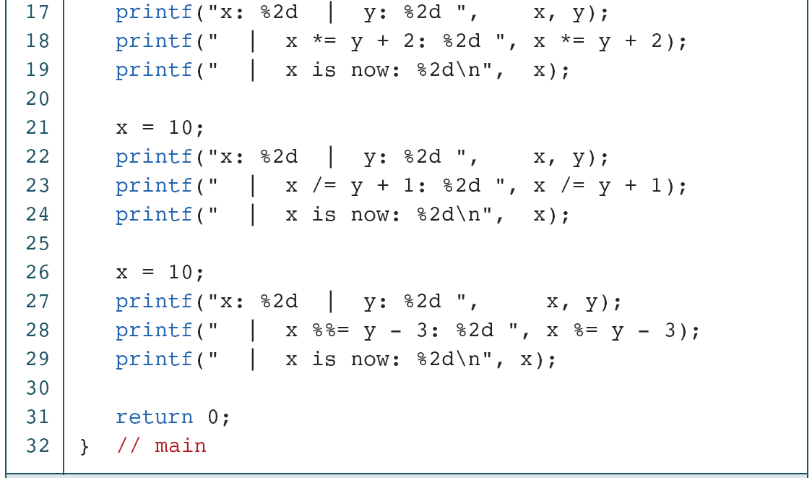
Demonstration of Compound Assignments

Slide 45
Demonstration of Compound Assignments

Slide 46
Side Effects
A side effect is an action that results from the evaluation of an expression. For example, in an assignment, C first evaluates the expression on the right of the assignment operator and then places the value in the left variable. Changing the value of the left variable is a side effect.

Slide 47
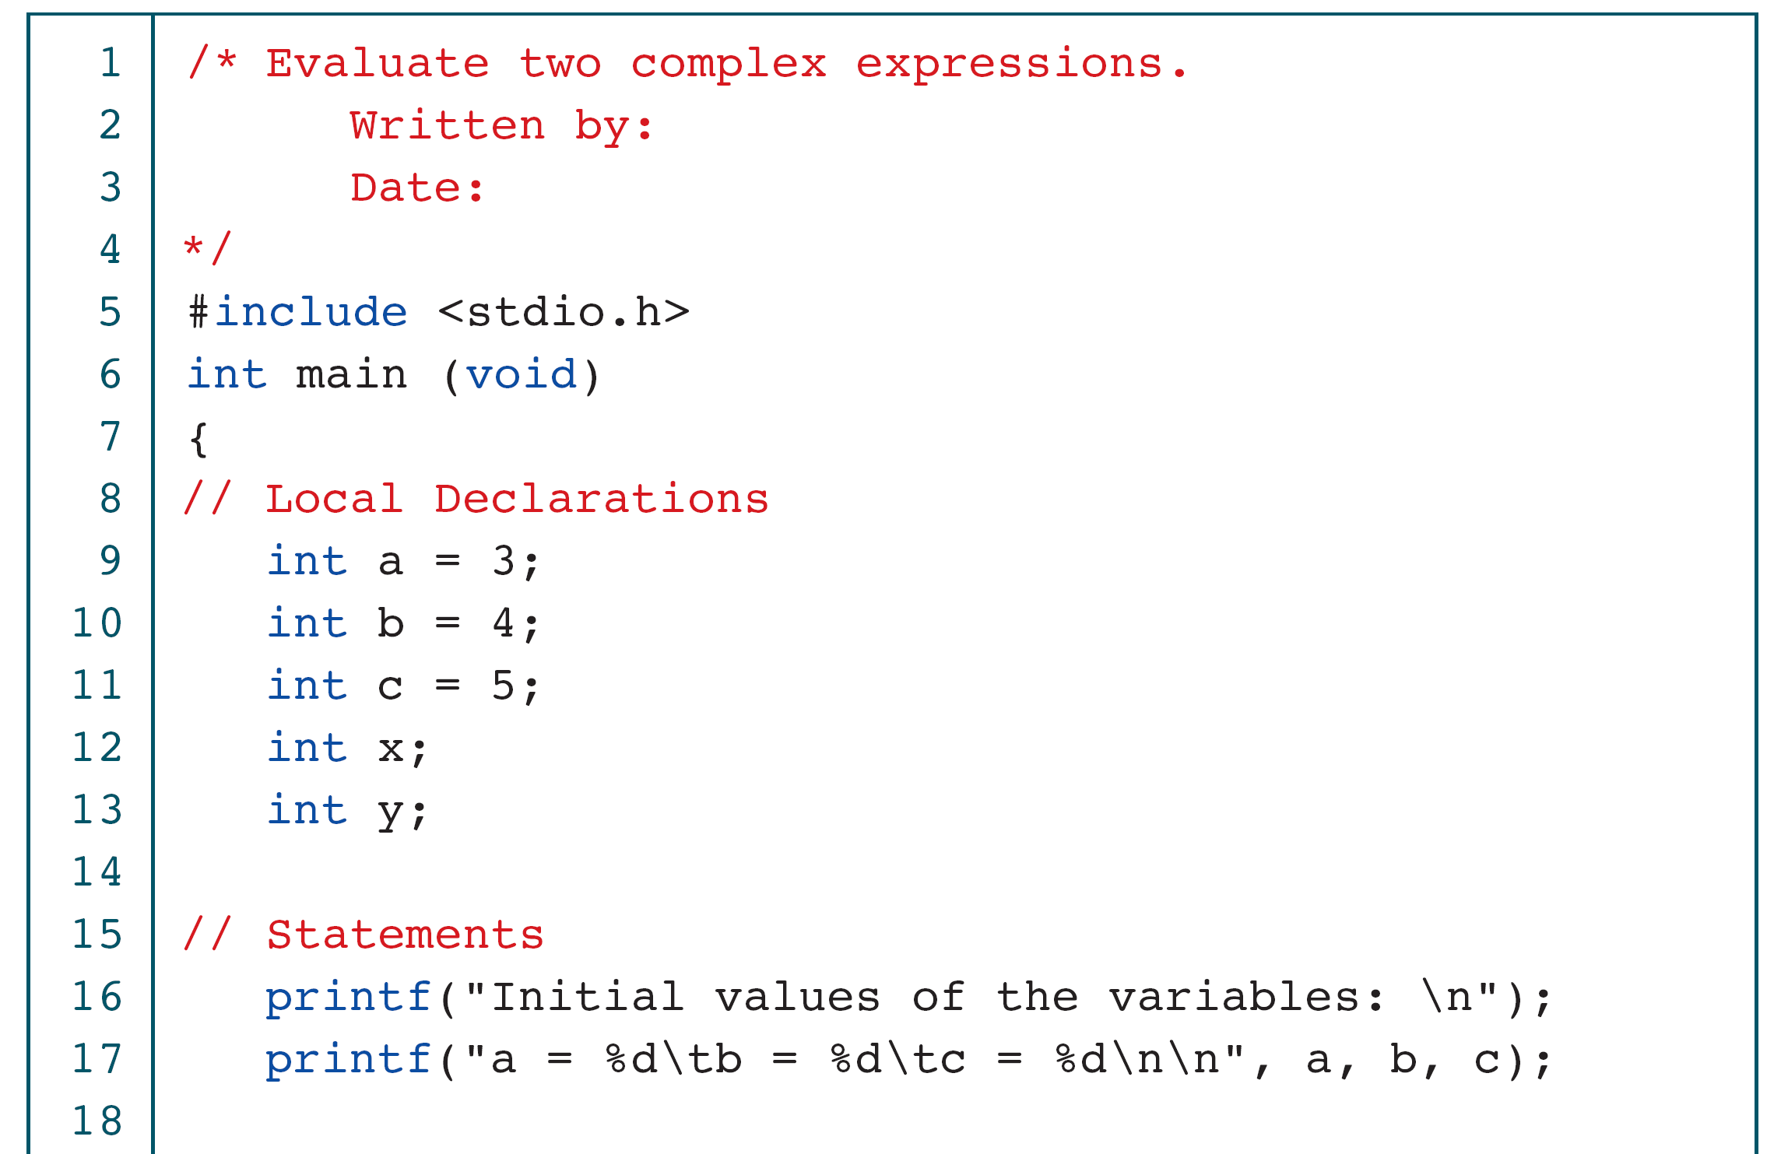
Evaluating Expressions

Slide 48
Evaluating Expressions

Slide 49
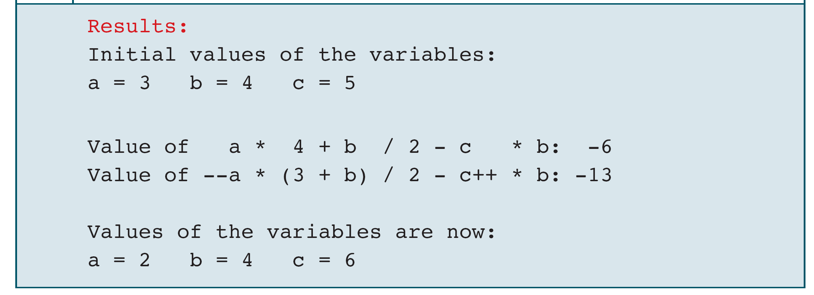
Evaluating Expressions

Slide 50
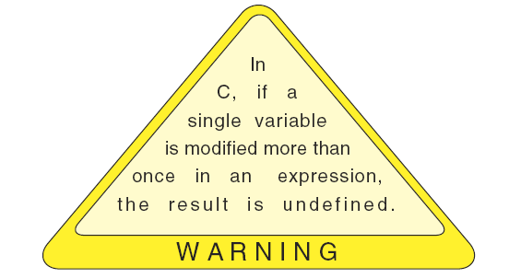

Slide 51
Type Conversion
Up to this point, we have assumed that all of our expressions involved data of the same type. But, what happens when we write an expression that involves two different data types, such as multiplying an integer and a floating-point number? To perform these evaluations, one of the types must be converted.

Slide 52
Conversion Rank

Slide 53
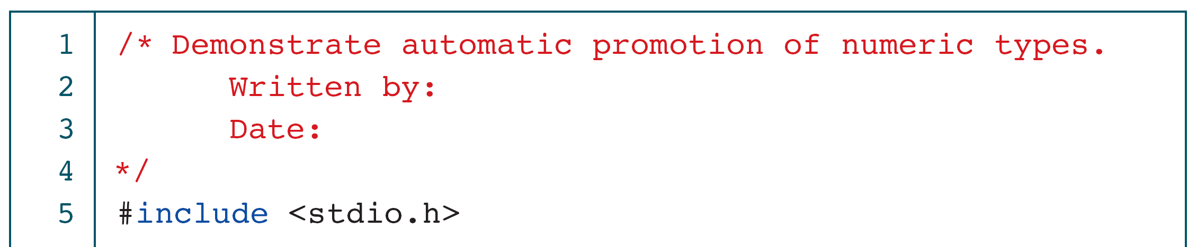
Implicit Type Conversion

Slide 54
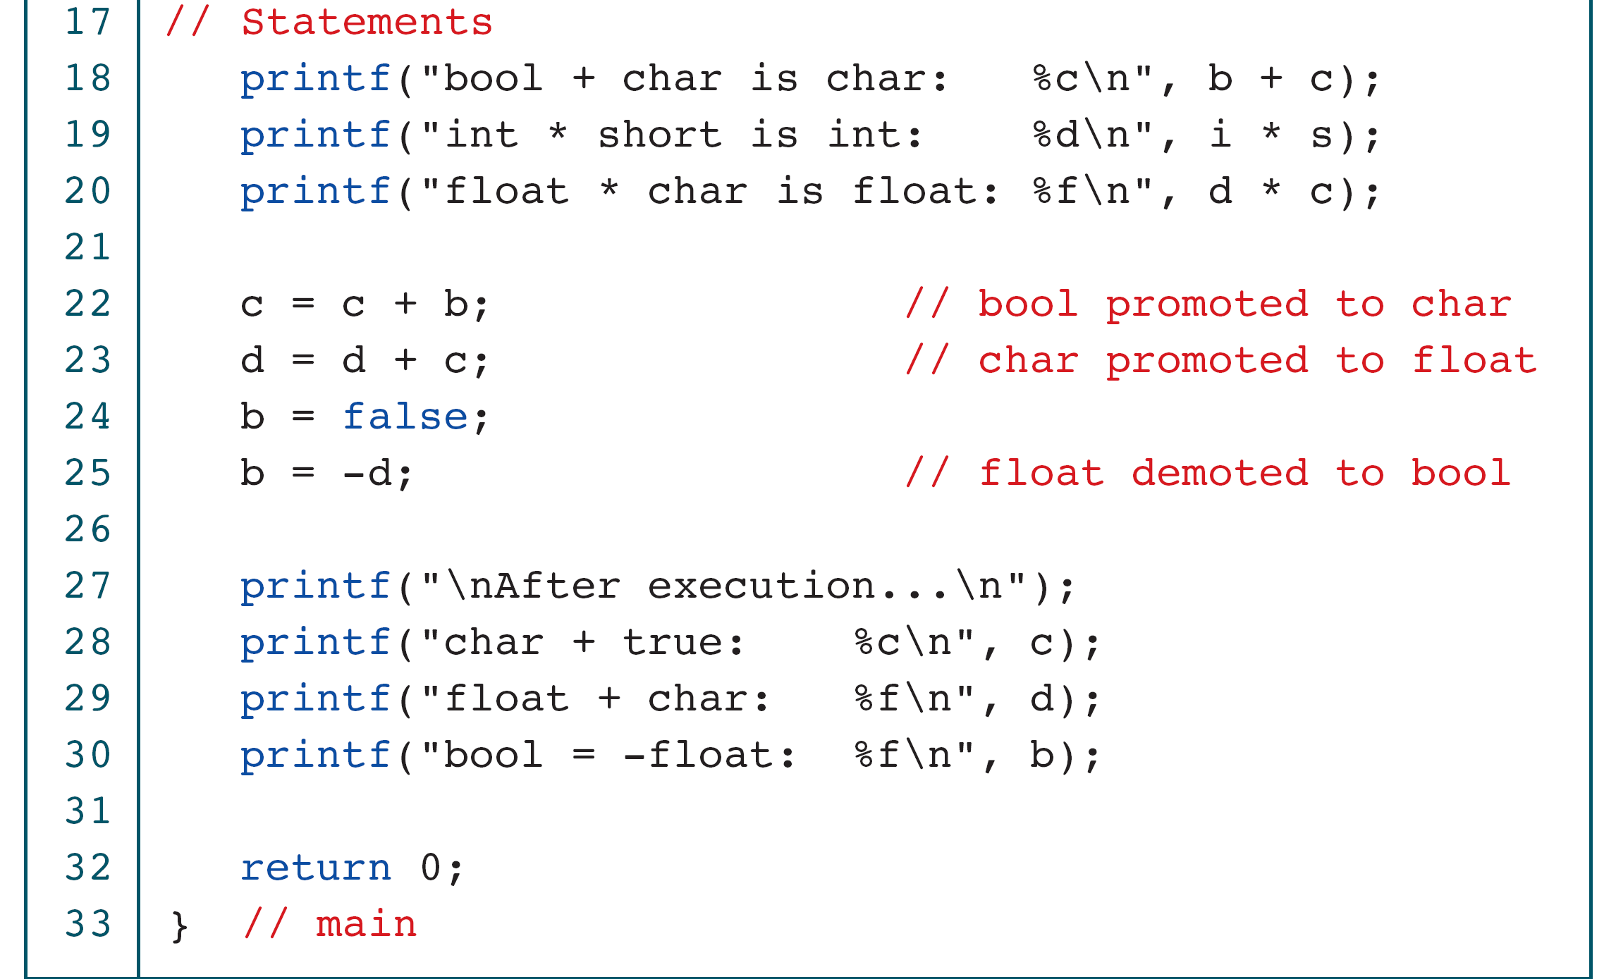
Implicit Type Conversion

Slide 55
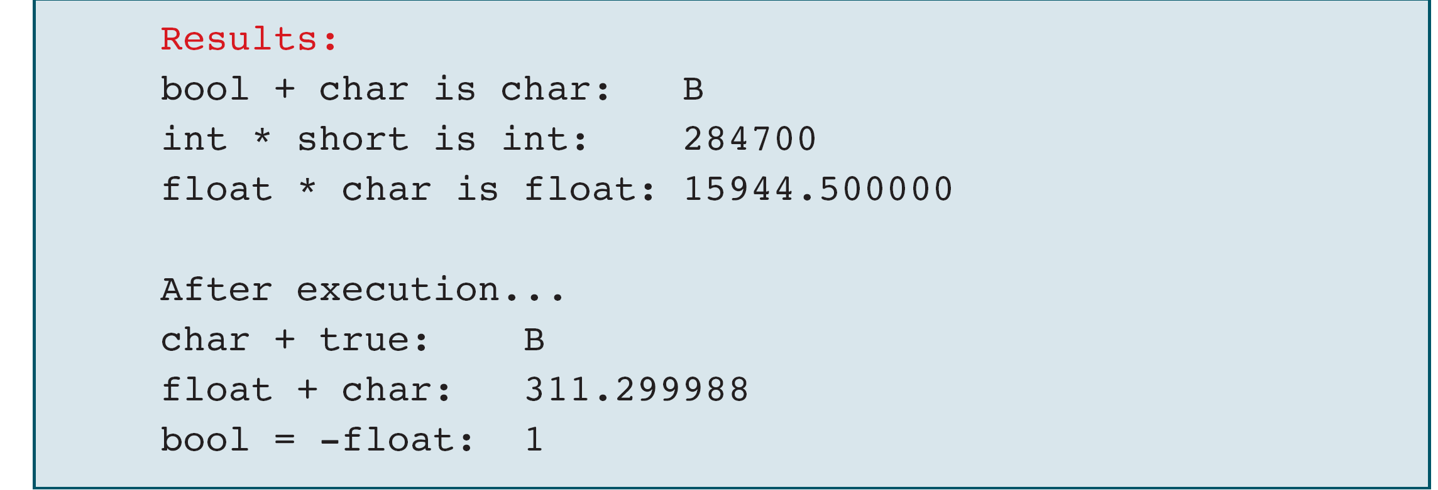
Implicit Type Conversion

Slide 56
Explicit Casts

Slide 57
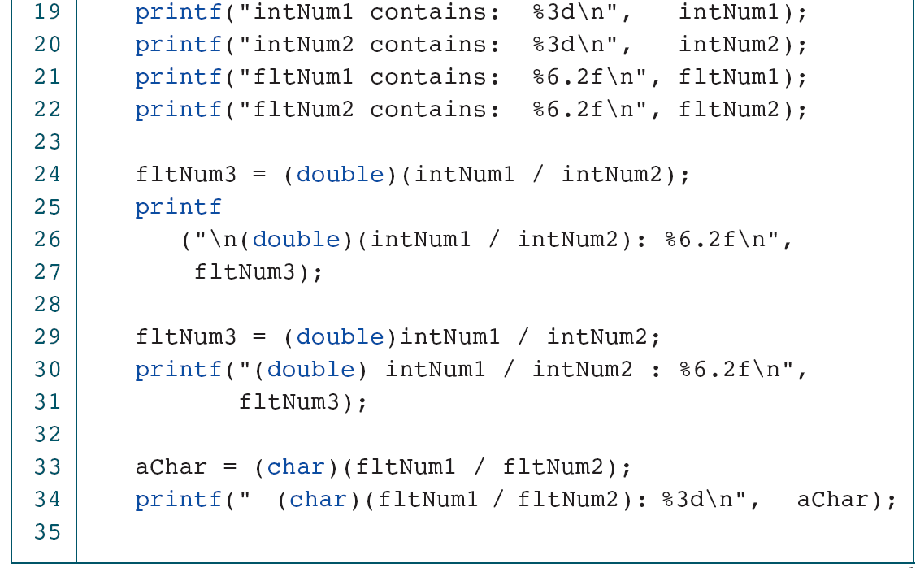
Explicit Casts

Slide 58
Explicit Casts

Slide 59
3-6 Statements
A statement causes an action to be performed by the program. It translates directly into one or more executable computer instructions.
You may have noticed that we have used a semicolon at the end of the statements in our programs. Most statements need a semicolon at the end; some do not.

Slide 60
Types of Statements

Slide 61
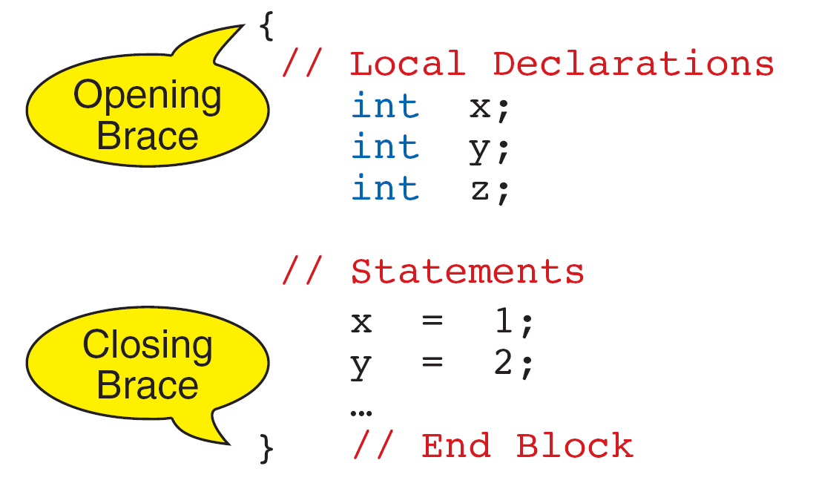
The compound statement does not need a semicolon.
Compound Statement

Slide 62
Sample Programs
This section contains several programs that you should study for programming technique and style.

Slide 63
Calculate Quotient and Remainder

Slide 64
Calculate Quotient and Remainder

Slide 65
Print Right Digit of Integer

Slide 66
Print Right Digit of Integer

Slide 67
Calculate Average of Four Numbers

Slide 68
Calculate Average of Four Numbers

Slide 69
Calculate Average of Four Numbers

Slide 70
Calculate Average of Four Numbers

Slide 71
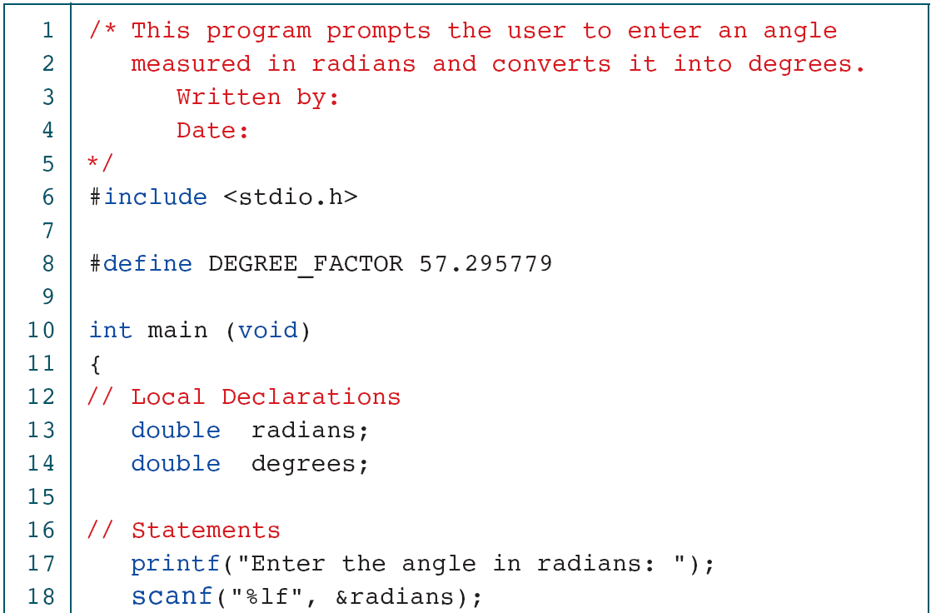
Convert Radians to Degrees

Slide 72
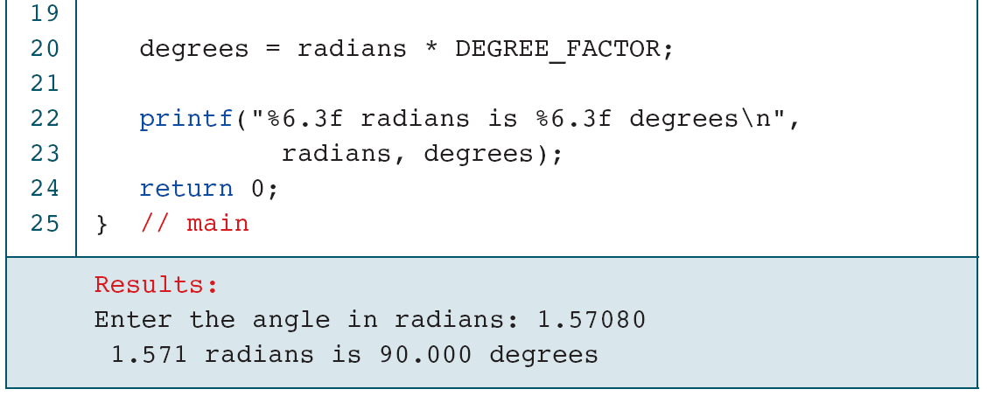
Convert Radians to Degrees

Slide 73
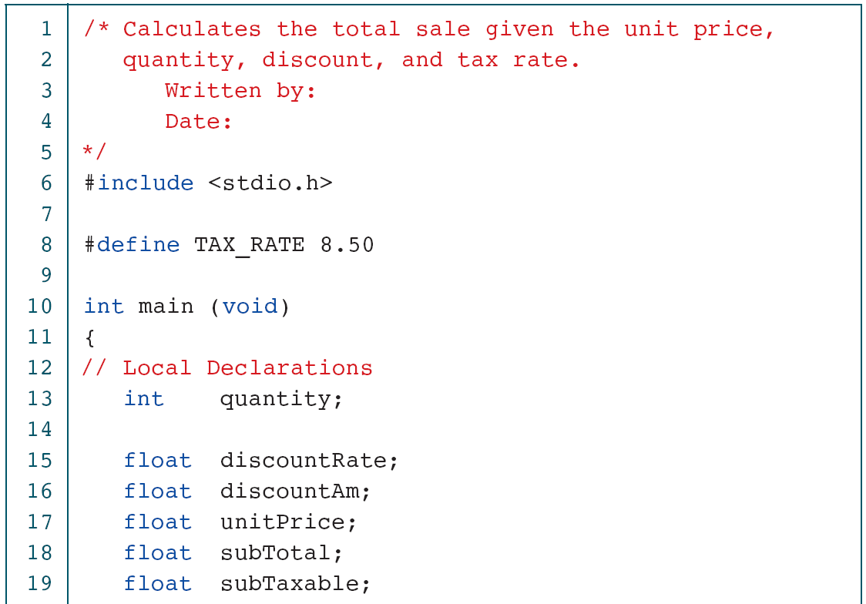
Calculate Sales Total

Slide 74
Calculate Sales Total

Slide 75
Calculate Sales Total

Slide 76
Calculate Sales Total

Slide 77
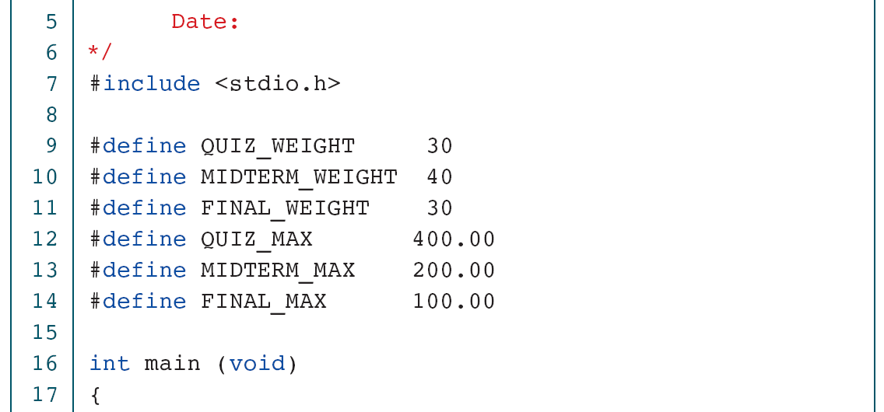
Calculate Student Score

Slide 78
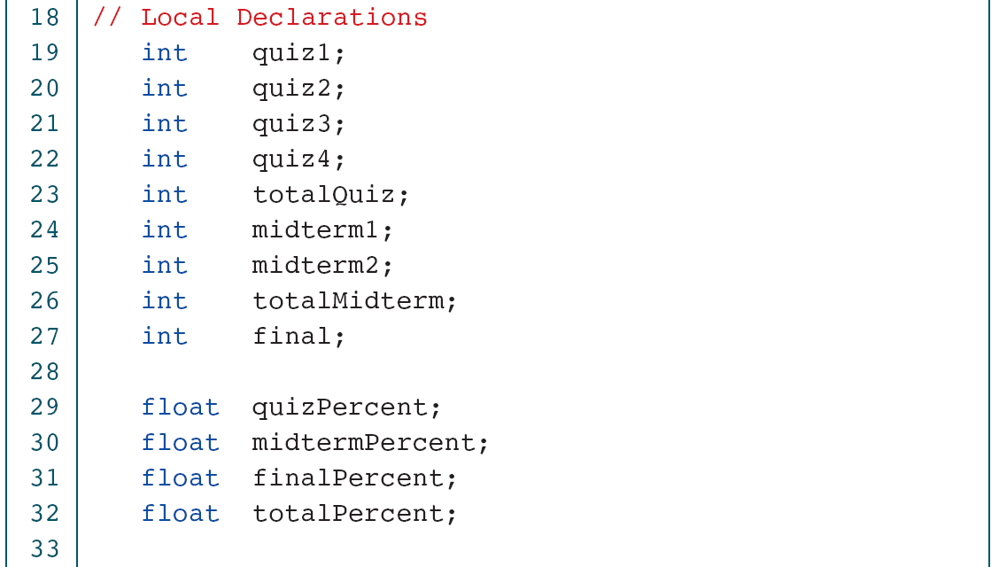
Calculate Student Score

Slide 79
Calculate Student Score

Slide 80
Calculate Student Score

Slide 81
Calculate Student Score

Slide 82
Calculate Student Score

Slide 83
Calculate Student Score

