Slide 1
Pointers Introduction
A pointer is a constant or variable that contains an address that can be used to access data. Pointers are built on the basic concept of pointer constants.

Slide 2
Character Constants and Variables

Slide 3
Pointer Constants

Slide 4
Note
Pointer constants, drawn from the set of addresses for a computer, exist by themselves. We cannot change them;
we can only use them.

Slide 5
Note
An address expression, one of the expression types in the unary expression category, consists of an ampersand (&) and a variable name.

Slide 6
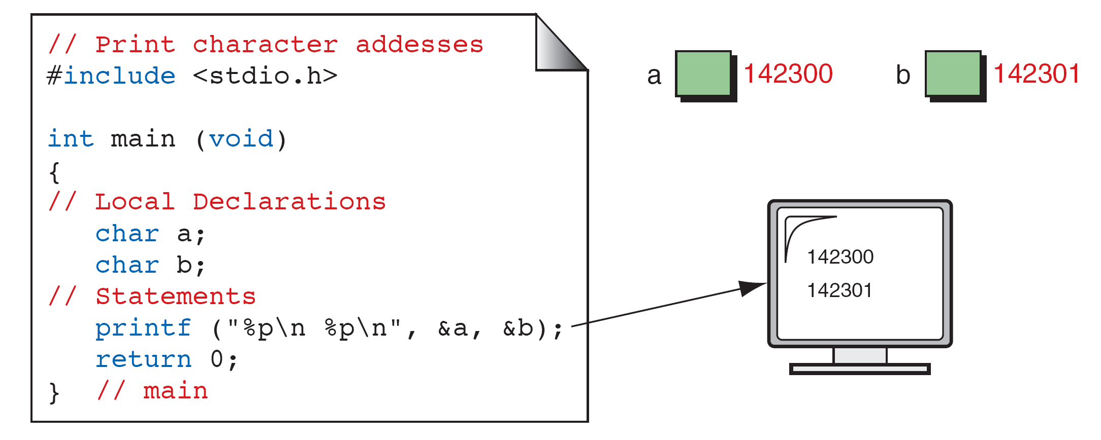
Print Character Addresses

Slide 7
Note
A variable’s address is the first byte occupied
by the variable.

Slide 8
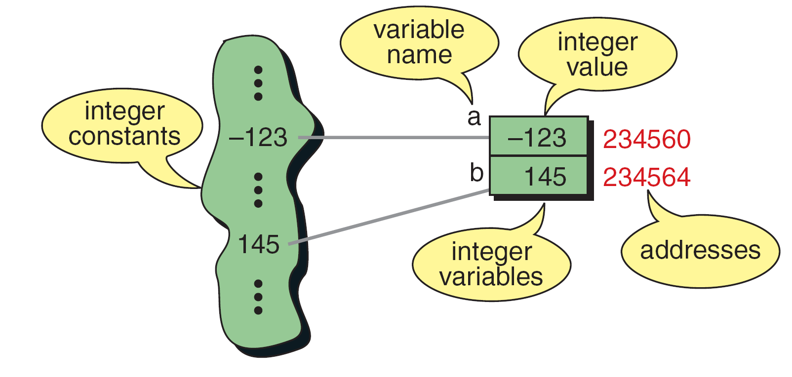
Integer Constants and Variables

Slide 9
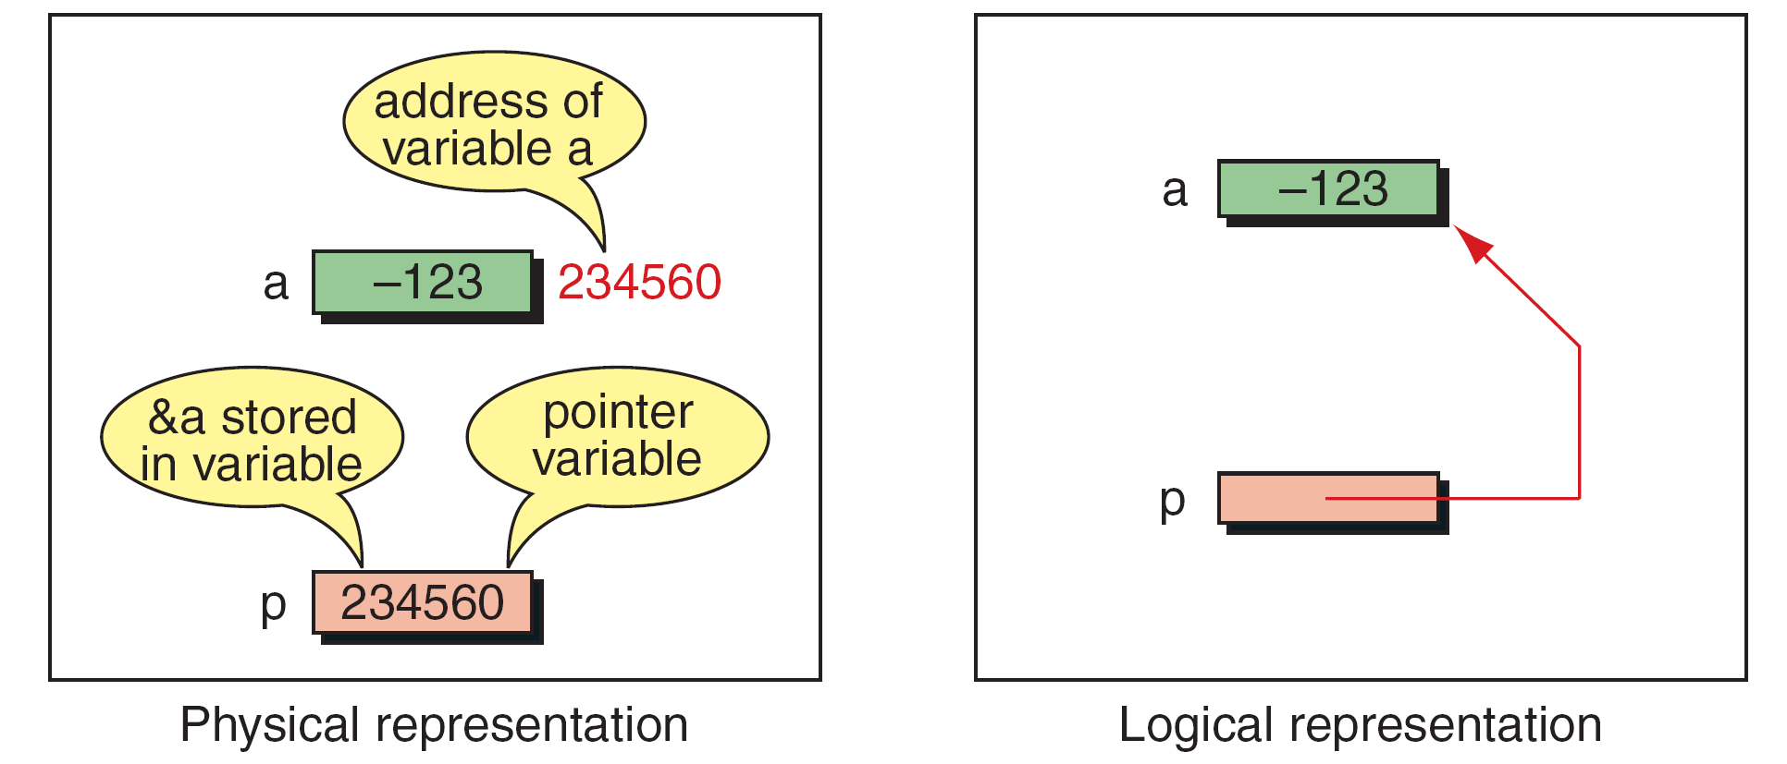
Pointer Variable

Slide 10
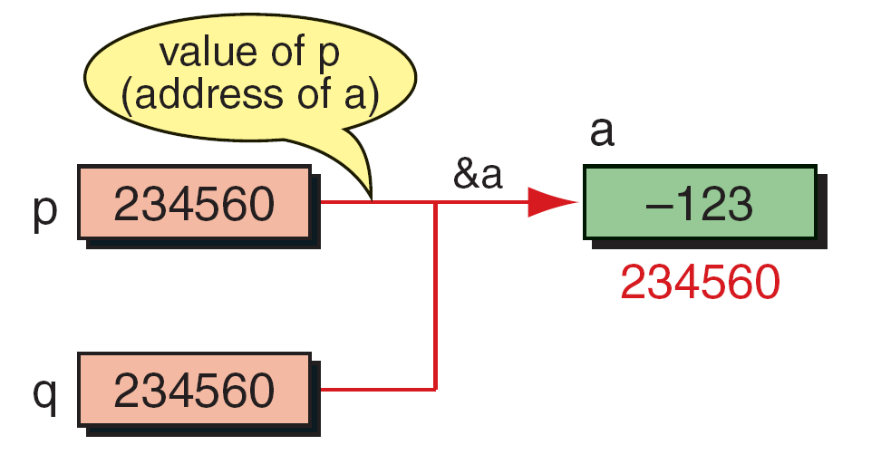
Multiple Pointers to a Variable

Slide 11
Note
A pointer that points to no variable contains the
special null-pointer constant, NULL.
An indirect expression, one of the expression types in the unary expression category, is coded with an
asterisk (*) and an identifier.

Slide 12
Accessing Variables Through Pointers

Slide 13
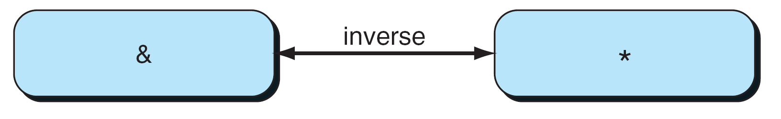
Address and Indirection Operators

Slide 14
Pointer Variable Declaration

Slide 15
Declaring Pointer Variables

Slide 16
Demonstrate Use of Pointers

Slide 17
Demonstrate Use of Pointers

Slide 18
Uninitialized Pointers

Slide 19
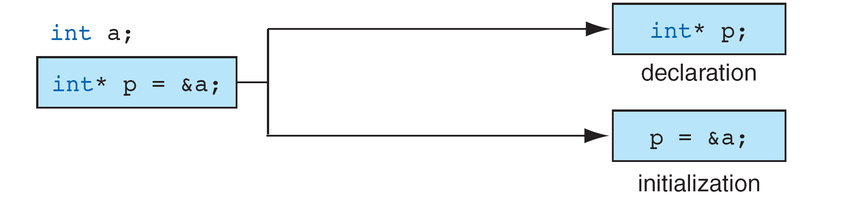
Initializing Pointer Variables

Slide 20
Fun with Pointers

Slide 21
Fun with Pointers

Slide 22
Fun with Pointers

Slide 23
Add Two Numbers Using Pointers

Slide 24
Add Two Numbers Using Pointers

Slide 25
Add Two Numbers Using Pointers

Slide 26
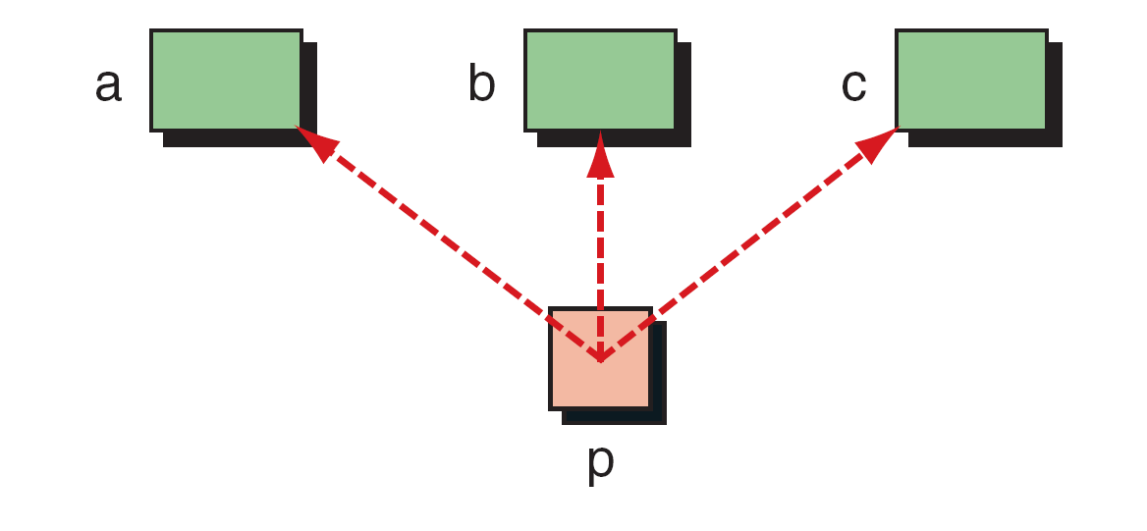
Demonstrate Pointer Flexibility

Slide 27
Using One Pointer for Many Variables

Slide 28
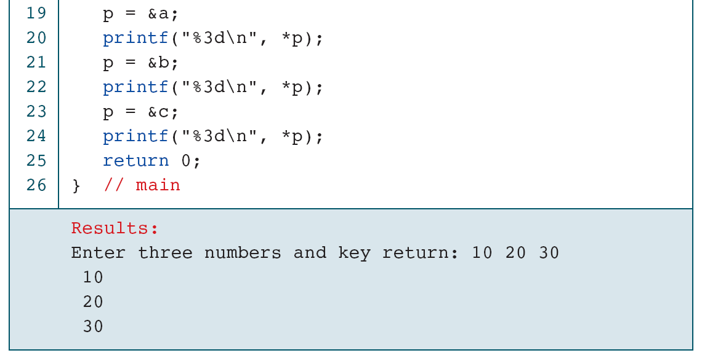
Using One Pointer for Many Variables

Slide 29
One Variable with Many Pointers

Slide 30
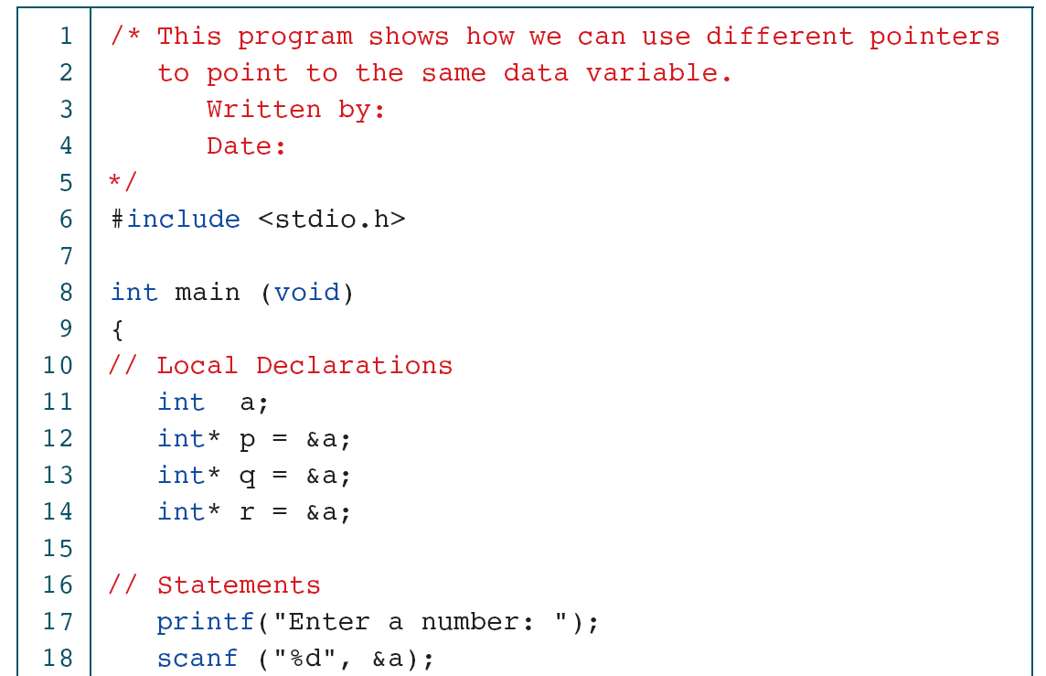
Using A Variable with Many Pointers

Slide 31
Using A Variable with Many Pointers

Slide 32
Pointers for Inter-function
Communication
One of the most useful applications of pointers is in functions. When we discussed functions in Chapter 4, we saw that C uses the pass-by-value for downward communication. For upward communication, we normally pass an address. In this section, we fully develop the bi-directional communication.

Slide 33
An Unworkable Exchange

Slide 34
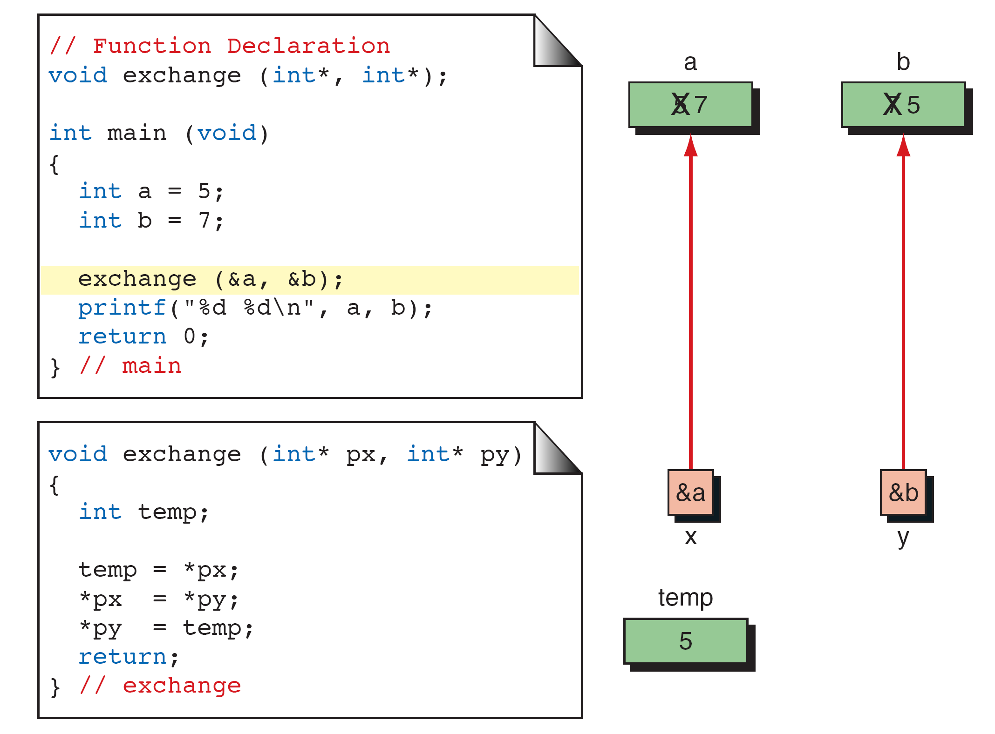
Exchange Using Pointers

Slide 35
Note
Every time we want a called function to have access to a variable in the calling function, we pass the address
of that variable to the called function and use
the indirection operator to access it.

Slide 36
Functions Returning Pointers

Slide 37
Note
It is a serious error to return a pointer to a local variable.

Slide 38
Pointers to Pointers
So far, all our pointers have been pointing directly to data. It is possible—and with advanced data structures often necessary—to use pointers that point to other pointers. For example, we can have a pointer pointing to a pointer to an integer.

Slide 39
Pointers to Pointers

Slide 40
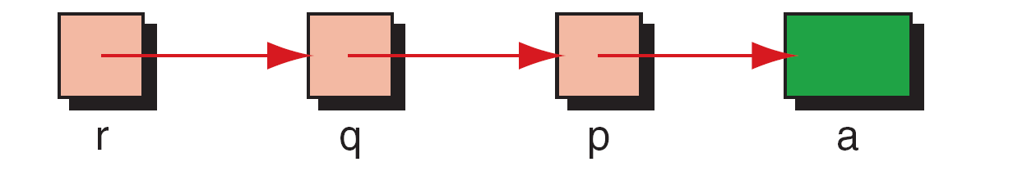
Using Pointers to Pointers

Slide 41
Using pointers to pointers

Slide 42
Using pointers to pointers

Slide 43
Using pointers to pointers

Slide 44
9-4 Compatibility
It is important to recognize that pointers have a type associated with them. They are not just pointer types, but rather are pointers to a specific type, such as character. Each pointer therefore takes on the attributes of the type to which it refers in addition to its own attributes.

Slide 45
Demonstrate Size of Pointers

Slide 46
Demonstrate Size of Pointers

Slide 47
Demonstrate Size of Pointers

Slide 48
Dereference Type Compatibility

Slide 49
Note
A void pointer cannot be dereferenced.

Slide 50
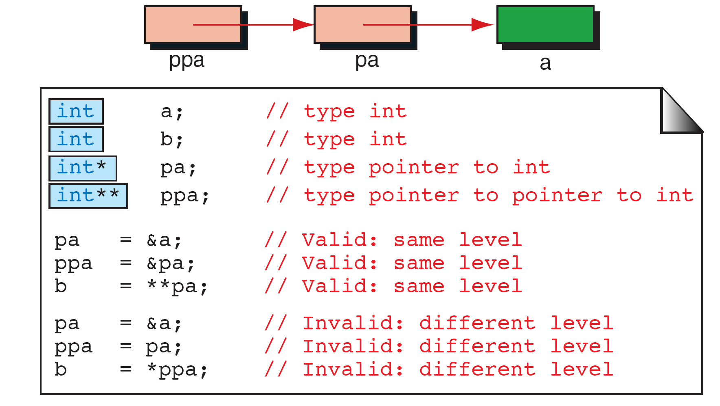
Dereference Level Compatibility

Slide 51
Lvalue and Rvalue
In C, an expression is either an lvalue or an rvalue. As you know, every expression has a value. But the value in an expression (after evaluation) can be used in two different ways.

Slide 52
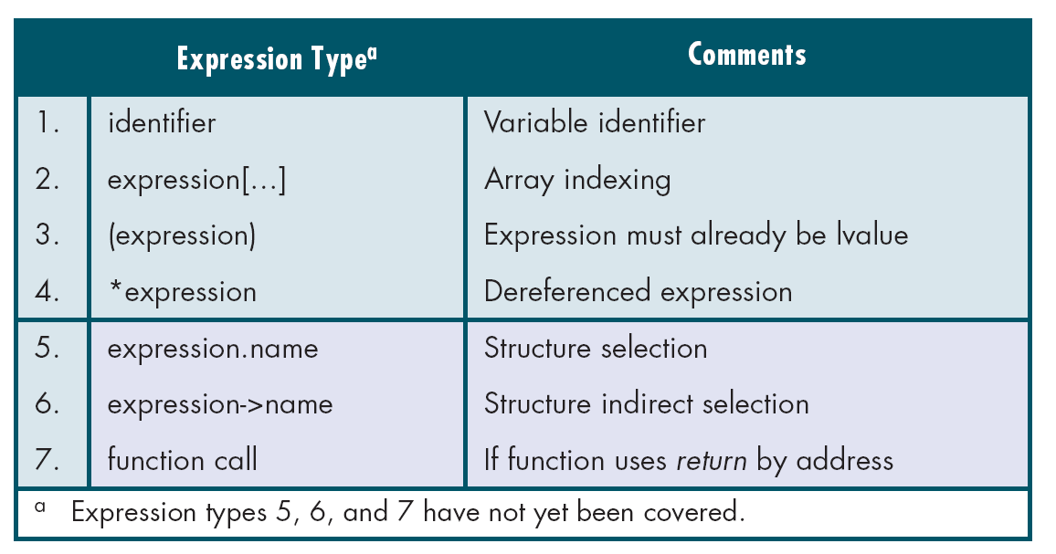
lvalue Expressions

Slide 53
Note
The right operand of an assignment operator must be an rvalue expression.

Slide 54
Operators That Require lvalue Expressions

Slide 55
Invalid rvalue Expressions

Slide 56
Convert Seconds to Hours, Minutes, and Seconds

Slide 57
Convert Seconds to Hours, Minutes, and Seconds

Slide 58
Note
Create local variables when a value parameter will be changed within a function so that the original
value will always be available for processing.

Slide 59
Note
When several values need to be sent back to the calling function, use address parameters for all of them.
Do not return one value and use address
Parameters for the others.

Slide 60
A Common Program Design

Slide 61
Using Pointers as Parameters

Slide 62
Quadratic Roots

Slide 63
Quadratic Roots

Slide 64
Quadratic Roots

Slide 65
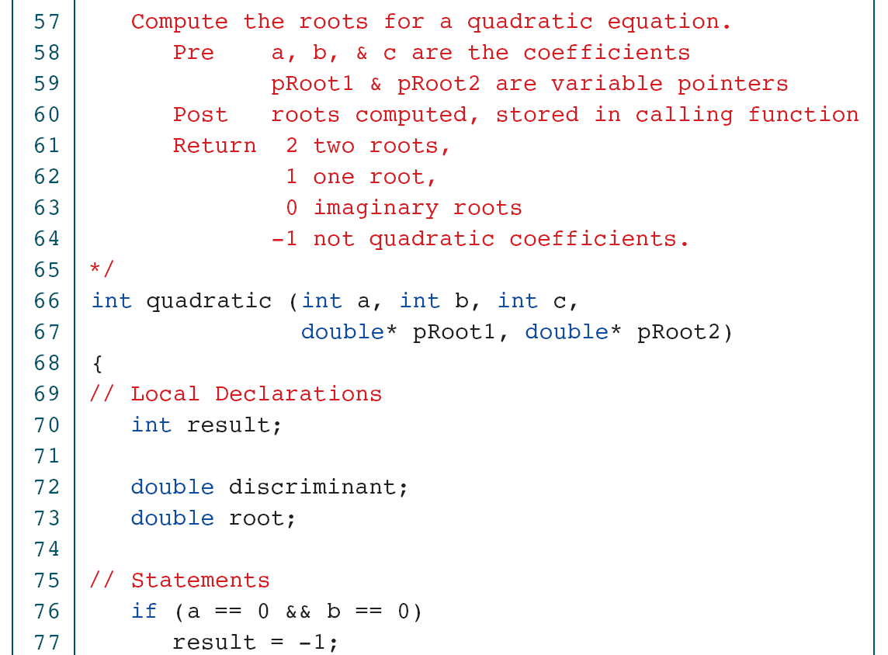
Quadratic Roots

Slide 66
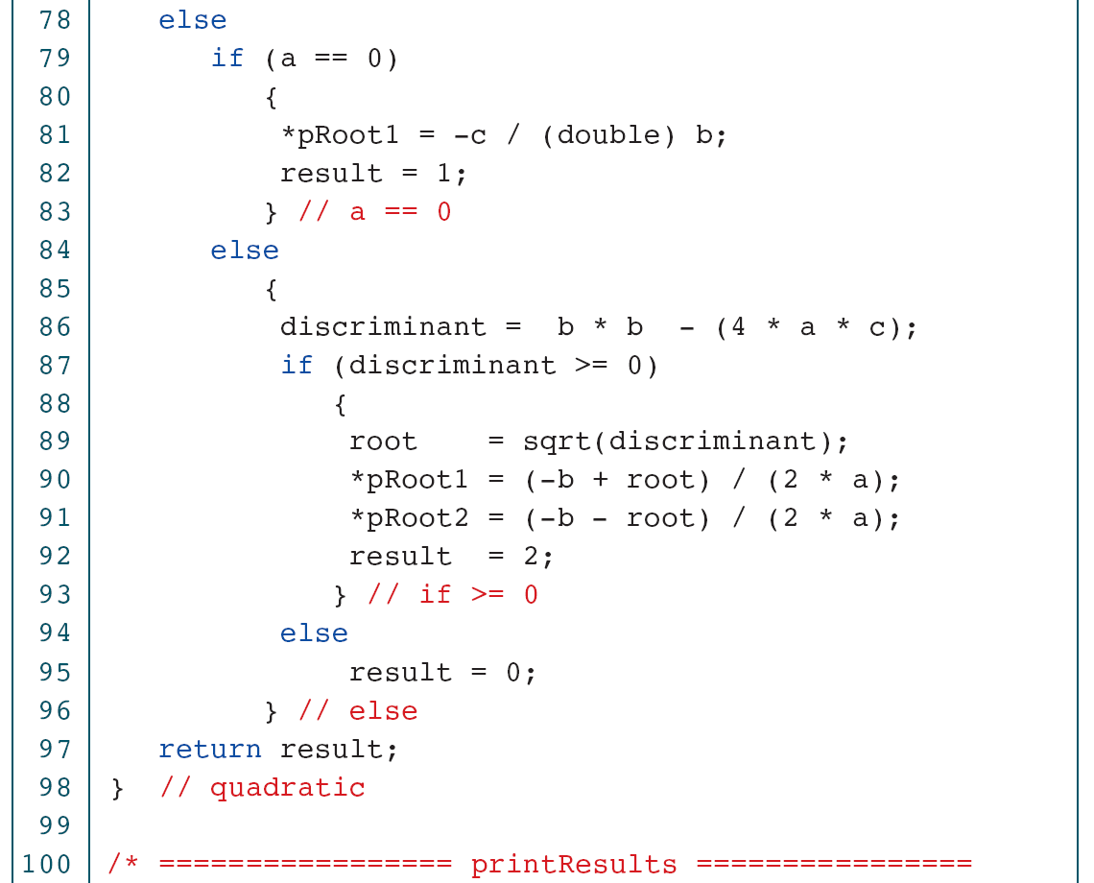
Quadratic Roots

Slide 67
Quadratic Roots

Slide 68
Quadratic Roots

Slide 69
Quadratic Roots

Slide 70
12-4 Unions
The union is a construct that allows memory to be shared by different types of data. This redefinition can be as simple as redeclaring an integer as four characters or as complex as redeclaring an entire structure.

Slide 71
Unions

Slide 72
Demonstrate Effect of Union

Slide 73
Demonstrate Effect of Union

Slide 74
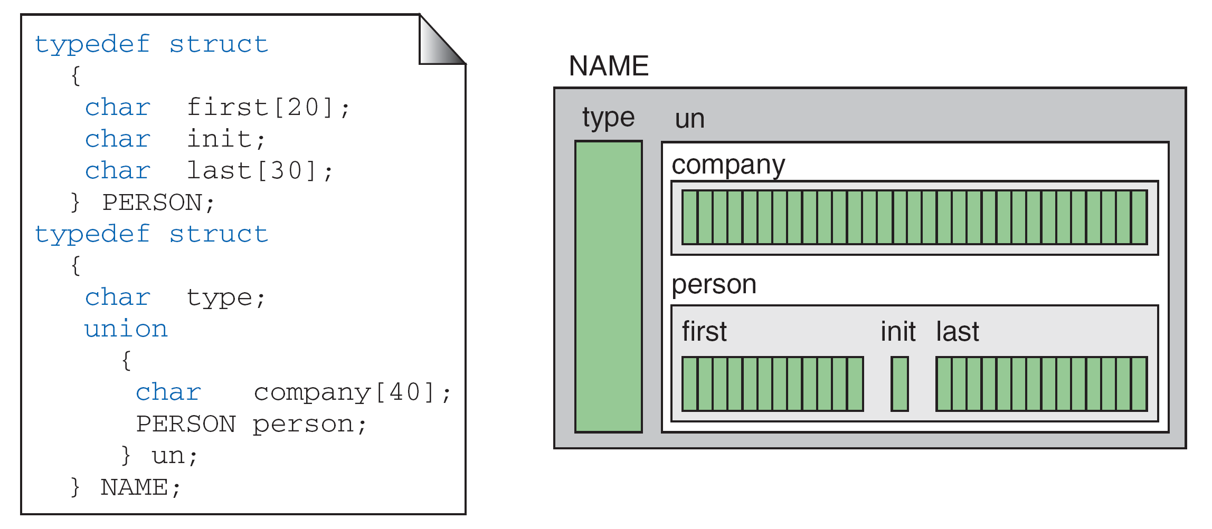
A Name Union

Slide 75
Demonstrate Unions in Structures

Slide 76
Demonstrate Unions in Structures

Slide 77
Demonstrate Unions in Structures

Slide 78
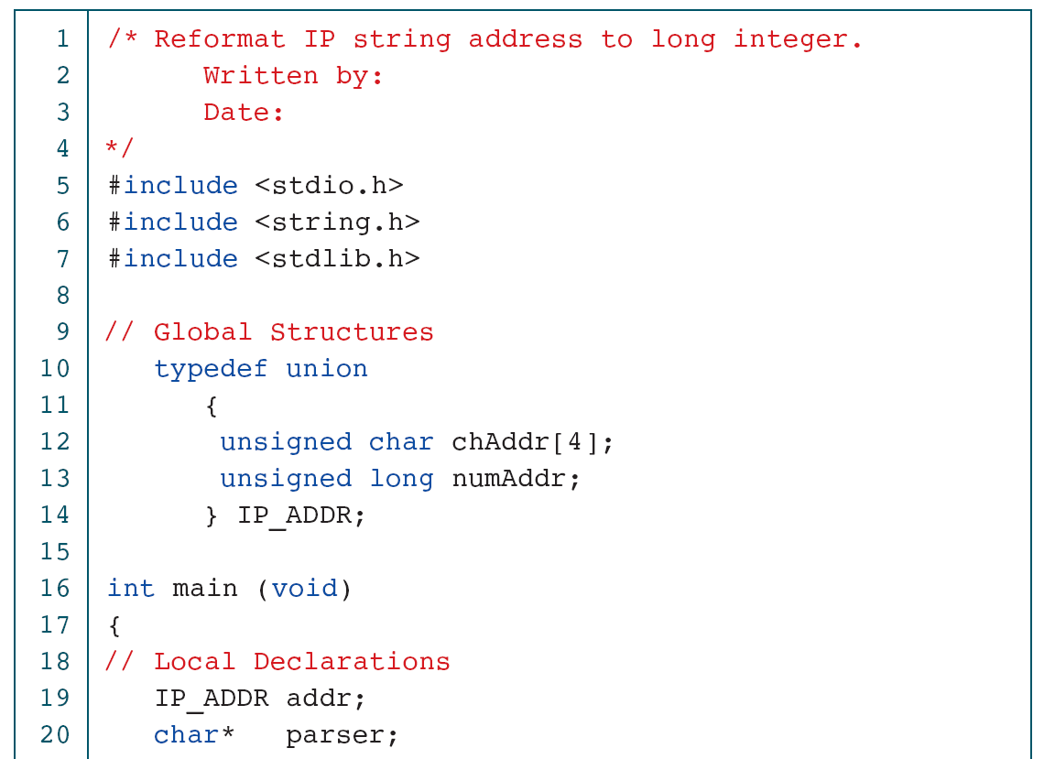
Convert IP Address to long

Slide 79
Convert IP Address to long

Slide 80
Convert IP Address to long

