Slide 1
Chapter 7
Text Input/Output
Objectives
❏ To understand the basic properties and characteristics of external files
❏ To understand the C implementation of file I/O using streams
❏ To write programs that read and write text files using the formatting functions
❏ To write programs that read and write text files using the C character I/O
functions
❏ To write programs that handle simple I/O errors
❏ To understand and implement basic data validation concepts

Slide 2
Files
A file is an external collection of related data treated as a unit. The primary purpose of a file is to keep a record of data. Since the contents of primary memory are lost when the computer is shut down, we need files to store our data in a more permanent form.

Slide 3
Streams
As we already discussed, data is input to and output from a stream. A stream can be associated with a physical device, such as a terminal, or with a file stored in auxiliary memory.

Slide 4
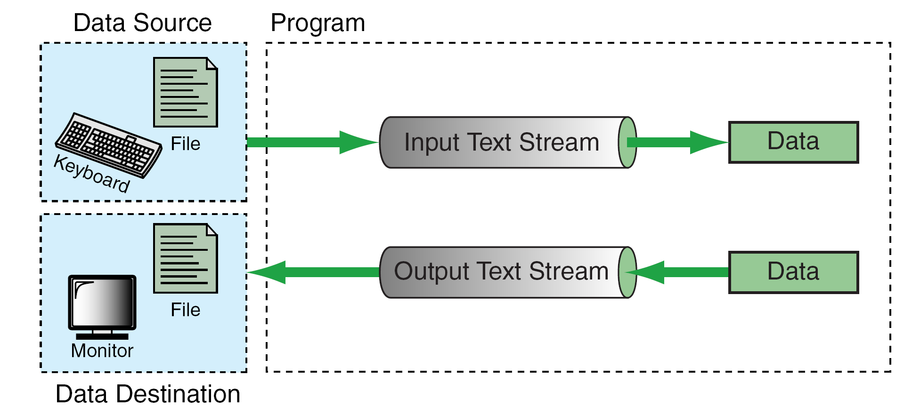
Streams

Slide 5
Notes
Standard stream names have already been declared in the stdio.h header file and cannot be declared again in our program.
There is no need to open and close the standard streams. It is done automatically by the operating system.

Slide 6
Standard Library Input/Output
Functions
The stdio.h header file contains several different input/output function declarations. They are grouped into eight different categories.
The first three will be discussed in the following sections. Later on we will discuss those in the shaded boxes.

Slide 7
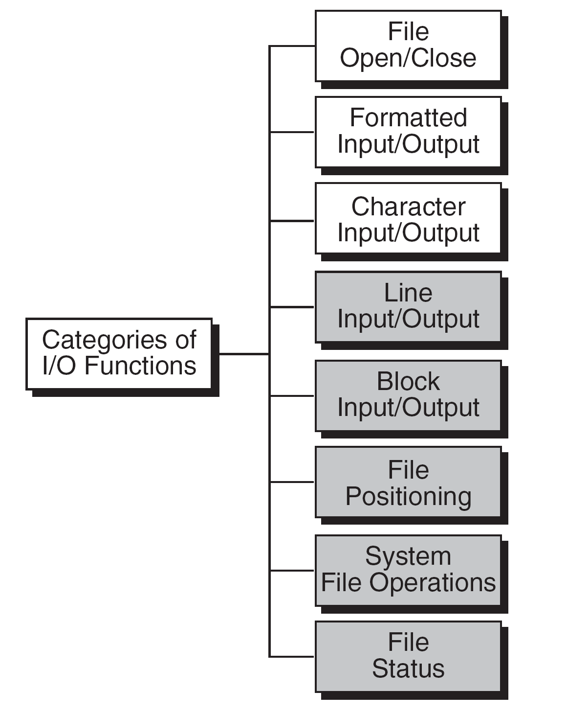
Categories of Standard Input/Output Functions

Slide 8
File Open Results

Slide 9
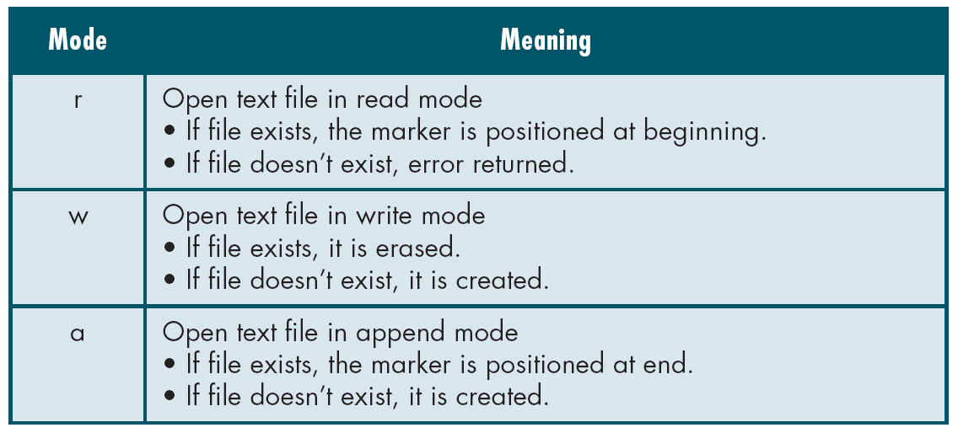
Table 7-1
Text File Modes

Slide 10
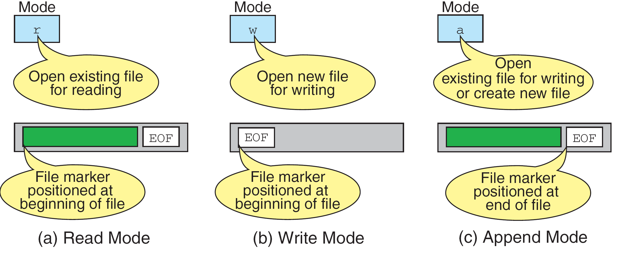
File-Opening Modes

Slide 11
PROGRAM 7-1
Testing for Open and Close Errors

Slide 12
PROGRAM 7-1
Testing for Open and Close Errors

Slide 13
Formatting Input/Output
Functions
Earlier we introduced two formatting input/output functions, scanf and printf. These two functions can be used only with the keyboard and monitor. The C library defines two more general functions, fscanf and fprintf, that can be used with any text stream.

Slide 14
Table 7-2
Formatting Functions

Slide 15
Notes
A whitespace character in an input format string causes leading whitespace characters in the input to be discarded. A whitespace character in an output format string is copied to the output stream.
The number, order, and type of the conversion specifications must match the number, order, and type of the parameters in the list. Otherwise, the result will be unpredictable and may terminate the input/output function.

Slide 16
Conversion Specifications

Slide 17
Note
scanf reads from stdin;
fscanf reads from a user-specified stream.

Slide 18
Sizes and Conversion Code for scanf Family

Slide 19
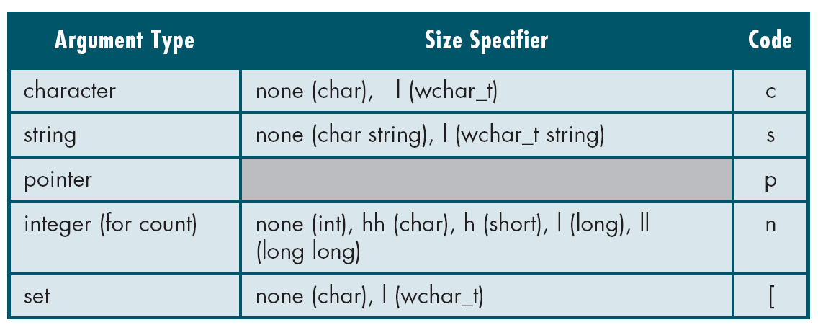
Sizes and Conversion Code for scanf Family

Slide 20
Side Effect and Value of scanf and fscanf

Slide 21
FIGURE 7-7 Another Common Error

Slide 22
PROGRAM 7-2
Checking scanf Results

Slide 23
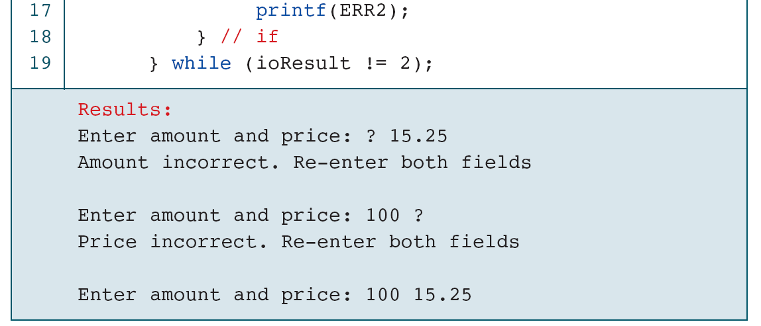
PROGRAM 7-2
Checking scanf Results

Slide 24
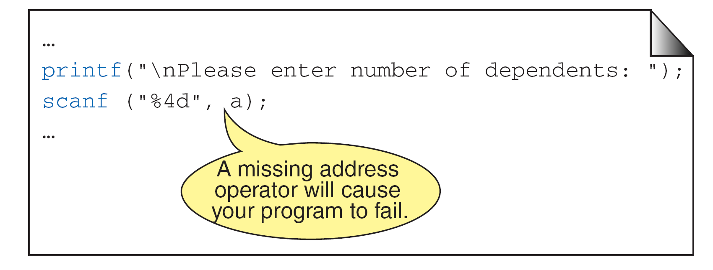
Missing Address Operator in scanf

Slide 25
Data Type Conflict

Slide 26
fscanf Examples

Slide 27
Note
Discarding the return character is different
from consuming it.
Discarding can be done by whitespaces
in the control string;
consuming can only be done by reading
the return character with a %c.

Slide 28
Flags, Sizes, and Conversion Codes for printf Family

Slide 29
Flags, Sizes, and Conversion Codes for printf Family

Slide 30
Flag Formatting Options

Slide 31
Side Effect and Value of printf

Slide 32
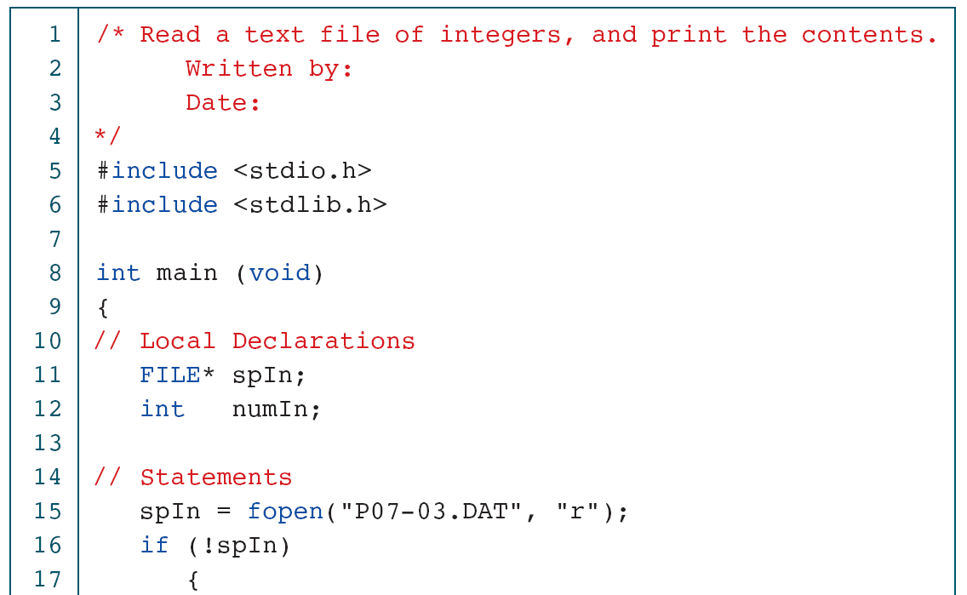
Read and Print Text File of Integers

Slide 33
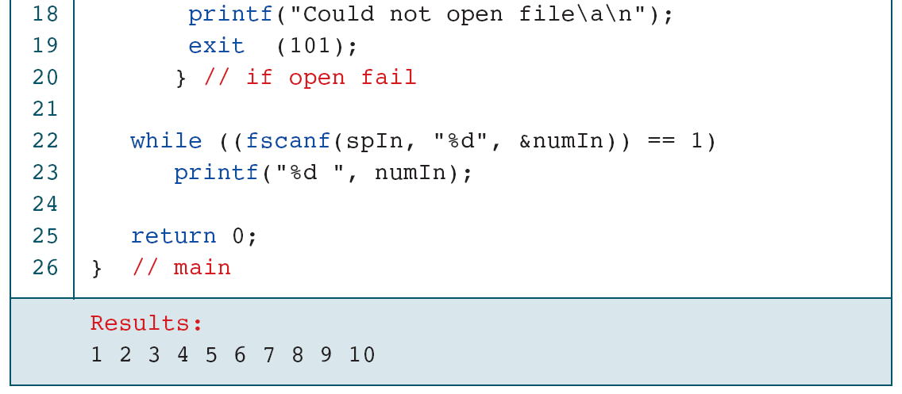
Read and Print Text File of Integers

Slide 34
Copy Text File of Integers

Slide 35
Copy Text File of Integers

Slide 36
Copy Text File of Integers

Slide 37
Append Data to File

Slide 38
Append Data to File

Slide 39
Append Data to File

Slide 40
Student Grades

Slide 41
Student Grades

Slide 42
Student Grades

Slide 43
Student Grades

Slide 44
Student Grades

Slide 45
Student Grades

Slide 46
Student Grades

Slide 47
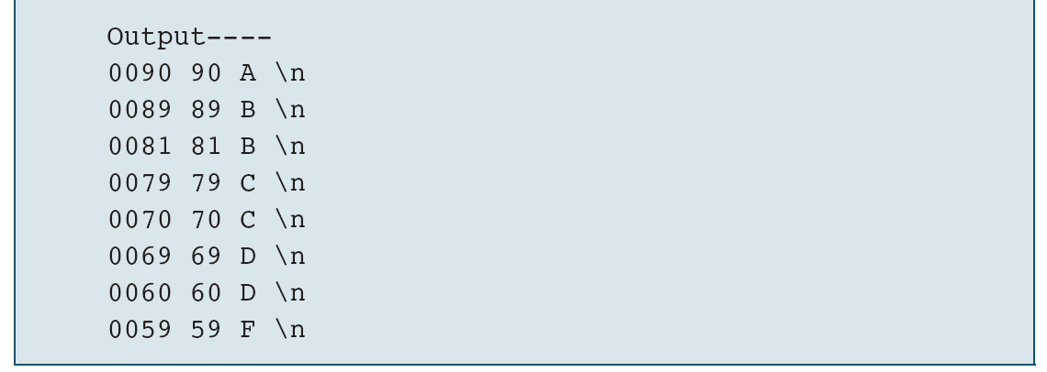
Student Grades

Slide 48
Character Input/Output
Functions
Character input functions read one character at a time from a text stream. Character output functions write one character at the time to a text stream.

Slide 49
Character Input/Output Functions

Slide 50
Create Text File

Slide 51
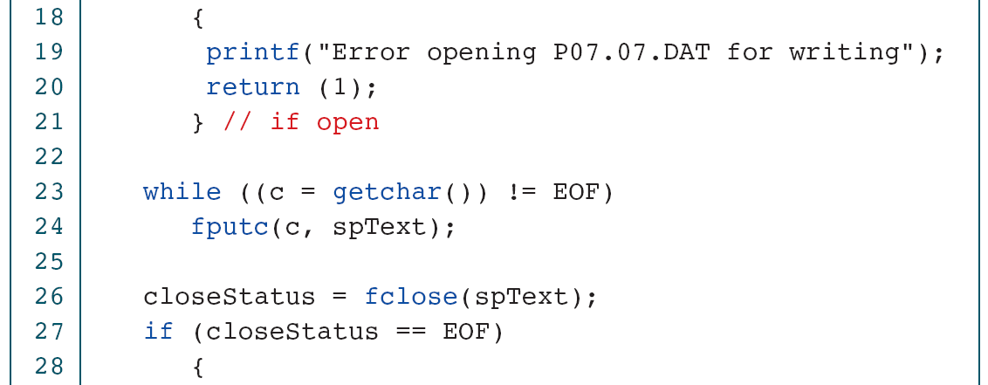
Create Text File

Slide 52
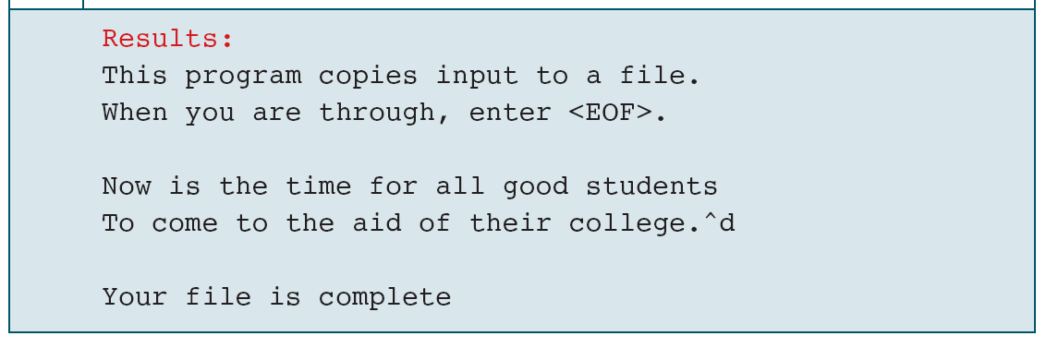
Create Text File

Slide 53
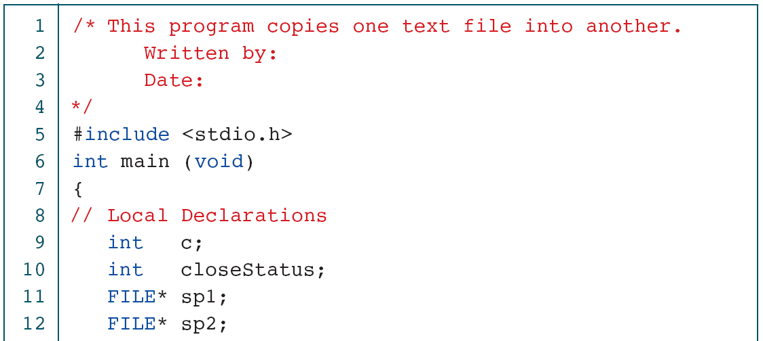
Copy Text File

Slide 54
Copy Text File

Slide 55
Count Characters and Lines

Slide 56
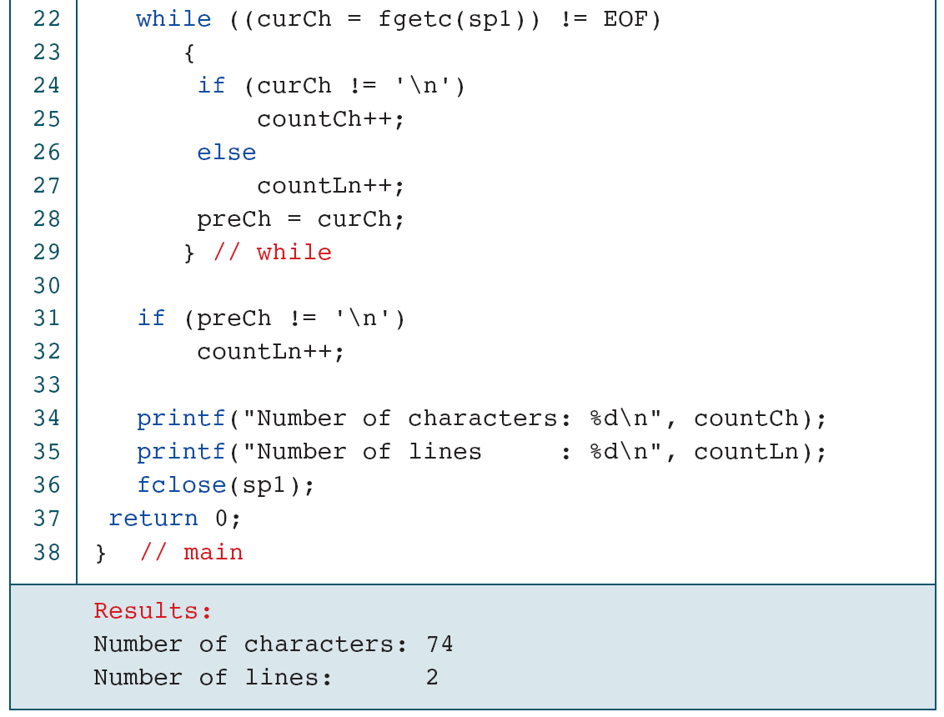
PROGRAM 7-9
Count Characters and Lines

Slide 57
Count Words

Slide 58
Count Words

Slide 59
Software Engineering
In this section, we discuss some software engineering issues related to files.

Slide 60
PROGRAM 7-11
Handling Errors—the Right Way

Slide 61
Handling Errors with Explanations

Slide 62
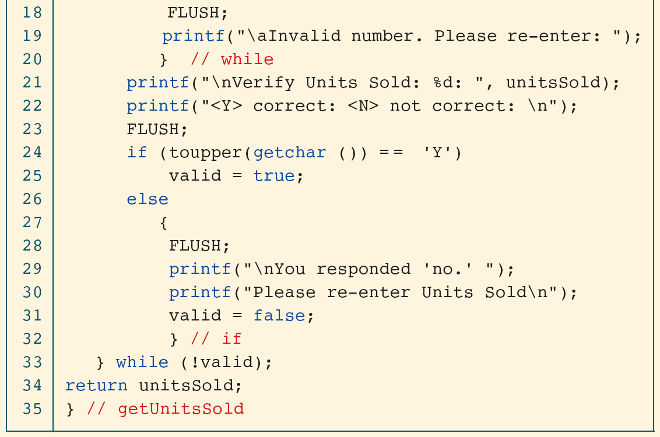
Handling Errors with Explanations

Slide 63
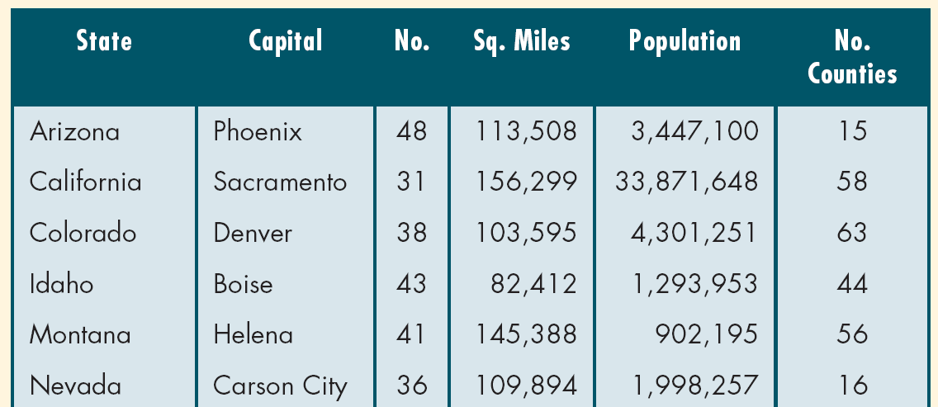
Ten Western States (2000 Census)

