Slide 1
Loops in C
C has three loop statements: the while, the for, and the do…while. The first two are pretest loops, and the
the third is a post-test loop. We can use all of them
for event-controlled and counter-controlled loops.

Slide 2
C Loop Constructs

Slide 3
For Loops
Initialization of loop counters should be outside of loop.
More than one initialization can occur
More than one test can occur
int i;
int j;
for (i = 1, j = 51; i <= 50 && j<75; i++, j++)

Slide 4
Other Statements Related
to Looping
Three other C statements are related to loops: break, continue, and goto. The last statements, the goto, is not valid for structured programs and therefore is not discussed.

Slide 5
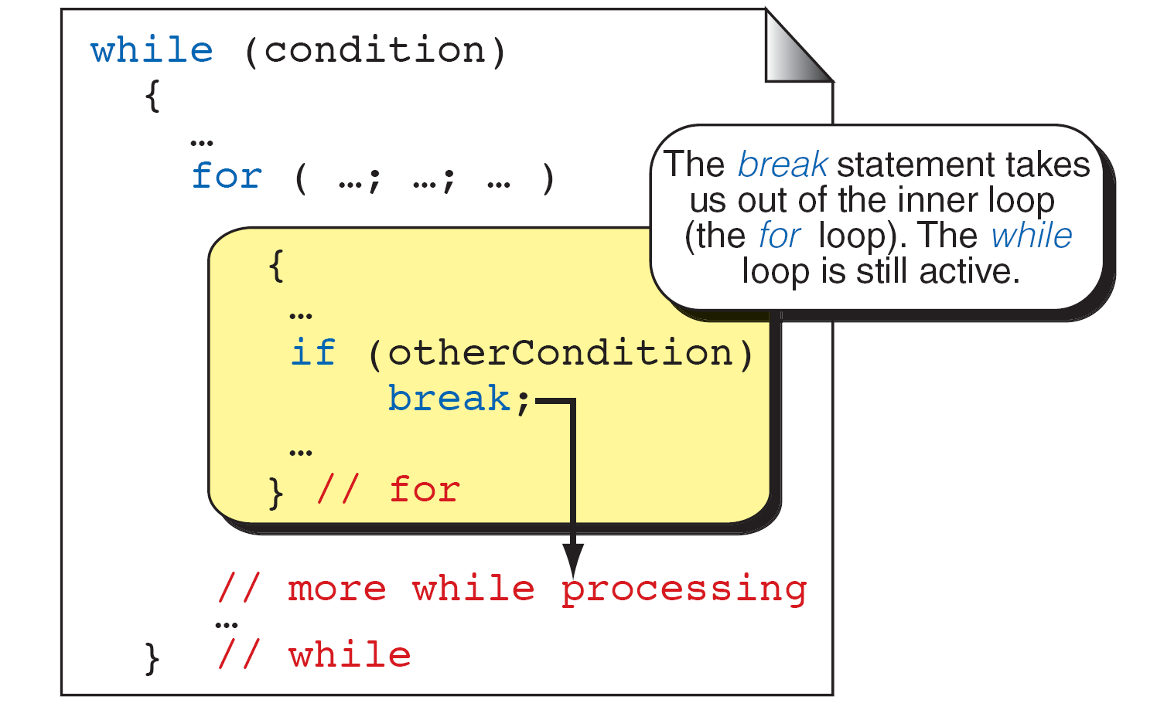
break and Inner Loops

Slide 6
The for and while as Perpetual Loops

Slide 7
Using a break Flag

Slide 8
The continue Statement

Slide 9
Recursion
In general, programmers use two approaches to writing repetitive algorithms. One approach uses loops; the other uses recursion. Recursion is a repetitive process in which a function calls itself.

Slide 10
Note
Every recursive call must either solve part of the problem
or reduce the size of the problem.

Slide 11
Calling a Recursive Function

Slide 12
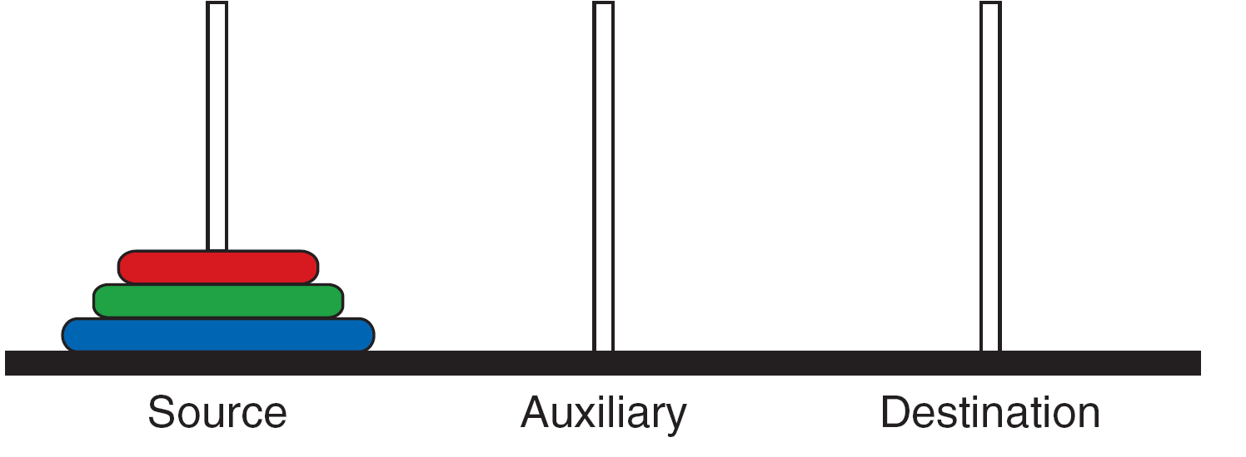
Towers of Hanoi—Start Position

Slide 13
Towers of Hanoi Solution for Three Disks (Part I)

Slide 14
Towers of Hanoi Solution for Three Disks (Part II)

Slide 15
Towers of Hanoi

Slide 16
Towers of Hanoi

Slide 17
Tracing of Program, Towers of Hanoi

Slide 18
Static Local Variables
You can include variables that persist even when a function ends. Use the word static before the declaration and what ever value it is at the end of the function will be what it is when the function starts again.
Storage is allocated only once, before the program begins execution.
They are known only in the function where they are declared.

