Slide 1
String Concepts
In general, a string is a series of characters treated as a unit. Computer science has long recognized the importance of strings, but it has not adapted a standard for their implementation. We find, therefore, that a string created in Pascal differs from a string created in C.

Slide 2
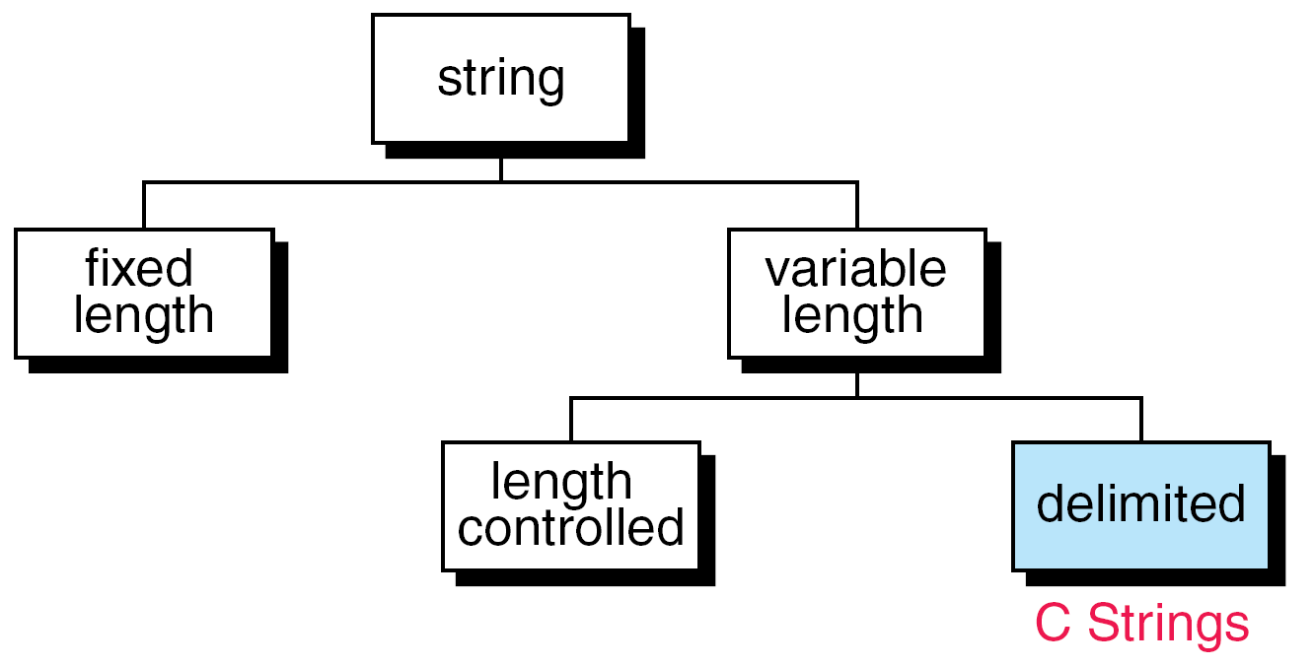
String Taxonomy

Slide 3
String Formats

Slide 4
C Strings
A C string is a variable-length array of characters that is delimited by the null character.
C uses variable-length, delimited strings.
A string literal is enclosed in double quotes.

Slide 5
Storing Strings

Slide 6
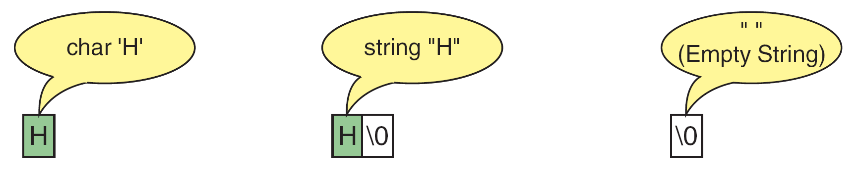
Storing Strings and Characters

Slide 7
Differences Between Strings and Character Arrays

Slide 8
FIGURE 11-6 Strings in Arrays

Slide 9
Character Literals and String Literals

Slide 10
String Literal References

Slide 11
Defining Strings

Slide 12
Note
Memory for strings must be allocated before the
string can be used.

Slide 13
Initializing Strings

Slide 14
String Input/Output Functions
C provides two basic ways to read and write strings. First, we can read and write strings with the formatted input/output functions, scanf/fscanf and printf/fprintf. Second, we can use a special set of string-only functions, get string (gets/fgets) and put string ( puts/fputs ).

Slide 15
Note
The string conversion code(s) skips whitespace.

Slide 16
Reading Strings
The edit set does not skip whitespace.
Always use a width in the field specification when reading strings.
The maximum number of characters to be printed is specified by the precision in the format string of the field specification.

Slide 17
PROGRAM 11-2
Demonstrate String Scan Set

Slide 18
PROGRAM 11-2
Demonstrate String Scan Set

Slide 19
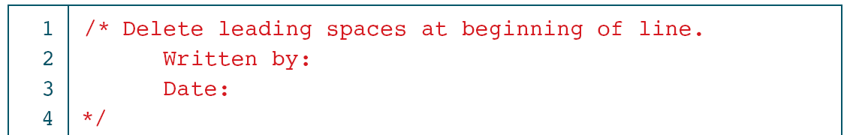
Delete Leading Whitespace

Slide 20
Delete Leading Whitespace

Slide 21
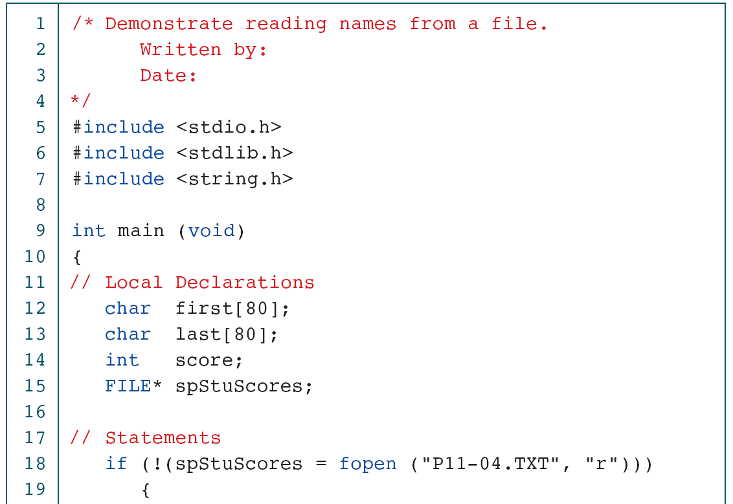
Read Student Names and Scores

Slide 22
Read Student Names and Scores

Slide 23
gets and fgets Functions

Slide 24
Demonstrate fgets Operation

Slide 25
Demonstrate fgets Operation

Slide 26
puts and fputs Operations

Slide 27
Demonstration of Put String

Slide 28
Demonstration of Put String

Slide 29
Typewriter Program

Slide 30
Typewriter Program

Slide 31
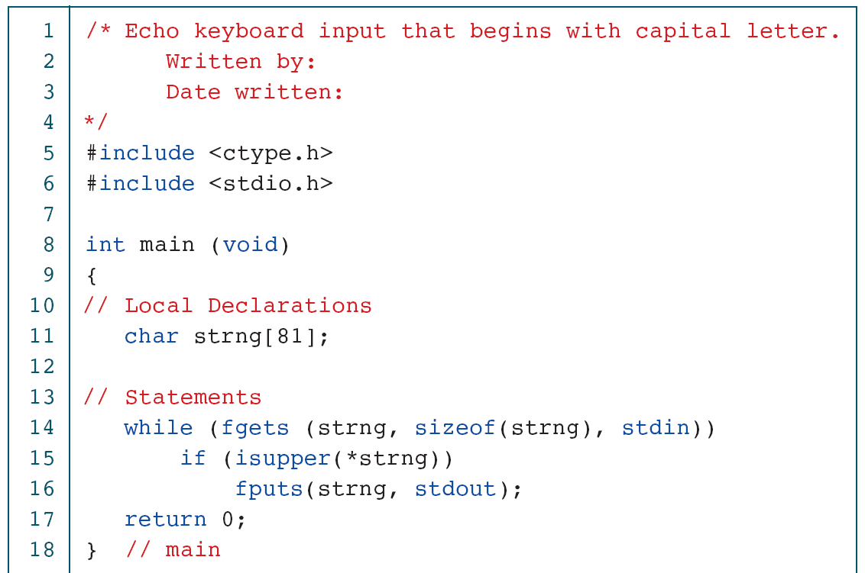
Print Selected Sentences

Slide 32
Print Selected Sentences

Slide 33
Print File Double spaced

Slide 34
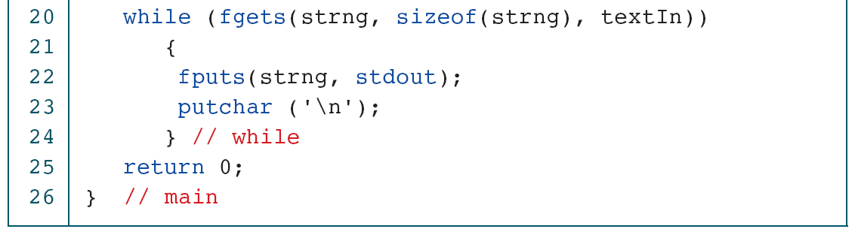
Print File Double spaced

Slide 35
Arrays of Strings
Ragged arrays are very common with strings. Consider, for example, the need to store the days of the week in their textual format. We could create a two-dimensional array of seven days by ten characters, but this wastes space.

Slide 36
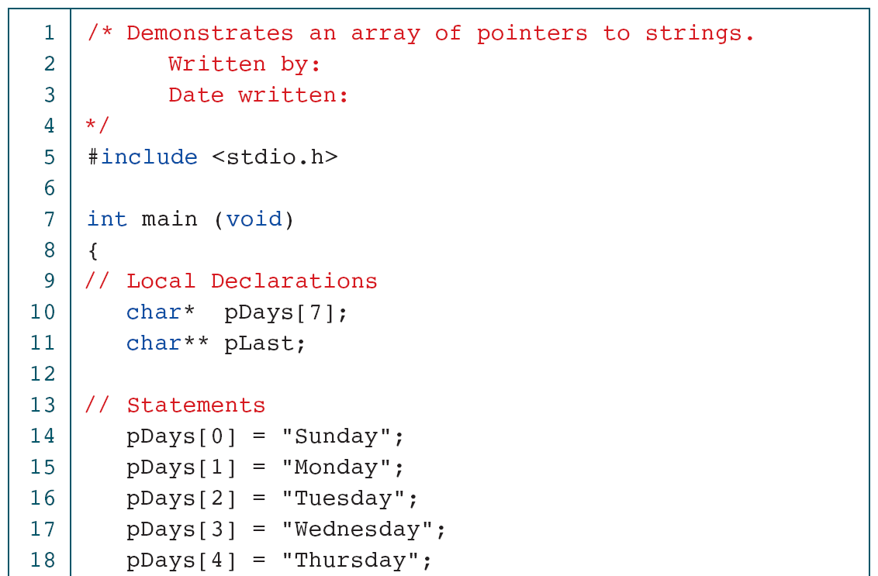
Print Days of the Week

Slide 37
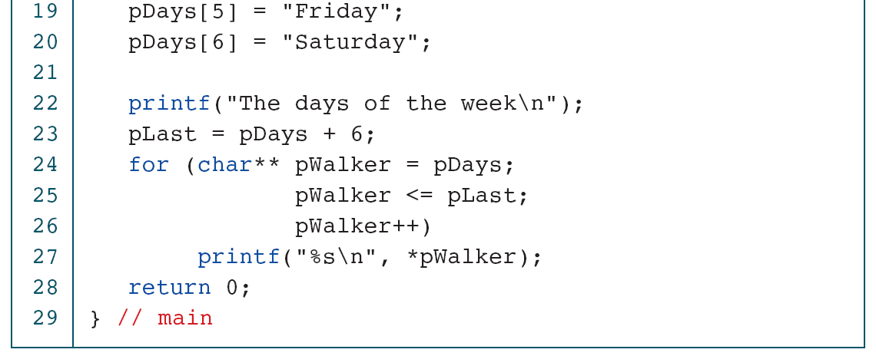
Print Days of the Week

Slide 38
Pointers to Strings

Slide 39
String Manipulation
Functions
Because a string is not a standard type, we cannot use it directly with most C operators. Fortunately, C provides a set of functions to manipulates strings.

Slide 40
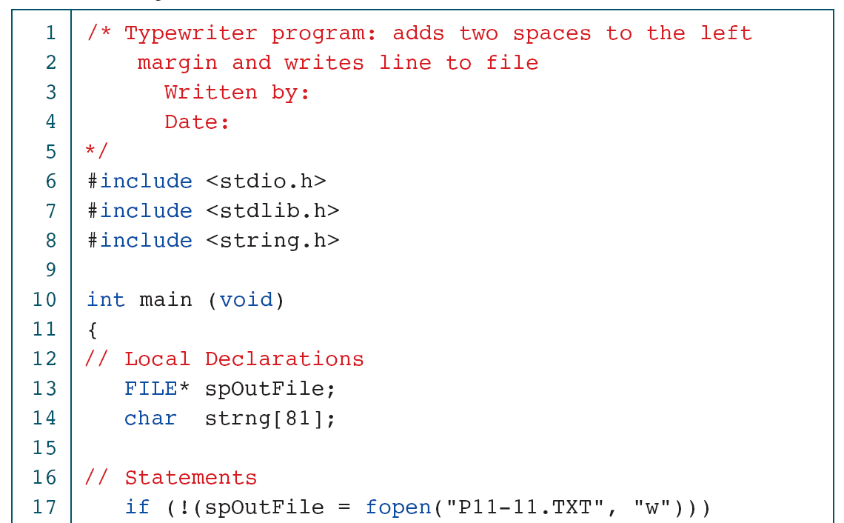
Add Left Margin

Slide 41
Add Left Margin

Slide 42
String Copy

Slide 43
String-number Copy

Slide 44
Note
Always use strncpy to copy one string to another.

Slide 45
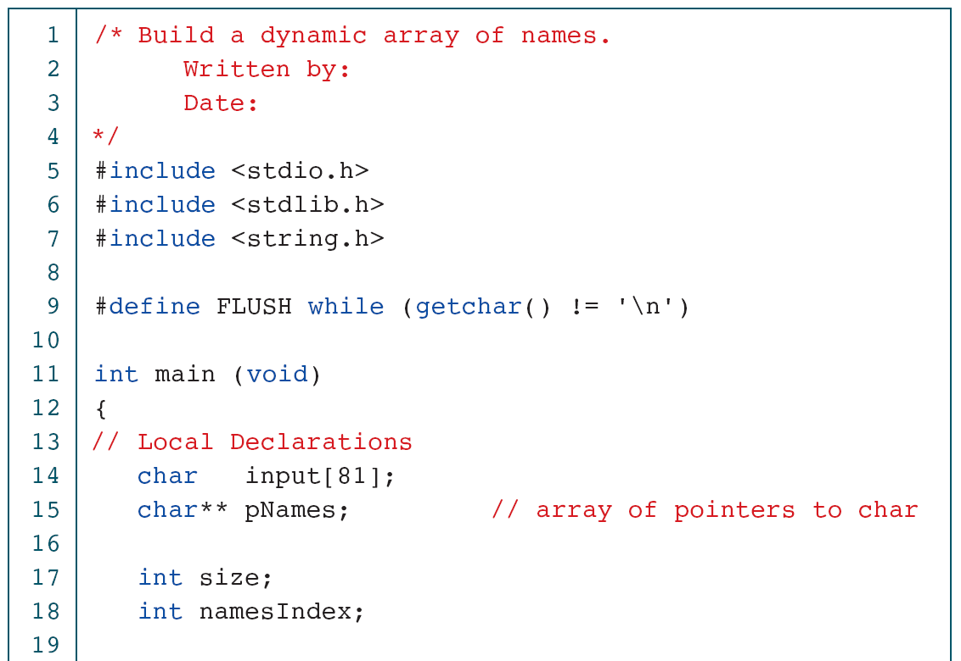
Build Name Array in Heap

Slide 46
Build Name Array in Heap

Slide 47
PROGRAM 11-12
Build Name Array in Heap

Slide 48
Structure for Names Array

Slide 49
String Compares

Slide 50
Results for String Compare

Slide 51
String Concatenation

Slide 52
Character in String (strchr)

Slide 53
String in String

Slide 54
String Span

Slide 55
Streams

Slide 56
Demonstrate String to Long

Slide 57
Demonstrate String to Long

Slide 58
Demonstrate String to Long

Slide 59
String-to-Number Functions

Slide 60
Parsing with String Token

Slide 61
Parsing a String with String Token

Slide 62
Parsing a String with String Token

Slide 63
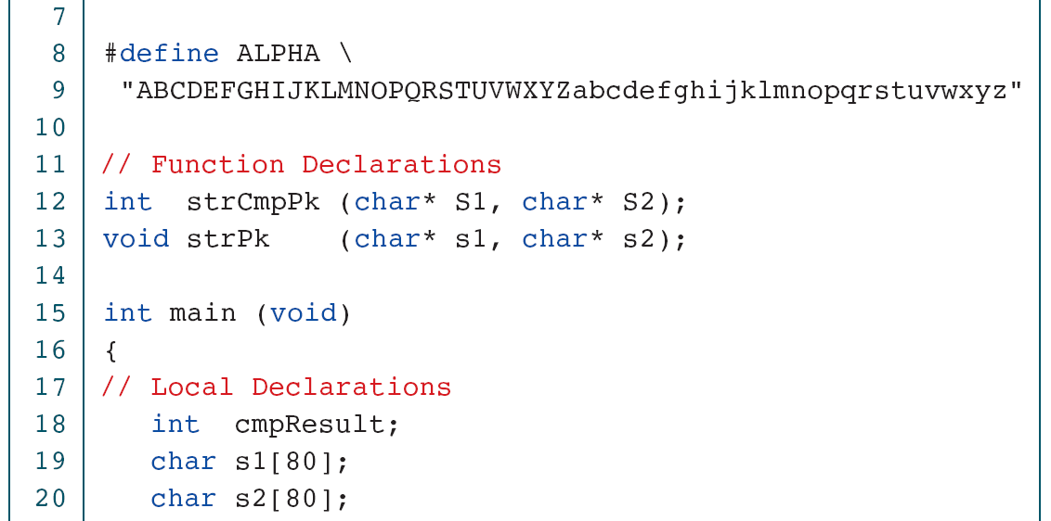
Compare Packed String Function

Slide 64
Compare Packed String Function

Slide 65
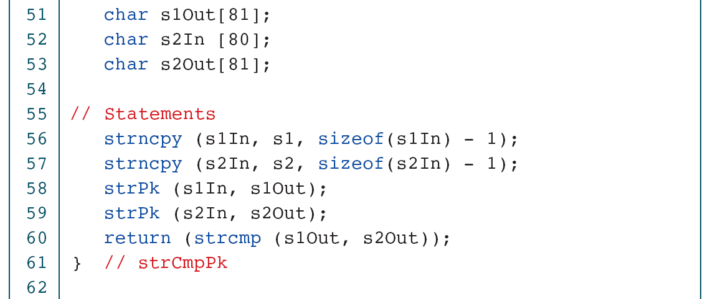
Compare Packed String Function

Slide 66
Compare Packed String Function

Slide 67
Compare Packed String Function

Slide 68
String/Data Conversion
A common set of applications format data by either converting a sequence of characters into corresponding data types or vice versa. Two such applications are parsing and telecommunications.

Slide 69
sscanf Operation

Slide 70
Note
sscanf is a one-to-many function. It splits
one string into many variables.

Slide 71
sprintf Operation

Slide 72
Demonstrate Memory Formatting

Slide 73
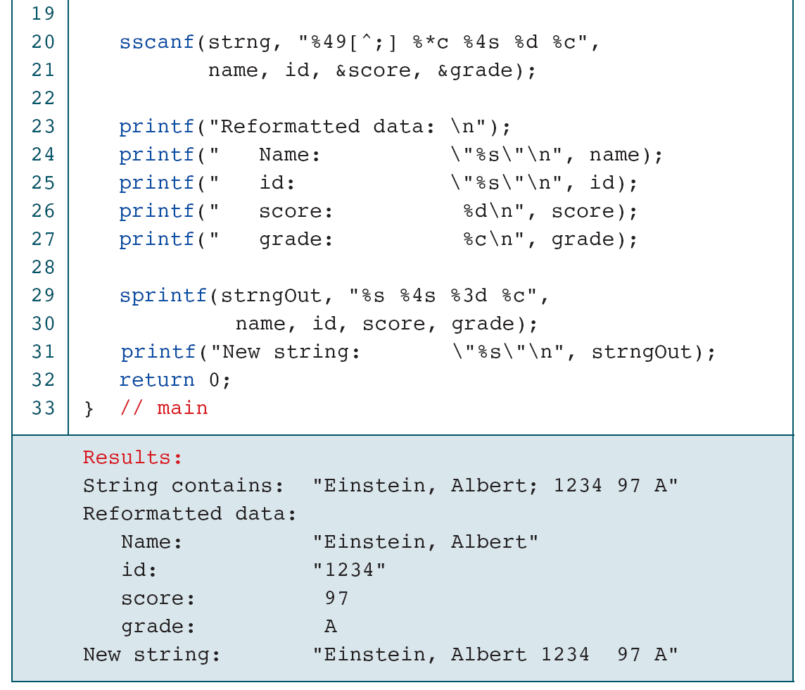
Demonstrate Memory Formatting

Slide 74
Testing for Open and Close Errors

Slide 75
Testing for Open and Close Errors

Slide 76
Testing for Open and Close Errors

Slide 77
A Programming Example—
Morse Code
Morse code, patented by Samuel F. B. Morse in 1837, is the language that was used to send messages by telegraph from the middle of the nineteenth century until the advent of the modern telephone and today’s computer controlled communications systems. In this section, we use a C program to convert English to Morse and Morse to English.

Slide 78
Morse Code

Slide 79
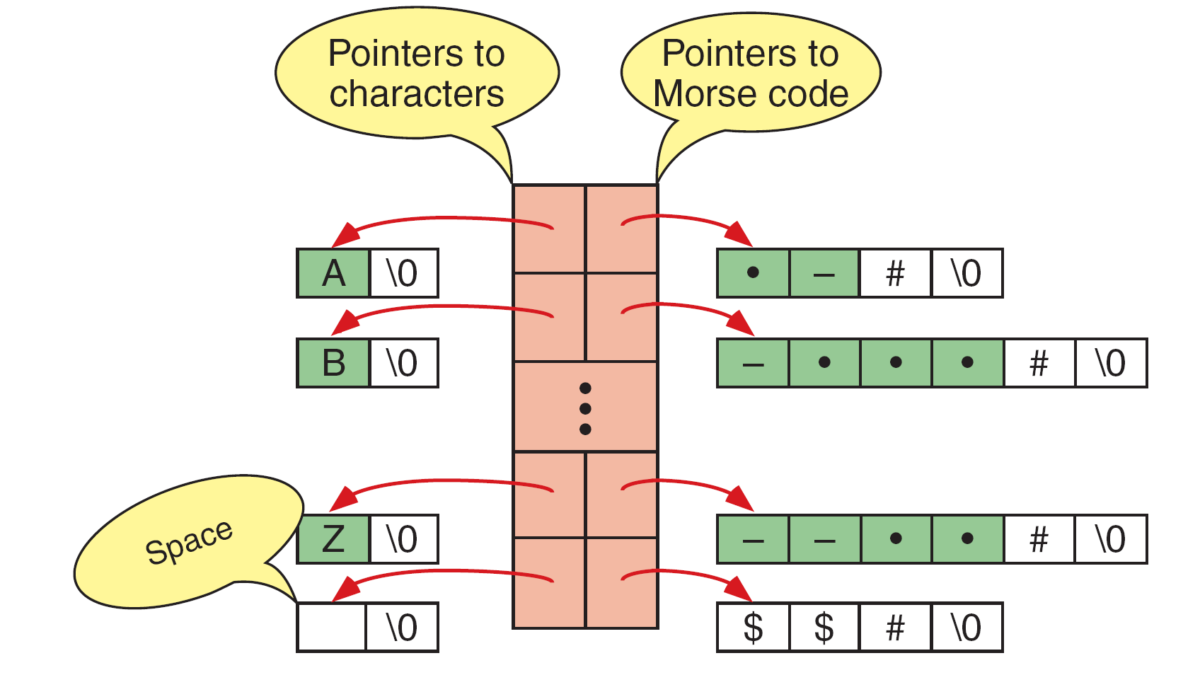
Character to Morse Code Structure

Slide 80
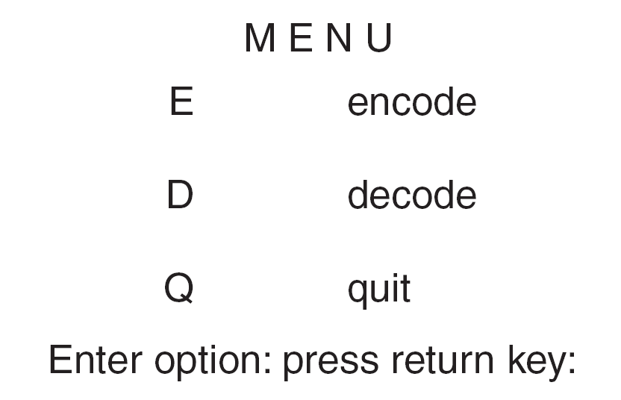
Morse Code Menu

Slide 81
Morse Code Program Design

Slide 82
Morse Code: main

Slide 83
Morse Code: main

Slide 84
Morse Code: main

Slide 85
Morse Code: main

Slide 86
Morse Code: main

Slide 87
Morse Code: main

Slide 88
Morse Code: Menu

Slide 89
Morse Code: Menu

Slide 90
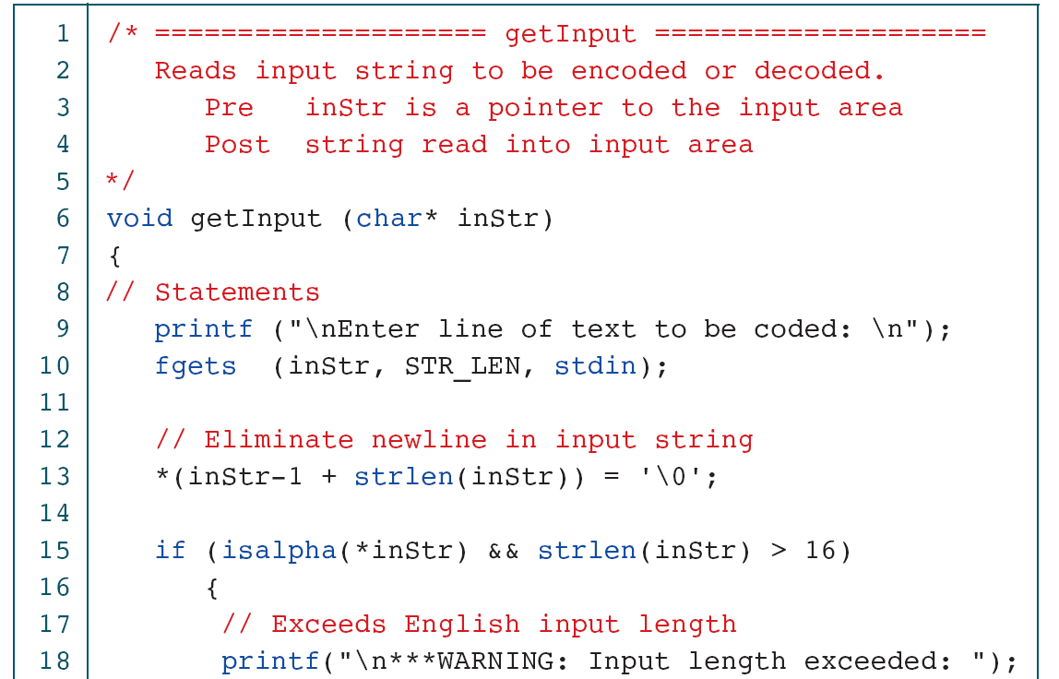
Morse Code: Get Input

Slide 91
Morse Code: Get Input

Slide 92
PROGRAM 11-21
Morse Code: Print Output

Slide 93
Morse Code: Encode to Morse

Slide 94
Morse Code: Encode to Morse

Slide 95
Morse code: Decode to English

Slide 96
Morse code: Decode to English

Slide 97
Morse Code: Convert Codes

Slide 98
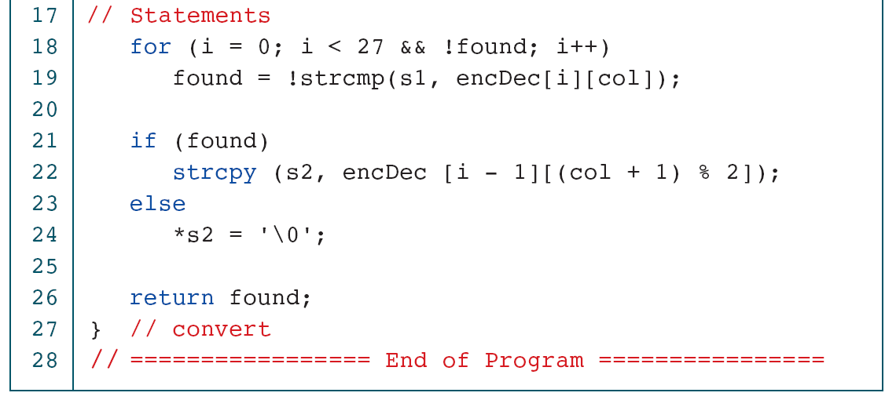
PROGRAM 11-24
Morse Code: Convert Codes

