Slide 1
UNIX Introduction
Caryl Rahn

Slide 2
UNIX and Linux
Backround
Layers of a UNIX System
Function of UNIX Shells
Options for Connecting to a UNIX System
Syntax used for Entering UNIX Commands
Role of the System Administrator
Log On and Log Out
Redirection Symbol

Slide 3
Introducing the UNIX Operating System
UNIX is a multi-user system
  Lets many people simultaneously access and share the resources of a server computer
UNIX is a multitasking system
  Lets one user execute multiple programs
UNIX is also a portable operating system
  Can be used in a variety of computing environments (different types of hardware)
  It is the only operating system that spans all classes of computers from mainframes to PDAs.

Slide 4
UNIX Concepts
Microsoft DOS and Microsoft Windows adopted original UNIX design concepts, such as the idea of a shell--an interface between the user and the operating system--and the hierarchical structure of directories and subdirectories
The kernel is the base operating system, which interacts directly with the hardware and services the user programs

Slide 5
Unix Concepts - Layers
The kernel is only accessible through kernel mode - reserved for system administrator
This prevents unauthorized commands from invading the foundation layer or the hardware that supports the entire UNIX structure
User mode provides access to higher layers where all application software resides

Slide 6
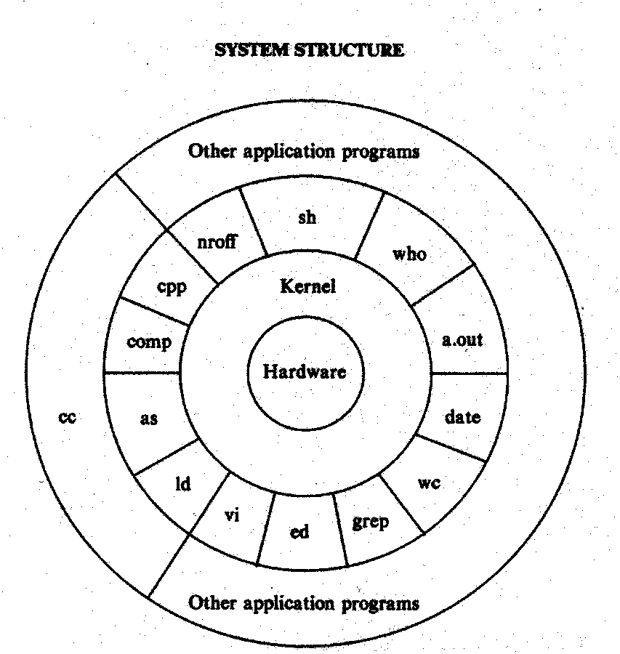
Layers of a UNIX System

Slide 7
Functions of UNIX Shells
Used to Communicate between the user and the Operating System
Two major types of Shells
  GUI – Graphical User Interface
  CLI – Command Line Interface

Slide 8
Graphical User Interface
GUI
X Windows System
Common Desktop Environment – CDE
Fast Virtual Window Manager (fvwm) – Linux
Open Look Window Manager (olwm) – Sun Microsystems
K Desktop Environement – KDE
Open Windows
What is the most common GUI running a UNIX system?

Slide 9
Command Line Interface
CLI
You choose a shell when the system administrator sets up your user account
Most users choose the Bash shell, although you can choose any of these:
  Bourne Shell (sh) – first one at AT&T
  C Shell (csh) – C programmers like this one
  TC Shell (tcsh) – derived from the C shell
  Korn Shell (ksh) - includes many extensions, such as a history feature that lets you use a keyboard shortcut to retrieve commands you previously entered
  Bourne again Shell (bash) – Linux
Start-up scripts are different for the different shells

Slide 10
Options for Connection to a UNIX System
Workstation
  Usually run versions of UNIX specifically for that workstation - Sun-OS, Solaris, HP_UX
Personal Computer
  There are several versions of UNIX that run on PC’s - Solaris, UNIXware, XENIX
Dumb Terminal

Slide 11
Making the Connection
LAN Connection
  Appears as if the local computer is running UNIX
Telnet Connection
  A client program connects to a telnet server running on the UNIX system.
  Appears like a dumb terminal
  Can run over a Network Connection or a modem

Slide 12
Connecting to UNIX via Telnet
Telnet is a terminal emulation program for the Internet
  putty
Internet Protocol (IP) address
Domain name such as ocelot.aul.fiu.edu

Slide 13
Syntax used for Entering UNIX Commands
UNIX is Case Sensitive!
Launch Applications from the CDE
CLI Syntax
  Enter the program (command) on the command line
  ls –l
  vi myfile.txt

Slide 14
Role of the System Administrator
Sets up access and permissions for Users of the System
  You can log on to any UNIX or Linux system as long as you have a user account and password on the host (server) computer
Perform System Backups
Install and Upgrade Programs
a.k.a. superuser

Slide 15
The System Administrator Continued
The system administrator has a unique user name: root
The system administrator owns the root account, which means no one else can be assigned to that account
The password for the root account should be confidential; only the system administrator and a back-up person know it

Slide 16
The System Administrator Command Line
The system administrator’s prompt is the # (pound) symbol
The UNIX system generates a default setting for the command prompt for the system administrator in the following format:
[root@hostname]#

Slide 17
The Ordinary User Command Line
The $ (dollar sign) is traditionally associated with ordinary users
The UNIX system generates a default setting for the command prompt for ordinary users in the following format:
[user name@hostname]$

Slide 18
Users and Groups
/etc/passwd
  Contains user login name
  Password is encrypted
  There is a User ID number (UID) that is unique, set by the System Administrator
  Has the users primary group ID
  Has the users home directory
  Has the users logon shell
/etc/group
  Contains groups and their members

Slide 19
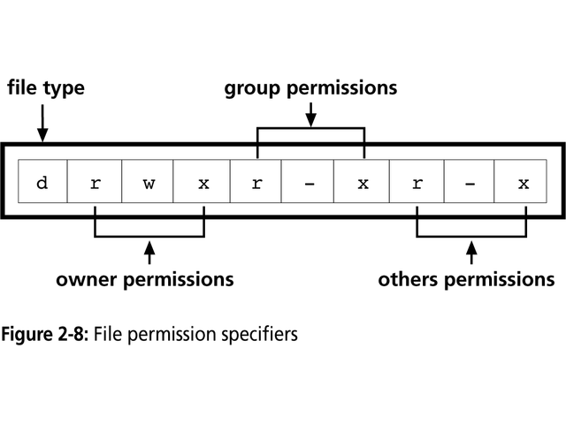
Setting File Permissions
A directory listing gives you the access permissions for a file.
The first character of file type can be
  d – directory
  b,c or p for devices
  A hyphen means it is a file
chmod ugoa =+- rwx filename

Slide 20
File Permission Codes
Diagram on Previous Slide
d Indicates the file type (d=directory)
R File’s owner has read permission
w File’s owner has write permission
x File’s owner has execute permission (can run the file as an executable program)
r Group has read permission
- Group does not have write permission
x Group has execute permission
r Others have read permission
- Others do not have write permission
x Others have execute permission

Slide 21
Entering Commands
UNIX is case-sensitive
You type most UNIX commands in lowercase
You must know a command’s syntax
Syntax
  Command options arguments
  ls –alt /usr/users/*

Slide 22
Multiple Commands
You may type more than one command on the command line by separating each command with a semicolon(;)
When you press Enter, UNIX executes the commands in the order you entered them

Slide 23
Command Line Entry Continued
The clear Command
  You can use the clear command to clear your screen; it has no options or arguments
The Command-line History
  You can access the command history with the up and down arrow keys
  Pressing the up arrow key once recalls the most recently used command
  Each time you press the up arrow key, you recall an older command

Slide 24
Commonly Used Shell Commands - man
All UNIX systems include man pages
  Online help manual
  Syntax
    man ls
This is probably the most important command to learn!

Slide 25
man Pages
Name: the name of the command and a short statement describing its purpose
Synopsis: a syntax diagram showing the usage of the command
Description: a more detailed description of the command than the name item gives
Options: a list of command options and their purposes
See Also: other commands or man pages that provide related information
Bugs: a list of the command’s known bugs

Slide 26
Commonly Used Shell Commands - logout
Logging out ends your current process and indicates to UNIX that you are finished
How you log out depends on the shell you are using
  exit
  logout

Slide 27
Commonly Used Shell Commands - passwd
passwd command
  new password must differ from the old password by at least three characters
  password must have more than five characters
  at least two letters and one number
  password is different from your user name

Slide 28
Commonly Used Shell Commands
Three UNIX commands let you view the contents of files: cat, more, and less
The more and less commands display a file, one screenful at a time, while the cat command displays the whole file at once
Two other commands, head and tail, let you view the first few or last few lines of a file

Slide 29
Commonly Used Shell Commands - cal
cal calendar of the current month
cal –j 2000 julian date format
cal august 2002 calendar of august, 2002

Slide 30
Commonly Used Shell Commands - date
date today’s date
date –u system date

Slide 31
Commonly Used Shell Commands - who
who –h
  Displays remote users logged in
who –i
  Shows idle time for each user
who –iH
  List of login names and total #
who -q
  Your username and what terminal you are logged into

Slide 32
More Commonly Used Shell Commands
pwd – print working directory
cd
ls
touch
whatis
clear
find

Slide 33
Redirection Symbol
>
cat > myfile.txt
>>
cat >> myfile.txt
Ctrl D

Slide 34
The UNIX File System
Standard Tree Structure
Partitions
Mount
Paths and Pathnames
Creating Directories
Copying Files
Setting File Permissions

Slide 35
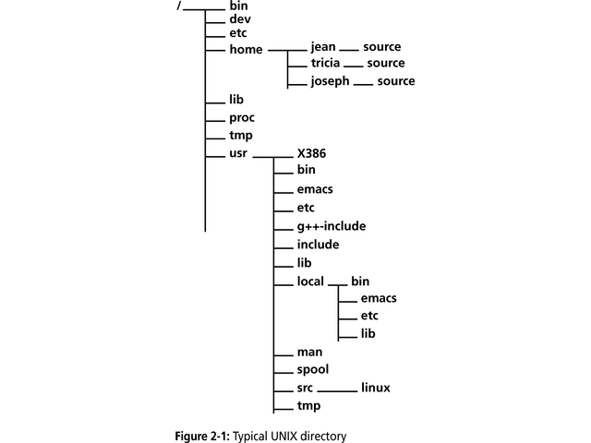
A Typical UNIX Directory Tree

Slide 36
UNIX File Types
Everything looks like a file to UNIX
There are 4 Types of Files
  Binary Files
  Text Files
  Links
  Device Files

Slide 37
Partitions
Can have one or more partitions
  Having different partitions protects your data
Root partition
  /etc and /bin
Partition for users home directories
Other partitions
  /home
  /var
  /tmp
  /usr
  /swap

Slide 38
The Swap Partition
Swap partitions support virtual memory
Virtual memory
  swap partitions prove space on disk that acts like an extension of physical memory
  The system can use it to swap information between disk and RAM
The rule of thumb is:
  Swap space = 3 x RAM

Slide 39
The /bin and /boot Directories
The /bin Directory
  The /bin directory contains binaries, or executables, the programs needed to start the system and perform other essential system tasks
The /boot Directory
  The /boot directory often contains the files that the bootstrap loader (the utility that starts the operating system) needs and the kernel (operating system) images

Slide 40
The /dev Directory
The /dev Directory
  Files in the /dev are device drivers, which access system devices and resources such as hard disks, the mouse, printers, consoles, modems, memory, floppy disks, and the CD-ROM drive
  The device files are divided into two major classifications: block and character types

Slide 41
The /etc Directory
The /etc directory contains configuration files the system uses when the computer starts
Most of this directory is reserved for the system administrator, and it contains system-critical information stored in files:
  psswrd, the user database (passwd)
  rc, scripts or directories of scripts to run when the system starts
  Fstab, lists of file systems mounted automatically when the system starts
  group, the user group database

Slide 42
The /lib Directory
This directory houses the shared library images, files that programmers generally use to share code in the libraries rather than creating copies of this code in programs
This makes the programs smaller and faster
Many files in this directory are symbolic links to files in system libraries
A symbolic link is a name that points to and lets user access a file located in a directory other than the current directory

Slide 43
The /mnt and /proc Directories
The /mnt Directory
  Mount points for temporary mounts by the system administrator reside in the /mnt directory
    This directory is often divided into subdirectories such as /mnt/cdrom and /mnt/floppy, to clearly specify device types
The /proc Directory
  The /proc directory occupies no space on the disk: it is a virtual file system allocated in memory only

Slide 44
The /root and /sbin Directories
The /root Directory
  The /root directory is the home directory for the user root, usually the system administrator
The /sbin Directory
  The /sbin directory is reserved for the system administrator

Slide 45
The /tmp Directory
The /tmp Directory
  Many programs need a temporary place to store data during processing cycles
  The traditional location for these files is the /tmp directory

Slide 46
Mount
The root(/) file system is mounted by the kernel when the system starts
Other file systems can be attached to your system using the mount command
The mount point is an empty directory
The mount command maps the new file system to the mount point

Slide 47
Mount Continued
The system administrator uses the mount command to mount a file system
Syntax:
  mount device-name mount-point
  mount –t cdfs –r /dev/cdrom /mnt/cdrom
    Mounts the cdrom
  mount /dev/fd0 /mnt/floppy
    Mounts the floppy disk
df – lists all mounted file systems

Slide 48
Paths and Pathnames
Absolute Pathnames
  Begins at the root level and lists all subdirectories to the destination file
Relative Pathnames
  Starts from the current point
A forward slash (/) separates each directory name

Slide 49
Miscellaneous File Info
. – current directory
.. – up one directory
* – wildcard matches anything

Slide 50
Creating Directories
mkdir – can create one or more directories
rmdir – remove one or more directories
Be very careful deleting files and directories, they are really gone.

Slide 51
Copying Files
cp source_file target_file
cp temp/listofnames save
  Copies the file called listofnames from the temp directory to the save directory
Common options for cp
  -p keep the modification date & time
  -i interactive mode
  -r copy all files and subdirectories

