Slide 1
On-Demand Digital Health Agents for Parkinson’s Disease
Dr. Abosch and Dr. Lisetti’s FIU VISAGE Lab Collaboration

Slide 2

Assessing Perceived Stress Level – Research Prototype

Slide 3
Coming soon…

Slide 4
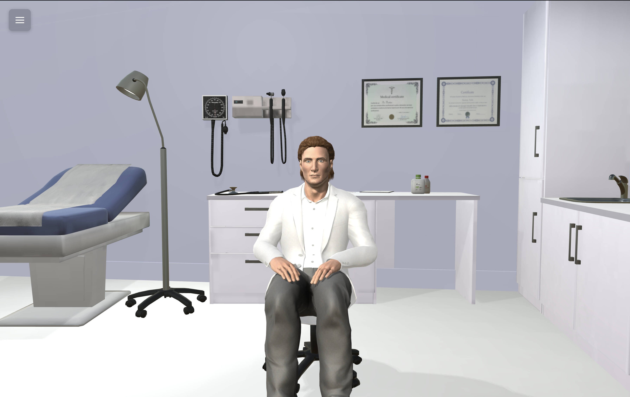
Decreasing anxiety about surgery
Hypothesis: Providing a participatory conversation with an empathetic digital health agent in a 3-D simulated operating room environment and simulated procedural steps to patients with movement disorders who are candidates for DBS surgery will result in
  focusing preoperative clinic discussion on relevant questions, and
  decreasing patient anxiety regarding surgery.
”I’d like to discuss the steps involved in awake deep
brain stimulation with you today. Is that OK with you?”

Slide 5
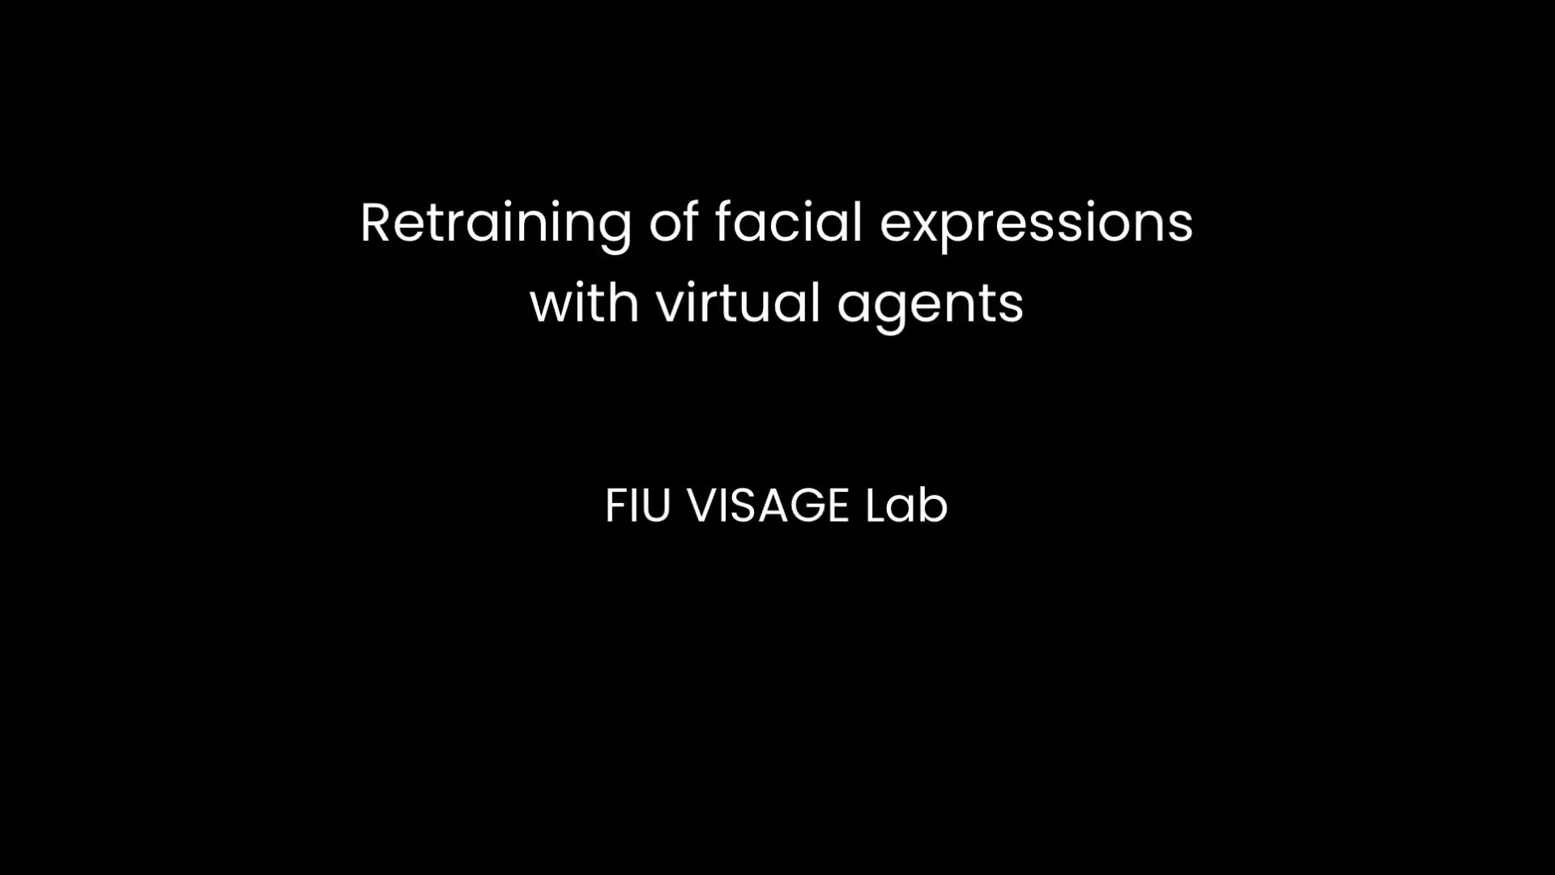
Retraining the face
Hypothesis: Tracking facial expression and providing visual feedback to patients with masked facies (hypomimia) of Parkinson’s disease during scripted conversations with digital health agents will allow
  baseline deficit characterization,
  visual feedback to restore facial expressions (digital representation of patient’s own facial expressions will be provided side-by-side with animated avatar), and
  improve interpersonal social functioning.
Please tell me how you feel, and I will show you what to show…

