Slide 1
COP3804 - Intermediate java
Review of COP2250 Concepts

Slide 2
Java Development Kit (JDK)
The JDK provides the environment required to program in Java.
It includes:
  the Java Virtual Machine
  tools like javac.exe, java.exe, javadoc.exe
  an extensive library of classes ready to be used in your applications
Can be downloaded from:
http://www.oracle.com/technetwork/java/javase/downloads/index.html

Slide 3
Application Programmer Interface (API)
The API is the library of classes (organized by packages) provided by the Java platform that is suitable for use in your own applications.
https://docs.oracle.com/javase/9/docs/api/index.html?overview-summary.html

Slide 4
Structure of a Java Program
public class ClassName
{
public static void main(String[] args )
{
// program execution begins here
}
}

Slide 5
Variables
Named storage location in the computer’s memory.
Used as placeholders for information that might change throughout the execution of the program.
Naming Convention:
  Use descriptive names.
  Use “camel case” beginning with a lowercase letter.
  May use letters, digits, and underscore.
  Do not use reserved words, spaces, or symbols.
  Variable names are case sensitive.
Variable Declaration Syntax:
    typeName variableName = value;
    or
    typeName variableName;

Slide 6
Variable Assignment
Variable values are changed with the assignment operator (=).
The expression to the right of the assignment operator is evaluated and the result is stored in the variable. The resulting value must have the same type as the variable.

Slide 7
Kinds of Variables
Instance Variables (Non-Static fields) – values are unique to each instance of a class (objects).
Class Variables (Static fields) – there is only one copy of this variable to be shared among all objects of the class.
Local Variables – only visible to the method or block of code in which they are declared.
Parameters – extra information passed to methods.

Slide 8
Data Types
Programs process values of different types: numbers, strings, etc. The type determines the operations that may be performed, the amount of memory the variable uses, and the way the variable formats and stores data.
Variables may be of reference data type or primitive data type. Reference variables store the address of an object in memory whereas primitive data types store a simple value.
Primitive Data Types
byte, short, int, and long for whole numbers
float and double for numbers with a fractional part
boolean
char
A literal is a fixed value written in the code that may be assigned to a variable of a primitive type.
Special support is provided for the java.lang.String class. Enclosing a character string within double quotes automatically creates a new String object; for example, String s = "this is a string";

Slide 9
Conversion between Primitive Data Types
double
float
long
int
short
byte
holds larger value
floating point
integer
holds smaller value
Converting from a type that holds a smaller value to a type that holds a larger value happens automatically.
To convert the other way around, use the cast operator.

Slide 10
Cast Operator
The cast operator lets you manually convert the data type of a value into another data type.
Write the cast operator in front of the expression that needs to be converted.
Syntax: (typeName) expression
When casting from a double to an int, the fractional part gets discarded.

Slide 11
Wrapper Classes
A class that contains a primitive type value.
The Java platform provides wrapper classes for each of the primitive data types:
  Byte
  Boolean
  Character
  Double
  Float
  Integer
  Long
  Short
The BigDecimal and BigInteger classes are used for high-precision calculations.

Slide 12
Constants
Values that do not change throughout program execution.
Identified with the reserved keyword final.
Naming convention: use all uppercase letters and underscores.
May be declared locally inside a method, but if they are needed in several methods, then they can be declared with the instance variables of the class as static and final.
They may be declared as public since they cannot be modified.
Example: Math.PI

Slide 13
Operators
Operators perform an operation on operands and return a result.
Assignment Operator: =
Combined Assignment Operators: += -= *= /= %=
Arithmetic Operators:
  Addition + (also used for String concatenation)
  Subtraction -
  Multiplication *
  Division /
  Remainder %

Slide 14
Operators
Unary Operators:
  Unary plus + indicates positive value
  Unary minus - negates an expression
  Increment ++ increments a value by 1
  Decrement -- decrements a value by 1
  Logical complement ! inverts the value of a boolean

Slide 15
Operators
Equality and Relational Operators:
  Equal to ==
  Not equal to !=
  Greater than >
  Greater than or equal to >=
  Less than <
  Less than or equal to <=
Logical Operators:
  AND &&
  OR ||

Slide 16
Operators and their Precedence
Operators | Precedence
postfix | expr++ expr--
unary | ++expr --expr +expr -expr ~ !
multiplicative | * / %
additive | + -
relational | < > <= >= instanceof
equality | == !=
logical AND | &&
logical OR | ||
ternary | ? :
assignment | = += -= *= /= %=

Slide 17
Strings
Objects that represent a sequence of characters.
The concatenation operator (+) is used to join strings together.
When using + operator, if either expression is a string, the other one is converted to a string automatically. For objects, the toString method is invoked.
Use a backslash as an escape character within string literals.
  i.e. “She said \”hello\”.”

Slide 18
Strings
To convert a string that has a numeric value into a number, you may use the following methods:
  Integer.parseInt converts a String to an int
  Double.parseDouble converts a String to a double
  Integer.valueOf converts a String to an Integer
  Double.valueOf converts a String to a Double
Use the equals method to compare two strings.

Slide 19
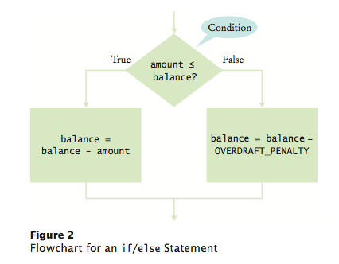
If Statements
Used to implement decisions in your programs
if (amount <= balance)
balance = balance - amount;
else
balance = balance – OVERDRAFT_PENALTY

Slide 20
Dangling Else Problem
This may happen if you don’t have curly braces around nested if statements.
For example:
if( richter >= 0 )
if( richter <= 4 )
System.out.println(“The earthquake is harmless”);
else
System.out.println(“Negative value not allowed”);
An else clause gets paired with the nearest previous if clause that doesn’t already have an else.

Slide 21
Switch Statement
The switch statement compares a single value to multiple constant alternatives.
It can have a number of possible execution paths (when the break keyword is not used for some cases).
The values in the case clauses must be constants.
The values must be integers, characters, enumerations and as of Java 7, strings.

Slide 22
Conditional Operator
condition ? value1 : value2
If the condition is true the value returned is value1, otherwise it’s value2.
For example:
y = x >= 0 ? x : -x;
Is equivalent to:
if (x >= 0)
y = x;
else
y = -x;

Slide 23
Formatting output
The printf method of the PrintStream class allows you to format your output.
The first parameter is a string that includes format specifiers. The rest is the arguments referenced by the format specifiers.
%[flags][width][.precision]conversion-character
Flags:
  - : left-justify
  + : output a plus ( + ) or minus (-) sign for a numerical value
  0 : forces numerical values to be zero-padded
  , : comma grouping separator (for numbers > 1000)
  : space displays a minus sign if the number is negative or a space if it is positive

Slide 24
Formatting Output
Conversion Characters for the printf method:
  d : decimal integer [byte, short, int, long]
  f : floating-point number [float, double]
  c : character Capital C will uppercase the letter
  s : String Capital S will uppercase all the letters in the string

Slide 25
While Loops
While loops are used to execute a block of code repeatedly.
A condition determines how many times the block of code executes.
Syntax: while (condition)
statement

Slide 26
For Loops
For loops are used to repeatedly execute a block of code for a specific number of times: from a start value of a variable to an end value.
During each iteration, the variable gets incremented/decremented by a constant value.
Syntax: for (i = start; i <= end; i++)
{ …
}

Slide 27
Reading and Writing to Files
The Scanner class breaks its input into tokens using a delimiter pattern, which by default matches whitespace.
The resulting tokens may then be converted into values of different types using the various next methods.
  You have used this class with System.in to prompt the user for values. We'll be using it now with a File object.
The PrintWriter class prints formatted text to an output stream. We'll use it to print to a file.
The FileWriter class lets you append data to an existing file.

Slide 28
Method Declaration
Syntax of a method implementation:
  accessSpecifier returnType methodName(parameter list)
  {
  // body of the method
  }
Examples:
  public String getLetterGrade()
  {
  return letterGrade;
  }
  private String toProperCase(String str)
  {
  …
  }

Slide 29
Parameter vs. Argument
Parameters refers to the list of variables in a method declaration.
Arguments are the actual values that are passed in when the method is invoked.
When you invoke a method, the arguments used must match the declaration's parameters in type and order.

Slide 30
Call by value vs. call by reference
Parameter variables come into existence when the method starts getting executed and they cease to exist when the method finishes.
As the method starts, the parameter variable is set to the same value as the corresponding argument.
If the parameter variable gets modified inside the method, that has no effect on the argument because they are separate variables.
If the argument is a reference to an object, then mutator methods may be used inside the method to modify the state of the object.

Slide 31
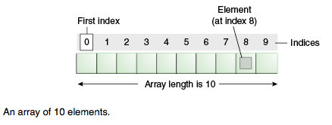
Arrays
An array is a container object that holds a group of values of a single type.
The length is established when the array is created. After creation, its length is fixed.
Each item in an array is called an element, and each element is accessed by its numerical index.
The java.util.Arrays class provides some Array methods.

Slide 32
ArrayLists
Unlike arrays, array lists grow and shrink dynamically.
You don’t need to specify the size during its declaration.
All elements in an array list have to be objects, not primitive values.
Syntax to create an array list:
  new ArrayList<typeName>()
The ArrayList class provides methods such as:
  add
  remove
  set
  get
  size

Slide 33
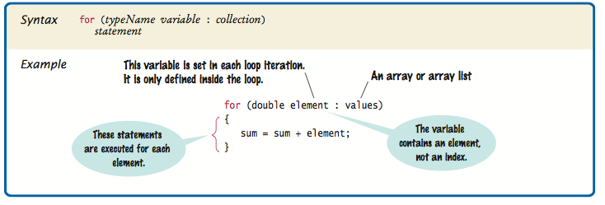
Enhanced For Loop
Iterates through all the elements in an array or array list.
It allows you to get the elements but not modify them.

Slide 34
Length of Array, ArrayList, and String
You get the length of an Array, an ArrayList and a String in different ways:
  For an Array, use the length property.
  For an ArrayList, use the size() method.
  For a String, use the length() method.

Slide 35
References
Horstmann, Cay. Big Java 4th ed. New York, USA: John Wiley & Sons, Inc., 2010.
Oracle. The Java Tutorials, 2013. Web. 25 Aug. 2013. http://docs.oracle.com/javase/tutorial/index.html
Gaddis, Tony, and Godfrey Muganda. Starting out with Java: from Control Structures through Data Structures 2nd ed. Boston, USA: Addison-Wesley, 2012

