Slide 1
Student Headcount and Demographics
File created on: 10/25/2019 5:59:00 AM

Slide 2
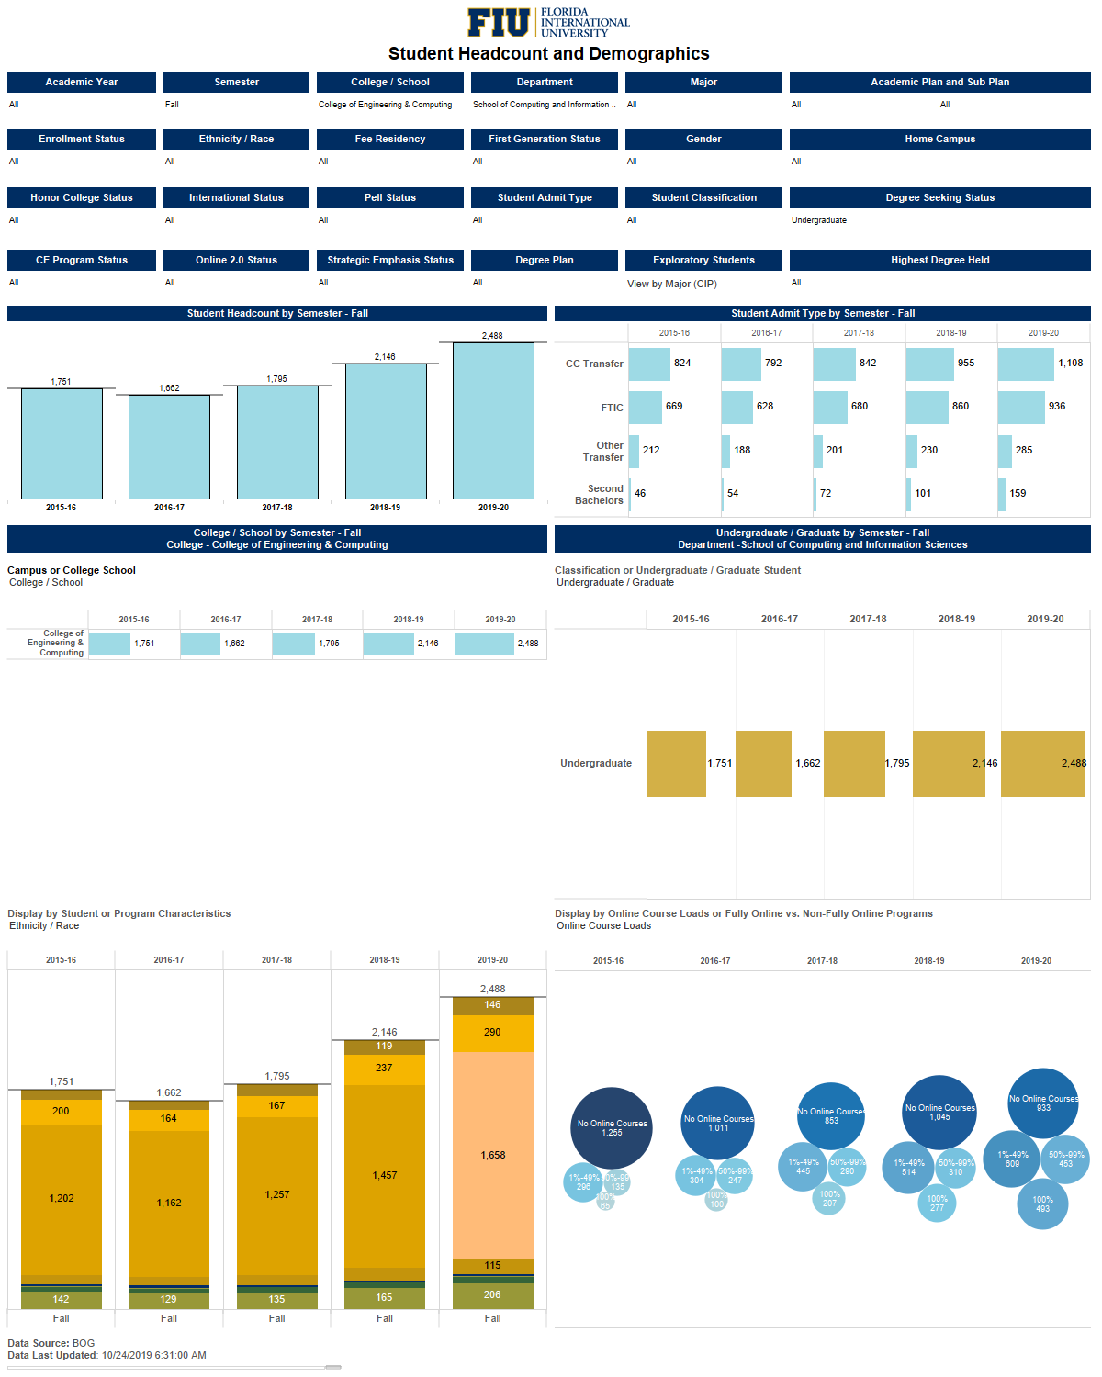

Slide 3
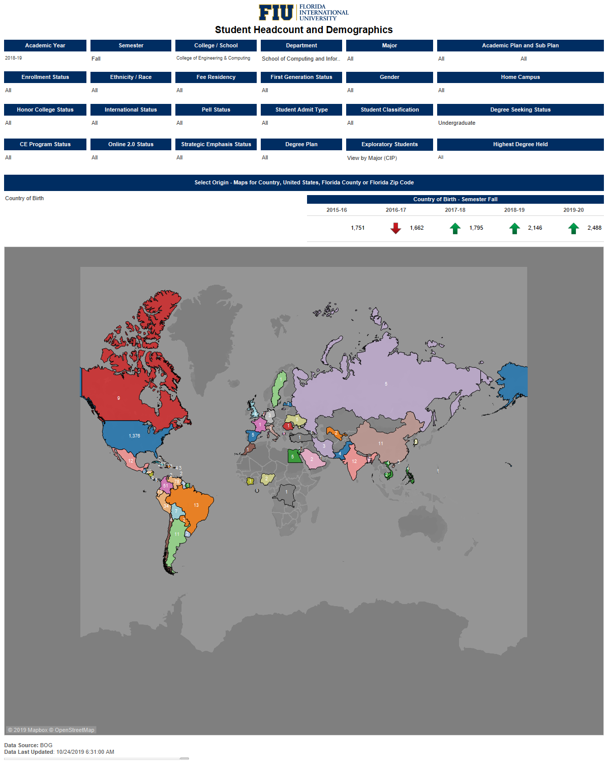

Slide 4
