Slide 1

Welcome to the School of Computing and Information Sciences
MEGA DAY!

Slide 2
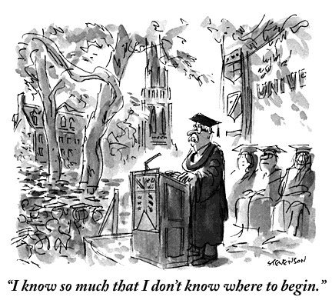
And now a word from our Director…

Slide 3

Points of Pride
10
Future Computer Scientist

Slide 4
Points of Pride - Faculty Highlights
Dr. Mark Weiss has been promoted to Distinguished University Professor
Dr. Iyengar received the Outstanding Research Award known as the “Test of Time Award” for his work in creating the Brooks-Iyengar Algorithm (IEEE Cybermatics Congress in Atlanta)
Dr. Mark Finlayson has been selected as the United States Patent and Trademark Office (USPTO) Edison Fellow for AI, he has also been recognized and honored with the FIU Faculty Award for Excellence in Research and Creative Activities, and has received an IBM Faculty Award.
Dr. Monique Ross was awarded the National Science Foundation (NSF) Career Award

Slide 5
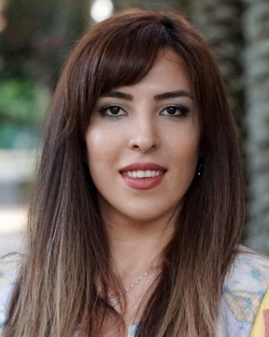
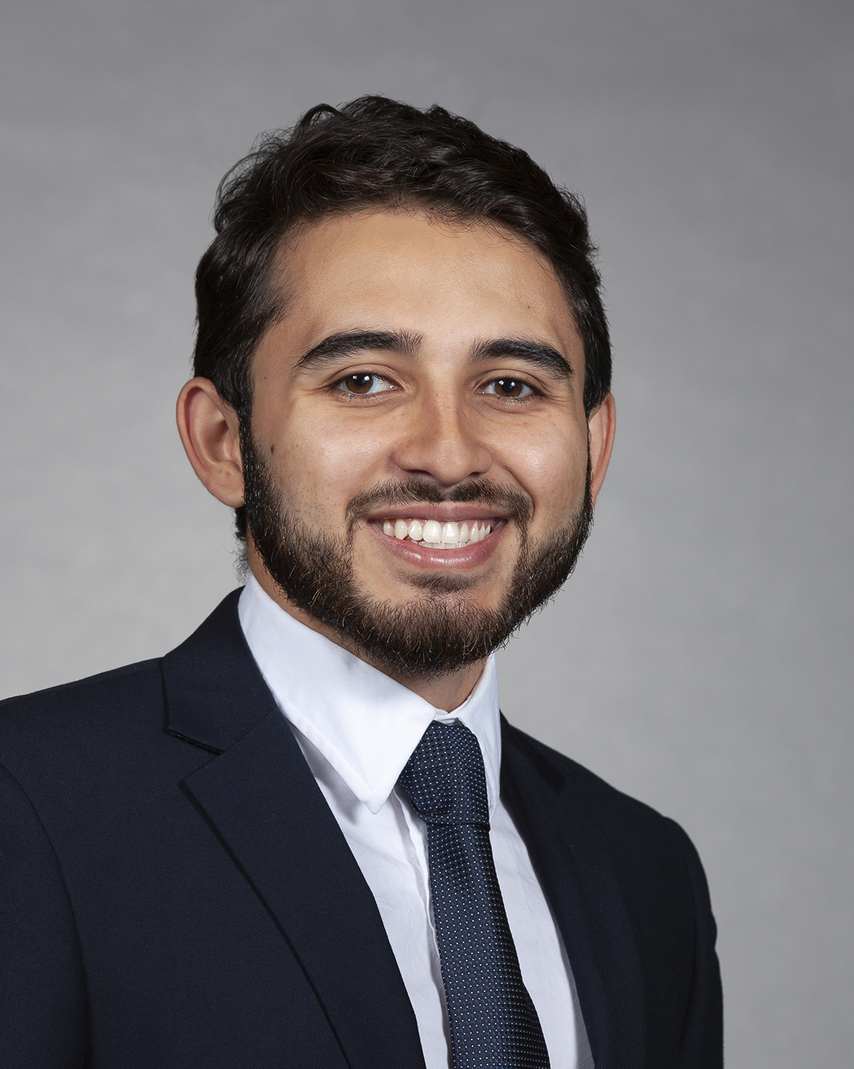
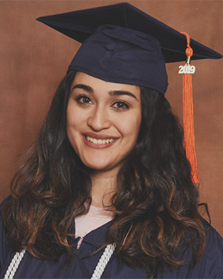
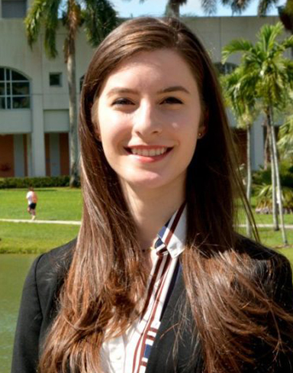

Points of Pride - Students Highlights
Four SCIS Students honored for FIU's World Ahead: Samira Pouyanfar, PhD in Computer Science and Julian Alarcon, BS in IT, Cesia Bulnes and Sheila Alemany.
UPE received Top National Chapter of 2018.
This award is given to the most outstanding
chapter out of over 290 chapters in the United
States and overseas.

Slide 6
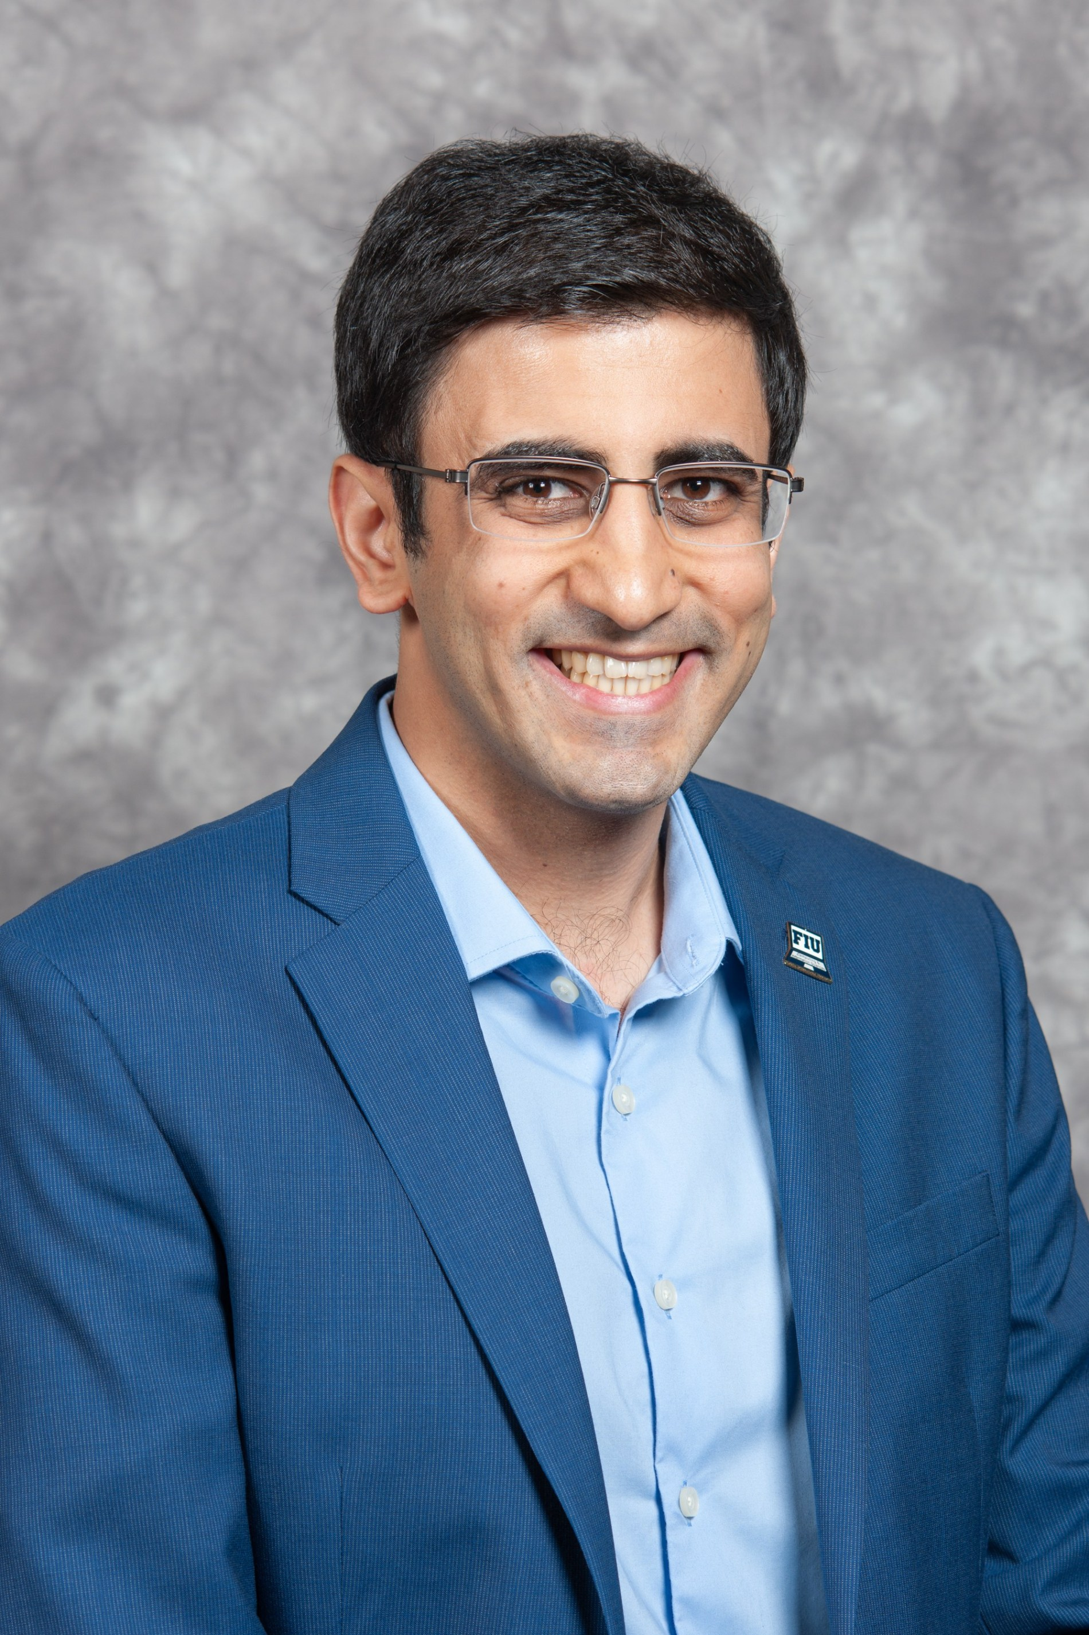
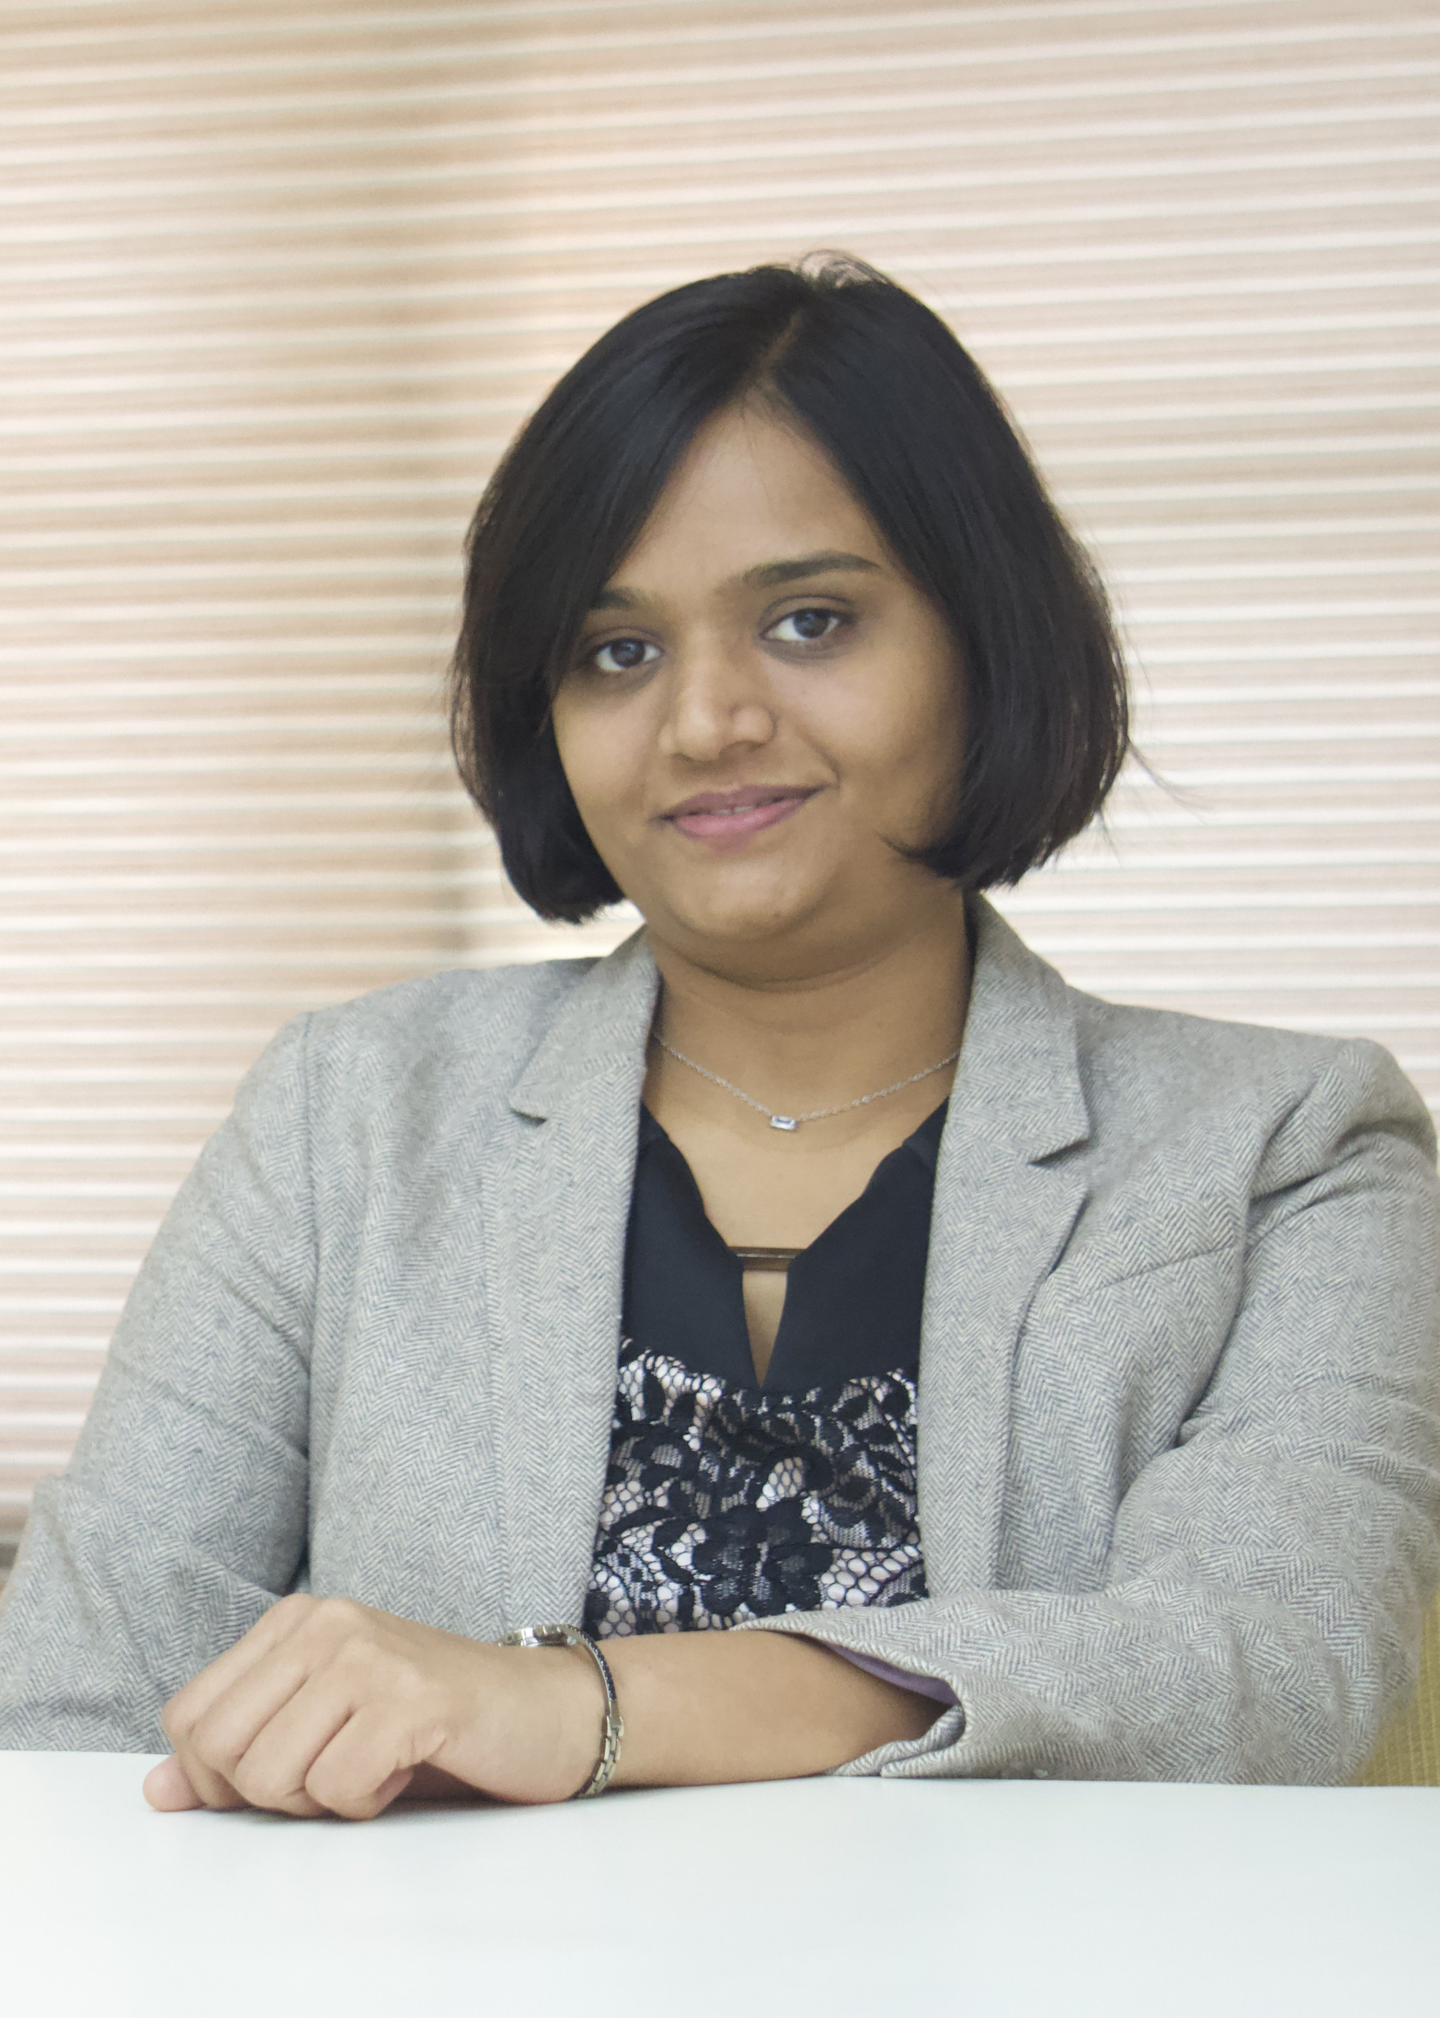
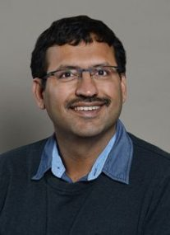
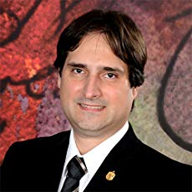
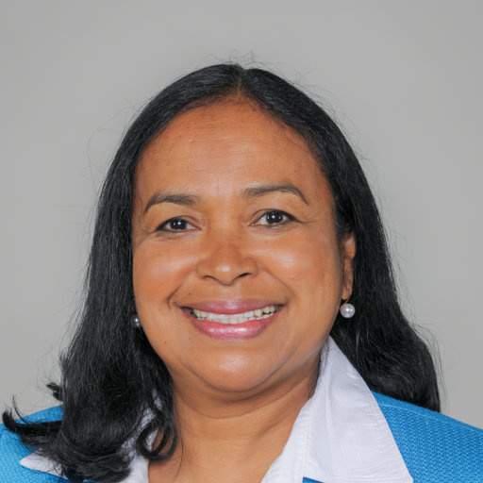
New Faculty
New Instructors:
New Graduate Program Advisor: Rebeca Arocha
Dr. M. Hadi Amini
Ph.D. in Electrical and Computer Engineering Carnegie Mellon University
Dr. Janki Bhimani
Ph.D. Computer Engineering
Northeastern University, Boston
Dr. Rohit Chadha
Ph.D. Dept. of Mathematics
University of Pennsylvania
Dr. Sergio Pisano Tiana Solis

Slide 7
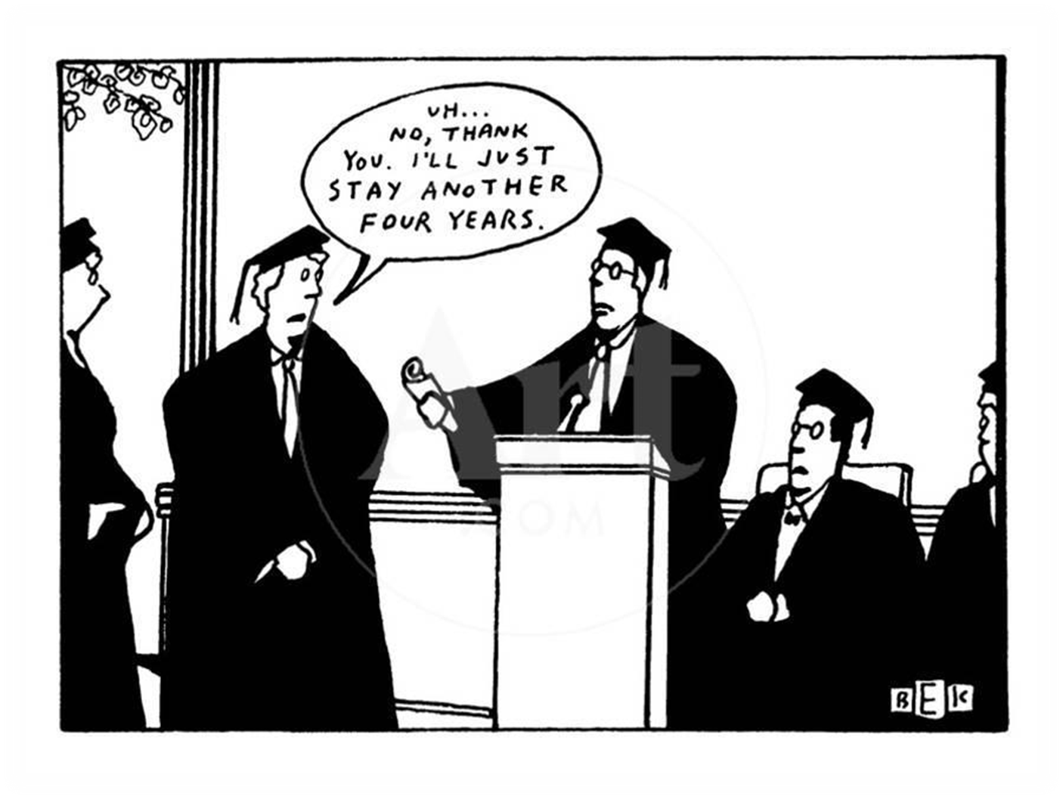
We want you to enjoy your time at FIU, BUT… please graduate in 4 years!!!

Slide 8
SCIS Undergraduate Programs
Important curriculum changes
  Course flowchart enhancements
    Improved visual presentation
    New embedded syllabi links

Slide 9
Curriculum Redesign
Benefits of the redesign
  Decrease in the prerequisite dependency length
  Reduction in the number of core courses
  Increase in the number of elective courses
  Improved flexible elective course options
  Replacement of CDA-3103 and CDA-4101 with one combined new course CDA-3102

Slide 10
Impact on programs
  Programs not affected by this redesign:
    B.S. in Information Technology
    B.A. in Information Technology
  Programs relevant to this redesign:
    B.A. in Computer Science
    B.S. in Computer Science
    B.S. in Computer Science (Software Design and Development Track)
    B.S. in Information Technology (Software Track)

Slide 11
CDA Courses
New course CDA-3102 replaces both CDA-3103 and CDA-4101
CDA-3102 will be offered from Spring2020
CDA-3103 will be discontinued from Spring2020
CDA-4101 will be offered in Spring2020 and Summer2020
CDA-4101 will be discontinued from 2021

Slide 12
CDA Courses (contd.)
If you complete CDA-3103 with "C" or better grade by December 2019,
you need to enroll in CDA-4101 in Spring/Summer 2020
After you complete both CDA-3103 and CDA-4101 (with "C" or better grade),
on the revised plan, you will be waived from
CDA-3102 (3 credits)
and one upper division elective course (3 credits).

Slide 13
Graduation Requirement
Before following the restructured curriculum:
you need to consult an advisor,
complete the student information,
on the change of program plan form
and sign on the form
for your consent to the new graduation requirements.

Slide 14
Questions?

Slide 15
Thank you

