Slide 1
Faculty Meeting School of Computing and Information Sciences
Friday, November 22 2019

Slide 2
Meeting Agenda
Welcome remarks (Dr. Iyengar)
Undergraduate Curriculum Proposals (Dr. Prabakar)
SCIS Research Funding Update (Dr. Scott Graham)
Faculty Success & Joint Faculty Appointments (Dr. Iyengar)
Announcements (Ariana)

Slide 3
Welcome Remarks
Dr. S.S. Iyengar

Slide 4
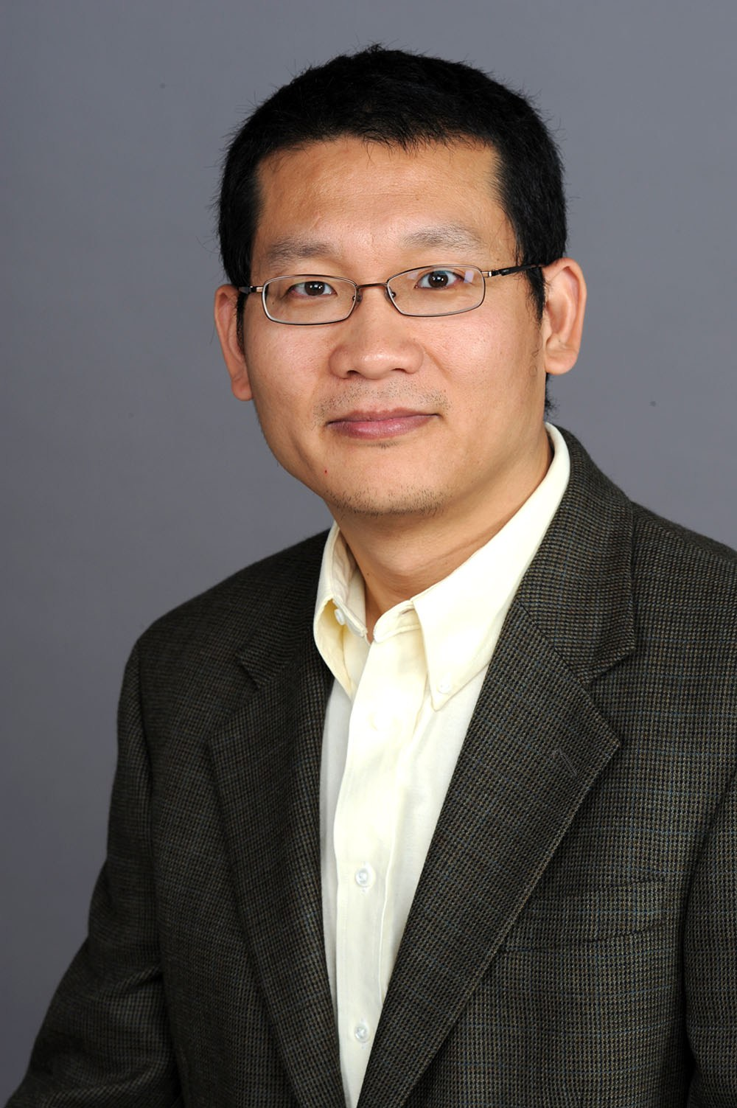
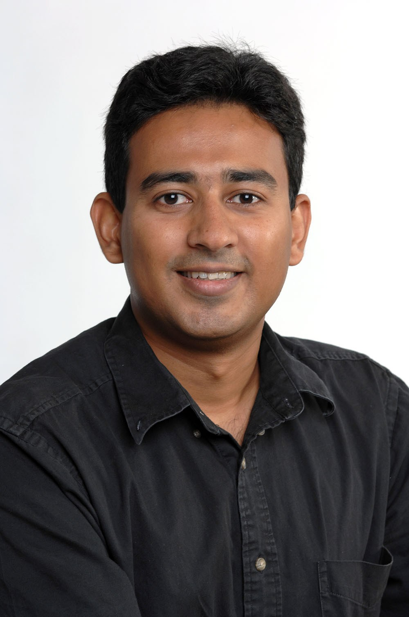
NEWS
Congratulations New Eminent Scholar Chair Professors!
Dr. Jason Liu
Dr. Raju Rangaswami
FIU SCIS Has been ranked 29 NSF RESEARCH EXPENDITURES

Slide 5
Proposed New Award Categories
Existing Award:
For Full Professors: Eminent Scholar Chair Professor Designation
New Proposed:
For Associate Professors: Preeminent Scholar Associate Professorship
For Assistant Professors: Emerging Preeminent Scholar Assistant Professorship

Slide 6
Undergraduate Curriculum
Dr. Nagarajan Prabakar

Slide 7
Undergraduate Curriculum Proposals
Catalog change proposal BS-in-CS Replace Senior Project with a two course sequence as CIS-4XXX Senior Project I (1-credit) and CIS-4911 Senior Project II (2-credits) Revised flowcharts: BS-CS-Main BS-CS-SDD
Course change proposal CIS 4911 New title: Senior Project II Credits: 2 Prereq: Senior Project I and Senior standing
New course proposals: CIS 4XXX Senior Project I – by Masoud Sadjadi Credits: 1 Prereq: COP 3337 and Senior standing

Slide 8
Motions
Motion 1:
SCIS Faculty approves replacement of the 3-credit Senior Project course with a two-course sequence namely 1-credit Senior Project I and 2-credit Senior Project II along with the approval of the proposed BS-CS catalog change, new 1-credit course and the course changes to CIS-4911.
IDC 2XXX Introduction to Crypto-currencies (for non-CS majors) – by Kianoosh Credits:3 Prereq: MAC-XXXX or MAD-XXXX or MGF-XXXX (any math course at any level)

Slide 9
Motion 2
SCIS Faculty approves the new course IDC-2XXX “Introduction to Crypto-currencies” (for non-CS majors).
CIS 4XXX Fundamentals of Blockchain Technologies (CS: Systems elective) – by Kianoosh Credits:3 Prereq: COP-3530

Slide 10
Motion 3
SCIS Faculty approves the new course CIS-4XXX “Fundamentals of Blockchain Technologies” (CS: Systems elective).
CGS 2XXX IT Fundamentals (for Non-SCIS majors) – by Michael Credits:3 Prereq: None Embrace Project: Flowchart
Motion 4
SCIS Faculty approves the new course CGS-2XXX “IT Fundamentals” as a service course.

Slide 11
Faculty Success
Dr. S.S. Iyengar

Slide 12
Faculty Success
We are at a significant cross-road regarding our research funding, where our traditional methods of obtaining grants are significantly less effective than they have been in the past, and not bearing the expected fruits.
We are proud to state that the School of Computing and Information Sciences comprises more than half of the College of Engineering and Computing, with our more than 3000 undergraduate students, 300 graduate students and nearly 100 PhD students. Yet, we have a hard time supporting our students through research funding. At the College level our $4 million annual research funding represents only 12% of the College’s total research effort.

Slide 13
The President and Provost have already set our new strategic vision for 2025 to be a top 50 University in the country. This will require more overall University research funding. The Dean has declared numerous times that we in the College of Engineering and Computing are the research and innovation engine for the University. But this engine will only work if we are productive in our competitive research funding and scholarship.
As a Carnegie-1 Research University, FIU has already adopted an embedded approach to research.
Good research drives increased research funding - allows for increased numbers of graduate students, who drive research publications, which in turn drives more and better research

Slide 14
It’s time for a new paradigm in SCIS to achieve our research goals, as we in SCIS no longer have the luxury of using School funding to pay for our graduate students. We need to individually and as a School, look at how we can drive a change in our research funding that will build our reputation along with our resources.
Research funding coupled with excellent teaching, and production of more graduate students, will be the new paradigm going forward.

Slide 15
We need to move us forward in research funding. One way might be for us to seek “workforce development” and educational funding pathways, especially in STEM, and research in your own specific areas, as we had previously done with the IT Performance funding.
Please identify these opportunities and help us lead the efforts to write large competitive grants.

Slide 16
For more information with ONR, please visit the link below:
https://www.onr.navy.mil/en/work-with-us/funding-opportunities
For more information with DARPA, please visit the link below:
https://www.darpa.mil/work-with-us/opportunities/more
For other Government grants, please see link below:
https://www.grants.gov/learn-grants/grant-making-agencies/department-of-energy.html

Slide 17
Joint Faculty Appointments
Candidates must apply to the Director of the School announcing their interest in a joint appointment and their research focus areas, and the courses they can teach.
The Director then sends the information to the SCIS Faculty Committee for a recommendation.
Recommended candidates will be asked to present a seminar on their work.
Faculty will attend the presentation and afterwards discuss the candidates work and make a recommendation to the Director for Joint Appointment.
The Director will review the recommendation and make a recommendation to the Dean for Joint Appointment for Faculty who are already on Campus.
For new Faculty, it is essentially the same process, except the Faculty will also need time for interviews and coordinate with all interested departments on the candidates potential.

Slide 18
Moving Forward
Continue to work towards improving ranking
Continue SCIS More funding with some centers of excellence
Increase national award applications

Slide 19
SCIS Research Funding
Dr. Scott Graham

Slide 20
SCIS Research Funding Update
C&G revenue still lagging – presently $1,278,789
C&G expenditures still lagging - $1.36M through 11/20; was $1.42M same date last year, $1.82M year before.
Through October – 22 proposals (with SCIS PI) totaling $11.7M.
In November (to-date) – 20 proposals (with SCIS PI) totaling $7.5M
Please let me know as decisions are made and be sure to work with Lian to budget expenditures, including Academic Year effort commitments and to charge GRAs as budgeted

Slide 21
SCIS Technology Innovation Update
Invention Disclosures: 22 in FY18, 13 in FY19, 6 in FY20
Patent Applications Filed: 9 in FY18, 7 in FY19, 1 in FY20
US Patents Awarded: 9 in FY18, 9 in FY19, 2 in FY20

Slide 22
Postdoctoral Research Associates
It is possible to have Courtesy Appointments for Postdocs.

Slide 23
Announcements
Ariana

Slide 24
Announcements
2019 Annual SCIS Awards Ceremony Date: Tuesday, Nov. 26th, 2019 Time: 12:00pm to 2:30pm Location: MARC 290
SCIS Thanksgiving - Holiday Potluck Date: Tuesday, December 3rd Time: 12:00 pm – 2:00 pm Location: CASE 349 If you intend to participate, please email Ariana with what you will be bringing. Thank you!

Slide 25

Thank you and

